Slide 1

COURSE TITLE
BUILDING TECHNOLOGY
Chapter 5 - (Week 5)
ROOFS
LECTURE – 5
Roofs
Ar. Ranju Kamal
Lecturer
Advanced college of engineering and management, Nepal
Affiliated to Tribhuvan University
Thailand, Bangkok (photo credit:Abhinay Kushwaha)

Slide 2
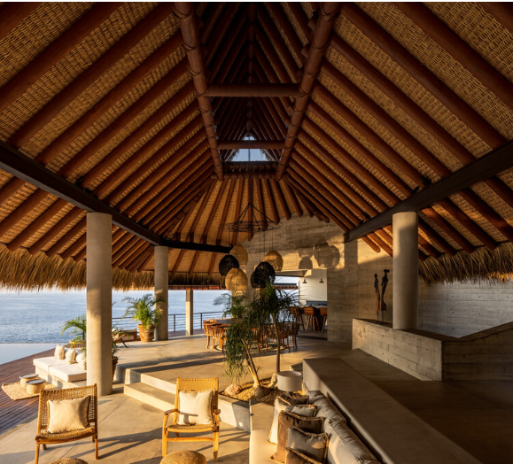
LEARNING OUTCOMES
1. Roofs & their types
2.functional requirement of roofs
3.Different types of roofs
4.Materials used for construction of roofs
5. Roof Coverings
6.General idea about timber roofs
7.Steel trusses and their components
At the end of the session students will get acquainted to:
Figure:Roofing(source:Tourinho, 2023:Online), https://www.archdaily.com/1002973/what-to-consider-when-choosing-roofing-materials?ad_source=search&ad_medium=search_result_articles

Slide 3


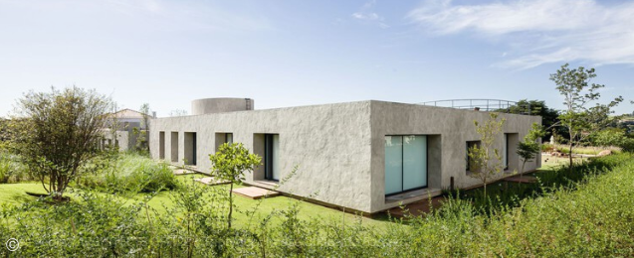
INTRODUCTION
Roofs:
Roof is the upper most portion of the building which protects the building from rain, wind and sun.[1]
Various types of roofs used may be divided broadly into three types:[1]
Flat roofs
Pitched roofs
3. Shells and folded plates.
Figure: Pitch roof
Figure: shell roof
Figure: Flat roof
Source:(Martino, n.d.:Online)
https://www.archdaily.com/986652/pitched-or-flat-different-types-of-roofs-for-houses?ad_source=search&ad_medium=search_result_articles

Slide 4
ELEMENTS OF ROOFS
Ridge: The spine (beam) at the top of the roof.
Rafters: Load bearing members of a roof, spanning between wall and the ridge.
Wall plate: The bearing and fixing medium for roof members; it distributes load over the supporting walls. [2]
Purlins: Beams that support the roof covering; run perpendicular to rafters, ties rafter together & help reduce the span of rafters. [2]
Struts: Compression members of a roof truss transferring load to support within the span of the roof
Rise: The vertical distance between wall plate and the ridge top
Pitch: The inclination (slope) of sides of the roof

Slide 5
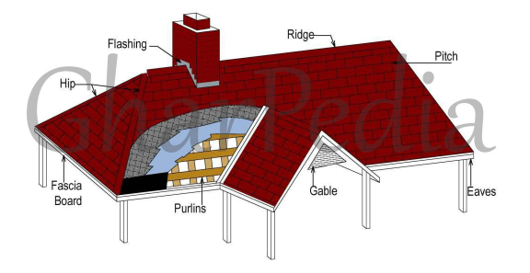
Valley: Acute angle gutter formed by intersection of two slopes [2]
Hip: The ridge formed by the intersection of two sloped surfaces at an angle of more than 180° [2]
Gable: Triangular portion of end wall
Eaves: The lower edge of the roof surface of a pitched roof
Battens: Small timber bits nailed to the rafters supporting the covering materials[2]
Figure:Roof Elements(source:Desai, 2017:Online)
https://gharpedia.com/blog/basic-components-roof/

Slide 6
FUNCTIONAL REQUIREMENTS OF ROOFS
Strength
Stability
Safety
Fire Safety
Resistance to weather
Durability
Freedom from Maintenance
Resistance to passage of heat
Resistance to passage of sound
Aesthetic beauty

Slide 7
Flat roofs are used in plains where rainfall is less and climate is moderate.
Pitched roofs are preferred wherever rainfall is more.
Shells and folded plate roofs are used to cover large column free areas required for auditoriums, factories etc [1]
Flat Roofs:
These roofs are nearly flat. slight slope (not more than 10°) is given to drain out the rainwater.
All types of upper storey floors can serve as flat roofs.
Top of these roofs are treated with water proofing materials chemicals in concrete.
With reliable water proofing techniques such roofs are constructed even in areas with heavy rain fall.[1]

Slide 8
In the areas of heavy rain falls and snow fall sloping roof are used.
The slope of roof shall be more than 10°. They may have slopes as much as 45° to 60° also. [1]
The sloped roofs are known as pitched roofs. The sloping roofs are preferred in large spanned structures like workshops, factory buildings and warehouses. [1]
In all these roofs covering sheets like A.C. sheet, G.I. sheets, tiles, slates etc. are supported on suitable structures. [1]
The pitched roofs are classified into
(a) Single roofs
(b) Double or purlin roofs
(c) Trussed roofs.
Pitched Roofs:
Notes:
The advantages of flat roofs are:
(a) The roof can be used as a terrace for playing and celebrating functions.
(b) At any latter stage the roof can be converted as a floor by adding another storey.
(c) They can suit to any shape of the building.
(d) Over-head water tanks and other services can be located easily.
(e) They can be made fire proof easily compared to pitched roof.
The disadvantages of flat roofs are:
(a) They cannot cover large column free areas.
(b) Leakage problem may occur at latter date also due to development of cracks. Once leakage
problem starts, it needs costly treatments.
(c) The dead weight of flat roofs is more.
(d) In places of snow fall flat roofs are to be avoided to reduce snow load.
(e) The initial cost of construction is more.
(f) Speed of construction of flat roofs is less.

Slide 9
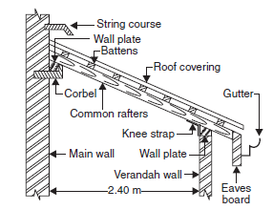
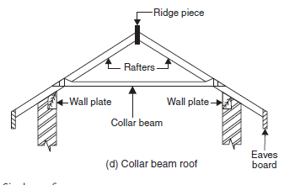
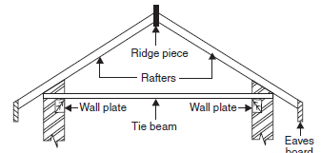
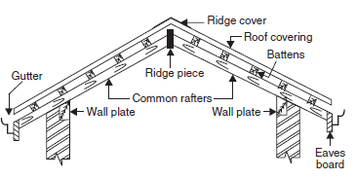
(a) Single Roof:
If the span of roof is less than 5 m the following types of single roofs are used.
Lean to roofs
Coupled roofs
Coupled-close roof
Collar beam roof
In all these roofs rafters placed at 600 mm to 800 mm spacing are main members taking load of the roof. Battens run over the rafters to support tiles. [1]
Figure: Lean To Roof
Figure: Collar Beam Roof
Figure: Coupled Close Roof
Figure: Coupled Roof
Source: Bhavikati, S. (2010). Basic Civil Engineering. New Delhi: New Age International (P) Ltd., Publishers

Slide 10
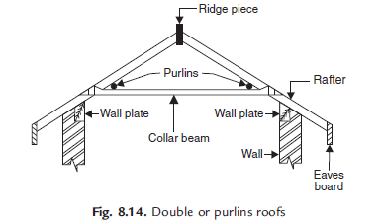
(b) Double or Purlin Roofs:
If span exceeds, the cost of rafters increase, and single roof becomes uneconomical. For spans more than 5 m double purlin roofs are preferred.[1]
The intermediate support is given to rafters by purlins supported over collar beams. [1]
Figure: Double Purlins Roofs
Source: Bhavikati, S. (2010). Basic Civil Engineering. New Delhi: New Age International (P) Ltd., Publishers

Slide 11
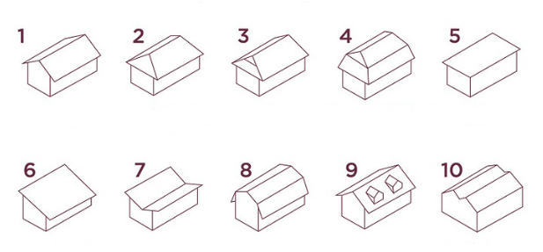
Figure: Different types of Roof(source:(Souza, 2020):Online),
https://www.archdaily.com/950937/10-types-of-roofs-and-the-possibilities-of-slate-tiles?ad_source=search&ad_medium=search_result_articles
1.Gable roof
2. Hip roof
3. Dutch roof
4. Mansard roof
5. Flat roof
6. Shed roof
7. Butterfly roof
8. Gambrel roof
9. Dormer
roof
10. M Shaped roof

Slide 12
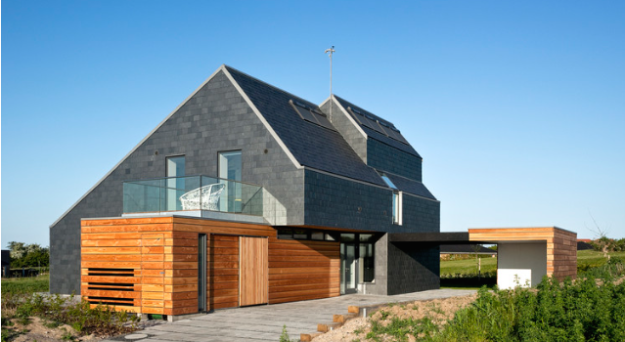
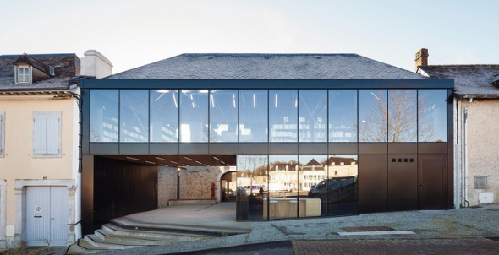
1. Gable roof: the most common type, consisting of two planes that can be symmetrical or asymmetrical. It can include eaves or not. Finally, this type of roof is very functional: it is easy to build, drains water well, facilitates ventilation, and adapts to most architectural projects.[3]
2. Hip roof: also quite common, it is a slightly more complex construction, composed of 4 inclined planes. It is suitable especially for regions with strong winds, as none of the gables represents a barrier to wind passage. [3]
Figure source:(Souza, 2020):Online),
https://www.archdaily.com/950937/10-types-of-roofs-and-the-possibilities-of-slate-tiles?ad_source=search&ad_medium=search_result_articles

Slide 13
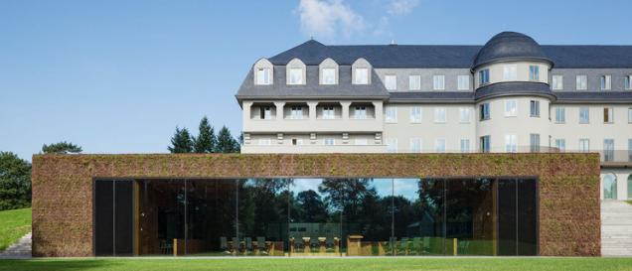
3. Dutch roof: similar to a gabled roof, but with two pronounced planes of inclination. This type of roof provides access to the attic, in addition to adding natural light and extra space. [3]
4.Mansard roof: very common in Paris, this is a roof with four sides constituted by 8 planes, the lower ones being steeply inclined and the upper ones lying almost flat, providing space below the roofing. [3]
Figure source:(Souza, 2020):Online),
https://www.archdaily.com/950937/10-types-of-roofs-and-the-possibilities-of-slate-tiles?ad_source=search&ad_medium=search_result_articles

Slide 14
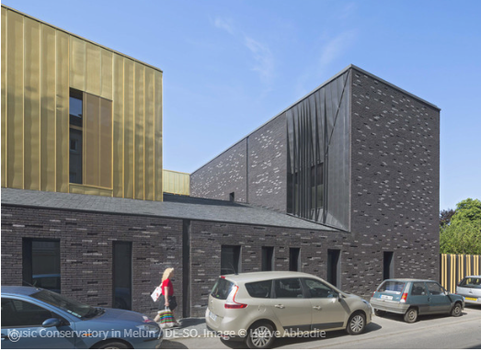
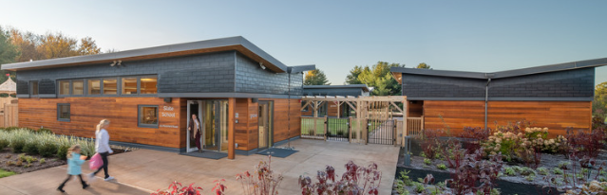
5. Flat roof: Most flat roofs are not 100% flat, but slope slightly. This subtle slope allows water to drain better. [3]
6. Shed roof: a unique plan, which provides space for large windows and a high ceiling. [3]
7.Butterfly roof: two planes inclined to a central track. This type of roof provides plenty of light and ventilation, but the detailing of the gutters must be done very well to avoid infiltration problems. [3]
Figure source:(Souza, 2020):Online),
https://www.archdaily.com/950937/10-types-of-roofs-and-the-possibilities-of-slate-tiles?ad_source=search&ad_medium=search_result_articles

Slide 15
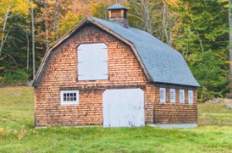
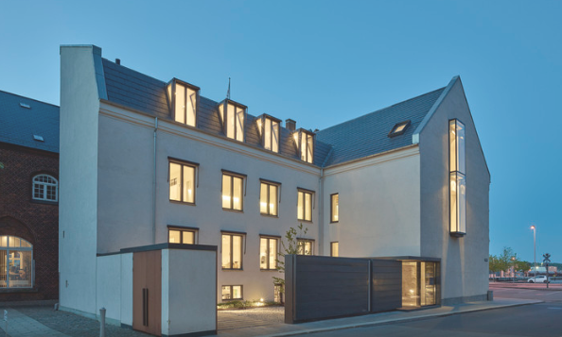
8. Gambrel roof: can be characterized as a gable roof, but with four planes of different slopes. This allows for better use of the internal space in the attic. [3]
9. Dormer roof: characterized by roof windows illuminating and increasing the existing space. They protrude and create useful space outside the roof, as well as providing additional natural light and ventilation. [3]
Figure source:(Souza, 2020):Online),
https://www.archdaily.com/950937/10-types-of-roofs-and-the-possibilities-of-slate-tiles?ad_source=search&ad_medium=search_result_articles

Slide 16
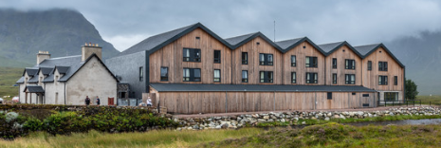
10. M Shaped roof: composed of two or more gabled roofs. [3]
Figure source:(Souza, 2020):Online),
https://www.archdaily.com/950937/10-types-of-roofs-and-the-possibilities-of-slate-tiles?ad_source=search&ad_medium=search_result_articles

Slide 17
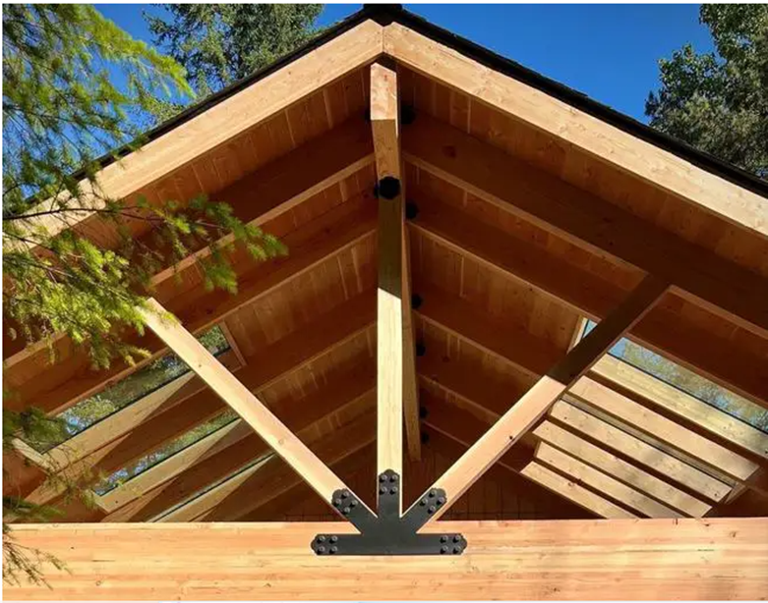
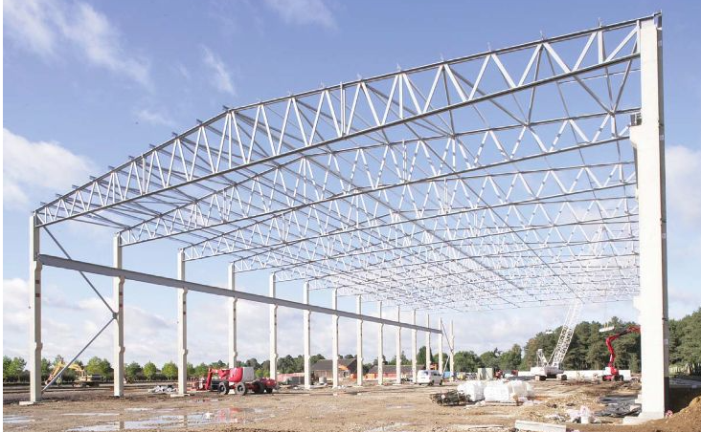
(c) Trussed Roof:
If span is more, a framework of slender members are used to support sloping roofs. [1]
These frames are known as trusses. A number of trusses may be placed lengthwise to get wall free longer halls. [1]
Purlins are provided over the trusses which in turn support roof sheets. For spans up to 9 m wooden trusses may be used but for larger spans steel trusses are a must. [1]
In case of wooden trusses suitable carpentry joints are made to connect various members at a joint. Bolts and straps are also used. [1]
In case of steel trusses joints are made using gusset plates and by providing bolts or rivets or welding. [1]
Depending upon the span, trusses of different shapes are used. End of trusses are supported on walls or on column. [1]
Figure: Timber truss(Source:Obinna, 2018:Online)
https://structville.com/2018/04/design-of-timber-roof-truss-to-british-code.html
Figure : Truss roof( source: AM INDUTRIES, n.d :Online)
https://aminds.com/steel-roof-truss-and-five-main-types/

Slide 18
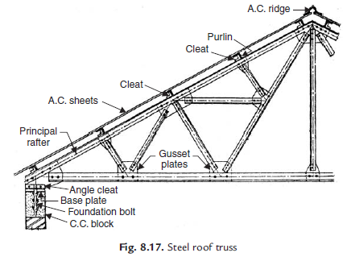
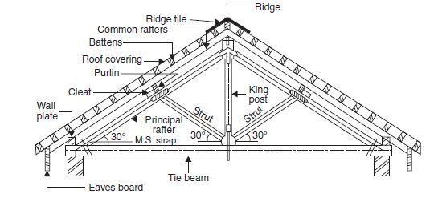
Figure: A Typical Wooden Truss (King Post)
Figure: Steel Roof Truss
Source: Bhavikati, S. (2010). Basic Civil Engineering. New Delhi: New Age International (P) Ltd., Publishers

Slide 19







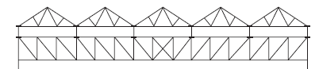
Figure: King Post Spans Up to 8 m
Figure: King Post Spans Up to 10 m
Figure: Compound French Truss Span 20 m to 30 m
Figure: Cambered French Roof Truss Span 20 m to 30 m
Figure: Pratt Truss Spans 6m to 100 m Modified Pratt Truss
Figure: Quadrangular Truss
Figure: Truss Used for Large Span
Figure: Fan Truss Spans 10m to 15m
Figure: North Light Roof Truss Span 8m to 10m
Figure: Howe Truss with 4 and 8 Panels Spans 6m to 30 m
Figure: Fink or French Roof Trusses Spans up to 10m
Figure: Truss Used for Large Spans
Source: Bhavikati, S. (2010). Basic Civil Engineering. New Delhi: New Age International (P) Ltd., Publishers

Slide 20
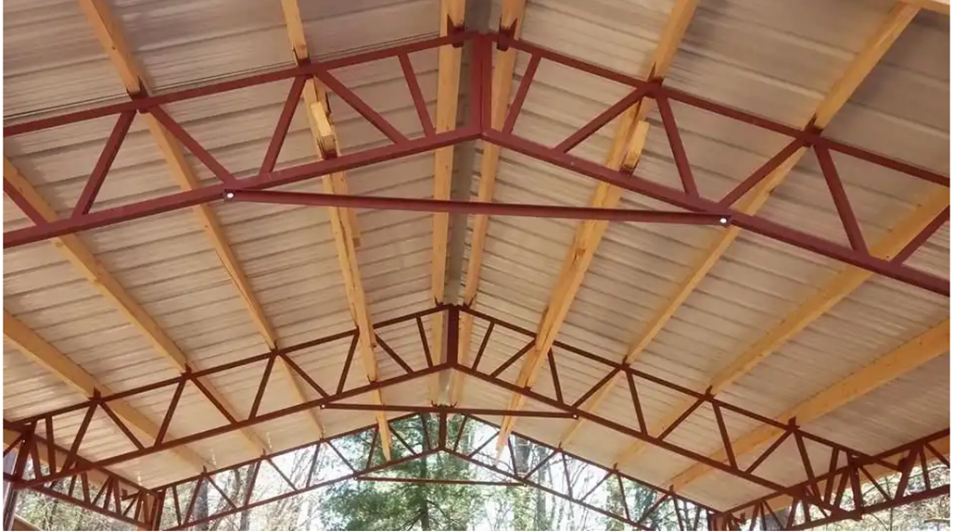
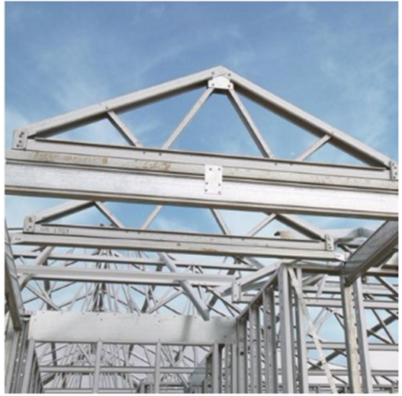
Figure: Quadrangular Truss
Figure: Fink or French Roof Trusses Spans up to 10m
Figure : Truss roof( source: AM INDUTRIES, n.d :Online)
https://aminds.com/steel-roof-truss-and-five-main-types/

Slide 21

3. Shells and Folded Plate Roofs:
Shell roof may be defined as a curved surface, the thickness of which is small compared to the other dimensions. [1]
In these roofs lot of load is transferred by membrane compression instead of by bending as in the case of conventional slab and beam constructions. [1]
Caves are having natural shell roofs.
An examination of places of worships built in India, Europe and Islamic nations show that shell structures were in usage for the last 800 to 1000 years. [1]
The shells of middle ages were massive masonry structures but nowadays thin R.C.C. shell roofs are built to cover large column free areas. [1]
Figure : Shell roof( source: Sharma, 2023:Online)
https://www.novatr.com/blog/shell-structures

Slide 22
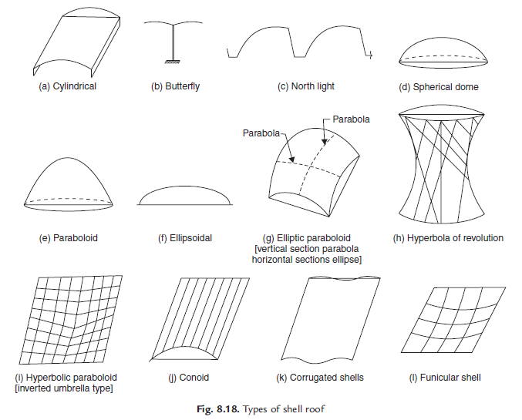
Figure: Butterfly
Figure: North Light
Figure: Elliptic Paraboloid [Vertical Section Parabola Horizontal Sections Ellipse]
Figure: Spherical Dome
Figure: Paraboloid
Figure: Cylindrical
Figure: Ellipsoidal
Figure: Hyperbolic Paraboloid [Inverted Umbrella Type]
Figure: Conoid
Figure: Corrugated Shells
Figure: Funicular Shell
Figure: Hyperbola of Revolution
Figures: Types of Shell Roof
Source: Bhavikati, S. (2010). Basic Civil Engineering. New Delhi: New Age International (P) Ltd., Publishers

Slide 23


Figure: Spherical Dome
Figure: Hyperbola of Revolution
Figure : Shell roof( source: Sharma, 2023:Online)
https://www.novatr.com/blog/shell-structures

Slide 24

Figure: Vaults
Figure : Shell roof( source: Sharma, 2023:Online)
https://www.novatr.com/blog/shell-structures

Slide 25

Advantages and Disadvantages of Shell Roofs
Advantages of shell roofs are:
(a) Good from aesthetic point of view
(b) Material consumption is quite less
(c) Form work can be removed early
(d) Large column free areas can be covered.
Disadvantages are:
(a) Top surface is curved and hence advantage of terrace is lost.
(b) Form work is costly.

Slide 26
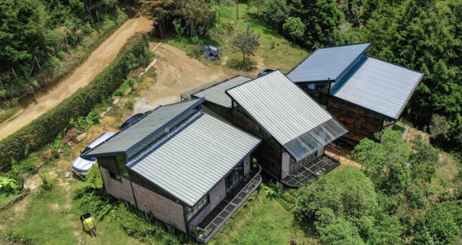
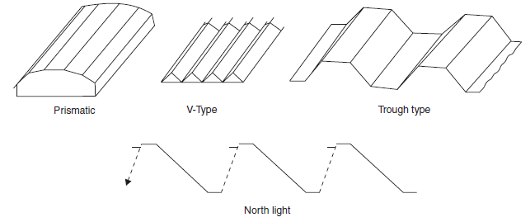

Folded plate roofs may be looked as slab with a number of folds. These roofs are also known as hipped plates, prismatic shells. In these structures also bending is reduced and lot of load gets transferred as membrane compression. folded plates are not so efficient as shells. [1]
Figure : Folded plate roof( source: Sharma, 2023:Online)
https://www.novatr.com/blog/shell-structures
Figure: Types of Folded Plate Roofs
Source: Bhavikati, S. (2010). Basic Civil Engineering. New Delhi: New Age International (P) Ltd., Publishers

Slide 27

Advantages and Disadvantages of Folded Plate Roofs Over Shell Roofs
Advantages are:
(a) Form work required is relatively simpler.
(b) Movable form work can be employed.
(c) Design involves simpler calculations.
Disadvantages are:
(a) Folded plate consume more material than shells.
(b) Form work can be removed after 7 days while in case of shells it can be little earlier.

Slide 28
Various types of covering materials are available for pitched roofs and their selection depends upon the climatic conditions, fabrication facility, availability of materials and affordability of the owner. [1]Commonly used pitched roof covering materials are:
(a) Thatch
(b) Shingle
(c) Tiles
(d) Slates
(e) Asbestos cement (A.C.) sheets
( f ) Galvanised iron (G.I.) sheets

Slide 29
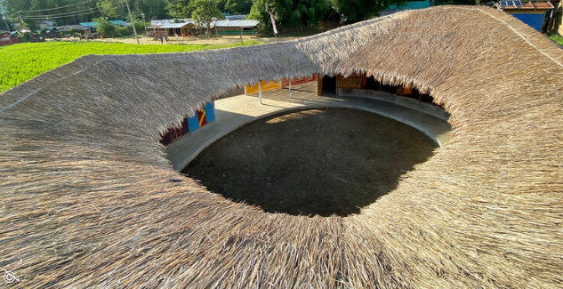
Thatch Covering:
These coverings are provided for small spans, mainly for residential buildings in villages. [1]
Thatch is a roof covering of straw, reeds or similar materials.
The thatch is well-soaked in water or fire resisting solution and packed bundles are laid with their butt ends pointing towards eves. [1]
Thickness varies from 150 mm to 300 mm. They are tied with ropes or twines to supporting structures. The supporting structure consists of round bamboo rafters spaced at 200 mm to 300 mm over which split bamboos laid at right angles at close spacing. [1]
It is claimed that reed thatch can last 50 to 60 years while straw thatch may last for 20–25 years. [1]
The advantage of thatch roof is they are cheap and do not need skilled workers to build them. [1]
The disadvantages are they are very poor fire resistant and harbour rats and other insects. [1]
Figure:Roofing(source:Tourinho, 2023:Online), https://www.archdaily.com/1002973/what-to-consider-when-choosing-roofing-materials?ad_source=search&ad_medium=search_result_articles

Slide 30
(b) Shingles:
Wood shingles are nothing but the split or sawn thin pieces of wood. Their size varies from 300 mm to 400 mm and length from 60 mm to 250 mm.[1]
Their thickness varies from 10 mm at one end to 3 mm at the other end.
They are nailed to supporting structures.
They are commonly used in hilly areas for lowcost housing.
They have very poor fire and termite resistance.[1]

Slide 31
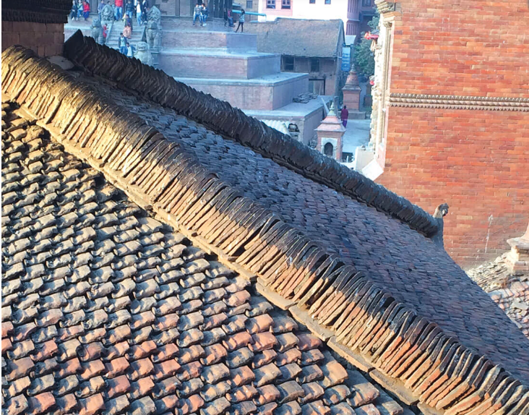
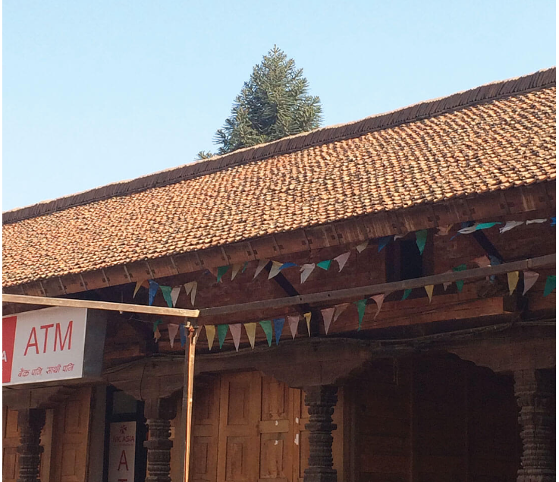
(c) Tiles:
Various clay tiles are manufactured in different localities. They serve as good covering materials.
Tiles are supported over battens which are in turn supported by rafters/trusses etc.
They give good appearance also.
Figure: Clay tiles( Source: Feenstra, Nepalitimes, 2019):Online)
https://nepalitimes.com/here-now/protecting-kathmandu-s-historic-roofscape

Slide 32
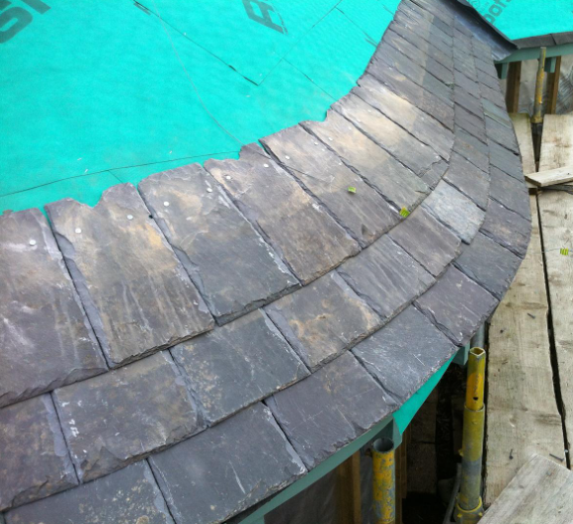
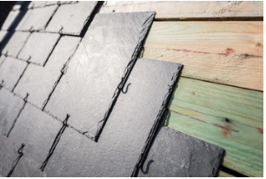
(d) Slates:
A slate is a sedimentary rock. Its colour is gray. It can be easily split into thin sheets.
Slates of size 450 mm to 600 mm wide, 300 mm long and 4 to 8 mm thick are used as covering materials of pitched roofs in the areas where slate quarries are nearby.
A good slate is hard, tough, durable.
They are having rough texture and they give ringing bell like sound when struck.
They do not absorb water.
Figure: Slate roofing( Source: Architecture, 2020:Online)
https://www.designingbuildings.co.uk/wiki/Conical_roof_slating

Slide 33
(e) A.C. Sheets:
Asbestos cement is a material which consists of 15 per cent of asbestos fibres evenly distributed and pressed with cement. [1]
They are manufactured in sufficiently large size.
The width of a A.C. sheet varies from 1.0 to 1.2 m and length from 1.75 to 3.0 m. [1]
To get sufficient strength with thin sections they are manufactured with corrugation. [1]
They are fixed to the steel purlins using J-bolts. [1]
The roofing is quite economical, waterproof.
not very good thermal resistant.
They are commonly used as covering materials in warehouses, godowns or for larger halls. [1]
In auditorium etc., if these sheets are used, false ceilings are provided to get good thermal resistance. [1]

Slide 34
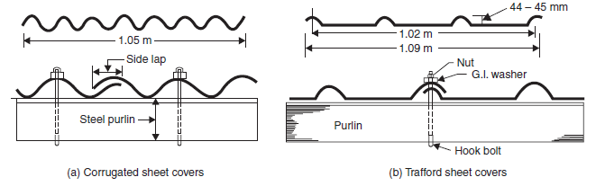
( f ) G.I. Sheets:
Galvanised iron corrugated sheets are manufactured in the sizes 1.0 to 1.2 m wide and 1.65 m length[1]
Galvanisation of iron makes them rust proof.
They are fixed to steel purlins using J-bolts and washers.
They are durable, fireproof, light in weight and need no maintenance. [1]
They are commonly used as covering materials for warehouses, godown, sheds etc. [1]
Figure: A.C. Sheet Roofing
Source: Bhavikati, S. (2010). Basic Civil Engineering. New Delhi: New Age International (P) Ltd., Publishers

Slide 35
REFERENCES
[1] Bhavikati, S. (2010). Basic Civil Engineering. New Delhi: New Age International (P) Ltd., Publishers.
[2] Singh, G. (2005). Building Constructions and materials. Standard Book House, Delhi.
[3] Souza, E. (2020, November 12). Archdaily. Retrieved from Archdaily.com: https://www.archdaily.com/950937/10-types-of-roofs-and-the-possibilities-of-slate-tiles?ad_source=search&ad_medium=search_result_articles
[4]AM INDUTRIES. (n.d.). Retrieved from aminds.com: https://aminds.com/steel-roof-truss-and-five-main-types/
[5]Architecture, R. (2020, December 12). CIOB. Retrieved from https://www.designingbuildings.co.uk/wiki/Conical_roof_slating
[6]Desai, J. (2017, July 11). Gharpedia. Retrieved from gharpedia.com: https://gharpedia.com/blog/basic-components-roof/

Slide 36
REFERENCES
[7]Feenstra, A. (2019, september 13). Nepalitimes. Retrieved from nepalitimes.com: https://nepalitimes.com/here-now/protecting-kathmandu-s-historic-roofscape
[8]Martino, G. (n.d.). Archdaily. Retrieved from Archdaily.com: https://www.archdaily.com/986652/pitched-or-flat-different-types-of-roofs-for-houses?ad_source=search&ad_medium=search_result_articles
[9]Obinna, U. (2018, April 12). Structville. Retrieved from www.structville.com: https://structville.com/2018/04/design-of-timber-roof-truss-to-british-code.html
[10]Sharma, P. (2023, August 10). NOVATR. Retrieved from novatr.com: https://www.novatr.com/blog/shell-structures
[11]Souza, E. (2020, November 12). Archdaily. Retrieved from Archdaily.com: https://www.archdaily.com/950937/10-types-of-roofs-and-the-possibilities-of-slate-tiles?ad_source=search&ad_medium=search_result_articles
[12]Tourinho, H. (2023, july 6). Archdaily. Retrieved from Archdaily.com: https://www.archdaily.com/1002973/what-to-consider-when-choosing-roofing-materials?ad_source=search&ad_medium=search_result_articles

Slide 37
THANK YOU

