Slide 1
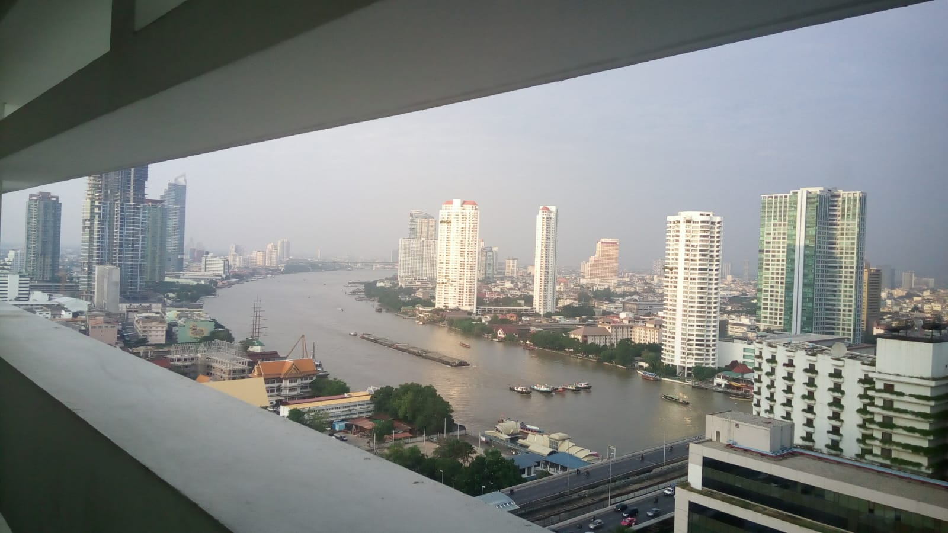
COURSE TITLE
BUILDING TECHNOLOGY
Chapter 6 - (Week 6)
Stair, lifts and escalators
LECTURE – 6
Vertical circulation in Building
Ar. Ranju Kamal
Lecturer
Advanced college of engineering and management, Nepal
Affiliated to Tribhuvan University
Thailand, Bangkok (photo credit:Abhinay Kushwaha)

Slide 2
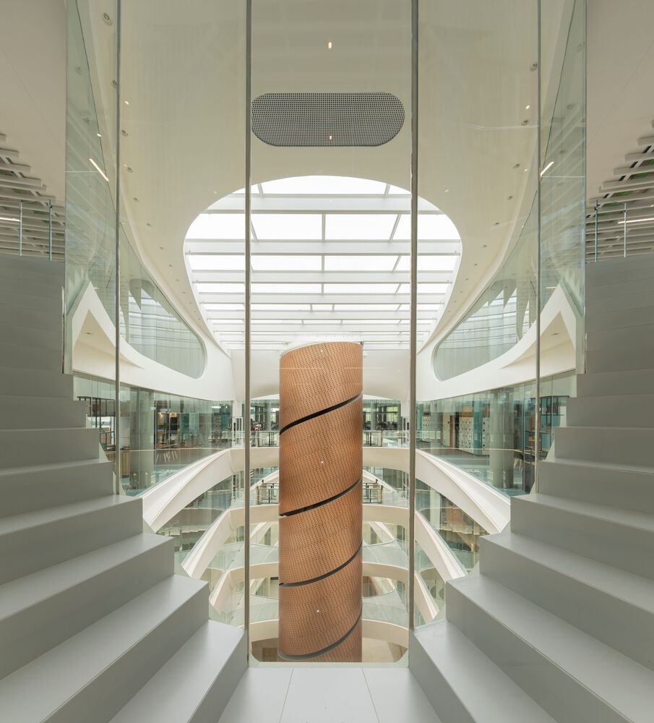
LEARNING OUTCOMES
At the end of the session students will get acquainted to:
1.Stairs and their elements
2.functional requirement of stairs
3.Different types of stairs
4.Materials used for construction of stairs
5. General idea about escalators
6.General idea about lifts
Figure 1: Vertical Circulation(Source: Moreira, 2022:Online),
https://www.archdaily.com/1004727/icon-douro-building-luis-pedro-silva-arquitecto-lda?ad_medium=image_search

Slide 3
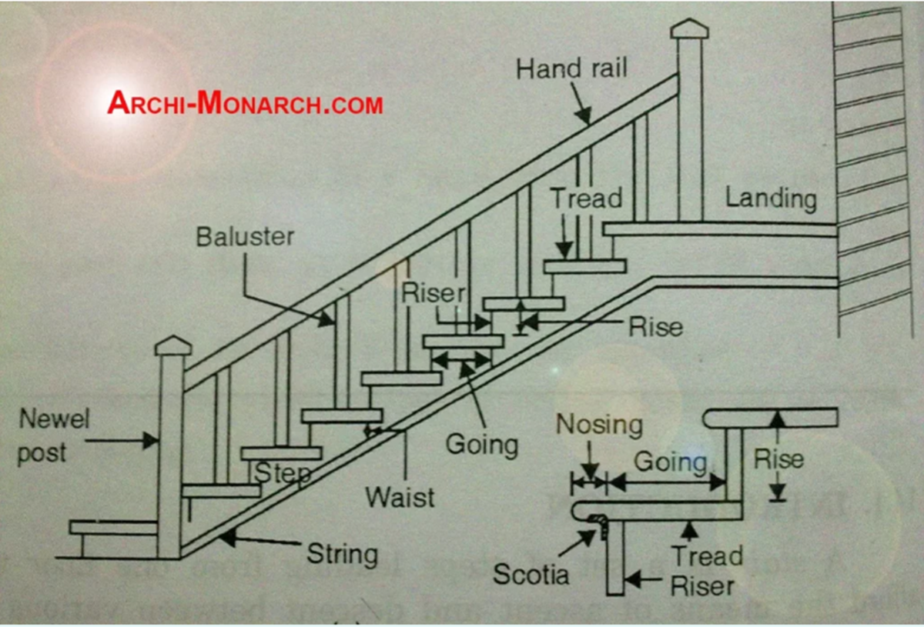
INTRODUCTION
Stairs:
It is a structure having series of steps and afford the means of ascent and descent between the floors or landings. The encloser or room in which stair is located is known as a staircase. The opening or space occupied by the stair is known as stairway.[1]
Figure:Stairs component(source:Archi-Monarch, n.d.,Online), https://archi-monarch.com/staircase-design/

Slide 4
ELEMENTS OF STAIRS
Elements | Description
Stairs: | A stair is a series of steps which is arranged to connect different floors of a building.
Riser: | vertical portion of a stair providing support to the tread
Rise: | It is a vertical distance between two successive tread faces
Tread: | horizontal upper surface of steps on which foot is placed
Nosing: | It is the projecting part of the tread beyond the face of the riser
Going: | It is a horizontal distances between two successive riser faces
Step: | portion of stair which permits accent and decent (Riser + Tread)

Slide 5
ELEMENTS OF STAIRS
Elements | Description
Landing : | A platform or resting place provided between two flights. It may be half, quarter or full depending on the span.
Scotia : | Moulding provided under nosing to beautify the elevation of the step
Winders : | Tapering steps, which are provided for changing the direction of a stair
Soffit : | Under-surface of a stair
Slope or pitch : | Angle between horizontal line and the line of nosing
Hand rail : | Member of stair at the top of baluster and acts as the support of hand of passerby
Baluster : | Vertical member that supports handrail
Balustrade : | Frame consisting of balusters and acts as fence or guard to the users of stair
Head room : | Clear vertical distance between the tread of a step and soffit of flight or ceiling of a landing immediately above
Spandrel : | Triangular framing under the outside string of an open string stair

Slide 6
FUNCTIONAL REQUIREMENT OF STAIRS
1. Location
  Easily accessible and well ventilated.
  For residential building, it should be centrally located.
  For public building, this should be near to the entrance.
  For apartment building, stair should be one in the central location and other by the side of the building for easy escape in case of emergency.[1]
2. Width of stair
  Wide enough to carry the users with out much crowd or inconvenience.
  Minimum width for public and residential building is -200 cm & 80 cm respectively.[1]
3. Slope of stair
It should be just enough to be comfortable to the users. In general, it is taken between 25º-40º. [1]

Slide 7
FUNCTIONAL REQUIREMENT OF STAIRS
4. Head room
Clear space between tread and the soffit of the stair above may be more than 2m. (7ft) [1]
5. Material - Should be strong & safe (Fire resisting).
6. Landing
More than or equal to the width of the flight.
7. Number of riser per flight
Not more than 15
8. Baluster
Stair should be provided with baluster so as to avoid accidents.
9. Winders
Should be avoided as far as possible

Slide 8
CLASSIFICATION OF STAIRCASE
Types of Stairs
Method of construction
Straight
Open well
Material Used
Timber
Quarter turn
Spiral
Doglegged
Bifurcated
Stones
Bricks
Concrete
steels
Geometrical
Circular

Slide 9
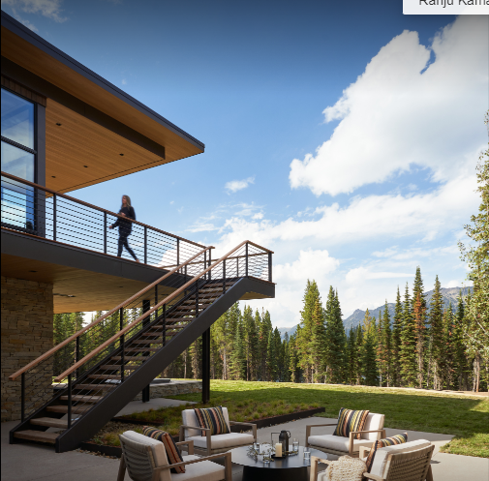
Straight stairs
If the space available for stair case is narrow and long, straight stairs may be provided. Such stairs are commonly used to give access to porch or as emergency exits to cinema halls. In this type all steps are in one direction. They may be provided in single flight or in two flights with landing between the two flight.[5]
Straight Stairs
Figure: Straight stairs(Source: : pinto, 2022:Online), https://www.archdaily.com/search/gallery/1007554/basecamp-residence-clb-architects/651565da7316322d15a00f1a-basecamp-residence-clb-architects-photo

Slide 10
Quarter-turn stairs
Quarter turn stairs are the perfect choice for homes with limited space and can be a good choice for townhouses or smaller homes. They consist of a straight flight of stairs that makes a 90-degree turn at the landing, making them an ideal option for areas where space is limited.
Figure: stairs(Source: : Archi-Monarch. (n.d.) :Online
https://archi-monarch.com/staircase-design

Slide 11
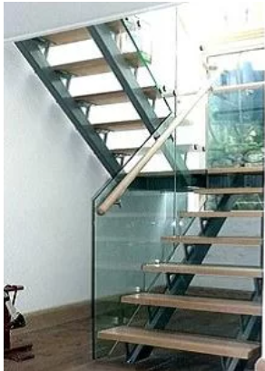
Dog Legged Stairs
It consists of two straight flights with 180° turn between the two. They are very commonly used to give access from floor to floor. Figure shows the arrangement of steps in such stairs. [5]
Dog Legged Stair
Figure: stairs(Source: : Archi-Monarch. (n.d.) :Online
https://archi-monarch.com/staircase-design/

Slide 12
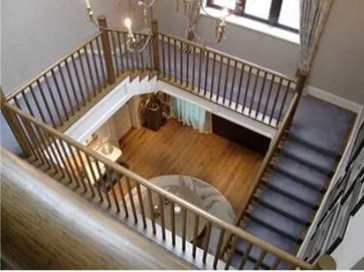
Well or Open-newel Stairs
It differs from dog legged stairs such that in this case there is 0.15 m to 1.0 m gap between the two adjacent flights. [5]
Figure: stairs(Source: : Archi-Monarch. (n.d.) :Online
https://archi-monarch.com/staircase-design/

Slide 13
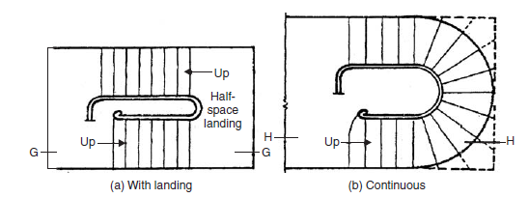
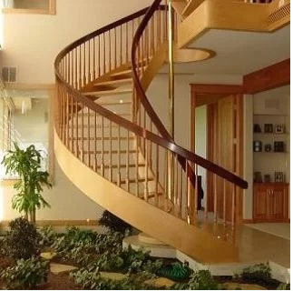

Geometric Stairs
Geometrical Stair
This type of stair is similar to the open newel stair except that well formed between the two adjacent flights is curved. The hand rail provided is continuous. [5]
Figure: stairs(Source: : Archi-Monarch. (n.d.) :Online
https://archi-monarch.com/staircase-design/

Slide 14
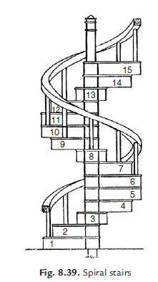
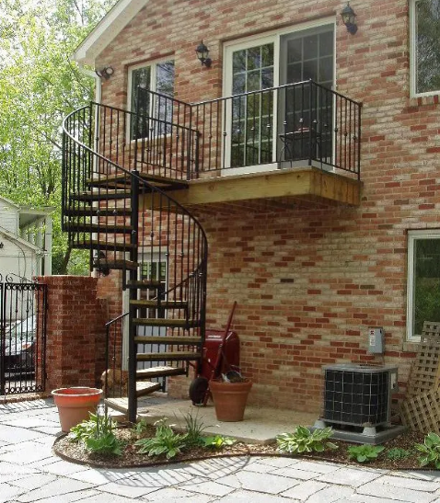
Spiral Stairs
Spiral Stairs
These stairs are commonly used as emergency exits. It consists of a central post supporting a series of steps arranged in the form of a spiral. At the end of steps continuous hand rail is provided. Such stairs are provided where space available for stairs is very much limited. [5]
Figure: stairs(Source: : Archi-Monarch. (n.d.) :Online
https://archi-monarch.com/staircase-design/

Slide 15
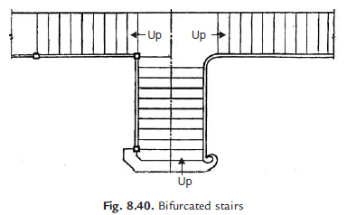
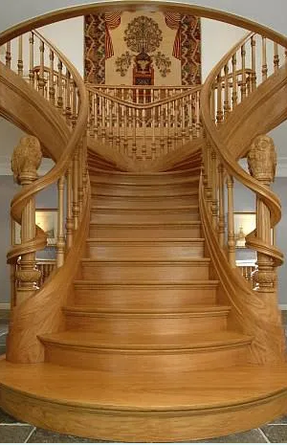
Bifurcated stairs
Turning Stairs
Apart from dog legged and open newel type turns, stairs may turn in various forms. They depend upon the available space for stairs. Quarter turned, half turned with few steps in between and bifurcated stairs are some of such turned stairs. [5]
Figure: stairs(Source: : Archi-Monarch. (n.d.) :Online
https://archi-monarch.com/staircase-design/

Slide 16
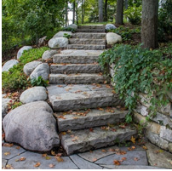
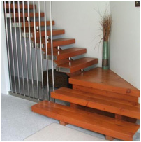
Stone Stairs
Stone stairs are heavy and require strong supports.They are widely used in places where ashlar stones are readily available. Stones that are hard, non-absorbent and weather resistant are preferred to avoid danger as they become slippery on use of a regular basis.[4]
Timber Stairs
Timber stairs or wooden stairs are light and easy to construct but are very poor in fire resistance. These stairs are generally used in residential buildings and most preferred in areas where abundant wood is available. Well-treated fire-resistant hardwood of proper thickness should be used, and it should be free from fungal decay, insect attacks and other defects. Timber stairs are used only in low-rise buildings. [4]
Figure: stairs(Source: Builders mart, 2019 :Online
https://www.buildersmart.in/blogs/staircases/

Slide 17
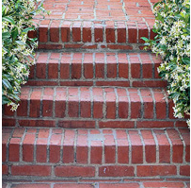
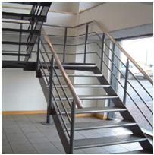
Brick Stairs
Brick stairs may be of solid masonry construction with arches provided in the lower portion. Entrance steps form a typical brick stair. These steps need a facing with a coat that can resist wear and tear as concrete finished with mortar. The treads and risers of the brick stair should be finished with the suitable flooring material. [4]
Steel Stairs
Mild steel or iron cast stairs are of a special type, used in factories, workshops, godowns, etc. These are made of pre-stressed sheet steel that is strong and fireproof. The disadvantage of these stairs is that they produce a lot of noise when used and also look unattractive. Therefore, they are not preferred in residential buildings. Cast iron is commonly used for spiral stair types. [4]
Figure: stairs(Source: Builders mart, 2019 :Online
https://www.buildersmart.in/blogs/staircases/

Slide 18
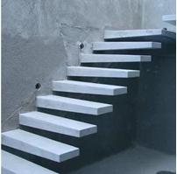
Concrete Stairs
Plain concrete stairs are preferred in place of stone stairs these days . RCC stairs are widely used in almost all types of buildings, as they offer a number of advantages compared to other types. [4]
They are:
They can be cast into any required shape and size.
They have excellent resistance to wear and fire better than any other material.
They give a highly attractive appearance.
They are very durable and easy to maintain.
They are less noisy.
They can be easily rendered non-slippery.
They can be designed to accommodate greater widths and longer spans. [4]
Figure: stairs(Source: Builders mart, 2019 :Online
https://www.buildersmart.in/blogs/staircases/

Slide 19
REQUIREMENTS OF STAIRCASE AS PER NBC
Staircase Every stair having two or more risers shall conform to the following conditions in addition to Fire Safety requirement set out in NBC 107
The minimum clear width (unobstructed by projections or handrails) of staircase shall be as follows:
a) Apartments Shared 1000 mm - (Within each multilevel unit) Internal 800 mm
Auditoriums Below 500 capacity 1500 mm - Above 500 capacity 2000 mm
Hospitals 2000 mm
Cold Storages and Warehouses 1250 mm
Buildings more than 4 stories high 1250 mm
(Industrial or Commercial)
Recommended for other types of buildings:
Educational 2000 mm
Residential 800 mm
Cinemas
Below 500 capacity 1500 mm
Above 500 capacity 2000 mm
Public Assembly 2500 mm
for capacities greater than 2500 occupants
Note: For reduced use staircases such as accesses to lofts, attics and terraces, the minimum width shall be 600mm.

Slide 20
The minimum tread shall be 250 mm excluding nosing and the maximum riser will be 175 mm for all buildings except for internal staircases of Apartments, which can be permitted up to 190 mm.
Handrails shall be provided in all open staircases
Handrails shall not be lower than 900 mm above the centre of the tread.
The maximum number of risers shall be limited to 15 per flight.
The minimum headroom under a staircase shall not be less than 2000 mm
Measured vertically from the nosing of the tread to the soffit plane above.

Slide 21
Lifts:
Elevator is mandatory for a building which has more than four to five floors high. For most of the people, an elevator offer ease as well as convenience, and also makes life easier for physically handicapped persons.[8]
An elevator can be defined as an electric lift which is used as vertical transportation of goods as well as people among the floors in buildings. these are activated with the electrical motors that also to drive counterweight system cables for drive transaction such as a hoist, pump hydraulic fluid for raising a cylindrical piston such as a jack. [8]
Elevators are classified into different types based on requirement. Elevators are frequently used in the multistorey constructions, wherever ramps of wheelchair would be not practical. [8]

Slide 22
The different types of lifts or elevators include :
Building lift
Capsule lift
Hydraulic elevator
Pneumatic elevator
Passenger lift
Freight elevator
Traction elevator/cable driven
Residential elevators
Machine room-less elevator

Slide 23
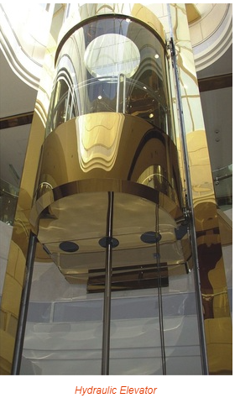
1) Hydraulic Elevator: A hydraulic elevator is power-driven by a piston that moves within a cylinder. The applications of hydraulic elevators involve in five to six-floor buildings. The operating of these elevators can be done at speeds up to 200 ft or 61 meters for each minute. [8]
Source:Electronics project focus. (n.d.). Retrieved from www.elprocus.com: https://www.elprocus.com/what-is-elevator-working-different-types-and-their-uses/

Slide 24
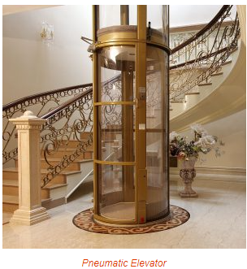
2) Pneumatic Elevator: Pneumatic elevators are very easy to fit, operate as well as maintain when compared with the traditional elevators. These are used in existing homes because of their solid design. The main benefits of using these elevators include solid design & smooth, speed and flexibility, energy efficient and very safe. The pneumatic elevator can be designed with an external cylinder, and the cylinder is a crystal clear self-supporting cylinder. [8]
Source:Electronics project focus. (n.d.). Retrieved from www.elprocus.com: https://www.elprocus.com/what-is-elevator-working-different-types-and-their-uses/

Slide 25
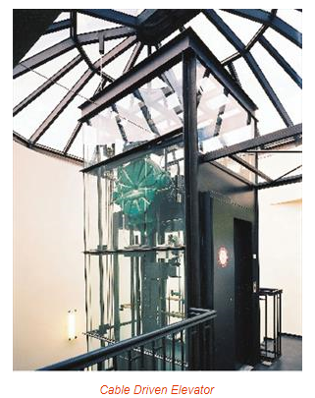
3) Cable Driven or Traction Elevator: The traction elevator or cable driven elevators are the most popular elevators. It consists of steel cables as well as hoisting ropes that run above a pulley which is connected to the motor. [8]
Source:Electronics project focus. (n.d.). Retrieved from www.elprocus.com: https://www.elprocus.com/what-is-elevator-working-different-types-and-their-uses/

Slide 26
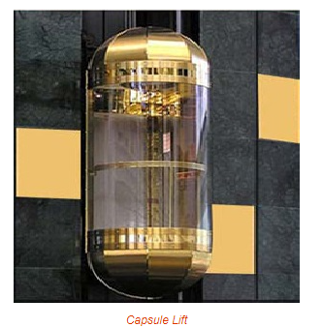
4) Capsule Lift: Capsule lift or Elevators are used in prestigious buildings, which can be called as decoration of a building because they improve the building’s beauty as well as carries life into it. The main features of this elevators mainly include design, and travel comfort is best. The interior design of these lifts is attractive with a large glass panel for viewing. The ultramodern design of these lifts offers a cosmic zone travel experience for the passengers. These lifts are consistent and inexpensive with the least maintenance. [8]
Source:Electronics project focus. (n.d.). Retrieved from www.elprocus.com: https://www.elprocus.com/what-is-elevator-working-different-types-and-their-uses/

Slide 27
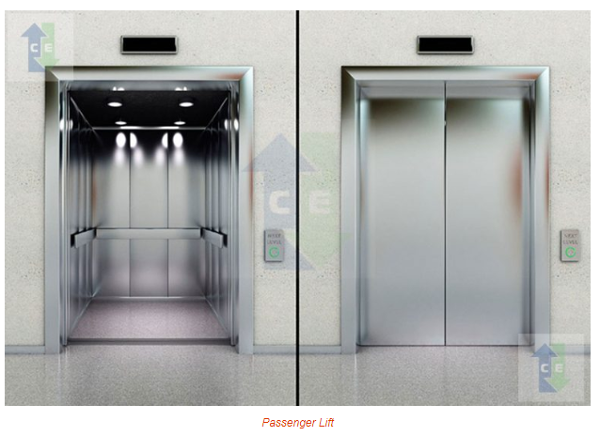
5) Building Lift: A building lift is a vertical transportation among the floors of the building. These are frequently used in public buildings, complexes, offices, and multistory building. These lifts are important in providing vertical movement, mostly in high buildings, for a wheelchair as well as other non-ambulant building customers. [8]
6) Passenger Lift: This type of lift has entirely included a lift car that moves vertically in a specially equipped lift shaft. Passengers are traveled between the floors in the building at quick speed. These lifts are very space efficient which are used in existing buildings where space is at a best. The main advantages of using passenger lift give a very comfort traveling among different floors, particularly space efficient, fully fixed shaft, small construction works, and no level loadings on the building. [8]
Source:Electronics project focus. (n.d.). Retrieved from www.elprocus.com: https://www.elprocus.com/what-is-elevator-working-different-types-and-their-uses/

Slide 28
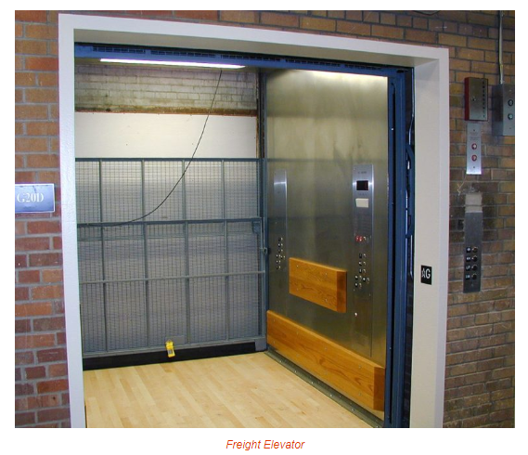
7) Freight Elevator:
In the world of elevators, these lifts are workhorses. These are very useful for transporting materials, goods in warehouses, manufacturing industries, shopping malls, seaports, etc. This type of elevator is separated into classes, to describe their load capacity as well as application. These lifts are strong in nature, and they are specially manufactured by engineers.
The benefits of these elevators include; these elevators are designed for commercial as well as industrial applications.
Source:Electronics project focus. (n.d.). Retrieved from www.elprocus.com: https://www.elprocus.com/what-is-elevator-working-different-types-and-their-uses/

Slide 29
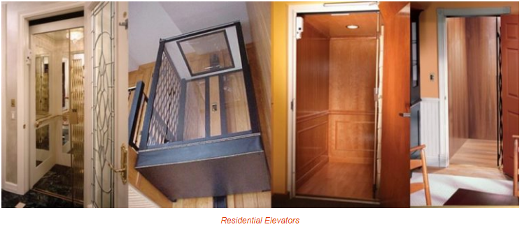
8) Residential Elevators:
Residential elevators provide stylish options to the platform as well as stair lifts. These lifts can be effortlessly incorporated in any available home, otherwise incorporated in edifice plans for latest homes. These types of elevators are available in different styles, and these can be installed in your home walls, otherwise included effortlessly to improve your home’s decoration. The main benefits of residential elevators are; they can move you securely among floors even during a power failure. Quick installation and offers you an effortless life.
Source:Electronics project focus. (n.d.). Retrieved from www.elprocus.com: https://www.elprocus.com/what-is-elevator-working-different-types-and-their-uses/

Slide 30
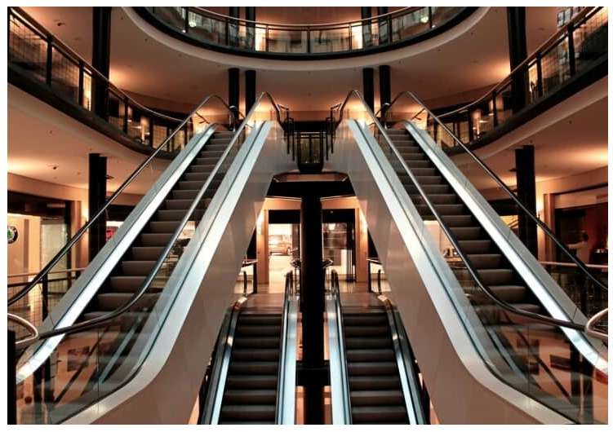
ESCALATORS:
Escalators and elevators are mechanical devices that allow vertical transportation of people between different levels of a building.[6]
The meaning of an escalator is a moving staircase. it is a conveyor transport device that consists of a single aluminum or stainless steel, motor-driven chain of steps guided by a track system arranged in a continuous loop. [6]
Figure: Escalators(Source: B & I. (n.d.). :Online)
Retrieved from https://buildingandinteriors.com/escalators-professionals-guide/

Slide 31
They find their usage in buildings that witness heavy traffic and movement of large masses of people such as in malls, halls, and other public establishments. [6]
They are used in places where elevators would be impractical to move pedestrian traffic. [6]
Some types of escalators can be constructed outdoors and covered in case of bad weather. Helping in the management of the flow of people, escalators and elevators make the movement of an individual easy. [6]

Slide 32
STEP TYPE
This type remains one of the most popular and commonly seen escalators today. with steps made of metals, it is safer than most other forms. [6]
Its movement is upward then flat, and then downward. This movement continues vice versa . [6]
One can find these in malls and other public places, and are suitable for buildings with one-directional passenger traffic flow. [6]

Slide 33
Wheelchair accessible
A wheelchair escalator is just like any normal one but with special provisions for the movement of wheelchairs. Moreover, when used by a wheelchair user, this is put in a special mode in which three steps change and level out to form a platform. [6]
Next, spikes come from the back of the step that remains closer to the lower landing to prevent the wheelchair from falling. [6]
These are greatly useful for people with special abilities; thus, making the building inclusive. [6]
We can find these in hospitals. They are gaining popularity in other places such as metro stations and malls as well. [6]

Slide 34
Spiral
These special spiral escalators have curved steps accounting for a very fancy and unique appearance. Also, these are exclusively been manufactured by Mitsubishi since 1985. [6]
So far, there are only 91 of these in the world. Also, the design and dimensions of this type of escalator remain very tricky. Therefore, not all buildings can accommodate them easily. [6]
These offer a great panoramic view of the building. Therefore, art galleries, museums, casinos, and buildings with state-of-the-art interiors need more of the spiral escalator. [6]

Slide 35
LEVYTATOR
This new type- the levitator is a free type of escalator that can curve multiple times in both upward and downward directions. [6]
Having two escalators share loops of steps allows a levitator to curve differently. These designs have uniquely built steps as well. [6]
This free-form design is used in every place from airports and subways to shopping malls. [6]
The best thing about the levytator remains its energy efficiency. Since it goes up and down without using two separate motors, it saves power consumption; thus, making the building more efficient and power-saving. [6]
Moreover, the levytator gives architects the privilege to give a desired shape and dimension to the escalators as it remains capable of offering freeform curves. [6]
This can be laid down on an existing normal staircase as well. Therefore, we can use it for homes too. [6]

Slide 36
Proper inclination of escalators
The angle of inclination of an escalator is typically 30 degrees. Also, this may increase to 35 degrees only if the vertical rise does not exceed 6 m and the speed is limited to 0.5 m/s. [6]
These are usually designed at an inclination of 27.3, 30, and 35 degrees angle. [6]
Although 35-degree escalators are suitable for a total transportation height of 6 m and require the least amount of space, the 27.3-degree inclination is ideal in case the height exceeds 6 m. [6]
Moreover, the 30-degree inclination offers maximum safety and traveling comfort to the users. [6]

Slide 37
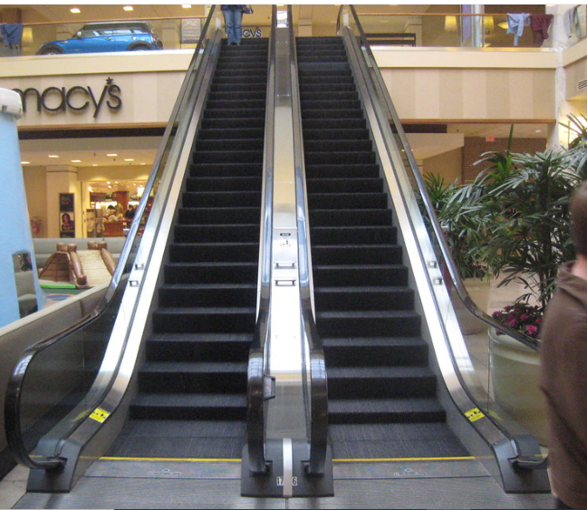
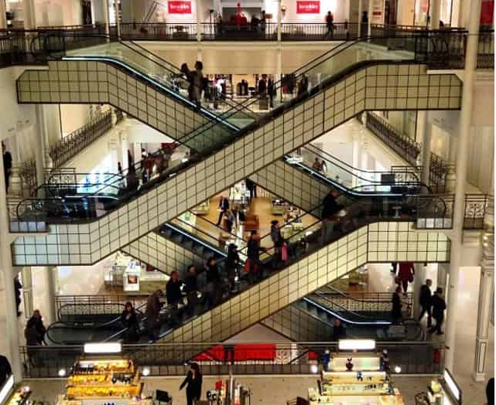
Figure: Escalators(Source: B & I. (n.d.). :Online)
Retrieved from https://buildingandinteriors.com/escalators-professionals-guide/

Slide 38
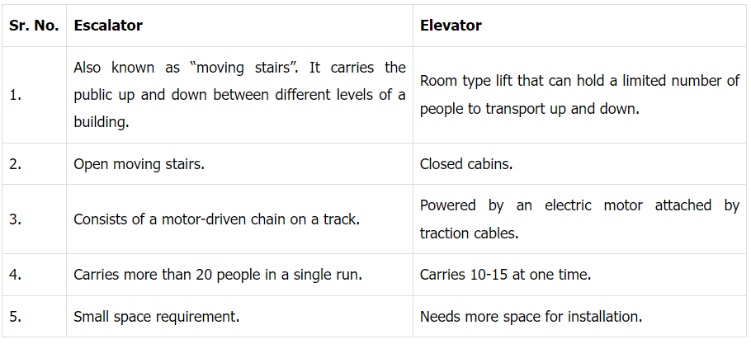
Source: B & I. (n.d.). :Online)
Retrieved from https://buildingandinteriors.com/escalators-professionals-guide/

Slide 39
REFERENCES
[1] Singh, G. (2005). Building Constructions and materials. Standard Book House, Delhi.
[2]Archi-Monarch. (n.d.). Retrieved from archi-monarch.com: https://archi-monarch.com/staircase-design/
[3]Civiltej. (2020, June 8). Civil Construction. Retrieved from civiltej.com: https://civiltej.com/staircase-design/
[4] Builders mart. (2019, May 3). Retrieved from www.buildersmart.in: https://www.buildersmart.in/blogs/staircases/
[5] Bhavikati, S. (2010). Basic Civil Engineering. new delhi: New Age International (P) Ltd., Publishers.

Slide 40
REFERENCES
[5] Bhavikati, S. (2010). Basic Civil Engineering. new delhi: New Age International (P) Ltd., Publishers.
[6]B & I. (n.d.). Retrieved from https://buildingandinteriors.com/escalators-professionals-guide/
[7] Moreira, S. (2022). Arch Daily. Retrieved from www.archdaily.com: https://www.archdaily.com/1004727/icon-douro-building-luis-pedro-silva-arquitecto-lda?ad_medium=image_search
[8] Electronics project focus. (n.d.). Retrieved from www.elprocus.com: https://www.elprocus.com/what-is-elevator-working-different-types-and-their-uses/

Slide 41
THANK YOU

