Slide 1
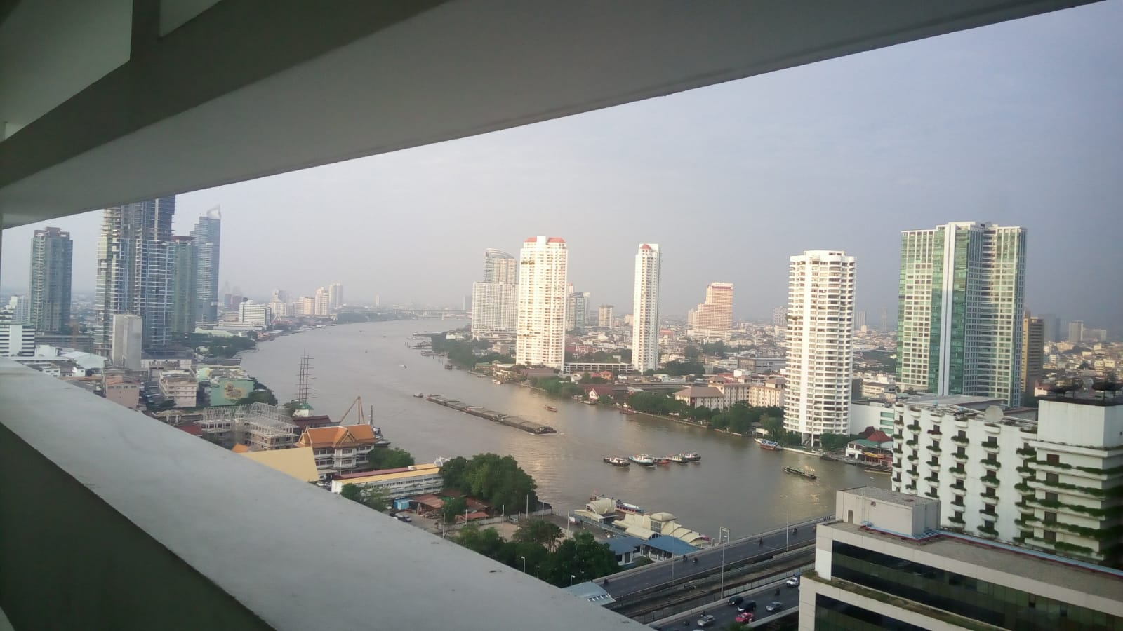
COURSE TITLE
BUILDING TECHNOLOGY
Chapter 7 - (Week 7)
Doors and Windows
LECTURE – 7
Doors and Windows
Ar. Ranju Kamal
Lecturer
Advanced college of engineering and management, Nepal
Affiliated to Tribhuvan University
Thailand, Bangkok (photo credit:Abhinay Kushwaha)

Slide 2
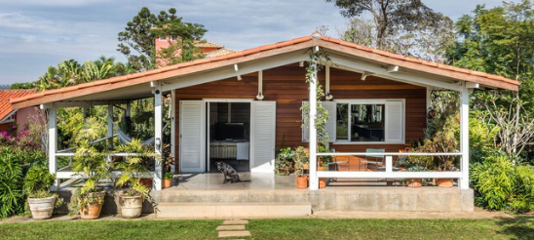
LEARNING OUTCOMES
1. Doors & their types
2.functional requirement of doors
3.Different types of windows
4.Materials used for construction of doors and windows
At the end of the session students will get acquainted to:
Figure: Doors and Windows(source: Team, A. 2023, February 5:Online),
https://www.archdaily.com/992145/different-types-of-windows-and- how-to-use-them?ad_medium=widget

Slide 3
DOORS
The function of a door is to give access to building and to different parts of the building and to deny the access whenever necessary.[1]
Number of doors should be minimum possible.
The size of the door should be of such dimension as will facilitate the movement of the largest object likely to use the doors[1]
In case of the residental buildings, the size of the door should not be less than 0.9 m × 2.0 m. [1]
Larger doors may be provided at main entrance to the building to enhance the aesthetic view. [1]
Minimum sized doors are used for bathrooms and water closets. The size recommended is 0.75 m × 1.9 m. [1]
As a thumb rule height of door should be 1 m more than its width. [1]

Slide 4
DOORS
arrangement of door components
Battened and Ledged Doors:
Battened, Ledged and Braced Doors:
Battened, Ledged and Framed Doors
Battened, Ledged, Braced and Framed Doors
method of construction
Framed and Panelled Doors
Glazed Doors
Flush Doors
Louvered Doors
Wire Gauged Doors

Slide 5
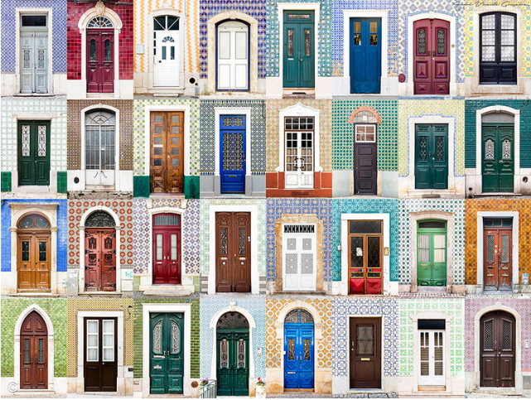
Figure:Doors(Source:Oh, E. (2016, 3, 16). Archdaily. Retrieved from Archdaily.com:
Source:
https://www.archdaily.com/784307/andre-vicente-goncalves-documents-hundreds-of-doors-and-windows-around-the-world?ad_source=search&ad_medium=search_result_articles

Slide 6
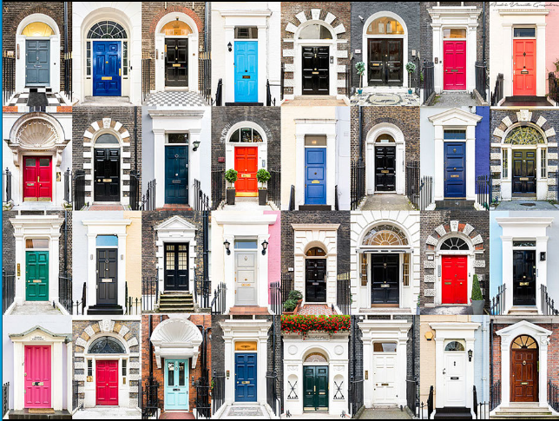
Figure:Doors(Source:Oh, E. (2016, 3, 16). Archdaily. Retrieved from Archdaily.com:
https://www.archdaily.com/784307/andre-vicente-goncalves-documents-hundreds-of-doors-and-windows-around-the-world?ad_source=search&ad_medium=search_result_articles

Slide 7
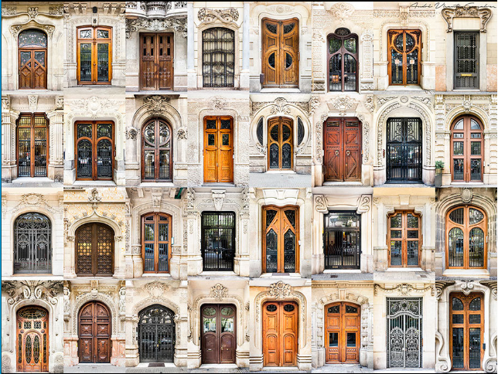
Figure:Doors(Source:Oh, E. (2016, 3, 16). Archdaily. Retrieved from Archdaily.com:
https://www.archdaily.com/784307/andre-vicente-goncalves-documents-hundreds-of-doors-and-windows-around-the-world?ad_source=search&ad_medium=search_result_articles

Slide 8
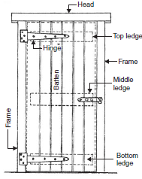
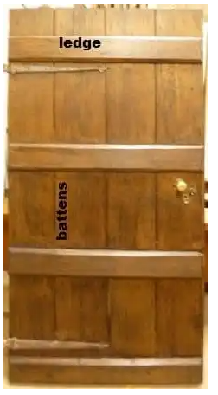
TYPES OF DOORS
Battened and Ledged Doors:
Battens are 100 mm to 150 mm wide and 20 mm thick wooden boards. [1]
Their length is that of door opening. The battens are connected by horizontal planks, known as ledges of size 100 to 200 mm wide and 30 mm thick. [1]
Usually three ledges are used one at top, one at bottom and the third one at mid-height. [1]
This is the simplest form of door and the cheapest also. Battens are secured by tongued and grooved joint. [1]
Figure: Battened and ledged door(Source: The Constructor: Building ideas. (n.d.). Retrieved from https://theconstructor.org/building/types-of-doors/11898/
Figure: door types(Source: Bhavikati, S. (2010). Basic Civil Engineering. New Delhi: New Age International (P) Ltd., Publishers)

Slide 9
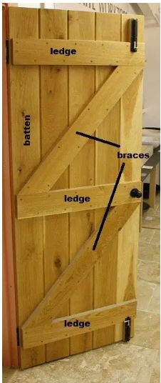
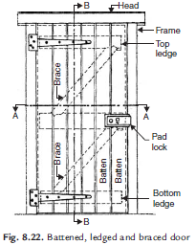
Battened, Ledged and Braced Doors:
If doors are wide apart from using battens and ledges diagonal members, known as braces, are provided to strengthen the door. [1]
Sometimes above two types of shutters are provided within wooden framework and in those cases they may be called as battened, ledges and framed doors. [1]
Figure: Battened, ledged and braced door(Source: The Constructor: Building ideas. (n.d.). Retrieved from
Figure: door types(Source: Bhavikati, S. (2010). Basic Civil Engineering. New Delhi: New Age International (P) Ltd., Publishers)
Source:`https://theconstructor.org/building/types-of-doors/11898/

Slide 10
Battened, Ledged and Framed Doors
For the simple battened and ledged door, framework is provided in the form of two verticals, known as stiles.[4]
Stiles are generally 100mm wide and as far as thickness is concerned, the thickness of stile should be equal to the combined thickness of ledge and batten. Preferably 40 mm. [4]
Battened, Ledged, Braced and Framed Doors
In this type, the door made up of battens, ledges, stiles and braces. So, it is more rigid. [4]
The braces are connected diagonally between the ledges, at about 40mm from the stiles. [4]

Slide 11
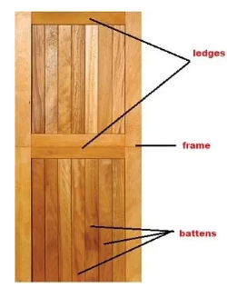
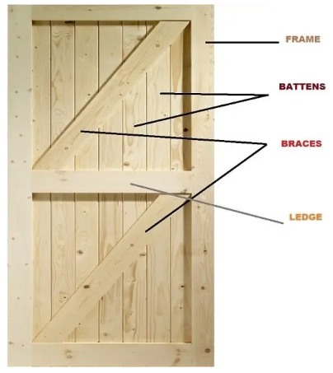
Figure: Types of Door(Source: The Constructor: Building ideas. (n.d.). Retrieved from
https://theconstructor.org/building/types-of-doors/11898/

Slide 12
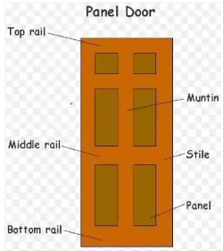
3. Framed and Panelled Doors:
This type of door consists of vertical members, called styles and horizontal members called rails. [1]
The styles and rails are suitably grooved to receive panels. [1]
The panels may be of wood, A.C. sheet, glasses etc. [1]
The panels may be flat or of raised type to get good appearance. [1]
These are very commonly used doors. [1]
They may be of single shutter or of double shutter. [1]
If glass panels are used they may be called as glazed doors. [1]
Figure: Types of Door(Source: The Constructor: Building ideas. (n.d.). Retrieved from
`https://theconstructor.org/building/types-of-doors/11898/

Slide 13
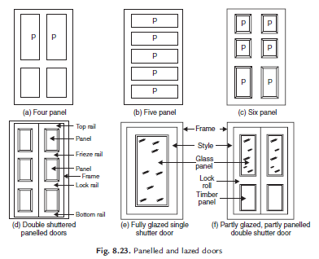
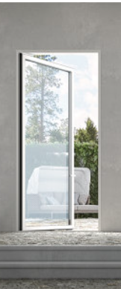
Figure: Types of Door(Source: The Constructor: Building ideas. (n.d.). Retrieved from
https://theconstructor.org/building/types-of-doors/11898/
Figure: door types(Source: Bhavikati, S. (2010). Basic Civil Engineering. New Delhi: New Age International (P) Ltd., Publishers)
Figure: Panelled and lazed doors

Slide 14
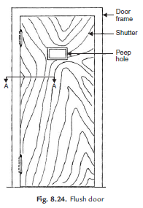
4. Flush Doors:
The shutters of these doors are made of plywood or block boards. [1]
They are of uniform thickness. [1]
These shutters are available with different attractive veneer finishes. [1]
The time consumed in making such doors at site is quite less. [1]
These doors are suitable for interior portion of a building. [1]
Nowadays flush doors are commonly used in residential and office buildings. [1]
Figure: Flush door
Figure: door types(Source: Bhavikati, S. (2010). Basic Civil Engineering. New Delhi: New Age International (P) Ltd., Publishers)

Slide 15
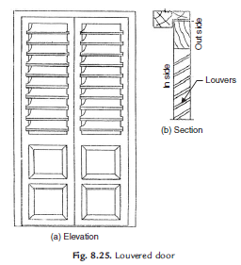
5. Louvered Doors:
Whenever privacy as well as ventilation is required such doors can be used. [1]
Louvers are the glass, wooden or A.C. sheet strips fixed in the frame of shutter such that they prevent vision but permit free passage of air. [1]
The doors may be fully or partially louvered. [1]
Such doors are commonly used for public bathrooms and latrines. [1]
Figure: Louvered door
Figure: door types(Source: Bhavikati, S. (2010). Basic Civil Engineering. New Delhi: New Age International (P) Ltd., Publishers)

Slide 16
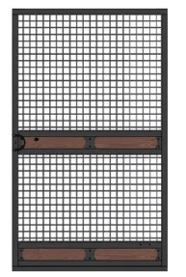
Wire Gauged Doors
Wire gaged doors permits natural ventilation and restrict the entry of flies, mosquitoes, insects etc.[4]
These doors are commonly used in hotels, restaurants and for cup boards containing eatables.[4]
Figure: Types of Door(Source: The Constructor: Building ideas. (n.d.). Retrieved from
https://theconstructor.org/building/types-of-doors/11898/

Slide 17
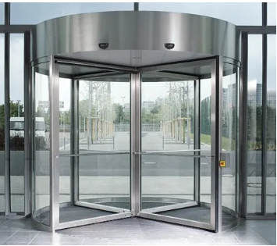
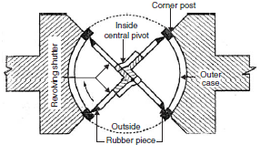
Revolving Doors:
It consist of a centrally placed pivot to which four radiating shutters are attached. [1]
The central pivot is supported on ball bearing at the bottom and has a bush bearing at the top. The shutters may be partly or fully made up of glass. [1]
A circular space of entrance is provided within which shutters rotate. As shutters rotate they give entrance on one side and exit on other side. [1]
These doors are preferred in public buildings like stores, banks, hotels, theatres where continuous use of doors is necessary. [1]
They are very much required in entrance to air conditioned public buildings. [1]
Figure: Types of Door(Source: The Constructor: Building ideas. (n.d.). Retrieved from
https://theconstructor.org/building/types-of-doors/11898/
Figure: Revolving door
Figure: door types(Source: Bhavikati, S. (2010). Basic Civil Engineering. New Delhi: New Age International (P) Ltd., Publishers)

Slide 18
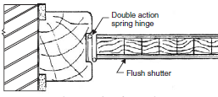
Swing Doors:
Swing door has its shutter attached to the frame by means of double action springs. [1]
Hence shutter can move both inward and outward. They may be single shuttered or double shuttered. Such doors are preferred in offices and banks. [1]
Since these doors can open on both sides it is desirable to provide glass panels or peep holes to enable user to see the persons from other side. [1]
Figure: Plan of swing door
Figure: door types(Source: Bhavikati, S. (2010). Basic Civil Engineering. New Delhi: New Age International (P) Ltd., Publishers)

Slide 19
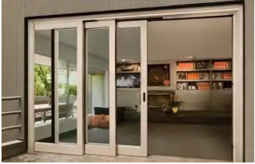
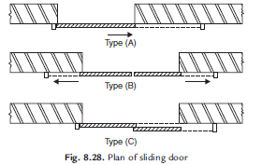
Sliding Doors:
In this type of doors, shutter slides on the sides. For this purpose runners and guide rails are provided.
Sliding shutters may be one, two or even three. Such doors are used in banks, offices etc.
Figure: Plan of sliding door
Figure: Types of Door(Source: The Constructor: Building ideas. (n.d.). Retrieved from
https://theconstructor.org/building/types-of-doors/11898/
Figure: door types(Source: Bhavikati, S. (2010). Basic Civil Engineering. New Delhi: New Age International (P) Ltd., Publishers)

Slide 20
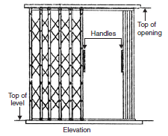
Collapsible Doors:
Steel channels 16 to 20 mm wide are used as verticals.
They are placed with 12 to 20 mm gap.
Steel flats 16 mm to 20 mm wide and 5 mm thick are hinged to them.
The rollers are provided at their top as well as at bottom so that shutter can be pulled or pushed side ways with slight force.
There may be single or double shutters.
These doors are used for additional safety.
They are commonly used for front doors , bank locker rooms, school and college entrance doors.
Figure: Collapsible steel door
Figure: door types(Source: Bhavikati, S. (2010). Basic Civil Engineering. New Delhi: New Age International (P) Ltd., Publishers)

Slide 21
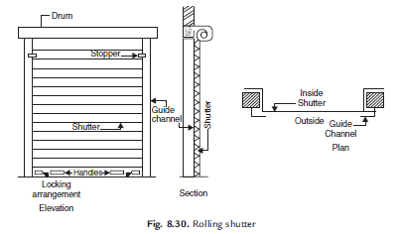
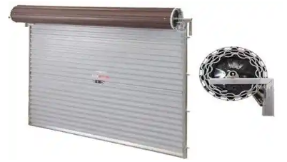
Rolling Shutters:
It consists of a frame, a drum and a shutter made of thin steel plates.
The width of the door may vary from 2 to 3 m.
The shutter moves on steel guides provided on sides and can easily roll up.
For this counterbalancing is made with helical springs on the drum.
The shutter can be easily pulled down.
This type of doors are commonly used as additional doors to shops, offices, banks, factory, buildings from the point of safety.
Figure: Rolling shutter
Figure: Types of Door(Source: The Constructor: Building ideas. (n.d.). Retrieved from
https://theconstructor.org/building/types-of-doors/11898/
Figure: door types(Source: Bhavikati, S. (2010). Basic Civil Engineering. New Delhi: New Age International (P) Ltd., Publishers)

Slide 22
Windows
Windows are fundamental to bringing more comfort to a room.
Besides the desired connection between the interior and exterior, it is through their openings that it is possible to provide natural lighting and ventilation to the rooms.[2]
Window frames are made of aluminum, steel, wood or PVC.
There are several technologies for choosing the glasses and treatments they can receive.
Light quality in the room can be improved through these treatments, as well as thermal and acoustic insulation.

Slide 23
Windows
While providing views, daylight and natural ventilation, these insulate from cold and heat, protect from external threats and enhance a facade’s appearance. [3]
They are also associated with a strong poetic or symbolic value; it is through them that we are able to connect with and enjoy our surroundings, be it a beautiful natural landscape or a dense urban environment. [3]
An expressive part of any building, windows serve as a visual bridge between the inside and outside, acting somewhat as a refreshing escape from our everyday routine.[3]

Slide 24
With countless practical and ornamental functions, choosing the right type of window is critical and cannot be taken lightly.
It must fit certain spatial requirements, address users’ specific needs and respond to pre-existing conditions like orientation, climate and location. [3]
However, the infinite options available in the market make the decision quite complex. [3]
Windows can vary in size, thickness, glass type, framing material, movement, sealing method and degree of transparency. And if the decision wasn’t already complex enough, modern technologies have also developed innovative glass features that range from fireproof panels to security and sound-proofing properties.[3]
Together and in various combinations, all of these factors can greatly impact ventilation, lighting, energy efficiency and safety, as well as define a project’s identity and aesthetic language.[3]

Slide 25

Figure:Windows(Source:Oh, E. (2016, 3, 16). Archdaily. Retrieved from Archdaily.com:
https://www.archdaily.com/784307/andre-vicente-goncalves-documents-hundreds-of-doors-and-windows-around-the-world?ad_source=search&ad_medium=search_result_articles

Slide 26
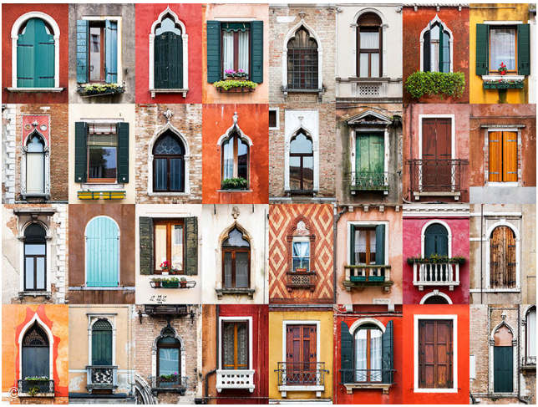
Figure:Windows(Source:Oh, E. (2016, 3, 16). Archdaily. Retrieved from Archdaily.com:
Source:
https://www.archdaily.com/784307/andre-vicente-goncalves-documents-hundreds-of-doors-and-windows-around-the-world?ad_source=search&ad_medium=search_result_articles

Slide 27

Figure:Windows(Source:Oh, E. (2016, 3, 16). Archdaily. Retrieved from Archdaily.com
https://www.archdaily.com/784307/andre-vicente-goncalves-documents-hundreds-of-doors-and-windows-around-the-world?ad_source=search&ad_medium=search_result_articles

Slide 28
Various windows used may be classified on the basis of materials used, types of shutters, types of openings of shutters and the position of windows.[1]
Timber, steel and aluminium are commonly used to make window frames. Timber may get termite attacks ,steel may rust but aluminium do not have any such defects. However they are costly.[1]
Shutters of windows may be panelled, glazed or louvered. Louvered windows are generally used for bathrooms and toilets where vision is not to be allowed but ventilation is required. Lower parts panelled and upper parts glazed windows are commonly used. Instead of panelled one may think of using translucent glasses.[1]
Window shutters may be fixed, centrally pivoted, sliding type or double hung. [1]

Slide 29
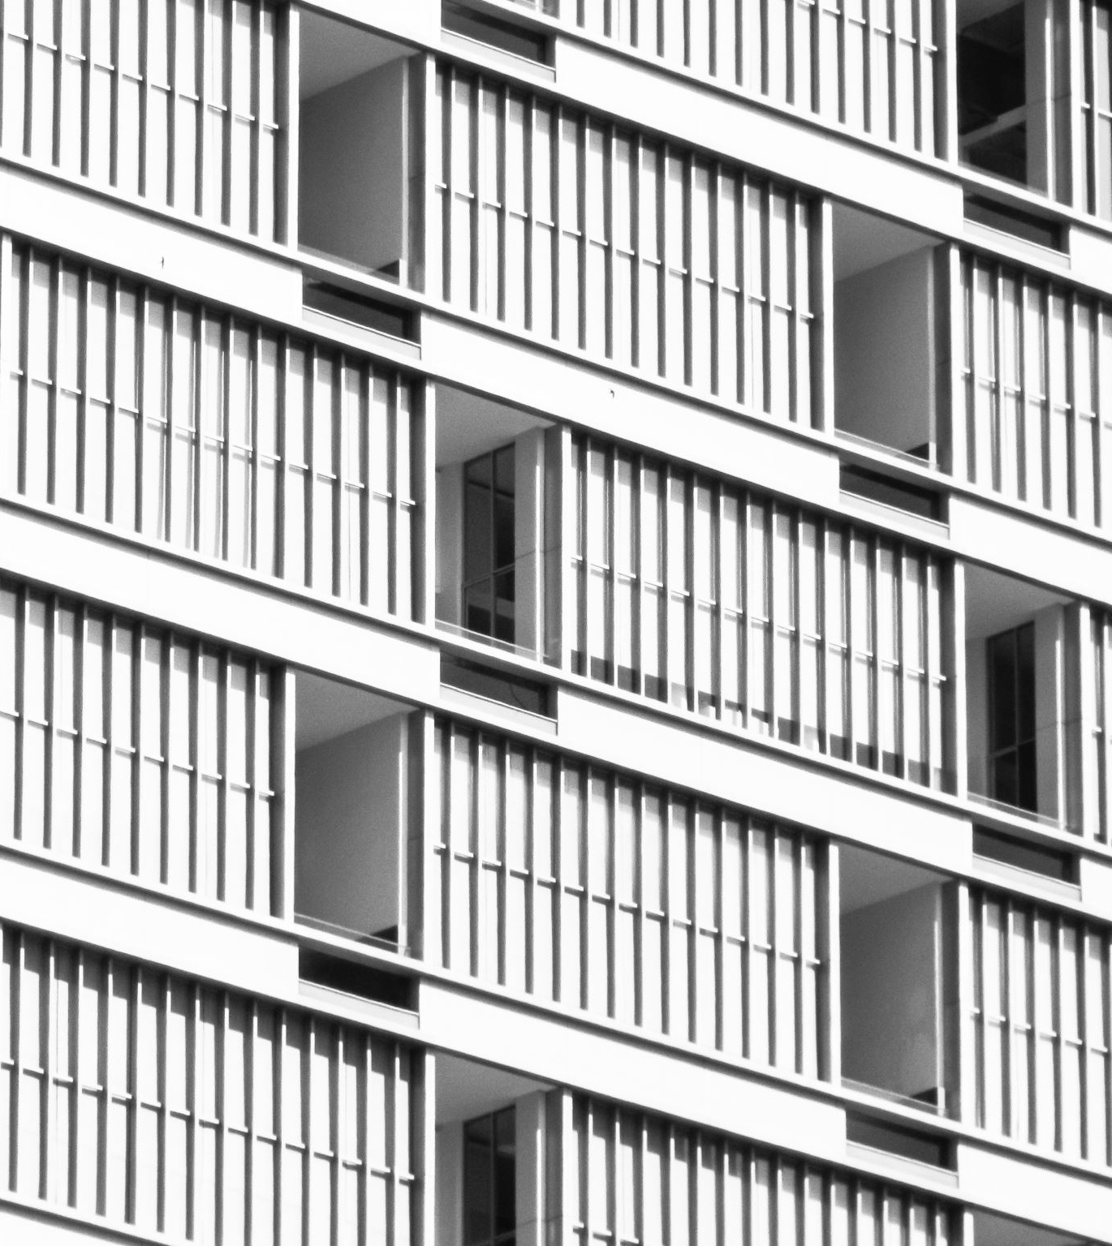
Depending upon the position of windows, they may be classified as:
(a) Casement windows
(b) Bay windows
(c) Corner windows
(d) Clear storey windows
(e) Gable windows
(f) Sky light windows
(g) Dormer windows
(h) Ventilators

Slide 30
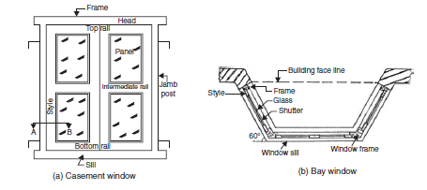
Casement Windows
Casement windows are usually fixed on the side of the frames and rotate vertically. [1]
Installing locks on the walls to hold their sheets prevents them from closing with the wind.[1]
Casement windows are fixed to the frame by one or more hinges at the side, similar to conventional doors[2]
Usually fitted in on single or double panels, these allow for full top to bottom ventilation when opened.[2]
Figure: Casement window(source: Team, A. 2023, February 5:Online),
https://www.archdaily.com/992145/different-types-of-windows-and- how-to-use-them?ad_medium=widget
Source: Bhavikati, S. (2010). Basic Civil Engineering. New Delhi: New Age International (P) Ltd., Publishers

Slide 31
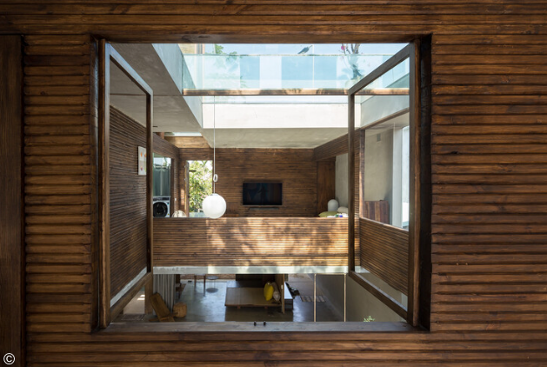
Source: Montjoy, V. (2023, February 4). Archdaily. Retrieved from archdaily.com: https://www.archdaily.com/992118/from-frameless-to-pivot-20-types-of-windows-for-architectural-design?ad_source=search&ad_medium=search_result_articles

Slide 32
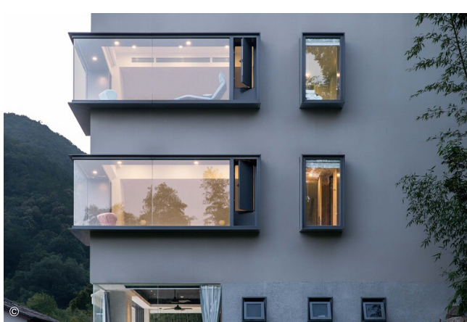
Bay window
This window projects outwards from the building.
It uses glass and creates a small space inside the room where benches or decorative elements can be placed.
Figure: Window Types(Source:Team, A. (2023, February 5). Archdaily. Retrieved from archdaily.com: https://www.archdaily.com/992145/different-types-of-windows-and-how-to-use-them?ad_medium=widget
Figure: Bay window
Source: Bhavikati, S. (2010). Basic Civil Engineering. New Delhi: New Age International (P) Ltd., Publishers

Slide 33
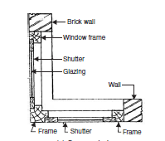
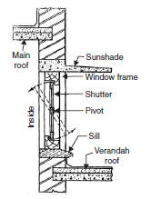
Figure: Corner window
Figure: Clear storey window
Figure: door types(Source: Bhavikati, S. (2010). Basic Civil Engineering. New Delhi: New Age International (P) Ltd., Publishers)

Slide 34
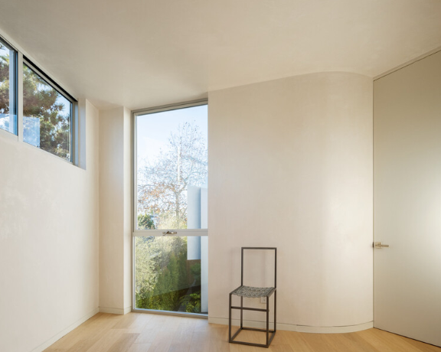
Awning
Awning windows are basically casement windows that swing vertically instead of horizontally.
They are usually found in high or narrow places –such as above doors or other windows– and typically seal well.[2]
Figure: Window types (Source: Montjoy, V. (2023, February 4). Archdaily. Retrieved from archdaily.com: https://www.archdaily.com/992118/from-frameless-to-pivot-20-types-of-windows-for-architectural-design?ad_source=search&ad_medium=search_result_articles

Slide 35
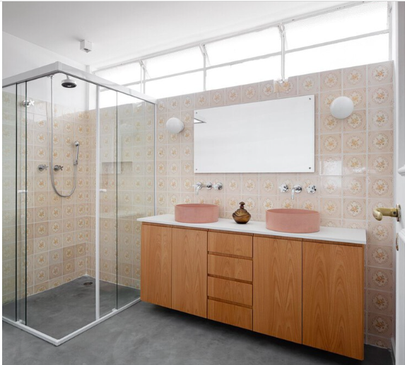
Tilt Windows
Tilt windows are suitable for areas that need constant ventilation, such as kitchens, service areas and bathrooms.
They open from a side lever and, depending on the treatment of the glass, can maintain complete privacy from the environment while ventilating it.[2]
Figure: Window types (Source: Montjoy, V. (2023, February 4). Archdaily. Retrieved from archdaily.com: https://www.archdaily.com/992118/from-frameless-to-pivot-20-types-of-windows-for-architectural-design?ad_source=search&ad_medium=search_result_articles

Slide 36
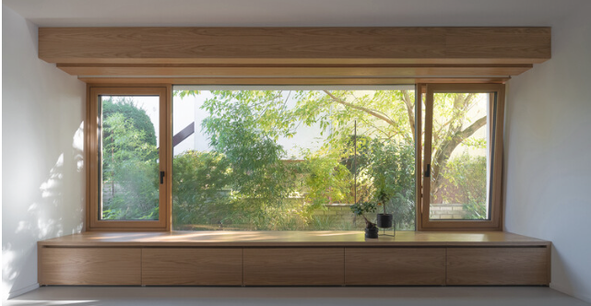
Tilt-and-turn
Widely used in kitchens and bathrooms, these windows feature a hinge mechanism that enables them to be opened in two ways: they can open fully like a casement window, or slightly tilt open inwards to create a small opening at the top.[2]
Figure: Window types (Source: Montjoy, V. (2023, February 4). Archdaily. Retrieved from archdaily.com: https://www.archdaily.com/992118/from-frameless-to-pivot-20-types-of-windows-for-architectural-design?ad_source=search&ad_medium=search_result_articles

Slide 37
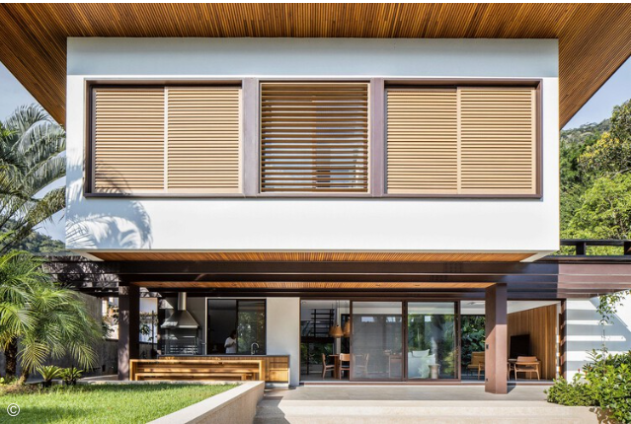
Shutter Window
A very popular window, ideal for environments that receive a lot of sunlight or for privacy, as it allows airflow even when it is closed.[2]
Its sheets are made of timber or metal and, depending on the frame, can be accompanied by opening or sliding glass sheets, which allow an even wider use.[2]
Figure: Window Types(Source:Team, A. (2023, February 5). Archdaily. Retrieved from archdaily.com: https://www.archdaily.com/992145/different-types-of-windows-and-how-to-use-them?ad_medium=widget

Slide 38
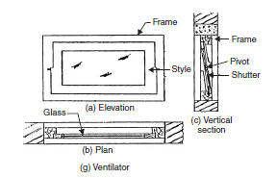
Figure: Types of window on their position
Source: Bhavikati, S. (2010). Basic Civil Engineering. New Delhi: New Age International (P) Ltd., Publishers

Slide 39
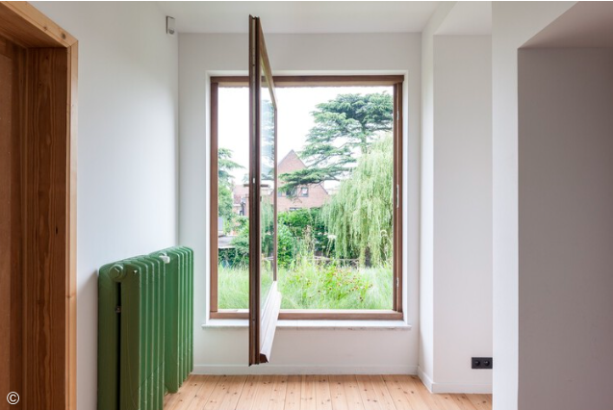
Pivot Windows
This window has two pivots that form the axis through which the glass will rotate to open.
In this way, while part of it occupies an internal area, the other occupies an external area of the house.[2]
Figure: Window Types(Source:Team, A. (2023, February 5). Archdaily. Retrieved from archdaily.com: https://www.archdaily.com/992145/different-types-of-windows-and-how-to-use-them?ad_medium=widget

Slide 40
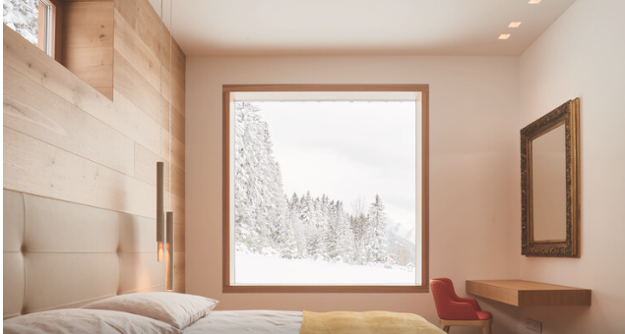
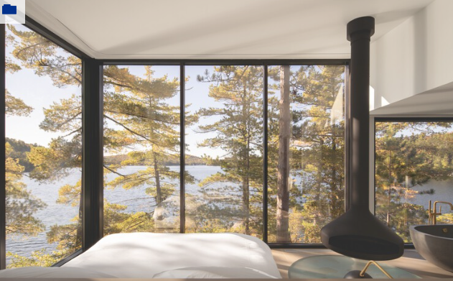
Frame material
Wood
Since wood frames are susceptible to moisture and insect damage, they often require regular maintenance. However, they come from a renewable resource, are extremely versatile and offer a warm, timeless, nature-inspired appearance that is unmatched. [2]
Steel
Although they can be quite heavy, steel windows are strong, secure and especially suitable for sleek and modern designs. They are also low maintenance, versatile and recyclable. In some cases, the frame actually has a timber core that is then coated in steel.[2]
Figure: Window types (Source: Montjoy, V. (2023, February 4). Archdaily. Retrieved from archdaily.com: https://www.archdaily.com/992118/from-frameless-to-pivot-20-types-of-windows-for-architectural-design?ad_source=search&ad_medium=search_result_articles

Slide 41
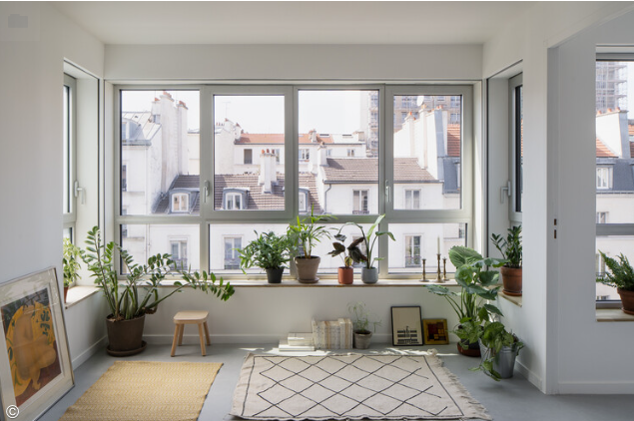
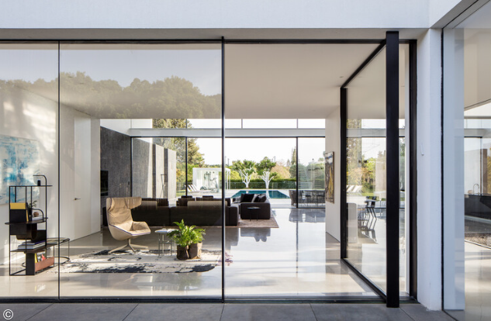
Plastic
Vinyl windows are made out of polyvinyl chloride (PVC), a plastic material. They are widely used in various formats, standing out for their durability, insulation properties, cost-efficiency and low maintenance[2]
Aluminium
Particularly known for their sturdiness, aluminium frames can last up to 30 years. They are also 100% recyclable, thermally efficient and practically maintenance-free, which explains their popularity in many architectural settings.[2]
Figure: Window types (Source: Montjoy, V. (2023, February 4). Archdaily. Retrieved from archdaily.com: https://www.archdaily.com/992118/from-frameless-to-pivot-20-types-of-windows-for-architectural-design?ad_source=search&ad_medium=search_result_articles

Slide 42
REFERENCES
[1] Bhavikati, S(2010). Basic Civil engineering, New Delhi: New Age International (p) LTD,Publishers
[2] Montjoy, V. (2023, February 4). Archdaily. Retrieved from archdaily.com: https://www.archdaily.com/992118/from-frameless-to-pivot-20-types-of-windows-for-architectural-design?ad_source=search&ad_medium=search_result_articles
[3] Oh, E. (2016, March 24). Archdaily. Retrieved from archdaily.com: https://www.archdaily.com/784307/andre-vicente-goncalves-documents-hundreds-of-doors-and-windows-around-the-world?ad_source=search&ad_medium=search_result_articles
[4] Team, A. (2023, February 5). Archdaily. Retrieved from archdaily.com: https://www.archdaily.com/992145/different-types-of-windows-and-how-to-use-them?ad_medium=widget
[5] The Constructor: Building ideas. (n.d.). Retrieved from https://theconstructor.org/building/types-of-doors/11898/

Slide 43
THANK YOU

