Slide 1
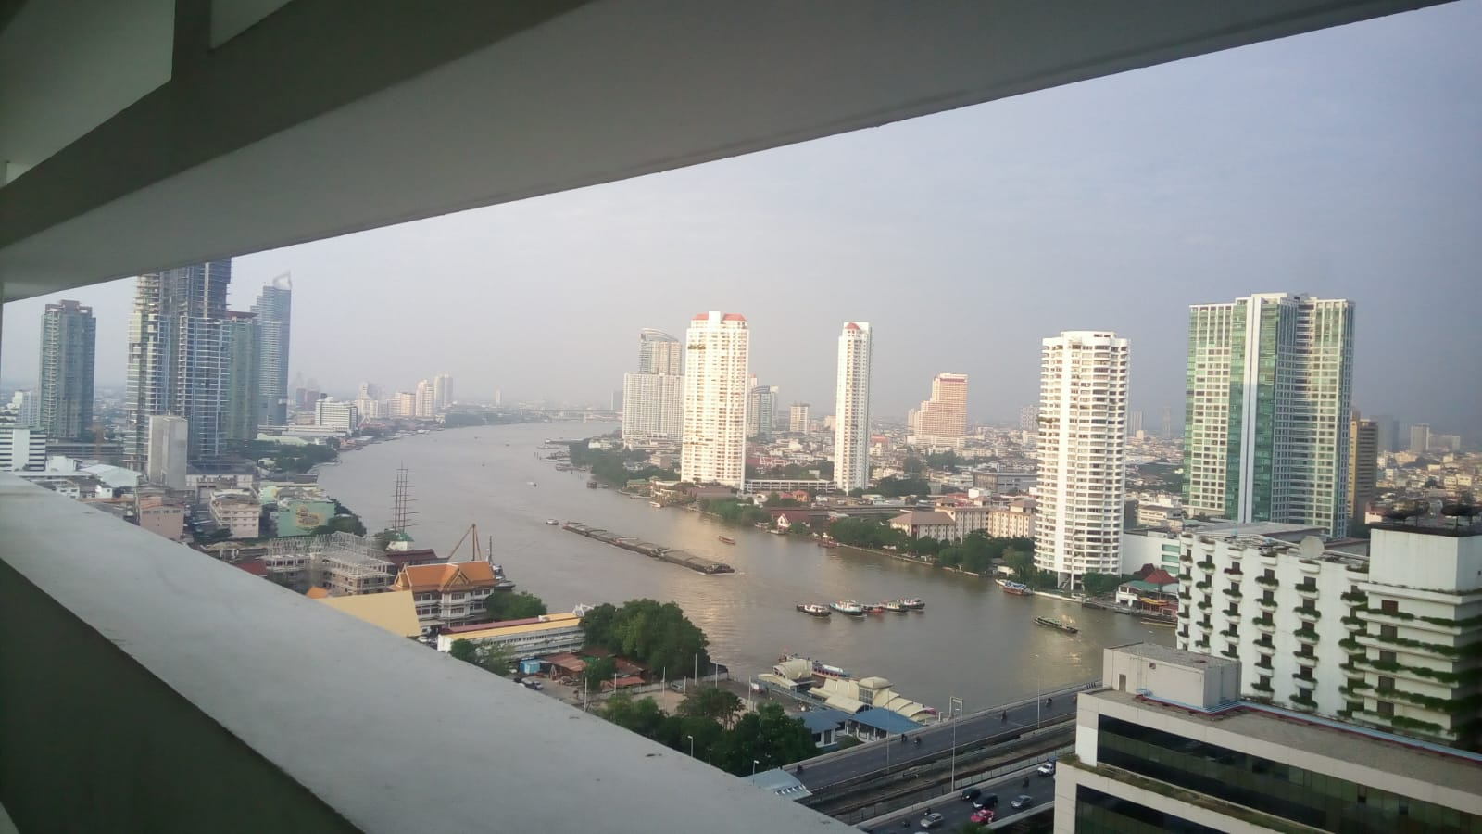
COURSE TITLE
BUILDING TECHNOLOGY
Chapter 8 - (Week 8)
FLOORING
LECTURE – 8
FLOORING
Ar. Ranju Kamal
Lecturer
Advanced college of engineering and management, Nepal
Affiliated to Tribhuvan University
Thailand, Bangkok (photo credit:Abhinay Kushwaha)

Slide 2
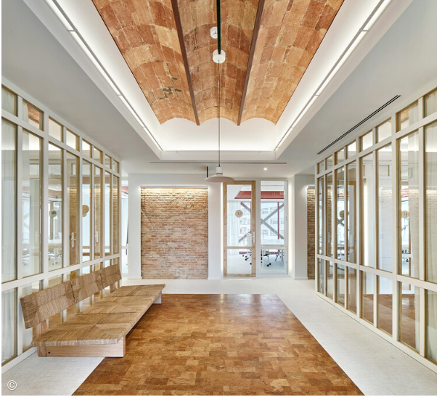
LEARNING OUTCOMES
At the end of the session students will get acquainted to:
1. Flooring and its Types
2. Special Types of Floor finishing
3. Floor and Wall ties
Figure: Flooring(Source:Wormald, J.(2023, 15 August): Retrieved from:
https://www.archdaily.com/1005393/when-changes-in-flooring-alter-our-spatial-experience?ad_source=search&ad_medium=search_result_articles

Slide 3
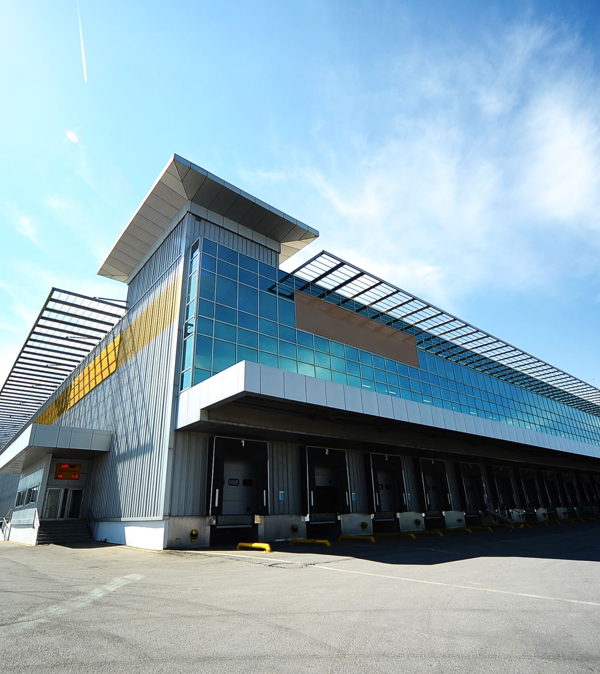
Flooring and its types
Floors:
Floors are the horizontal elements of a building structure which divide the building into different levels for the purpose of creating more accommodation within a restricted space one above the other and provide support for the occupants, furniture, equipment etc. of a building.[1]
Floor system is the building’s primary horizontal planes which support both live and dead loads.
Floor should transfer these loads to beams or columns or load bearing wall.

Slide 4
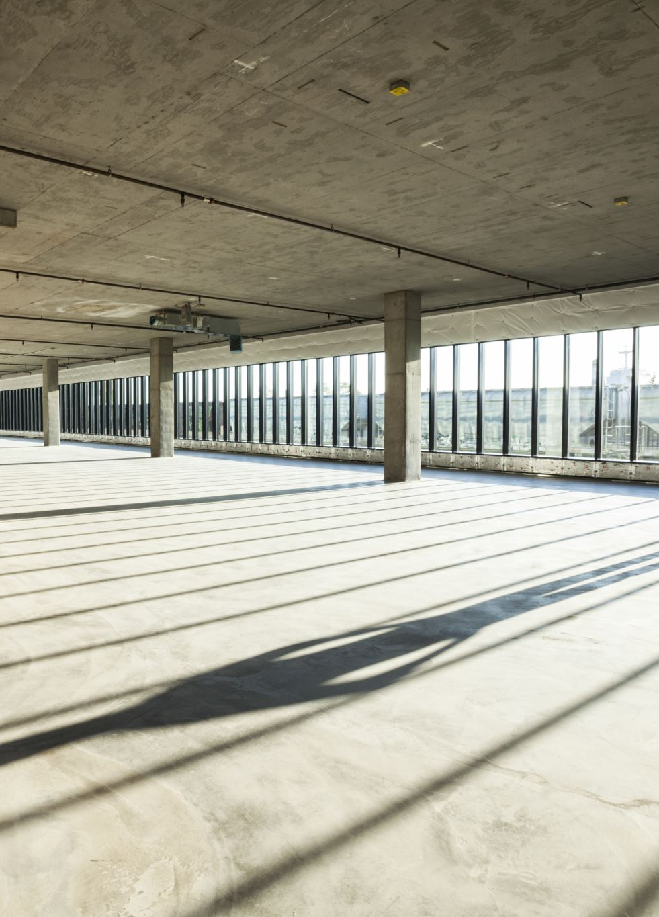
Types
Ground floor
Basement floor
Upper floor
1. Ground floor
The bottom floor near the natural surrounding ground level is termed as ground floor.
OR
The floor of a building immediately above ground is known as ground floor.
Two types of ground floor
a) Solid ground floor
b) Suspended ground floor[1]

Slide 5
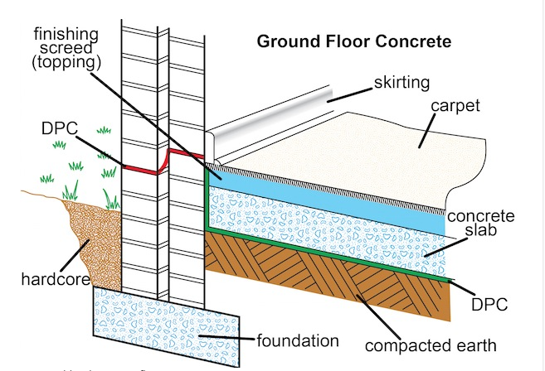
a) Solid ground floor
In this floor there is no gap between ground level and plinth level (ground floor level). The gap between ground level and plinth level are completely filled with solid materials.[1]
Figure:Section(Source:Janek(2013,March 6):Online
https://www.sans10400.co.za/floors-and-flooring/

Slide 6

Steps involved in solid flooring works
Preparation of Subgrade (Compaction, sand filling and consolidation)
1
Laying of brick or stone soling
2
PCC work
3
Screeding and floor finish
4

Slide 7
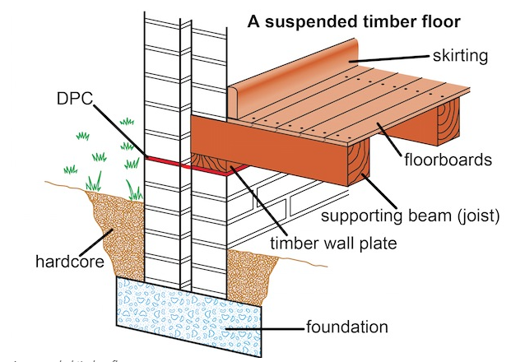
Suspended ground floor
Suspended ground floor is a timber floor that is not touching the ground level and it is suspended above the ground. [1]
In this floor, there is a certain air gap between the ground level and the plinth level.[1]
Ventilation is provided in the wall to keep the air circulation and hence floor becomes dry. [1]
Mostly used in dancing hall, stage, auditorium, etc.[1]
Figure:Section(Source:Janek(2013,March 6):Online
https://www.sans10400.co.za/floors-and-flooring/

Slide 8
2. Basement floor
A floor when provided for the accommodation below the natural ground level is termed as basement floor. Generally, used for parking and storing goods.
3. Upper floor
All other floor above the ground floor are termed as upper floor.
The major problems of ground and basement floors are damp exclusion and thermal insulation. The moisture is generally present in ground and unless suitable measures are taken to prevent its entry, it will pass into the building through the floors.
On the other hand, the problems of stability and strength are relatively of less importance because full support from the ground is available at all points.

Slide 9
Factors affecting the selection of choice of flooring[3]
Appearance: Desired appearance; Produce color effect in conformity with the use in building.
Cleaning: Easily and effectively cleaned; Effective resistance against absorption of oil, grease, etc.
Comfort: Comfortable when used; if it possesses reasonably good thermal insulation then it imparts comfort to the residents of the building.
Cost : Not very costly and low maintenance cost.
Damp resistance: Offer sufficient resistance against dampness.
Durability: Durable and Strong enough to impart resistance to wear, tear, chemical action, temperature changes.
Fire resistant
Hardness: Hard enough to resist marks or signs caused by shifting or rubbing of furniture, equipment, etc.
Maintenance: Easy to maintain.
Noise: If noise is created by use of flooring material, it leads to discomfort.
Slipperiness: Should not be too slippery.[3]

Slide 10
Special types of floor finishing
The materials used for floor finishing or floor covering or flooring are[3]:
Mud and muram (disintegrated Rocks)
Bricks
Flag stones
Concrete
Terrazzo
Mosaic
Tiles
Marble
Granite finish
Wood or timber
Asphalt
Rubber
Linoleum flooring
Cork
Glass
Plastic or P.V.C.

Slide 11
Mud and Muram flooring
Used only in lowcost housing and unimportant buildings.
Mud flooring
Cheap, hard, fairly impervious, easy to construct and maintain.
Has good thermal insulation property due to which it remains cool in summer and fairly warm in winter.[3]
Procedure:
25 cm thick selected moist earth is spread and is then rammed well to get a consolidated thickness of 15 cm.
To prevent cracks due to drying, small quantity of chopped straw (acts as reinforcement) is mixed in moist earth before ramming.
To maintain the mud floor in good condition, a thin coat of cow-dung mixed with moist earth or cement-cow dung in proportion of 1:2 to 1:3 is applied on the top.[3]

Slide 12
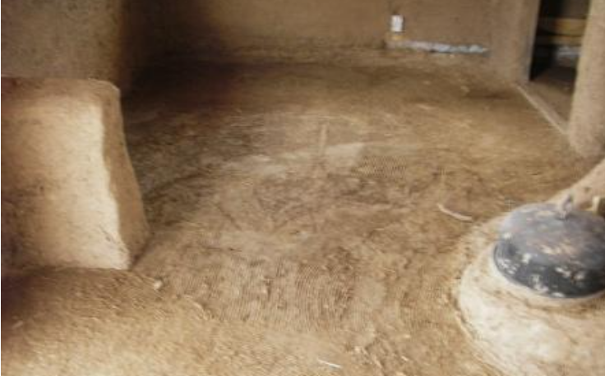
Mud Flooring

Slide 13
Muram flooring
Any disintegrated rock with binding material is called muram.
Flooring has practically same properties as that of mud flooring.
Procedure[1]:
15 cm thick layer of muram is laid over prepared sub grade of 25 cm. Then 2.5 cm thick layer of powder muram (fine muram) is spread and water is sprinkled over it and then rammed well.
After that, surface is saturated and a thin film of water is observed on the top.
Now, the surface is trampled till a cream of muram rises. This state is allowed undisturbed for about 1 day.
Rammering is done with wooden rammer for 2-3 days.
After dry hard surface is formed, it is rubbed with thin paste of cow-dung and rammed again for two days during morning hours.
Finally, over the dry hard surface, a thin coat of cement cow dung plaster (1 cement: 4 cow dung) is applied evenly and wiped clean immediately by hand.
Once a week, cow-dung should be applied.

Slide 14
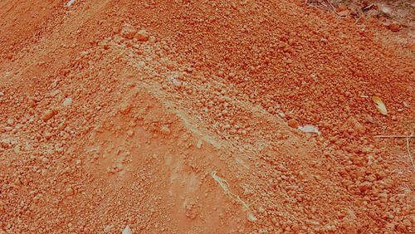
Muram

Slide 15
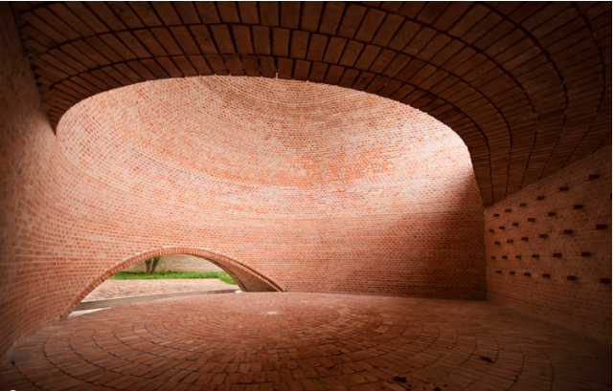
Brick flooring
Used in cheap construction, specially where good bricks are available, especially suited to houses, stores, etc.
Procedure[1]:
Firstly, sub-grade is compacted and over this 10-15 cm thick PCC is done.
Now, brick are laid on 10mm thick bed of mortar.
Joints are finished with mortar and properly cured.
Figure: Flooring types(Source:Pereira, Matheus. "9 Projects that Demonstrate the Versatility of Brick Floor" (21 Feb 2020. ArchDaily.)
https://www.archdaily.com/933775/9-projects-that-demonstrate-the-versatility-of-brick-floor?ad_source=search&ad_medium=search_result_articles

Slide 16
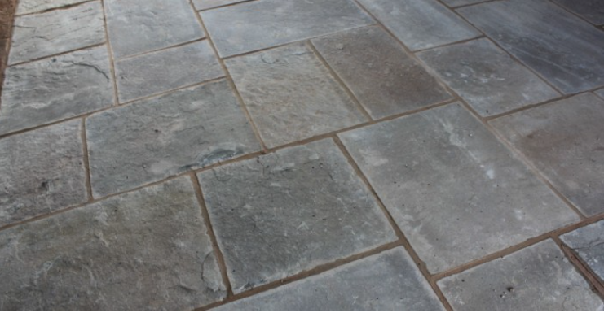
Flag stone flooring
Flagstone is any laminated sandstone available in 2cm to 4cm thickness, in the form of stone slabs of square (30cm*30cm, 45cm*45cm or 60cm*60cm) or rectangular size (45cm*60cm).
Also called paved flooring and laid on concrete base.[1]
Procedure[1]:
Sub-grade is prepared and then 10-15 cm thick PCC is laid.
Now, flagstones are laid over 20-25 mm thick layer of mortar.
Slope is necessary to be given in flagstone flooring for proper drainage.
Figure: Flooring types (Source: Concrete civil(n.d.):Online
https://concretecivil.com/flooring-and-its-types/

Slide 17
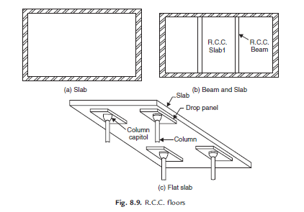
Cement concrete flooring
Commonly used for residential, commercial, industrial buildings.[1]
Moderately cheap, quite durable and easy to construct.[1]
Floor consists two components:
Base concrete
Topping or wearing surface
Figure Source: Bhavikati, S. (2010). Basic Civil Engineering. New Delhi: New Age International (P) Ltd., Publishers.

Slide 18
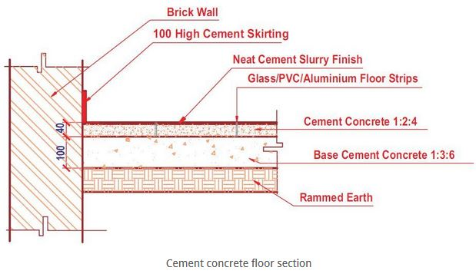
Figure: Cement Concrete floor section( Source: Suryakanta(2015,January 31):Online
https://civilblog.org/2015/01/31/how-to-construct-cement-concrete-floor/

Slide 19
Procedure:
First properly compact the earth in the plinth. While compacting, care has to be taken that a proper slope as required for the floor is provided.
Over this compacted earth filling, uniformly spread a layer of clean coarse sand about 10 to 15 cm thick.[3]
A base concrete of grade M10 (1 cement : 3 sand : 6 coarse aggregate) is then laid over the sand layer in the required slope and tamped properly. The thickness of base concrete is generally 100 mm.[3]
Level the top of the base concrete and left it to set and harden.
Thoroughly clean the surface upon hardening.
Divide the top of the floor into panels, rectangular or square in shape, by using glass or other strips. The area of the panels should preferably less than 2 square meters.[3]
After completion of the paneling, moist the top of the base concrete and apply cement slurry on it.
Over this cement slurry, provide a layer of cement concrete of grade M15 (1:2:4) of required thickness (say 40 mm).[3]
Tamp the top surface thoroughly to compact it and use wooden floats to obtain a smooth surface. The surface so obtained is cured for about 10 days before putting it to use.[3]

Slide 20
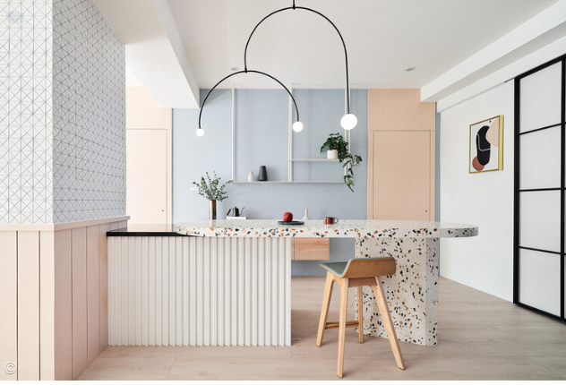
Terrazzo flooring (chips of polished stone set in concrete)
Composite material made up of cement and marble chips.[1]
It is a concrete containing marble chips as an aggregate.[1]
Very decorative and expensive.[1]
Easy to clean.[1]
Figure: Flooring types(Source:James Wormald. "What Is Terrazzo and Where Do You Find It?" 11 Jul 2023. ArchDaily. Retrieved from
https://www.archdaily.com/1003432/what-is-terrazzo-and-where-do-you-find-it?ad_source=search&ad_medium=search_result_articles

Slide 21
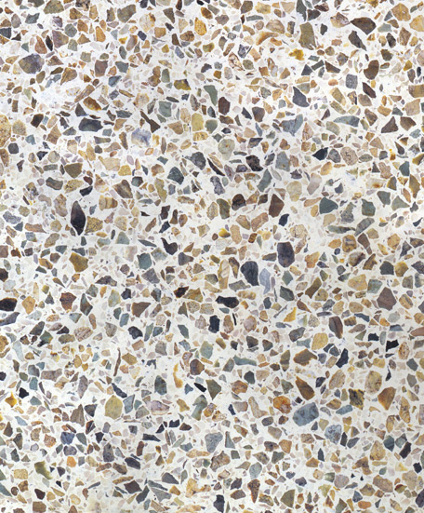
Terrazzo flooring (chips of polished stone set in concrete)

Slide 22
Procedure:
Earth is first rammed well.
A layer of brick is laid over the soil and compacted.
Now, PCC is laid over the brick layer.
Then, marble chips are arranged as per desired on the top of the PCC.
Mixture of cement and sand is now laid over the gaps present in the marble chips.
Now, grinding of the marble is done and finally waxing is done to obtain an appealing texture.

Slide 23
6. Mosaic flooring (small pieces of colored stone or glass)
Made of small pieces of broken tiles or marble of different color arranged in different patterns.[1]
On a concrete base, 5 to 8 cm thick cement-sand mortar is spread and level. Then 3mm thick cementing material in the form of paste of two parts of cement, one part of powdered marble and one part of Pozzolana materials are spread and left to dry for about 4 hours.[1]
Then small pieces of broken tiles or marble pieces of different colors are arranged in definite patterns and hammered into cementing layer.
This is a superior type of flooring used in bathrooms and kitchens of residential buildings and hospitals, etc.[1]

Slide 24
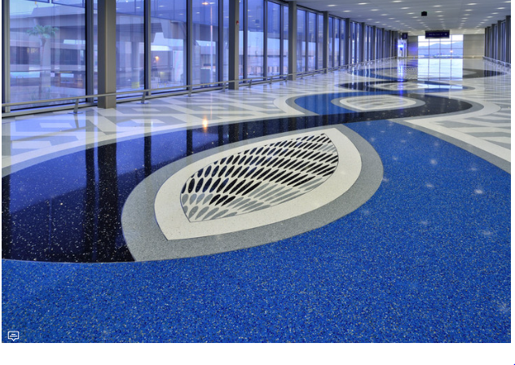
Mosaic Flooring
Figure: Flooring types(Source:"Terrazzo Floors Bring History to Life" 15 Oct 2018. ArchDaily.Retrieved from:
https://www.archdaily.com/903781/terrazzo-floors-bring-history-to-life?ad_source=search&ad_medium=search_result_articles

Slide 25
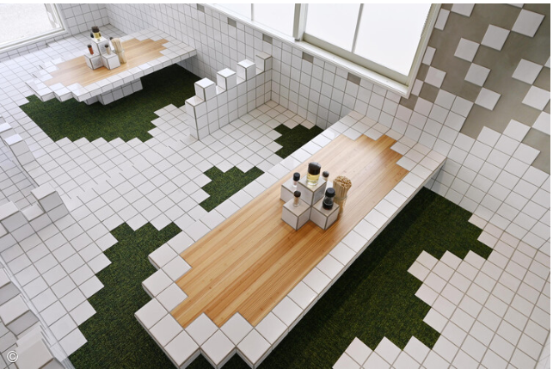
7. Tiles flooring
Tiles are made from baked clay.[1]
Tiled Method of layering tiled flooring is similar to the flag stone except that greater care is required.[1]
Before layering the tiles, neat cement slurry is spread over the bedding mortar and the tiles are laid flat over it, gently pressing.[1]
Available in different sizes and shapes.
Problem of cracks can occur when laid over uneven surfaces.[1]
White ceramic tiles
Figure: Flooring(Source:Wormald, J.(2023, 15 August): Retrieved from:
https://www.archdaily.com/1005393/when-changes-in-flooring-alter-our-spatial-experience?ad_source=search&ad_medium=search_result_articles

Slide 26
8. Marble flooring
Superior type of flooring used in bathroom, kitchen.[1]
Marble slabs are available in different sizes.[1]
Concrete base is prepared in same manner as that for concrete flooring [1]
20 mm thick bedding mortar of (1:4 cement sand) is spread under the area of each individual slab and laid over the base concrete by gently pressed with wooden matter and leveled. [1]
Marble is a natural stone so it contains pores inside it. Therefore, before laying a marble slab on the floor-sealant-both below and above the surface must be applied.[1]

Slide 27
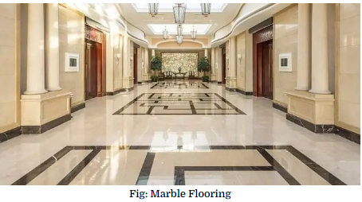
Marble flooring
Figure: Flooring Types(Source: The Constructor: Building ideas. (n.d.). :Online
https://theconstructor.org/building/types-of-flooring-materials-uses-building/16992/

Slide 28
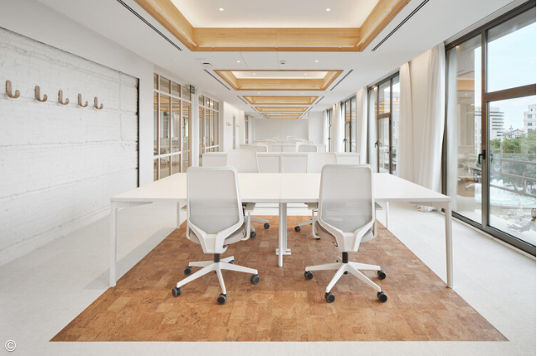
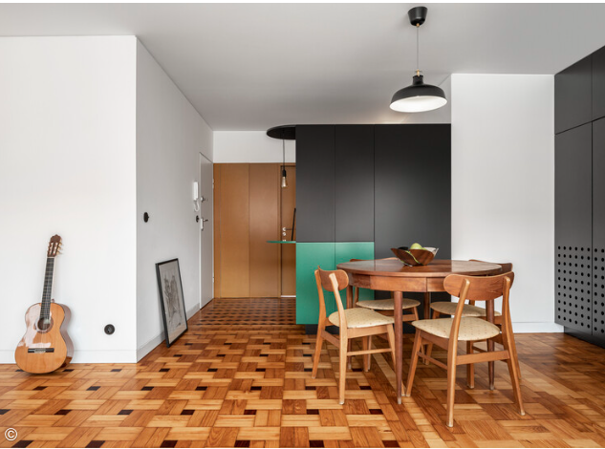
9. Timber flooring
This floor may be suspended type or solid type.
Engineering woods, solid woods and laminated woods may be used for flooring.
Flooring can be done by 3 methods.
Nailing/Stapling method
Gluing method
Floating method
Figure: Flooring(Source:Wormald, J.(2023, 15 August): Retrieved from:
https://www.archdaily.com/1005393/when-changes-in-flooring-alter-our-spatial-experience?ad_source=search&ad_medium=search_result_articles
Figure: Flooring types(Source:Ghisleni,C.(2023,May 05):Online)
https://www.archdaily.com/1000026/take-off-your-shoes-5-floors-to-experience-barefoot?ad_source=search&ad_medium=search_result_articles

Slide 29
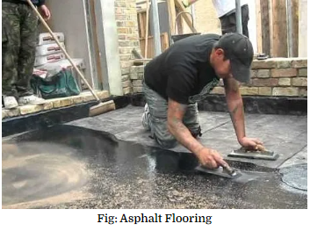
10. Asphalt Flooring
Dustless, elastic, durable, water proof, acid proof and attractive in appearance.[1]
Clean sharp sand or grit is mixed to melted asphalts (molten mass) in proportion of 2:1.[1]
The mixture of uniform thickness(13mm to 25mm) is poured on the previously prepared concrete bed by means of iron ladle.[1]
Before the layer becomes hard, very fine sand in small quantity is shifted over it and the surface is well rubbed.[1]
Asphalt flooring is of 4 types[1]
Asphalt mastic flooring
Asphalt tiles flooring
Asphaltic terrazzo flooring
Acid proof mastic flooring
Figure: Flooring Types(Source: The Constructor: Building ideas. (n.d.). :Online
https://theconstructor.org/building/types-of-flooring-materials-uses-building/16992/

Slide 30
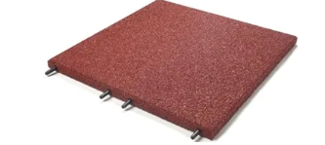
11. Rubber Flooring
Consists of sheets or tiles of rubber in variety of patterns and color with thickness varying from 3 to 10 mm.
Sheets or tiles are fixed to concrete base.
Resilient and noise proof.
Figure: Flooring Types(Source: The Constructor: Building ideas. (n.d.). :Online
https://theconstructor.org/building/types-of-flooring-materials-uses-building/16992/

Slide 31
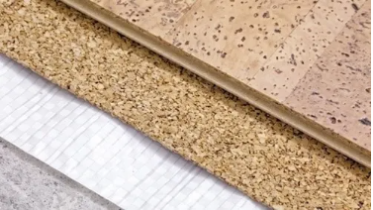
12. Cork Floor
Perfectly noiseless and used in libraries, theaters, art galleries etc.
Cork comes from the bark of the cork oak tree (Quercus suber) and is periodically harvested from the living trees in plantations planted for commercial purposes.
To create flooring products, cork is ground up, compressed, and formed into sheets bonded with resins.
Available in the form of cork carpet or cork tiles, fixed to concrete base.
Figure: Flooring Types(Source: The Constructor: Building ideas. (n.d.). :Online
https://theconstructor.org/building/types-of-flooring-materials-uses-building/16992/

Slide 32


13. Glass Flooring
Special purpose flooring, used in circumstances where it is desired to transmit light from upper floor to lower floor.
Available in the form of tiles or slabs in varying thickness of 12 to 30 mm.
Figure: Flooring types (Source: Archdaily.com(n.d)):Online
https://www.archdaily.com/27612/glass-balcony-at-sears-tower?ad_source=search&ad_medium=search_result_articles

Slide 33
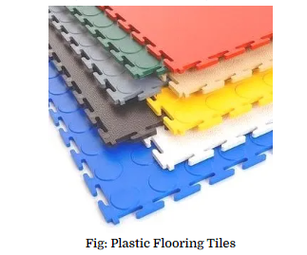
14. Plastic or P.V.C. Flooring
Made of plastic material called Poly Vinyl Chloride (P.V.C.), fabricated in the form of tiles of different size and color shades.
PVC is a petroleum based (a non-renewable) synthetic product.
Widely used in all residential as well as non-residential buildings.
Costly and slippery.
Wears up easily than linoleum and are prone to fire.
Figure: Flooring Types(Source: The Constructor: Building ideas. (n.d.). :Online)
https://theconstructor.org/building/types-of-flooring-materials-uses-building/16992/

Slide 34
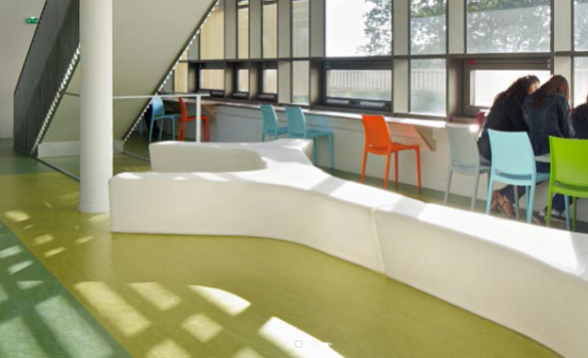
15. Linoleum Flooring
It is a eco-friendly product (Bio-degradable) made with linseed oil and natural ingredients.
Such types of flooring are highly durable (lasts for 30-40 years).
Comparatively expensive than PVC/plastic flooring.
Figure: Flooring types (Source: Archdaily.com(n.d)):Online
https://www.archdaily.com/search/products?q=linoleum%20flooring

Slide 35
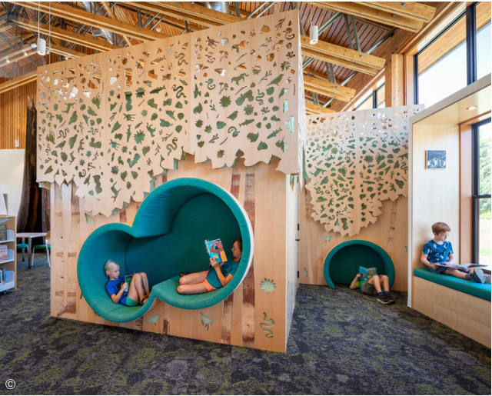
16.Carpet Flooring
Mostly used.
The material of the carpet may be natural wool, nylon, etc.
Provides high degree of softness to the user.
Available in different colors, styles, etc.
https://www.archdaily.com/1000026/take-off-your-shoes-5-floors-to-experience-barefoot?ad_source=search&ad_medium=search_result_articles
Figure: Flooring types(Source:Ghisleni,C.(2023,May 05):Online)

Slide 36
Floor and Wall Ties
Wall ties:
Iron rods or elements that are embedded into the wall so as to avoid brittle failure of the wall.
Generally, wall ties are used in cavity walls to make the inner wall and outer wall act as a single homogenous wall under loading.[4]
Ductile failure is the priority rather than brittle failure so wall ties are arranged into intervals into the wall.
Horizontally, wall ties are embedded in an interval of 900mm and vertical distance between wall ties are about 450mm.[4]
When wall ties are inserted into the opening walls, then the horizontal distance is kept about 225mm and from the edge, the distance should not be > than 225mm.[4]
Staggered pattern wall ties are also embedded into the wall.

Slide 37
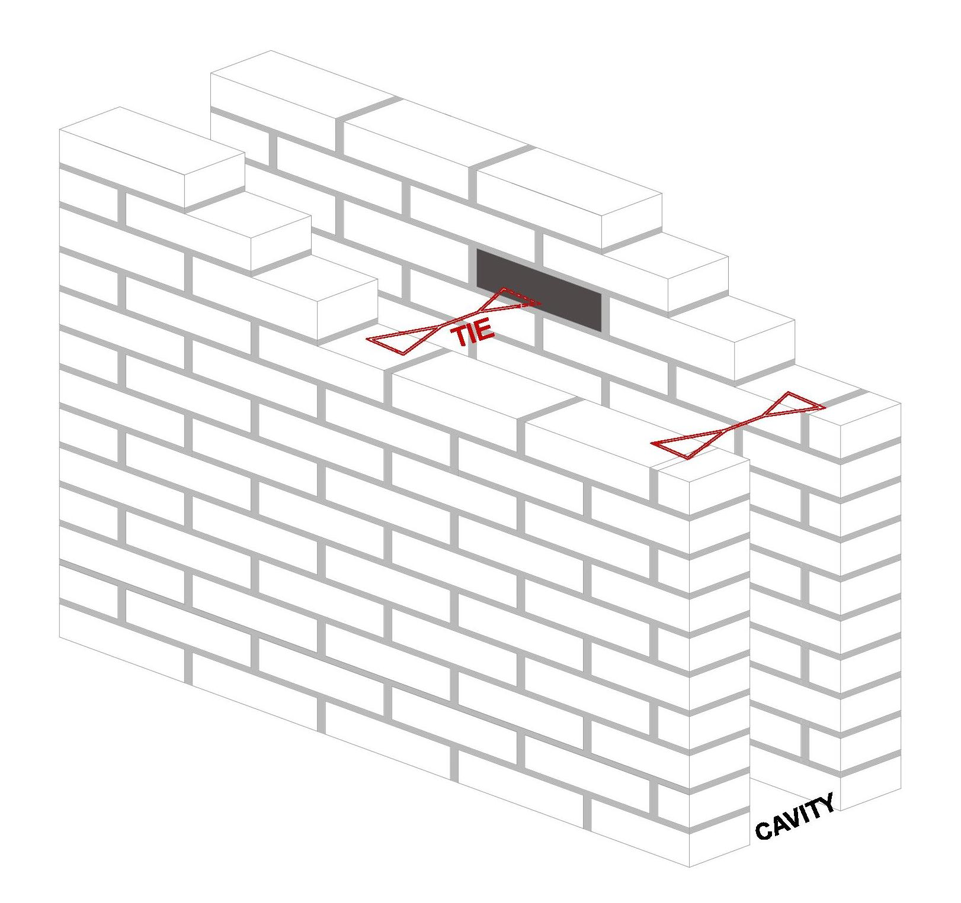
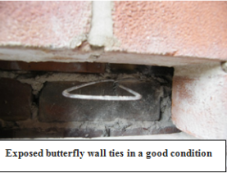
Floor and Wall Ties
Figure: Wall ties(source:Olympic Construction. (n.d.). Retrieved from https://www.olympic-construction.co.uk: https://www.olympic-construction.co.uk/services/structural-repairs/wall-ties/
Figure: Cavity ties(Source: wikkipedia,(n.d),Retrieved from:
https://en.wikipedia.org/wiki/Tie_%28cavity_wall%29

Slide 38
Reinforced bars are precast in the wall elements at regular spacing adjacent the intended final position of a floor slab. Each bar is bent out at right angles in the wall and one end is tied to the floor slab.[1]
Inserting the wall ties into the wall will increase the load. The wall ties, if it is in the form of reinforcement, should be hooked or connected to the floor for support. This will create the floor and the wall, a homogeneous mass.[1]

Slide 39
REFERENCES
[1] Giri, O. P. (2018). A textbook of Building Technology. Heritage Publishers and Distributors Pvt Ltd.
[2] Bhavikati, S(2010). Basic Civil engineering, New Delhi: New Age International (p) LTD,Publishers
[3] Singh, G. (2005). Building Constructions and materials. Standard Book House, Delhi.
[4] Dr B.C. Punima, E. A. (2017). Building Construction. New Delhi: Laxmi Publications (P) Ltd.
[5] The Constructor: Building ideas. (n.d.). Retrieved from https://theconstructor.org/building/types-of-doors/11898/

Slide 40
THANK YOU

