Slide 1
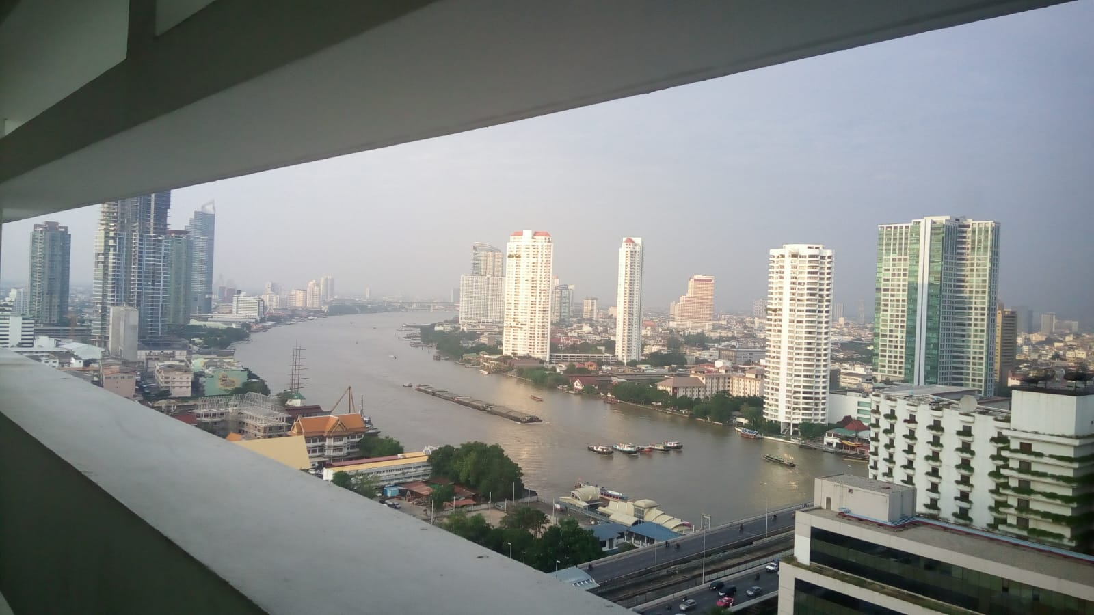
COURSE TITLE
BUILDING TECHNOLOGY
Chapter 10 - (Week 10)
FINISHING WORKS
LECTURE – 10
Finishing works
Ar. Ranju Kamal
Lecturer
Advanced college of engineering and management, Nepal
Affiliated to Tribhuvan University
Thailand, Bangkok (photo credit:Abhinay Kushwaha)

Slide 2
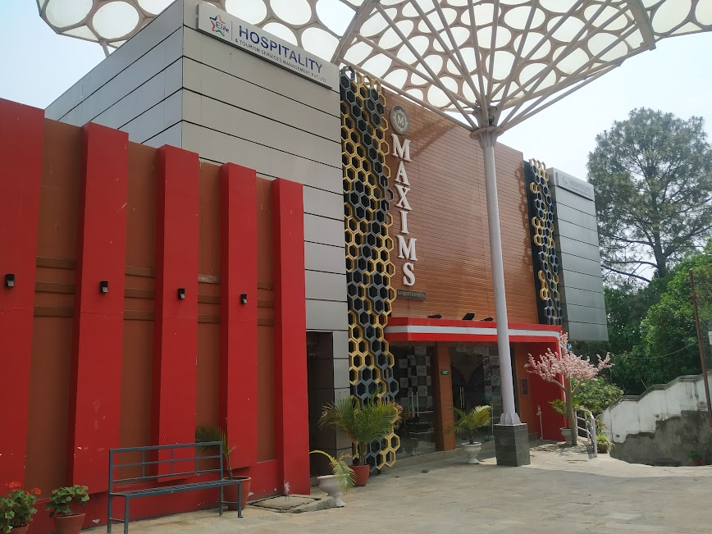
LEARNING OUTCOMES
At the end of the session students will get acquainted to:
1. Cladding (types, fixing process)
2. Partitions & Suspended ceilings
3. Plastering & Pointing (types and process of application)
4. Painting works in wooden, metal and masonry surfaces
Figure: Different cladding materials used in facade

Slide 3
CLADDING:
"Cladding" refers to the components that are linked to the structure of a building to form non-structural external surfaces.[5]
Cladding systems have important functions in buildings. They can confer thermal insulation, protect internal spaces from the weather and–just as important–give the building a "face", improving its appearance and clearly identifying the element of design.[5]
There are currently multiple possibilities of materials, colors, weights, textures, anchoring systems, and many other variables available. Below, we outline some of the main materials used for façade cladding, and the projects that use them in a remarkable way.[5]

Slide 4
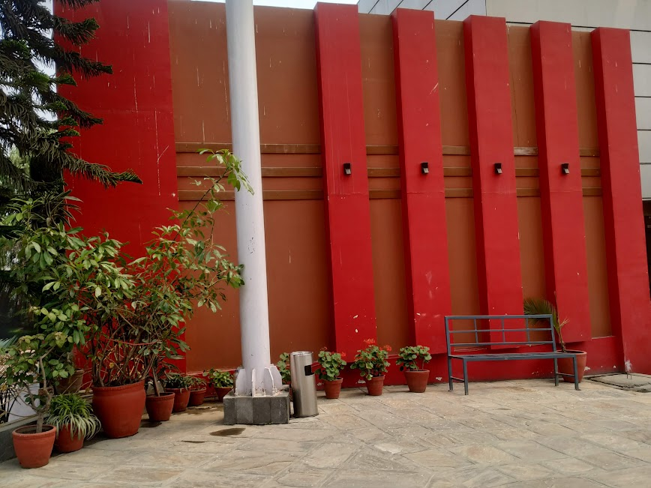
Functions of Cladding
  To provide necessary resistance to rain penetration.[1]
  To resist both positive and negative wind pressures.[1]
  To provide required degree of thermal/sound insulation.[1]
  To give required degree of fire resistance.[1]
  To generate aesthetic appearance (facade) of a building.
Figure: cladding materials

Slide 5
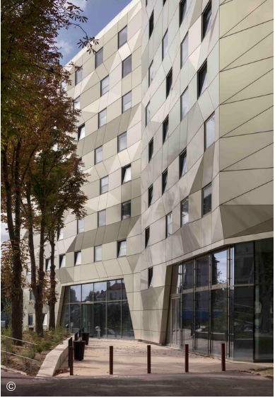
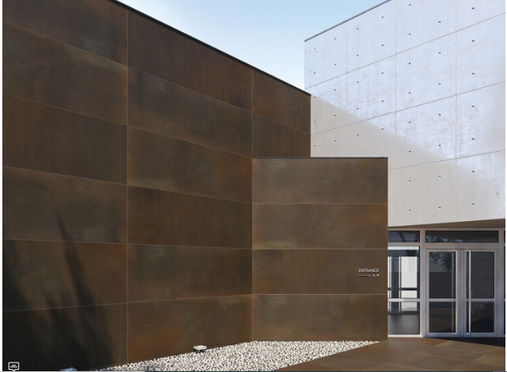
ACM (Aluminum Composite Material)
Ceramics
ACM is the acronym for "Aluminum composite material", a type of high-strength coating which consists of a three-layer panel, with two pre-painted aluminum plates connected to a polyethylene core (PE). ACM panels are applied to interiors and exteriors, with good dimensional stability, low weight and an elegant appearance that can have endless colors and textures.[5]
Ceramics are formed through the burning of clay. Most modern processes add several other components to the mixture, resulting in extremely sturdy products which can take on any shape[5]
Figure: cladding materials(Source: Souza, E.(2022,15th April):Online)https://www.archdaily.com/979639/what-materials-can-be-used-for-facade-cladding?ad_source=search&ad_medium=search_result_articles

Slide 6
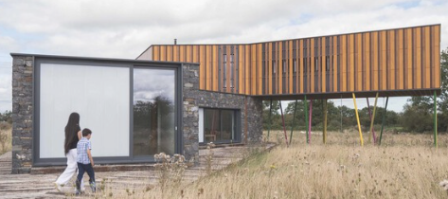
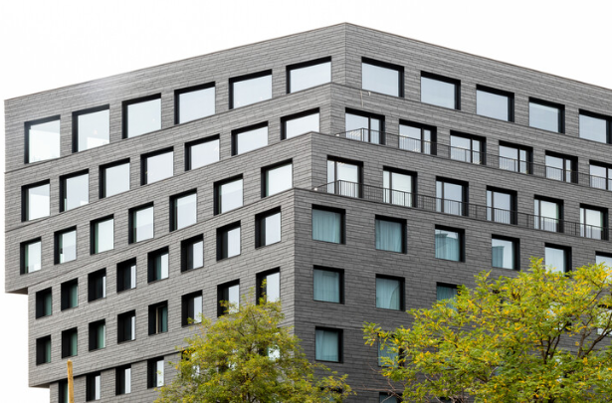
Wood
Natural Slate
Wood can bring warmth and heat to any project; its natural and distinct shades and tonalities make it a material that can please all manner of tastes.[5]
With shades ranging from dark gray to black, natural stone façades such as slate adds thermal comfort and ease of installation for ventilated façades. The slate supports extreme temperatures, barely accumulates snow, has fire resistance and is totally waterproof.[5]
Figure: cladding materials(Source: Souza, E.(2022,15th April):Online)https://www.archdaily.com/979639/what-materials-can-be-used-for-facade-cladding?ad_source=search&ad_medium=search_result_articles

Slide 7
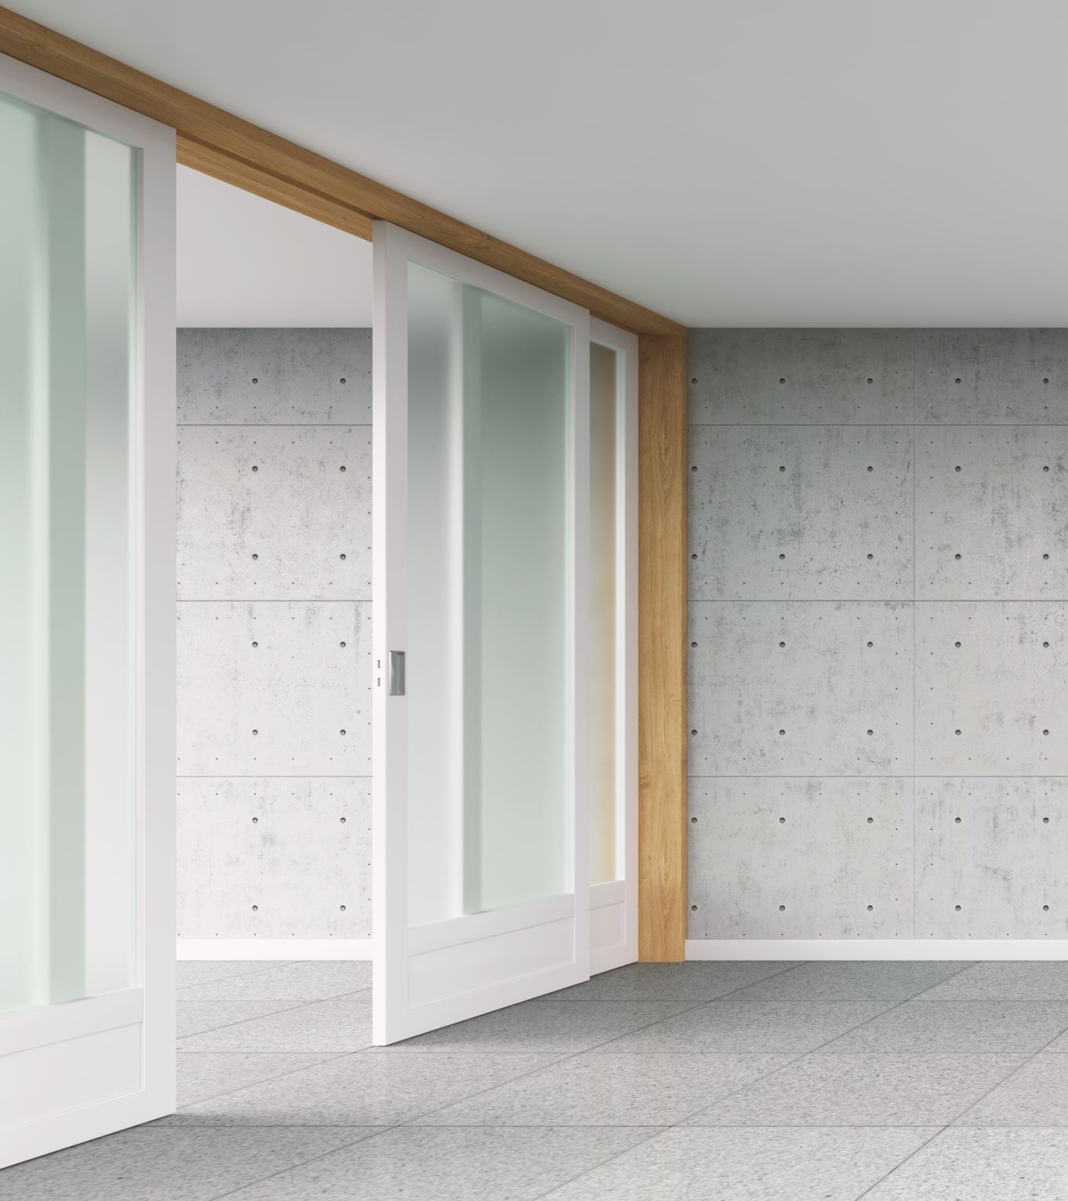
PARTITION WALLS
A partition wall may be defined as a wall or division made up of bricks, timber, glass or other such materials provided for the purpose of dividing one room or portion of a room from another.[1]
  Partitions are internal walls, usually thin in section and of light construction. This is used to divide building space into areas for accommodation and circulation.[4]

Slide 8
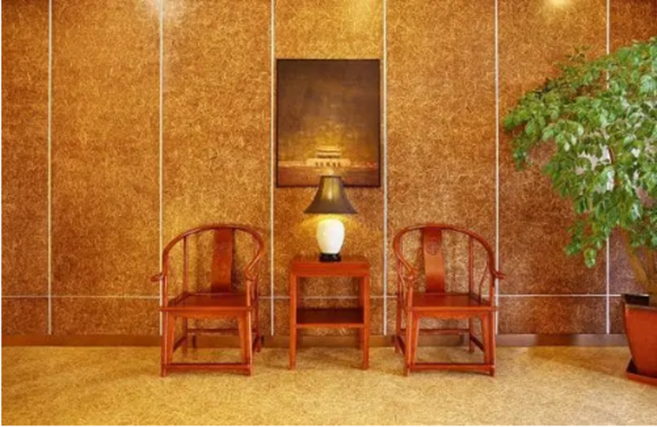
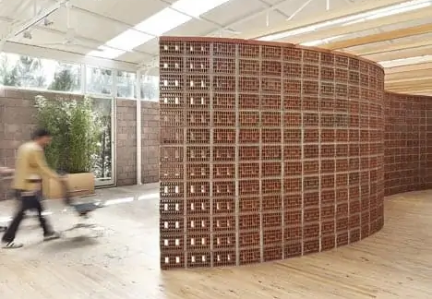
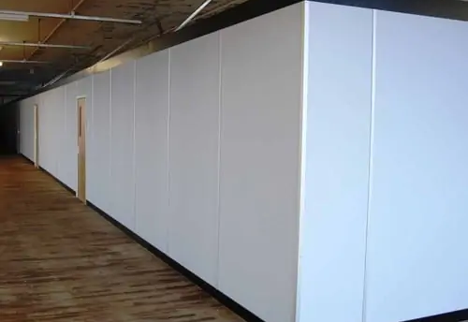
Straw Board Partition
Hollow Clay Block Partitions
Plastic Board Partitions
Figure: Partitions(Source: Daily Civil(n.d):Online)
https://dailycivil.com/partition-wall-types-advantages-requirements/

Slide 9
Requirements of good partition
Strong enough to carry its own weight or dead loads.[1]
Thin in section to utilize maximum floor area.[1]
Provide adequate privacy in rooms for both sight and sound[1]
Insulation for sound.
Should be constructed of durable, light, strong and homogeneous material.[1]
Should have capacity to support suitable decorative surfaces.
Should have capacity to support sanitary fittings and heavy fixtures.[1]
Simple, easy and economical in construction.[1]
Offer resistant to fire, heat, dampness.[1]
Resistant to insect and fungus attack.[1]

Slide 10
Advantages:
1. Divides the whole area into numbers of rooms.[1]
2. Thin in section and therefore occupies less floor area.[1]
3. Offers privacy.[1]
4. Insulation for sound.[1]
5. Easy in construction in any position.[1]
Types of Partition:
I. According to nature of loading transfer
According to use of materials

Slide 11
According to the nature of load transfer:
Load bearing partitions
  Designed and constructed to receive superimposed loads and transferring the loads to the foundation. [4]
  It supports the joints of the floors (i.e. suspended floor), purlins and ceiling joist of the roof.
  This is generally constructed with bricks, hollow/solid blocks.
  This partition is considered to be permanently positioned.
Non-load bearing partitions
  This partition has only it own weight to hold in position. [1]
  It also carries fixtures and fittings necessary in the room. [1]
  It resists impact loading on its face and also vibration caused from any reason. [1]

Slide 12
According to use of materials:
  Brick partitions
    Plain brick
    Reinforced brick (after 3/4 layers)
    Brick nogging (bricks in wooden frame)
  Glass partitions
  Concrete partitions
  Plain
  Reinforced
  Metal lath & plastered partitions
  AC sheets or CGI sheets partitions
Timber partitions
Hollow blocks partitions
Aluminum partitions
Gypsum board partitions
Strawboard
PVC board

Slide 13
  Brick partitions:
  The half brick partitions are very common.
    Plain brick:
    The plain brick partitions of half brick thickness cannot take heavy load.
    Their height is restricted to 2m.
    Reinforced brick (after 3 or 4 layers):
    Reinforced brick are more durable and possess more strength.
    Reinforcement is put up at every third course.
    Reinforcement may be in form of wire mesh or hoop-iron or steel bars.
    Brick nogging (bricks in wooden frame):
    It consists of a framework of timber within which half brick partitions are fitted.
    The framework of timber consists of head, sill, vertical members known as studs, horizontal members known as nogging pieces and cross braces.

Slide 14
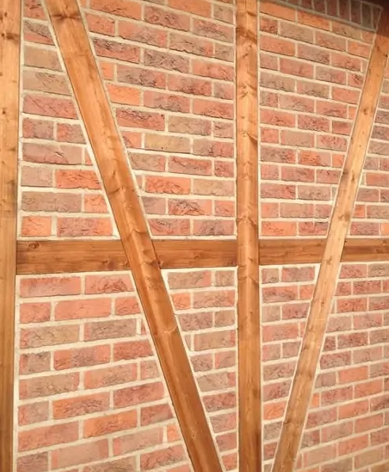
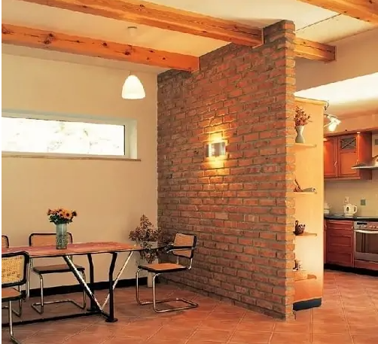
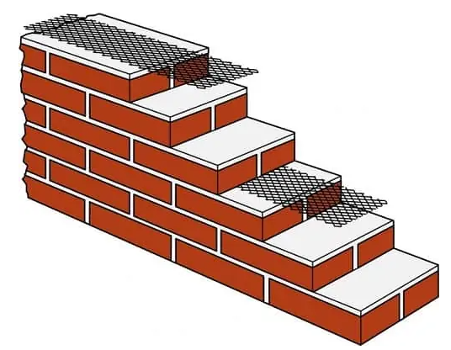
Reinforced brick
Plain brick
Brick nogging
Figure: Partitions(Source: Daily Civil(n.d):Online)
https://dailycivil.com/partition-wall-types-advantages-requirements/

Slide 15
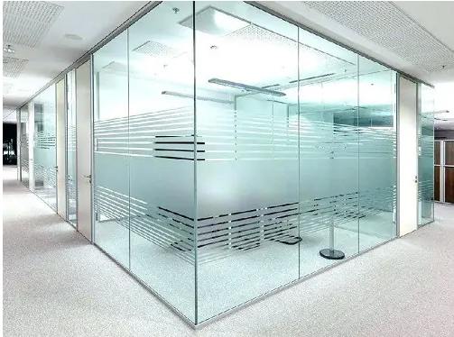
  Glass partitions
  May be in form of glass sheets or glass blocks.
  Glass blocks of opaque or some coloured glass and are of different shapes and sizes.
  Glass partitions are cheap, light, easy in construction, attractive, sound & heat insulating and provide reasonable privacy.
  But cost of maintenance is much more as glass is liable to breakage.
Figure: Glass partitions(Source: Daily Civil(n.d):Online)
https://dailycivil.com/partition-wall-types-advantages-requirements/

Slide 16
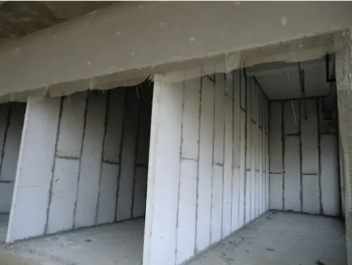
  Concrete partitions:
  It can be either precast or cast in-situ.
  Can be reinforced or plain.
Figure: Concrete partitions(Source: Daily Civil(n.d):Online)
https://dailycivil.com/partition-wall-types-advantages-requirements/

Slide 17
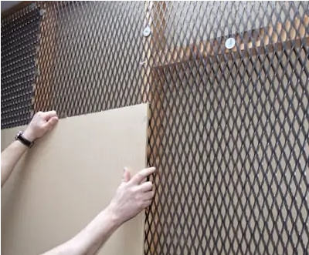
  Metal lath & plastered partitions:
  These are constructed by placing 2 cm or 2.5 cm channels vertically (called studs) and fixing metal lath to it on one side.
  Channels are spaced 15 to 30 cm apart.
  Metal lath is fixed to channels by galvanized iron wire.
  Plaster is then applied to both the sides.
  Thickness of such partition may vary between 5 to 7.5 cm.
  Metal lath & plastered partitions are thin, strong, durable and fire resistant.
Figure: Metal partitions(Source: Daily Civil(n.d):Online)
https://dailycivil.com/partition-wall-types-advantages-requirements/

Slide 18
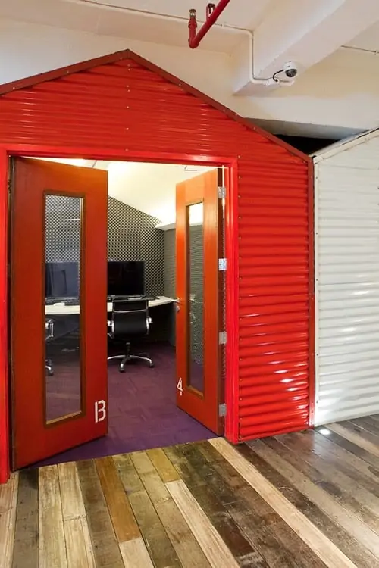
  AC sheets or CGI sheets partitions
  Asbestos cement sheets are made of asbestos material and cement and fixed into timber framework.
  Light in weight, impervious, durable, water tight and fire-proof.
  Sheets are placed in position and joined by cement mortar.
  Banned in US for production due to carcinogenic effect of Asbestos
Figure: AC/CGI partitions(Source: Daily Civil(n.d):Online)
https://dailycivil.com/partition-wall-types-advantages-requirements/

Slide 19
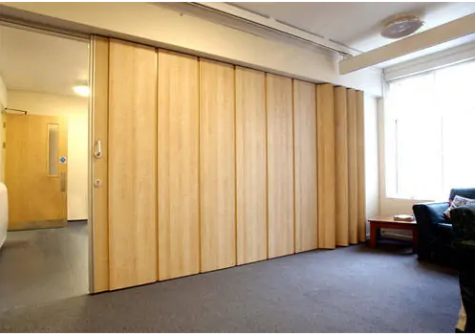
Timber partitions:
The framework consists of rigid arrangement of timber members which may be plastered or covered with boarding etc.
Such partitions are not fire resistant and timber is likely to decay or eaten by white ants.
Light and easy to construct.
Figure: Timber partitions(Source: Daily Civil(n.d):Online)
https://dailycivil.com/partition-wall-types-advantages-requirements/

Slide 20
Suspended ceilings
A suspended (false) ceiling is the construction below the roof slab. [1]
It is the false structure (not load bearing) in overhead of the room below the roof or slab[1]
It has a framework suspended (supported) from the main structure, usually in the roof slab and covering material is then fixed on the frame.[1]
It forms void between the ceiling and the roof/slab.[1]
This void is used for housing electricity trunk-lines, AC ducts, pipes etc.
It is frequently made of wooden frames and planks are fixed on it.
Metals and other materials may also be used for the ceiling.

Slide 21
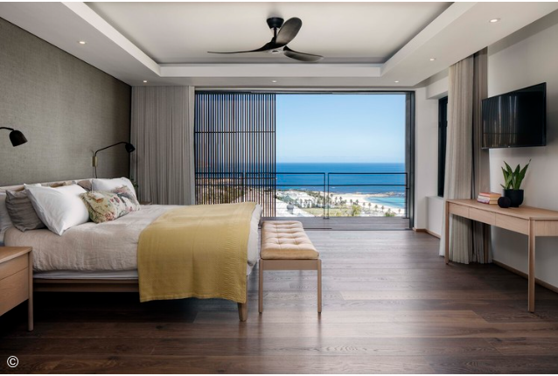
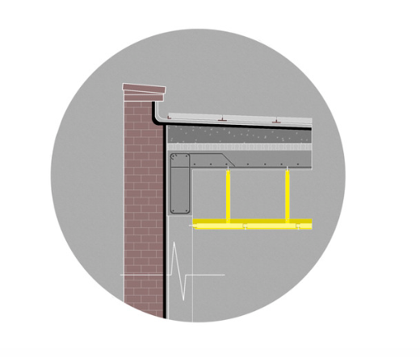
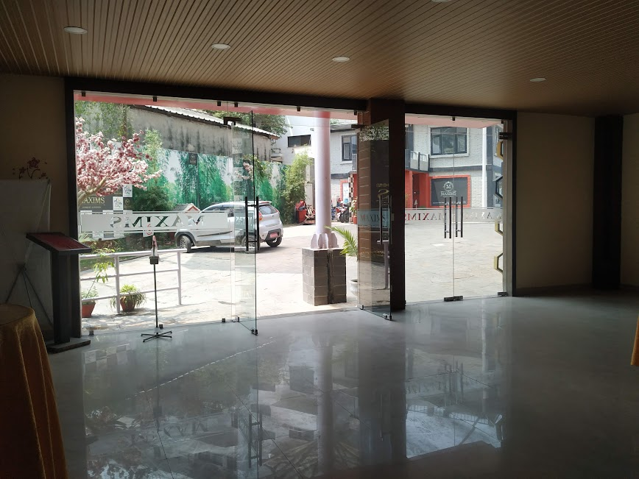
Figure: Suspended Ceilngs (Source: Archdaily Team(2023, July 31):Online)
https://www.archdaily.com/1004082/ceilings-for-residential-architecture-benefits-and-disadvantages-of-each-material?ad_source=search&ad_medium=search_result_articles

Slide 22
The ceilings are also covered by rails, and panels in different patterns.
Depending on the purpose, plasterboards, straw-boards, Paris-boards etc, are also secured to ceilings.
Uses[1]:
  For pleasing appearance.
  Space for housing utilities, pipes, electrical wires, telephone wires, channel wires etc.
  Sound and heat insulation.
Requirements of suspended ceilings:
  Easy in construction.
  Easy to clean, repair and maintain.
  Confirm the building standards and norms of the country.
  Provide adequate means of access (enough space) for maintenance of concealed services therein.
  Light in weight.

Slide 23
Types of Ceilings
According to use of material[1]:
  Timber (bamboo, plywoods, wooden planks etc)
  RCC
  Metal (steel, aluminum)
  Composite
  Gypsum board
  PVC board
  Straw board
  Glass
  Paper
  Textile, and others
According to construction methods[1]:
  Jointless
  Jointed
  Open

Slide 24
Jointless ceiling
  It is monolithic in appearance and no joints can be seen on the surface. [1]
  This can be done by applying plaster on the ceiling plaster board/expanded metal lathing or spraying of asbestos/ vermiculite cement/ any other chemicals may be made on the metal background. [1]

Slide 25
Jointed ceilings
  Are very commonly used in practice.[1]
  The joints on the ceiling may be made in decorative appearance. [1]
  The frame is made according to the desired shape and sized ceiling boards. [1]
  Ceiling materials may be fixed with spring clips or nails/ screws.[1]
Open ceiling
  The frame is fixed in such a way that voids are formed to give virtual effect. [1]
  Voids are largely provided for decorative purpose. [1]
  This may be a means for acoustic absorption as well.[1]

Slide 26
Procedure for ceiling fixing
Ceiling joists are fixed on desired height from the floor, if necessary, vertical struts are fixed to set joists.
Battens are than fixed on the joists.
Ceiling material, such as planks, plywood, metal sheets, etc. is fixed on the battens.
Finally, painting and finishing is done.

Slide 27
Plastering:
Plastering is the process of covering rough surface of walls, column, ceiling and other components of building with a thin coat of mortar to get smooth durable surface. Plastering hide defective workmanship.[1]
  Plaster is the finishing work that gives even, smooth, regular and clean surface on wall, ceiling, floor, roof and other parts of the building.
Often plastering is required to provide a satisfactory base for decorating the surface by white-washing, color washing, painting, etc. [1]

Slide 28
Objective of plastering[1]:
To protect the external surface against penetration of rainwater.
To protect surface against atmospheric agents.
    To conceal inferior materials and defective workmanship.
    To develop decorative effect and improve appearance.
Requirements of good plaster[1]:
It should attached to the background and remain during all variation in seasons.
It should be hard and durable.
It should possess good workability.
It should be possible to apply in all weather conditions.
It should be cheap.
It should check moisture penetration.

Slide 29
Types of plasters[1]
  Lime plaster (lime, sand, water)
  Cement plaster (cement, sand, water)
  Mud plaster (earth, optional sand, straw and water.)
  Surkhi plaster (surkhi, sand, water)
  Bajra plaster (burnt brick dust, molases, lime, earth, water) (lentils, chaku, egg white, milk, and cow dunk are added to improve its quality.)

Slide 30
Procedure of plastering
Selection of materials without having lumps etc.
Materials mixed thoroughly in desired ratio.
Water is mixed at last forming pest.
Surface to be plastered is cleaned and made wet
In case of cement plaster, the surface is sprinkled by cement slurry or cement dust
Now prepared paste is applied on the surface
The paste is leveled and made smooth with trowel and wooden floats

Slide 31
Method of plastering[1]
Preparation of surface background
Application of rendering coat
Application of final coat
Preparation of surface background[1]
Before plastering, the mortar joints should be raked to a depth of 10-15mm so that the plaster can easily catch to the wall.
All dust should be removed from wall by using stiff wire brush.
Any uneven should be removed for easy plastering.
The wall should be uniformly wet before plastering.
After that dots are placed of the interval of 2m×2m with the equal level or thickness of about generally 12mm.
This type of dots are provided on the wall where plastering operation being operating.
After that the whole wall is cover by plaster by the help of gauging tool(trowel), float and floating rule.

Slide 32
Cracking
Efflorescence
Defects in plaster work[1]:
Blistering
Falling out of plastering

Slide 33
Pointing
It is the process of treatment of joints in the masonry works. [1]
The joints are the weakest points for giving access to rainwater or damp in exposed brick and stone masonry & joints are to be treated properly.[1]
Pointing is the process of raking and applying rich mortar with desired finishing in the joints of masonry. [1]
It is preferable when the joint has not completed final setting time (in plastic state). It is easy to rake and apply mortar in this condition. [1]
The mortar used in pointing should be richer than masonry mortar.

Slide 34
Purpose of pointing
1. Protecting joints from adverse effect of atmosphere.
2. Give better appearance.
3. Economy to plaster.
4. Preventing entry of water into wall through joints.
Pointing procedure[1]
Joints are raked to 10 mm depth.
Raked joints are cleaned by using brushes.
Joints are kept wet for few hours.
Mortar is applied on the joints by means of small trowel.
Applied mortar is given the shape of desired type of pointing.
Curing is done for 3-10 days.

Slide 35
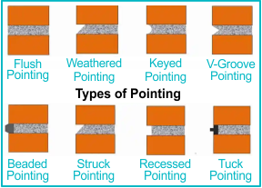
Types of pointing[1]
Keyed/rubbed/grooved pointing - Steel rod of 6mm dia. Used to form circular groove.
Recessed pointing - Mortar is pressed inside of joint by 6 mm by suitable tool.
Weathered (V) pointing - V-shaped projection of mortar in joints.
Beaded pointing - Steel rod of suitable size giving groove is applied on joint, good appearance.
Flush pointing - Raked joint is filled with mortar and leveled.
Struck/cut pointing - Mortar is pressed in joint such that upper side is more pressed.
Tuck-pointing - Mortar is flushed to joints, mortar is cut to form raised ruler outside.
V-grooved pointing - Steel rod is used to form V-groove.
Figure: Types of Pointing(Source:testbook(n.d):Online
https://testbook.com/civil-engineering/plastering-and-pointing

Slide 36
Paints and Painting works
Paints
  It is the liquid material applied on timber, metal or masonry surfaces. [2]
  It acts as protective or decorative on applied surface.
  It is composed of two main components; pigment and organic binders.[2]
  Constituents of oil paint[2]
Base - metallic oxide in the form of powder, chief ingredient of paint, keep surface opaque
Extender or inert filler - cheap pigment for volume
Pigment for color - mixed to give desired color
Vehicle - liquid that acts as binder, makes paint fluid & spread ingredient uniformly
Thinner or solvent - liquid that makes the paint thin & evaporates after applying paint
Drier - material containing metallic compound, accelerates the drying of paint

Slide 37
Characteristics of good paint
Should stick to the surface & seal the pores thereby.
Consistency for easy workability.
Adequate thickness of paint for good protection and decoration of surface.
Rapid drying of paint.
Paint film be able to stand the adverse weather effects.
Resistance to cracking, flaking etc.
Possessing moisture resistance.
Giving permanent color.

Slide 38
Types of paints
Aluminum paints | Used for woodwork and metal surface.
Anticorrosive paints | Metal protective paint.
Asbestos paints | For patch works in metal roof, it controls leakage.
Bituminous paints | For water proofing on roof and DPC.
Bronze paints | For metallic surface.
Cellulose paints | Made from celluloid sheets & amyl-acetate substitutes, superior type of paints.
Casein paints | Protein substance milk, curd etc.

Slide 39
Types of paints
Cement paints | Available in powder form, water is vehicle, used on masonry surface
Enamel paints | Base material-lead, white zinc etc., Vehicle-varnish
Rubber base paints | Rubber with chlorine gas, applied on cement surfaces.
Emulsion paints | Contains synthetic resins & polyvinyl acetate.
Graphite paints | Of black color and used in mines
Plastic paints | Plastic in suspension and gives pleasing shades.
Silicate paints | Mixing of calcium and silicate with resinous materials
Luminous paints | Mixing calcium sulfide with varnish, it is very shiny

Slide 40
Painting on woodwork
Painting process on new woodwork
Painting process on old woodwork
  Painting process on new woodwork[1]
    Preparation of surface
    Knotting
    Priming
    Stopping
    Second and succeeding coats (under coats)
    Finishing coat

Slide 41
Preparation of surface
  Woodwork be properly seasoned.
  The surface be clean, dry and free from dust.
  The surface is made smooth by rubbing with sand /glass paper.[1]

Slide 42
Knotting
  This is the process of sealing the knots (resin flows from it & destroys paint).
  Patent knotting
  Applying of one or more coats of Shellac (a resinous substance (obtained from the lac insect) melted into thin flakes) or aluminum varnish on the knots
  Size knotting
  Applying of first coat of mixture of red lead in water with glue and is hot on knots, Applying of second coat of mixture of red lead in oil thinned with boiled oil & turpentine on dried first coat
  Lime knotting
  The knot is covered by hot lime for 14 hours, the lime is than scrapped off & knot be treated by size knotting

Slide 43
3. Priming
Primer: a substance used as a preparatory coat on wood, metal, or canvas, especially to prevent the absorption of subsequent layers of paint or the development of rust.
Types: oil-based, latex and pigmented shellac primer.
  The surface is painted by first coat of primer before fixing woodwork and fills all pores on it.
4. Finishing coat
    The last coat of desired colored paint is applied to give smooth & good surface.

Slide 44
Painting on old woodwork[1]
1. Preparation of surface
Old painting if blistered & flaked should be completely removed.
  Removing of old paint by blow lamp
    The paint is softened by heat (from blow of lamp).
    Thus softened paint is removed by stripping knife.
  Removing of old paint by paint removers
    Paint removers are available in the market and are applied on the painted surface.
    The old paint lifts up, wrinkles and can be easily removed by sharp knife etc.
    Caustic soda solution is also useful for removing old paint. The solution of caustic soda and water is applied on the surface and it is made wet for 48 hours.
    Old paint is softens and can be easily scraped off.

Slide 45
2. Coating of paint
  First coat of desired paint is applied on the clean and smooth surface of woodwork. If necessary, second coat is also applied.
3. Finishing coat
  Final coating is applied to give smooth, uniform and pleasing surface.
Knotting and priming do not required in the painting of old woodwork. But, the stopping may be required if holes, cracks and opens are seen on the surface.

Slide 46
Painting on Metal works[1]
This is the process of prevention of rust in metal works.
Procedure of painting on metal surfaces
  The scale and rust if any are removed by scrapping or brushing.
  Oil, grease and dust are removed by washing with petrol, benzene or limewater.
  The surface thus clean and dry is treated with phosphoric acid. This protects the surface from rusting and provides adhesive surface.
  Now, the prime coating is done underneath which further 2-3 coats are laid.
  After the under-coat is dried, final coat of desired type of paint is applied giving uniform and pleasant surface.

Slide 47
Painting works on masonry
Step 1 - Clean the Surface
Loose paint has to be removed, make sure that the surface is clean.
Any oil or grease on the masonry surface will bleed through the paint, causing discoloration, and possibly interfering with the longevity of the paint job. Use tri-sodium phosphate, also simply known as TSP, to clean the concrete surface before applying any product. Mix it up in a bucket and scrub it into to the surface with a scrub brush to remove any grease or oil, ensuring that your paint will stick well.

Slide 48
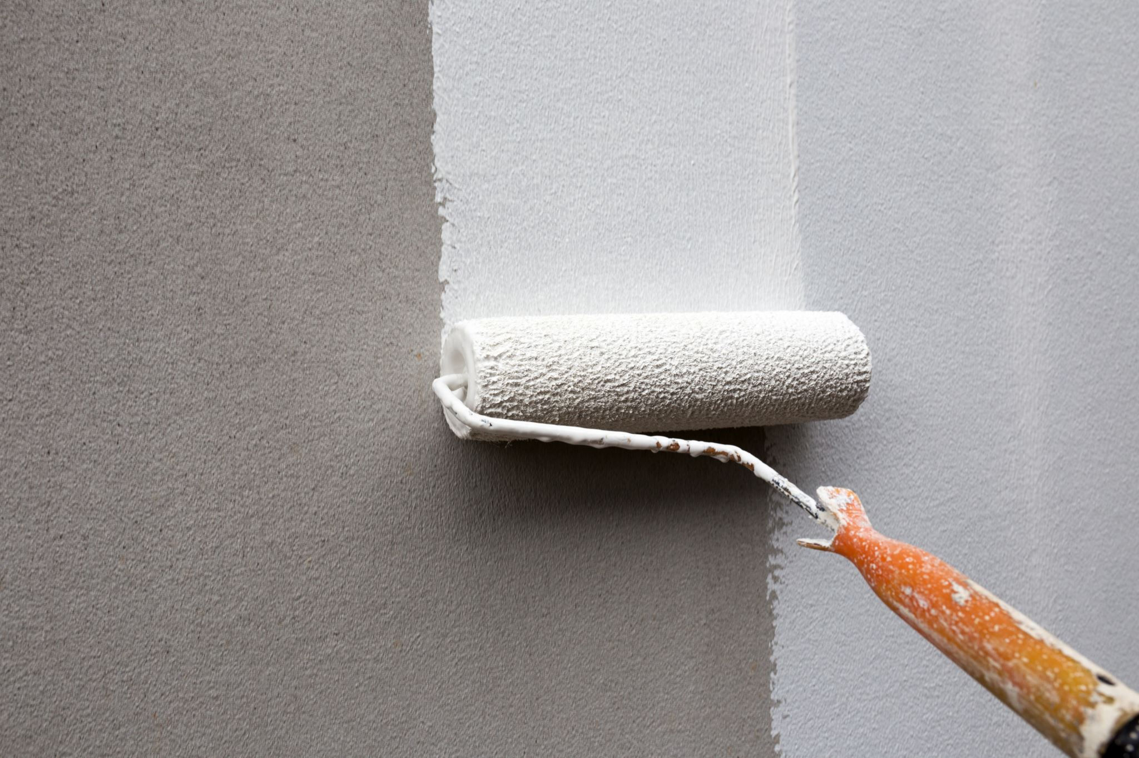
Step 2 - Make any Repairs
If there is any major defects in the surface to repair, use a simple, ready-mix concrete patch to make those repairs after you clean it.
Step 3 - Seal and Prime
The sealer is often clear, but keeps moisture from coming through the concrete. This is especially true in basements, which tend to hold moisture anyway.
If you are not sure whether your basement has been sealed or not, tape all four sides of a square of plastic kitchen wrap onto the floor and leave it for 24 hours. If the floor hasn't been sealed, you will see condensed water between the plastic wrap and the floor that has evaporated up through the concrete.
Use the two step process of sealing and priming to build a strong, waterresistant foundation for your paint.

Slide 49
Step 4 - Paint the Surface
After your sealer and primer coats are completely dry, now apply the paint.
Apply several thin coats, rather than trying to apply one very thick coat, as paint actually forms a harder surface when thin coats are laid on top of each other. One thick coat often results is a gummy or soft surface.
This drying thoroughly is often called “curing.” It means that the paint has dried through all the layers down to the original surface.
After your final coat of paint is applied, allow the paint to cure for the recommended time.

Slide 50
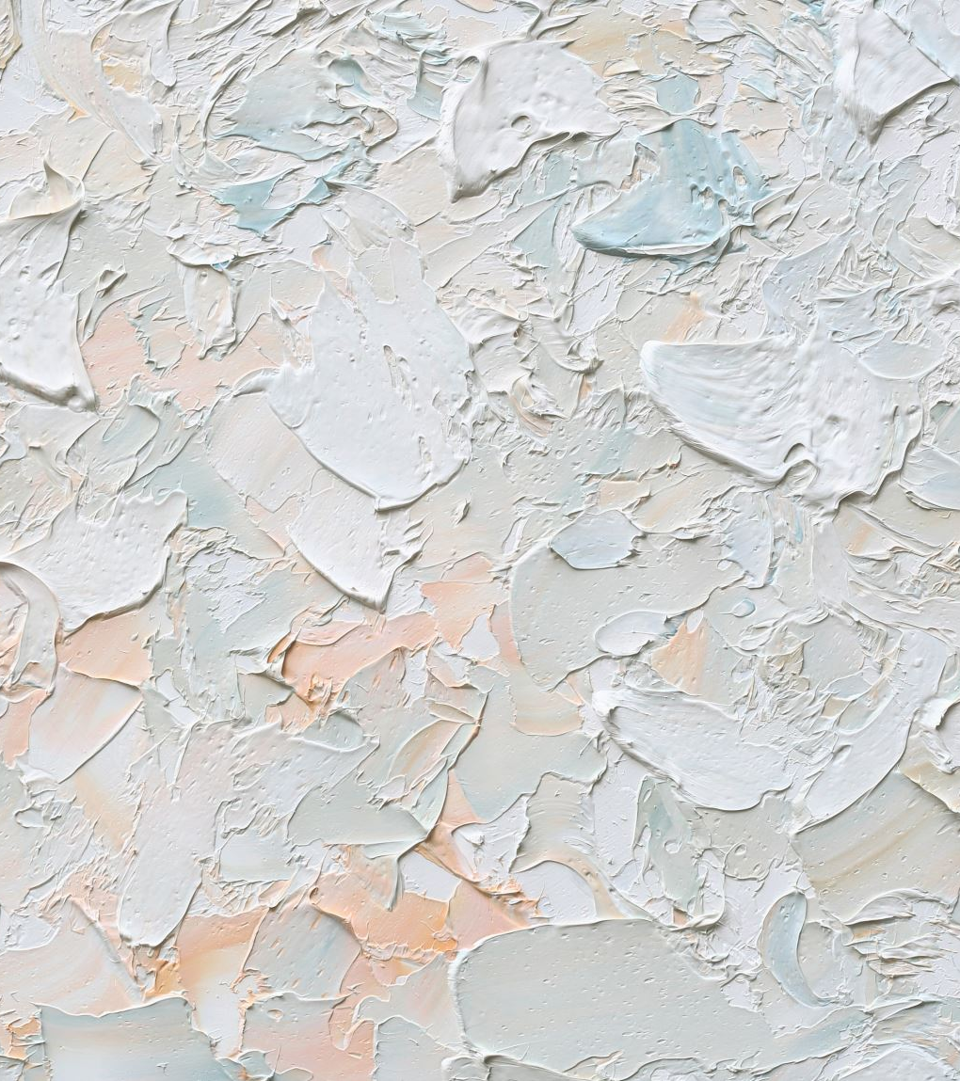
Painting on plastered surface
Preparation of surface.
Priming coat
First coat
Final coat

Slide 51
Preparation of surface[1]
  Allow freshly plastered surface to mature.
  Repair and correct any water seepage problems. Avoid rusting and leakage from the water pipe.
  Any holes and cracks are repaired by plaster of paris or by wall putty.
  In old surfaces previous coatings of lime wash/powder distemper/cement paint must be thoroughly scraped off.
  Fungus affected area must be given separate treatment i.e. 5-10% solution of bleach powder and water should be applied and left to dry for 8-10 hours.
Priming coat of mixture of equal parts of white and red lead in boiled linseed oil is applied on the surface. Drying time🡪10-12 hours.[1]
First coat of desired paint is applied on the surface.[1]
Final coat of the desired paint is applied on the dried first coating.[1]

Slide 52
Varnish
  It is the clear and pale solution of resinous substance dissolved in either oil turpentine or alcohol. The solution on drying forms a hard, transparent glossy film on the varnish surface. [1]
Importance of varnish
  The varnish applied on the decorative surfaces enhances the appearance of the paint.[1]
  Safeguards the woodwork from atmospheric agents.[1]
  Increases the durability of paint.[1]

Slide 53
Types of varnish
Oil varnish | Oil & resin dissolved in volatile liquid (takes 24 hours to dry).[1]
Spar varnish | Used in spar & other parts of ship, weather resistance[1]
Flat varnish | Dull appeared varnish, addition of more wax, metallic soap etc.[1]
Asphalt varnish | Dissolving asphalt in linseed oil & gives black color, used for metal.[1]
Spirit varnish | Resin dissolved in volatile liquid (spirit) and fast to dry, used in wooden furniture.[1]

Slide 54
REFERENCES
[1] Giri, O. P. (2018). A textbook of Building Technology. Heritage Publishers and Distributors Pvt Ltd.
[2] Bhavikati, S(2010). Basic Civil engineering, New Delhi: New Age International (p) LTD,Publishers
[3] Singh, G. (2005). Building Constructions and materials. Standard Book House, Delhi.
[4] Dr B.C. Punima, E. A. (2017). Building Construction. New Delhi: Laxmi Publications (P) Ltd.
[5] Souza, Eduardo. "What Materials Can Be Used for Façade Cladding?" [Quais as opções para revestimentos de fachadas?] 15 Apr 2022. ArchDaily. Accessed 7 Nov 2023. <https://www.archdaily.com/979639/what-materials-can-be-used-for-facade-cladding> ISSN 0719-8884

Slide 55

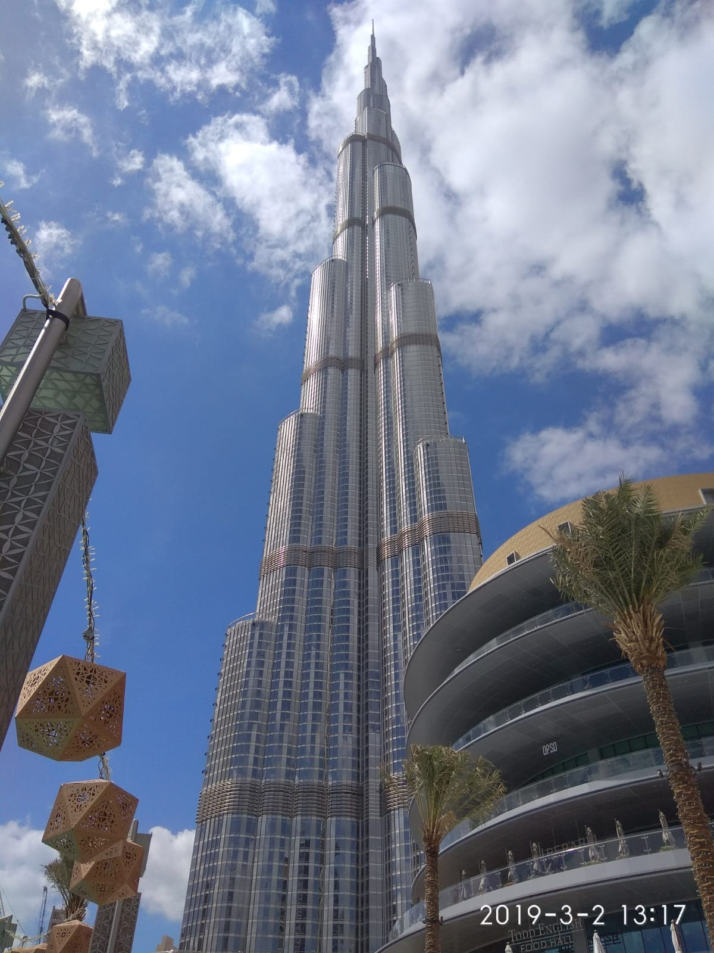
THANK YOU

