Slide 1
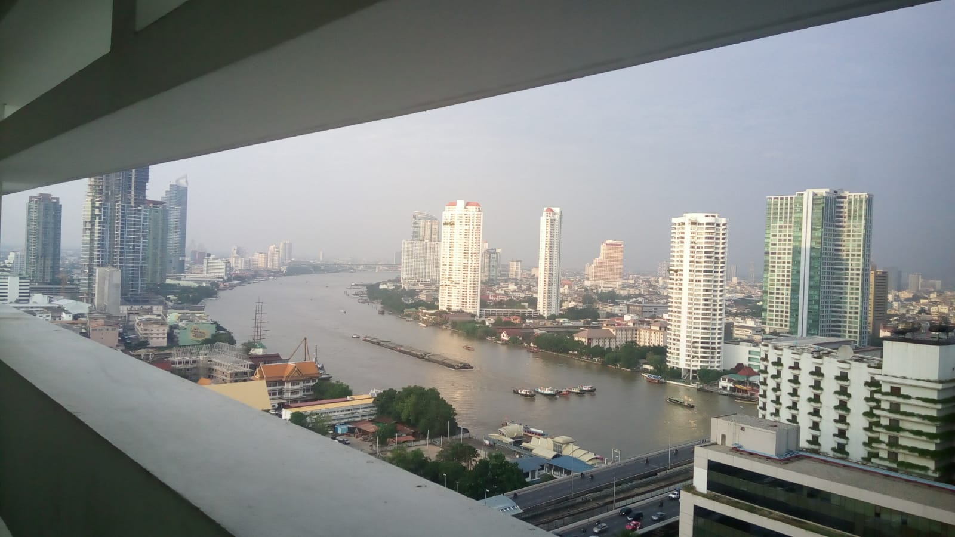
COURSE TITLE
BUILDING TECHNOLOGY
Chapter 11 - (Week 11)
CAUSES AND PREVENTION OF CRACKS IN BUILDING
LECTURE – 11
Causes and prevention of cracks in building
Ar. Ranju Kamal
Lecturer
Advanced college of engineering and management, Nepal
Affiliated to Tribhuvan University

Slide 2
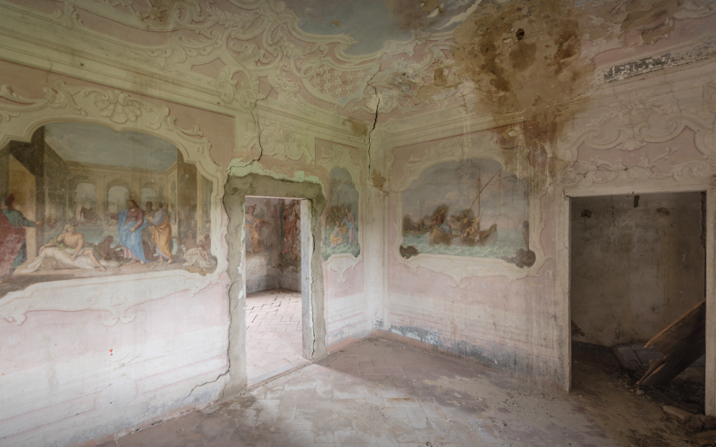
LEARNING OUTCOMES
1.Cracks in different components of buildings (walls, roofs, floors, plasters, windows, RCC, joints etc.)
At the end of the session students will get acquainted to:
2. Causes of cracks in building
3.Repair of Cracks
Figure :Cracks (Source: Stouhi,D.( 2019,March 30):Online)
https://www.archdaily.com/913780/dust-cracked-walls-and-enchanting-artwork?ad_medium=gallery

Slide 3
CRACKS
Occurrence of various crack patterns in the building during construction, after completion when it is subjected to super imposed load or during the service life, is a common phenomenon. [1]
A building component develops cracks whenever the stress in the components exceeds its strength. [1]
Stress in the building component could be caused by externally applied forces, such as dead, live, wind or seismic loads, foundation settlement etc. or it could be induced internally due to thermal movements, moisture changes, elastic deformation, chemical action etc. [1]

Slide 4
CRACKS
Cracks, which could be classified according to their thickness as fissures or fractures, are serious problems in the construction industry that can negatively affect aesthetics, durability and, most importantly, the structural characteristics of a project.[2]
They can happen anywhere, but occur especially in walls, beams, columns, and slabs, and usually, are caused by strains not considered in the design.[2]
Fractures are usually of lesser severity. In general, they appear more on the surface of the structure. They are narrow and elongated, with openings less than 0.5mm. Sometimes they are not even visible to the naked eye. [2]
Generally, they do not imply structural problems but can lead to more serious consequences. It is important to note if the fracture grows over time or remains stable, because it may be the first stage of a fissure.[2]

Slide 5
CRACKS
If not looked after, the next stage or a fracture could lead to deeper openings of 0.5 to 1.5mm. They can be seen without difficulty and are much more dangerous than the fractures because the rupture of the structural element has already occurred and can affect the safety of the part.[2]
Fissures are slits with openings greater than 1.5mm, deep and well highlighted. With this magnitude, it allows air and water to penetrate the interior of the part, which requires immediate attention. [2]
They may cause corrosion of the armature or undesired chemical reactions in the material. One should not simply close them without researching the causes and provide the solution to the problem that caused it.[2]

Slide 6
CRACKS
The main reasons that may be related to the occurrence of these cracks are the following:
Unplanned structural impairment: due to poorly designed calculations and inadequately overload predictions;[2]
Unforeseen accommodation of constructive elements: Whenever a building is built, there is a settlement of the ground, a settlement to a greater or lesser degree. Thus, depending on how the foundation was made, one part of the construction can yield more than the other and with that displacement, it could cause cracks, known in the technical area as differential repression;[2]
Early removal of shoring elements: during the construction phase it is necessary to wait for the structural parts to acquire a minimum resistance before the shoring is removed. For example, slabs and beams should remain supported for at least 28 days;[2]

Slide 7
Thermal expansion: some parts of the building are more or less exposed to the sun during periods of the day, thus dilate or retract more than others, which can cause cracks, such as a slab that dilates with the sun causing the cracks;[2]
Material retraction: it is the loss of water by chemical reactions or evaporation in the coating layers and in concrete pieces such as slabs, pillars, and beams. For example, paint in the drying period, grout mortar, slab upon receiving too much sun and chemical reactions of the cement, these occur when there is the loss of moisture and thus the parts retract, their size is reduced and can arise cracks;[2]
Infiltration: when there is a leak or poor waterproofing of the slab or reservoirs of water enter the part, in the case of concrete the water will penetrate and will gradually reach the iron armature causing oxidation and, consequently, increasing the diameter of the bars, which will result in the pressure of the concrete and hence the beginning of the cracks. The consequence of this will be the fall of parts of the concrete, leaving the ironwork exposed, accelerating the process of corrosion[2]

Slide 8
Vibrations and tremors: poorly designed foundations along with excess traffic on the street, elevators, nearby buildings, and subway are some reasons for continuous vibration to cause cracks;[2]
Defects in the formulation of the product and errors in the application: The concrete traces, represented by the proportion of the different materials that compose it, must be very well dimensioned, as it is fundamental to obtain the resistance to withstand the expected loads. A mortar with a lot of or little water, or being used after its period of handle, can cause numerous cracks in the coating of a wall.[2]

Slide 9
Introduction:
A crack is a complete or incomplete separation of building member into two or more parts, produced by breaking or fracturing;
Majority of cracks occur when the building or its components or the material of which the building is made up of is subjected to forces which are greater than those forces which it can withstand.
Cracks may also occur if the material used in the building is of poor quality and the construction is not carried out in accordance with relevant drawings, prescribed job specifications and workman like manner.
Cracks in concrete can scar a building’s architectural appearance.

Slide 10
They can be the cause of leaks from rain or groundwater. Or they can be the first telltale signs of a potential wall collapse. Thus, no crack should go unexamined;
The crack in concrete is an inherent feature, which cannot be completely prevented but can only be controlled and minimized.
Concrete being a material having very low tensile strength, readily cracks when such tensile stress beyond the tensile strength of concrete occur in structure.
An engineer should have a sound knowledge of all the facts of concrete technology i.e. of the behavior of construction material, construction techniques, and types of crack likely to occur, their causes and respective remedial measure. In short, treatment of cracks involves detection, diagnosis and remedy.

Slide 11
Types of cracks:
Structural cracks
These occur due to incorrect design, faulty construction or overloading and these may endanger the safety of a building.[1]
Extensive cracks of foundations walls, beams, columns or slabs etc, are examples of structural cracks.[3]
Structural cracks may arise due to various reasons such as.[3]
Defective ductile detailing in the structures
Incorrect load assumption and
false perception about the behavior of the structure
Overloading of the structural components
Overloading of the soil on which the building is constructed
Poor constructional technique and workmanship
Incorrect assessment of bearing capacity and soil property

Slide 12
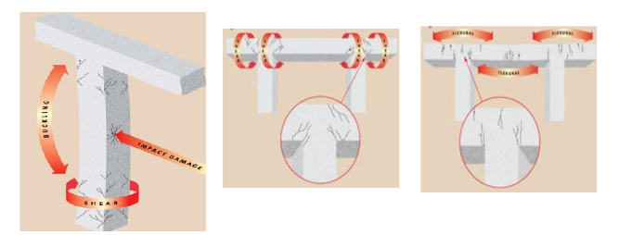
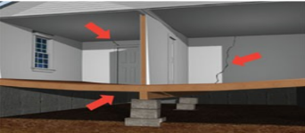
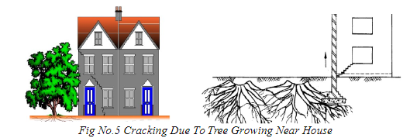
Cracks on Beams and Columns
Figure: Cracks Due to Weak Foundation
Figure: Cracking Due to Tree Growing Near House
Source: Rajabather, Arvind. (2016). INVESTIGATION OF CRACKS IN BUILDINGS.

Slide 13
Prevention:[3]
Proper and correct structural design
Correct information about the soil condition should be considered
Using required grade of concrete
Adequate thickness of cover for the reinforcement and quality steel bars should be used
Proper reinforcement layout should be done
Proper workmanship

Slide 14
Types of cracks:
Non-structural cracks:
These are mostly due to internally induced stresses in buildings materials and do not endanger safety of a building but may look unsightly, or may create an impression of faulty work or may give a feeling of instability. In some situations due to penetration of moisture through them nonstructural cracks may spoil the internal finishes thus adding to the cost of maintenance, or corrode the reinforcement, thereby adversely affecting the stability of the Structure in long run.[1]
Non-Structural cracks may arise due to various reasons such as.
internal forces developed in the building on account of changes in the size of building components
due to moisture variation
temperature variation
growth of vegetation
the effect of gases, liquid and solids on the building components.

Slide 15
Non-structural cracks(Hair cracks):
Cracks may appreciably vary in width from very thin hair crack barely visible to naked eye to gaping crack. Depending upon the crack width , the cracks are classified as : [1]
Thin Crack -less than 1 mm in width.
Medium Crack -1 to 2 mm in width.
Wide Crack -more than 2 mm in width.
Crazing -Occurrence of closely spaced fine cracks at the surface of a material is called crazing. Crazing is the development of a network of fine random cracks on the surface of concrete or mortar caused by shrinkage of the surface layer.[1]

Slide 16
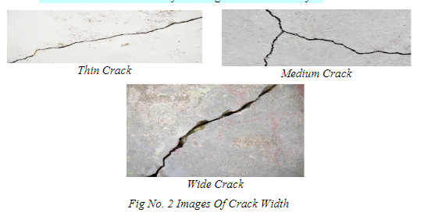
Thin Crack
Medium Crack
Wide Crack
Source: Rajabather, Arvind. (2016). INVESTIGATION OF CRACKS IN BUILDINGS.

Slide 17
Non-structural cracks
Can be repaired when reasons for cracks are identified and suitable remedial measures are taken to prevent their reoccurrence.
Non-structural cracks give the impression that the structure is getting unsafe but does not affect the building significantly but,
if remedial measures are not taken, the nonstructural cracks due to penetration of moisture in the cracks, result in
reducing the durability of the materials (by erosion, chemical attacks, corrosion of reinforcement etc.) and
ultimately affect the stability of the structure.

Slide 18
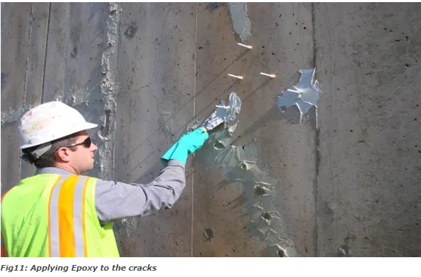
METHODS TO REPAIR CRACK
1. EPOXY INJECTION
Epoxy injection is an economical method of repairing non-moving cracks in concrete walls, slabs, columns and piers a sit is capable of restoring the concrete to its pre-cracked strength. The technique generally consists of establishing entry and venting ports at close intervals along the cracks, sealing the crack on exposed surfaces, and injecting the epoxy under pressure.[4]
Figure: Applying Epoxy to the Cracks
Source: Rajabather, Arvind. (2016). INVESTIGATION OF CRACKS IN BUILDINGS.

Slide 19
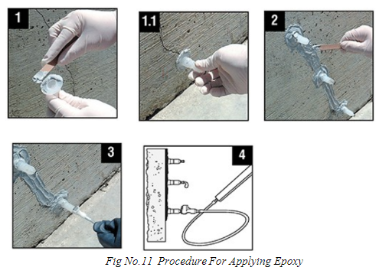
Figure: Procedure for Applying Epoxy
Source: Rajabather, Arvind. (2016). INVESTIGATION OF CRACKS IN BUILDINGS.

Slide 20
2. GRAVITY FILLING
Low viscosity monomers and resins can be used to seal cracks with surface widths of 0.001 to 0.08 in.by gravity filling. High molecular weight methacrylates, urethanes, and some low viscosity epoxies have been used successfully.[4]
3. GROUTING AND SEALING
In this method, the crack is made wider at the surface with a saw or grinder, and then the groove is filled with a flexible sealant. This is a common technique for crack treatment and it is relatively simple in comparison to the procedures and the training required for epoxy injection. Initially clean the surface; the surface should be free from paint, dirt, oil, efflorescence or any bond inhibiting agents. Then apply epoxy. To prevent epoxy flowing out insert a foam breaker or rod of suitable diameter and sealant is applied to it.[4]

Slide 21
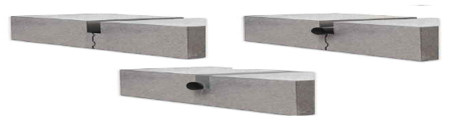
Figure: Procedure for Routing And Sealing
Source: Rajabather, Arvind. (2016). INVESTIGATION OF CRACKS IN BUILDINGS.

Slide 22
4. STITCHING
This method is done to provide a permanent structural repairs solution for masonry repairs and cracked wall reinforcement. It is done by drilling holes on both sides of the crack, cleaning the holes and anchoring the legs of the staples in the holes with a non-shrink grout.[4]
5. DRY PACKING
It is the hand placement of a low water content mortar followed by tamping or ramming of the mortar into place and also helps in producing intimate contact between the mortar and the existing concrete.[4]

Slide 23
6. POLYMER IMPREGNATION
Monomer systems can be used for effective repair of some cracks. A monomer system is a liquid consisting of monomers which will polymerize into a solid. The most common monomer used for this purpose is methyl methacrylate.[4]
7. UNDERPINNING
This is the best solution whereby the footings of the building are underpinned with either concrete, masonry or piles to carry the load of the building down to a more stable stratum (e.g. rock or soils below the reactive zone).This solution is usually the most costly, particularly if there are access difficulties or if internal walls require underpinning, which may require lifting internal floors.[4]

Slide 24
Classification of Cracks:
Cracks can be broadly classified as:
Vertical cracks
Horizontal cracks
Diagonal cracks
Toothed cracks
Irregular cracks or random cracks.
Closely spaced fine cracks on surface of the material are known as crazing.
From the examination of the portion in which the cracks appear, it is possible to have an idea of the possible factors responsible for the formation of cracks.

Slide 25
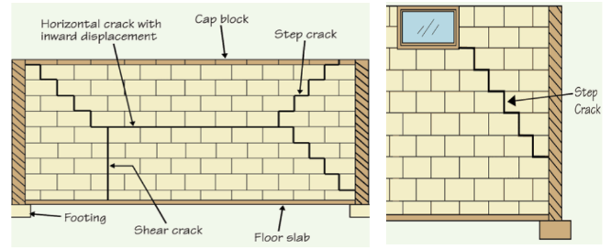
Cracks on Walls
Figure: Different Types of Cracks on Walls
Source: Rajabather, Arvind. (2016). INVESTIGATION OF CRACKS IN BUILDINGS.

Slide 26
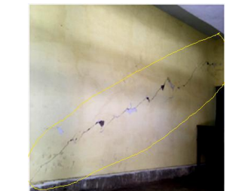
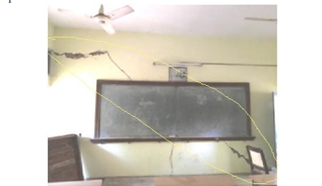
Case Study 1: Political Science, Economical and Archaeological block of Jiwaji University. In political science building the cracks were found in partition walls and a rear column of the block.
Figure 1: Short Wall of classroom 16 (political block)
Width- above 2mm
Type- Wide (Non-structure)
Shapte- Diagonal, Horizontal Crack
Cause- Settlement of Foundation
Figure 2: Wall in archaeological block
Type- Medium, non-structural crack
Shape- Diagonal
Cause- Settlement of Foundation
Source: Rishabh Pathak, D. R. (2017). Case Study on Cracks in Public Buildings and their. International Journal of Science and Research (IJSR), 327,328.

Slide 27
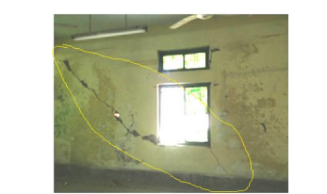
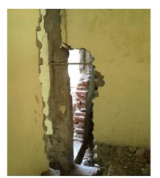
Figure 3: Long Wall of Sir Alexander Cunningham hall (political block)
Width – above 2mm
Type- Wide, non-structural crack
Shape- Stair Step Crack
Cause- Settlement of Foundation
Figure 4: Rear Column
Type- Major Structural Crack
Cause- Settlement of Foundation
Source: Rishabh Pathak, D. R. (2017). Case Study on Cracks in Public Buildings and their. International Journal of Science and Research (IJSR), 327,328.

Slide 28
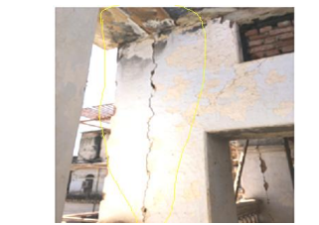
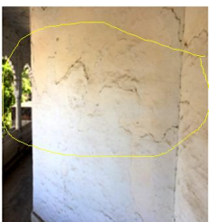
Case Study 2: Moti Mahal Building.
Figure 1: Column at industrial court
Type- Major Structure Crack
Shape- Vertical Crack
Cause- Thermal variation, due to joint
Figure 2: Wall of Labour Court
Type- Medium (Non-Structural Crack)
Source: Rishabh Pathak, D. R. (2017). Case Study on Cracks in Public Buildings and their. International Journal of Science and Research (IJSR), 327,328.

Slide 29
REFERENCES:
[1] (February 2004). Cracks in building. Maharajpur, GWALIOR : Centre for advanced maintenance technology.
[2] Souza, J. C. (2019, August 22). Archdaily. Retrieved from archdaily.com: https://www.archdaily.com/879953/what-do-the-cracks-in-concrete-structures-mean?ad_source=search&ad_medium=search_result_articles
[3] Giri, O. P. (2018). A textbook of Building Technology. Heritage Publishers and
Distributors Pvt Ltd.
[4] M, S. K. (2021, June 15). Constructofacilitator. Retrieved from constructofacilitator.com: https://constrofacilitator.com/the-investigation-of-cracks-and-repair-methods-in-buildings/
[5] Rishabh Pathak, D. R. (2017). Case Study on Cracks in Public Buildings and their. International Journal of Science and Research (IJSR), 327,328.
[6] Rajabather, Arvind. (2016). INVESTIGATION OF CRACKS IN BUILDINGS.

Slide 30

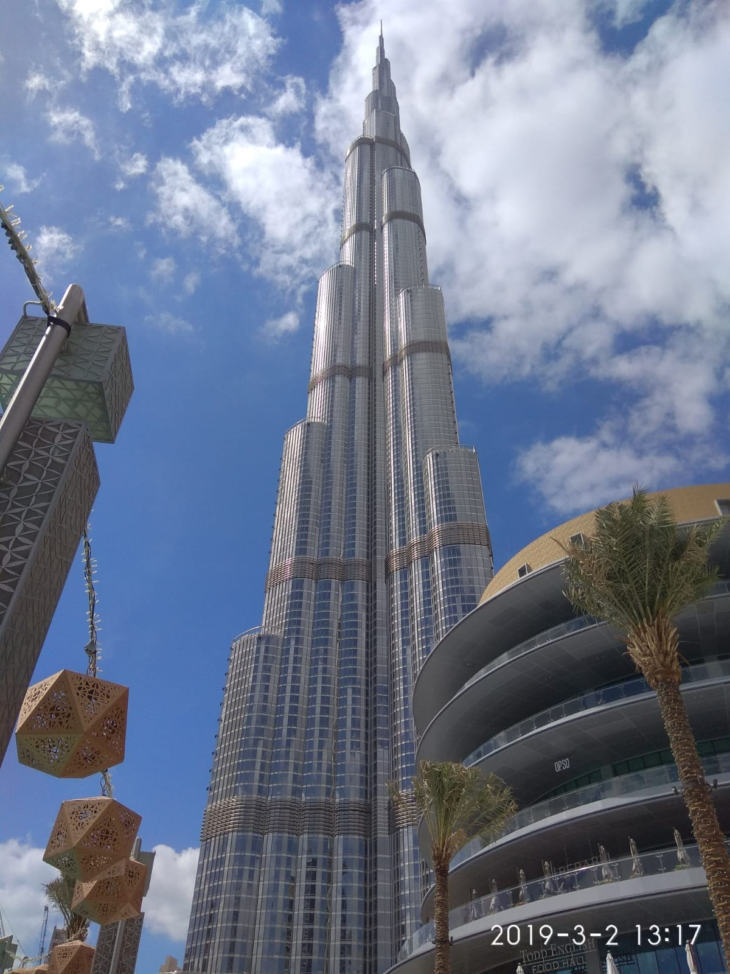
THANK YOU

