Slide 1

COURSE TITLE
BUILDING TECHNOLOGY
Chapter 12 - (Week 12)
Earthquake protection & Retrofitting in building
LECTURE – 12
Earthquake protection & Retrofitting in building
Ar. Ranju Kamal
Lecturer
Advanced college of engineering and management, Nepal
Affiliated to Tribhuvan University
Thailand, Bangkok (photo credit:Abhinay Kushwaha)

Slide 2
LEARNING OUTCOMES
At the end of the session students will get acquainted to:
1. Earthquake Protection of Buildings
2. Techniques of Retrofitting and Retrofitting materials

Slide 3
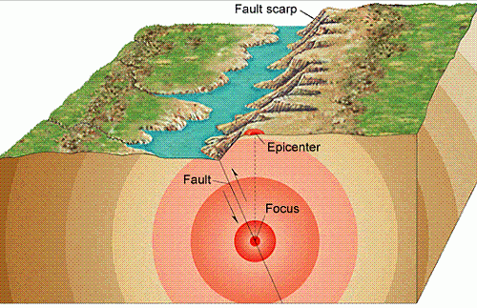
Earthquake
An earthquake is a sudden and violent shaking of the ground, often caused by the movement of tectonic plates beneath the Earth's surface. This natural phenomenon results in the release of energy in the form of seismic waves, causing the ground to shake and, in some cases, leading to the displacement of the Earth's crust.[1]
Figure:Earthquake(Source: Online]
https://www.thinglink.com/scene/586901527789043712

Slide 4
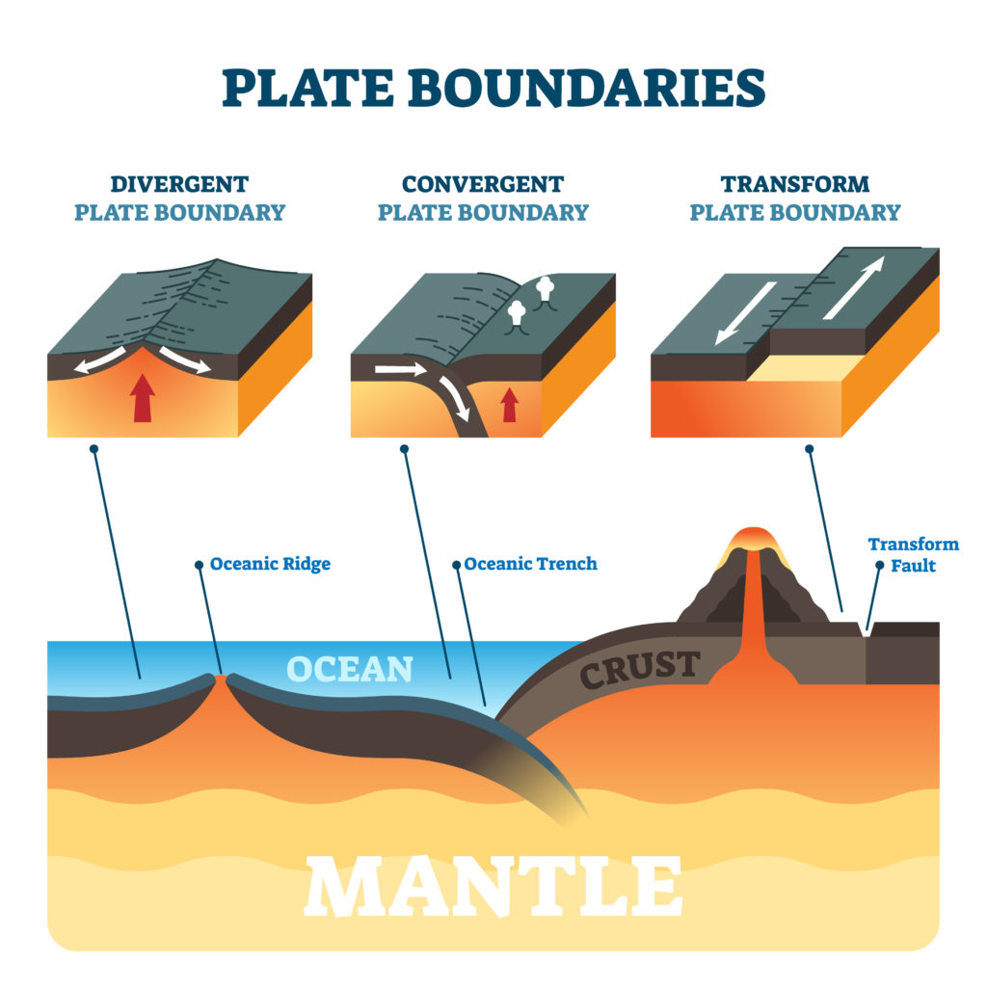
Key Characteristics of Earthquakes
1. Tectonic Plate Movement
Earthquakes are primarily caused by the movement of tectonic plates that make up the Earth's outer shell. These plates are constantly in motion, and when they interact, they can collide, pull apart, or slide past each other, leading to seismic activity.[1]
Figure: Tectonic Plate Movement(Source:Vannstone,E.(2023,September 6):Online)
https://www.science-sparks.com/orange-peel-plate-tectonics/

Slide 5
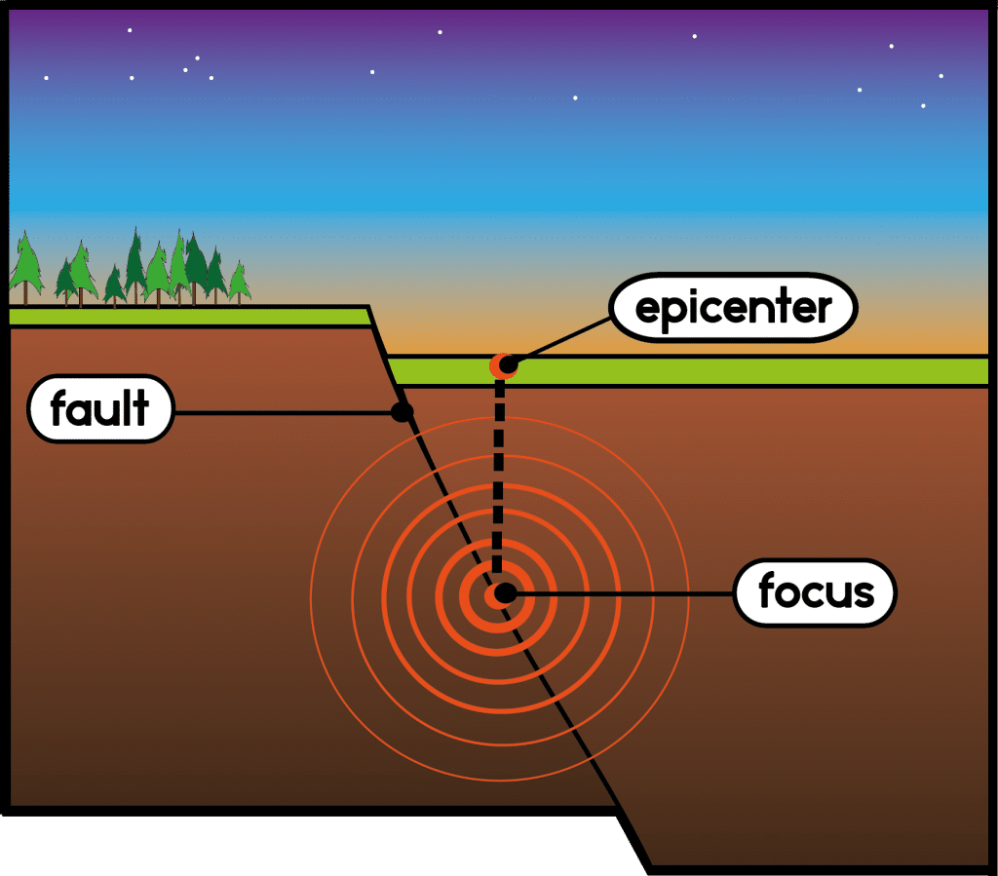
Key Characteristics of Earthquakes
2. Focus and Epicenter
The point within the Earth where the earthquake originates is called the focus or hypocenter. The point on the Earth's surface directly above the focus is termed the epicenter. The severity of shaking is often more intense near the epicenter.[1]
Figure: Focus and Epicenter(Source:Nittygritty Science(n.d.):Online
https://nittygrittyscience.com/textbooks/forces-that-shape-the-earth/section-2-earthquakes/

Slide 6
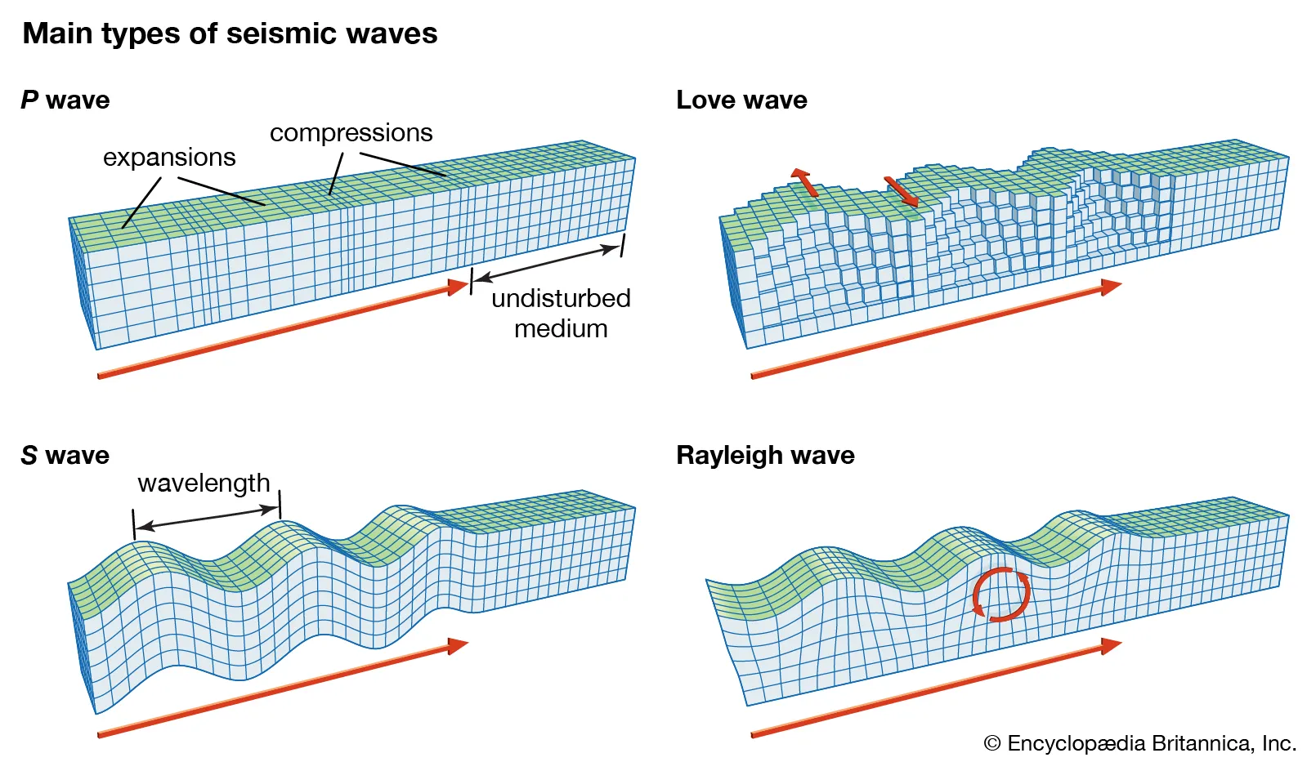
Key Characteristics of Earthquakes
3. Seismic Waves
The energy released during an earthquake travels in the form of seismic waves. The two primary types of seismic waves are P-waves (primary or compressional waves) and S-waves (secondary or shear waves). These waves propagate through the Earth, causing the ground to shake.[1]
Figure: Types of Seismic wave(Source:ASCE,2016)

Slide 7
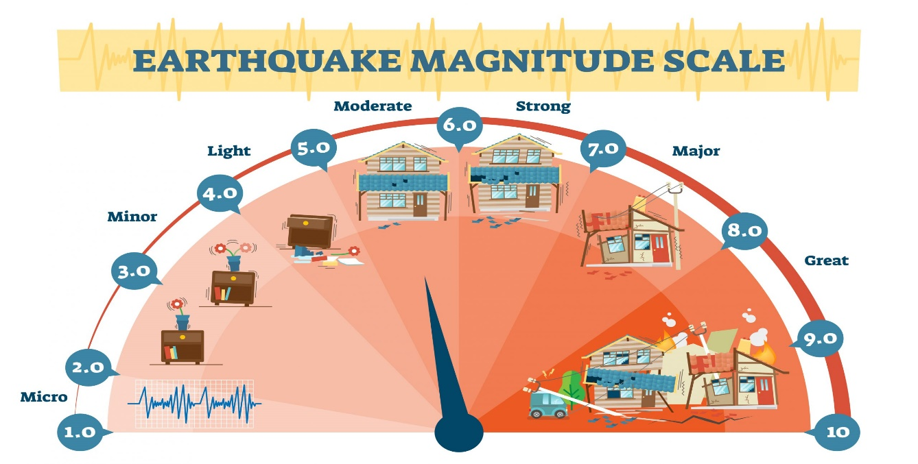
Key Characteristics of Earthquakes
4. Magnitude and Intensity
Earthquakes are measured on the Richter scale or the moment magnitude scale, indicating the amount of energy released. The severity of shaking at a specific location is described by the Modified Mercalli Intensity (MMI) scale, which assesses the impact on people, structures, and the Earth's surface.[1]
Figure: Earthquake Magnitude Scale(Source: sciencemadefun(2021, April 22):Online
https://sciencemadefun.net/blog/themagnitude/earthquake-magnitude-levels-vector-illustration-diagram-richter-scale-seismic-activity-diagram/

Slide 8
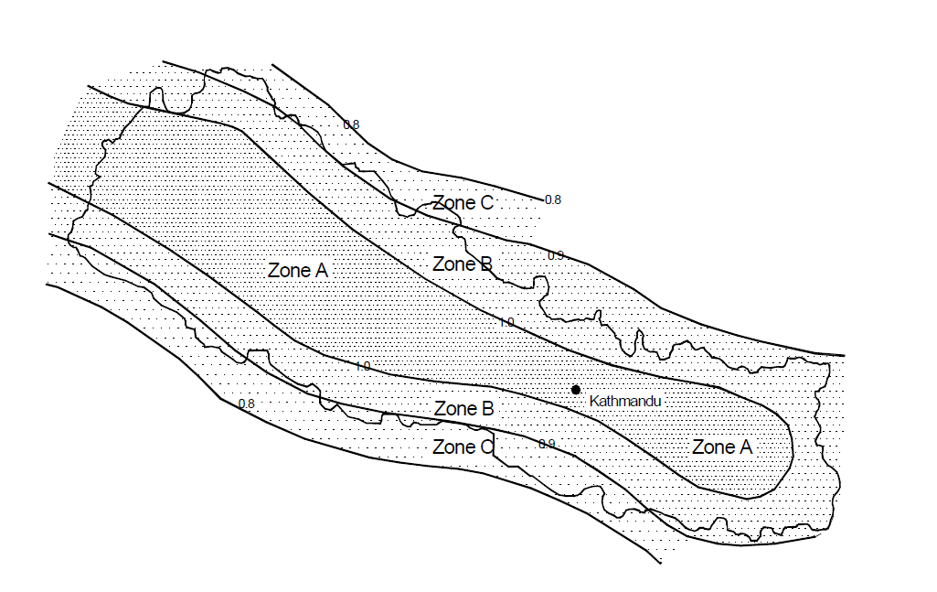
Basic Considerations in Building for Earthquake Resistance
1. Seismic Design Principles
Apply seismic design principles that consider ground motion characteristics specific to the region. These principles guide the structural design to effectively resist seismic forces.[1]
Seismic Zoning Map of Nepal for this MRT
Reference: American Society of Civil Engineers (ASCE). (2016). "ASCE 7-16: Minimum Design Loads for Buildings and Other Structures." Reston, VA: ASCE.

Slide 9
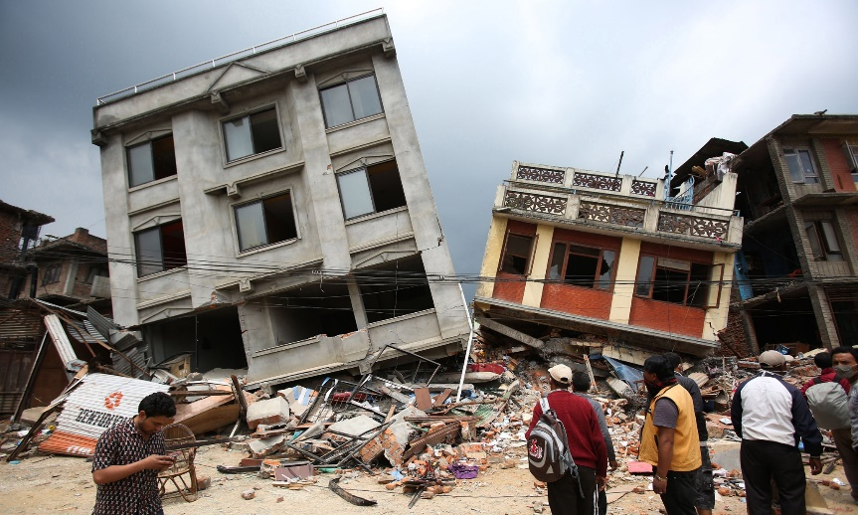
Basic Considerations in Building for Earthquake Resistance
2. Foundation Design
Implement a robust foundation design that considers soil conditions and provides stability against seismic forces. Proper foundation engineering is crucial for preventing settlement or tilting.[2]
Figure: Earthquake effect(Source:The Guardion(n.d.):Online)
https://www.theguardian.com/cities/2015/apr/30/nepal-earthquake-disaster-building-collapse-resilience-kathmandu

Slide 10
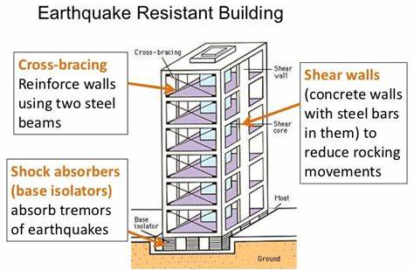
Basic Considerations in Building for Earthquake Resistance
3. Seismic Bracing and Shear Walls
Integrate seismic bracing systems and shear walls into the building's design to improve lateral stability and distribute seismic forces effectively.[3]
Figure: Earthquake Resistance(Source: Pinterest(n.d.):Online)
https://za.pinterest.com/arios26270/earthquake-proof-structures/

Slide 11
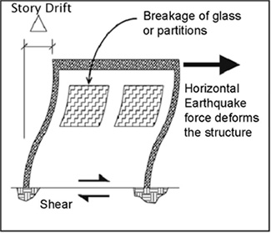
Basic Considerations in Building for Earthquake Resistance
4. Flexible and Ductile Design
Design buildings with flexibility and ductility to allow controlled deformation during an earthquake, preventing sudden failure and collapse.[4]
Figure: Storey drift(Source: Engineersdaily(2011, March 14): Online
https://www.engineersdaily.com/2011/02/storey-drifts.html

Slide 12
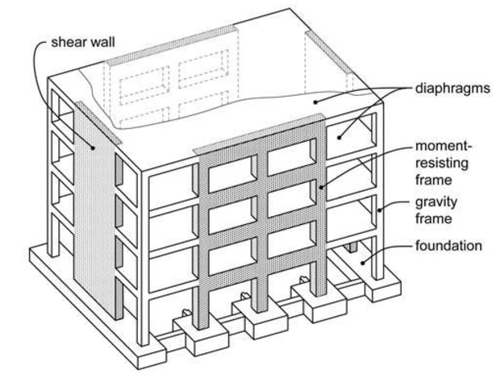
Basic Considerations in Building for Earthquake Resistance
5. Roof and Floor Diaphragms
Design roofs and floors as diaphragms to distribute seismic forces uniformly throughout the structure, maintaining overall stability.[4]
Source:Chourasiya, R., & Sakalle, R. (2015). SEISMIC EVALUATION OF MULTI-STOREY R.C. STRUCTURE USING DIFFERENT FLOOR DIAPHRAGMS.
https://www.semanticscholar.org/paper/SEISMIC-EVALUATION-OF-MULTI-STOREY-R.C. STRUCTURE-Chourasiya-Sakalle/f02d32d72990e0c1b9755bbaee8bf6de219b0ab6/figure/1

Slide 13
Basic Considerations in Building for Earthquake Resistance
6. Reinforced Structural Elements
Reinforce structural elements with materials such as reinforced concrete or structural steel to enhance strength and ductility, allowing them to better withstand seismic forces. [5]

Slide 14
General Requirements for Earthquake Resistance Construction
The principal seismic resistant factors have to be properly incorporated during the construction of a building. Some basic factors leading to enhanced seismic safety are:
1. Proper Site Selection
The construction site has to be stable and safe enough to withstand the total building load, including that of its occupants and their belongings. [6]
Site selection shall be done to minimize the risk of natural hazards. No buildings shall be constructed in the hazardous areas, including the areas stated here under.[6]
Geological Fault or Ruptured Areas: Buildings should be constructed at least 500 m away from these lines. (Light and flexible structures may be built closer)[6]

Slide 15
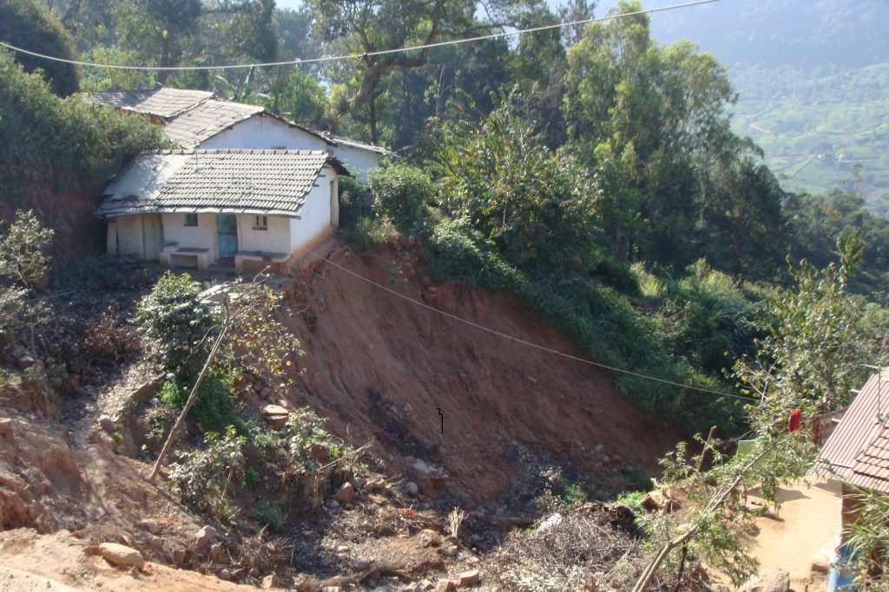
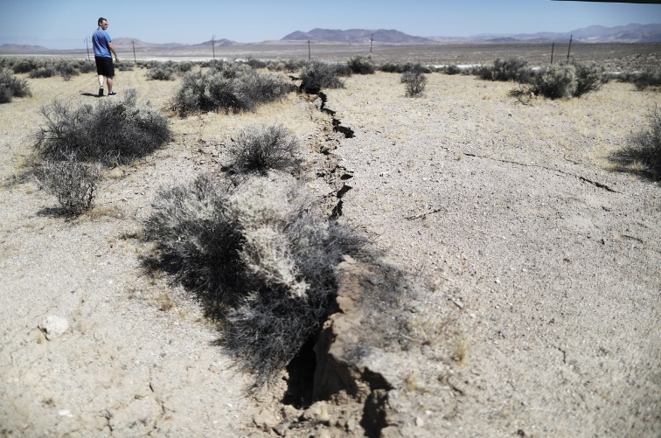
1. Proper Site Selection
Areas Susceptible to Landslide.
Boulder Hazard
River Bank
Water-Logged Area
Figure:Landslide(Source:Hancock, M.(2017, December 15): Online
Figure:Fault Ruptured in California(Source:Bryner, J.(2019, July 7): Online
https://www.geplus.co.uk/news/landslide-early-warning-system-to-protect-indian-communities-15-12-2017/
https://www.livescience.com/65885-southern-california-earthquakes-weird-faults.html

Slide 16
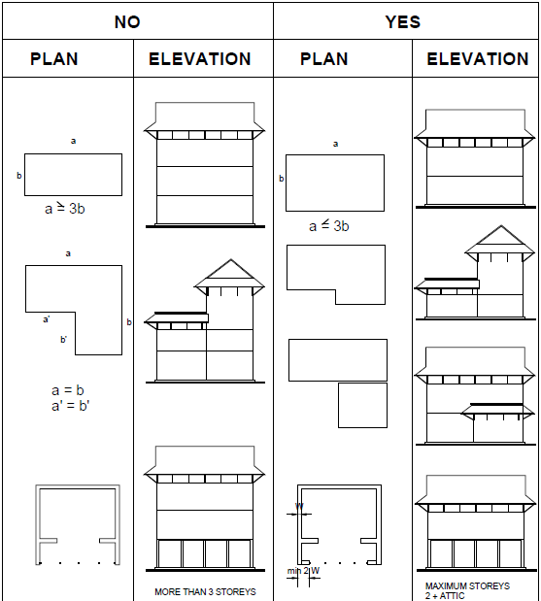
2. Appropriate Planning
The shape, size, and proportion of a building is important for its seismic safety. Buildings that are symmetrical in plan and regular in elevation are safer than the asymmetrical ones. Buildings with asymmetric plans and elevations are more vulnerable to earthquakes than those having symmetrical ones.[6]
Figure: Recommended Forms of Buildings(Source:Nepal National Building code NBC 203:2015)

Slide 17
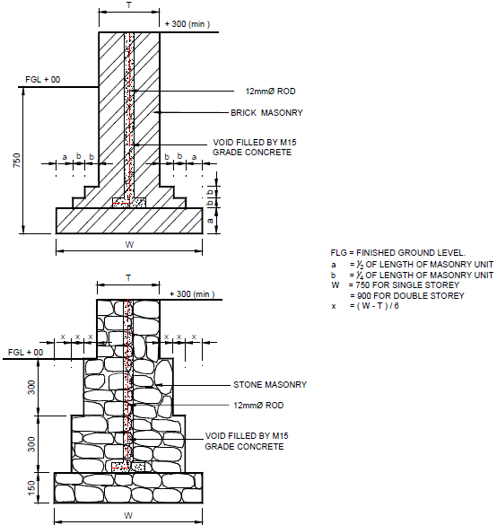
3. Good Foundation Resting on a Firm Base
The quality of foundation and the base on which the foundation rests are equally important for the safety of a building. [6]
The foundation trench shall be of uniform width. The foundation bed shall be on the same level throughout the foundation in a flat area. [6]
Figure: Details of Strip Footing Masonry Foundation (Where cement and concrete available)
Source:Nepal National Building code NBC 203:2015

Slide 18
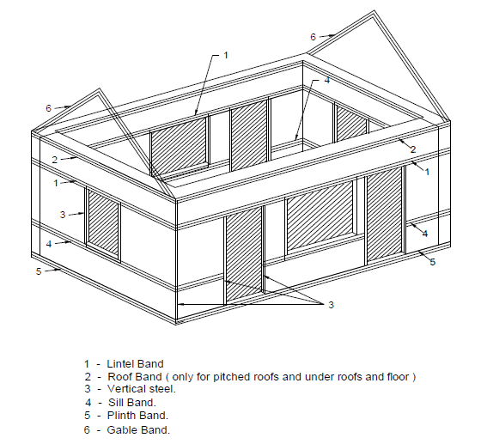
4. Creating a Box Effect
The building has to act as a single unit for it to have good earthquake resistance. This can be achieved by incorporating certain elements in the construction.
Vertical reinforcement
Horizontal bands well-connected to the vertical reinforcements and embedded in masonry
Diagonal bracing (horizontal and vertical)
Lateral restraints[6]
Figure: An overall view of a building with seismic-resistant components
Source:Nepal National Building code NBC 203:2015

Slide 19
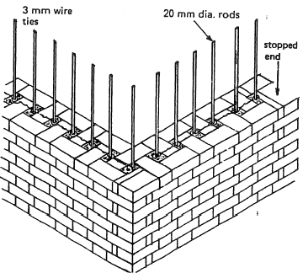
5. Better Bonding between Masonry Units
The type and quality of the bond within the walling units is the main contributor to the integrity and strength of the walls. All the masonry units have to be properly laid to provide the integrity.[6]
Figure: Masonry units Bonding(Source:Marked by teachers(n.d.):Online)
https://www.markedbyteachers.com/university-degree/physical-sciences/the-brick-and-brickwork.html

Slide 20
6. Controlled Size and Location of Openings
Large un-stiffened openings create a soft-storey effect which leads to a greater deformation of the building during an earthquake. To prevent such effects, the opening size and location have to be controlled.[6]
For one-storey buildings, the openings shall not exceed 30 % of the total wall length.[6]
For two-storey buildings, the openings shall not exceed 25 % of the total wall length.[6]
Openings are to be located away from inside corners by a clear distance equal to at least 1/4th of the height of the opening, but not less than 600mm.[6]
The horizontal distance (pier width) between two openings is to be not less than one-half of the height of the shorter opening but not less than 600mm.[6]
The vertical distance between two openings shall not be less than 600 mm or half the width of the smaller opening, whichever is greater.[6]

Slide 21
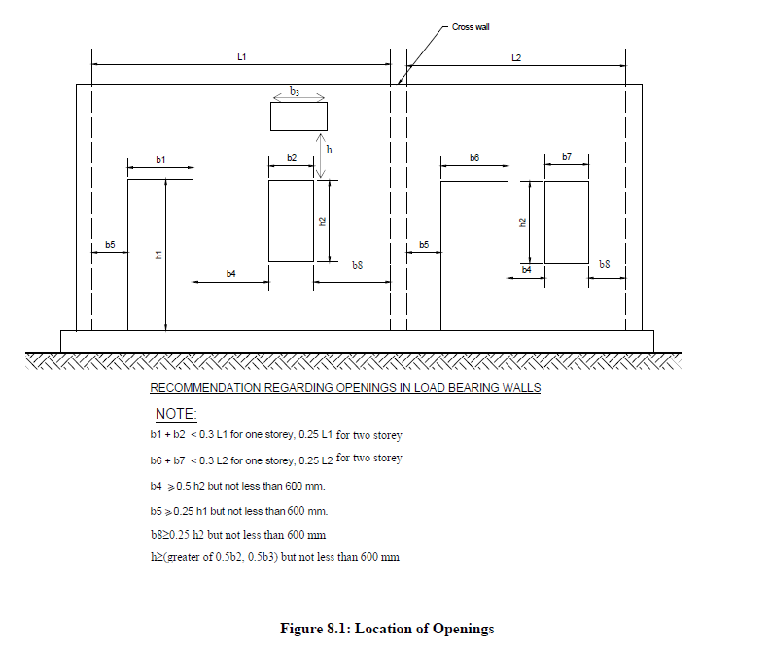
Figure: Location of Openings(Source:Nepal National Building code NBC 203:2015

Slide 22
7. Light Construction
As the damaging forces during earthquake shaking of the building are directly proportional to the mass of the building, lighter structures will attract less earthquake force, and hence less damage. Lighter materials like timber and bamboo are preferred provided they are available and suitable, considering all other constraints. The wall thickness shall be as low as possible, but in no case less than 230mm for brick masonry and 350mm for stone masonry in mud mortar.[6]

Slide 23
Retrofitting
Retrofitting in building construction refers to the process of making modifications or enhancements to existing structures to improve their performance, safety, and compliance with modern standards.[7]
It involves upgrading various components, such as foundations, materials, and systems, to meet current building codes and to address specific vulnerabilities or deficiencies identified in the structure.[7]
Retrofitting can be an effective way to improve the energy efficiency and sustainability of existing buildings and homes.[7]
By reducing energy consumption and reducing waste, retrofitting can also help reduce environmental impact and save property owners money on utility bills.
Retrofitting of RCC structural members is carried out to regain the strength of deteriorated structural concrete elements.[7]
The main goal of retrofitting is to stabilize the current structure of buildings and make them earthquake resistant.[7]

Slide 24
Purpose of Retrofitting
The purpose of retrofitting in building construction is multifaceted, encompassing various objectives aimed at enhancing the safety, functionality, and resilience of existing structures. Key purposes of retrofitting include:[7]
Structural Strengthening: Addressing and reinforcing structural deficiencies to enhance a building's ability to withstand various loads and environmental forces.[7]
Seismic Resilience: Implementing measures to improve a building's capacity to resist seismic forces, reducing the risk of damage or collapse during earthquakes.[7]
Code Compliance: Ensuring that existing structures meet or exceed current building codes and safety standards to guarantee occupant safety and well-being.[7]
Modernization: Upgrading outdated components or systems to align with contemporary technologies and construction practices, promoting overall efficiency and functionality.[7]
Extension of Lifespan: Prolonging the useful life of a building by mitigating the effects of aging, wear and tear, and environmental factors.[7]

Slide 25
Purpose of Retrofitting
Energy Efficiency: Introducing energy-efficient technologies and materials to improve the building's environmental performance and reduce operational costs.[7]
Adaptation to Changing Needs: Modifying structures to accommodate changes in occupancy, functionality, or usage requirements without the need for complete reconstruction.[7]
Mitigation of Hazards: Minimizing risks associated with natural disasters, such as earthquakes, floods, or hurricanes, by implementing measures that reduce vulnerability.[7]
Preservation of Heritage Buildings: Safeguarding the historical and cultural significance of older structures by retrofitting to meet modern safety standards while preserving their original character.[7]
Cost-Effective Alternative: Offering a cost-effective solution compared to the construction of entirely new buildings, especially when dealing with structures of historical or architectural importance.[7]

Slide 26
Common Retrofitting Techniques:
The following are the most common method of retrofitting a building:[7]
Adding New Shear Wall
Adding Steel Bracing
Wall Thickening Technique
Base Isolation Technique
Jacketing Method
Fiber Reinforced Polymer (FRP)
Epoxy Injection Method
External Plate Bonding

Slide 27
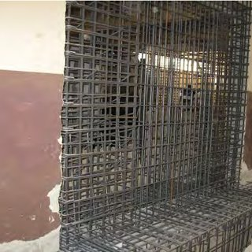
1. Adding New Shear Wall:
This is a frequently used technique for retrofitting of a building of non-ductile reinforced concrete frame buildings.[7]
The elements can be either cast-in-place or pre-cast concrete elements.[7]
New elements preferably are placed at the exterior of the building.[7]
This method is not preferred in the interior of the structure to avoid interior moldings.[7]
Figure:shear wall (Source: Civiconcepts(n.d.):Online
https://civiconcepts.com/blog/retrofitting

Slide 28
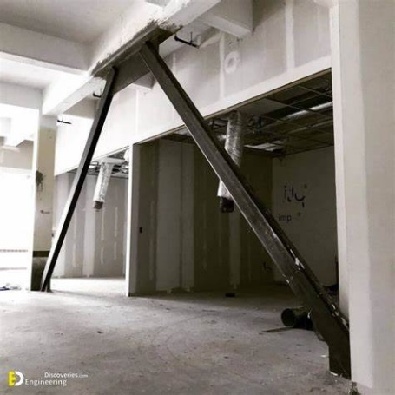
2. Adding Steel Bracing:
Steel bracing is a widely employed retrofitting technique designed to reinforce existing structures and improve their resistance to lateral forces.[7]
This technique involves the strategic installation of steel braces within a building to enhance its overall stability and performance.[7]
Figure: Steel Bracing(Source:Engineering Discoveries(n.d.): Online)
https://engineeringdiscoveries.com/types-of-bracing-system-used-in-steel-structures/

Slide 29
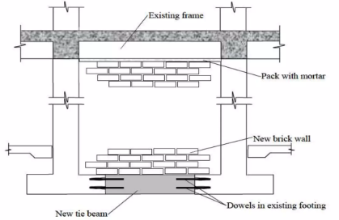
3. Wall Thickening Technique:
The primary goal of wall thickening is to augment the load-carrying capacity of existing walls, improving their ability to withstand vertical and lateral forces.[7]
The existing walls of a building are added a certain thickness by adding bricks, concrete, and steel aligned at certain places as reinforcement.[7]
The weight of the wall increases and it can bear more vertical and horizontal loads.[7]
Figure:wall thickening(Source: Slideshare(n.d.): Online
https://www.slideshare.net/YASHKUMAR131/retrofitting-93249452

Slide 30
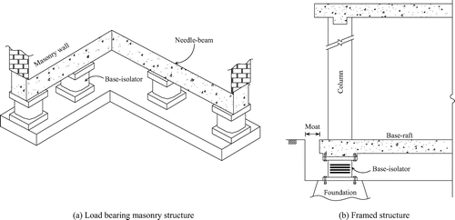
4. Base Isolation Technique:
Isolation of the superstructure from the foundation is known as base isolation. It is the most powerful method for passive structural vibration control techniques.[7]
This method involves the installation of isolators at the building's base, allowing it to move independently of the ground motion during an earthquake.[7]
The primary goal is to mitigate the impact of seismic forces by isolating the building from ground motion, reducing the transmission of forces to the structure.[7]
Figure:Base isolation(Source:Ascelibrary(n.d.):Online)
https://ascelibrary.org/doi/abs/10.1061/(ASCE)1084-0680(2008)13%3A4(175)

Slide 31
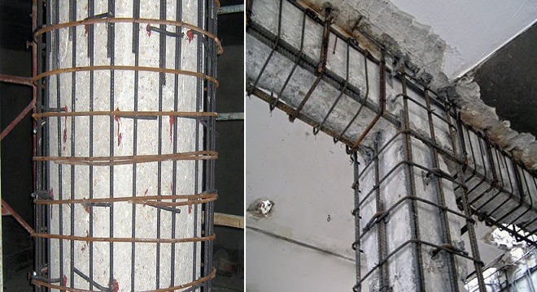
5. Jacketing Method:
It is the most used method of retrofitting of building.[7]
The jacketing method is used to reinforce and strengthen existing structural elements, such as columns or beams, by encasing them in additional layers of material. [7]
This method aims to enhance the load-carrying capacity and resilience of the structure, particularly in cases where the original components exhibit deterioration or inadequacy.[7]
Various materials can be used for jacketing, including reinforced concrete, steel, fiber-reinforced polymers (FRP), or a combination of these, depending on the specific requirements of the retrofitting project.[7]
Figure:Jacketing(Source: Civiconcepts(n.d.):Online
https://civiconcepts.com/blog/retrofitting

Slide 32
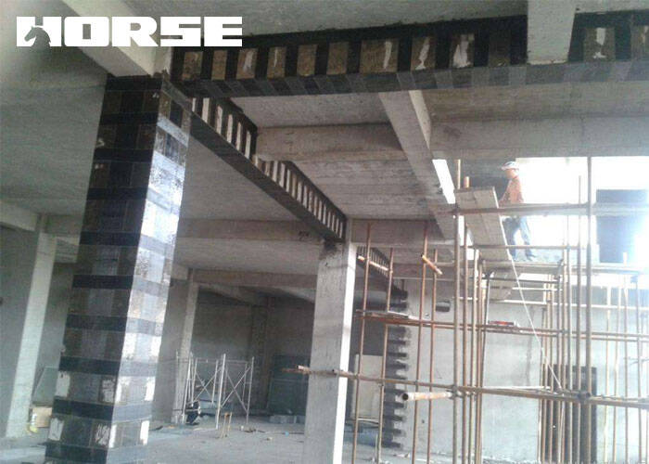
6. Fiber Reinforced Polymer (FRP):
Fiber Reinforced Polymer (FRP) is a versatile and effective material used in retrofitting existing structures to improve their strength, durability, and resilience.[7]
FRP sheets or wraps are applied to beams and columns to enhance their flexural capacity, providing additional strength to resist bending forces[7]
FRP materials can be used to increase the shear capacity of structural elements, such as walls and beams, improving their ability to resist lateral forces.[7]
Wrapping columns with FRP sheets increases their axial and flexural capacities, addressing deficiencies and enhancing overall column performance.[7]
FRP is inherently corrosion-resistant, making it a suitable choice for reinforcing structures in corrosive environments or those prone to environmental degradation.[7]
Figure: . Fiber Reinforced Polymer(Source:Horseen(n.d.): Online)
https://www.horseen.com/solution/carbon-fiber-reinforced-polymer-retrofit-for-columns

Slide 33
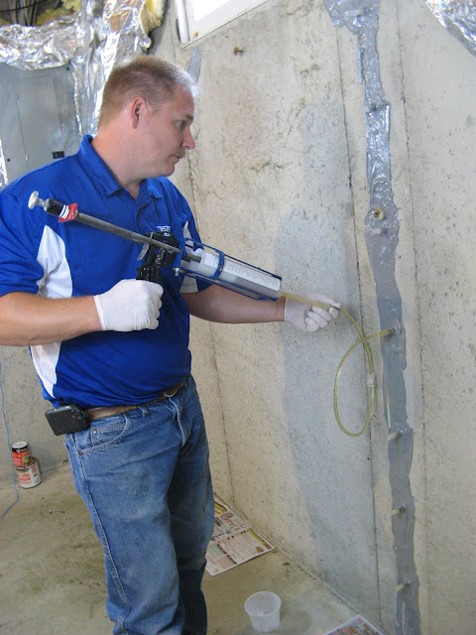
7. Epoxy Injection Method:
The epoxy injection method is a retrofitting technique commonly used to repair and strengthen concrete structures by injecting epoxy resin into cracks and voids.[7]
This method is particularly effective for addressing concrete deterioration, enhancing structural integrity, and preventing further damage.[7]
Figure: . Epoxy Injection Method(Source:Ascelibrary(n.d.):Online)
https://ascelibrary.org/doi/abs/10.1061/(ASCE)1084-0680(2008)13%3A4(175)

Slide 34
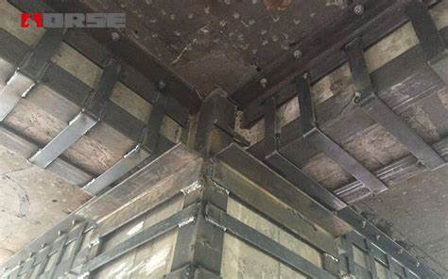
8. External Plate Bonding:
External plate bonding is a retrofitting technique that involves attaching additional plates or layers to the external surfaces of existing structural elements, such as beams or columns, to enhance their load-carrying capacity and overall performance. This method is commonly used to strengthen and reinforce structures that may have experienced deterioration or are subject to increased loads.[7]
Figure: . Fiber Reinforced Polymer(Source:Horseen(n.d.): Online)
https://www.horseen.com/solution/what-is-bonded-steel-plate-reinforcement

Slide 35
Benefits of Retrofitting
The retrofitting of buildings offers various benefits, contributing to the improvement of structural performance, safety, and sustainability. Here are some key advantages:
Enhanced Structural Performance: Retrofitting improves the structural performance of buildings, making them more resilient to various hazards, including seismic events and extreme weather conditions.[7]
Occupant Safety: By addressing structural vulnerabilities, retrofitting enhances the safety of building occupants. This is especially crucial during earthquakes, storms, or other emergencies[7]
Compliance with Standards: Retrofitting ensures that buildings comply with current building codes and safety standards. Adherence to standards is crucial for the safety and well-being of occupants.[7]
Sustainability and Environmental Impact: Retrofitting contributes to sustainable development by repurposing existing structures, reducing the need for new construction and minimizing the environmental impact associated with new building materials.[7]

Slide 36
Benefits of Retrofitting
Cost-Effective Solution: Retrofitting is often more cost-effective than demolishing and rebuilding. It allows for the preservation of existing structures while addressing performance and safety issues.[7]
Energy Efficiency: Retrofitting projects frequently include energy-efficient upgrades, such as improved insulation, energy-efficient windows, and modern HVAC systems. This contributes to energy savings and environmental sustainability.[7]
Adaptive Reuse: Retrofitting facilitates adaptive reuse, allowing buildings to be repurposed for changing needs without the need for extensive construction. This adaptability is particularly relevant in urban planning.[7]
Historical and Cultural Preservation: Retrofitting historic buildings preserves their architectural and cultural value, contributing to the overall preservation of a community's heritage.[7]
Quick and Efficient Implementation: Retrofitting projects can be implemented more quickly than new construction, minimizing disruption to occupants and operations.[7]

Slide 37
REFERENCES:
[1] American Society of Civil Engineers (ASCE). (2016). "ASCE 7-16: Minimum Design Loads for Buildings and Other Structures." Reston, VA: ASCE.
[2] National Earthquake Hazards Reduction Program (NEHRP). (2009). "Recommended Seismic Provisions for New Buildings and Other Structures (NEHRP Recommended Provisions)." FEMA P-750. Washington, D.C.: FEMA.
[3] Federal Emergency Management Agency (FEMA). (2000). "Seismic Design of Reinforced Concrete and Masonry Buildings (FEMA 356)." Washington, D.C.: FEMA.
[4] Applied Technology Council (ATC). (1997). "Minimum Design Loads for Buildings and Other Structures (ATC-7)." Redwood City, CA: ATC.

Slide 38
REFERENCES:
[5] Building Seismic Safety Council (BSSC). (2015). "NEHRP Recommended Provisions for Seismic Regulations for New Buildings and Other Structures (BSSC NEHRP Recommended Provisions)." Washington, D.C.: FEMA.
[6] Nepal National Building code NBC 203:2015
[7] Federal Emergency Management Agency (FEMA). (2012). "Risk Management Series: Design Guide for Improving School Safety in Earthquakes, Floods, and High Winds - Providing Protection to People and Buildings." https://www.fema.gov/

Slide 39


THANK YOU

