Slide 1

COURSE TITLE
BUILDING TECHNOLOGY
Chapter 13 - (Week 13)
OTHER SERVICES IN BUILDING
LECTURE – 13
Other services in building
Ar. Ranju Kamal
Lecturer
Advanced college of engineering and management, Nepal
Affiliated to Tribhuvan University
Thailand, Bangkok (photo credit:Abhinay Kushwaha)

Slide 2
LEARNING OUTCOMES
At the end of the session students will get acquainted to:
1. Water supply & sanitation
2. Fire Protection
3. Rainwater harvesting

Slide 3
SEPTIC TANK
Septic tank is one of the simplest form of on-site treatment technologies, which allows to undergo anaerobic digestion of organic materials of wastewater coming into the system.[1]
Effluent from septic tank is infiltrated into ground using soak pit/leach field or is sent to sewer line for further treatment.[1]
A properly designed, constructed and operated septic tank can treat wastewater to produce an effluent suitable for discharging without violating environmental health.[1]
Septic tank can be built using brick, concrete or stone. [1]
These days readymade/ precast septic tank made up of fiberglass, plastic, cement concrete is also available in the market.[1]

Slide 4
Key Features of Septic Tank
A septic tank should have following three key characteristics:
It should be watertight.[1]
It should consist of at least two chambers separated by a baffle wall.[1]
It should be assembled with soak pit or provided with outlet.[1]

Slide 5
WORKING PRINCIPLE OF SEPTIC TANK
Septic tank is a primary treatment unit, which is installed as a stand-alone structure to treat household wastewater and is prior to the secondary treatment then it passes out to sewage.[1]
During the storage, the heavy solids settle down at the bottom of the tank and the lighter solids float above liquid. During the storage period, anaerobic digestion takes place inside it and biodegradable solids are converted into sludge and gases. In this way, significant amount of pollution is reduced and deposited in the form of sludge. Liquid part is then conveyed to soak pit or sewerage network or secondary treatment plant.[1]
The removal efficiency of septic tank depends, mainly, upon the hydraulic retention time and temperature. Normally, septic tank removes 30 - 50 per cent of BOD (Biological Oxygen Demand) and 40 - 60 per cent of TSS (Total Suspended Solids).

Slide 6
KEY COMPONENTS OF A SEPTIC TANK
A septic tank consists of seven main components:[1]
Inlet
Outlet
Manhole
Liquid retention tank
Baffle wall
Soak pit
Vent pipe
The soak pit is also an integral part of the standard septic tank though is a separate structure.[1]

Slide 7
Inlet Chamber
Inlet is simply a chamber with cover, which allows wastewater in. Generally, it is located at center along the breadth of septic tank and it should be at the level of 100 -150 mm above the outlet level in order to avoid clogging the diameter of the Inlet should not be less than 100 mm. It consists of down pipe inside the septic tank.[1]
Outlet Chamber
Outlet is similar to inlet chamber, which is provided at the end of the septic tank. Generally, it is also located at center along the breadth of septic tank. The level of outlet chamber should be minimum 1.2 m from bottom of septic tank. Normally the diameter of the Inlet should not be less than the inlet pipe. A down pipe is also provided at starting point of outlet inside the septic tank.[1]

Slide 8
Manhole
Manhole is provided for easy access during desludging and to inspect inside the septic tank. Manhole should be well covered and the weight of the lid should be lighter enough to be opened easily. At the same time, it should be strong enough to bear a weight of an adult person.[1]
Hydraulic Retention Tank
This is a major component of septic tank. A baffle wall separates Hydraulic Retention Tank (HRT) into two compartments. LRTs collect and store sewage till the hydraulic retention time. During the storage of sewage, heavy particles settle down and anaerobic digestion of organic part takes place inside the liquid retention tank. The collected sewage stores in three layers, namely sludge, liquid and scum.[1]

Slide 9
Sludge Layer:
Heavy solids (heavier than water) settle down at the bottom of the septic tank and forms a layer. Over the time, the biodegradable solids accumulated at bottom undergoes into anaerobic digestion. Sludge is generated during digestion and deposits at bottom and forms a sludge layer.[1]
Scum Layer:
The light-weight solids (lighter than water) such as grease, oils, soap films and other solid waste float above the liquid and forms a layer which is called scum layer.[1]
Liquid Layer:
The layer in between the sludge layer and scum layer is termed as liquid layer. It holds liquid portion of sewage, which contains microscopic biodegradable and non-biodegradable solids suspended in the liquid. Anaerobic digestion process takes place in this layer as well. During the process, biodegradable suspended solids are digested and settle down at bottom. Thus, treated/ clearer liquid is conveyed to the soak pit or sewerage network.[1]

Slide 10
Baffle Wall
Baffle wall is a component that divides liquid retention tank into two compartments. It is provided at the 2/3rd of length from inlet side. Series of holes are provided in this wall and size of holes is minimum dimension of 100 cm diameter or square. Generally, the holes are provided at the height above the half of the liquid depth.[1]
Vent Pipe
Anaerobic digestion process produces poisonous, inflammable, and foul gases. A Vent pipe inserted in the septic tank allows safe exit to gases. Vent pipe also prevents smell entering to the toilet via conveyance system. The vent pipe should be erected with the minimum height greater than an average height of a person.[1]

Slide 11

Vent Pipe
Liquid Retention Tank
Manhole
Inlet
Outlet
Scum Zone
Liquid Zone
Sludge Zone
Baffle Wall
Soak Pit
Figure: Key Components of septic tank and various zones(Source: Shrestha, 2020)

Slide 12
Advantages and Limitations
Though there are several on-site sanitation technologies, septic tank is commonly used because of its several advantages compared to other on-site technologies. However, it has few limitations as well. Some of the most common advantages and limitations are listed below:[1]

Slide 13
Advantages of Septic Tank:
Since septic tank is a water sealed treatment technology and effluent discharged out through soak pit or leach field resulting less environmental or ground water pollution;[1]
Though septic tank needs regular desludging but it requires less other maintenance;[1]
Depending upon the material used to install and usage, it lasts for more than 20 years;[1]
It is an excellent onsite options especially for the areas with no or/and unfeasible sewerage networks;[1]
Septic tank can be constructed in situ using locally available materials (brick, concrete or stone) and human resource. These days there is a provision of buying readymade (made up of concrete, plastic, and fiberglass). Comparatively readymade septic tanks are cost effective and faster to install.[1]

Slide 14
Limitations of Septic Tank:
Since a septic tank is biological treatment technology, traces of chemicals like toilet cleaner, acid can be harmful to microorganisms (which helps to maintain the eco-system to treat wastewater) those cause the failure of septic tank. [1]
Since the septic tank is a structure with fixed capacity and piping systems, non-degradable or solid, that takes time to degrade, materials such as tampons, sanitary wipes, too much toilet paper may cause clogging of the septic tank. [1]
If the septic tank is not properly built, operated and maintained, it may cause bad odor, overflow, frequent clogging and untimely desludging.[1]
In case of flood prone or water logging area, especial attention should be paid while designing so that unwanted water does not enter from outside the tank.[1]
If the underground water table of the location is high, the soak pit cannot absorb the effluent.[1]

Slide 15
SOAK PIT
Structurally soak pit is a separate entity. [1]
However, it is an integral part of the standard septic as the effluent from septic is safely discharges into ground via soak pit.[1]
A soak pit is a lined, generally circular in shape, pit with cover and porous or honeycomb wall.[1]
The pit is filled with brickbats or brick ballast or stone aggregates of size 50 - 100 mm as media up to the inlet level.[1]
The unsealed surface and media facilitates to spread incoming flow into ground and provides support to protect from collapse of porous wall.[1]
The distance between soak pit and water sources should not be less than 4m vertically and 30m horizontally to minimize risk of biological contamination in water body.[1]

Slide 16
Advantages and Limitations
Advantages:[1]
It is a simple technology which can be built and repaired with locally available mason and materials;
Small land area is required;
It is cost effective technology i.e. low investment and low operating cost;
It recharges groundwater bodies.
Limitations:[1]
At least primary treatment is required to prevent clogging the filling media;
It may affect soil negatively and might contaminate groundwater depending upon the type and concentration of inflow;
It is not feasible for cold climate as there is chance of freezing the pores;
It is not feasible for location having impermeable soil layer.

Slide 17
Site Selection for Soak Pit
Following factors should be considered during the site selection for soak pit:
It should be at least 1m away from the outlet of septic tank and is recommended that it should not be too far. Longer distance cost high;[1]
The site should be at least 4m away vertically and 30m horizontally from water sources like dug well, spring etc.;[1]
Technically sloppy, elevated terrain, sunny area is preferred for septic systems because these locations have no chance of water logging even during rain and it dries out in a short time.[1]

Slide 18
Design of Soak Pit
Purpose of soak pit design is to determine the surface area of soak pit that can absorb particular volume of water coming into it. And absorption capacity of soak pit is determined also by the infiltration capacity of soil.[1]
Soak pit design principles are:
To provide sufficient surface area to percolate water coming into it;[1]
To ensure uniform distribution of water over the surface for efficient percolation and to avoid choking due to concentrated application.[1]

Slide 19

FIRE RESISTANT BUILDING

Slide 20
FIRE RESISTANT BUILDING
A building may be made more fire resistant by[2]
1. Using suitable materials
2. Taking precautions in building construction
3. By providing fire alarm systems and fire extinguishers.
The fire resisting material is having the following characters:[2]
(a) It should not disintegrate under the effect of heat
(b) It should not expand under heat so as to introduce unnecessary stresses in the building
(c) The material should not catch fire easily
(d) It should not lose its strength when subjected to fire.

Slide 21
Fire resisting characters of some of the commonly used building materials are given below:
Stone: It is a bad conductor of heat. Sand stones with fire grains can resist fire moderately.
Granite disintegrate under fire. Limestone crumbles easily. Most of the stones disintegrate during cooling period after heated by fire.[2]
Brick: Bricks can resist heat up to 1200°C. At the time of construction, if good quality mortar is used, fire resistance is extremely good.[2]
Timber: Any structure made of timbers is rapidly destroyed in fire. Timber enhances the intensity of fire. Use of heavy sections of timber in buildings is not desirable. To make timber more fire resistant the surface of timber is coated with chemicals such as ammonium phosphate and sulphate, boric acid and borax. Sometimes fireresistant paint is applied to timber used in the building.[2]

Slide 22
Concrete:
Concrete has got very good fire resistance. [2]
The actual behaviour of concrete in case of fire depends upon the quality of cement and aggregates used. [2]
In case of reinforced concrete and prestressed concrete, it also depends upon the position of steel. Larger the concrete cover, better is the fire resistance of the member.[2]
There is no loss in strength in concrete when it is heated up to 250°C. The reduction in strength starts if the temperature goes beyond 250°C. Normally reinforced concrete structures can resist fire for about one hour at a temperature of 1000°C.[2]
Hence cement concrete is ideally used fire resistant material.[2]

Slide 23
Steel: It is a good conductor of heat. Steel bars lose tensile strength. Steel yields at 600°C. They melt at 1400°C. Steel columns become unsafe during fire. Steel reinforcement weaken the reinforced concrete structures. Hence steel columns are usually protected with brick works or by encasing in concrete. Reinforcement in concrete are protected by concrete cover. Steel grills and beams are applied with fire resistant paints.[2]
Glass: It is a poor conductor of heat. It expands little during heating. After heating when it cools, cracks are formed in glass. Reinforced glass with steel wire is more resistant to fire and during cooling process, even if it breaks, fractured glasses are in their original position.[2]
Aluminium: It is good conductor of heat. It has got higher resistance to fire.[2]
Asbestos Cement: It is non-combustible material. It posseses high fire resistance.[2]

Slide 24
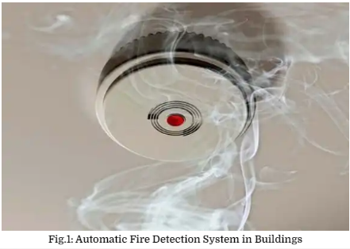
Fire Safety and Protection Systems for Buildings
Automatic Detection of Fire
The first and most important measure against fire, which is slow with smoke but without fire and low heat that does not activate sprinkler head, is an exact early warning. [3]
From life safety point of view, detectors are substantially significant because they warn occupants close to the source of the fire to run away. [3]
To alert fire department, alarm systems could be installed to decline reaction time of firefighters, increase the speed of rescue operation, and restricting the spread of fire and structural damages.[3]
If detectors are fixed at corridors and connected to central alarm, the evacuation of the whole occupant will be easy and potential injury and death will be reduced. [3]
Figure: Automatic Fire Detection System in Buildings
(Source: The Constructor: Building ideas. (n.d.). ):Online
https://theconstructor.org/concrete/building-fire-safety-protection-systems/16417/

Slide 25
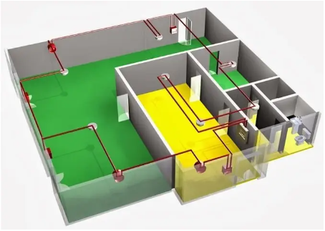
Smoke sensing fire detector is the most usual detector that employed for early warning. [3]
Generally, detectors need to be connected to continuous power supply and should have a battery as a backup for the case where power is failed.[3]
Figure: Layout of Automatic Fire Detection System in Buildings(Source: The Constructor: Building ideas. (n.d.). ):Online
https://theconstructor.org/concrete/building-fire-safety-protection-systems/16417/

Slide 26
Automatic suppression of Fire in Buildings
The purpose of automatic sprinkler system is to control fire at its origin.
Automatic sprinkler can reduce the possibility of flashover that can be dangerous event. Not only does the fire suppression permits access to building to help occupants out of dangerous area but also allows the continuation of fire suppression.[3]
The National Fire Protection Association (NFPA) recommends minimum standard for sprinkler system design and installation. Standard for the installation of sprinkler systems (NFPA-13) involves sprinkler system for general utilization while standard for the installation of sprinkler systems in residential occupancies up to and including four stories in height (NFPA 13R) covers residential applications.[3]

Slide 27
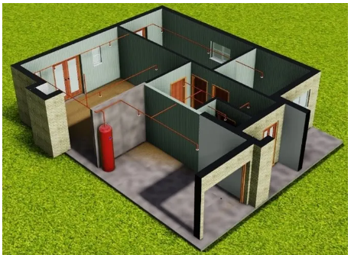
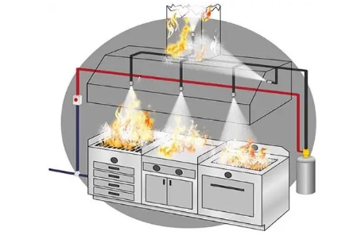
The design, installation, testing, and maintenance of sprinkler systems are dealt with by NFPA standards. Clearly, effective and influential sprinkler head needs sufficient water supply and piping system to supply adequate water to the sprinkler head. [3]
The standard determines areas or rooms which are not needed to be sprinkled. After the completion of sprinkler installation, based on standards, inspection and acceptance of piping valves, pumps, and tanks of the system. Insufficient maintenance and improper watersupply lead to poor performance of the sprinkler.[3]
Figure: Installed Fire Suppression System in Residential Building(Source: The Constructor: Building ideas. (n.d.). ):Online
https://theconstructor.org/concrete/building-fire-safety-protection-systems/16417/
Figure: Automatic Fire Suppression System in Kitchen(Source: The Constructor: Building ideas. (n.d.). ):Online https://theconstructor.org/concrete/building-fire-safety-protection-systems/16417/

Slide 28
Compartmentation of Buildings
Compartmentation restricts the spread of fire by dividing the building into compartment areas surrounded by fire walls and by fire rating floors and ceilings.[3]
the spread of smokes and poisons fumes to adjacent areas of the building is limited by compartments.[3]
Not only do compartments provide a safe place for occupants for whom unable to escape such as elderly and handicapped but also safe refuge areas for long time when the fire are blocked or filled with smokes.[3]
Until the fire is controlled, compartments work to contain the fire. Each concrete or masonry walls that construct compartments walls need to have adequate fireresistant rating and need to have the capability of protecting structural integrity of the building during fire. [3]
If joints between floors and walls, exterior curtain wall, or between ceilings and walls are not adequately fire protected, the Compartmentation effect is decreased.[3]
These weakness points in the compartment boundary need to be dealt with properly to avoid fire movement[3]

Slide 29
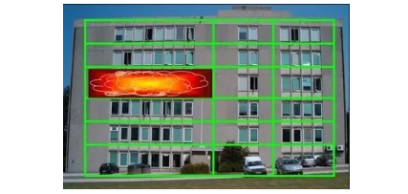
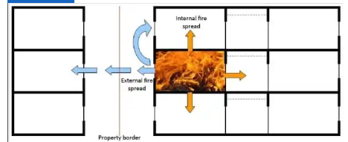
Figure: Compartmentation of Fire to Protect Building Content and Other Property(Source: The Constructor: Building ideas. (n.d.). ):Online
https://theconstructor.org/concrete/building-fire-safety-protection-systems/16417/
Figure: Compartmentation of Building to Prevent the Spread of Fire(Source: The Constructor: Building ideas. (n.d.). ):Online
https://theconstructor.org/concrete/building-fire-safety-protection-systems/16417/

Slide 30

RAINWATER HARVESTING IN BUILDING

Slide 31
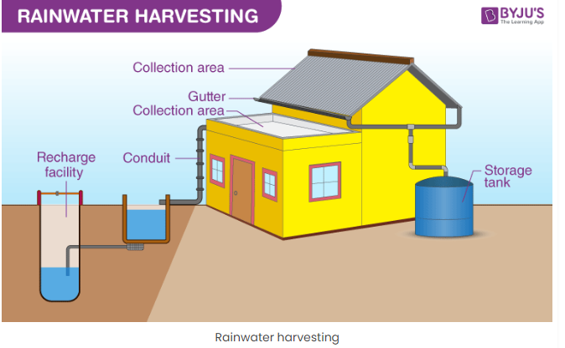
Rainwater harvesting is a sustainable and environmentally-friendly method that involves collecting, storing, and utilizing rainwater for various purposes.
By implementing rain harvesting systems, we can effectively reduce our dependence on municipal water supplies, promote water conservation, and better use a naturally occurring resource[5]
Rainwater harvesting system components are used for transporting rainwater through pipes or drains, filtration and tanks for storage of harvested water.[5]
Figure: Rainwater Harvesting(Source:BYJU”S:The learning app(n.d.):Online
https://byjus.com/biology/rainwater-harvesting/#:~:text=Rainwater%20harvesting%20is%20the%20simple,%2C%20etc.%20for%20later%20use.

Slide 32
.
Importance of Rainwater Harvesting
Rainwater harvesting plays a crucial role in addressing various water-related challenges, including:
Water scarcity: By capturing and storing rainwater, we can supplement our water supply, particularly in regions where water scarcity is a pressing concern.[5]
Water conservation: Rainwater harvesting helps conserve water by reducing reliance on groundwater and surface water sources, which can become depleted or contaminated over time.[5]
Reducing demand on municipal water systems: By utilizing harvested rainwater for non-potable uses, we can lessen the burden on municipal water supplies, decreasing the need for costly infrastructure investments and energy-intensive water treatment processes.[5]
Stormwater management: Collecting rainwater helps mitigate stormwater runoff, which can lead to flooding and soil erosion and negatively impact water quality in rivers and streams.[5]

Slide 33
Methods of Rainwater Harvesting
1. Surface Runoff Harvesting
In urban areas, rainwater flows away as surface runoff. This runoff can be caught and used for recharging aquifers by adopting appropriate methods.[4]
2. Rooftop Rainwater Harvesting
It is a system of catching rainwater where it falls. In rooftop harvesting, the roof becomes the catchment, and the rainwater is collected from the roof of the house/building.
It can either be stored in a tank or diverted to an artificial recharge system. This method is less expensive and very useful and, if implemented correctly, helps in augmenting the groundwater level of the area.[4]

Slide 34
Components of the Rooftop Rainwater Harvesting
The system mainly constitutes of following sub-components:
1. Catchment
The surface that receives rainfall directly is the catchment of rainwater harvesting system. It may be a terrace, courtyard, or paved or unpaved open ground.
The terrace may be a flat RCC/stone roof or sloping roof. Therefore the catchment is the area, which actually contributes rainwater to the harvesting system.[4]
2. Transportation
Rainwater from the rooftop should be carried through down to take water pipes or drains to the storage/harvesting system. Water pipes should be UV resistant (ISI HDPE/PVC pipes) of the required capacity.
Water from sloping roofs could be caught through gutters and down take the pipe. At terraces, the mouth of each drain should have wire mesh to restrict floating material.[4]

Slide 35
3. First Flush
The first flush is a device used to flush off the water received in the first shower. The first shower of rains needs to be flushed-off to avoid contaminating storable/rechargeable water by the probable contaminants of the atmosphere and the catchment roof.
It will also help in cleaning of silt and other material deposited on the roof during dry seasons. Provisions of first rain separators should be made at the outlet of each drainpipe.[4]
4. Filter
Filters are used for the treatment of water to effectively remove turbidity, color, and microorganisms. After the first flushing of rainfall, water should pass through filters.
A gravel, sand, and ‘netlon’ mesh filter is designed and placed on top of the storage tank. [4]

Slide 36
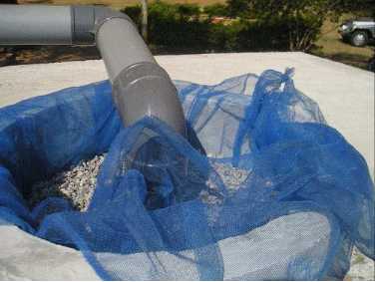
This filter is very important in keeping the rainwater in the storage tank clean. It removes silt, dust, leaves, and other organic matter from entering the storage tank.[4]
The filter media should be cleaned daily after every rainfall event. Clogged filters prevent rainwater from easily entering the storage tank and the filter may overflow. The sand or gravel media should be taken out and washed before it is replaced in the filter. [4]
Figure: Photograph of Typical Filter in Rainwater Harvesting (Source: The Constructor: Building ideas. (n.d.). ):Online
https://theconstructor.org/water-resources/methods-rainwater-harvesting/5420/#google_vignette

Slide 37
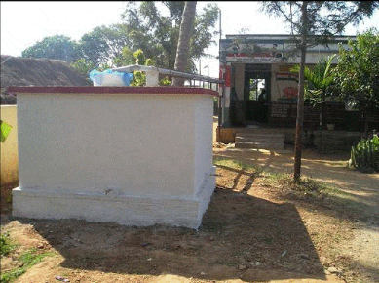
Methods of Rooftop Rainwater Harvesting
1. Storage of Direct Use
In this method, rainwater collected from the roof of the building is diverted to a storage tank.[4]
The storage tank has to be designed according to the water requirements, rainfall, and catchment availability.[4]
Each drainpipe should have a mesh filter at the mouth and first flush device followed by a filtration system before connecting to the storage tank. Each tank should have an excess water overflow system.[4]
Excess water could be diverted to the recharge system. [4]
Water from storage tanks can be used for secondary purposes such as washing and gardening etc. [4]
This is the most cost-effective way of rainwater harvesting.[4]
Figure: A storage tank on a platform painted white(Source: The Constructor: Building ideas. (n.d.). ):Online
https://theconstructor.org/water-resources/methods-rainwater-harvesting/5420/#google_vignette

Slide 38
2. Recharging Groundwater Aquifers
Groundwater aquifers can be recharged by various kinds of structures to ensure the percolation of rainwater in the ground instead of draining away from the surface.[4]
Commonly used recharging methods are:-
Recharging of bore wells
Recharging of dug wells.
Recharge pits
Recharge Trenches
Soakaways or Recharge Shafts
Percolation Tanks

Slide 39
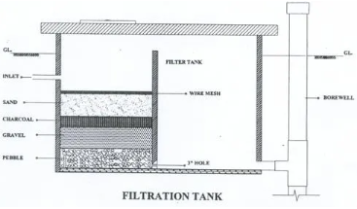
3. Recharging of Bore Wells
Rainwater collected from the rooftop of the building is diverted through drainpipes to settlement or filtration tank.[4]
After settlement, filtered water is diverted to bore wells to recharge deep aquifers. Abandoned bore wells can also be used for recharge.[4]
Optimum capacity of the settlement tank/filtration tank can be designed based on the area of catchment, intensity of rainfall, and recharge rate. While recharging, entry of floating matter and silt should be restricted because it may clog the recharge structure.[4]
The first one or two showers should be flushed out through rain separator to avoid contamination.[4]
Figure: Filtration Tank(Source: The Constructor: Building ideas. (n.d.). ):Online
https://theconstructor.org/water-resources/methods-rainwater-harvesting/5420/#google_vignette

Slide 40
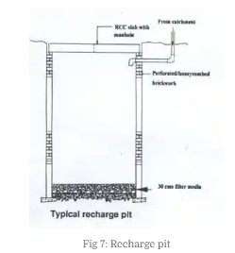
4. Recharge Pits
Recharge pits are small pits of any shape rectangular, square, or circular contracted with brick or stone masonry wall with weep hole at regular intervals. Top of the pit can be covered with perforated covers. The bottom of the pit should be filled with filter media.[4]
The capacity of the pit can be designed based on the catchment area, rainfall intensity, and recharge rate of the soil. Usually, the dimensions of the pit may be of 1 to 2 m width and 2 to 3 m deep, depending on the depth of previous strata.[4]
These pits are suitable for recharging of shallow aquifers, and small houses.
Figure: Recharge Pit(Source: The Constructor: Building ideas. (n.d.). ):Online
https://theconstructor.org/water-resources/methods-rainwater-harvesting/5420/#google_vignette

Slide 41
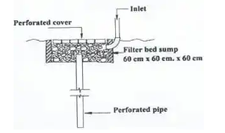
5. Soakway or Recharge Shafts
Soak away, or recharge shafts are provided where the upper layer of soil is alluvial or less porous. These are the bored hole of 30 cm dia. up to 10 to 15 m deep, depending on the depth of the pervious layer. Bore should be lined with slotted/perforated PVC/MS pipe to prevent the collapse of the vertical sides.[4]
At the top of the soakaway, the required size sump is constructed to retain runoff before the filters through the soakaway. Sump should be filled with filter media. [4]
Figure: Schematic Diagram of Recharge Shaft(Source: The Constructor: Building ideas. (n.d.). ):Online
https://theconstructor.org/water-resources/methods-rainwater-harvesting/5420/#google_vignette

Slide 42
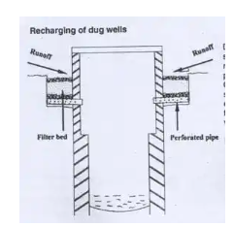
6. Recharging of Dug Wells
Dug wells can be used as a recharge structure. Rainwater from the rooftop is diverted to drilled wells after passing it through the filtration bed. Cleaning and desalting of dug well should be done regularly to enhance the recharge rate. The filtration method suggested for bore well recharging could be used. [4]
Figure: Schematic Diagram of Recharging to Dug Well(Source: The Constructor: Building ideas. (n.d.). ):Online
https://theconstructor.org/water-resources/methods-rainwater-harvesting/5420/#google_vignette

Slide 43
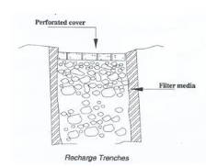
7. Recharge Trenches
The recharge trench is provided where upper impervious layer of soil is shallow. The recharge trench excavated on the ground and refilled with porous media like pebbles, boulders, or brickbats. It is usually made for harvesting the surface runoff.
Bore-wells can also be provided inside the trench as recharge shafts to enhance percolation. The length of the trench is decided as per the amount of runoff expected.[4]
This method is suitable for small houses, playgrounds, parks, and roadside drains. The recharge trench can be of size 0.50 to 1.0 m wide and 1.0 to 1.5 m deep. Fig. 10 presents a schematic diagram of recharging to trenches.[4]
Figure: Recharging to Trenches(Source: The Constructor: Building ideas. (n.d.). ):Online
https://theconstructor.org/water-resources/methods-rainwater-harvesting/5420/#google_vignette

Slide 44
8. Percolation Tank
Percolation tanks are artificially created surface water bodies, submerging a land area with adequate permeability to facilitate sufficient percolation to recharge the groundwater. These can be built on big campuses where land is available, and topography is suitable.[4]
Surface runoff and roof topwater can be diverted to this tank. Water accumulating in the tank percolates in the solid to augment the groundwater.[4]
The stored water can be used directly for gardening and raw use. Percolation tanks should be built in gardens, open spaces, and roadside greenbelts of urban areas.[4]

Slide 45
Environmental Benefits
Preserving ecosystems: By reducing the demand for groundwater and surface water sources, rainwater harvesting helps protect and preserve aquatic ecosystems, which are often negatively impacted by excessive water extraction.[5]
Mitigating stormwater runoff: Capturing rain minimizes stormwater runoff, which in turn helps reduce soil erosion, flooding, and contamination of water bodies like rivers and streams. This contributes to healthier ecosystems and improved water quality.[5]
Recharging groundwater aquifers: When stored rainwater is allowed to infiltrate and percolate into the ground, it can help replenish groundwater aquifers, ensuring the sustainability of these crucial water sources.[5]
Saving energy: By decreasing the demand for treated and distributed water from municipal sources, rainwater harvesting reduces the energy consumption associated with water treatment, pumping, and distribution. This contributes to lower greenhouse gas emissions and a smaller carbon footprint.[5]

Slide 46
Economic Benefits
Lower water bills: Utilizing harvested rainwater for various purposes can lead to significant savings on water bills for consumers and businesses, making it an economically attractive solution.[5]
Reduced infrastructure investments: By lessening the demand on municipal water systems, rainwater harvesting can help reduce the need for costly infrastructure investments, such as new water treatment plants or distribution networks.[5]
Increased property value: Properties incorporating sustainable features like rainwater harvesting systems tend to have higher market values, as they are seen as more environmentally responsible and cost-efficient.[5]

Slide 47
Social Benefits
Enhanced water security: Rainwater harvesting can bolster water security, particularly in areas prone to droughts or water scarcity, by providing an additional, more reliable water source.[5]
Promoting water conservation awareness: Implementing rainwater harvesting systems raises awareness about the importance of water conservation and encourages individuals and communities to adopt more sustainable water use practices.[5]
Fostering self-sufficiency and resilience: Rainwater harvesting promotes self-sufficiency by allowing individuals and communities to rely less on external water sources. This increased independence and resilience can be precious during water shortages or emergencies.[5]

Slide 48
REFERENCES
[1] Shrestha, M. R. (2020, December). SEPTIC TANK DESIGN MANUAL. Environment and public health organization(ENPHO). Environment and public health organization(ENPHO).
[2] Bhavikati, S(2010). Basic Civil engineering, New Delhi: New Age International (p) LTD,Publishers
[3] The Constructor: Building ideas. (n.d.). Retrieved from https://theconstructor.org/concrete/building-fire-safety-protection-systems/16417/
[4] The Constructor: Building ideas. (n.d.). Retrieved from https://theconstructor.org/water-resources/methods-rainwater-harvesting/5420/#google_vignette
[5] UGREEN. (n.d.). Retrieved from ugreen.io: https://ugreen.io/how-rainwater-harvesting-works-a-guide-for-building-professionals/

Slide 49


THANK YOU

