Slide 1

MULTINATIONAL BUSINESS MANAGEMENT
LECTURE TWO
Globalization of labor, land, capital and entrepreneurship
LECTURER: MUGISHA PATRICK

Slide 2

Unit two objectives
By the end of this unit, you will be able to:
Know the meaning of globalization
Understand what is globalization of labor
Explain what is globalization of land
Understand the meaning of globalization of capital
Know what is globalization of entrepreneurship
Be aware of the effects of globalization

Slide 3

Meaning of globalization
For the first time globalization was used in 1983 by an American economist. It is the integration of the world’s economies, politics, and cultures.
The process of greater interconnection and interdependence of nations, economies, cultures, and civilizations worldwide is referred to as globalization. It entails the fusion of political institutions, markets, technology, and communication networks, resulting in increased international contact and interchange.

Slide 4
Globalization
Interconnectedness
(Various connections)
Interdependence
(Reliance)

Slide 5

Globalization of the factors of production
They four factors of production:
Land
Labor
Capital
Entrepreneurship

Slide 6

What do we understand by globalization of the factors of production?
The term globalization of factors of production describes the process in which the essential resources needed for economic production labor, land, capital, and entrepreneurship become more mobile and integrated internationally.
Technological developments, trade and investment liberalization, and modifications to international economic structures are the main causes of this phenomena, which is a major facet of economic globalization.

Slide 7

Globalization of land
One important facet of economic globalization is the globalization of land, which involves the utilization and cross-border movement of natural resources.
it involves:
Foreign investment and acquiring land in a foreign country
Outsourcing agricultural activities
Extracting natural resources in different countries.

Slide 8
Con’t
Land has become a valuable commodity for both economic development and profit generation on a worldwide scale with the growing integration of global markets and the rise of multinational enterprises
The tendency of foreign governments, corporations, and investors acquiring land abroad, especially in developing nations, is one facet of the globalization of land and this has led to what many have called land grabbing.

Slide 9
Con’t
While supporters agree that foreign investment in real estate (this case land acquisition in a foreign country) can have positive effects on the local economy, including the creation of jobs, improved infrastructure, and technology transfer, others believe that there are challenges with land tenure rights, food security, environmental sustainability, and social justice for the community.
The outsourcing of agricultural production to nations with comparative advantages in land resources, labor costs, or regulatory frameworks is another aspect of the globalization of land.

Slide 10

Con’t
Global supply chains in agriculture are being established under this trend, where agricultural products are produced in one nation and exported to others for distribution, processing, and consumption.
Globalization of land gives better opportunities for trade, investment, and development but also raises issues with social inequality, environmental degradation, land rights, and sustainable land use practices.

Slide 11
Globalization of capital
Definitions
According to Rodrik (1997) globalization of capital is the integration of financial markets and financial institutions in different countries, he added that this integration has led to greater volatility, interconnectedness, and systemic risks in the global financial system.
Stiglitz (2003) discusses the globalization of capital as the increasing internationalization of financial markets, the liberalization of exchange controls, and the expansion of multinational corporations.

Slide 12
Meaning of globalization of capital
The increasing integration and cross-border mobility of financial resources is one of the many characteristics of the multidimensional process known as globalization of capital
It includes the movement of:
Cash
Investment
Financial assets

Slide 13
Con’t
Globalization of capital is the increase of integration and cross-border mobility of financial resources.
It includes all types of capital, such as cash, investments, and financial assets that are freely transferred between nations in search of better investment possibilities, increased profits, and the ability to take advantage of disparities in interest rates, currency exchange rates, and regulatory frameworks.
The globalization of capital has also facilitated the rise of multinational corporations and financial intermediaries, which operate across borders, channeling capital flows, providing financial services, and engaging in cross-border investment and financing activities.

Slide 14
Con’t
Globalization of capital has facilitated:
Multinational firms to finance their intermediaries
Directing capital flows
Offering financial services
Taking part in international financing
Investment activities

Slide 15
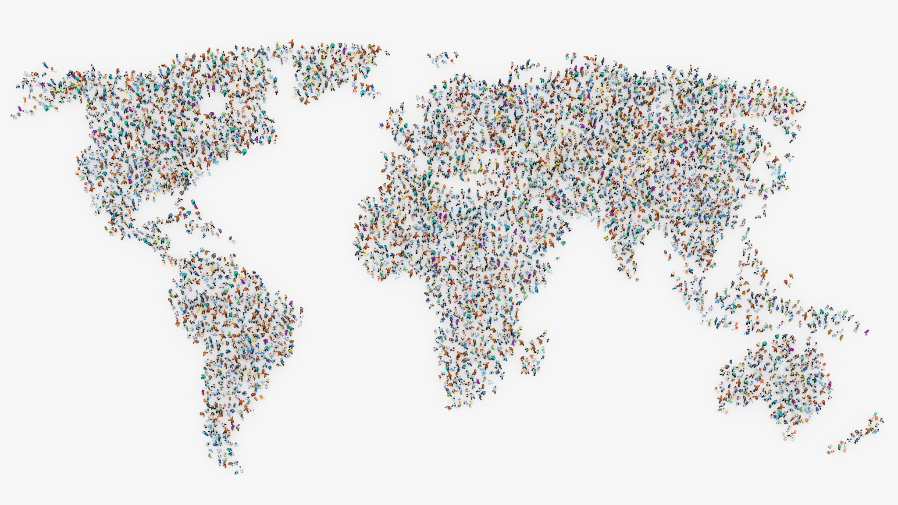
Globalization of labor
Meaning
The globalization of labor refers to the process by which labor markets become increasingly integrated across national borders, leading to the movement of workers, skills, and employment opportunities on a global scale.
The growing integration of labor markets across countries, facilitated by factors such as international migration, outsourcing, and the spread of information and communication technologies.

Slide 16

Con’t
Globalization of labor has impacts such as:
Job displacement
Wage disparity
Labor rights
Social inclusion

Slide 17
Implications of labor globalization
Globalization of labor has deep implications for countries, companies and individuals, some are the following:
Employment displacement and wage inequality: labor movement may cause employment displacement in some industries or geographical areas as a result of labor globalization. Lower-paid workers in developing nations may compete with workers in rich nations, pushing wages downward and widening the income gap.
Skill upgrading and Human Capital Development: As businesses need for specialized knowledge and abilities to stay competitive in the global economy, globalization promotes the growth of highly skilled labor markets. Workers may upgrade their skills as a result of education, training, and technology adaption.

Slide 18

Con’t
Brain Drain and Migration: As workers travel abroad in search of better job prospects, more pay, and higher living conditions, globalization encourages this movement of labor. Although migration can alleviate labor shortages, foster economic expansion, and advance cross-cultural understanding, it also gives rise to worries regarding brain drain, as highly qualified individuals depart from their native countries in search of better opportunities overseas, resulting in a depletion of human capital and a shortage of skills in the sending countries.
Labor Rights and Social Protections: As workers participate in informal, insecure, or contingent employment arrangements in the global economy, globalization presents problems for labor rights and social protections.

Slide 19
Con’t
Globalization of labor drives productivity increases, innovation, and economic growth by intensifying competition among nations, businesses, and laborers in the global labor market.
Globalization brings about winners and losers, though, with certain nations and laborers reaping the rewards of its opportunities while others are left out and marginalized. Policies that maximize the positive aspects of globalization while reducing its negative consequences on marginalized communities and vulnerable populations are necessary to promote inclusive and sustainable development.

Slide 20

Globalization of entrepreneurship
Meaning
Globalization of entrepreneurship means the growing cross-border internationalization and integration of entrepreneurial endeavors, initiatives, and operations. It entails the spreading of innovative concepts, business endeavors, and entrepreneurial ideas as well as the involvement of entrepreneurs in international cooperation, investment, and market expansion.
This is kind of globalization is fueled by various factors, including advancements in communication and transportation technologies, liberalization of trade and investment, and the rise of global networks and platforms that facilitate entrepreneurial exchange and cooperation.

Slide 21
Con’t
Globalization of entrepreneurship can take one of the following form:
Internationalization of Startups: Entrepreneurs increasingly launch startups with the intention of entering international markets from the outset. These startups may leverage digital platforms, e-commerce, and cross-border partnerships to reach customers globally and expand their operations internationally.
Global Value Chains and Outsourcing: Entrepreneurs participate in global value chains by outsourcing production, sourcing inputs, or collaborating with suppliers, manufacturers, and distributors across multiple countries. This allows them to access specialized skills, reduce costs, and tap into global markets more effectively.

Slide 22
Con’t
Cross-Border Collaboration and Networks: Entrepreneurs engage in cross-border collaboration and networking activities, such as joint ventures, strategic alliances, and business incubators, to access new markets, share knowledge, and pool resources with partners from different countries.
International Investment and Venture Capital: Entrepreneurs attract investment and venture capital from global investors, including angel investors, venture capitalists, and corporate investors, to fuel the growth and expansion of their businesses. This capital infusion enables entrepreneurs to scale their ventures, enter new markets, and pursue innovation more aggressively.

Slide 23

Merits of globalization
Economic Development: As a result of enhanced trade and investment brought about by globalization, participating nations experience economic growth.
Access to Markets: Businesses can offer their goods and services internationally and grow their clientele by having access to bigger markets.
Technological breakthroughs: Cross-border innovation and technological breakthroughs are fueled by globalization, which makes it easier to share information and technology.

Slide 24

Con’t
Better Living Standards: It raises income levels, lowers poverty, and facilitates easier access to necessities like food and services, all of which help to raise living standards.
Cultural interchange: Globalization fosters an awareness of diversity and interchange of cultures, which results in a more comprehensive understanding of the world's cultures.
Employment Creation: It generates jobs by boosting investment, economic activity, and industry expansion in both developed and developing nations.

Slide 25

Con’t
Access to Resources: Globalization facilitates nations' ability to obtain raw materials and resources from throughout the globe, which promotes the efficiency and optimization of resources.
Enhanced Communication: People can interact and work together across boundaries more easily as a result of globalization, which makes communication and networking easier thanks to technological advancements.

Slide 26
Demerits of globalization
Economic disparity: Because certain groups, such multinational firms and trained workers, profit more from globalization than others, it exacerbates income disparity.
Labor Exploitation: This may result in underpaying and unfavorable working conditions for laborers in underdeveloped nations.
Cultural Homogenization: Cultural variety may be lost as a result of globalization, which can also give rise to the domination of one sector’s cultural norms and values.

Slide 27

Con’t
Degradation of the Environment: It causes ecological imbalances and biodiversity risks as a result of growing demand, resource extraction, and pollution.
Loss of Local Industries: As local businesses struggle to compete with multinational enterprises and international marketplaces, globalization may cause a fall in these sectors and traditional livelihoods.
Dependency on Global Economic factors: As a nation's reliance on these factors grows, so does its susceptibility to foreign shocks and economic crises.

Slide 28

Con’t
Social changes: As societies experience quick changes in way of life, morals, and social structures, globalization may lead to social dislocation as well as cultural disintegration.
Issues with Sovereignty: Because nations may give up control over economic policy and decision-making to international organizations and forces of the global market, it raises questions about national sovereignty and autonomy

Slide 29

Examples of globalization
Example one
Globalization of Supply Chains during COVID-19 Pandemic: The COVID-19 pandemic highlighted the interconnectedness of global supply chains. As countries implemented lockdowns and restrictions, disruptions occurred in the production and distribution of goods worldwide. For example, the closure of factories in China led to shortages of critical components for industries globally. This event underscored the reliance of businesses on international suppliers and the vulnerability of supply chains to global shocks, prompting calls for diversification and resilience in supply chain management.

Slide 30

Example two
Rise of Remote Work and Digital Nomadism: The increasing adoption of remote work and digital nomadism represents a form of globalization in the modern workforce. With advancements in communication technology and the widespread availability of high-speed internet, workers can now perform their jobs from anywhere in the world. This trend has been accelerated by the COVID-19 pandemic, as companies transitioned to remote work arrangements

Slide 31
Example three
Globalization of E-Commerce and Online Marketplaces: The globalization of e-commerce has transformed retail and consumer behavior worldwide. Platforms like Amazon, Alibaba, and eBay facilitate cross-border trade by connecting buyers and sellers from different countries. This has led to the proliferation of online marketplaces offering a wide range of products and services to consumers globally.

Slide 32

Example four: The AfCFTA
The African Continental Free Trade Area (AfCFTA) is expected to have a significant impact on continental trade by promoting economic integration, facilitating intra-African trade, and fostering economic growth and development across the African continent. Here are several ways in which the AfCFTA affects continental trade:
Promotion of trade between African nations
Accessibility of large markets

Slide 33

Con’t
Diversification of exports
Infrastructure development for easy connectivity
Strengthening the integration of different regions (East African Community (EAC), Economic Community of West African States (ECOWAS), and Southern African Development Community (SADC).

Slide 34
References
Stiglitz, Joseph E (2003). Globalization and its Discontents. WW Norton & Company. Pge 20-30
Rodrik, Dani (1997). Has Globalization Gone Too Far? Institute for International Economics, 1997

