Slide 1

Group Counseling
Lecture 4
Group Process
Lecturer: Dr. Susan Gitau (PhD)

Slide 2

Introduction
Making the relevant plans and decisions before starting a group for counseling class or project is very important because this shapes the direction the group will take.
This prior planning engagement helps to see how the group leader navigates any challenges that may arise.

Slide 3
Expected Learning Outcomes
Be
At the end of this lecture, you will be able to:
Define
Define the term group process.
Describe
Describe the stages of group formation.
Apply
Apply skills and techniques of leadership in different stages of group process.

Slide 4

Defining Group Process
This is the step-by-step act of bringing together individuals to form a whole unit (referred to as a group) with a common goal or purpose. The term group process can also refer to the different stages of a group or the interaction process that happen within a group.

Slide 5

Group Process

Slide 6
Group Development Stages
The group process can be described in terms of group stages. The two major ones are:
Tuckman’s group stages
Gerald Corey group stages

Slide 7

Tuckman’s Stages
The five stages of team development, also known as Tuckman’s theory, was developed, and created by psychologist Bruce Tuckman in 1965. Tuckman stated that the teams must cover five stages of development which are: forming, storming, norming, performing and adjourning.
An important point he considered is that the team must go over these five stages to achieve its full potential, and according to this theory, the first approach is when the group members first meet, and the last moment happens when the team finishes the process

Slide 8

Tuckman’s Model
Originally the model, Bruce Tuckman (1965) only included four stages of team development, these were forming, storming, norming, and performing.
However, in the late 1970s, he included a fifth stage which is adjourning. this last stage is known as mourning or termination.
Model aims at maturity and ability, establishes relationships among the members, and the changes of the leader
Tuckman’s model is an explanation and understanding of how a team develops and also trains people in group work enabling them to accomplish their full

Slide 9
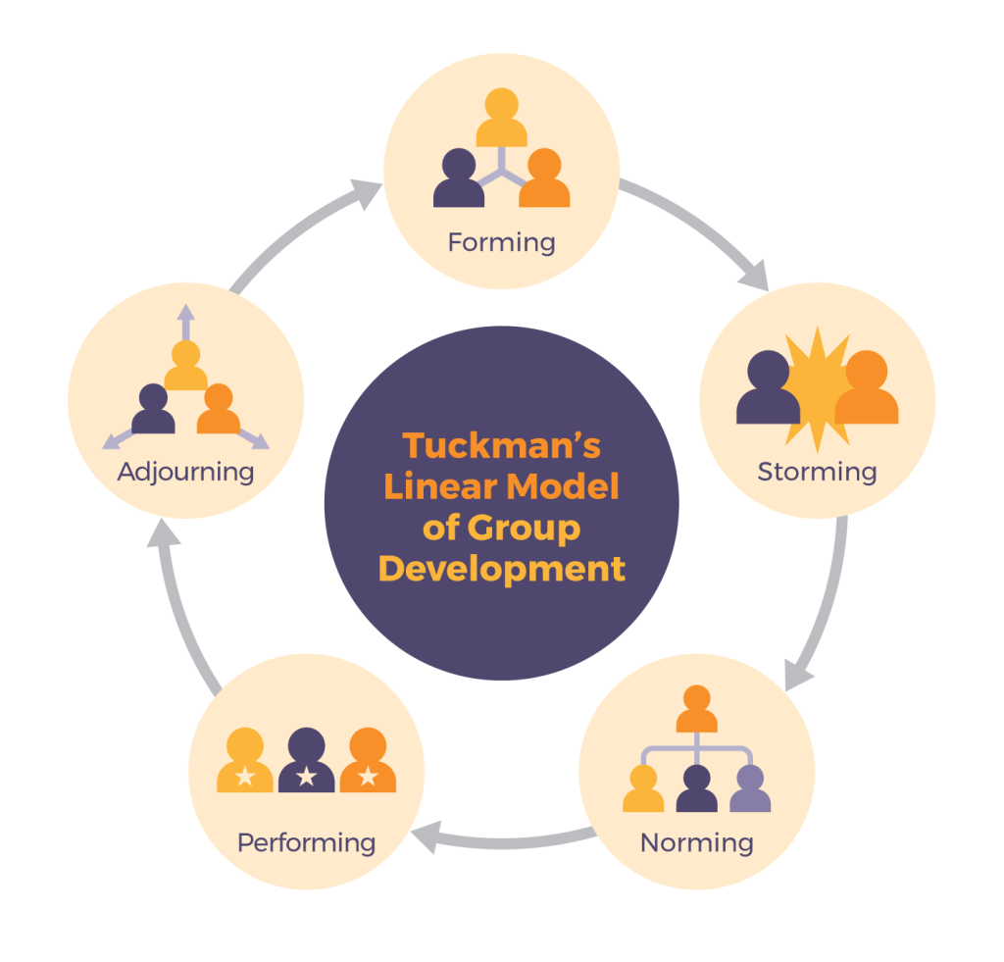
Group Stages According to Tuckman

Slide 10
Group Stages According to Tuckman
Forming up the group also called sizing up of a group. The members are getting to know each other; they have come together with common interest and have agreed to form a group.
Storming-there is a lot of uncertainty (storms) and things are not clear to the members. This stage is also called brainstorming stage, where members get to know each other and air their views openly and forcefully on the way forward.

Slide 11
Tuckman’s Stages …..
Norming
Performing
Termination

Slide 12
GERALD COREY’S GROUP STAGES
Stage 1: Pre – Group Stage
Formation of the group: this includes announcing the group and recruiting members.
Screening and selecting group members:
Choosing a meeting place
Determining the group size.
Determine the frequency and length of meetings
Determining whether the group is short or long term.

Slide 13
Factors to be Considered in the Formation of a Group
Group size: This will be determined by the size preferred, age, issues to be dealt with, leader’s experience and gender.
Meeting place: If it’s a room it should be safe, private, spacious, clean, well ventilated and accessible.
Total life of the group:. The recommended duration is between 16-20 weeks

Slide 14
Factors…….
Frequency and length of the meetings: How many times and how long the meetings will take place. There should be a specified period of time that one meeting should last.
The type of group being formed: Groups can be open, closed, voluntary, heterogeneous or homogeneous.
Goals of the groups: The purpose of the group needs to be clear to all members including the issues to be explored.
Follow ups and evaluation: Any follow-ups after the groups have been dissolved need to be clear to all members including the methods and purpose of the follow-ups.

Slide 15
Stage 2 – Initial Stage
The main undertaking in this stage is about orientation and exploration.
Characteristics of the stage
Participants test the atmosphere and get acquainted.
Members learn:
What is expected.
How the group functions.
How to participate in the group.

Slide 16
Stage 2…….
Members display socially acceptable behavior.
Members are concerned whether they are included or excluded and beginning defining their place in the group.
There is trust and/or mistrust.
There are period s of silence and awkwardness.

Slide 17
Members’ Functions
They should take an active step to create a trusting climate
They should learn to express their feelings and thoughts during interactions
Being willing to express fears, hopes, concerns, reservations and expectations.
Be willing to make oneself known to others.
Being involved in making group norms.
Establishing personal and specific goals that will govern group participation.
Learning basis of the group process.

Slide 18
Likely Problems in Stage 2
Members may wait passively for “something to happen”
Members may keep to themselves feelings of distrust and fears about the group.
Members may keep themselves vague and unknown making meaningful interaction difficult.
Members may slip into problem solving and advice – giving.

Slide 19

Stage 3 – Transition Stage
The main concern here in this stage is dealing with resistance.
Characteristics of the stage
Anxiety: there is increased anxiety and defensiveness. It comes from fears of letting others see yourself beyond your public image. It results from fear of being judged or misunderstood.
Conflict and struggle for control: struggle for power between members and the leader. Conflicts manifest in form of comments and criticisms, interference, rudeness, withdrawal, sabotage

Slide 20

Stage 3…..
Challenging the group leader: this could be on personal or professional grounds.
Resistance: this keeps member from exploring personal or painful issues in-deathly. It should be pointed out and dealt with.
Testing the leader and members to see whether they are accepting or not.

Slide 21

Members’ Function
Recognizing and expressing the range of feelings and thoughts.
Respecting one’s own struggles and continuing to explore them in the group.
Moving from dependent to independent.
Taking increased responsibility for what they are doing in the group.
Learning to confront self and others inconsistencies.
Being willing to work through conflicts rather than avoid them.

Slide 22
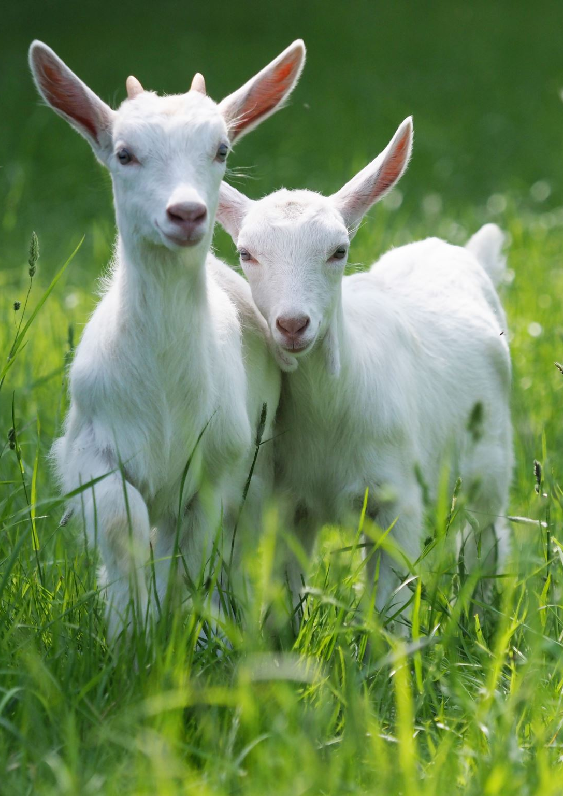
Problems that may arise
Members may start labeling each other e.g. “the problem type”.
Members may refuse to express persistent negative reactions among themselves, hence causing distractions.
If confrontations are poorly handled, members may retreat in defense postures.
Members may identify a scape–goat to project their own feelings.
Members may collude by forming subgroups and cliques to express their negative reactions which may interfere with interactions in the actual group.

Slide 23

Stage 4: Working Stage
This stage is about in-depth exploration of significant problems and effective action to bring about the desired behavior change.
There is commitment by members to the process.
Characteristics
Level of trust and cohesion is high
Communication is open and involves accurate expression of what is being expressed
Members interact with one another freely and directly
Willingness to risk making oneself know
Conflict among members is recognized and dealt with directly and effectively
Participants feel supported in their attempts to change
Members feel hopeful that they can change and are willing to takr action
Here and now focus

Slide 24
Members’ Function
Bring issues they feel they need to discus
Give others feedback and be open to receiving it
Share how they are affected by others presence and work
Practice new skills and behaviors
Continually assess their satisfaction in the group and take steps to improve where necessary
Problems that may arise
Members may not transfer change outside the group
Members may withdraw because of other members’ intensity

Slide 25

Therapeutic Factors in Stage 4
The following are specific factors that ensure that the group will move into productive work;
Trust and acceptance
Empathy and caring
Intimacy
Freedom to experiment
Catharsis – emotional relief of pent up feelings
Cognitive restructuring and hope

Slide 26
Therapeutic Factors
Commitment
Self disclosure
Confrontation;
How to confront
Must be based on respect for others
Used only if you want to get closer to the client and stay with them after confrontation
Differentiate between what may be a judgmental attack and a caring confrontation
When confronting addresses a person’s specific behavior that affects others and how and why it affects them
Encourage responsibility self behavior and not blame others

Slide 27

Give Feedback
How to give feedback
Global feedback is of little value – it should be specific
Concise feedback given in a clear and straight forward manner is helpful than interpretative statements
The feedback is rated as more desirable, influential etc when it focuses on one’s strengths
Different feedback must be timed well and given in a non - judgmental way
Corrective feedback seems to be credible and helpful when it is focused on observable behavior
Should have quality of “here and now” – immediacy

Slide 28

Stage 5: Consolidation and Termination
This is the concluding or the final stage of the group process
Characteristics
There may be sadness and anxiety over separation
Members are likely to pull back and participate in less intensity se ways in anticipation of termination
Members are determining what cause of action to take
Members may express their hopes and concerns for each other
Members may talk about follow – up meetings or some plan for accountability so that embers are encouraged to carry out their plans

Slide 29
Effective Ways of Terminating
Deal with feelings
Prepare members in advance
Examine effects of group n self
Giving and receiving feedback
Completing unfinished business

Slide 30
Stage 6: Post Group Issues, Evaluation and Follow – Up
It is a basic aspect of any group experience
Ethical practice requires a realistic assessment of the learning that has occurred
It should be a termination procedure but an ongoing process throughout life of a group
Assess if group ever achieved set goals
Examine if members learnt from each other
Pick any concerns for follow up

Slide 31
Relationship Between Group Stages According to Tuckman and Corey
Gerald Corey | Tuckman | Common features
Pre – group stage | Pre – group stage | Proposal Pre–group screening Recruitment Announcements Practicalities Misconceptions

Slide 32
Relationship between the two models
Initial stage: Orientation Exploration Initial resistance | Forming stage: Understanding the purpose of the group Getting to know other members of the group | Fear Trust building Hope Establishing some group ground rules and cohesion
Transition stage: Anxiety Defensiveness Transference Counter - transference | Storming stage: Uncertainty Competition Formation of cliques | Conflicts Struggle for control. Problem behaviors

Slide 33
Relationship between the two models
Working stage: Members are committed. Direct communication | Norming stage: Negotiation Mutual support Focus on the process. Performing stage: Interdependence Flexibility Not all groups reach this point | Solidification of group norms Collaboration productivity
Consolidation and Termination stage: Consolidation of learning Separation | Adjourning stage: Completion Disengagement Evaluation | Evaluation Clearing up unfinished business Separation Closure Termination

Slide 34
Conclusion
This lecture covered the definition of group formation, described Tuckman’s and Corey’s stages of group process and looked at the characteristics of group members at each stage. In our next lecture, we shall learn more about group facilitation.

Slide 35

References
Ezhumalai, S., Muralidhar, D., Dhanasekarapandian, R., & Nikketha, B. (2018). Group Interventions. Indian Journal of Psychiatry, 1(1), 60.
Leddick, G. R. (2010). The Oxford Handbook of Group Counseling. London: Oxford University.
Patterson, D. (2022). Strategic management: theory and practice of human resource professionals. New York: Press Books.
Turkman, B., & Jensen , M. (1977). stages of small group and organizational studies. London: SAGE.

