Slide 1

International Business Strategy
Lecture Three: Analyzing Foreign Environment
Lecturer: Githii. S.K

Slide 2
Introduction
In topic two we looked at foreign investment, theories that explain it, how, and why the government intervenes in it
In this topic we will delve into how business can do an analysis of the foreign markets that they may be interested in
The topic presents a systematic process of analyzing possible foreign environment or markets

Slide 3
Learning Outcomes
Understand the steps used in analyzing foreign environment or market
Be able to analyze a given environment/market

Slide 4
Screening Potential Foreign Environments or Markets
The exercise is time and resources consuming, and every firm undertaking this process will always be concerned with cost and results
The topic will use Wild, Wild, and Han (2010) framework that has four main steps

Slide 5
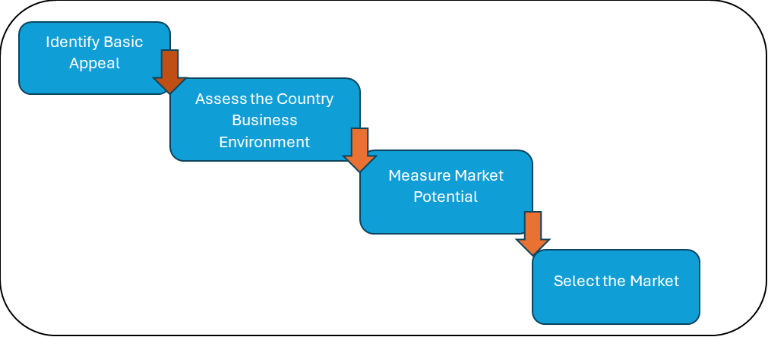
Analysis Steps

Slide 6


Identifying the Basic Appeal
Basic Demand for the company’s product
Is the product needed
Are there bans
This Photo by Unknown author is licensed under CC BY.

Slide 7
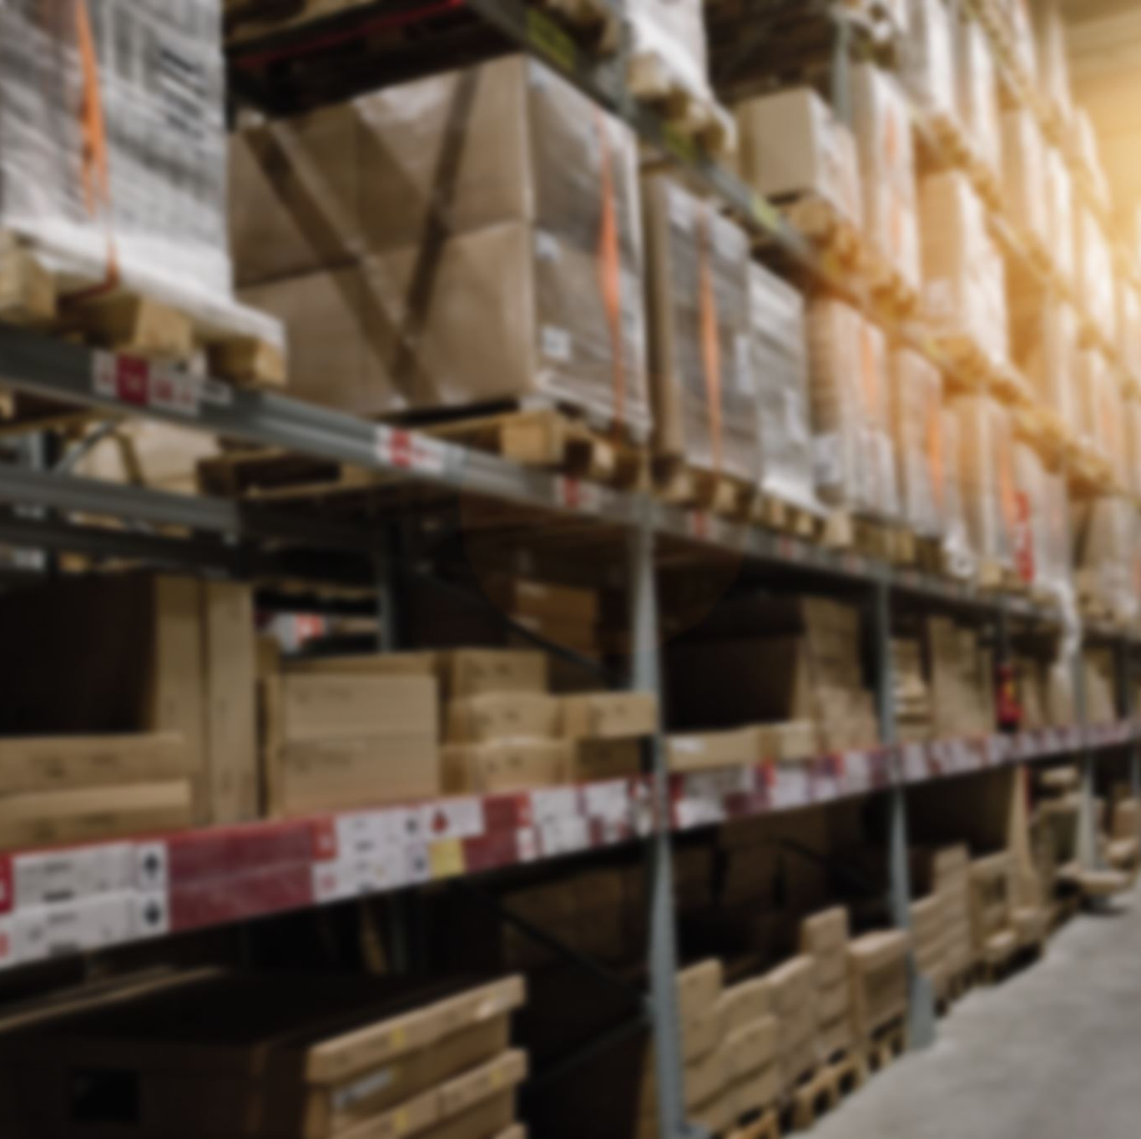
Basic Appeal
Resources Availability:
  Are raw materials available or will be imported?
  Is labor available?
  Is local financing available and at what cost?

Slide 8

Basic Appeal conclusion
Countries that fail on these two tests are struck from the list of options, those that are left can proceed to step two

Slide 9
2. Assess the Country’s Business Environment
Economies differ greatly when it comes to their environment for doing business
When assessing the attractiveness of a given country the following factors are worthy of consideration: Social-cultural forces, political and legal framework, economic and financial forces, technological factors
PESTEL Framework is common in analyzing business environments

Slide 10
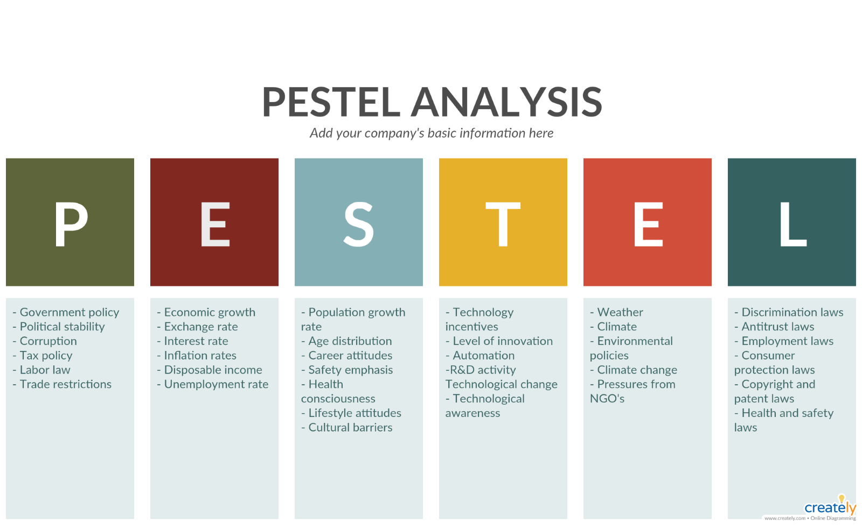
Source: douglasbaseball.com

Slide 11
Political
Under this variable, the concern is stability or lack of it
how smooth is power transition, the government attitude towards foreign businesses,
The extent of corruption,
The government bureaucracy,
Government relations with other countries,
Sanctions issued to the country or by the country

Slide 12

Political
For businesses investing in foreign countries, they are concerned about the political environment since it presents one of the risks that they must address

Slide 13

Political
In a country where the government of the day has a negative attitude towards foreign investment, corruption is high and there is red tape bureaucracy especially in starting a business, unless otherwise should be ranked low as an option

Slide 14

Economic Factors
economic growth,
exchange rate,
interest rate,
disposable income,
employment rate,
fiscal policies

Slide 15

Economic
Economic growth rate or cycle being witnessed in a country is likely to be replicated in business growth and therefore, a country that is experiencing a boom or bust may be ranked high in the list of choices

Slide 16

Economic
The interest in Africa by businesses from the north is largely because of the economic transformations its leadership is carrying out with the results being out there for all to see

Slide 17
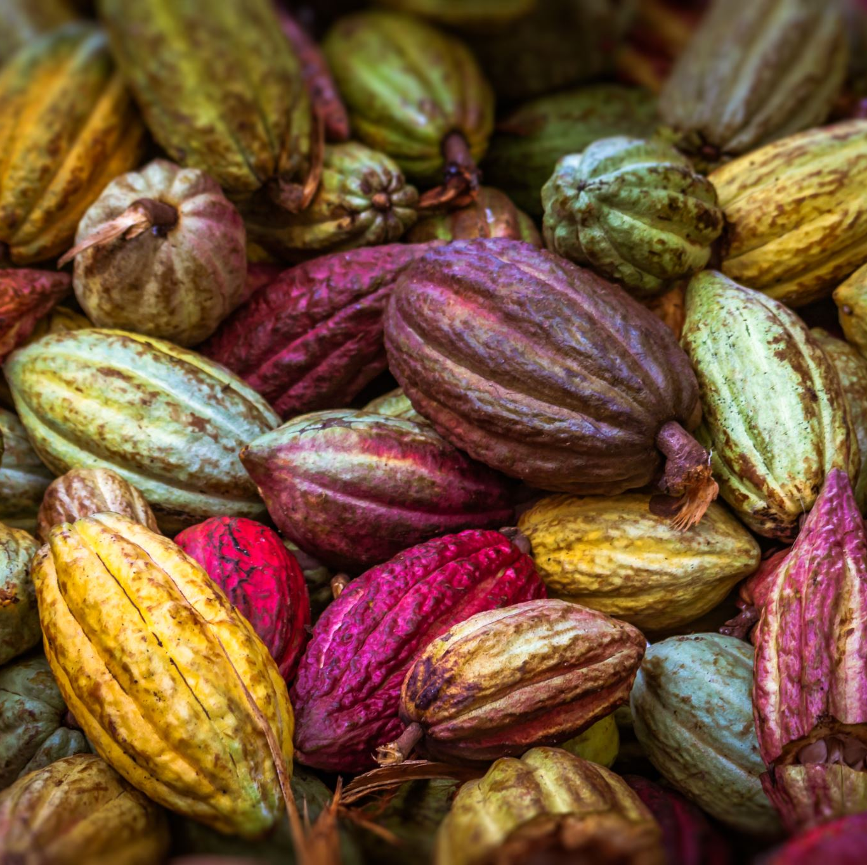
Economic
The Macroeconomic transformation in most of Africa’s countries is bearing fruit in attracting foreign investment coupled with a relatively stable political environment

Slide 18

Economic Factors conclusion
The ideal environment would be that which support the demand and growth of the form's product

Slide 19

Social Cultural Factors
These factors encompass:
Beliefs,
Norms,
Traditions,
Values,
Lifestyles,
Demographics
Behaviors among others

Slide 20



Social Cultural
The extent to which these factors are different from the home country of the firm will determine the extent to which the firm must adopt its products and marketing strategies as they venture in a new market

Slide 21

Social Cultural
Countries where health consciousness is high, products and marketing campaigns must mirror such if they are to be successful.

Slide 22
Conclusion on Social Cultural Factors
A firm would be better of where the culture of the new environment/market is not distant from it home market's
This will ensure minimal adjustments to its product and strategy

Slide 23

Technological Factors
Are there technological incentives in the country?
What is the level of innovation?
What is the population acceptance level when it comes to new technologies?
What is the country’s investment in research and development?

Slide 24

Conclusion on Technological Factors
A firm will be better off where the four questions are favorable or positive.

Slide 25
Environmental Factors
Eecological issues,
Climate change concerns,
Sustainability issues and
Environmental protection issues

Slide 26

Environmental
Different countries are at different levels as far as these issues are concerned

Slide 27

Conclusion on Environmental
When analyzing the business environment in respect to this factor, firms would be interested in a country where the government is supporting such efforts

Slide 28

Legal Factors
As mentioned earlier, this is a category that is highly connected to politics and tends to influence the economy of a country

Slide 29

Legal Factors
Laws,
Regulations,
Intellectual property protection,
Labor laws,
Taxation,
Trade policies governing business operation in a country

Slide 30

Legal Framework
The implication of explicit legal framework in a country is for the business community to have a predictable environment to operate in

Slide 31
3. Measure the Market Potential
Market size- this could be tied closely to the population size
Market growth rate- help to unearth those markets that are growing and those that are shrinking
Market intensity- this is concerned with the purchasing power of the population as shown in per capital GDP
Market Consumption capacity- this indicates the estimate spending capacity
Economic freedom- this try to gauge the extent to which free market tenets are upheld in a country
Country risk- this tries to gauge the combined risk of doing business in a country

Slide 32
4. Market Selection
How many competitors there are and their composition
Market share of each
The market they appeal
Quality focus of the competitors
The extent to which suppliers, distributors, and customers have been locked-in
Threat of substitute products
Threat of new entrants into the market
Competitors competitive advantage

Slide 33
Topic Review
In this topic we looked at the process of market/environment analysis,
identifying basic appeal,
assessing country’s business environment,
measuring market potential and we have concluded with market selection

Slide 34

Topic Review
Having settled on a market, the next topic will now be about strategy formulation where we will now start answering the how question

Slide 35

References
Collier, P. (2010, June 1). The case for investing in Africa. McKinsey & Company. https://www.mckinsey.com/featured-insights/middle-east-and-africa/the-case-for-investing-in-africa
Rankings. World Bank. (n.d.). https://archive.doingbusiness.org/en/rankings
Wild, J., Wild, K., & Han, J. (2010). International Business (5th ed.). Pearson Education, Inc.

