Slide 1

International Business Strategy
Lecture Seven: International Alliances
Lecturer: Githii S. K

Slide 2

Introduction
In our lecture six we talked about foreign direct investment
The question we have been trying to use in our previous topic is the same we will further in the current topic-HOW

Slide 3

Introduction
In this topic we look at strategic alliances by international business,
What they are,
The forms they take, and
Their management

Slide 4

Learning Outcomes
1
2
3
Define international alliances
Point out why partner selection is a crucial aspect of international alliances
Differentiate several management structures of international alliances

Slide 5
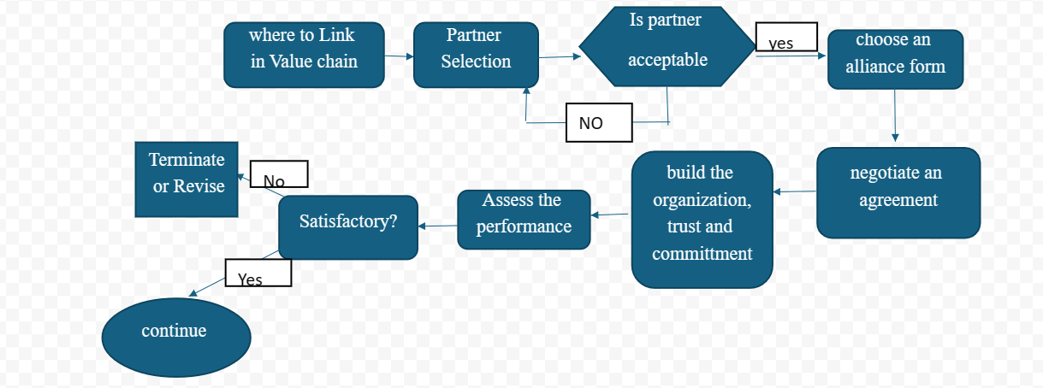
Topic Approach

Slide 6



Introduction
The starting point is in determining where you want the alliance to be in your value chain
As we will be able to see in the different forms of alliance, any point makes sense, but the firm must decide on this
The next sections we will look at other aspects of the framework pertaining to international alliance

Slide 7

Definition
An international alliance is a relationship between two or more entities from different countries who collaborate to achieve a mutual strategic goal.

Slide 8



Selecting a Partner for Alliance
SEEK STRATEGIC COMPLEMENTARITY: UNDERSTAND EACH OTHER’S STRATEGIC OBJECTIVES, WHERE THERE IS COMPLEMENTARITY, IT MAY WORK
SKILLS COMPLEMENTARITY:

Slide 9


Patner Selection.
Product complementarity: To avoid partnering with a direct competitor
Compatible management styles: Seek a firm that has similar or compatible leadership styles and philosophies
Mutual dependency: Go for a partner where contribution and dependency will be mutual

Slide 10


Selecting a Partner for Alliance
Sizes matters: It is encouraged to go for a partner who equals you in term of sizes
Cross cultural communication issues: proactively assess issues that may emanate from the fact that the partners could not be using the same language

Slide 11

Choosing the form of International Alliances
Informal international alliance- this is an agreement between two or more firms from different countries that is not legally binding

Slide 12
Form of Alliance
Formal international alliance- This is a non-equity partnership between two or more firms from different countries with a formal contract specifying what each partner must bring to the table

Slide 13

Form of Alliance
International joint venture- Here the two or more firms from different countries come together to form a separate International joint venture- a separate legal entity where they have the ownership positions or control

Slide 14

Managing International Alliances
Dominant parent: Where there is a clear majority contribution of resources, they tend to control or dominate decision making and their managers occupy the most important positions in the alliance

Slide 15

Managing I.A
Shared management: The parties to the alliance contribute about equally to the decision-making process, shown in managers' position spread and board of directors

Slide 16

Management of I.A
Split control: This is like shared management, although when it comes to the operational level, the partners share out based on their unique skills/strengths

Slide 17

Managing I.A
Independent management: In mature alliances which are separate entities, the partners may decide to recruit managers and employees from outside their firms and give them decision-making autonomy

Slide 18

Managing International Alliances
Rotating management: In this structure, managers from the partners rotate through the key positions on the management ladder

Slide 19


Commitment and Trust in International Alliance Management
We have mentioned not once, the importance of trust in alliance, indeed it is likened to the place of trust in marriage
Why Marriage?

Slide 20

Commitment
Commitment in alliance means that each partner is willing to take care of each other and to do all they can to make the alliance work

Slide 21

Trust
Trust on the other hand is the confidence and belief that the other partner has genuine intent and ability to meet their side of the bargain

Slide 22

Assessing the Performance of International Alliance
Remember, international business is getting into an alliance to attain a certain goal
How well that goal is being achieved must be assessed
Assessed to determine the way forward

Slide 23

Performance of I.A
It is therefore important that an evaluation of how well the alliance is achieving its objectives is done
Reflection

Slide 24

How to Measure Performance of I.A
Growth- sale
Expansion- market entry/portfolio
More competitive
Customer knowledge
Market knowledge

Slide 25

Advantages or drivers of I.A
Access to new markets- One of the major drivers for alliance is for a multinational to gain access to a market
Cost sharing- A serious advantage that partners in an alliance are likely to have been cost sharing in the investment that they are making

Slide 26

Advantanges of I.A
Tapping into competitor’s/partner’s strengths-
Gain access to partner’s distribution channels-

Slide 27

Advantages of I.A
Reduce or share risks- Venturing in foreign markets comes with its risk; financial, market, and political

Slide 28


Advantages or drivers of International Alliances
Access to new technology-
Possible economy of scale-

Slide 29



Topic Recap
It is one of the options that a multinational can use to enter a foreign market
In the topic we have looked at what international alliance is, different forms of it, partners selection, alliance management and we concluded by looking at the drivers or the advantages that may be derived from pursuing this strategy
In our next lecture we will look at the internationalization process, which will depict the process through which firms internationalize

Slide 30

References
Alliances. KPMG. (n.d.). https://kpmg.com/xx/en/home/about/alliances.html
Tesla Motors and Toyota Motor Corporation intend to work jointly on EV development, TMC to invest in Tesla. Tesla. (n.d.). https://www.tesla.com/blog/tesla-motors-and-toyota-motor-corporation-intend-work-jointly-ev-development-tm
Parboteeah. P, Cullen. J. (2011). Strategic International Management, 5th Edition South
-West Cengage Learning, Canada.

