Slide 1

International Business Strategy
Lecture Eight: Internationalization
Lecturer: Githii S.K

Slide 2

Introduction
In our week seven, we covered international alliances as part of the answer to HOW to enter a foreign market
In this lecture we will look at how businesses internationalize
We will look at internationalization approaches and models as well as ways in which SMEs can cheaply get contacts internationally

Slide 3
Learning Outcomes
Understand the process of internationalization
Differentiate models of internationalization
Propose some of the cheap strategies SMEs can use to get international contacts

Slide 4
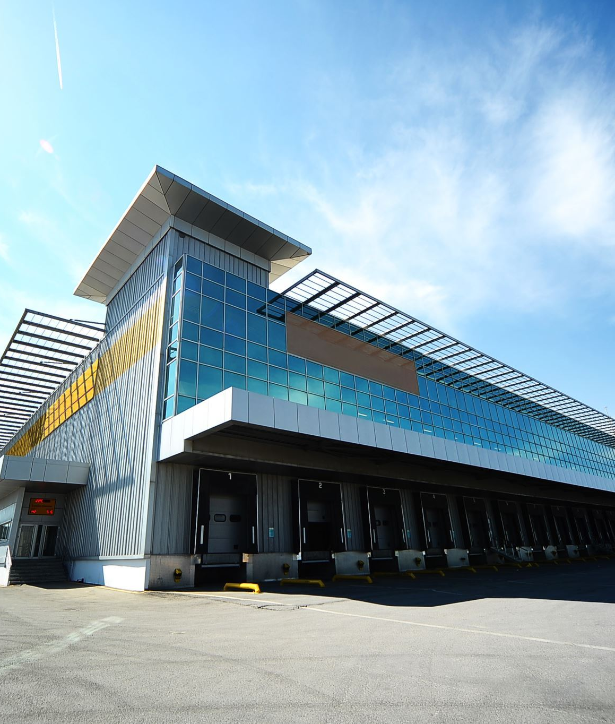
Small Businesses and their Significance
Definition of Small business as per United Nation quoted by Parboteeah and Cullen are those firms having less than 500 employees

Slide 5
Small Businesses and their Significance
World Bank SME Finance, noted that SMEs represent 90% of businesses and 50% of employment worldwide

Slide 6
Small Businesses and their Significance
This lecture will investigate some of these as well as show how basic entrepreneurial strategies can help SMEs in taking their products or services into the global marketplace

Slide 7

Internationalization of SMEs
The term internationalization in our context means the process through which a business increases its activities outside its country of origin

Slide 8
Internationalization of SMEs
According to Parboteeah and Cullen , SMEs have two main broad approach to go international

Slide 9

Incremental Approach
Stage 1: Passive exporting- The SME only fulfills the orders it is receiving from foreign customers
Stage 2: Export management- Export is seen as an opportunity and a designated person is assigned the role

Slide 10
Incremental Approach
Stage 3: Export department- There is significant resources dedicated to export and need to increase it
Stage 4: Sales branches- The increased and often high demand for the SME’s products in the foreign market justifies the establishment of a local sales office

Slide 11
Incremental Approach
Stage 5: Production abroad-The SME establishes local production unit to allow adaptation or efficiency
Stage 6: The Transnational: Here the SMEs establish themselves in more than one region adapting to the local needs

Slide 12

Born Global
In a few instances a firm may develop a product that has demand internationally, therefore requiring it to go global immediately or rapidly
Such firms are referred to as global start-ups or born global firms

Slide 13
Born Global
It works where the owners or managers have high international market knowledge mostly because they could have worked with a multinational

Slide 14

Internationalization Models
Uppsala-Model - The model was proposed by Johanson and Vahlne in 1970s

Slide 15
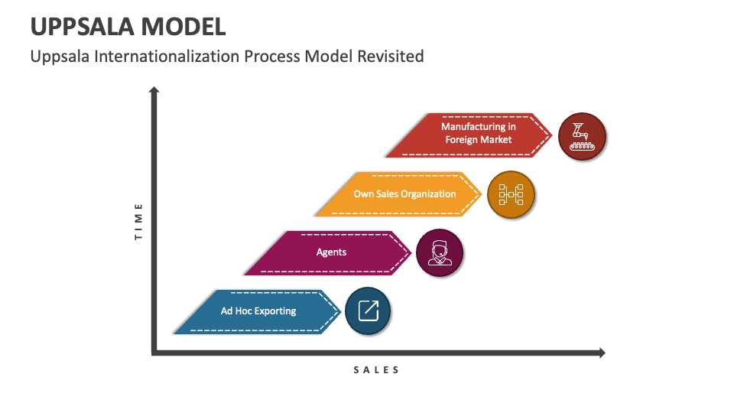

Slide 16
Internationalization Models
Network Model- The model puts emphasis on the power of networks and relationships in international business

Slide 17
Internationalization Models
Born Global Model- In a few instances a firm may develop a product that has demand internationally, therefore requiring it to go global immediately or rapidly.
Common in technology industry

Slide 18
How can SMEs develop Global Culture
Have managers/employees or founders who have international experience
Overcome the perceived psychological distance between home and foreign markets

Slide 19
How can SMEs develop Global Culture
Managers who are risk takers
Having employees who have the right attitude toward international strategies and markets

Slide 20
When should a SME go International?
Do we have a global or service?
Do we have the managerial, organizational, and financial resources to internationalize?

Slide 21
When should a SME go International?
Are we willing to commit our resources to internationalization?
Is there a country where we feel comfortable doing business?

Slide 22
When should a SME go International?
Do we have a unique product that the big firms may not easily copy?
Can we afford to be multinational?

Slide 23

SMEs customers contact techniques
Trade shows: Both national and international trade shows present an inexpensive way to get in contact with potential customers and business partners

Slide 24
SMEs customers contact techniques
Catalog expositions: These are mostly done by embassies and consulates
International advertising agencies: Firms can also get in touch with agencies that are involved in international advertising who may specialize in certain products or markets

Slide 25
SMEs customers contact techniques
Government sponsored trade missions: As we discussed in an earlier lecture, governments are at time interested in encouraging export from their countries, to achieve this they may promote local business or products through sponsoring trade missions in potential foreign countries

Slide 26
SMEs customers contact techniques
Direct contact: Though not easy or cheap, a local firm could reach out directly to a potential alliance partner, distributor or customer

Slide 27
SMEs customers contact techniques
Web pages and electronic commerce: In the current age and with technology, firms can utilize their webpage as well as social media to reach out to potential customers, funders, and partners

Slide 28
Entry Wedge for SMEs in a new Market
First mover advantage: Here the SME seeks to be the first one to introduce a new product or service in the market
A wedge is a strategic competitive advantage that helps a business to break through an established market.

Slide 29
Entry Wedge for SMEs in a new Market
Technological or innovation leadership: The SME is the first one to introduce a new technology
Copycat businesses: The me-too strategy can work in varying product or services

Slide 30
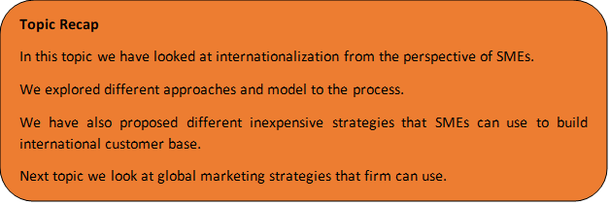
Topic Recap

Slide 31

References
Parboteeah. P, Cullen. J. (2011). Strategic International Management, 5th Edition South-West Cengage Learning, Canada.
World Bank SME Finance. (n.d.). World Bank. https://www.worldbank.org/en/topic/smefinance
Accessed on 01/05/2024.
Roque, Ana & Alves, Maria do Céu & Raposo, Mario. (2019). Internationalization Strategies
Revisited: Main Models and Approaches. IBIMA Business Review. 1-10.
10.5171/2019.681383.

