Slide 1

International Business Strategy
Lecture 11: International Competitive Advantage
Lecturer: Githii S.K

Slide 2

Introduction
In week 10 we looked at the global supply chain, where we explore what it is, how it differs from domestic and the key players
In this week, we will handle international competitive advantage from a national/country and a company perspective

Slide 3

Learning Outcomes
Understand the concept of competitive advantage
Differentiate between international, national, and company competitive advantage
Analyze factors contributing to competitive advantage at both levels

Slide 4
International Competitive Advantage
This is what makes a firm, its products or services, more preferred by consumers than its opponents
It comprises of attributes that allow a firm to outperform its competitors
These attributes would allow a firm to charge higher prices and/or be more acceptable in the marketplace
If a firm has an international competitive advantage, it will find it easy to enter different markets and perform in those markets as well
In the next section we will look at national competitive advantages before looking at how firms could achieve international competitive advantage

Slide 5

National Competitive Advantage
In 1990s, Michale Porter in trying to explain why some countries are leaders or do better in production of certain products developed national competitive advantage theory
The theory posits that a country’s competitiveness in an industry is dependent on the industry’s ability to innovate and upgrade

Slide 6
National Competitive Advantage
He pointed out that there are four elements that are present in any country that is competitive usually called Porter’s Diamond
Resources such as labor, natural resources, and climate are important in what a country will produce and export, but Porter went further to note that advanced factors are even more critical

Slide 7

National Competitive Advantage
The advanced factors include the skills levels of the workforce and the quality of the technological infrastructure in a country
Sustainable advantage is gained through advanced factors
A country can develop advanced factors through deliberate measures and investments,
It is important to note where factor conditions exist, they attract foreign investment, and more businesses are likely to flock in to enjoy such a business environment

Slide 8

Demand Conditions
The caliber of consumer in the home market is equally important in driving innovation among the companies operating in such markets
A country where consumers are sophisticated, they put pressure on firms to innovate and design new features
This helps to establish the country as competitive in such a sector compared with other nations

Slide 9

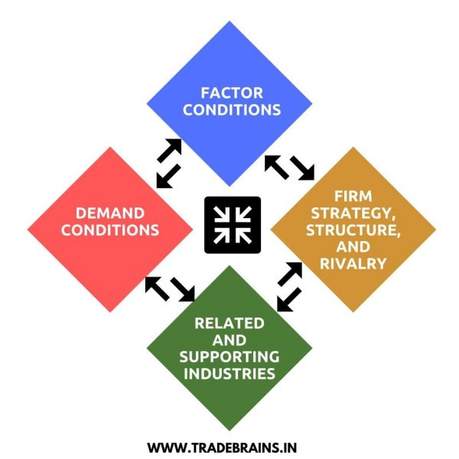
Porter’s Diamond

Slide 10
Related and Supporting Industries
For companies to have international competitive advantage, they cannot do it alone, they will need supporting industries to provide inputs required by the industry
This happens around the same geographic area, where firms dealing in related products or services are located
A cluster is a geographic concentration of related firms in a particular sector or field

Slide 11

Industries Clusters in U.S
A cluster may include suppliers, providers of specialized skills, universities, colleges, government agencies, trade associations among others
Some good examples would be Silicon Valley with technologies related industries, Wallstreet with finance, Japan with consumer electronics, and Hollywood with entertainment industries
The issue of cluster points to the fact that what happens in the immediate business environment is vital to determining a firm’s competitiveness

Slide 12
Industries Clusters in U.S
The clusters in a country or state, usually account for a major share of regional economic activity as well as what is exported from that state or area
Cluster boosts both cooperation and competition, which are both vital for success of a cluster

Slide 13

Industries Clusters
Though competitive advantage driven by location has been questioned in the wake of possible global sourcing with just a click of a button, we continue to witness clusters across the globe
In Italy we have the fashion industry, in California we have the Wine cluster, a testament to the competitiveness that location could give to a firm

Slide 14

Firm’s strategy, Structure and Rivalry
Important to the spirit of competitiveness both at the national and international levels is the strategies that the firm has adopted to compete as well as the caliber of management in the very firm
In addition, the level of competition in each industry or country will determine competitiveness
In an industry or country where the rivalry is high it means the struggle to survive is intense

Slide 15

Government and Chance
Government can increase competition in their territory through actions such as privatization or licensing more foreign firms to venture in the local market
Chance such as an outbreak of a diseases or phenomenon could also work for an industry and change their competitiveness

Slide 16
Government and Chance
Global happenings such as the September 11th bombing of the twin towers in the US brought immediate need for security infrastructures and this changed so many industries including insurance

Slide 17

How Firms can Achieve International Competitive Advantage
Besides the need to a have national factors for a firm to achieve competitiveness, there are strategies and approaches that businesses can use to be competitive in the international arena

Slide 18

1.Quality Management
There are firms that have continued to be leaders in their industry through quality management or differentiation
Such companies are always pursuing high quality standards for their customers

Slide 19

2. Innovation
Through research and development, a firm can seek to be the leader in innovation
Having new and better products or features could set you apart from your peers
This is the case with Apple Inc., which is always leading in innovation in its markets

Slide 20
3. Cost leadership
In our earlier lecture we said that seeking to be the leader of low-cost production could as well put you ahead of your peers
This could indeed give a firm an international competitive advantage if it manages to produce at the least cost possible
Toyota has over the years managed to keep its production efficiency

Slide 21
4.Market expansion
Where a firm can achieve consistent growth in its markets, it will be building power to fight off competition
It is therefore possible for a firm to be competitive internationally due to the mere fact that it has the widest reach across the globe
The number of countries an airline flies to is always a bragging point when they are marketing themselves

Slide 22

5. Partnership and Alliances
It is possible for a firm to gain international competitiveness through joining hands with other firms that complements its resources and capabilities
This signifies that a firm need not have everything, but linking up with strategic partners could elevate its competitiveness in the industry
Airlines are known for route/code sharing

Slide 23
6. Local adaptation
If a firm masters local market adaptation better than its competitors in the respective markets that it operates in, then it might be way apart from its rivals
Though this may be expensive, it will give firm mileage in weeding out competition
Unilever, which has hundreds of products, is one such company that has mastered the art of localization and you are therefore likely to find it in most homes across many countries

Slide 24

7. Effective supply chain management
A firm that can manage its supply chain will be in a better position to compete in the global arena
Walmart is known as one store that has stayed ahead because it efficiently manages its supply chain

Slide 25
7. Top notch competitive intelligence
For a firm to stay ahead of its competitors it must have a way to gather and decipher intelligence from the environment
You must be proactive about the changes that are likely to hit the industry, changes likely to come from the consumers, government and the likes
This failure is what saw Kodak go down, and this capability is what has kept companies such as Apple and Samsung alive

Slide 26
8. Sustainable environmental, social & governance
In today’s business environment, every stakeholder is concerned about how the business operations are affecting society and the environment
Transparency of firm's operations is becoming a concern not just for the government but also consumers and other stakeholders
Therefore, firms must chart a path that is sustainable as far as these issues are concerned

Slide 27

Frameworks to Evaluate Competitive Advantages
There exist several frameworks that firms can use to evaluate their competitive advantage
In the next section we will briefly look at the five forces and VRIO framework

Slide 28

VRIO Framework
This is an acronym for Value, Rarity, Imitability and Organization

Slide 29

VRIO Framework Questions
Does competitive advantage add value to the firm and customers?
Is the competitive advantage rare?
Is the competitive advantage difficult to copy or imitate?
Is our firm ready or organized to exploit this advantage?

Slide 30

Porter’s Five Forces
Threat of new entrants: This can either be high or low
Bargaining Power of Suppliers: If a firm is so dependent on a single supplier of raw materials or key components, the supplier will be powerful thereby diminishing your power and competitiveness

Slide 31
Porter’s Five Forces
Bargaining Power of Buyers: Where there are availability alternative products to your products, the buyer will have higher bargaining power, and this is not good for a business
Threat of Substitutes: This is usually high where brand loyalty is absent or low and consumers are price sensitive
Industry Rivalry: This denotes the fight for market share and being number one in the industry

Slide 32
Topic Recap
We have looked at what competitive advantage is both at the national and international levels
We have also looked at Porter’s Diamond that gives the necessary ingredient for a country to be competitive as compared to others
We have explored different strategies that a firm can use to gain international advantage and we have concluded by looking at two frameworks that can be used to assess a firm's competitiveness
In the next topic we will explore some of the emerging trends in international business

Slide 33
References
Wild, J., Wild, K., & Han, J. (2010). International Business (5th ed.). Pearson Education, Inc.

