Slide 1

International Business Strategy
Week 13: Globalization versus Glocalization
Lecturer: Githii S.K

Slide 2

Introduction
In lecture 12, we looked at the current trends in international business, their impact on competitive advantage, and possible strategies to swim in such a highly dynamic environment
In this lecture we will look at two opposing phenomena that are being witnessed at the same time- globalization and glocalization

Slide 3

Learning Outcomes
Differentiate globalization from glocalization
Participate in the debate about globalization and glocalization

Slide 4

Globalization
The concept represents the falling trade barriers resulting to growth of world trade
Money , people and goods are now flowing more freely across national borders than before, and investors are now having wider choice of where to invest as the options span the whole globe
The result of this is the fact that the world’s economies are borderless and more interlinked than ever before
In this section we will look at the drivers, benefits and counter arguments of globalization

Slide 5

Drivers of Globalization
The factors behind globalization are many and can be categorized into the following headings

Slide 6

Economic Policies
Over the years we have seen enactment of policies that are friendly to international trade be it at treaties level or regional blocs
The World Trade Organization and other agencies have successfully been able to reduce trade barriers through negotiation to eliminate or reduce such things as quotas and tariffs
The trade pact between Africa and the US was enacted in 2000 and has helped to bolster economic growth in 38 countries that are party to this

Slide 7

Globalization Drivers

Slide 8
1.Technology Advancement
Growth in use and penetration of Internet and mobile technology has had serious impact in reducing cost of doing business, communication, and information exchange
Equally, transportation has benefited from technological advancement, it is now cheaper and faster to move goods from one corner of the globe to the other

Slide 9
2. Shifting Political Perspective
We have seen a shift from the traditional mindset where rulers were against economic liberation
Today, even those countries that were pursuing socialist and communist economies have all opened their economies to the outside world
This shift has boosted international trade

Slide 10
3. Growth of the role of media
This has allowed cultural exchange and understanding of other cultures, so we have a global culture
Growth of such network as Netflix, Sports like English premier league, world cup, and music are all contributing to unite us into a global culture
For instance, you are likely to find a supporter of Manchester United or any other team from different corners of the world

Slide 11
4. Demand driver
With the growth of global culture there is growing global consumer who are demanding similar products and services irrespective of their cultural differences
The taste and preferences of these consumers are converging and pushing businesses to develop global products

Slide 12

5. Global supply chain
As business seek optimization and efficiency, they are finding themselves increasingly source materials from outside their home country
This is due to the availability of cheaper alternative sourcing coupled with cheaper transportation

Slide 13

6.Migration
People movement across borders for such reasons as education, work, tourism as well as refuge is high
As people move firms have found it fit to follow them as their customers

Slide 14

7. Global challenges
Whenever there is a pandemic or disaster of great magnitude, it somewhat ends up uniting different nations
The US 9/11 terrorist attack, and COVID-19 pandemic united economies as they sort solutions to the problem at hand
These events saw countries put aside their differences and work together

Slide 15
8. Global standards
We have also witnessed the rise of global standards for quality and production and even in different sectors
The International Organization for Standards is a testament to this
Accountants have their version- International Financial Reporting Standards , International Accounting Standards , and General Accepted Accounting Principles

Slide 16
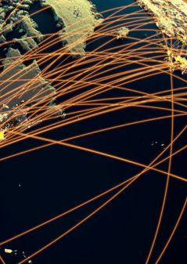
Benefits of Globalization
The opening up of economies and the resulting increased international trade is probably with more benefits than demerits
The benefits illustrate how globalization can contribute to economic prosperity, cultural enrichment, and improved quality of life on a global scale
In this section we explore some of the benefits resulting from globalization phenomenon
This Photo by Unknown author is licensed under CC BY-ND.

Slide 17
Lower Prices
Due to heightened competition and wider array of choices that consumers and firm can choose from there is tendency to have price come down or remain competitive

Slide 18

2. Higher quality
The fact that the options are enhanced and beyond the national boundaries, firms are left with no choice but to improve their product quality as they are not the only producer of a commodity

Slide 19

3. Access to raw materials
firms are now able to access raw materials that would have been difficult to get before economies opened or would have been expensive to do so

Slide 20

4. Labor mobility and job creation
Now firms can source or produce from anywhere in the world, this has seen people move to where there is work and the creation of jobs in economies where there are other factors of production

Slide 21

5. Economic development and growth
This is especially being witnessed by emerging markets and developing countries who for a long time have been sidelined from international trade

Slide 22

6. Technology access
globalization allows firms and people from least developed economies access advanced technologies improving their production and efficiency

Slide 23
7. Widened consumer choice
Through goods mobility consumers are accorded a wider choice as they can source from anywhere on the globe through possibilities created via electronic commerce

Slide 24

8. Cultural exchange
Globalization has allowed different cultures to interact and learn from each other

Slide 25
9.Poverty reduction
As least developed countries take part in international trade and their economies improve, living standards of their inhabitants are improved in the process

Slide 26

10. Global peace
THROUGH TRADE PEACE IS PERPETUATED

Slide 27

11. Enhanced connectivity and communication
Globalization and the need to do so has increased connectivity and communication of humanity as well as that of businesses

Slide 28

Counter- argument for globalization
While it is evident that there are various ways in which we benefit from globalization, it is not without some worrisome effects

Slide 29
Economic inequality
Globalization is criticized for continued widening of economic gaps between the poor and rich countries
Critics say that it the wealthier countries and individual will continue to grow rich while the poor will continue being poor

Slide 30

2. Environmental degradation
As population grows and demand increases, production must match this
The result is over production and exploitation of our natural resources without limits, and this can be connected to deforestation and climate change we are witnessing today

Slide 31

3. Intellectual property issues
Global trade has been connected to the increased theft of intellectual property rights
Since there are global consumers, it is becoming attractive to infringe on property rights
Companies such as Microsoft have been losing a lot of money due to piracy of its software across developing countries

Slide 32

4. Local industries victimization
Whenever economies open, it is possible that local small industries may not have financial muscles to wade or compete with big multinationals
Without government interventions such firms may have to fold, local suppliers and populations working in those firms will be affected negatively

Slide 33
5. Health risk
globalization aspects such as international travel has been blamed for making the spread of diseases possible and faster
This can be exemplified by how COVID managed to spread across all countries from China

Slide 34

6. Financial risk
Due to the interconnectedness of economies due to trade ties any financial shock in one country is likely to be felt in the other trade partners

Slide 35

7. National sovereignty loss
Largely, in a country where multinationals are controlling the market possibility of them extending the wish of their home government cannot be ruled out
This is possible due to dependencies that develop

Slide 36

8. Labor exploitation
There is always concern that the pressure to reduce cost tend to push firms to outsource or source labor and raw materials from countries where people are paid very low wages and poor working conditions and at times without adhering to human rights

Slide 37
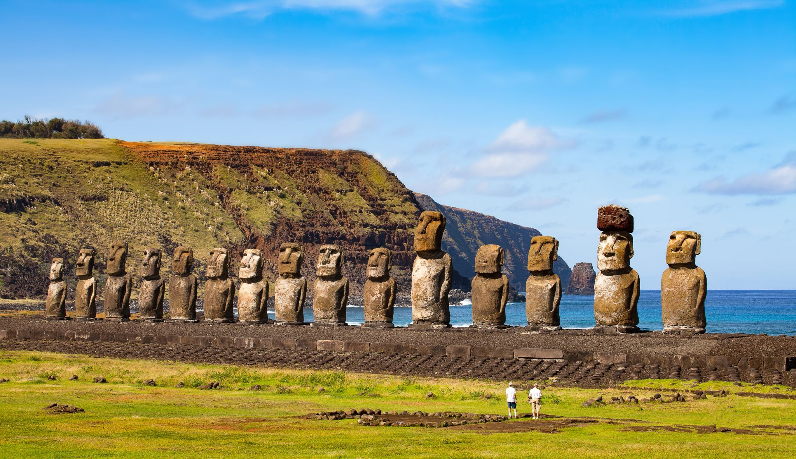
9. Loss of culture heritage
As people travel and migrate, as media allow culture sharing and interaction, as goods permeate through national boundaries, cultural heritage of some countries are at risk
Some governments are concerned about this and as a result they may be apprehensive for foreigners to invest in some sector or industries

Slide 38
Glocalization
This is a term that combines both globalization and localization
It emphasizes the need for a balance between globalization efficiency and local responsiveness enabling firms to thrive in a very volatile and competitive environment
It blends both the global and local strategies
Next section we look at the drivers for glocalization

Slide 39

Cultural sensitivity
The need to deliver products or services that resonate with the cultural specificity is driving firms to adopt their global products
Recall McDonald adopting their burger to have chicken burger when they ventured into the Indian market, that is an example of the need to be sensitive to the cultural differences

Slide 40
Regulatory differences
At times countries may have peculiar requirements, and this may force multinationals to adapt their products to align with the legal requirements
Access to such markets may be denied if the regulations are not met

Slide 41
Data analytics
The advancement in this field can now enable a firm to gather and analyze vast information and draw insights that will enable them to localize their product without much cost implications

Slide 42
Competitive Edge
Firms are also trying to differentiate themselves from the pack by localizing their products or services
Unilever gained acceptance in different markets because they can resonate with the locals

Slide 43

Agile supply chain
In the advent of COVID-19 pandemic, firms have entertained the thought of having local sourcing of raw materials if production is to be sustainable in the event of such global pandemic

Slide 44

Topic Recap
In this topic we have looked at the concept of globalization and how this differs from glocalization
We have looked at both sides of globalization by identifying its benefits and counter arguments
We have concluded by pointing out some of the drivers of glocalization

