Slide 1
VISUAL COMMUNICATION
WEEK 1 Introduction to Visual Communication via Digital Desktop Publishing and the course overview
By Dr. Raphael Ogutu

Slide 2
VISUAL COMMUNICATION
Introduction to visual communication
Intended Learning Outcome
At end of this week lesson the students should briefly:
Show an understanding of visual communication
Explain the how media are used in the creation of visual imaging
Critique and apply the principles and elements of graphic design in publication and digital design
Critique and effectively communicate using typography, graphics, and photography in print and digital publications.
Critique and Design with colour in print and digital publications.

Slide 3
Introduction to visual communication
This course introduces students to the process of using a computer and specialized software to create visual documents for print or digital media.
Visual Communication via Desktop publishing (DTP) is the process of using a computer and specialized software to create and layout documents for print or digital media.
This can include books, brochures, magazines, newspapers, and other types of publications in print and digital media.
Digital DTP software provides tools for creating and editing text, graphics, and other elements, as well as for controlling page layout and typography.
The output can be sent directly to a printer or saved in a digital format, such as a PDF, for distribution and viewing on electronic devices.

Slide 4

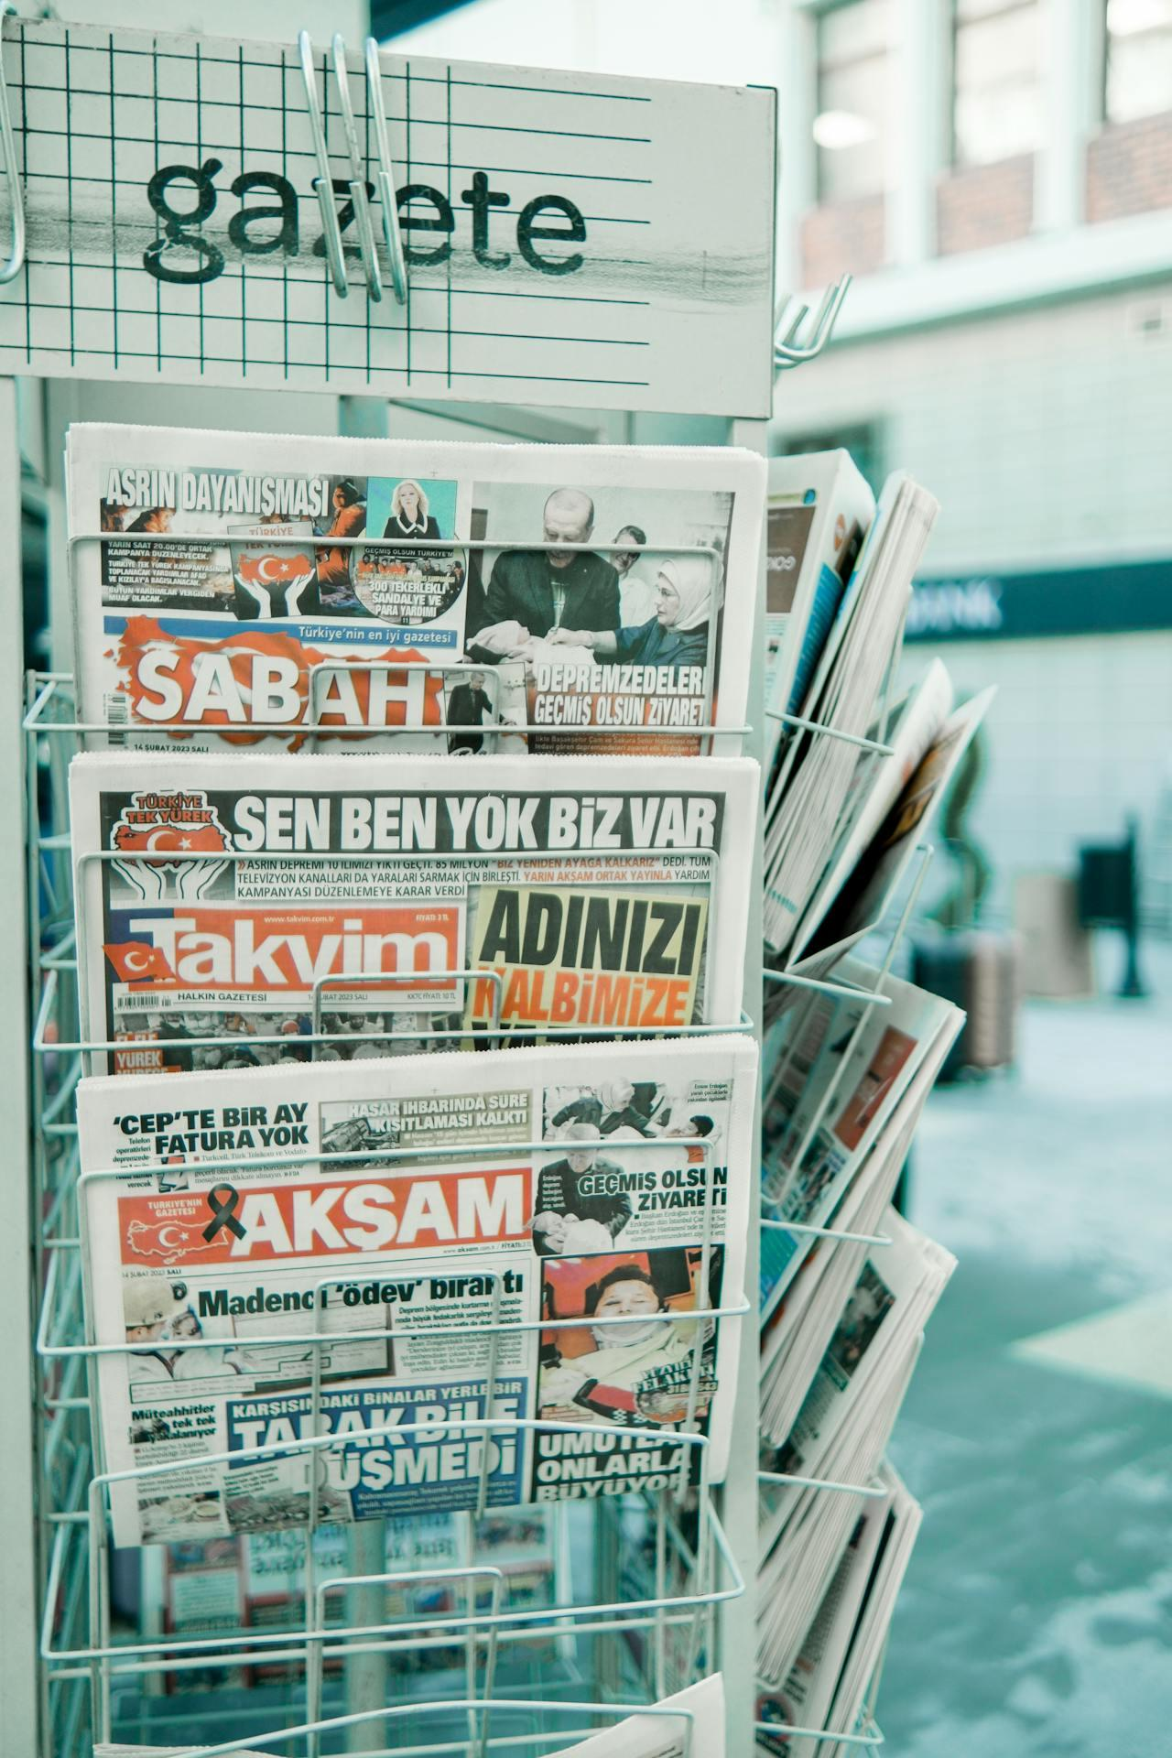
Digital and print media
Sources: https://www.pexels.com/photo/crop-unrecognizable-person-reading-documents-and-working-on-laptop-7128963/
https://www.pexels.com/photo/close-up-of-stand-with-newspapers-on-street-15686356/

Slide 5
What is communication?
Latin is communicare, which means to share, or to make common-the process of understanding and sharing meaning
is the process of exchanging information, ideas, thoughts, or feelings between individuals or groups.
requires encoding messages in a way that the intended audience can understand, transmitting them through appropriate channels, and decoding them accurately by the receiver.
essential for human interaction, social relationships, collaboration, decision-making, problem-solving, and the functioning of organizations and societies as a whole.

Slide 6
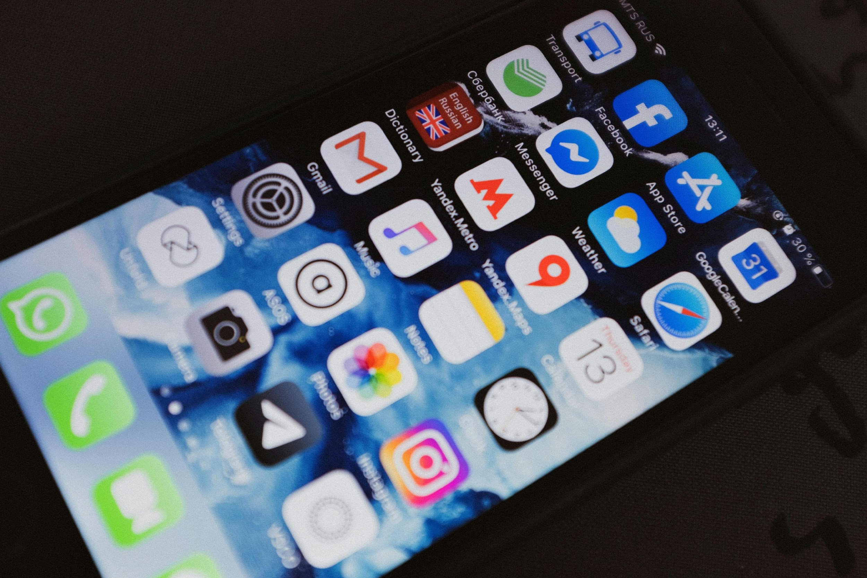


Sources: https://www.pexels.com/photo/two-women-holding-pen-601170/ https://www.pexels.com/photo/black-iphone-4-turned-on-displaying-icons-3850262/ https://www.pexels.com/photo/photograph-of-men-having-conversation-seating-on-chair-1015568/

Slide 7
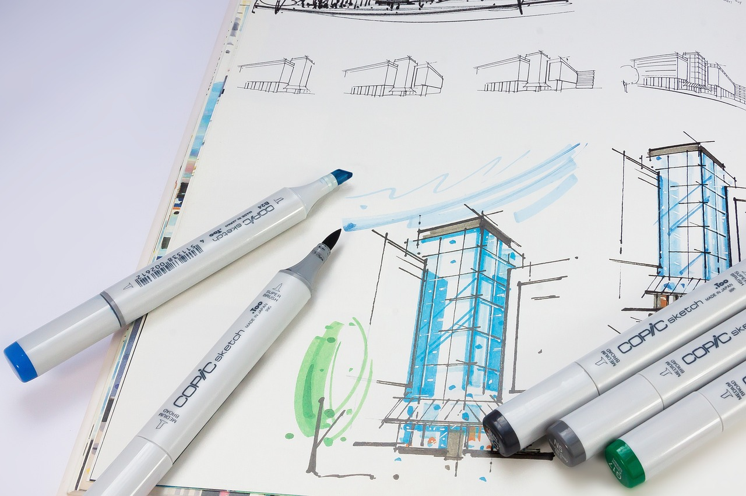

Introduction to visual communication
COURSE OVERVIEW
WEEK 1 Introduction to Visual Communication via Digital Desktop Publishing and the course overview
WEEK 2 Design Elements and Principles
WEEK 3 Typography Principles
WEEK 4 Advanced Typography Principles
Sources: https://pixabay.com/photos/communication-workplace-imac-2805785/ https://pixabay.com/photos/sketchbook-sketch-marker-455698/

Slide 8
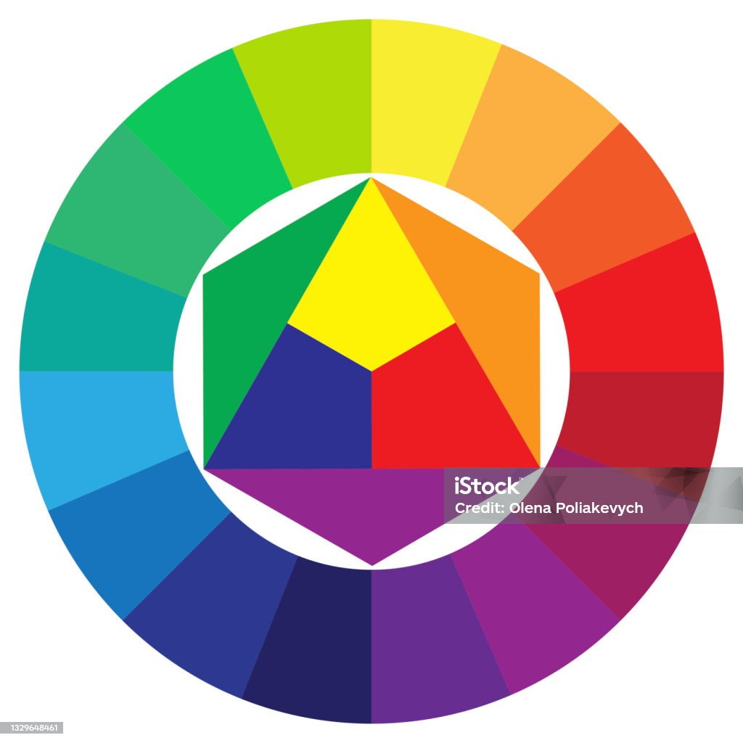

Introduction to visual communication
COURSE OVERVIEW
WEEK 5 Communicating with colour
WEEK 6 Mid-term quiz (Objective or Multiple choice)
WEEK7 Designing with Images (Photography and drawings)
WEEK8 Layout and Business Publications
WEEK 9 Cartoons, video and film
WEEK 10 Creating Publications using Ms. Publisher
Sources: https://www.istockphoto.com/vector/color-palette-on-white-background-graphic-color-background-circle-triangle-vector-gm1329648461-413308867
https://www.pexels.com/photo/trendy-sunglasses-reflecting-neon-light-sign-in-dark-room-4550249/

Slide 9
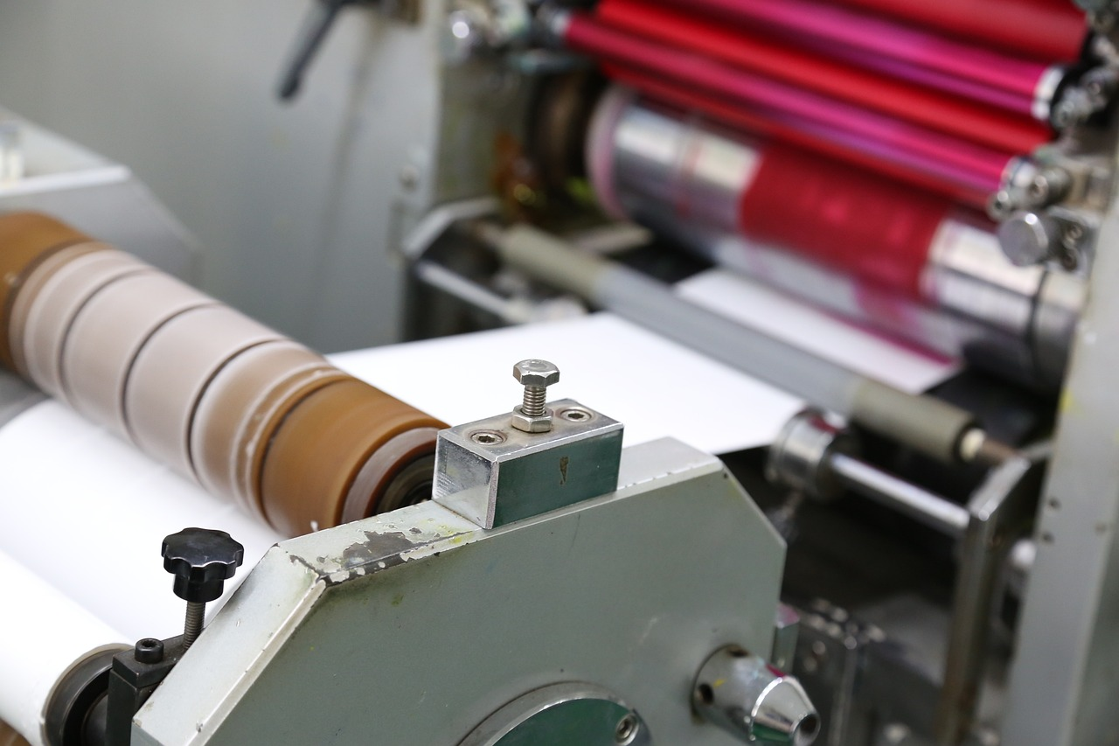

Introduction to visual communication
COURSE OVERVIEW
WEEK11 Creating Publications using Adobe InDesign, Illustrator and Photoshop
WEEK 12 Publication Printing techniques
WEEK 13 Publication Binding Techniques
WEEK 14 MAIN EXAM - 60% (Multiple choice and practical projects, subjective or Essay)
Sources: https://pixabay.com/photos/offset-printing-macine-3634411/
https://pixabay.com/photos/spiral-binding-multicoloured-610196/

Slide 10
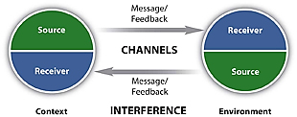
Eight Essential Components of Communication
Source: https://open.lib.umn.edu/businesscommunication/chapter/1-2-what-is-communication/

Slide 11
Eight Essential Components of Communication
Source: The source imagines, creates, and sends the message.
Message: “The message is the stimulus or meaning produced by the source for the receiver or audience.”
Channel: “The channel is the way in which a message or messages travel between source and receiver.”
Receiver: “The receiver receives the message from the source, analyzing and interpreting the message in ways both intended and unintended by the source.”
(McLean, 2005)

Slide 12
Eight Essential Components of Communication
Feedback: When you respond to the source, intentionally or unintentionally (verbal or nonverbal), you are giving feedback.
Environment: “The environment is the atmosphere, physical and psychological, where you send and receive messages.”
Context: “The context of the communication interaction involves the setting, scene, and expectations of the individuals involved.”
Interference: Interference, also called noise, can come from any source. “Interference is anything that blocks or changes the source’s intended meaning of the message.”(McLean, 2005)

Slide 13
Defining Visual Communication
the shared or transmission of information and ideas using symbols and imagery.
is one of three main types of communication, along with verbal communication (speaking) and non-verbal communication (tone, body language, etc.).
is believed to be the type that people rely on most, and it includes signs, graphic designs, films, typography, and countless other examples (Study.com, 2003)

Slide 14
Defining Visual Communication
refers to the transmission of information and ideas through visual elements such as images, graphics, diagrams, charts, animations, videos, and other visual aids.
It is a form of communication that relies primarily on visual cues rather than written or verbal language.
Visual communication is used in various contexts, including advertising, marketing, education, entertainment, business presentations, instructional materials, and information design.

Slide 15
Key aspects of visual communication
Clarity: Visual communication aims to convey information clearly and effectively to the intended audience. This often involves simplifying complex concepts, organizing information logically, and using visual cues to enhance understanding.
Engagement: Visual elements have the potential to capture the audience's attention and engage them more effectively than text alone. Well-designed visuals can evoke emotions, stimulate curiosity, and encourage active participation.

Slide 16
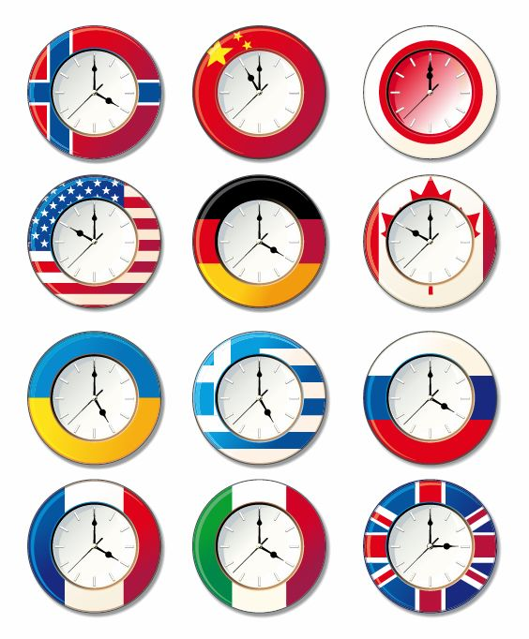
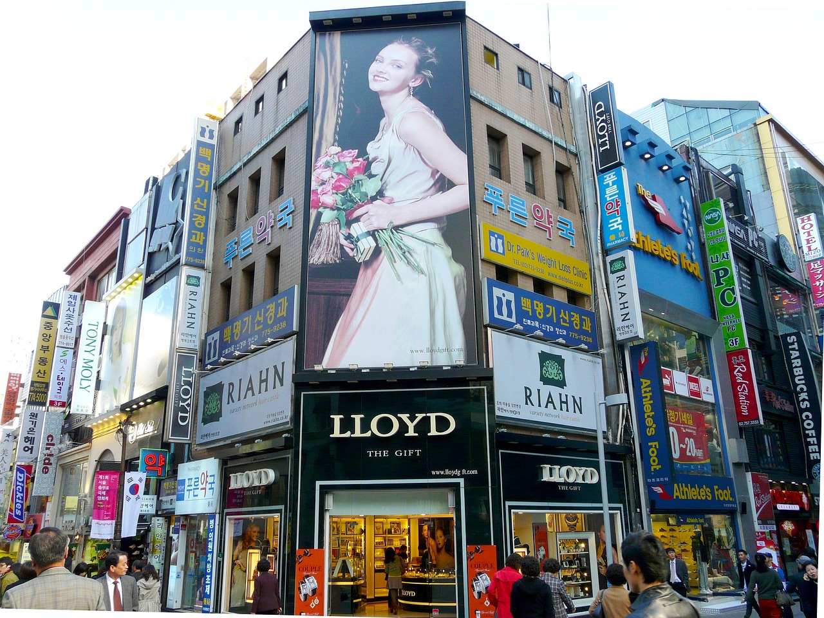
Clarity and engagement
Sources:: https://www.freeimages.com/download/vector-clock-with-different-national-flags-5380203
https://pixabay.com/photos/illuminated-advertising-street-219129/

Slide 17
Key aspects of visual communication
Visualization of Data: Visual communication is often used to represent data and information in a visual format, making it easier to interpret and analyze. This includes creating charts, graphs, infographics, and other visual representations of quantitative and qualitative data.
Brand Identity: Visual communication plays a crucial role in establishing and reinforcing brand identity. Consistent use of visual elements such as logos, colors, typography, and imagery helps to create a recognizable and cohesive brand image.

Slide 18
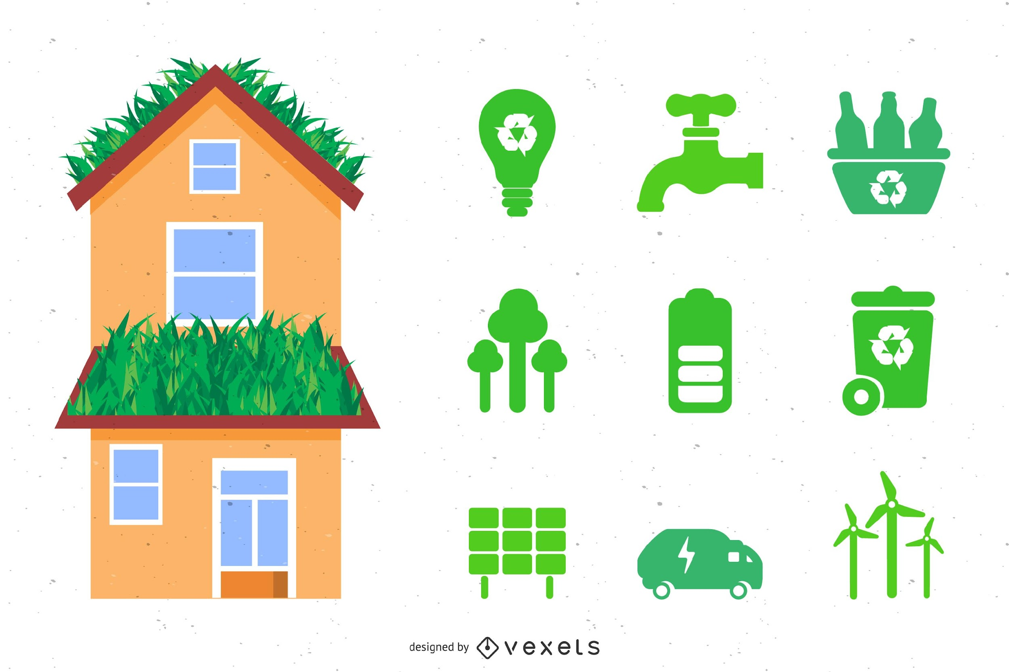

Visualization of Data and Brand Identity
Sources::
https://www.freeimages.com/download/eco-home-icon-pack-5691357
https://pixabay.com/photos/neon-neon-font-advertisement-170182/

Slide 19
Key aspects of visual communication
Storytelling: Visuals are powerful tools for storytelling, enabling narratives to be conveyed through images, illustrations, and sequential visual sequences. Visual storytelling can be used to evoke emotions, convey messages, and communicate complex ideas in a compelling manner.
Accessibility: Effective visual communication takes into account the diverse needs and preferences of the audience, including those with visual impairments or disabilities. Designing for accessibility ensures that visual content is perceivable, understandable, and usable by all users.

Slide 20
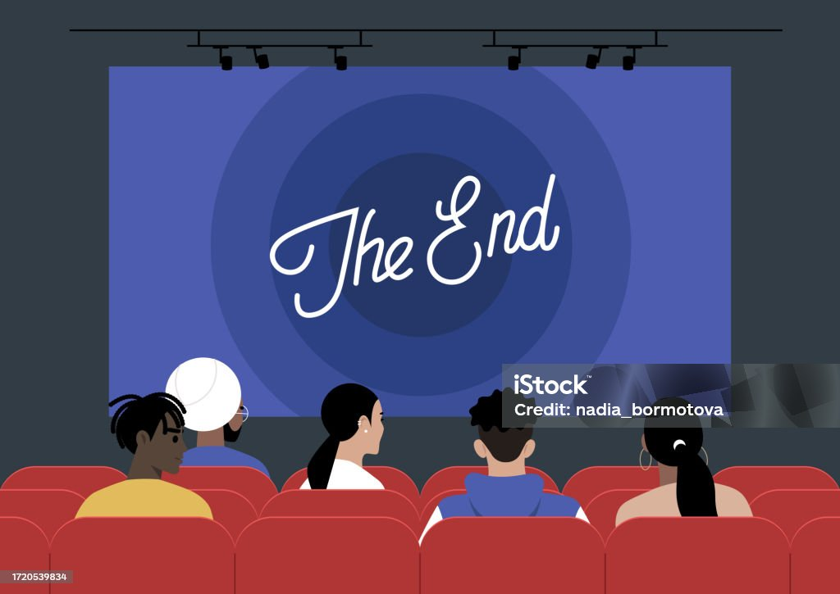
Storytelling and Accessibility
Sources : https://https://www.istockphoto.com/vector/a-cinema-movie-screen-displaying-the-end-signage-encompassing-the-realm-of-art-and-gm1720539834-540732188?irclickid=yr5S4TXnMxyPUOby9kXFOxSfUkHy4KW5vVpg2U0&irgwc=1&cid=IS&utm_medium=affiliate_SP&utm_source=FreeImages&clickid=yr5S4TXnMxyPUOby9kXFOxSfUkHy4KW5vVpg2U0&utm_campaign=download_freevector_null-inline-popup&utm_content=270498&irpid=246195

Slide 21
Key aspects of visual communication
Interactivity: With advancements in technology, visual communication can incorporate interactive elements such as animations, videos, and multimedia presentations. Interactive visuals enable users to explore content, manipulate data, and engage with information in a more dynamic and immersive way.
Cross-Cultural Communication: Visual communication transcends language barriers and can be understood by people from different cultural backgrounds. Universal visual symbols and icons are often used to convey meanings that are easily recognizable across cultures (Dutta, 2024).

Slide 22
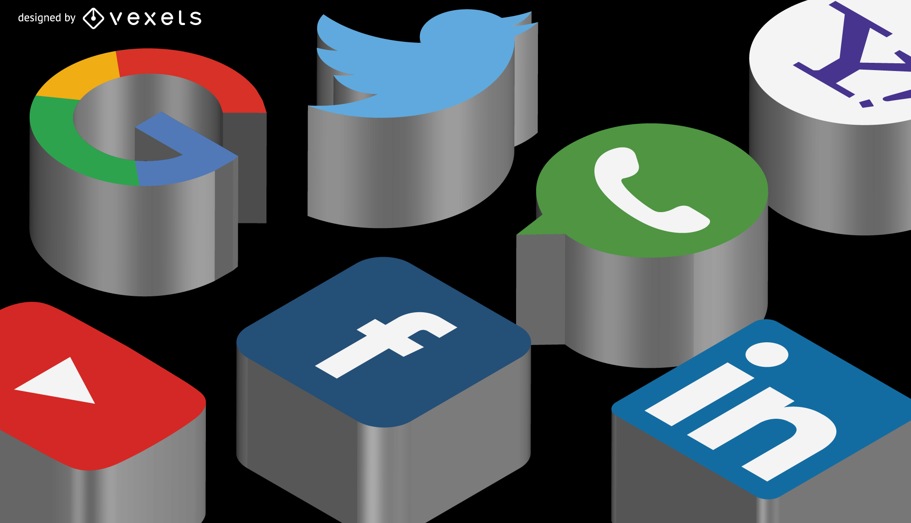
Interactivity and Cross-Cultural Communication
Source: https://www.freeimages.com/download/social3d-icon-set-5690405

Slide 23
Communicating with Images
Given how broad a category visual communication is, it is somewhat difficult to trace its history.
There is evidence to suggest that it is the oldest form of communication. For example, there are cave paintings from thousands of years ago, some dating back as far as 40,000 years.
Cave paintings are a primitive form of communication that were drawn or etched into cave walls and ceilings.
Though their exact purpose is not clear, these paintings include representations of, among other things, animals, landscapes, and sacred spaces, and act as a kind of prehistoric documentation.

Slide 24
Communicating with Images
As societies became more advanced, travel brought people that spoke different languages into contact with each other.
In order to communicate, people developed pictograms around the 4th millennium BC as a way to communicate.
Pictograms are images that represent physical objects and were used to share ideas or ask questions.
For example, if I was in a foreign country and wanted to buy a tree, I could use a pictogram of a money sign and a tree to indicate my interest (Study.com, 2003).

Slide 25
Communicating with Images
People began printing with woodblocks around the year 600, the ability to communicate visually blew wide open.
The printed word and other symbols allowed for ideas and information to be reproduced, shared, and preserved in a non-verbal way.
Once these documents were translated into other languages, they were capable of traveling around the world
visual communication design (formerly graphic design) is a creative process that combines the visual arts and technology to communicate ideas.

Slide 26
It begins with a message that, in the hands of a talented designer, is transformed into visual communication that transcends mere words and pictures.
By controlling color, type, movement, symbols, and images, the visual communication designer creates and manages the production of visuals designed to inform, educate, persuade, and even entertain a specific audience.
Visual communication design

Slide 27
What is Desktop Publishing?
Desktop publishing (DTP) is the process of using a computer and specialized software to create and layout documents for print or digital media.
This can include books, brochures, magazines, newspapers, and other types of publications.
DTP software provides tools for creating and editing text, graphics, and other elements, as well as for controlling page layout and typography.
The output can be sent directly to a printer or saved in a digital format, such as a PDF, for distribution and viewing on electronic devices.

Slide 28
What is Desktop Publishing?
Desktop Publishing packages are often used to produce physical media such as newspapers, magazines, marketing materials, point of sale displays, product packaging designs, business cards, and outdoor signs.
In the digital space, they are used to create things like web pages, GUI (Graphical User Interfaces) and e-books.
The term "desktop publishing" is used to distinguish it from traditional typesetting, which was done by hand or using specialized equipment.

Slide 29
The advantages of DTP
Handles far more graphical elements than a word processor, Word processing software certainly has its place. But Desktop Publishing software has taken over from it in almost any project where different fonts, pictures, layout and graphics are going to be involved.
Frame-based. A sizeable part of the advantages of Desktop Publishing packages, even the basic Microsoft Publisher, is that they are frame-based. This means that frames of text or images can be moved over, around and on top of one another and rescaled with ease.

Slide 30
The advantages of DTP
3) Easy import
Text and graphics can also be easily imported from outside sources. You can bring together disparate elements such as:
• Images from a scanner
• Frames shot by a digital video camera
• Text written in a word processor
• Graphics created using your favourite drawing software
4) WYSIWYG
WYSIWYG stands What You See Is What You Get. This acronym refers to the fact that, with DTP software, what you see on the screen will be what the final document looks like in printed form.
Automatic restructuring
Many DTP software packages can be set to automatically restructure other elements around a frame which has been moved.

Slide 31
The disadvantages of DTP
1) Expensive tools
One of the main disadvantages of Desktop Publishing is the relative expense of the tools themselves.
Many companies baulk at the costs of purchasing specialist software such as QuarkXPress or Adobe InDesign, Photoshop, Frame Maker or Illustrator.
Outsourcing to professionals is frequently the way that a company will choose to overcome this problem.
2) Lack of large scalability
Another disadvantage of DTP is that it sometimes struggles with very large-scale, highly complex projects.
That’s because these projects frequently require paying attention to more than just the presentation and content of a project

Slide 32
Summary
The communication process involves understanding, sharing, and meaning, and it consists of eight essential elements: source, message, channel, receiver, feedback, environment, context, and interference.
Visual communication is used by artists, designers and storytellers to express feelings, moods and narratives. It is the process of conveying information and ideas through visual elements such as images, symbols, typography and colours.
Desktop publishing (DTP) is the process of using a computer and specialized software to create and layout documents for print or digital media. This can include books, brochures, magazines, newspapers, and other publications.
DTP software provides tools for creating and editing text, graphics, and other elements, as well as for controlling page layout and typography. The output can be sent directly to a printer or saved in a digital format, such as a PDF, for distribution and viewing on electronic devices.

Slide 33
THANK YOU
LECTURE 1
BY DR. RAPHAEL OGUTU,
Mass Communication Department,
AFRICA NAZARENE UNIVERSITY

