Slide 1
VISUAL COMMUNICATION
WEEK 3 Typography Principles
By Dr. Raphael Ogutu

Slide 2
VISUAL COMMUNICATION
Introduction to Typography
Intended Learning Outcome
At end of this week lesson the students should be able to:
1. Show an understanding of typography basics
2. Explain Elements and Principles of Typography
3. Analyze a brief history of Typography

Slide 3
Introduction to Typography
Typography is the art and technique of arranging type to make written language legible, readable, and visually appealing when displayed or printed.
Involves selecting and arranging fonts, typefaces, font sizes, spacing, and alignment to effectively convey a message or communicate information.
Plays a crucial role in various forms of communication, including graphic design, advertising, publishing, and web design.
Is the art of arranging letters and text in a way that makes the copy legible, clear, and visually appealing to the reader.
is not only about choosing the right font, but also about adjusting letter-spacing, line-spacing, and paragraph-spacing to improve readability and visual interest

Slide 4

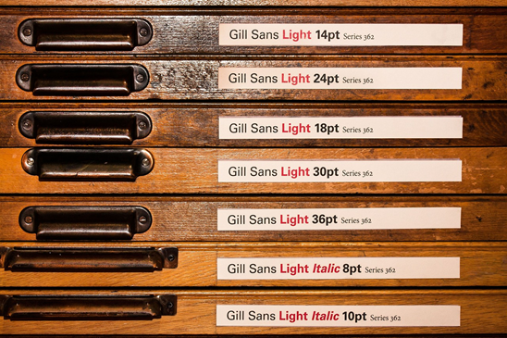
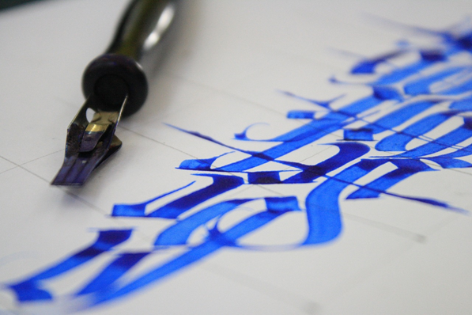
Introduction to Typography
Sources: https://pixabay.com/photos/vintage-text-typography-style-640941/
https://pixabay.com/photos/case-letters-lead-set-brief-417693/
https://pixabay.com/photos/calligraphy-letter-lettering-design-2432316/

Slide 5
Introduction to Typography
Why Typography is important?
Typography should guide and inform your users, optimize readability and accessibility, and ensure an excellent user experience.
Typography builds brand recognition
Not only will good typography enhance the brand’s personality, but your users will subliminally begin to associate the typeface featured on your site with your brand.
Unique, consistent typography will help you establish a strong user following, build trust with your users, and help to carry your brand forward.

Slide 6
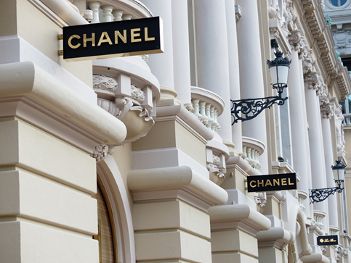


brand recognition
Sources: https://pixabay.com/photos/load-line-monaco-shopping-wealth-188952/
https://www.pexels.com/photo/luxurious-perfume-bottles-11028230/ by Yulia H.
https://www.pexels.com/photo/coca-cola-glass-bottle-macro-photography-2983100/ by
Jonathan Borba

Slide 7


Why Typography is important?
2.Typography influences decision-making
Typography has a profound effect on the way that users digest and perceive the information conveyed by the text.
Eye-catching type is much more persuasive than weak fonts that don’t reinforce the message of the text.
Sources: https://www.pexels.com/photo/formula-1-car-in-close-up-12749795/ https://www.pexels.com/photo/brand-watch-on-white-background-9982586/ by Antony Trivet

Slide 8


Why Typography is important?
3.Typography holds the attention of the readers
Good typography could be the difference between someone staying on your design for one minute or half an hour.
It’s important that your design is visually stimulating and memorable, and typography plays a huge role in this process.
When used effectively, typography grabs attention and builds hierarchy and brand recognition.
As a communication tool, it is essential to our society
Sources: https://pixabay.com/photos/whatsapp-app-mobile-chat-446995/
https://www.pexels.com/photo/hashtag-company-values-on-sticky-notes-on-a-whiteboard-15543048/

Slide 9

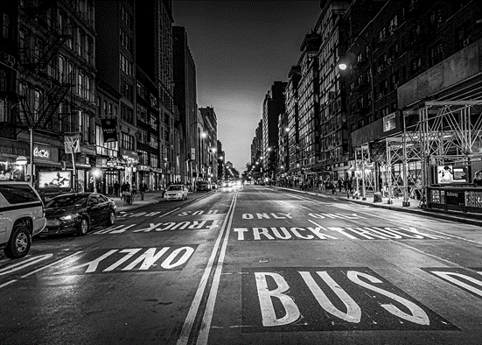
Why Typography is important?
4.Typography is everywhere
Typography is absolutely everywhere, on your phone, billboards, your coffee cup, or even the different styles used in this blog post.
Every font, letter, and character arrangement plays a part in determining how a message is conveyed
Sources: https://pixabay.com/photos/newyork-street-city-architecture-4504688/ https://pixabay.com/photos/urban-newyork-city-nyc-manhattan-4040696/

Slide 10
Elements and Principles of typography
The following are elements of typography that guide its use in design:
Typefaces/Fonts: The different styles or designs of characters, including serif, sans-serif, script, and decorative fonts. A font refers to a specific style, weight, and size of a typeface.
A typeface, on the other hand, refers to a set of characters with a consistent design, including letters, numbers, and symbols.
Examples of typefaces include Arial, Times New Roman, and Helvetica.
• Serif: These typefaces have tiny lines (serifs) trailing from the edges of strokes and stems. Often used for headlines and narratives.
• Sans Serif: Clean and modern, sans serif typefaces lack serifs. They’re great for digital interfaces and contemporary designs.

Slide 11
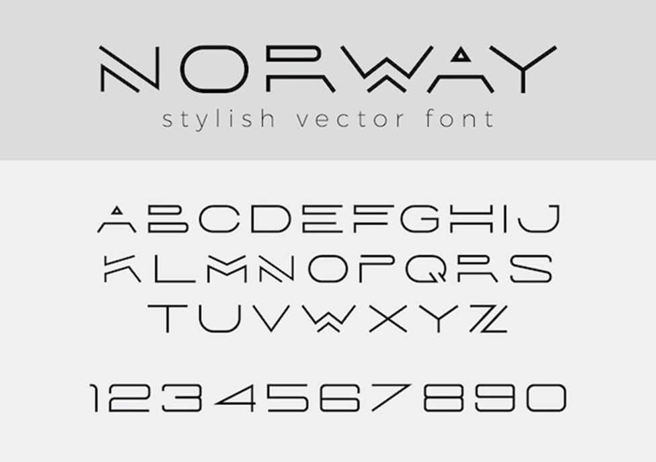
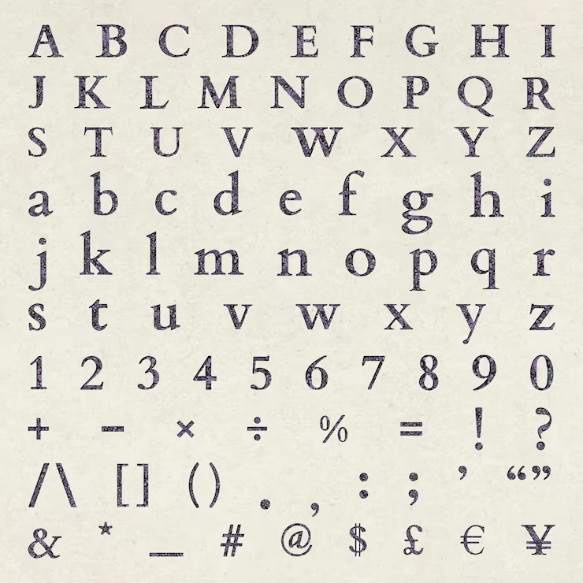
Typefaces/Fonts
Source: https://www.freepik.com/free-vector/creative-design-linear-font_14241124.htm#fromView=search&page=1&position=51&uuid=9c7808b4-6c30-4bf6-8751-747a48b88b52 https://www.freepik.com/free-vector/floral-letter-number-sign-set-vector-beige_36224590.htm#fromView=search&page=1&position=7&uuid=b426e7a8-7d93-4c45-adc2-ffba55e0db9f

Slide 12
Elements of typography
Type Size: Refers to the height of the characters, typically measured in points (pt) or pixels (px). Larger font sizes are used for headlines or titles, while smaller font sizes are used for body text or captions.
Type Style: Fonts come in various styles, such as regular, bold, italic, and bold italic. Each style conveys a different visual emphasis and tone.
For example, bold fonts are often used for headings or emphasis, while italic fonts may be used for emphasis or to denote quotes.

Slide 13
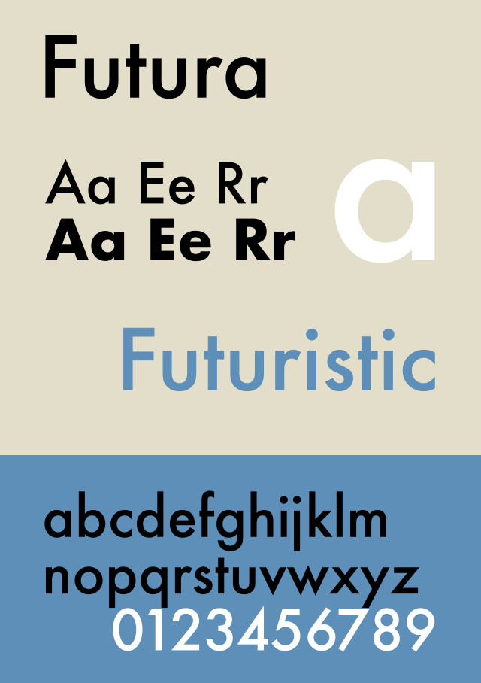
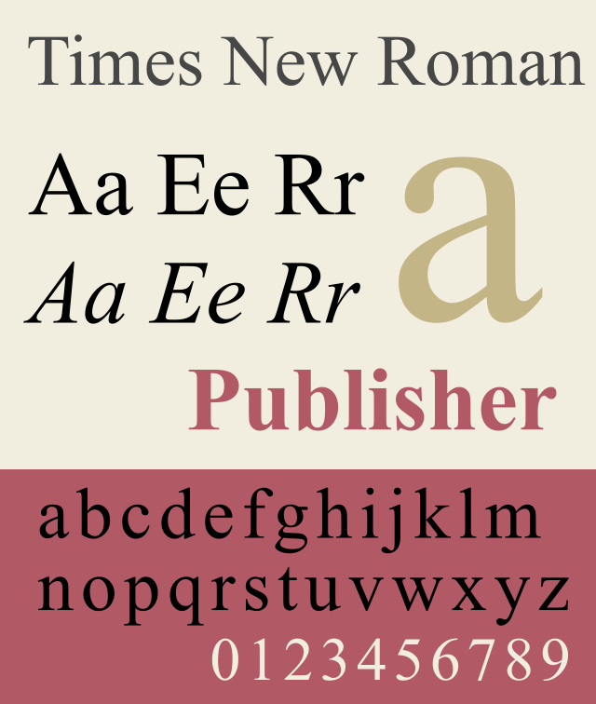
Type style and size
Sources: https://commons.wikimedia.org/w/index.php?search=typeface+futura&title=Special:MediaSearch&go=Go&type=image https://commons.wikimedia.org/w/index.php?search=typeface+new+times+roman&title=Special:MediaSearch&go=Go&type=image

Slide 14
Elements of typography
Type Weight: Refers to the thickness or heaviness of the characters, ranging from light to extra bold.
We think of weight in terms of "bold," "light," "normal," etc.
Many typefaces, however, are already either heavy or light to begin with.
When combining typefaces for a design and creating balanced typographical contrast, consider weight first.
It is also a good idea to choose a typeface with distinct weights.

Slide 15
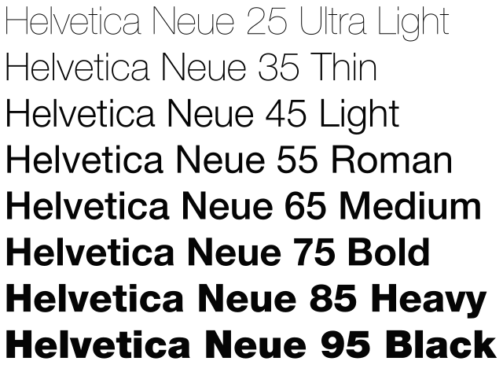
Type Weight
Source: https://commons.wikimedia.org/wiki/File:Helvetica_Neue_typeface_weights.svg

Slide 16
Elements of typography
5. Letter Spacing (Kerning): Letter spacing, or kerning, refers to the adjustment of space between individual letters or characters.
Kerning helps optimize readability by ensuring consistent spacing between letters and avoiding awkward gaps or overlaps.
6. Line Spacing (Leading): Line spacing, also known as leading, refers to the vertical space between lines of text.
Proper line spacing is essential for readability and legibility, ensuring that text is easy to follow and comprehend.

Slide 17
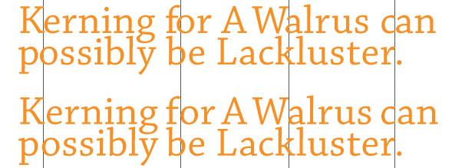
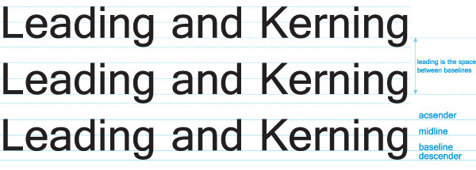
Visualization of Data and Brand Identity
Sources::
https://www.mmprint.com/blog/2011/typography-kerning-leading-tracking/

Slide 18
Elements of typography
7. Alignment: refers to the positioning of text relative to a specified layout or reference point.
Common alignment options include left-aligned, right-aligned, centered, and justified. Consistent alignment helps create a cohesive and organized layout.
8. Hierarchy: The organization and emphasis of text elements to guide the viewer's attention, often achieved through variations in size, weight, and style.
Typography helps establish a visual hierarchy within a design, indicating the relative importance of different pieces of text.
Hierarchy is achieved through variations in font size, weight, style, and placement, guiding the viewer's eye and emphasizing key information.

Slide 19
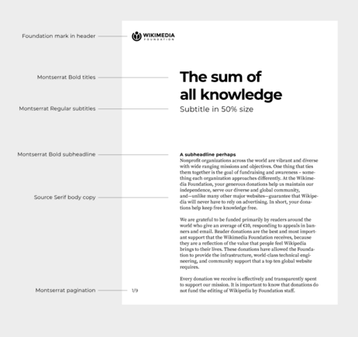
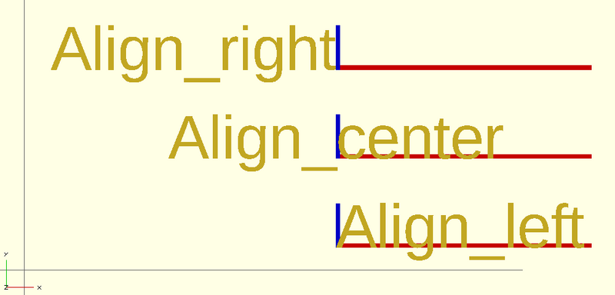
Alignment and Hierarchy
Sources : https://commons.wikimedia.org/wiki/File:OpenSCAD_text_align_horizontal.png https://commons.wikimedia.org/wiki/File:Wikimedia_Brand_Guidelines_Update_2022_-_Wikimedia_Typography_Hierarchy.png

Slide 20
Principles of Typography
Legibility: The ability of text to be easily read and understood, influenced by factors such as font choice, size, spacing, and contrast.
Readability: The ease with which text can be comprehended over longer passages, influenced by factors such as line length, leading, and alignment.
Choose legible typefaces and maintain proper spacing. Line height, letter spacing, and word spacing impact how easily users can read your text.

Slide 21
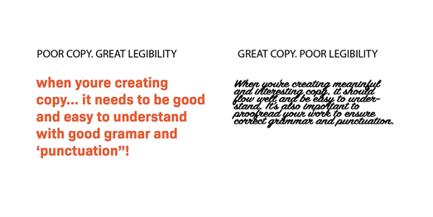
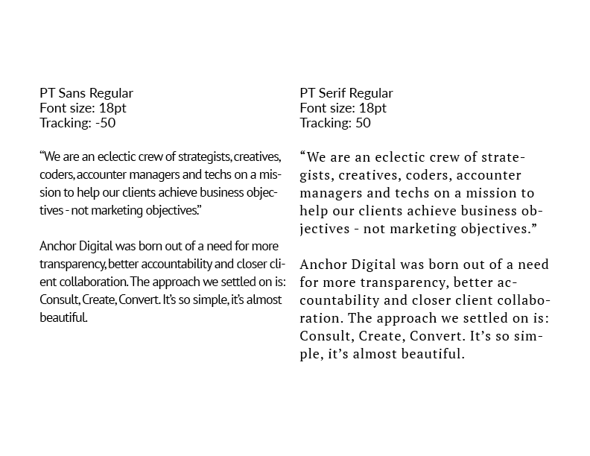
Legibility and Readability
Choice of Fonts and color matters. Use tracking to manipulate spacing in order to reduce density in a block of text, and increase legibility. Thoughtful tracking can make a world of difference in readability, as you can see in these examples.
Source: https://anchordigital.com.au/articles/read-between-the-lines-why-legibility-and-readability-is-essential-for-ux

Slide 22
Principles of Typography
3. Contrast: Creating visual interest and hierarchy through variations in font size, weight, style, and color.
Vary font sizes, weights, and styles to create visual interest. Contrast draws attention to important elements.
4. Alignment: Consistent positioning of text elements to establish visual order and organization within a design.

Slide 23


Contrast and alignment
Sources: https://www.pexels.com/photo/sign-with-inscription-in-urban-park-on-winter-day-6390192/
https://www.pexels.com/photo/neon-text-on-black-background-5745012/ by Ryutaro Tsukata

Slide 24
A brief history of Typography
over the long history of typography, creative people have used pretty much everything to make our texts beautiful and legible: swan feathers, brushes, carved woodblocks and even metal.
Innovative people developed our technology and invented printing presses to make it reproducible.
And whilst styles and designs may come and go, modern technology such as the internet and smartphones means that typography is continually and dramatically changing.
Today, typography is an integral part of graphic design, with a wide range of typefaces available for various applications. The digital age has further expanded typography’s scope, allowing for more experimentation and personalization in type design and usage.

Slide 25
The following is brief analysis of the history of typography:
Ancient Beginnings:
Hieroglyphs and Cuneiform: Typography traces its origins to the earliest naturalistic drawings by humans.
Ancient civilizations used symbols, hieroglyphs (in Egypt), and cuneiform (in Mesopotamia) for communication and record-keeping.
A brief history of Typography

Slide 26
A brief history of Typography
Medieval Manuscripts and Calligraphy:
  Carolingian Minuscule: In the 8th century, Charlemagne standardized a script known as Carolingian minuscule, combining roman capitals and lowercase letters.
  Black Letter (Gothic): By the 11th century, black letter (Gothic) emerged, characterized by pointed shapes and angular forms. It served as the first model for printer’s type when Johannes Gutenberg invented movable type.

Slide 27
A brief history of Typography
The Printing Revolution:
  Johannes Gutenberg: In the mid-15th century, Gutenberg’s invention revolutionized typography. His movable type allowed for mass production of books.
  Roman (Antiqua): In Italy, Humanist scholars favored a more rounded typeface called Antiqua (now known as roman) for Latin texts.
  Italic Typeface: Aldus Manutius introduced the italic typeface in 1501, providing a more elegant alternative to Gothic for Latin works.

Slide 28
A brief history of Typography
The Enlightenment and Beyond:
  Transitional and Modern Typefaces: The 18th century saw the rise of transitional typefaces (bridging old and new styles) and modern typefaces (with increased contrast between thick and thin strokes).
  Industrialization and Digital Age: The Industrial Revolution brought mechanization to typography. In the digital age, personal computers democratized type design and layout.

Slide 29
A brief history of Typography
Contemporary Typography:
  Digital Fonts: Today, we have an array of digital fonts, from classic serifs to sleek sans-serifs.
  Responsive Design: Typography adapts to various devices and screen sizes, emphasizing readability and aesthetics.
Typography continues to evolve, reflecting cultural shifts, technological advancements, and design trends. Whether in print or on screens, it remains a powerful tool for communication and expression.

Slide 30
Summary
Overall, typography is a fundamental element of design that influences how written language is perceived and understood.
By carefully selecting and arranging type, designers can create visually compelling and communicative layouts that effectively engage and inform their audience.
The following are some of the elements and principles of typography used in digital desktop publishing design:
Elements of Typography:
Typeface: The design or style of a set of characters, including letters, numbers, and symbols. Examples include Arial, Times New Roman, and Helvetica.
Font: A specific style, weight, and size of a typeface. For example, Arial Regular, Arial Bold, or Arial Italic.

Slide 31
Summary
Elements of Typography
Glyphs: Individual characters within a typeface, including letters, numbers, punctuation marks, and symbols.
Size: The height of characters, typically measured in points (pt) or pixels (px).
Weight: The thickness or boldness of characters within a typeface, ranging from light to bold.
Style: Additional variations of a typeface, such as italic, condensed, or expanded.
Spacing: The arrangement of characters and words, including kerning (space between individual characters), tracking (space between groups of characters), and leading (space between lines of text).

Slide 32
Summary
Principles of typography:
Legibility: The ability of text to be easily read and understood. Legibility is influenced by factors such as font choice, size, spacing, and contrast.
Hierarchy: The organization of text to create a visual hierarchy, indicating the relative importance of different pieces of information. Hierarchy is established through variations in font size, weight, style, and color.
Alignment: The positioning of text relative to a specified layout or reference point. Common alignment options include left-aligned, right-aligned, centered, and justified.
Contrast: The difference in visual characteristics between different elements of text, such as size, weight, color, and style. Contrast helps create visual interest and emphasizes important information.

Slide 33
Summary
Consistency: The uniformity of text formatting and styling throughout a design or document. Consistency ensures a cohesive and professional appearance and helps establish brand identity.
White Space: The empty space around and between elements of text. White space (also known as negative space) helps improve readability, create visual balance, and enhance the overall aesthetic of a design.
Accessibility: This may involve using appropriate font sizes, contrast levels, and spacing to ensure readability for all audiences.
Historically once we started using symbols to represent an idea, we had invented writing. As the style of writing evolved over time, it became an art form and—with different letter shapes and spacing—produced text that was both beautiful and full of meaning.

Slide 34
THANK YOU
LECTURE 3
BY DR. RAPHAEL OGUTU,
Mass Communication Department,
AFRICA NAZARENE UNIVERSITY

