Slide 1
VISUAL COMMUNICATION
WEEK 4 Advanced Typography Principles
By Dr. Raphael Ogutu

Slide 2
VISUAL COMMUNICATION
Introduction to Advanced Typography Principles
Intended Learning Outcome
At end of this week lesson the students should be able to:
1. Show an understanding of the Anatomy of Typography
2. Explain Readability and Legibility of Typography
3. Application of the Anatomy of Typography

Slide 3
Advanced Typography Principles
Since Gutenberg’s day, at least 40,000 different typeface styles have been created, with more than 176,000 attribute variations
With so many choices, a method was devised to group all of the typefaces into categories or families.
The resulting six basic typeface families became blackletter, roman, script, miscellaneous, square serif, and sans serif.
anatomy is the identification and description of the structures of living things.
is a branch of biology and medicine.
People who study anatomy study the body, how it is made up, and how it works.
The study of anatomy dates back more than 2,000 years, to the Ancient Greeks.

Slide 4
Anatomy of Typography
The word “anatomy” comes from the Greek words “ana,” meaning “up,” and “tome,” meaning “a cutting.”
Traditionally, studies of anatomy have involved cutting up, or dissecting, organisms.
Learning and understanding every aspect of the anatomy of typography is essential if you are to become a great typographer.
These advanced skills will enable you to clearly communicate complex messages effectively with limited means, especially when the whole design is only using typography, like for example the ‘wordmark’ logo, where you redraw some letters to make them unique.

Slide 5
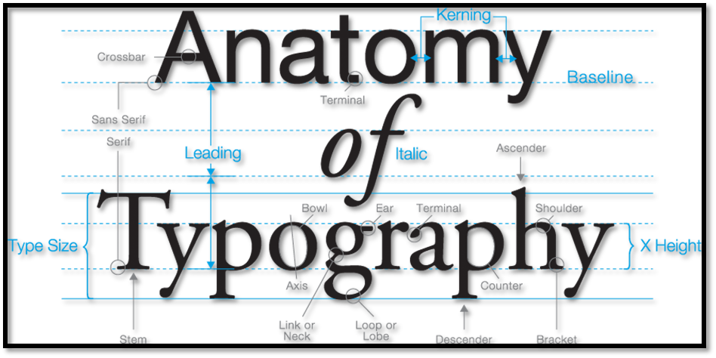
Anatomy of Typography
Sources: https://osmanassem.com/typography-the-anatomy-of-a-letter/

Slide 6
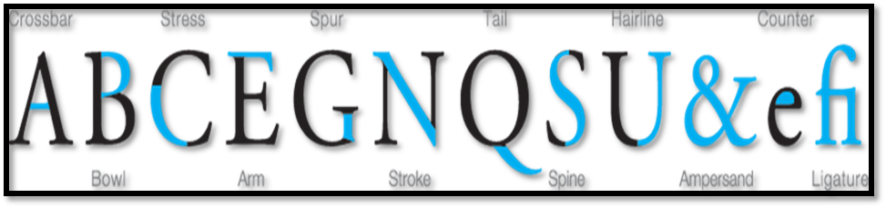
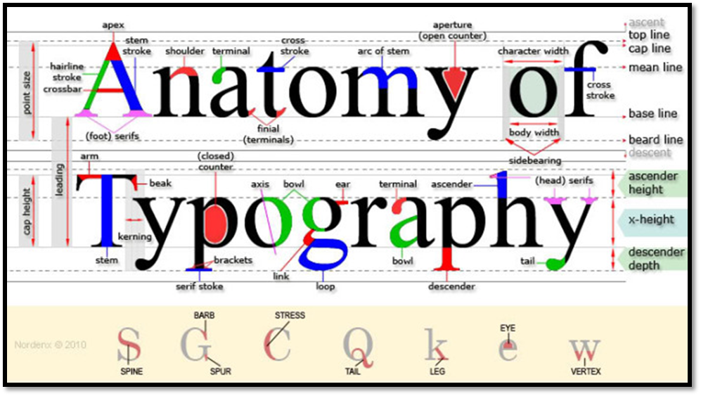
Anatomy of Typography
Sources: http://www.kupper.org.uk/graphics/anatomy-of-type/

Slide 7

Anatomy of Typography
Typographic Definitions of the anatomy
The following are the various parts of the anatomy:
Aperture
Opening at the end of an open counter for example on top of letter Y.
  (Assem, 2024)
Arm
A straight or curved portion of a letter that extends upwards or outwards, attached at one end and free at the other. A horizontal stroke not connected on one or both ends.

Slide 8
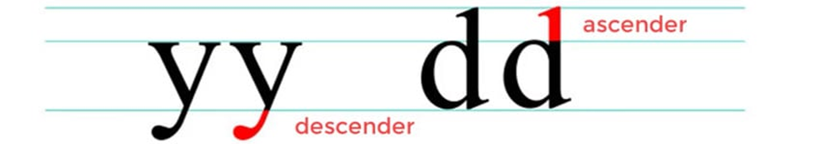
Typographic Definitions of the anatomy
Ascender and Descender
(Nieves, 2021)
Ascender: An upward vertical stroke found on lowercase letters that extends above the typeface’s x-height.
Descender: A downward vertical stroke found on lowercase letters that extends below the baseline.

Slide 9
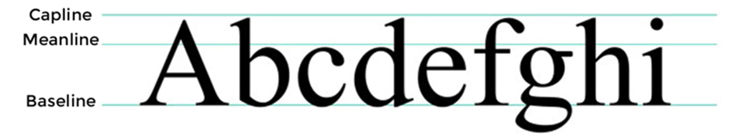

Typographic Definitions of the anatomy
Baseline
(Nieves, 2021)
The invisible line where letters sit.
• Bowl
The main curve that create the enclosed space of letters D, B, O, d & b.
A curved stroke that encloses a letter’s counter.
(Assem, 2024)

Slide 10


Typographic Definitions of the anatomy
Counter and Spine
Fully or partially enclosed space within a letter.
Fully or partially closed spaces found in letters like O, A, and B. If the letter isn't fully closed, then it's an Open Counter. Spine: The main curved stroke for a capital and lowercase s.
Crossbar
A bar is a horizontal stroke in letters like A, H, e and f. A horizontal stroke is the crossbar.
(Nieves, 2021)
(Assem, 2024)

Slide 11
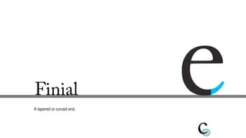

Typographic Definitions of the anatomy
• Ear and Shoulder
A small stroke projecting from the upper right bowl of some lowercase g’s. An Ear is a decorative detail that pokes out from letters like g. A Shoulder is a bumped curve seen in letters like m and n.
• Finial
A tapered or curved end.
(Nieves, 2021)
Source: https://www.slideshare.net/devinakothari/anatomy-and-aspects-of-typography

Slide 12
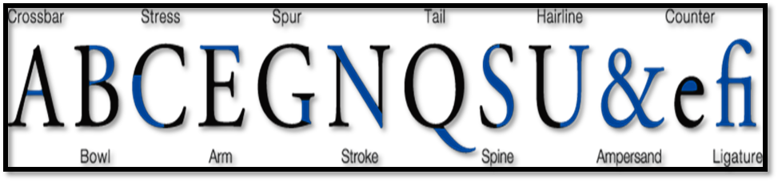
Typographic Definitions of the anatomy
Hairline
The thin strokes of a serif typeface.
• Ligature
Two or more letters are joined together to form one glyph.
Source: https://osmanassem.com/typography-the-anatomy-of-a-letter /

Slide 13
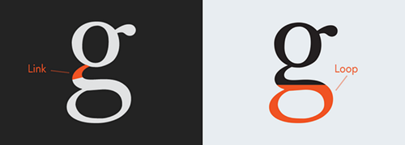
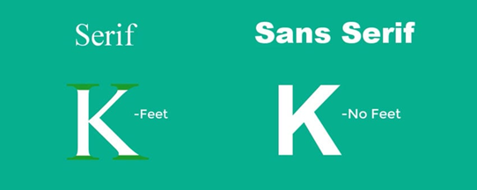
Typographic Definitions of the anatomy
• Link and Loop
A stroke that connects the top and bottom bowls of lowercase double-story g’s. The enclosed or partially enclosed counter below the baseline of a double-story g.
• Serif and Sans Serif
“Feet” or non-structural details at the ends of some strokes. Serif types feature extended stroke details also known as feet. These details are missing in sans serif styles.
(Assam, 2024)
(Nieves, 2021)

Slide 14


Typographic Definitions of the anatomy
Cap Height
The cap height is a measurement of all capital letters in the same typeface. The most accurate measurement is found in flat bottomed characters like the letter E.
Spur
A small projection from a curved stroke. A spur is a small projection that veers off the main stroke on many capital G’s
(Assam, 2024)
(Assam, 2024)

Slide 15
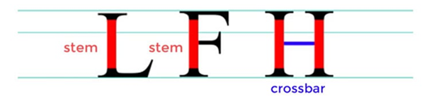


Typographic Definitions of the anatomy
• Stem
Primary vertical stroke. A single vertical stroke upwards to create letters like L or F. Connect one stem to another using a crossbar detail, like the letter H.
• Tail
The decorative curved descender of a capital Q, R and K. The descenders of the lower case g, j, p, q, and y are also sometimes called tails. A descending stroke, often decorative.
• Terminal
The end of a stroke that lacks a serif.
(Nieves, 2021)
(Assam, 2024)
Source: https://typography.guru/term/terminal-r110/

Slide 16


Typographic Definitions of the anatomy
Uppercase and lower case
A letter or group of letters of the size and form generally used to begin sentences and proper nouns. Also known as “capital letters”.
Uppercase letters are capital letters.
Lowercase letters are smaller ones. Use uppercase letters for names and places, and lowercase letters for casual settings and more readability.
• x-height
The x-height isn’t exactly a part but rather a measurement.
It measures the height of all lowercase letters that are part of the same typeface.
It’s called x-height because the letter x of each typeface is what determines the measurement.
The height of the main body of a lowercase letter.
(Nieves, 2021)
(Assam, 2024)

Slide 17
Readability and Legibility of Typography
Readability and legibility are two important aspects of typography that determine how easily text can be read and understood by readers.
Readability is how easy it is to read words, phrases, blocks of copy such as a book, a web page or an article.
Legibility is a measure of how easy it is to distinguish one letter from another in a particular typeface. While they are closely related, they refer to slightly different aspects of typographic design

Slide 18
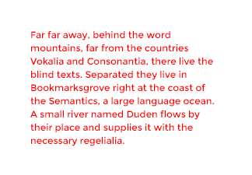


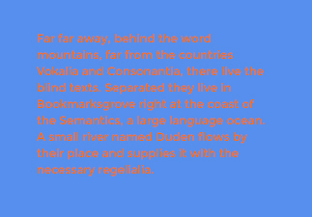
Readability and Legibility of Typography
Bright red text can cause reader fatigue. Low contrast can make words hard to see.
High contrast can cause colors to “vibrate.” Good contrast helps the reader access the content easily.
Sources::https://www.volusion.com/blog/content/images/wp/color1.jpg

Slide 19
Factors affecting readability:
• Font choice: Some typefaces are more readable than others due to their design characteristics.
For example, serif typefaces are often considered more readable for long passages of text in print, while sans-serif typefaces are commonly used for digital screens.
• Font size: Text should be set at a size that is comfortable for reading, typically ranging from 10 to 12 points for print and larger sizes for digital screens.

Slide 20
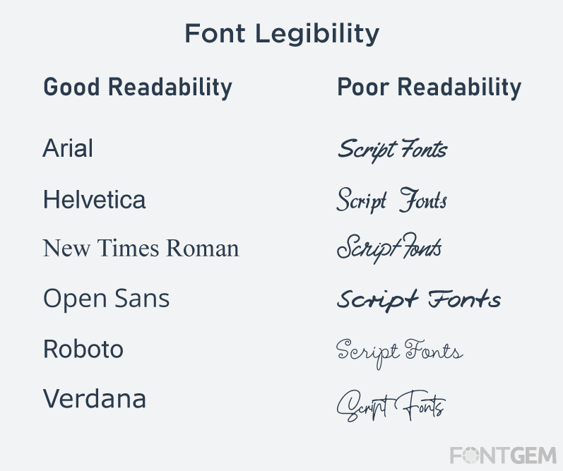
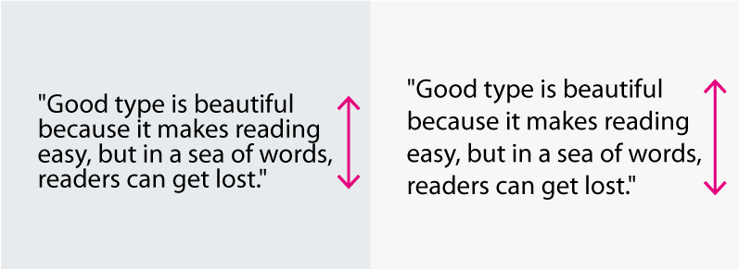
Factors affecting readability:
• Line spacing (leading): Adequate line spacing helps prevent lines of text from appearing crowded or cramped, improving readability by allowing readers to easily distinguish between lines.
• Line length: Text lines that are too long can be difficult to read, as readers may lose their place or have difficulty tracking from one line to the next. Optimal line length typically ranges from 50 to 75 characters per line.
Sources:: https://www.fontgem.com/power-of-typography-in-blogging

Slide 21
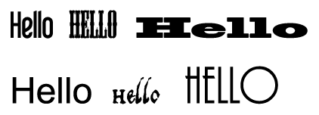
Factors affecting legibility
    Typeface design: Factors such as stroke contrast, x-height, and letter spacing can all influence legibility.
    Character spacing (kerning): Proper spacing between characters is crucial for ensuring that each letter is clearly defined and distinguishable from surrounding letters. Poor kerning can lead to letters appearing too close together or overlapping, reducing legibility.
    Typeface weight: The thickness or weight of a typeface can affect legibility, with heavier weights sometimes causing letters to appear too bold or dense, especially at smaller sizes.
Source: https://www.sitepoint.com/wp-content/uploads/2010/01/image6.png

Slide 22
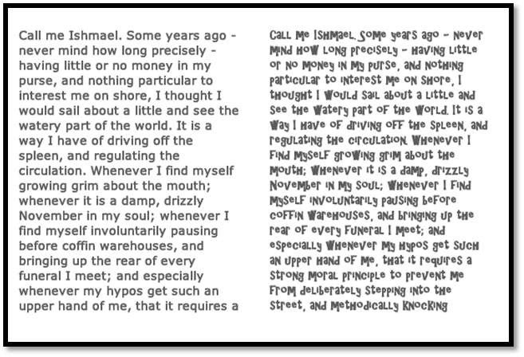
Storytelling and Accessibility
The paragraph on the right is set in a more decorative font that really tires your eyes quickly.
Sources : https://www.sitepoint.com/typography-readability-and-legibility-part-1/

Slide 23
Application of the Anatomy of Typography
Applying the anatomy of typography involves understanding the various parts and characteristics of individual letters within a typeface and using this knowledge to make informed decisions in typographic design.
As a designer, you know that typography is much deeper than knowing the difference between serif and sans-serif fonts.
Each letter, like designs or even people, can come with its own meaning, moods, styles—and even anatomical features!
Typography anatomy is crucial because it provides a framework for understanding the visual structure and characteristics of typefaces and implementing font psychology.

Slide 24
Application of the Anatomy of Typography
Font Selection: Choose typefaces that are appropriate for the intended context and audience of your design.
Consider factors such as readability, legibility, and the overall tone or personality conveyed by the typeface.
Typeface Analysis: Analyze the characteristics of the chosen typeface, including its x-height, ascenders, descenders, serifs (if applicable), and other features.
This understanding will help you utilize the typeface effectively and make adjustments as needed.
Source: https://www.freeimages.com/download/social3d-icon-set-5690405

Slide 25
Application of the Anatomy of Typography
Letter Spacing (Kerning): Adjust the spacing between individual characters to optimize legibility and readability.
Pay attention to the overall spacing and ensure that letters are evenly spaced to prevent awkward gaps or overlaps.
Line Spacing (Leading): Set appropriate line spacing to ensure comfortable reading and prevent text from appearing crowded or cramped.
Adequate leading helps guide the reader's eye smoothly from one line to the next.

Slide 26
Application of the Anatomy of Typography
Alignment: Choose alignment options (left-aligned, right-aligned, centered, justified) that best suit the design context and contribute to readability.
Ensure consistent alignment throughout the text to maintain visual harmony.
Hierarchy and Emphasis: Establish a visual hierarchy within the text by varying font size, weight, style, and color.
Use these variations to emphasize important information and guide the reader's attention effectively.

Slide 27
Application of the Anatomy of Typography
Consistency: Maintain consistency in typography throughout your design to create a cohesive and professional appearance.
Use consistent typefaces, font sizes, spacing, and alignment to ensure visual harmony and readability.
Whitespace: Utilize whitespace effectively to enhance the overall readability and aesthetic of your design.
Pay attention to margins, padding, and spacing between elements to create a balanced and visually pleasing layout.

Slide 28
Testing and Refinement: Test your typographic choices and layout design across different devices and media to ensure optimal readability and legibility.
Make adjustments as needed based on feedback and usability testing.
By studying and recognizing the various components that make up letterforms, such as the spine, stem, and stroke, designers gain a deeper understanding of how each element contributes to the overall appearance and legibility of a typeface.
This knowledge enables a designer to make informed decisions when selecting and working with typefaces, so they align with the intended tone, purpose, and message of a design.
Application of the Anatomy of Typography

Slide 29
Summary of the Anatomy of Typography
The anatomy of typography refers to the various parts and terms used to describe the components of individual characters within a typeface. Understanding the anatomy of typography is essential for designers and typographers to communicate effectively about type design and typography. Here's a breakdown of the key terms:
1. Baseline: The imaginary line upon which most characters’ sit. It provides a foundation for aligning characters and ensuring uniformity in the text.
2. X-Height: The height of lowercase letters, measured from the baseline to the top of most lowercase letters (excluding ascenders and descenders). It influences the overall legibility and readability of a typeface.

Slide 30
Summary of the Anatomy of Typography
3. Cap Height: The height of uppercase letters, measured from the baseline to the top of uppercase characters. Cap height is often used as a reference point for determining font size and spacing.
4. Ascender: The part of a lowercase letter that extends above the x-height. Ascenders are found in characters like "b," "d," and "h" and contribute to the overall visual rhythm and balance of a typeface.
5. Descender: The part of a lowercase letter that extends below the baseline. Descenders are found in characters like "g," "p," and "q" and can affect line spacing and legibility in text.

Slide 31
Summary of the Anatomy of Typography
6. Stem: The main vertical or diagonal stroke in a letter, such as the vertical stroke in the letter "I" or the diagonal stroke in the letter "A.“
7. Bowl: The rounded or curved part of letters like "a," "b," "d," "g," "o," and "p." The bowl contributes to the overall shape and character of the letterform.
8. Counter: The enclosed or partially enclosed space within letters like "a," "b," "d," "o," and "p." Counters can vary in size and shape and affect the overall legibility and aesthetic of a typeface.
9. Serif: Small decorative strokes or flourishes at the ends of the main strokes in a letter. Serifs are characteristic of serif typefaces and can be classified as bracketed, or slab serifs.

Slide 32
Summary of the Anatomy of Typography
10. Sans Serif: A typeface classification characterized by the absence of serifs. Sans serif typefaces are often considered more modern and minimalist in design.
11. Terminal: The end of a stroke or stem in a letter. Terminals can be flat, rounded, or angled and contribute to the overall style and personality of a typeface.
12. Spur: A small projection or serif-like feature extending from a curved stroke, as seen in letters like "b," "d," "g," and "q."
13. Aperture: The partially enclosed space within letters like "n," "m," "h," and "u" where strokes meet. Apertures affect legibility and spacing in typefaces.
14. Crossbar: The horizontal stroke in letters like "A," "H," and "T" that connects two stems or strokes. The design of the crossbar can vary in width and style.
.

Slide 33
Summary
The anatomy of typography allows designers and typographers to analyze and discuss typefaces more effectively, enabling them to make informed decisions about font selection, spacing, and layout in their designs.
Readability refers to the overall ease of reading a body of text, while legibility focuses on the clarity and distinctiveness of individual characters within that text.
Both readability and legibility are important considerations in typographic design, as they directly impact the effectiveness of written communication and the overall user experience for readers.
By applying the anatomy of typography in your design process, you can create typographic compositions that are not only visually appealing but also highly readable, engaging, and effective in communicating your message to your audience.
IMAGE REFERENCES: Assem, Osman (2024), Typography: The Anatomy of a Letter, Retrieved from https://osmanassem.com/typography-the-anatomy-of-a-letter /
Nieves, Melody (2021), Typography: The Anatomy of a Letter Retrieved from https://design.tutsplus.com/articles/typography-the-anatomy-of-a-letter--cms-29828

Slide 34
THANK YOU
LECTURE 4
BY DR. RAPHAEL OGUTU,
Mass Communication Department,
AFRICA NAZARENE UNIVERSITY

