Slide 1
VISUAL COMMUNICATION
WEEK 5 Communicating with colour
By Dr. Raphael Ogutu

Slide 2
VISUAL COMMUNICATION
Introduction to Communicating with colour
Intended Learning Outcome
At end of this week lesson the students should be able to:
1. Show an understanding of the element colour
2. Explain the colour wheel and its theory
3. Analyze colour symbolism

Slide 3
Introduction to colour
Color is the element of art that is produced when light, striking an object, is reflected back to the eye: that's the objective definition.
In art design, color has a slew of attributes which are primarily subjective.
Those include characteristics such as harmony — when two or more colors are brought together and produce a satisfying effective response; and temperature — a blue is considered warm or cool depending on whether it leans towards purple or green and a red whether it leans towards yellow or blue.
Subjectively, then, color is a sensation, a human reaction to a hue arising in part from the optic nerve, and in part from education and exposure to color, and perhaps in the largest part, simply from the human senses

Slide 4
Introduction to colour
According to Britannica online (2024), colour is the aspect of any object that may be described in terms of hue, lightness, and saturation.
In physics, colour is associated specifically with electromagnetic radiation of a certain range of wavelengths visible to the human eye.
Radiation of such wavelengths constitutes that portion of the electromagnetic spectrum known as the visible spectrum—i.e., light.
Clearly, the perception of colour depends on vision, light, and individual interpretation, and an understanding of colour involves physics, physiology, and psychology

Slide 5
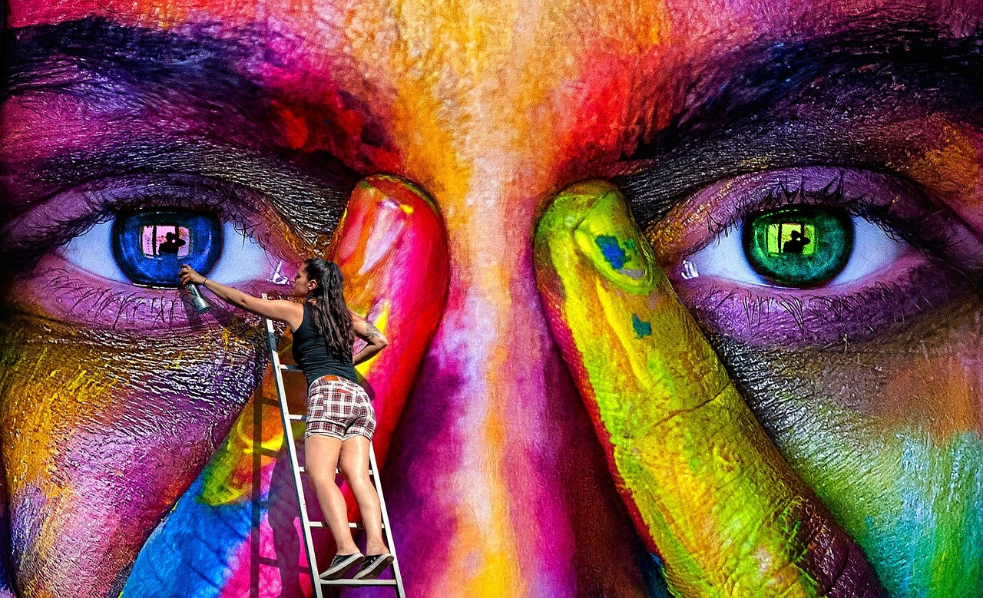
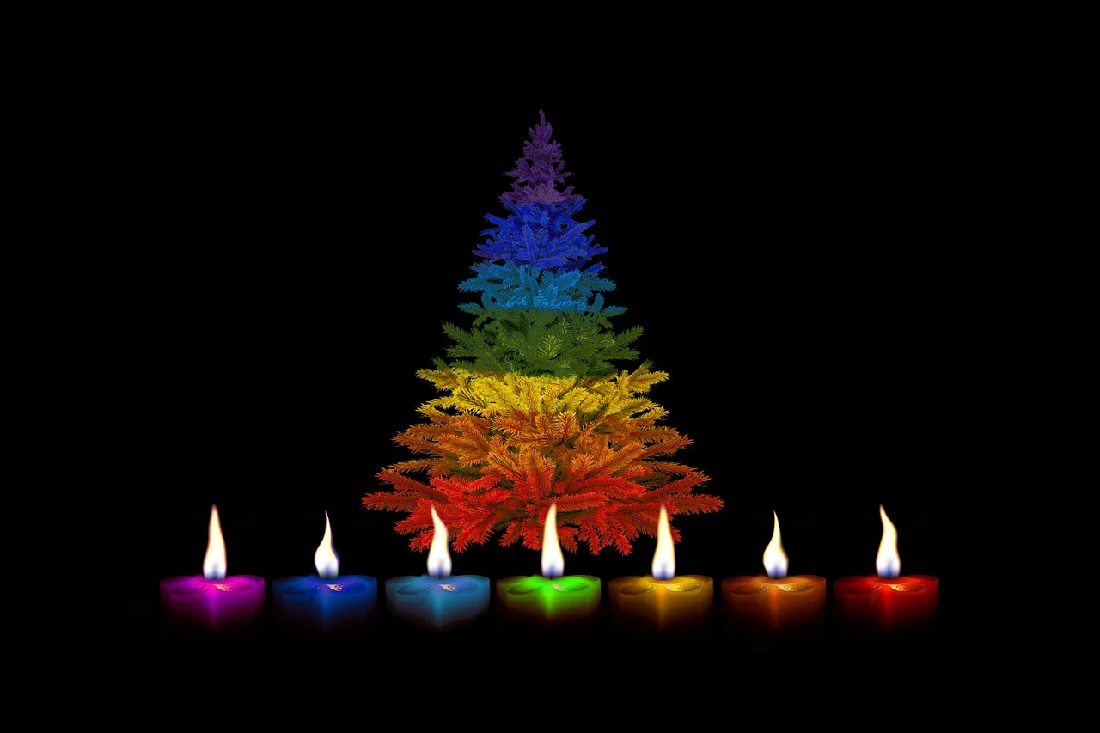
Introduction to colour
Sources: https://pixabay.com/photos/wall-art-spray-graffiti-woman-2852231/
https://pixabay.com/photos/candles-christmas-multicoloured-2899905/

Slide 6
The colour wheel and its theory
These are some key points about color:
1. Wavelengths of Light: Color is a product of the different wavelengths of light. When light interacts with an object, certain wavelengths are absorbed, while others are reflected. The reflected wavelengths are what we perceive as color.
2. Traditional (Think Paint or Crayons)
• Primary Colors: In traditional color theory, there are three primary colors: red, blue, and yellow. These colors cannot be created by mixing other colors together.
• Secondary Colors: Secondary colors are created by mixing two primary colors together. The secondary colors are orange (red + yellow), green (blue + yellow), and purple (red + blue).

Slide 7

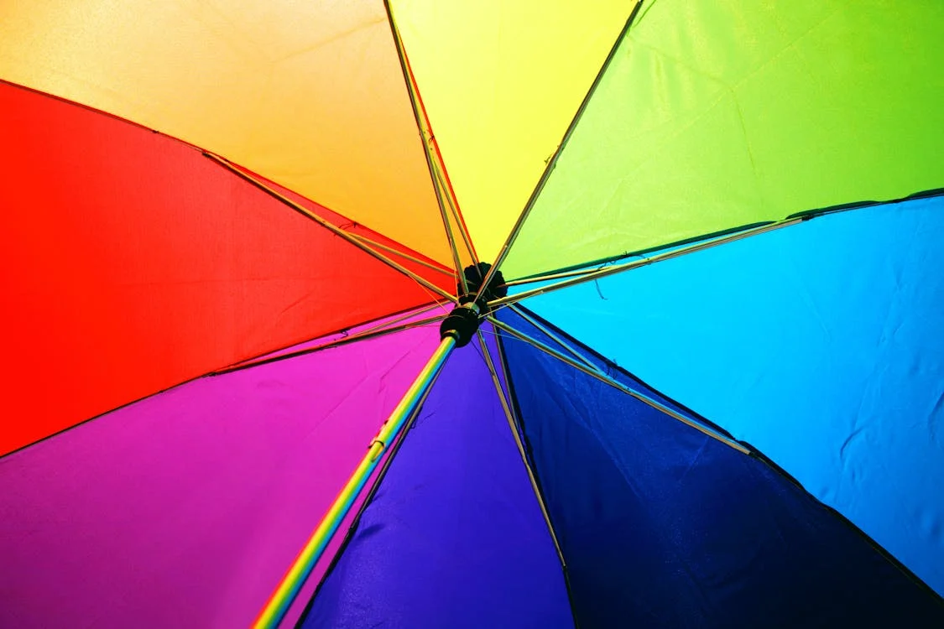
The colour wheel and its theory
Sources: https://www.pexels.com/photo/two-women-holding-pen-601170/ https://www.pexels.com/photo/multicolored-umbrella-1146851/

Slide 8
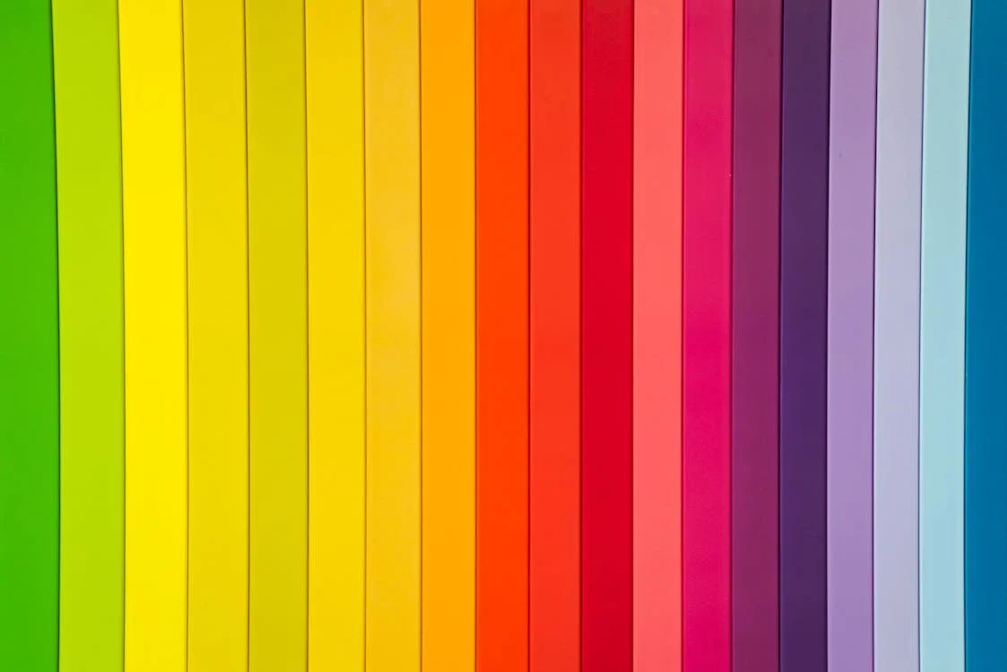
The colour wheel and its theory
• Tertiary Colors or intermediate: Yellow-orange, red-orange, red-purple, blue-purple, blue-green & yellow-green.
These are the colors formed by mixing a primary and a secondary color. That's why the hue is a two-word name, such as blue-green, red-violet, and yellow-orange.
Tertiary colors are created by mixing a primary color with a neighboring secondary color.
For example, mixing red (primary) with orange (secondary) creates red-orange. Note the primary colour comes first then the secondary colour.
Sources: https://www.pexels.com/photo/color-text-1279813/ by Magda Ehlers

Slide 9
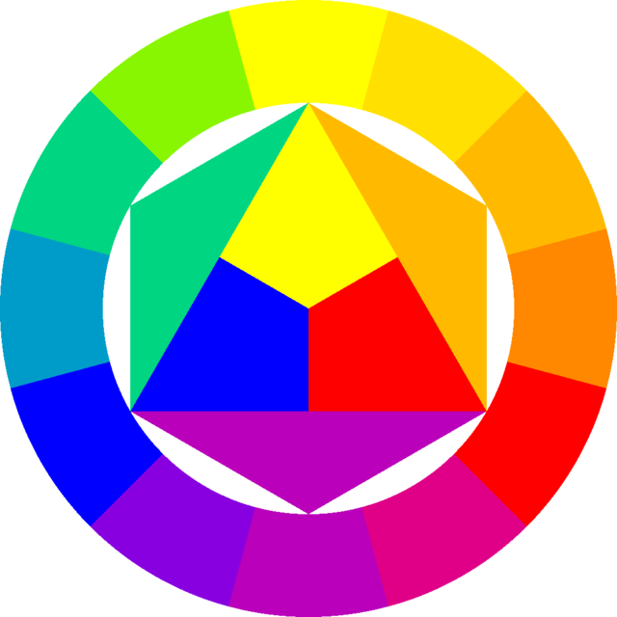
The colour wheel and its theory
3. Color Models: Different color models are used to represent and manipulate colors. Common color models include RGB (Red, Green, Blue) used in digital displays, CMYK (Cyan, Magenta, Yellow, Black) used in printing, and HSL/HSV (Hue, Saturation, Lightness/Value) used in graphic design and digital imaging.
• Adjacent or analogous colors appear next to each other on the color wheel. Two or more adjacent colors harmonize with one another. They work well together (usually but not always). Learn more about adjacent colors.
Sources:https://commons.wikimedia.org/w/index.php?search=Color+wheel&title=Special:MediaSearch&go=Go&type=image
A color wheel with 12 colors: red, orange red, orange, yellow orange, yellow, yellow green, green, blue green, blue, blue purple, purple, purple red.

Slide 10
The colour wheel and its theory
Contrasting colors appear in different segments of the color wheel (divide it in quarters to help visualize this).
The further apart from one another in hue, saturation, or value, the more contrast.
While contrast is often needed to provide optimum readability (such as high contrast between background and text) some contrasting colors when printed side by side can appear to vibrate and be very tiring on the eye.
•Complementary colors appear on opposite sides of the color wheel, directly or almost directly across from one another.
Learn more about complementary colors.
Complementary is often confused with complimentary.
Different meanings. Two colors that compliment (flatter) each other may or may not be complements of each other.

Slide 11
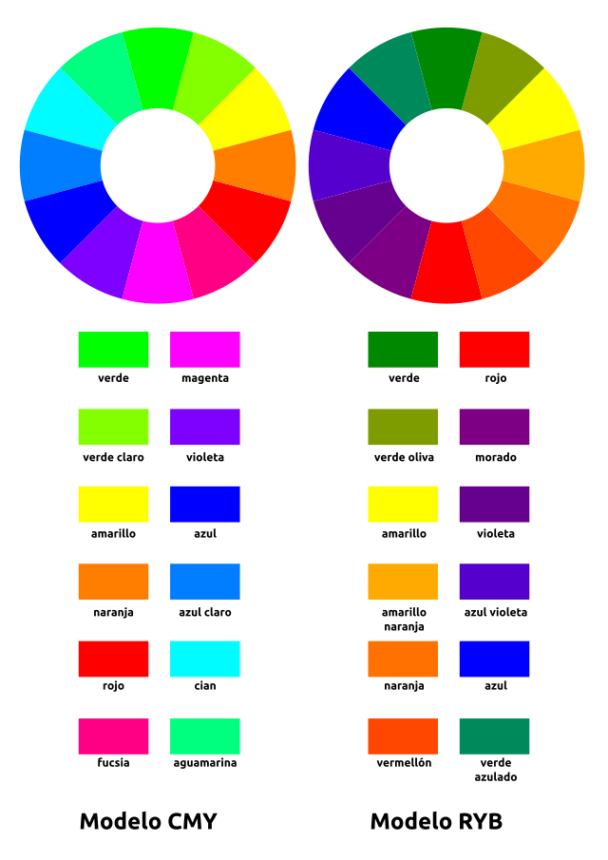

The colour wheel and its theory
Complementary colors in the traditional RYB color model.
Sources:https://commons.wikimedia.org/w/index.php?search=Contrasting+colors+&title=Special:MediaSearch&go=Go&type=image
https://commons.wikimedia.org/w/index.php?search=Contrasting+colors+&title=Special:MediaSearch&go=Go&type=image

Slide 12
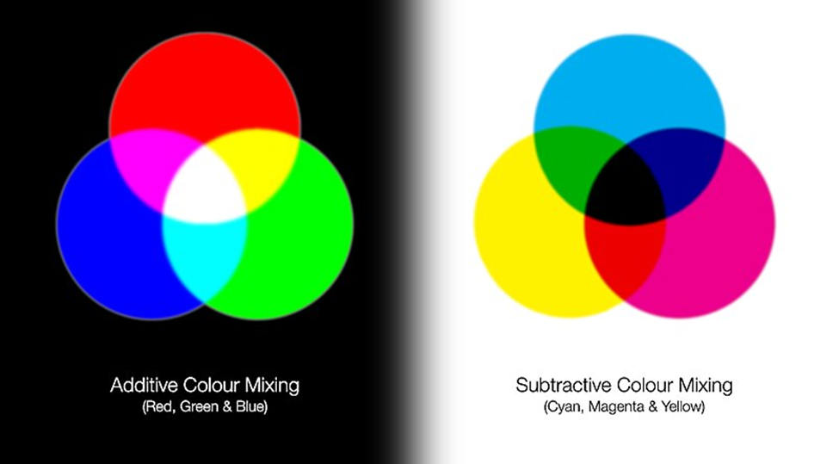
Additive (light) and Subtractive (pigments or reflective) colour systems
The primary colors for pigments, dyes and inks are magenta, yellow, and cyan (Red, Yellow and Blue)- subtractive mixing.
Every color we see can be made with three basic, primary colors—red, green, and blue. Equal amounts of these colored lights will add together to produce white light (The additive mixing).
This simulation demonstrates the mixing differences between the additive (light) and subtractive (pigments or reflective) colour systems.
Source: https://commons.wikimedia.org/wiki/File:Subtractive-Additive-Colour-Mixing.jpg

Slide 13
The colour theory
A tint is a mixture of a color with white, which increases lightness, while a shade is a mixture with black, which increases darkness.
Both processes affect the resulting color mixture's relative saturation.
A tone is produced either by mixing a color with gray, or by both tinting and shading.
In the graphic arts, especially printmaking and drawing, "tone" has a different meaning, referring to areas of continuous color, produced by various means, as opposed to the linear marks made by an engraved or drawn line.

Slide 14
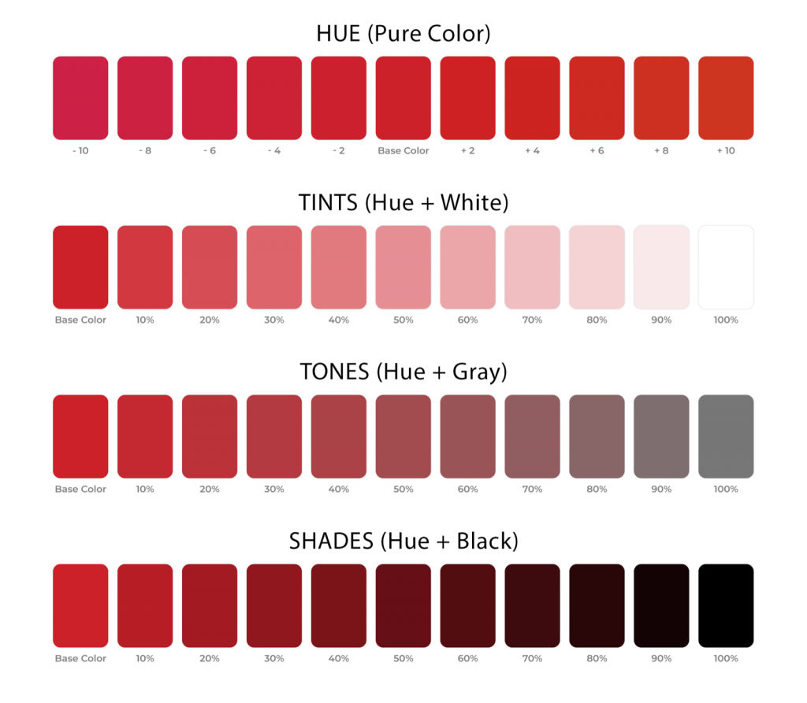
Shades, Tints, and Tones
Source: https://www.color-meanings.com/shade-tint-tone-difference/ by Jacob Olesen

Slide 15
The colour theory
Colour Perception: The perception of color is subjective and can vary based on individual differences in vision, culture, and personal experiences.
Factors such as lighting conditions, surrounding colors, and color contrast can also influence how we perceive color.
One of those factors can be shown by the position of colors on the color wheel in relation to other colors.
Color perception refers to the way in which humans perceive and interpret the wavelengths of light that are reflected off objects.
It involves the complex interaction between the eyes, brain, and external stimuli.

Slide 16
Colour Perception
a. Human Vision: The human visual system consists of the eyes, which capture light, and the brain, which processes this information to create visual perception.
The eyes contain specialized cells called cones, which are responsible for detecting color.
b. Trichromatic Theory: According to the trichromatic theory of color vision, there are three types of cones in the retina that are sensitive to different wavelengths of light: red, green, and blue.
By combining the signals from these cones, the brain is able to perceive a wide range of colors.

Slide 17
Colour Perception
c. Opponent Process Theory: The opponent process theory suggests that color perception is based on opposing pairs of colors, such as red-green, blue-yellow, and black-white.
When one color in a pair is stimulated, its opposite is suppressed, leading to the perception of color contrast.
d. Color Constancy: Color constancy is the phenomenon where the perceived color of an object remains relatively stable under different lighting conditions.
This allows us to perceive objects as having consistent colors even when viewed under different types of light.

Slide 18
Colour Perception
e. Color Blindness: Color blindness is a condition in which individuals have difficulty distinguishing between certain colors.
The most common type of color blindness is red-green color blindness, where individuals have difficulty distinguishing between red and green hues.
f. Cultural Influences: Cultural factors can also influence color perception.
Different cultures may associate certain colors with specific meanings or emotions, leading to variations in color preferences and interpretations.

Slide 19
Colour Perception
g. Emotional and Psychological Effects: Colors can evoke different emotional responses and psychological associations.
For example, warm colors like red and orange are often associated with energy and passion, while cool colors like blue and green are associated with calmness and tranquility.
h. Individual Variations: Color perception can vary between individuals based on factors such as age, gender, and genetics.
Some people may have more acute color vision or be more sensitive to certain colors than others.
Overall, color perception is a complex and dynamic process that plays a fundamental role in how we experience and interact with the world around us.
It is influenced by a combination of physiological, psychological, and cultural factors, shaping our visual experiences and interpretations of color.

Slide 20


Colour Perception
Sources : https://commons.wikimedia.org/w/index.php?search=colour+perception&title=Special:MediaSearch&go=Go&type=image
https://commons.wikimedia.org/w/index.php?search=colour+perception&title=Special:MediaSearch&go=Go&type=image

Slide 21
Color Symbolism
Is the use of color to represent traditional, cultural, or religious ideas, concepts, or feelings or to evoke physical reactions.
Choosing colors based on symbolism or color meanings can apply to everything from clothing to wall paint to home furnishings.
In desktop publishing and design choosing color based on color meanings applies to print and electronic projects from logos to Web site backgrounds.

Slide 22


Color Symbolism
Source: https://pixabay.com/photos/stop-icon-logo-graphics-design-7153484/ https://www.pexels.com/photo/man-in-white-and-green-crew-neck-t-shirt-9324345/

Slide 23
Color Symbolism
Psychological Effects: Colors can evoke different emotional responses and associations.
For example, warm colors like red and orange are often associated with energy, passion, and excitement, while cool colors like blue and green are associated with calmness, tranquility, and nature.
Color Harmony: Color harmony refers to the pleasing arrangement of colors in a design.
Different color harmonies, such as complementary, analogous, and triadic, can be used to create visual interest and balance in a composition.

Slide 24
Colour Symbolism
Color in Design: In design, color plays a crucial role in conveying meaning, establishing brand identity, and guiding user behavior.
Designers carefully select and manipulate colors to achieve specific visual effects and communicate effectively with their audience.
Color symbolism refers to the social cultural meanings and associations that people attribute to different colors.
Symbolic meanings can vary widely across cultures and contexts, but certain colors often evoke similar associations across different societies.

Slide 25
Colour Symbolism
Red: is often associated with passion, love, energy, and vitality. It can also symbolize danger, anger, or power.
In some cultures, red is used to symbolize luck, prosperity, and celebration.
Blue: is frequently associated with calmness, tranquility, and stability.
It can also symbolize trust, loyalty, and wisdom. In some contexts, blue is associated with sadness or melancholy.

Slide 26
Colour Symbolism
Green: is commonly associated with nature, growth, and renewal.
It can symbolize health, fertility, and harmony. Green is also associated with money, wealth, and prosperity.
Yellow: is often associated with happiness, optimism, and warmth.
It can also symbolize energy, creativity, and intellect.
In some contexts, yellow may symbolize caution or cowardice.

Slide 27
Colour Symbolism
Purple: is often associated with royalty, luxury, and spirituality. It can symbolize wealth, nobility, and ambition.
Purple is also associated with mystery, magic, and creativity.
White: is frequently associated with purity, innocence, and cleanliness.
It can symbolize peace, simplicity, and spirituality.
In some cultures, white is worn at funerals to symbolize mourning and remembrance.

Slide 28
Colour Symbolism
Black: is commonly associated with darkness, mystery, and power.
It can symbolize sophistication, elegance, and formality.
Black is also associated with mourning and death in many cultures.
Orange: is often associated with energy, enthusiasm, and warmth.
It can symbolize creativity, vitality, and adventure.
Orange is also associated with autumn and harvest.

Slide 29
Colour Symbolism
Pink: is frequently associated with femininity, sweetness, and romance.
It can symbolize love, affection, and tenderness.
In some contexts, pink may also symbolize youthfulness and innocence.
Brown: is commonly associated with earthiness, stability, and reliability.
It can symbolize warmth, comfort, and security.
Brown is also associated with nature and natural materials.

Slide 30
Colour Symbolism application in DTP
Text and graphics can also be created on the computer or imported from outside sources. You can put together elements such as:
Images from a scanner or a storage device or camera
Text written in a word processor
Graphics created using a drawing software
Colour application through graphics, illustrations, photography connotations and denotations
color symbolism, and the meanings of colors can vary widely depending on cultural and personal interpretations.
Understanding color symbolism can be valuable in various contexts, including art, design, marketing, and communication, as it can help evoke specific emotions, convey messages, and create meaningful experiences for the audience.

Slide 31
More about colours
Colors are more than a combination of red and blue or yellow and black. They are non-verbal communication.
Colors have symbolism and color meanings that go beyond ink. These are the colours currently cover in detail: Beige | Black | Blue (plus azure | beryl | cerulean | cobalt | corporate blue | indigo | navy | sapphire) | Brown | Gold | Gray | Green (plus chartreuse) | Ivory | Lavender | Orange | Pink (plus fuchsia) | Purple (plus lilac | plum | violet) | Red (plus blood red | crimson | scarlet | vermilion) | Silver | Turquoise | White | Yellow
As you design brochures, logos, and Web sites, it is helpful to keep in mind how the eye and the mind perceive certain colors and the color meanings we associate with each color.

Slide 32
Summary
Color theory is a set of principles and guidelines that explain how colors interact with each other and how they can be combined to create harmonious and visually pleasing compositions. It encompasses concepts such as color mixing, color harmony, and the psychological effects of color.
Color Wheel: The color wheel is a visual representation of the relationships between different colors. It organizes colors in a circular format, with primary colors spaced evenly around the wheel and secondary and tertiary colors positioned between them.
Color Mixing: There are two main methods of color mixing: additive and subtractive. Additive color mixing involves combining colored light sources, as seen in digital displays. Subtractive color mixing involves combining pigments, as seen in painting and printing.
Overall, color is a multifaceted and powerful element of visual communication, with a profound impact on how we perceive and interact with the world around us.

Slide 33
THANK YOU
LECTURE 5
BY DR. RAPHAEL OGUTU,
Mass Communication Department,
AFRICA NAZARENE UNIVERSITY

