Slide 1
VISUAL COMMUNICATION
WEEK 7 Designing with Images (Photography and drawings)
By Dr. Raphael Ogutu

Slide 2
VISUAL COMMUNICATION
Designing with Images (Photography and drawings)
Intended Learning Outcome
At end of this week lesson the students should be able to:
1. Explore the basics of designing with images
2. Learn to transform an image by cropping, resizing, flipping, and rotating it.
3. Develop an awareness of the tools available in image editing software.
4. Practice how Designing with Images work

Slide 3
What is design, designer, an image, and designing?
Designing is the activity, the process designers undergo to create the visual, material, spatial and experiential environments in response to a given problem, in a specific context.
The design process involves a structured design methodology including phases of research, ideation, iteration, prototyping and implementation.
This process considers the production technologies, distribution networks and the eventual economic, social, cultural and environmental impacts of the design outcomes.

Slide 4
What is design, designer, an image, and designing?
Designers are the professionals, people who hold creative, interdisciplinary knowledge bases, skills and experiences, with the shared obligation to recognize a code of ethics and conduct.
Designers consider the impact of their designs on individuals, humanity and the well-being of the planet
Designs are the artefacts produced by designing, the ‘objects’, ‘solutions’, ‘collaborations’ ‘systems’ and even ‘concepts’ produced by designing. Sometimes the result is not physically tangible, but is instead experienced in the abstract

Slide 5
What is design, designer, an image, and designing?
An image is a visual representation of something, while a digital image is a binary representation of visual data. These images can take the form of photographs, graphics and individual video frames.
In Desktop publishing an image could be a picture that was created or copied and stored in electronic form. An image can also be described in terms of vector graphics or raster graphics.

Slide 6
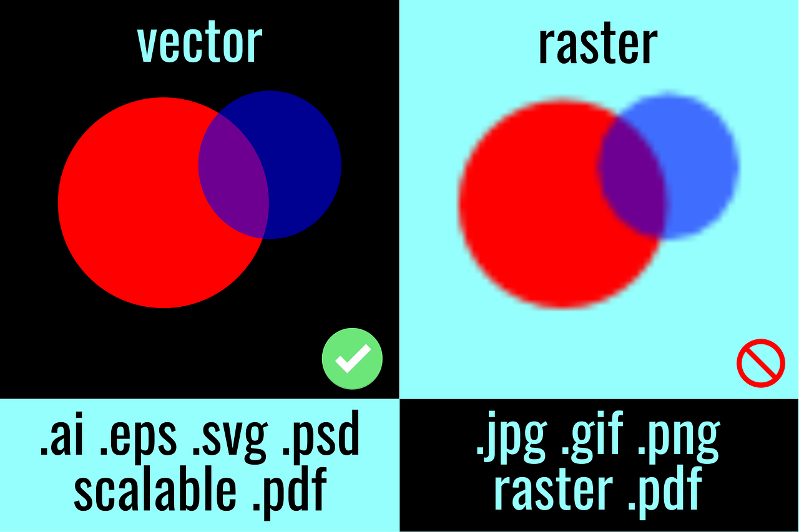
What is design, designer, an image, and designing?
Sources: https://pixabay.com/vectors/raster-vs-vector-artwork-5171211/

Slide 7
Defining art and design images
1. Art Images:
Expression: Art images are primarily created for self-expression, exploring emotions, ideas, and concepts without strict adherence to practical considerations.
Subjectivity: The interpretation of art images can vary widely among viewers, as they often evoke subjective responses and interpretations.
Originality: Art images typically prioritize originality and creativity, encouraging artists to experiment with unconventional techniques and styles.

Slide 8
Defining art and design images
Art Images
• Emotion: Art images aim to evoke emotional responses from viewers, whether through the use of color, composition, symbolism, or subject matter.
• Autonomy: Art images are often created autonomously, driven by the artist's personal vision and artistic sensibilities rather than external requirements or constraints.

Slide 9
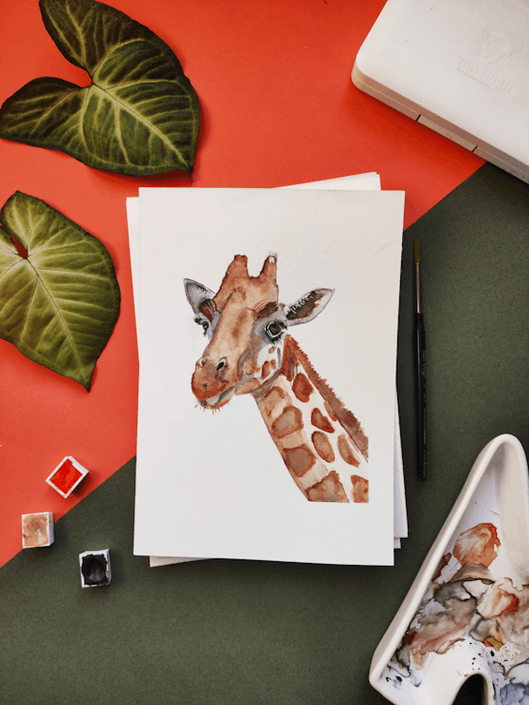
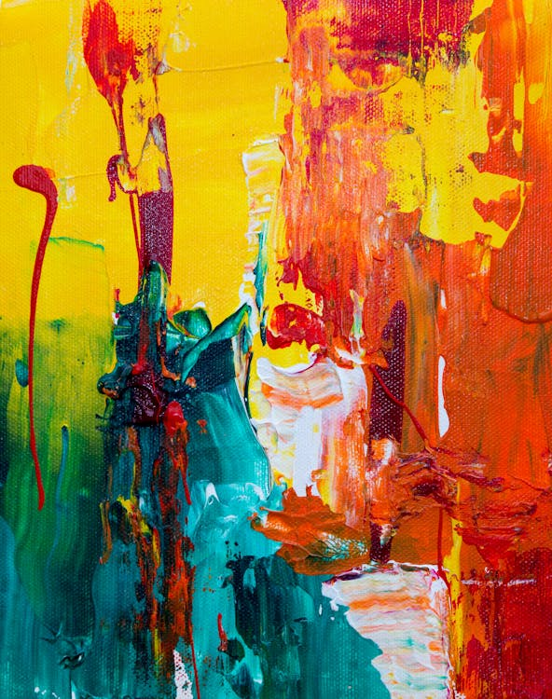
Defining art and design images
https://www.pexels.com/photo/orange-red-and-green-abstract-painting-1585325/
Sources:https://www.pexels.com/photo/painting-of-giraffe-3246665/

Slide 10
Defining art and design images
2. Design Images:
• Functionality: Design images are created with specific purposes and objectives in mind, such as communicating information, solving problems, or eliciting desired actions from the audience.
• Utility: Design images are intended to serve practical purposes, such as enhancing readability, guiding navigation, or promoting products and services.
• Clarity: Design images prioritize clarity and effectiveness in communication, often employing clear visuals and concise messaging to convey information efficiently.

Slide 11
Defining art and design images
2. Design Images:
• Consistency: Design images aim for consistency and coherence within a broader design context, adhering to established branding guidelines, visual hierarchy, and design principles.
• Audience-Centric: Design images are tailored to the needs and preferences of the target audience, considering factors such as demographics, cultural norms, and user experience.
• Problem-Solving: Design images often involve problem-solving processes, addressing specific challenges or requirements posed by the project brief or client brief.

Slide 12
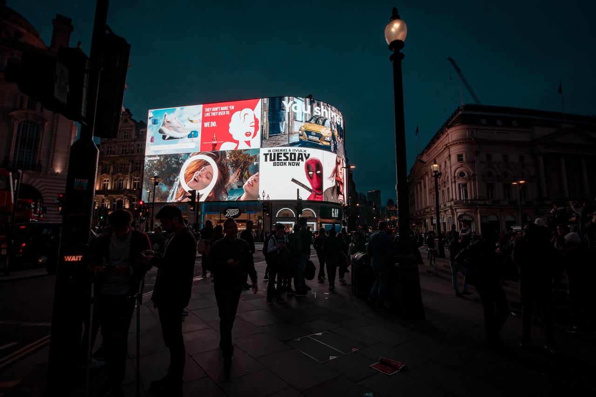
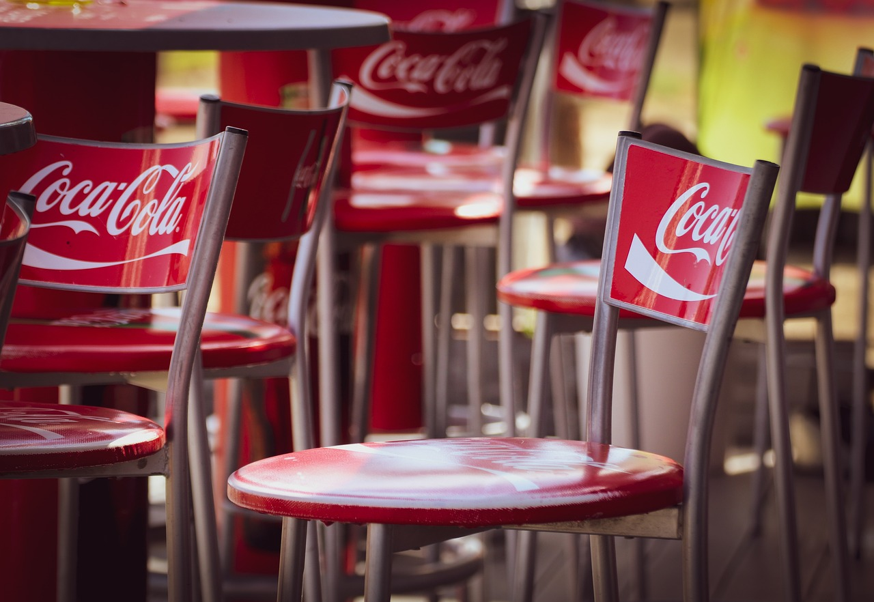
Defining art and design images
Sources: https://pixabay.com/photos/london-neon-sign-advertising-people-3794348//
https://pixabay.com/photos/coke-advertising-bar-restaurant-3807410/

Slide 13
Types of images in art and design
Art Images:
1. Paintings: Created with various painting mediums such as oil, acrylic, watercolor, or mixed media, paintings are highly expressive and often showcase the artist's unique style and vision.
2. Drawings: encompass a wide range of techniques, including pencil, charcoal, ink, pastel, and digital drawing. They can range from detailed and realistic to abstract and conceptual.
3. Sculptures: are three-dimensional artworks created by shaping or carving materials such as clay, wood, metal, stone, or plastic. They can be representational or abstract and are often displayed in galleries, public spaces, or outdoor environments.

Slide 14
Types images in art and design
4. Photography: involves capturing images with a camera, whether analog or digital. Photographs can document reality, convey emotions, tell stories, or explore artistic concepts through composition, lighting, and subject matter.
5. Printmaking: techniques such as etching, lithography, screen printing, and woodcut produce multiple copies of an image from a matrix. Each print can have unique characteristics due to variations in the printing process.
6. Digital Art: encompasses various forms of artwork created using digital tools and technologies, including digital painting, illustration, graphic design, 3D modeling, and animation. It allows for versatility, experimentation, and manipulation of imagery through software programs.

Slide 15
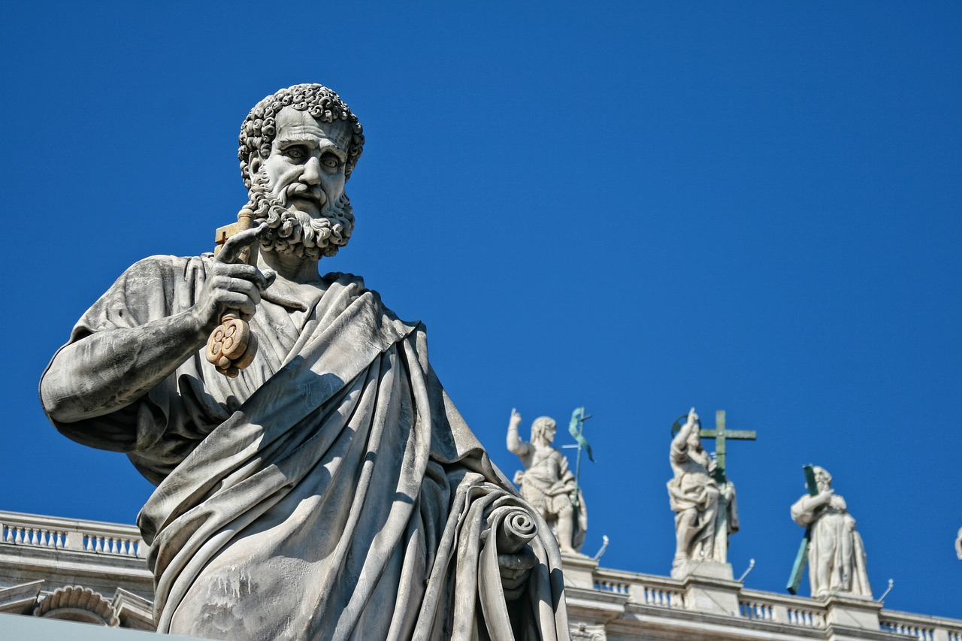
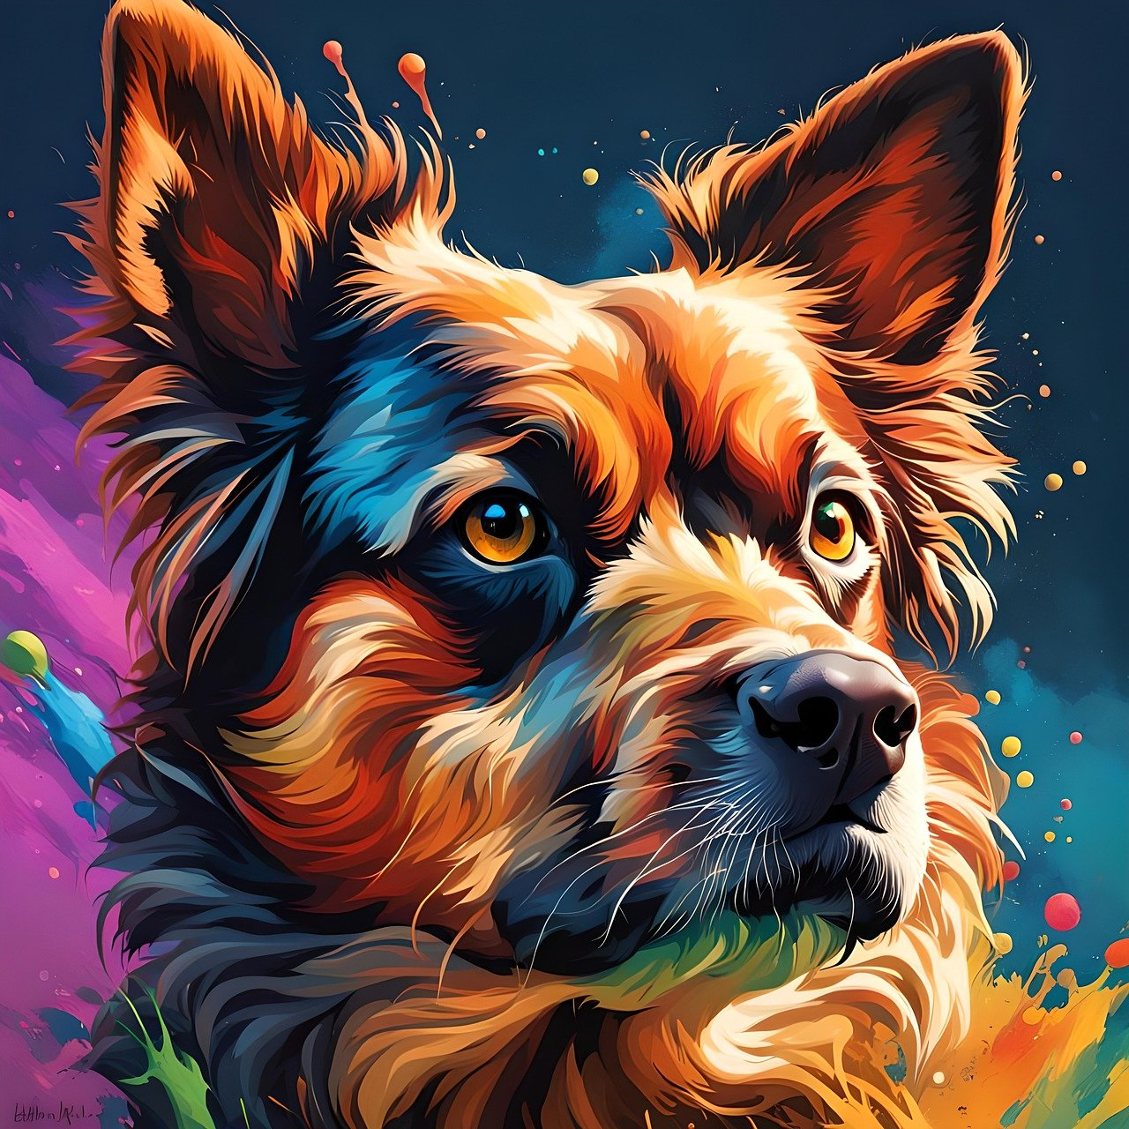
Types of images in art and design
Sources:https://pixabay.com/photos/saint-pierre-statue-sculpture-art-1633682/
https://pixabay.com/photos/dog-animal-mammal-cute-digital-art-8651438/

Slide 16
Types of images in art and design
Design Images
1. Logos and Icons: are visual symbols or marks representing brands, organizations, or products. Icons are simplified graphical representations used to represent actions, functions, or concepts within user interfaces.
2. Illustrations: are visual representations created to accompany text or convey specific messages in design projects such as books, magazines, websites, or advertisements. They can be hand-drawn, digitally created, or a combination of both.
3. Photography for Design: plays a crucial role in design, whether it's product photography for e-commerce websites, lifestyle photography for advertising campaigns, or editorial photography for magazines and brochures.

Slide 17
Types of images in art and design
4. Infographics: Infographics are visual representations of data, information, or processes designed to make complex concepts more understandable and engaging. They often combine text, icons, illustrations, and charts to communicate effectively.
5. UI/UX Graphics: User interface (UI) and user experience (UX) design rely heavily on visual elements such as buttons, menus, controls, and navigation bars to create intuitive and engaging digital experiences.
6. Packaging Graphics: Packaging design incorporates visual elements such as images, typography, colors, and branding to attract consumers, communicate product features, and differentiate products on store shelves.

Slide 18
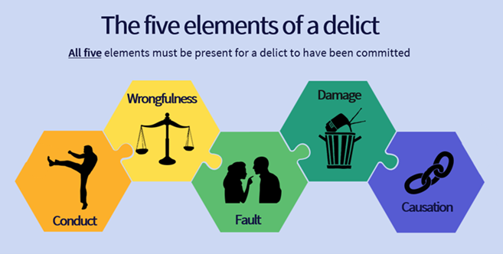
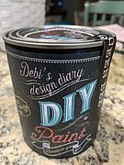
Readability and Legibility of Typography
Sources::https://commons.wikimedia.org/wiki/File:Inforgraphic_on_the_Elements_of_a_Delict.png https://commons.wikimedia.org/wiki/File:Can_Of_Debi%27s_design_diary_DIY_chalk_paint.jpg

Slide 19
Transforming an image by cropping, resizing, flipping, and rotating it
Cropping: is the process of removing part of an image.
Cropping is also about pulling out a single element that can be used in a way not possible if the entire image is selected
Resizing: You can resize within a desktop publishing program, but it is better to resize in an image editing program such as Photoshop.
By saving within an image management program, you will reduce the file size of your image and, therefore, of the final document.
You may need to make minor size adjustments once the image is placed in a document.
Resizing is also called scaling since you scale the size up or down.

Slide 20
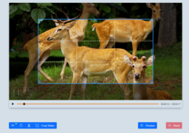

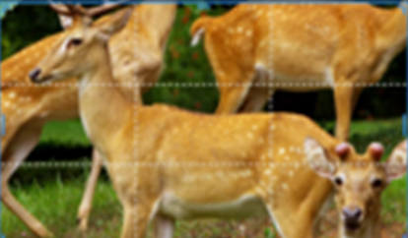
Transforming an image by cropping, resizing, flipping, and rotating it
Sources:: https://commons.wikimedia.org/w/index.php?search=cropping+images&title=Special:MediaSearch&go=Go&type=image

Slide 21
Transforming an image by cropping, resizing, flipping, and rotating it
Flipping an image vertically or horizontally is an option. Flipping is particularly useful when working with images of people. Generally, it is best if a person’s eyes are focused into a page rather than away from it.
Rotating: Photographs that have been shot horizontally rather than vertically need to be rotated before they can be used, which is easy to do and easy to see. This is more important, but less easy to see, when an image has been photographed slightly tilted.

Slide 22
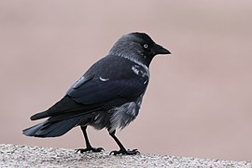
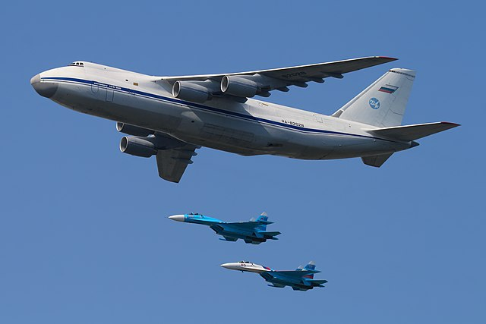

Transforming an image by cropping, resizing, flipping, and rotating it
Sources : https://commons.wikimedia.org/w/index.php?search=cropping+picture&title=Special:MediaSearch&go=Go&type=image

Slide 23
The tools available in image editing software
Selection Tools:
Marquee Selection: Allows you to select rectangular or elliptical areas of an image.
Lasso Selection: Enables freehand selection of irregular areas.
Magic Wand: Selects areas based on color similarity or tolerance.
Quick Selection: Automatically selects areas based on contrast and texture.
Drawing and Painting Tools:
Brush Tool: Allows you to paint or draw freehand strokes with various brush styles and sizes.
Pencil Tool: Similar to the brush tool but creates hard-edged strokes.
Eraser Tool: Removes portions of an image or drawing.
Clone Stamp Tool: Clones pixels from one area of an image to another.
Gradient Tool: Creates gradual transitions between colors.

Slide 24
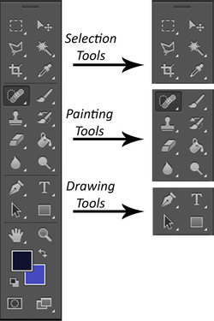
The tools available in image editing software
Source: https://www.digitalfxtbook.com/painting-tools.html

Slide 25
The tools available in image editing software
3. Transform Tools:
• Move Tool: Moves selected pixels or objects within the image.
• Scale Tool: Resizes selected objects or layers.
• Rotate Tool: Rotates selected objects or layers.
• Crop Tool: Crops the image to a specified size or aspect ratio.
• Transform Tool: Allows for more complex transformations like skewing, distorting, and perspective adjustments.

Slide 26
The tools available in image editing software
4. Adjustment Tools:
• Brightness/Contrast: Adjusts the overall brightness and contrast of the image.
• Levels: Fine-tunes the tonal range of shadows, mid-tones, and highlights.
• Curves: Provides precise control over tonal adjustments using a curve graph.
• Hue/Saturation: Modifies the hue, saturation, and lightness of specific color ranges.
• Color Balance: Adjusts the balance of colors in highlights, mid-tones, and shadows.

Slide 27
The tools available in image editing software
7. Filters and Effects:
• Blur/Sharpen: Softens or sharpens areas of the image.
• Noise Reduction: Reduces digital noise or graininess in photos.
• Artistic Filters: Applies artistic effects like oil painting, watercolor, or sketch.
• Lens Correction: Corrects distortion, vignetting, and chromatic aberration caused by camera lenses.

Slide 28
The tools available in image editing software
8. Layers and Masks:
• Layer Palette: Manages individual layers within the image.
• Layer Masks: Allows for non-destructive editing by hiding or revealing portions of layers.
• Blending Modes: Change how layers interact with each other to create different effects.

Slide 29
1. Understanding the Purpose: Before incorporating images into a design, it's crucial to understand the purpose of the project. Whether it's a website, poster, brochure, or any other medium, knowing the target audience and the message you want to convey will guide your image choices.
2. Selecting Relevant Images: Choose images that are relevant to the content and message of your design. Consider the tone, theme, and context of the project. For example, if you're designing a website for a travel agency, using high-quality images of exotic destinations can help evoke the desired emotions and attract potential customers.
3. Quality and Resolution: High-quality images are essential for a professional-looking design. Low-resolution images can appear pixelated or blurry when enlarged, diminishing the overall quality of your design. Use images with sufficient resolution for the intended size and format of your project.
Practice how Designing with Images work

Slide 30
Practice how Designing with Images work
4. Composition and Layout: Pay attention to the composition and layout of your design. Images should complement the text and other design elements, rather than overpowering them. Experiment with different arrangements and placements to find the most visually appealing layout.
5. Balance and Contrast: Achieving a balance between images and other design elements is important for visual harmony. Use contrast to draw attention to key elements or create visual interest. For example, pairing a bold image with minimalist text can create a striking visual contrast.
6. Consistency: Maintain consistency in the style, color scheme, and tone of your images to ensure a cohesive design. Consistent imagery helps reinforce branding and creates a unified look and feel across different parts of your project.

Slide 31
Practice how Designing with Images work
Accessibility: Consider accessibility when using images in your design. Provide alternative text descriptions for images to make your content more accessible to users with visual impairments. Additionally, ensure that images are optimized for fast loading times, especially on digital platforms.
8. Copyright and Licensing: Respect copyright laws and licensing agreements when using images in your design. Avoid using copyrighted images without permission, and consider using stock photos or hiring a photographer if needed. Make sure to credit the source of the image if required by the licensing terms.

Slide 32
Summary
While art and design images serve different purposes and follow distinct principles, they can both be powerful forms of visual communication and creativity.
Additionally, there can be instances where art and design intersect, such as in graphic design, where artistic elements are used to convey messages and achieve specific design goals.
These are just a few examples of the types of images found in both art and design.
Each type serves specific purposes and contributes to the overall visual language and communication of the artwork or design project.
Illustrations and drawings play a vital role in graphic design, offering a creative and versatile means of visual expression.

Slide 33
Summary
Whether used to communicate ideas, reinforce brand identity, evoke emotions, or enhance visual appeal, illustrations enrich the design process and contribute to creating memorable and impactful designs.
photography plays a multifaceted and essential role in graphic design, serving as a powerful tool for visual communication, brand identity, emotional storytelling, and aesthetic appeal.
By harnessing the creative potential of photography, graphic designers can create compelling and impactful designs that resonate with audiences and leave a lasting impression.
The many tools available in image editing software, providing users with the flexibility and control to edit and manipulate digital images to their desired specifications.

Slide 34
THANK YOU
LECTURE 7
BY DR. RAPHAEL OGUTU,
Mass Communication Department,
AFRICA NAZARENE UNIVERSITY

