Slide 1
VISUAL COMMUNICATION
WEEK 8 Layout and Business Publications
By Dr. Raphael Ogutu

Slide 2
VISUAL COMMUNICATION
Layout and Business Publications
Intended Learning Outcome
At end of this week lesson the students should be able to:
1. Show an understanding of basic layout design
2. Explore the principles and elements layout designs
3. Application of corporate identity design

Slide 3
Introduction to layout design
Layout composition is the arrangement of visual elements on a page.
There are numerous tools designers use to structure their composition, including the use of grids, emphasis and scale, balance, and hierarchy.
A layout refers to the arrangement or organization of visual elements within a design or composition, whether it's for print, digital media, or physical spaces.
It involves determining the placement, sizing, spacing, and relationship between various components to achieve a harmonious and effective presentation.

Slide 4
Introduction to layout design
Layouts play a crucial role in guiding the viewer's attention, conveying information, and creating visual hierarchy.
They can range from simple and minimalist to complex and dynamic, depending on the specific requirements and objectives of the design project.
In graphic design, editorial design, web design, and other creative disciplines, thoughtful layout design is essential for creating visually appealing and functional compositions that effectively communicate messages and engage the audience.

Slide 5
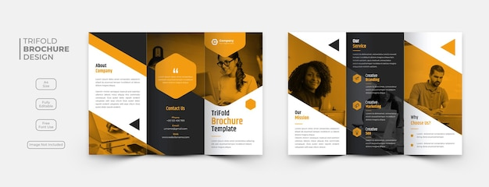
Introduction to layout design
Sources: https://www.freepik.com/free-psd/creative-business-trifold-brochure-template_19857741.htm#query=brochure%20design&position=0&from_view=keyword&track=ais_user_b&uuid=64bdc661-bbb1-4db6-971f-834f28b24418

Slide 6
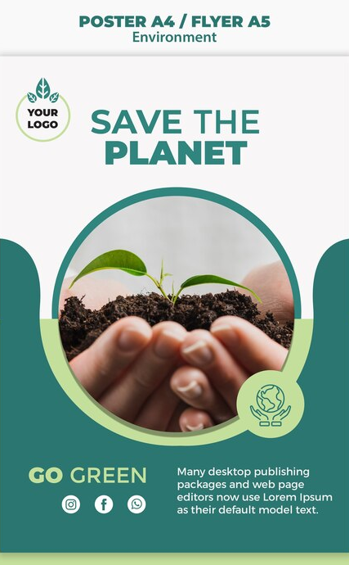
Layout in art and design
Play a vital role in structuring your design and determining how effectively you communicate visually.
help structure a design and guide the viewer to the key information, layout design includes the arrangement of images, text, and spaces, and how they relate to each other.
influences how a viewer interprets information and how clearly and easily they absorb a message.
In art and design, a layout refers to the arrangement of visual elements within a composition to achieve a desired aesthetic or communicative effect.
Sources: https://www.freepik.com/free-psd/save-planet-concept-mock-up_6674712.htm#query=cover&position=17&from_view=keyword&track=sph&uuid=0992027a-edfe-4a09-a752-fc6be61475e5

Slide 7
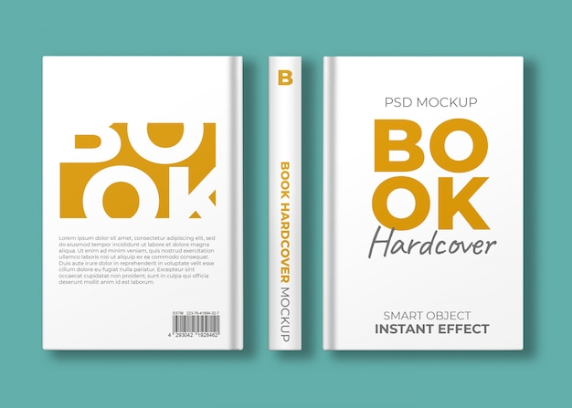
Layout in art and design
Involves the strategic placement of elements such as images, text, shapes, colors, and negative space to create a cohesive and balanced design.
Layouts serve as the foundation for various creative projects, including paintings, drawings, sculptures, graphic design, web design, and architectural design.
In art, layout considerations often revolve around principles of composition, such as balance, symmetry, rhythm, contrast, and unity.
Source: https://www.freepik.com/free-psd/book-hardcover-mockup-three-views_9866176.htm#query=book%20cover&position=3&from_view=keyword&track=ais_user_b&uuid=34854381-d4b8-4c3f-90d6-79bb0ed212c9

Slide 8
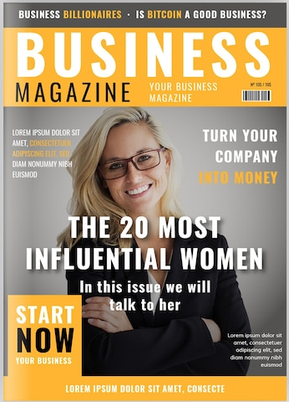
Layout in art and design
Artists carefully arrange elements within their artwork to create visually pleasing or thought-provoking compositions that convey their intended message or evoke specific emotions.
are instrumental in communicating information, guiding user interactions, and enhancing visual appeal.
Designers employ them to organize content effectively, establish visual hierarchy, and improve usability across a wide range of mediums, including print media, digital interfaces, environmental graphics, and product packaging.
Source: https://www.freepik.com/free-vector/business-magazine-cover-template-with-photo_2497036.htm#fromView=search&page=1&position=36&uuid=4f6fa463-b571-4931-addc-81a7a5acf6ea

Slide 9
Why is Layout Design so important?
1. Information Hierarchy: establishes an information hierarchy, guiding the viewer's eye to key content and ensuring the most critical information is readily accessible.
2. Visual Impact: determines the visual impact of a design, influencing the overall aesthetic and first impressions.
3. Storytelling: contributes to storytelling by arranging elements in a sequence that conveys a narrative or message.
4. User Experience: In digital design, layout affects the user experience by providing intuitive navigation and enhancing the usability of a website or application.
5. Brand Identity: Consistent layout design reinforces brand identity by creating a cohesive visual language for a company's materials.

Slide 10
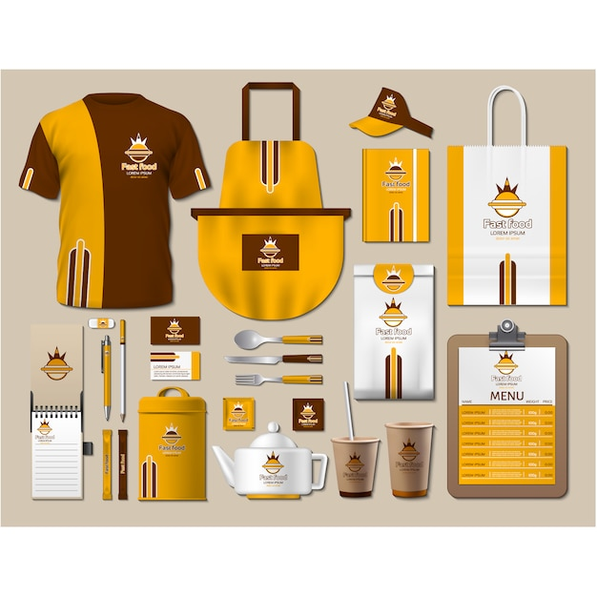
Applications of Layout Design
1. Editorial Design: used to structure content in newspapers, magazines, and books, ensuring readability and visual appeal.
2. Web Design: applied to create user-friendly and aesthetically pleasing websites, optimizing content organization and user interactions.
3. Advertising: creating of visually compelling and memorable advertisements that resonate with the target audience.
4. Packaging Design: Designers utilize layout design to communicate product information, branding, and benefits effectively.
5. Event Marketing: in promotional materials, such as flyers and posters, to convey event details and capture attention.
Source: https://www.freepik.com/free-vector/coffee-shop-stationery-with-yellow-design_1193058.htm#fromView=search&page=1&position=45&uuid=33738c3b-2310-40c0-b063-31224b708902

Slide 11
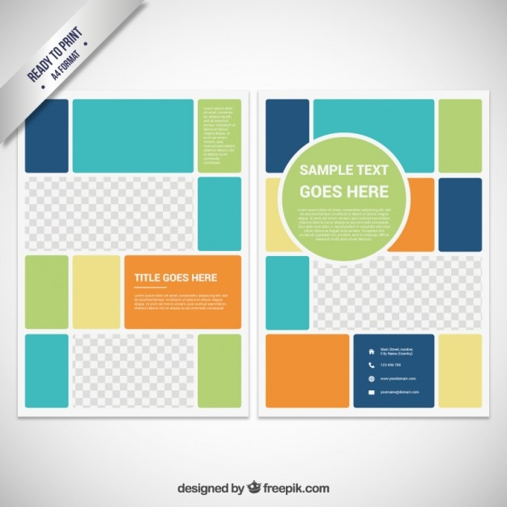
Creating Effective Layout Designs
1. Understanding the Audience: Know your target audience and tailor the layout to their preferences and needs.
2. Information Hierarchy: Establish a clear information hierarchy with prominent placement for crucial content.
3. Grid Systems: Employ grid systems for alignment and consistency, which help create a structured and visually pleasing layout.
4. Whitespace: Use whitespace strategically to create balance and prevent visual clutter.
5. Typography: Pay attention to typography choices and use fonts that enhance readability and aesthetics.
Source: https://www.freepik.com/free-vector/brochure-template-color-block-style_793543.htm#fromView=search&page=1&position=8&uuid=497c196e-cafa-4077-9f7d-35daec3c986a

Slide 12
Celebrating the Impact of Layout Design
The impact of layout design in the realm of visual communication is profound:
1. Effective Information Delivery: ensures that information is delivered in a structured and comprehensible manner, making it accessible to the viewer.
2. Visual Appeal: It influences the visual appeal of designs, creating a memorable and engaging experience for the audience.
3. Storytelling: is instrumental in conveying narratives, whether in editorial content, product presentations, or brand stories.
4. User Experience: In the digital world, it enhances the user experience by providing clarity and ease of navigation.
5. Brand Consistency: Consistent layout design reinforces brand identity, ensuring that materials maintain a cohesive and recognizable visual language (Luscombe, 2023).

Slide 13
Layout Design Across Diverse Industries
Layout design is pervasive in various industries:
1. Education: Educational materials, from textbooks to online courses, rely on layout design to present information effectively.
2. Healthcare: Layout design is essential for patient information materials, ensuring clarity and comprehension.
3. Entertainment: The entertainment industry utilizes layout design in promotional materials, event programs, and visual storytelling.
4. Retail: In the retail sector, layout design influences the presentation of products in physical stores and online marketplaces.
5. Technology: Technology companies employ layout design for user interfaces, creating user-friendly and visually appealing applications and websites (Luscombe, 2023).

Slide 14
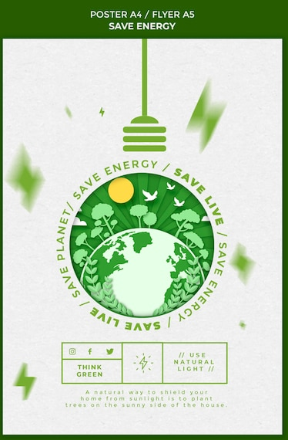
The Future of Layout Design
As design and technology continue to evolve, the future of layout design holds exciting possibilities:
1. Responsive Design: Layout design will continue to adapt to various devices and screen sizes, ensuring an optimal user experience.
2. User-Centric Design: The emphasis on user-centric design will lead to highly intuitive layouts prioritizing user needs.
3. Sustainability: Sustainable design practices may influence layout design, promoting eco-friendly and resource-efficient layouts (Luscombe, 2023).
Source: https://www.freepik.com/free-psd/save-energy-flyer-template_12548782.htm#fromView=search&page=1&position=47&uuid=7c557bfc-8d9d-4a81-ab2c-ba18bd8cc4f8

Slide 15
Principles & Elements of Layout Design
• Purpose and Audience
Approach page layout the same way that you do writing: determine your audience, define your purpose, and communicate your message.
• Organizing Information
Photographs, pull-quotes, decks, and headlines help you tell the story. Other elements such as subheads, boxes, rules, and white space help you organize the story.
• Getting Their Attention
In today's media-intensive culture, people often decide that reading an ad, brochure, or newsletter is not worth their time, so even if your publication is important, it may end up in the wastebasket.
An unusual design, however, can spark their interest.

Slide 16
Principles & Elements of Layout Design
Balance is another word for concerns about symmetry and asymmetry. Symmetry provides stability and rest for the eye, while asymmetry creates tension and visual interest. Finding ways to create balance often depends on the piece.
Alignment: Unify the appearance of your publication by aligning the elements on individual pages and creating strong page-to-page alignments, as well.
Repetition of key elements (logo, box, rules, graphics etc.,) from page to page unifies the appearance of your publication.
In a newsletter, for example, you might place the company logo at the bottom of every page, or in a brochure you might repeat a small graphic element in a variety of places.

Slide 17
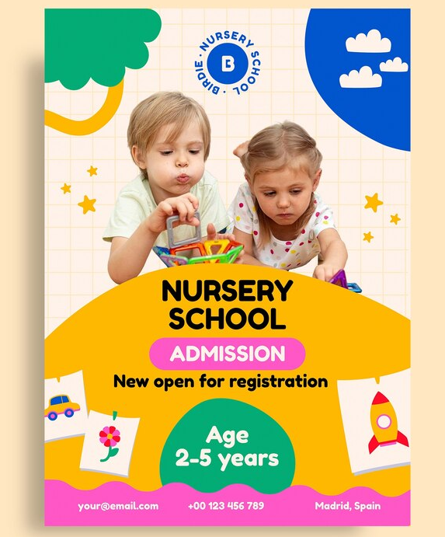
Principles & Elements of Layout Design
Emphasis: Use a hook to get the reader's attention. Anything from an interesting photo or graphic to a pull-quote isolated in a column of white space can catch the reader's eye.
Proximity: Place related information in proximity, and separate unrelated information with white space, rules, and borders.
Source: https://www.freepik.com/free-vector/school-poster-template-design_170661647.htm#fromView=search&page=1&position=21&uuid=43c10183-bab2-47e1-948f-77fc50d98458

Slide 18
Principles & Elements of Layout Design
The style sheet is one of the best features of electronic publishing.
Attributes such as typeface, type size, and leading can be predefined, making the job of formatting your project quick and easy.
Once styles are defined, you can instantly apply different attributes to a single word, several paragraphs, or an entire publication.
Before you begin defining styles for your publication, you should do the following:
Specify the page dimensions.
Assign the number of pages.
Set the width of the margins.
Sources::https://www.volusion.com/blog/content/images/wp/color1.jpg

Slide 19
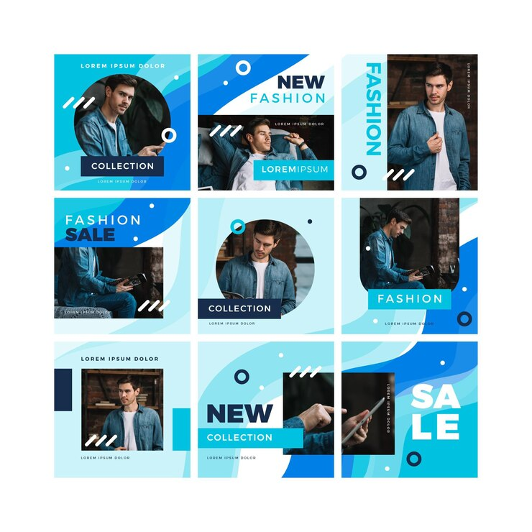
Principles & Elements of Layout Design
Non printing vertical and horizontal blue lines form a grid on the electronic page, creating an underlying structure for your layout.
PageMaker's or InDesign’s Master Page feature, found on the Window pull-down menu, makes the creation of a grid incredibly easy.
Margins and columns form the base of the grid, but you can intersect an unlimited number of vertical and horizontal blue lines across the columns to align headings, text, rules, and graphics with precision.
To drag and drop a blue line, just click on the ruler surrounding the page.
Source:https://www.freepik.com/free-vector/abstract-collection-social-media-puzzle-feed-posts_10276990.htm#fromView=search&page=1&position=21&uuid=6c3373f1-6cc0-4539-bac9-746ba814f262

Slide 20
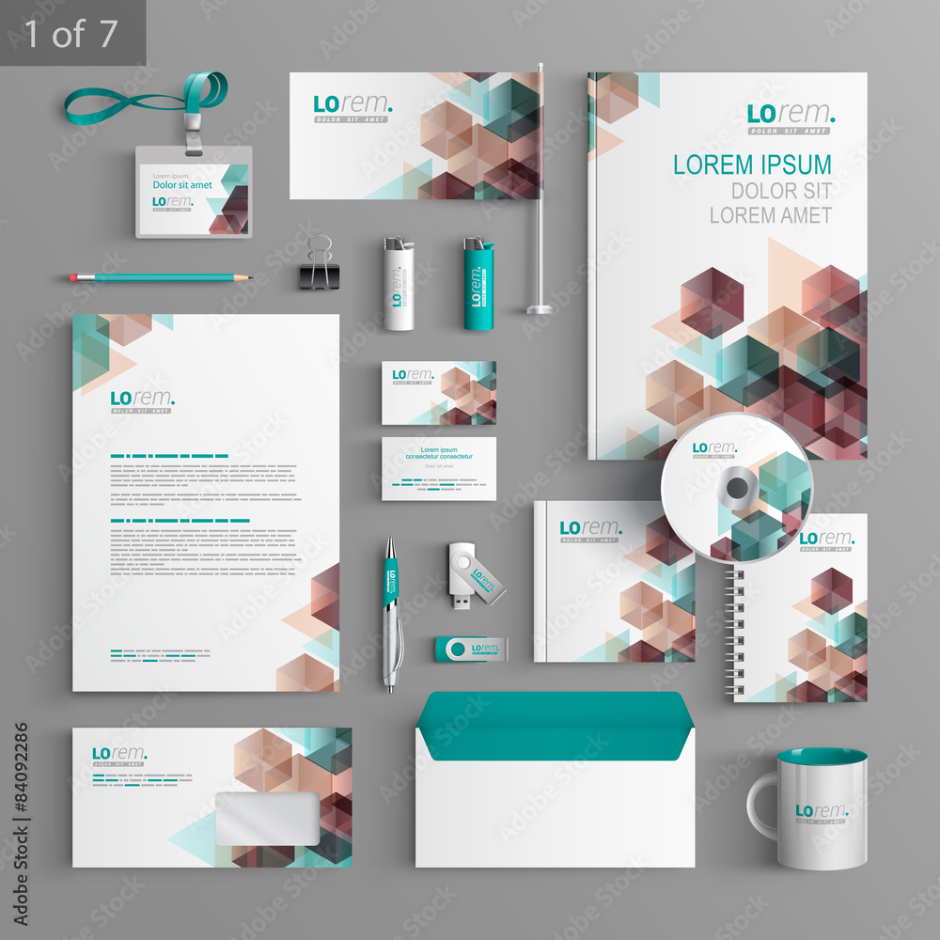
Business publications
What is corporate identity design?
The corporate design showcases the visual identity of the corporate.
includes all the visual assets of the company like name, logo, brand colors, brand visuals, tagline, etc. that help differentiate the company from others visually.
Corporate identity design, often referred to simply as corporate branding, encompasses the visual elements and design strategies used to establish and communicate the identity of a company or organization.
It goes beyond just a logo and extends to various visual elements that represent the company's values, mission, and personality consistently across all communication channels.
Sources::https://stock.adobe.com/images/id/84092286?clickref=1011lyxkjt4D&mv=affiliate&mv2=Freepik&as_camptype=&as_channel=affiliate&as_source=partnerize&as_campaign=Freepik&as_content=api&as_audience=srp&sdid=6WTV6YJ5#state=%7B%22ac%22%3A%22stock.adobe.com%22%7D&token_type=bearer&expires_in=86399

Slide 21
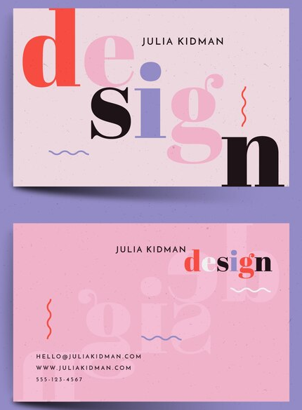
Corporate identity design
The following is a breakdown of what corporate identity design typically involves:
1. Logo Design: The logo is a central element of corporate identity design. It serves as the visual representation of the company and is often the first point of contact for customers. A well-designed logo should be memorable, versatile, and reflective of the company's brand identity.
2. Color Palette: Corporate identity design establishes a consistent color palette that reflects the company's brand personality and values. Colors evoke emotions and associations, so choosing the right colors is essential for conveying the desired message and creating a cohesive visual identity.
Source: https://www.freepik.com/free-vector/template-colorful-minimal-business-card_6403464.htm#fromView=search&page=1&position=28&uuid=9d4a0f1a-6ee9-46f4-b8b2-99f8a52dee69

Slide 22
Corporate identity design
3. Typography: Typography plays a crucial role in corporate identity design by defining the fonts and typefaces used in various communication materials. Consistent typography helps reinforce brand recognition and maintain a cohesive brand image across different platforms and media.
4. Visual Elements: Beyond the logo, corporate identity design may include other visual elements such as icons, patterns, illustrations, or photography styles that further enhance the brand's visual identity and contribute to a unified brand experience.

Slide 23
Corporate identity design
5. Brand Guidelines: Brand guidelines document the rules and specifications for using the company's visual identity elements consistently. They outline guidelines for logo usage, color usage, typography, imagery, and other brand elements to ensure brand consistency across all communication channels and touchpoints.
6. Stationery Design: Corporate identity design often extends to stationery items such as business cards, letterheads, envelopes, and presentation templates. Consistent branding across these materials helps reinforce the company's professionalism and credibility.

Slide 24
Corporate identity design
7. Marketing Collateral: such as brochures, flyers, posters, and banners should also adhere to the company's corporate identity guidelines.
Consistent branding across marketing materials helps reinforce brand recognition and build brand loyalty among customers.
8. Digital Presence: Corporate identity design extends to the company's digital presence, including website design, social media profiles, email templates, and digital advertisements.
Consistent branding across digital platforms helps create a cohesive brand experience for online audiences.
Source: https://www.freeimages.com/download/social3d-icon-set-5690405

Slide 25
Application of corporate identity design
1. Brand Recognition and Differentiation: Corporate identity design helps companies stand out in crowded markets by creating distinctive visual elements such as logos, colors, and typography.
2. Brand Consistency: Consistency is key in corporate identity design.
By establishing clear brand guidelines and ensuring adherence to them across all touchpoints, companies maintain a cohesive brand image and reinforce brand recognition. Consistent application of visual elements, messaging, and tone of voice builds trust and credibility with customers and stakeholders

Slide 26
Application of corporate identity design
3. Customer Experience: From the moment customers encounter the company's logo and branding to their interactions with products, packaging, and customer service, the application of corporate identity design influences how customers perceive and engage with the brand.
4. Employee Engagement and Pride: When employees feel aligned with the company's brand identity and values, they become brand ambassadors who embody the brand's personality and culture.
Consistent application of corporate identity design in internal communications, employee uniforms, and office decor fosters a sense of pride and belonging among employees.

Slide 27
Application of corporate identity design
5. Marketing and Communication: It guides the creation of marketing collateral, advertising campaigns, social media content, and other communication materials.
Consistent branding ensures that all marketing efforts are aligned with the company's brand identity and messaging, maximizing their impact and effectiveness.
6. Product and Packaging Design: Corporate identity design influences product design and packaging to ensure that they reflect the brand's identity and values.
From product logos and labels to packaging materials and colors, the application of corporate identity design enhances product visibility, recognition, and appeal to customers.

Slide 28
Application of corporate identity design
7. Digital Presence and User Experience: In today's digital age, corporate identity design extends to the company's online presence, including website design, mobile apps, social media profiles, and email communications.
Consistent branding across digital platforms creates a seamless user experience and reinforces brand recognition and trust among online audiences.
8. Corporate Events and Sponsorships: Corporate identity design is applied to corporate events, conferences, trade shows, and sponsorships to ensure that they align with the company's brand image and values.
Consistent branding at such events reinforces brand visibility and association with positive experiences and engagements.

Slide 29
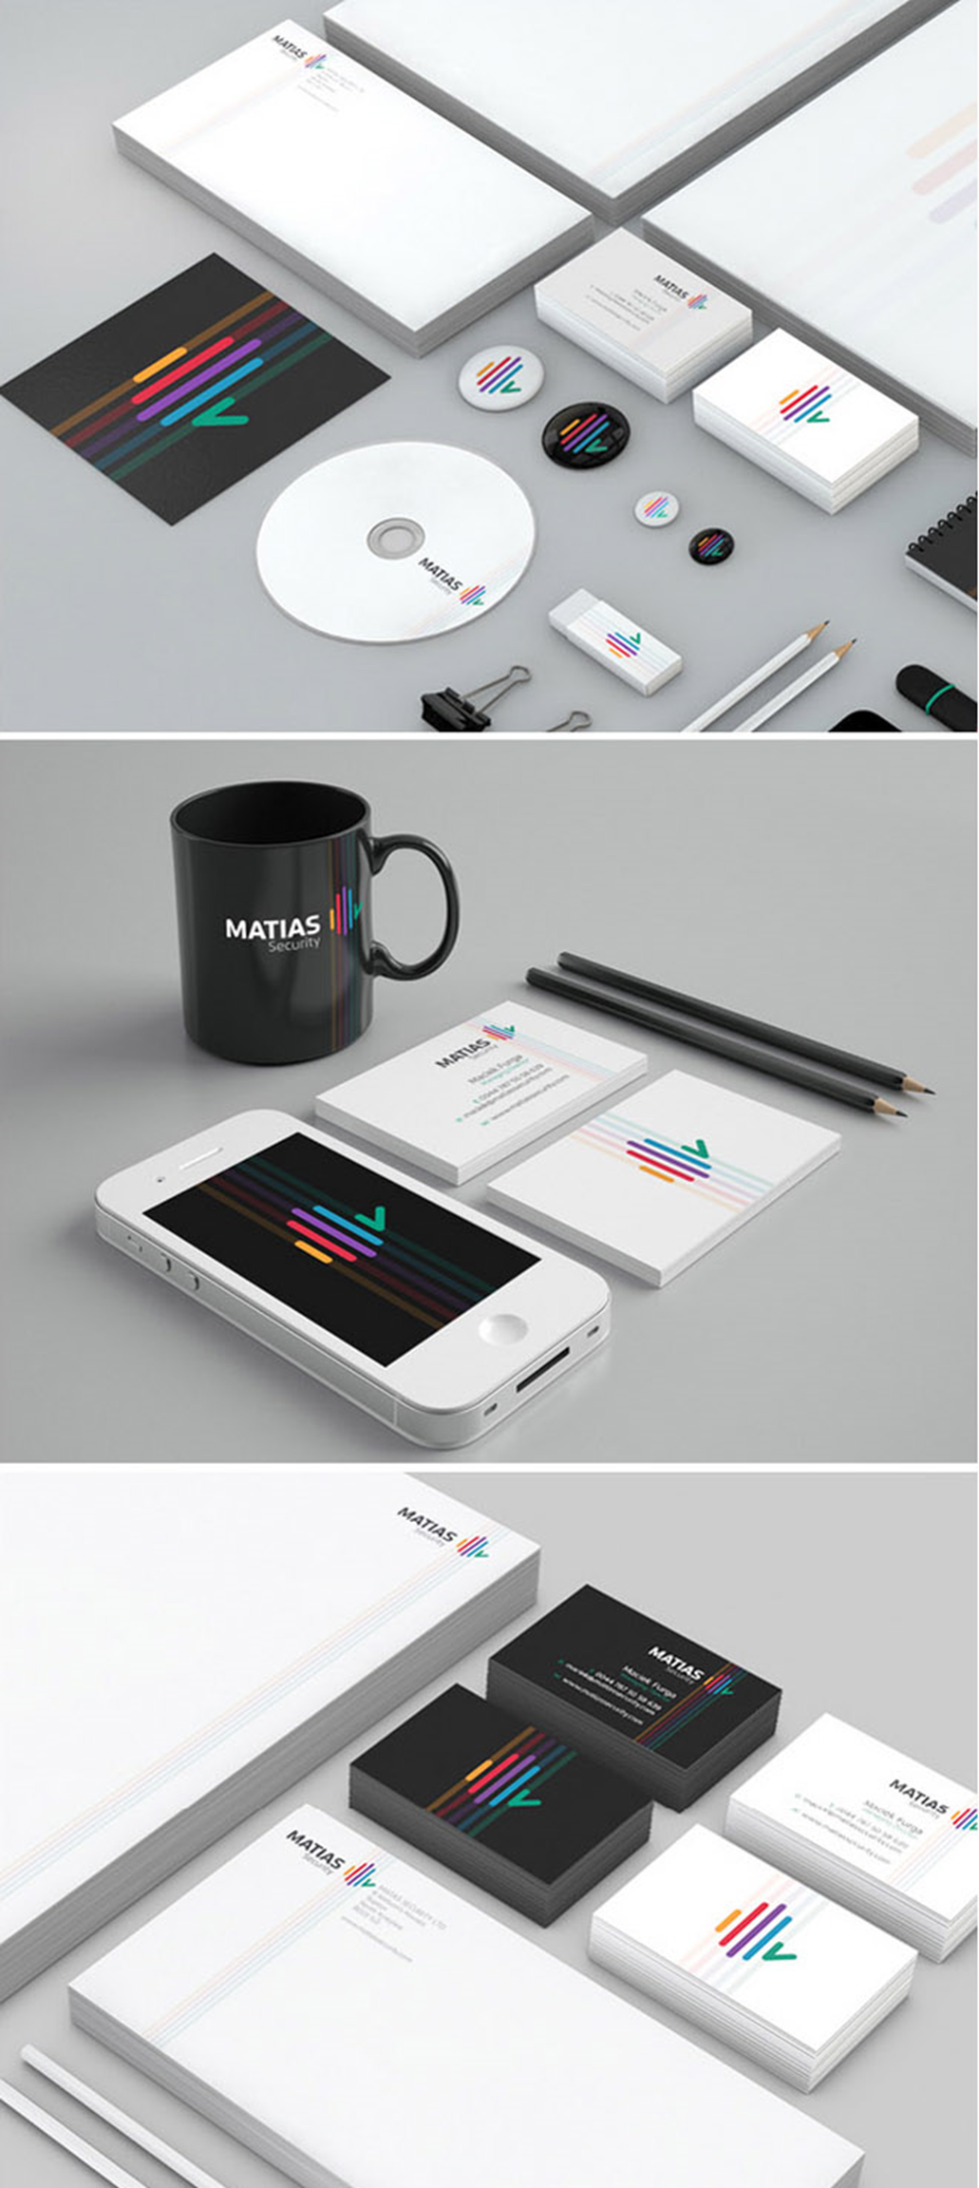
Examples of corporate identity design
Source: http://webneel.com/25-beautiful-branding-and-identity-design-ideas-your-inspiration

Slide 30
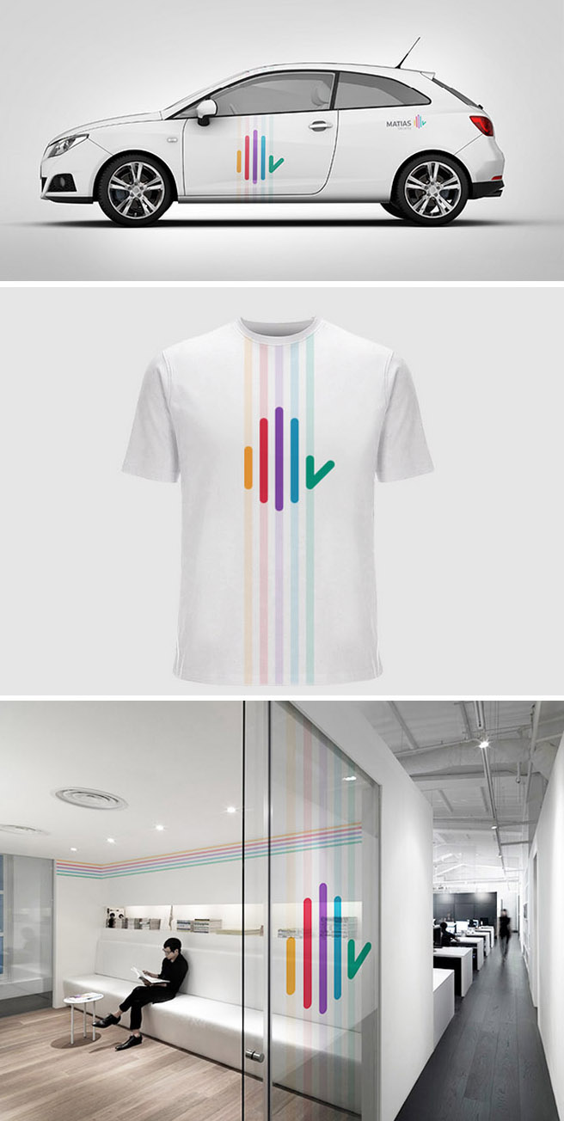
Examples of corporate identity design
Source: http://webneel.com/25-beautiful-branding-and-identity-design-ideas-your-inspiration

Slide 31
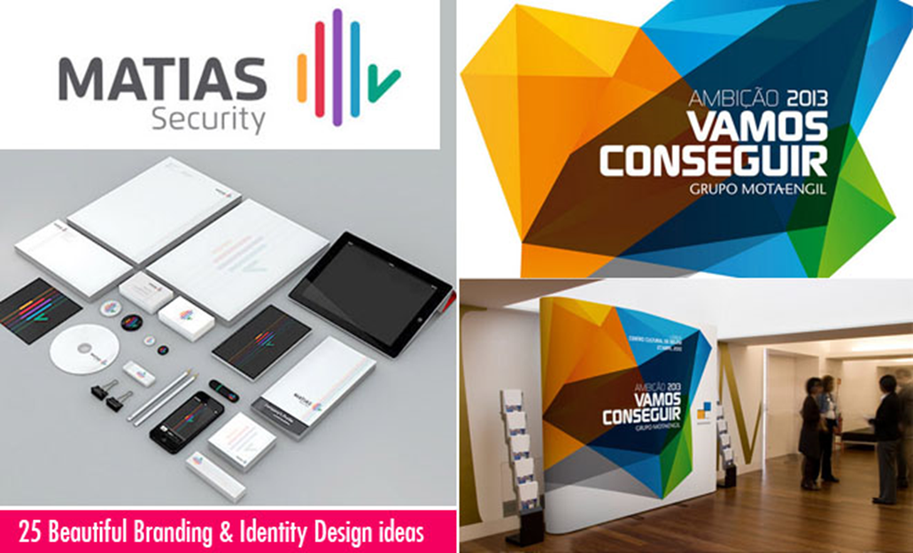
Examples of corporate identity design
Source: http://webneel.com/25-beautiful-branding-and-identity-design-ideas-your-inspiration

Slide 32
Summary
A layout refers to the arrangement or organization of visual elements within a design or composition, whether it's for print, digital media, or physical spaces. It involves determining the placement, sizing, spacing, and relationship between various components to achieve a harmonious and effective presentation.
By applying the anatomy of typography in your design process, you can create typographic compositions that are not only visually appealing but also highly readable, engaging, and effective in communicating your message to your audience.
In design, layouts are instrumental in communicating information, guiding user interactions, and enhancing visual appeal.
Designers employ layout principles to organize content effectively, establish visual hierarchy, and improve usability across a wide range of mediums, including print media, digital interfaces, environmental graphics, and product packaging.

Slide 33
Summary
In both art and design, the layout serves as a critical aspect of the creative process, influencing how viewers perceive and engage with the final work.
Corporate identity design is about creating a visual identity that effectively communicates the company's values, personality, and offerings to its target audience.
It helps establish brand recognition, build trust and credibility, and differentiate the company from competitors in the marketplace.
The application of corporate identity design is multifaceted and extends across various aspects of a company's operations, marketing efforts, customer interactions, and internal culture.
Consistent application of visual elements, messaging, and values reinforces brand recognition, differentiation, and trust, ultimately contributing to the overall success and reputation of the company.

Slide 34
THANK YOU
LECTURE 8
BY DR. RAPHAEL OGUTU,
Mass Communication Department,
AFRICA NAZARENE UNIVERSITY

