Slide 1
VISUAL COMMUNICATION
WEEK 9 Cartoons, video, and film
By Dr. Raphael Ogutu

Slide 2
VISUAL COMMUNICATION
Introduction to Advanced Typography Principles
Intended Learning Outcome
At end of this week lesson the students should be able to:
1. Understand the meaning of cartoons, animations, video, and film
2. Interpret the art of cartoons, animations, video, and film
3. Apply various skills in the creation of cartoons, animations, video, and film

Slide 3
Definitions of cartoons, animations, video, and film
Cartoons are humorous drawings, separated into political or editorial, which use caricature, humor, and satire to comment on current affairs and influence public opinion, and social or gag, which poke fun at daily life and its problems or merely illustrate jokes.
Are typically animated illustrations or sequences of drawings, often characterized by exaggerated features, simplified shapes, and humorous or whimsical themes.
They can be found in various mediums, including comic strips, animated television shows, movies, and web animations.
May target different audiences, from children to adults, and cover a wide range of genres, including comedy, adventure, fantasy, and satire.
They often employ vibrant colors, dynamic movement, and expressive characters to entertain viewers and convey messages or social commentary.

Slide 4
Definitions of cartoons, animations, video, and film
2. Video refers to moving images recorded or produced electronically, typically accompanied by audio.
It encompasses a broad range of visual content, including movies, television shows, documentaries, advertisements, music videos, and online videos.
Video production involves capturing or creating footage using cameras or digital devices, editing and assembling the footage using video editing software, and adding sound effects, music, narration, or dialogue to enhance the viewer's experience.
Videos are widely consumed across various platforms and formats, from traditional broadcast television to online streaming services and social media platforms.

Slide 5
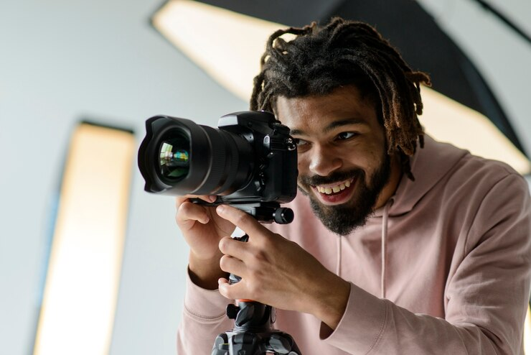

Definitions of cartoons, animations, video, and film
Sources: https://www.freepik.com/free-photo/happy-photographer-working_7591701.htm#fromView=search&page=1&position=17&uuid=b7de723a-d62e-4c63-b400-139511f0792b https://www.freepik.com/free-photo/side-view-woman-working-as-photographer_44990909.htm#fromView=search&page=1&position=22&uuid=b7de723a-d62e-4c63-b400-139511f0792b

Slide 6
Definitions of cartoons, animations, video, and film
3. Film refers to a medium of visual storytelling that involves the recording and projection of moving images onto a screen.
It encompasses a wide range of cinematic works, including feature films, short films, documentaries, experimental films, and animations.
Film production involves various stages, including scriptwriting, casting, filming, editing, and post-production.
Films use a combination of cinematography, editing, sound design, visual effects, and storytelling techniques to engage audiences, evoke emotions, and convey narratives or ideas.
They are often screened in theaters, film festivals, and other venues or distributed through streaming platforms, DVDs, or Blu-rays for home viewing.
The cast, the plot, the lightning and the audio editing are all aspects of filmmaking.

Slide 7
Definitions of cartoons, animations, video, and film
4. Animation is the process of creating the illusion of motion and change by rapidly displaying a sequence of static images or frames.
Each frame contains incremental changes from the previous frame, giving the impression of movement when played in succession at a high enough speed.
Animation can be produced through various techniques, including hand-drawn animation, computer-generated imagery (CGI), stop-motion animation, and motion graphics.
It is widely used in entertainment, education, advertising, and other fields to convey stories, ideas, and information in a visually engaging and dynamic manner.

Slide 8
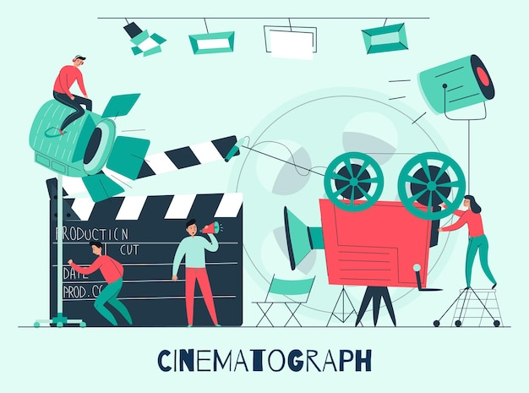
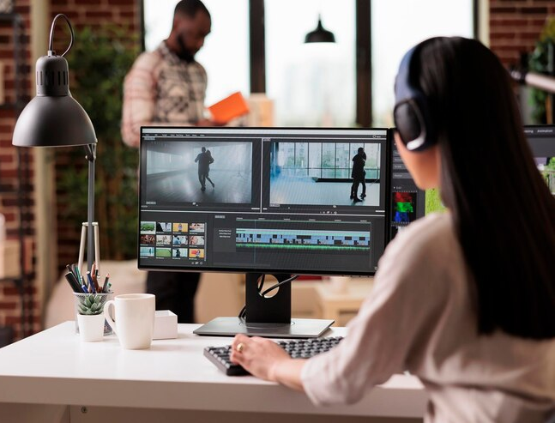
Definitions of cartoons, animations, video, and film
Sources: https://www.freepik.com/free-vector/cinema-composition-with-film-studio-shooting-team-work-flat-illustration_15330888.htm#fromView=search&page=1&position=33&uuid=996376c1-aa6e-434f-a2f1-80fe6e6df45c
https://www.freepik.com/free-photo/female-video-editor-working-with-creative-footage-editing-film-montage-with-color-grading-sound-working-freelance-home-using-post-production-software-make-movie_31445051.htm#fromView=search&page=2&position=34&uuid=be2885d5-f4d4-46a3-b4ae-525a3286bc05

Slide 9
The art of cartoon making
1. Conceptualization and Storytelling:
• Idea Generation: The cartoon-making process typically begins with brainstorming and generating ideas for characters, plots, and themes.
This phase involves tapping into creativity to come up with engaging and original concepts.
• Character Development: Cartoonists create memorable characters with distinct personalities, appearances, and quirks.
Characters drive the narrative and serve as the focal point of the cartoon, so their design and development are crucial.
• Storyboarding: Storyboarding involves sketching out the sequence of scenes or panels to outline the story visually.
This step helps in planning the pacing, composition, and flow of the cartoon before the actual drawing process begins.

Slide 10
The art of cartoon making
2. Artistic Techniques:
• Drawing Skills: Cartoonists use techniques such as line art, shading, and color theory to create visually appealing illustrations.
• Character Design: involves balancing simplicity with expressiveness.
Cartoonists often exaggerate features and use distinctive shapes and silhouettes to make characters instantly recognizable.
• Backgrounds and Settings: establishes the cartoon's world and atmosphere. Cartoonists employ various techniques from simple and stylized backgrounds to detailed and intricate landscapes.
• Movement and Action: Cartoonists use techniques such as motion lines, dynamic poses, and exaggerated expressions to convey movement and action in static images.
Capturing energy and dynamism is essential for engaging the audience and adding visual interest to the cartoon.

Slide 11
The art of cartoon making
3. Technical Tools and Software:
• Traditional Tools: Historically, cartoons were created using traditional art supplies such as pencils, ink, paper, and paint.
While many cartoonists still prefer working with traditional media for its tactile feel and authenticity, digital tools offer numerous advantages, such as flexibility, efficiency, and easy correction of mistakes.
• Digital Software: Digital drawing tablets and software such as Adobe Photoshop, Adobe Illustrator, and Clip Studio Paint have become popular among cartoonists for their versatility and convenience.
These tools allow artists to create, edit, and manipulate artwork digitally, offering a wide range of brushes, effects, and customization options.

Slide 12
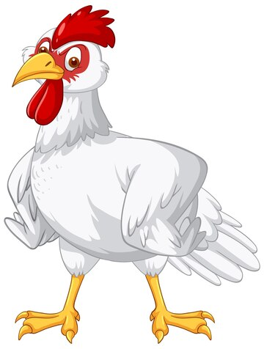
The art of cartoon making
4. Humor and Expression:
• Comic Timing: Timing is crucial in cartoon-making, especially in visual gags and comedic punchlines. Cartoonists use pacing, panel layout, and visual cues to set up jokes and deliver punchlines effectively.
• Expressive Characters: Facial expressions, body language, and gestures are essential for conveying emotions and humor in cartoons. Cartoonists use exaggerated expressions and physical comedy to evoke laughter and connect with the audience.
Source: https://www.freepik.com/free-vector/white-chicken-cartoon-character_24085356.htm#fromView=search&page=1&position=46&uuid=289dff94-a677-440a-bcb9-334222fea010 /

Slide 13
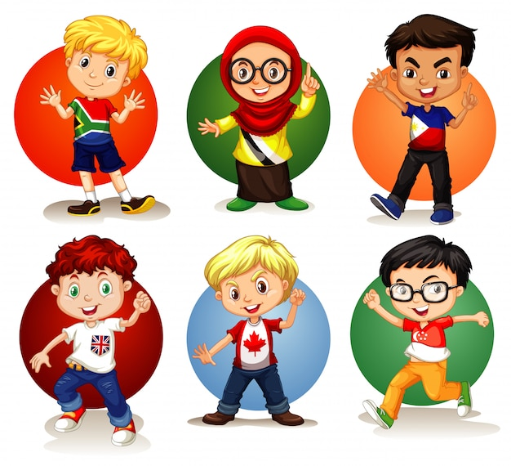
Typographic Definitions of the anatomy
5. Feedback and Iteration:
• Critique and Revision: Cartoonists often seek feedback from peers, mentors, or audiences to improve their work. Constructive criticism helps identify areas for improvement and refine the cartoon's storytelling, artwork, and humor.
• Iterative Process: Cartoon-making is an iterative process that involves multiple drafts, revisions, and refinements. Cartoonists continually tweak and adjust their work based on feedback and their artistic vision until they achieve the desired result.
Source: https://www.freepik.com/free-vector/six-children-from-different-countries_5982947.htm#fromView=search&page=1&position=49&uuid=289dff94-a677-440a-bcb9-334222fea010

Slide 14
The art of animation production
The art of animation production involves the creation of moving images through the manipulation of characters, objects, and environments.
1. Conceptualization and Pre-Production:
• Idea Generation: The animation production process begins with brainstorming and conceptualizing ideas for the storyline, characters, themes, and visual style. This phase involves developing engaging and original concepts that will resonate with the audience.
• Character Design: Character designers create the visual appearance and personality of the characters. They develop unique designs with distinct features, expressions, and movements that reflect the character's traits and emotions.
• Storyboarding: Storyboarding involves creating a visual representation of the animation, sketching out the sequence of scenes or shots to plan the visual narrative. It helps in visualizing the pacing, composition, and flow of the animation before production begins.

Slide 15
The art of animation production
2. Production:
• Animation Techniques: Animators bring the characters and scenes to life through various animation techniques, such as hand-drawn animation, 3D computer animation, stop-motion animation, and motion graphics. They create movement, expressions, and interactions that convey the story and emotions.
• Background Design: Background artists create the environments and settings in which the animation takes place. They establish the visual style, atmosphere, and mood of the animation, immersing viewers in the world of the story.
• Voice Acting: Voice actors provide the voices for the characters, bringing them to life with personality, emotion, and authenticity. Casting directors select actors who can capture the essence of the characters and deliver compelling performances.

Slide 16
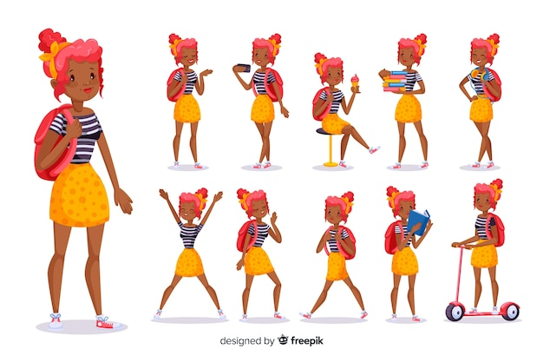
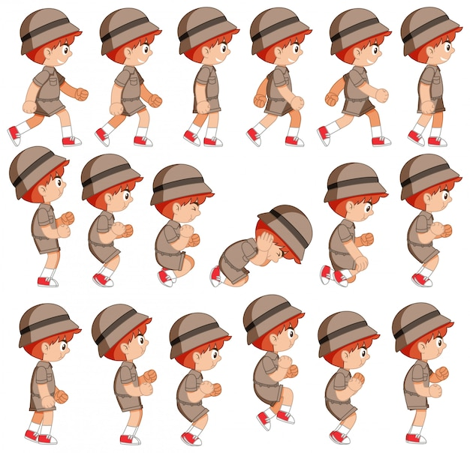
The art of animation production
Source: https://www.freepik.com/free-vector/student-doing-different-actions_2882135.htm#fromView=search&page=1&position=4&uuid=f2be0dab-7fad-4db9-8266-9b14d52e3424
Source: https://www.freepik.com/free-vector/children-different-positions-isolated-white-background_8700696.htm#fromView=search&page=1&position=0&uuid=5eef0ce0-7376-4d77-8ac4-accbb8d78a1b

Slide 17
The art of animation production
3. Post-Production:
Editing and Compositing: Editors assemble the animated sequences, add special effects, and fine-tune the pacing and timing to create a cohesive animation.
Compositors integrate the animated elements with backgrounds, effects, and audio to achieve a seamless final product.
Sound Design and Music: Sound designers create and manipulate audio elements such as dialogue, music, sound effects, and ambient noise to enhance the atmosphere, emotion, and realism of the animation.
Music composers create original scores that complement the visuals and enhance the storytelling.

Slide 18
The art of animation production
4. Narrative Structure and Storytelling:
• Plot Development: A well-crafted plot engages the audience with its narrative structure, character development, and thematic depth.
Animators use pacing, suspense, and visual storytelling techniques to maintain tension, build anticipation, and keep viewers invested in the story.
• Character Arcs: Compelling characters undergo growth and change throughout the animation, with arcs that explore their motivations, relationships, and personal journeys.
Animators use expressions, gestures, and movements to convey emotions and communicate the characters' inner worlds.

Slide 19
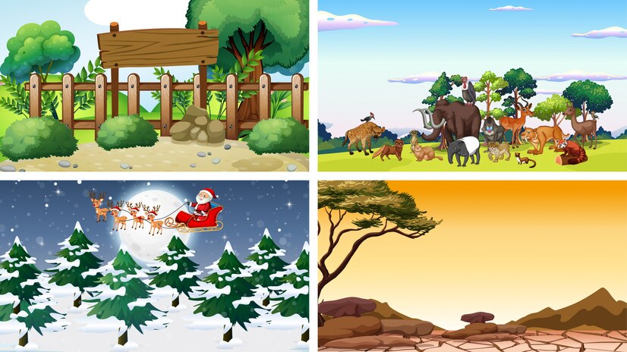
Narrative Structure and Storytelling
Sources:https://www.freepik.com/free-vector/four-different-scenes-with-animals_6481429.htm#fromView=search&page=1&position=1&uuid=1fe7bbf6-c061-4fb1-8d72-64bf1b6134ea

Slide 20
The art of animation production
5. Visual Style and Aesthetics:
• Art Direction: Art directors oversee the overall visual style and aesthetic of the animation, ensuring consistency and coherence across all elements.
They establish the color palette, lighting, textures, and visual motifs that define the animation's look and feel.
• Animation Principles: Animators adhere to fundamental animation principles such as squash and stretch, timing, anticipation, and follow-through to create believable movement and expressions.
These principles help bring characters to life and convey emotion and personality.

Slide 21
The art of animation production
•6. Audience Engagement and Impact:
• Emotional Connection: Successful animations evoke emotional responses from viewers, whether through laughter, tears, excitement, or empathy.
Animators use character development, visual storytelling, and expressive animation to create emotional resonance and connect with the audience.
• Cultural and Social Impact: Animations have the power to entertain, educate, and inspire audiences of all ages and backgrounds.
They explore universal themes, challenge societal norms, and provide a platform for diverse voices and perspectives.

Slide 22
The art of animation production
7. Feedback and Iteration:
• Test Screenings: Test screenings allow animators to gather feedback from test audiences before finalizing the animation.
This feedback helps identify areas for improvement and informs revisions to enhance the overall quality and effectiveness of the animation.
• Iterative Process: Animation production is an iterative process that involves multiple stages of planning, production, and post-production.
Animators continually review and adjust their work based on feedback and their artistic vision until they achieve the desired result.

Slide 23
The art of video-making
1. Conceptualization and Pre-Production:
• Idea Generation: The video-making process typically begins with brainstorming and conceptualizing ideas for the storyline, characters, themes, and visual style.
This phase involves tapping into creativity to develop engaging and original concepts.
• Scriptwriting: Scriptwriting is the foundation of video production, where the storyline, dialogue, and scene descriptions are crafted.
It lays out the structure and content of the video, guiding the filming and editing process.
• Storyboarding: Storyboarding involves creating a visual outline of the video, sketching out the sequence of shots or scenes to plan the visual narrative.
It helps in visualizing the pacing, composition, and flow of the video before filming begins.

Slide 24
The art of video-making
2. Technical Skills and Equipment:
• Cinematography: the art and technique of capturing moving images on camera. It involves considerations such as framing, composition, lighting, camera movement, and lens selection to create visually compelling shots.
• Audio Recording: Techniques such as capturing clear dialogue, recording ambient sound, and using music and sound effects effectively enhance the viewer's experience.
• Editing: Editing is where the raw footage is transformed into a cohesive video. Video editors use software such as Adobe Premiere Pro, Final Cut Pro, or DaVinci Resolve to assemble footage, add transitions, effects, and audio, and fine-tune the pacing and rhythm of the video.

Slide 25
The art of video-making
3. Visual Storytelling:
• Shot Composition: The composition of shots plays a crucial role in conveying mood, tone, and narrative in a video. Filmmakers use techniques such as framing, depth of field, and camera angles to guide the viewer's attention and evoke emotions.
• Color Grading: Color grading involves adjusting the color and tone of footage to create a specific look or atmosphere. It enhances visual consistency, adds mood, and reinforces storytelling themes.
• Visual Effects: Visual effects can be used to enhance realism, create fantastical worlds, or add visual flair to a video. Techniques such as CGI (computer-generated imagery), compositing, and motion graphics are employed to achieve desired visual effects.

Slide 26
The art of video-making
4. Narrative Structure and Pacing:
• Storytelling Techniques: Effective storytelling in video involves establishing a clear narrative structure with a beginning, middle, and end.
Filmmakers use techniques such as foreshadowing, suspense, and character development to engage viewers and keep them invested in the story.
• Pacing: Pacing refers to the rhythm and tempo of the video.
It involves balancing fast-paced action sequences with slower, contemplative moments to maintain audience engagement and emotional impact.

Slide 27
The art of video-making
5. Audience Engagement and Impact:
• Emotional Connection: Successful videos often evoke emotional responses from viewers, whether through humor, drama, suspense, or inspiration.
Filmmakers use storytelling, visuals, and music to create moments that resonate with the audience.
• Call to Action: Many videos aim to elicit specific actions or responses from viewers, such as making a purchase, signing up for a service, or spreading awareness about an issue.
Effective videos include clear calls to action that motivate viewers to take the desired next steps.

Slide 28
The art of video-making
6. Feedback and Iteration:
• Test Screening: Test screenings allow filmmakers to gather feedback from test audiences before finalizing the video.
This feedback helps identify areas for improvement and informs revisions to enhance the overall quality and effectiveness of the video.
• Iterative Process: Video-making is an iterative process that involves multiple stages of planning, filming, editing, and refining.
Filmmakers continually review and adjust their work based on feedback and their artistic vision until they achieve the desired result.

Slide 29
The art of film-making
1. Pre-Production:
• Scriptwriting: The foundation of any film is its screenplay. Scriptwriters develop the storyline, characters, dialogue, and scene descriptions, crafting the blueprint for the entire film.
• Storyboarding: Storyboarding involves creating a visual representation of the screenplay, sketching out the sequence of shots or scenes to plan the visual narrative. It helps in visualizing the pacing, composition, and flow of the film.
• Casting: Casting involves selecting actors to portray the characters in the film. Casting directors search for talent that fits the vision of the characters and can bring them to life convincingly.

Slide 30
The art of film-making
2. Production:
• Direction: The director is the creative visionary behind the film, responsible for interpreting the screenplay, guiding the performances of the actors, and overseeing all aspects of production.
• Cinematography: Cinematographers are responsible for capturing the visual elements of the film.
They use techniques such as framing, composition, lighting, camera movement, and lens selection to create visually compelling shots.
• Acting: Actors bring the characters to life through their performances.
They convey emotions, motivations, and relationships, immersing the audience in the story and creating empathy with the characters.

Slide 31
The art of film-making
3. Post-Production:
• Editing: is where the raw footage is transformed into a cohesive film. Video editors assemble footage, add transitions, effects, and audio, and fine-tune the pacing and rhythm of the film to create the desired impact.
• Sound Design: creating and manipulating audio elements such as dialogue, music, sound effects, and ambient noise to enhance the atmosphere, emotion, and realism of the film.
• Visual Effects: use of digital techniques such as CGI (computer-generated imagery), compositing, and motion graphics to create or enhance elements within the film, such as fantastical creatures, environments, or action sequences.

Slide 32
The art of film-making
4. Narrative Structure and Storytelling:
• Character Development: Compelling characters are at the heart of any great film.
Filmmakers develop complex, multidimensional characters with distinct personalities, motivations, and arcs that evolve throughout the story.
• Plot and Pacing: A well-crafted plot engages the audience with its twists, turns, and revelations.
Filmmakers use pacing, suspense, and structure to maintain tension, build anticipation, and keep viewers invested in the story.
• Themes and Subtext: Themes and subtext add depth and resonance to the film, exploring universal truths, social issues, and philosophical questions.
Filmmakers use symbolism, metaphor, and allegory to convey deeper layers of meaning beneath the surface narrative.

Slide 33
The art of film-making
5. Visual Style and Aesthetics:
• Production Design: Production designers create the visual world of the film, including sets, props, costumes, and locations.
They establish the film's aesthetic style, atmosphere, and mood, immersing viewers in the story's world.
• Cinematic Language: Cinematic language encompasses the visual and auditory techniques filmmakers use to convey meaning and emotion.
Techniques such as camera movement, framing, color palette, and editing contribute to the film's overall aesthetic and tone.

Slide 34
The art of film-making
6. Audience Engagement and Impact:
Emotional Connection: Successful films evoke emotional responses from viewers, whether through laughter, tears, suspense, or excitement.
Filmmakers use storytelling, character development, and visual and auditory cues to create emotional resonance and connect with the audience.
Social and Cultural Impact: Films have the power to influence society, spark conversations, and inspire change.
They explore universal themes and experiences, challenge societal norms, and provide a platform for marginalized voices and perspectives.

Slide 35
The art of film-making
7. Feedback and Iteration:
Test Screenings: Test screenings allow filmmakers to gather feedback from test audiences before finalizing the film.
This feedback helps identify areas for improvement and informs revisions to enhance the overall quality and effectiveness of the film.
Iterative Process: Filmmaking is an iterative process that involves multiple stages of planning, production, and post-production.
Filmmakers continually review and adjust their work based on feedback and their artistic vision until they achieve the desired result.

Slide 36
Summary
In summary, cartoons are animated illustrations characterized by exaggerated features and humorous themes, video refers to moving images accompanied by audio produced electronically, and film is a medium of visual storytelling involving the recording and projection of moving images onto a screen.
Each medium offers unique opportunities for storytelling, entertainment, and artistic expression.
The art of cartoon making requires a blend of creativity, technical skill, and storytelling acumen. It's a dynamic and rewarding process that allows artists to entertain, inspire, and connect with audiences through the power of visual storytelling.
The art of animation production requires a combination of artistic vision, technical expertise, and storytelling skill. It's a collaborative and iterative process that allows animators to create captivating worlds, compelling characters, and memorable stories that entertain, inspire, and connect with audiences around the world.

Slide 37
THANK YOU
LECTURE 9
BY DR. RAPHAEL OGUTU,
Mass Communication Department,
AFRICA NAZARENE UNIVERSITY

