Slide 1
VISUAL COMMUNICATION
WEEK 10 Creating Publications using Ms. Publisher
By Dr. Raphael Ogutu

Slide 2
VISUAL COMMUNICATION
Creating Publications using Ms. Publisher
Intended Learning Outcome
At end of this week lesson the students should be able to:
1. Show an understanding Ms. Publisher’s basics
2. Create a publication in Ms. Publisher
3. Application of Ms. Publisher step-by-step

Slide 3
What Is Microsoft Publisher Used For?
Microsoft Publisher lets you work as easily as you do in Microsoft Word, but instead of using tools for text, you’ll be using tools for editing page layouts and visual content. What are the things you can do in Microsoft Publisher?
The answer: almost anything you need to professionally design and publish your material. Some examples include:
• Personalized birthday cards
• Event posters
• Newsletters for small businesses and organizations
• Professional business cards
• Flyers and programs
• Postcards and brochures

Slide 4
Why Create Publications using Ms. Publisher?
It is part of the Microsoft Office suite of productivity software and is designed for creating various types of publications, such as brochures, newsletters, flyers, posters, and business cards.
Publisher provides users with a range of tools and templates to design and customize their publications, including text formatting options, graphic elements, layout tools, and pre-designed templates.
Users can add images, shapes, tables, and other objects to their publications and manipulate them to create professional-looking designs.
Publisher also offers features for managing page layout, arranging text and images, and preparing documents for print or digital distribution.

Slide 5
Summarized steps to create a Publication in MS Publisher
When you open Publisher, you’ll see a selection of design templates to jump-start your publication, as well as a blank template if you want to start from scratch. Here are the steps to create a greetings card:
1. Open Microsoft Publisher: Launch the Microsoft Publisher application on your computer. You can typically find it in the Microsoft Office folder or by searching for it in your computer's applications.
2. Choose a Template or Blank Document: Publisher offers a variety of pre-designed templates for different types of publications, such as brochures, flyers, newsletters, and business cards. You can select a template that closely matches your intended design or start with a blank document if you prefer to create your layout from scratch.
3. Customize the Layout: Once you have selected a template or opened a blank document, you can begin customizing the layout to suit your needs. This may involve adjusting the size and orientation of the page, adding or removing text boxes and graphic elements, and rearranging the placement of objects on the page.

Slide 6
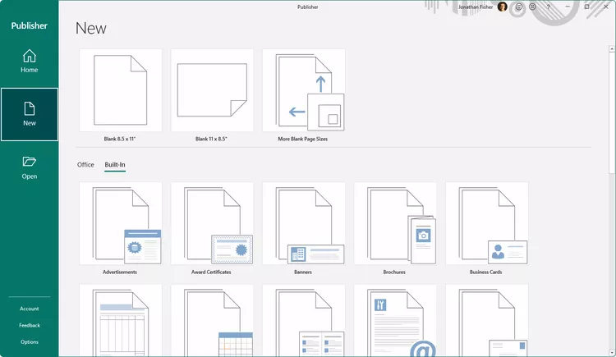
Summarized steps to create a Publication in MS Publisher
Select the Built-In tab above the templates shown.
Sources: https://www.lifewire.com/microsoft-publisher-basics-4138207

Slide 7
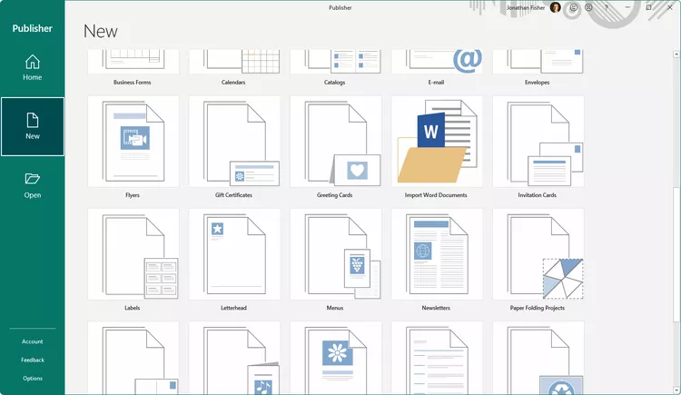
Summarized steps to create a Publication in MS Publisher
Scroll down a bit and select Greeting Cards.
Sources: https://www.lifewire.com/microsoft-publisher-basics-4138207

Slide 8
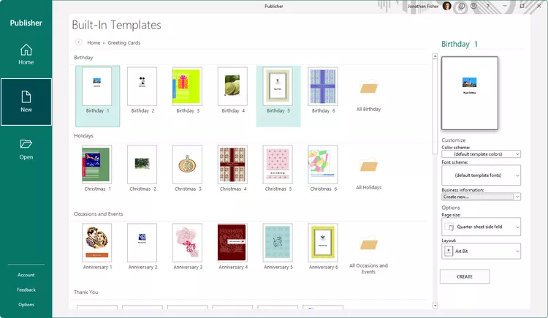
Summarized steps to create a Publication in MS Publisher
Select a template from the Birthday section at the top.

Slide 9
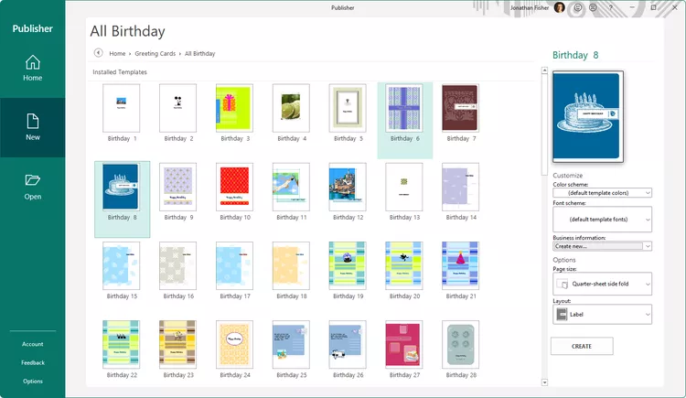
Summarized steps to create a Publication in MS Publisher
Choose Create in the right pane.

Slide 10
Summarized steps to create a Publication in MS Publisher
4. Add Text and Images: Enter your text content into the appropriate text boxes in the publication.
You can format the text using options such as font, size, color, alignment, and style.
Additionally, you can insert images, shapes, icons, and other graphic elements into your publication to enhance its visual appeal.
5. Modify Design Elements: Customize the appearance of your publication by modifying design elements such as colors, fonts, backgrounds, borders, and effects.
Publisher provides various tools and options for adjusting the visual style of your publication to achieve the desired look and feel.

Slide 11
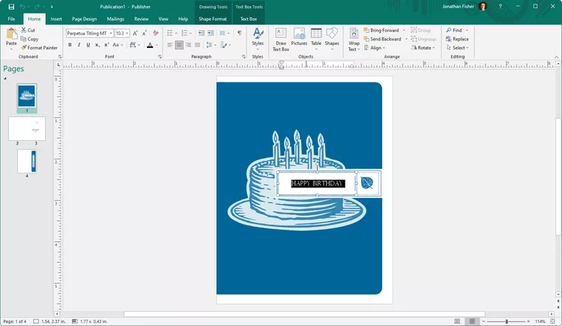
Summarized steps to create a Publication in MS Publisher
How to Edit Existing Text in Publisher
The pages of the birthday card display as thumbnails on the left side of Publisher, with the first page ready for you to customize.
To change the text that's already in the template, select a text box to highlight the text, and then start typing to replace it.

Slide 12
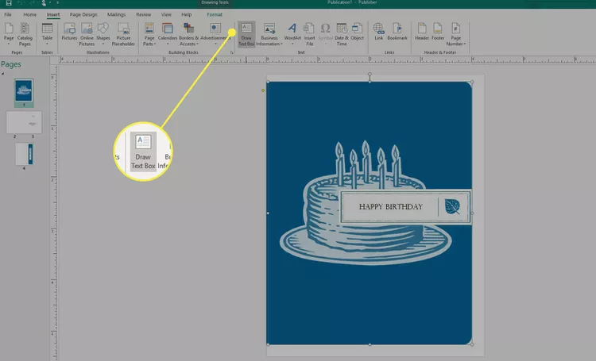
Summarized steps to create a Publication in MS Publisher
From the page you want to add text to, go to Insert > Draw Text Box. The cursor will change to a cross/plus sign.
Select and drag anywhere on the page to draw a text box.
After releasing the mouse button, the text box will become editable so you can type into it

Slide 13
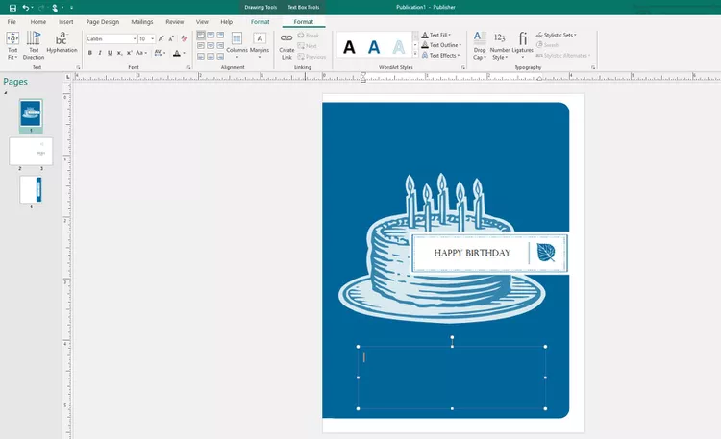
Summarized steps to create a Publication in MS Publisher
You can edit the text box if it's too big/small or in the wrong place. To resize it, select and drag one of the handles on the corner or edge of the box. Select a non-boxed edge to drag the text box elsewhere.

Slide 14
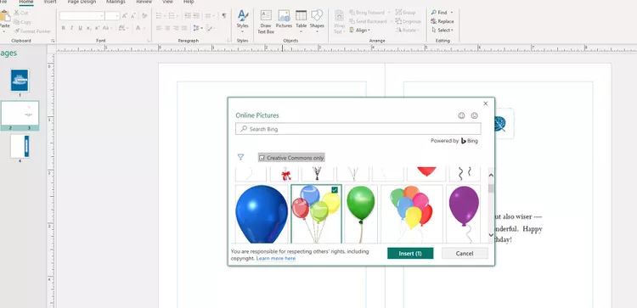
Summarized steps to create a Publication in MS Publisher
Insert a picture
You can insert a picture from your computer, or insert an online picture from OneDrive or the web.
Select Insert > Pictures or
Insert > Online Pictures.
Find the picture you want and select it.
Select Insert.
Save in Publisher
Select and drag the inserted image to move it where you want, and use the handles on the sides and corners to resize it as desired.

Slide 15
Summarized steps to create a Publication in MS Publisher
Save your business information to re-use
Save your business information to pre-populate fields, save time, and ensure consistency.
Select Insert >Business Information
> Edit Business Information.
Select Add Logo to add a logo or image. Browse to the logo, and select Open.
For Business Information set name, type a name like Personal, School, or Company.
Select Save.
.

Slide 16
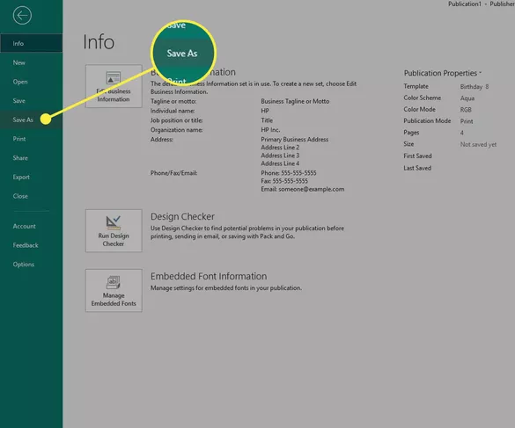
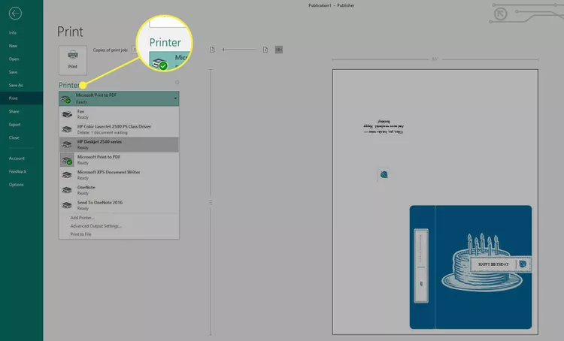
Summarized steps to create a Publication in MS Publisher
Go to File > Save As.
Select This PC or OneDrive. Choose Browse to manually locate the folder you want to save it to.
Select a printer from the Printer menu.

Slide 17
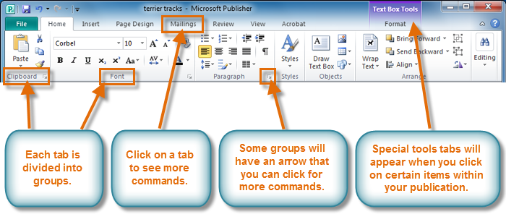
Microsoft Publisher, the workspace layout
The Ribbon
The Ribbon contains multiple tabs, each with several groups of commands. Some tabs, like Text Box Tools or Picture Tools, may appear only when you're working with certain items like text boxes or images.
Source: https://edu.gcfglobal.org/en/publisher2010/getting-to-know-publisher-2010/1/

Slide 18
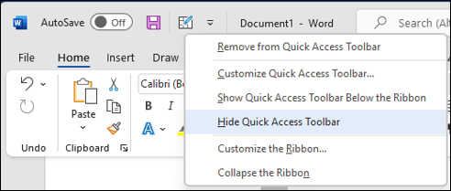
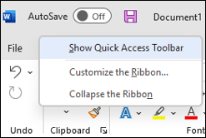
Microsoft Publisher, the workspace layout
If the Quick Access Toolbar is shown, select Hide Quick Access Toolbar.
If the Quick Access Toolbar is hidden, select Show Quick Access Toolbar.
The Quick Access Toolbar is located above the Ribbon and provides one-click access to frequently used commands and functions. Users can customize the Quick Access Toolbar by adding or removing commands to suit their preferences and workflow. Common commands such as Save, Undo, Redo, and Print are often included by default, but users can customize it according to their needs.
Source: https://support.microsoft.com/en-us/office/customize-the-quick-access-toolbar-43fff1c9-ebc4-4963-bdbd-c2b6b0739e52

Slide 19
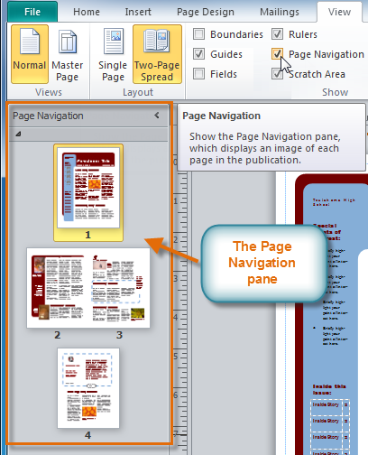
Microsoft Publisher, the workspace layout
3. Page Navigation Pane: The Page Navigation Pane is typically located on the left side of the Publisher window and displays thumbnails of all pages in the publication. Users can use the Page Navigation Pane to navigate between pages, rearrange page order, and manage page properties. It provides a visual overview of the publication's structure and layout, making it easy to manage multiple pages.
To open the Page Navigation pane, click the View tab on the Ribbon, then locate the Show group. Select the Page Navigation check box.
Source: https://edu.gcfglobal.org/en/publisher2010/creating-a-new-publication/1/

Slide 20
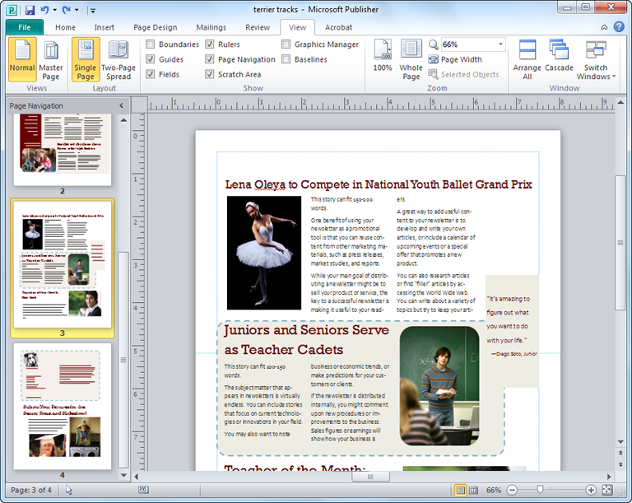
Microsoft Publisher, the workspace layout
•4. Publication Area: The central area of the Publisher window is reserved for creating and editing publications. It displays the current page or spread of the publication, allowing users to add and manipulate text, images, shapes, and other design elements. Users can interact directly with the publication area to make changes to their designs using various tools and options available in the Ribbon.
Sources:: https://edu.gcfglobal.org/en/publisher2010/getting-to-know-publisher-2010/1/

Slide 21
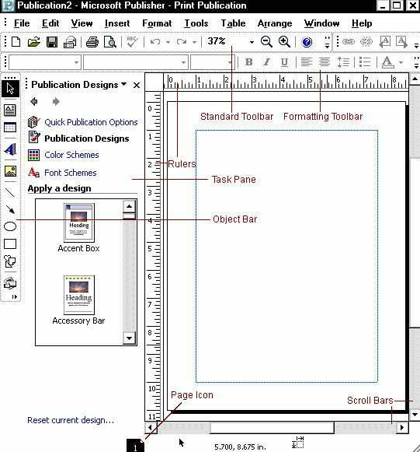
Microsoft Publisher, the workspace layout
    5. Task Panes: Task Panes are dynamic panels that provide access to specific tasks or features within Publisher. They can be docked to different areas of the workspace, such as the right side or bottom of the window, or floated freely for convenience. Task Panes display options, settings, and previews related to the current task, such as formatting options, color schemes, and object properties. Source: https://kb.uwec.edu/articles/microsoft-publisher-2003-the-publisher-environment

Slide 22
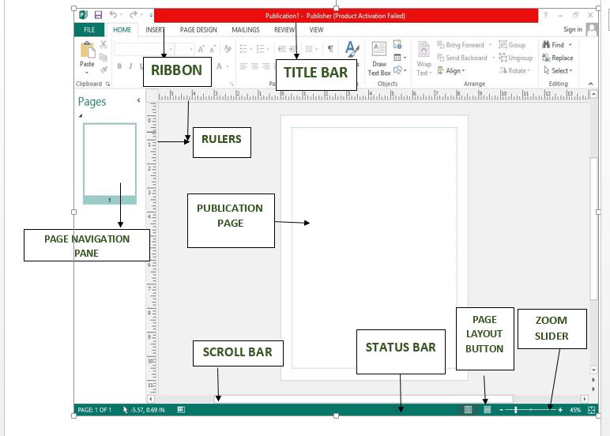
Microsoft Publisher, the workspace layout
6. Status Bar: The Status Bar is located at the bottom of the Publisher window and provides information about the current document, such as page count, zoom level, and status indicators. It also includes shortcuts for adjusting the zoom level, switching between different views (e.g., Normal, Print Preview), and accessing additional options such as ruler and grid settings.
Source : https://www.geeksforgeeks.org/what-is-microsoft-publisher/

Slide 23
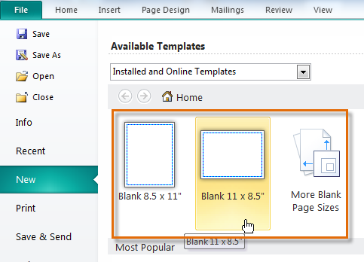
Creating blank publications
If you don't want to use a template or can't find a template that suits your needs, you can create a blank publication. Remember, when you create a blank publication you will have to set up page margins, add guides, and make all layout and design decisions on your own.
To create a blank publication, click the New tab in Backstage view, then select a blank page size in the Available Templates pane.
Source: https://edu.gcfglobal.org/en/publisher2010/creating-a-new-publication/1/

Slide 24
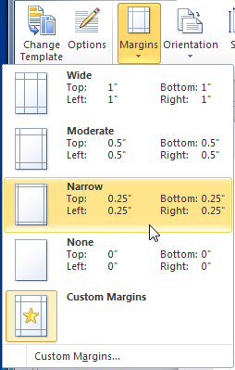
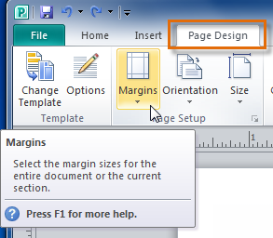
To modify page margins
A drop-down list will appear. Select the desired margins.
The new margins will be applied.
On the Ribbon, select the Page Design tab, then locate the Page Setup group.
Click the Margins drop-down command.
Source:https://edu.gcfglobal.org/en/publisher2010/creating-a-new-publication/1/

Slide 25
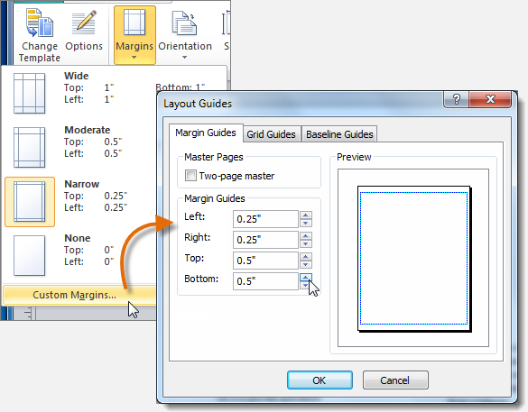
To modify page margins
If you are not satisfied with any of the margin options, select Custom margins... to open the Layout Guides dialog box. There, you can specify margin widths.
Source: https://edu.gcfglobal.org/en/publisher2010/creating-a-new-publication/1/

Slide 26
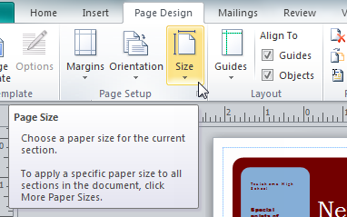
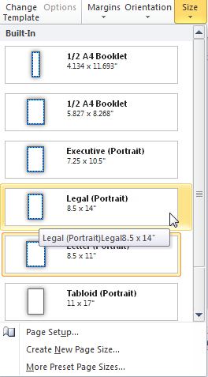
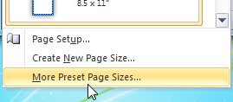
To change page size
Select the desired page size from the drop-down list that appears. Remember, you should make sure your printer is capable of handling paper that size.
On the Ribbon, select the Page Design tab, then locate the Page Setup group.
Click the Size drop-down command.
If the desired page size isn't included in the drop-down list, select More Preset Page Sizes... to view a larger list of page sizes.
Source: https://edu.gcfglobal.org/en/publisher2010/creating-a-new-publication/1/

Slide 27
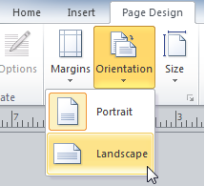
To change page orientation
On the Ribbon, select the Page Design tab, locate the Page Setup group, then click the Orientation drop-down command.
Select Portrait orientation to make your publication taller than wide or Landscape to make it wider than tall.
3. Your publication's page orientation will be changed.
4. Depending on the template you chose, changing the page orientation may have a negative effect on your presentation. While some templates work equally well in both orientations, others do not
Source: https://edu.gcfglobal.org/en/publisher2010/creating-a-new-publication/1/

Slide 28
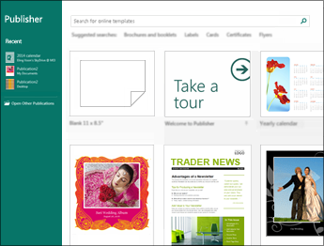
Create a publication
All publications begin with a template, even if it’s a blank template. The trick is to find a template that looks like the vision you have for your final publication. Publisher comes with built-in templates.
Source: https://support.microsoft.com/en-us/office/basic-tasks-in-publisher-0e5ed249-1927-433f-a35c-63beb8216fcf

Slide 29
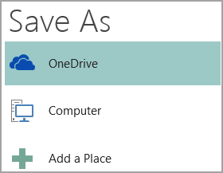
Save your publication
OneDrive is a free Microsoft service that provides password-protected online file storage.
Other Web Locations includes websites you’ve used recently, and a Browse button to save your publication to any website you have access to.
Computer includes any folder on your computer.
Add a Place lets you add an online location to save your publication.
Save your publication the first time by following these steps.
Click File > Save As.
In Save As, choose where you want to save your publication
Source: https://support.microsoft.com/en-us/office/basic-tasks-in-publisher-0e5ed249-1927-433f-a35c-63beb8216fcf

Slide 30
Add pictures to your publication
Click Home > Pictures.
Use the options in the Insert Pictures dialog box to find the picture you want to use.
Add effects to pictures
You can add effects like shadow, reflection, glow, soft edges, bevel, and 3-D rotation to pictures.
Select a picture.
Select Picture Tools Format > Picture Effects.
Select an effect: Shadow, Reflection, Glow, Soft Edges, Bevel, or 3-D Rotation.
Select the effect you want.

Slide 31
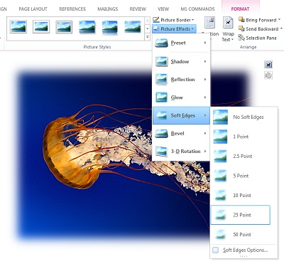
Add pictures to your publication
https://support.microsoft.com/en-us/office/add-or-change-an-effect-for-a-picture-d9f0f1f2-5227-450f-95b4-25ffdddbd965

Slide 32
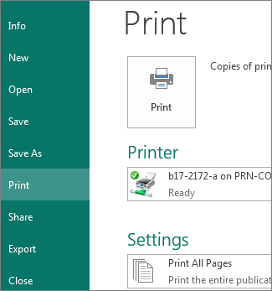
Print your publication
Click File > Print.
Under Print, enter the number of copies to print in Copies of print job box.
Make sure the correct printer is selected.
Note: The properties for your default printer are automatically entered for you.
Under Settings, do the following:
  Make sure the correct range of pages or sections is selected.
  Select the layout format for printing.
  Set the paper size.
  Set whether to print on one side of the paper or on both sides.
  If your printer is capable of color printing, choose whether you want to print color or grayscale.
  Click the Print button when you are ready to print.
Source: https://support.microsoft.com/en-us/office/basic-tasks-in-publisher-0e5ed249-1927-433f-a35c-63beb8216fcf

Slide 33
Summary
Microsoft Publisher is a desktop publishing application which allows you to professionally design and layout pages, whether they be for the Web, print publications, or both.
It caters to all aspects of publishing, allowing you to create everything from business cards to brochures and posters.
Traditionally aimed at entry-level users, it attempts to simplify much of the process at the expense of high-end functionality. (In other words, while beginners will be able to tackle the application with considerable success, advanced users may be hamstrung by the limited tools on offer.)
It is still significantly underpowered when compared to the likes of Adobe InDesign or QuarkXPress.
Users can add images, shapes, tables, and other objects to their publications and manipulate them to create professional-looking designs.
Publisher also offers features for managing page layout, arranging text and images, and preparing documents for print or digital distribution.

Slide 34
THANK YOU
LECTURE 10
BY DR. RAPHAEL OGUTU,
Mass Communication Department,
AFRICA NAZARENE UNIVERSITY

