Slide 1
VISUAL COMMUNICATION
WEEK 12 Publication Printing techniques
By Dr. Raphael Ogutu

Slide 2
VISUAL COMMUNICATION
Publication Printing techniques
Intended Learning Outcome
At end of this week lesson the students should be able to:
1. Explore the history and evolution of printing processes.
2. Analyze in detail printing methods
3. Apply the printing processes of publications
4. Visit and learn from printing industry

Slide 3
Introduction to Publication Printing techniques
printing is the activity or business of producing writing and images on paper or other material with a machine.
Printing is the process of reproducing text and images, typically using ink on paper or other materials, through various techniques and technologies.
It involves the transfer of an image or text from a digital file or physical template onto a substrate (e.g., paper, fabric, plastic) to create multiple copies of the original content.
printing, traditionally, a technique for applying under pressure a certain quantity of colouring agent onto a specified surface to form a body of text or an illustration.

Slide 4
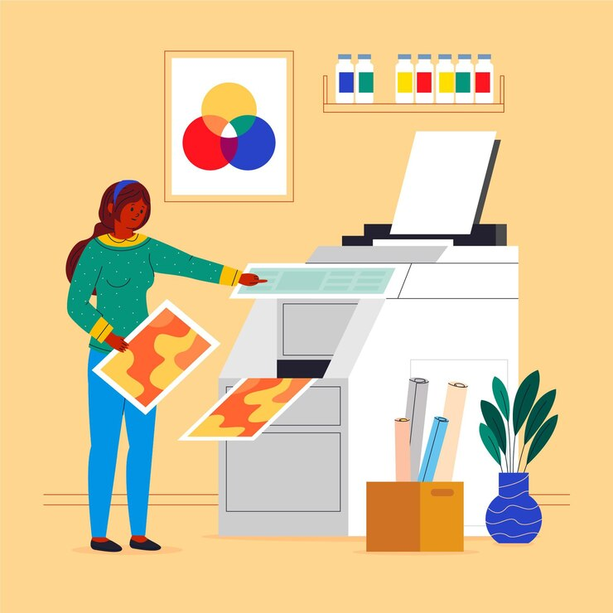
Introduction to Publication Printing techniques
Certain modern processes for reproducing texts and illustrations, however, are no longer dependent on the mechanical concept of pressure or even on the material concept of colouring agent.
Because these processes represent an important development that may ultimately replace the other processes, printing should probably now be defined as any of several techniques for reproducing texts and illustrations, in black and in colour, on a durable surface and in a desired number of identical copies.
Source: https://www.freepik.com/free-vector/printing-industry-flat-illustration_13295431.htm#query=print%20process&position=13&from_view=keyword&track=ais_user&uuid=b3c237cf-03e5-4dda-993a-6d33d882eb55

Slide 5
Analysis of the history and evolution of printing
The history and evolution of printing are vast and multifaceted.
Printing has played a crucial role in the dissemination of information, knowledge, and culture throughout human history.
Ancient and Early Methods
Woodblock Printing (circa 200 AD)
It is the oldest method used for printing and is now overtaken by newer techniques. This traditional method involved carving an image or text onto a wood block. Then that block was used to make ink impressions on paper, fabric, or other materials (Test Print, 2022).
  Origins: The earliest known form of printing, developed in China.
  Technique: Involved carving an image or text onto a wooden block, inking it, and pressing it onto paper or cloth.
  Uses: Primarily used for printing textiles and later for religious texts and images.

Slide 6
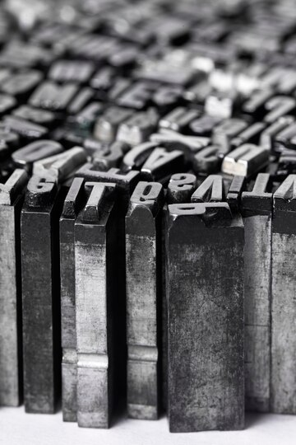
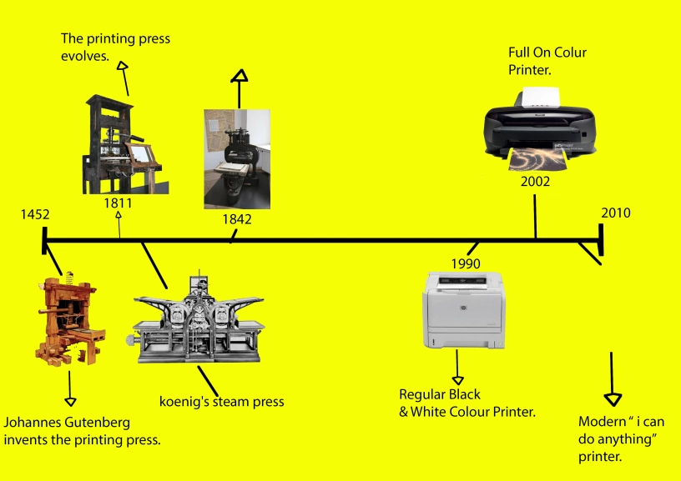
Analysis of the history and evolution of printing
Sources: https://www.freepik.com/free-photo/close-up-metallic-typesetting-letters_27506228.htm#fromView=search&page=1&position=1&uuid=53f45e6e-9f6d-4c94-8803-1b769238da23 https://kcimgdjamalgayle.wordpress.com/2016/10/19/printing-process/

Slide 7
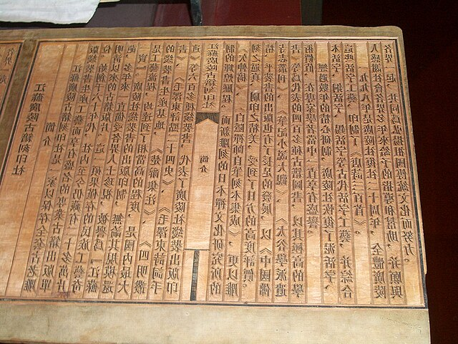
Ancient and Early Methods
2. Movable Type (circa 1040 AD)
Created by Bi Sheng in Song Dynasty China, Movable Type is similar to Woodcut, although this particular technique was used specifically for printing script.
Before Movable Type, lettering had to be written out in full, whereas this technique allowed individual letters to be configured and placed together in any order.
The tiles or tablets used to create the print were first made from clay, before wood and metal were introduced for better clarity and a more resilient finish (Instantprint, 2022).
Source:https://commons.wikimedia.org/wiki/File:Yangzhou_Museum_-_woodblock_for_printing_-_CIMG2878.JPG

Slide 8
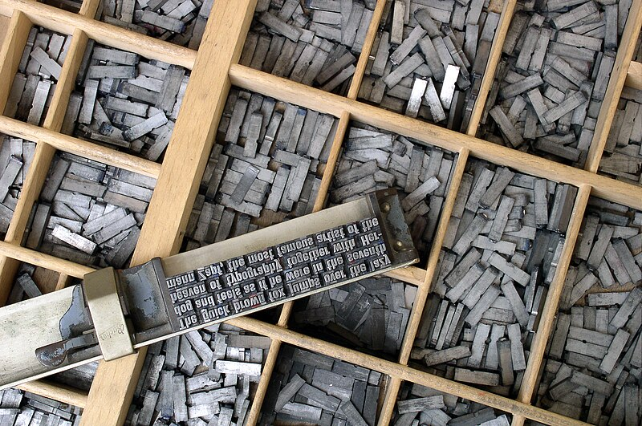
Ancient and Early Methods
It is also a form of relief printing, similar to flexography, and letterpress printing is considered an art form.
It uses a press with raised letters or images to transfer ink onto the printing surface
Inventor: Bi Sheng in China.
Method: Individual characters made from clay were assembled to form pages. After use, the characters could be rearranged for new pages.
Impact: While innovative, it was limited by the vast number of characters in Chinese writing, making it less practical than block printing.
Source: https://commons.wikimedia.org/wiki/File:Metal_movable_type.jpg

Slide 9
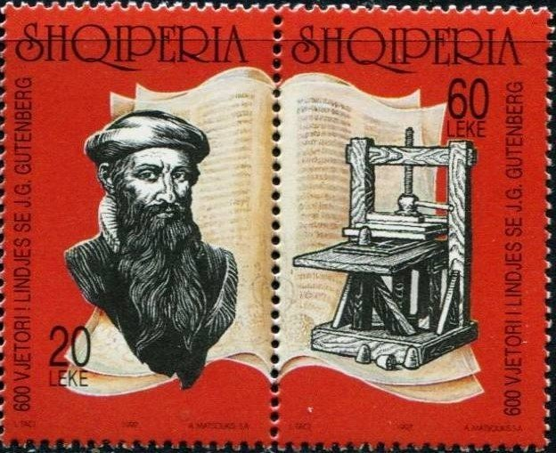
Ancient and Early Methods
The Gutenberg Revolution
3. Gutenberg Printing Press (circa 1440)
The text or design to be printed is first prepared and set in metal or wooden type. This includes selecting the typeface, size, and layout of the text or design. The type is then carefully arranged on a press bed in the desired layout, with the raised letters facing upwards. Finally, the press bed is then pressed against the printing surface, such as paper or cardstock, transferring the ink from the type to the surface to create the printed image. The final product is then cut to the desired size and shape (Test Print, 2022).
Source: https://commons.wikimedia.org/wiki/File:Stamp_of_Albania_-_1997_-_Colnect_370776_-_Johannes_Gutenberg_1398-1468_German_engraver_and_inventor.jpeg

Slide 10
Ancient and Early Methods
3. Gutenberg Printing Press (circa 1440)
• Inventor: Johannes Gutenberg, a German blacksmith and inventor.
• Innovation: Introduced the mechanical movable type printing press using metal type pieces.
• Process: Combined movable type with a press mechanism, significantly speeding up the printing process.
• Impact: Revolutionized the production of books and written materials. The Gutenberg Bible (1455) is one of the first major books printed using this method.
• Consequences: Facilitated the spread of knowledge, contributing to the Renaissance, Reformation, and Scientific Revolution.

Slide 11
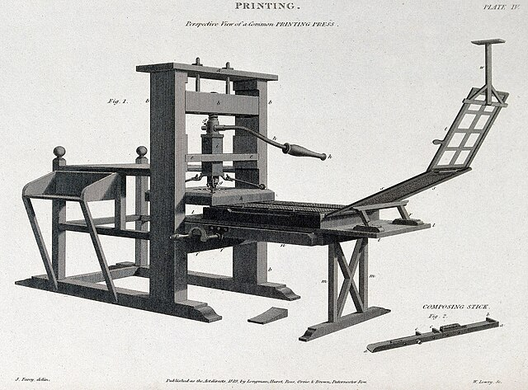
Expansion and Refinement
4. 16th to 18th Centuries
• Spread of Printing: The printing press spread rapidly across Europe and eventually to other parts of the world.
• Refinements: Improvements in press design and typecasting, the introduction of copperplate engraving, and other advancements enhanced printing quality and efficiency.
• Content: Growth in printed materials including newspapers, pamphlets, and books, which became more accessible to the public.
Source: https://commons.wikimedia.org/w/index.php?search=The+printing+press+&title=Special:MediaSearch&go=Go&type=image

Slide 12
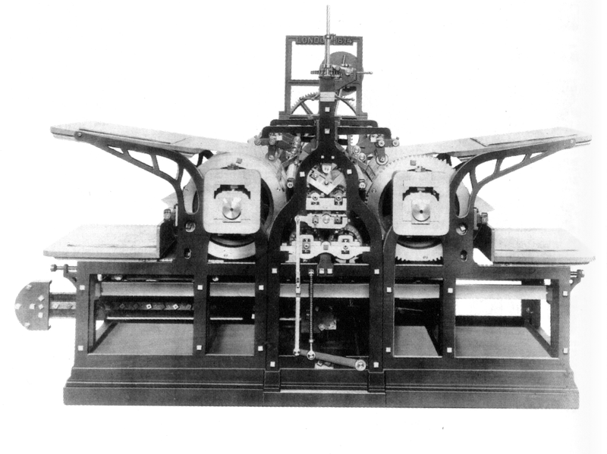
5. Industrial Revolution (19th Century)
• Steam-Powered Presses: Introduction of steam power increased printing speed and volume.
• Stereotyping: Technique of creating plates for entire pages, further speeding up the process.
• Lithography: Invented by Alois Senefelder, allowed for the printing of images and text from a single plate, improving cost-effectiveness and versatility.
• Impact: Enabled mass production of printed materials, contributing to increased literacy rates and the spread of information.
Koenig's steam press - 1814.
Source:https://commons.wikimedia.org/wiki/File:Koenig%27s_steam_press_-_1814.png

Slide 13
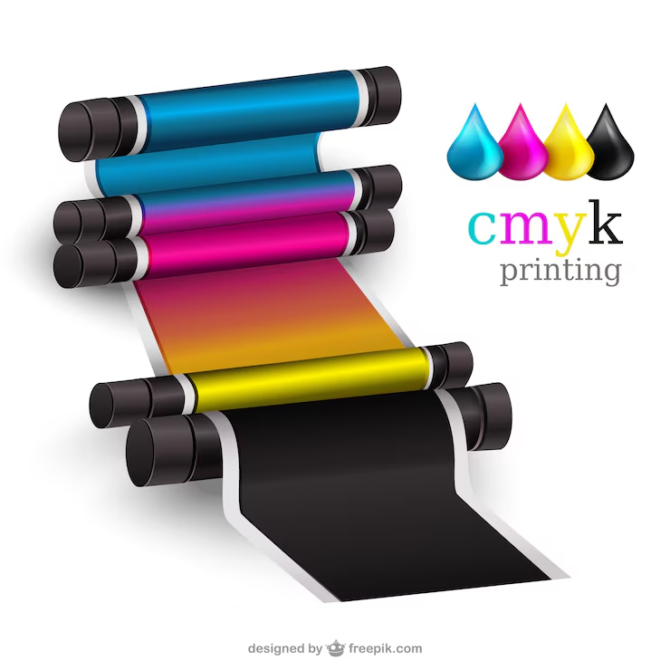
Modern Printing Technologies
6. 20th Century Advances
• Offset Printing: Developed in the early 20th century, it became the dominant commercial printing method. Involves transferring an inked image from a plate to a rubber blanket, then to the printing surface.
• Phototypesetting: Replaced hot metal typesetting in the mid-20th century, using photographic processes to set type.
• Digital Printing: Emerged in the late 20th century. Uses digital files to directly print onto substrates without the need for plates.
Source: https://www.clashgraphics.com/printing-tips/7-types-of-printing/

Slide 14
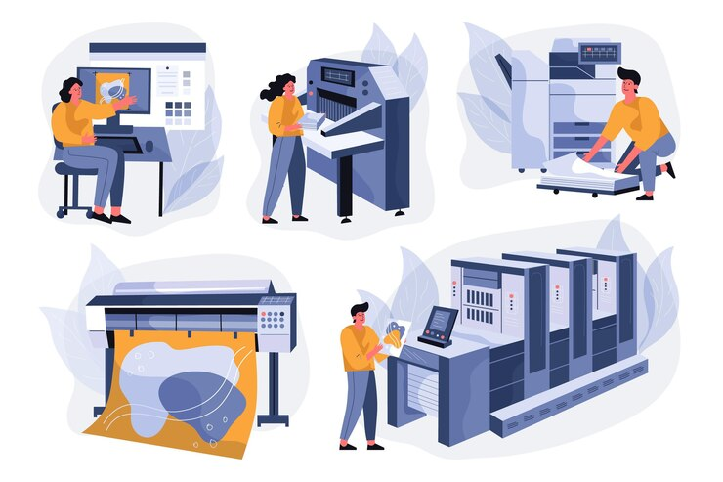
Contemporary Printing
7. 21st Century and Digital Revolution
• Inkjet and Laser Printers: Common in both personal and commercial use, offering high-quality prints with minimal setup time.
• 3D Printing: A transformative technology that builds three-dimensional objects layer by layer from digital models.
• Sustainability: Increased focus on eco-friendly practices, such as using recycled materials and sustainable inks.
• Customization: Digital printing allows for on-demand and personalized printing, reducing waste and allowing for greater flexibility.
Source: https://www.freepik.com/free-vector/organic-flat-printing-industry-illustration_13184957.htm#fromView=search&page=1&position=16&uuid=f3bd99a6-000b-4505-8267-3ab906dd46f8

Slide 15
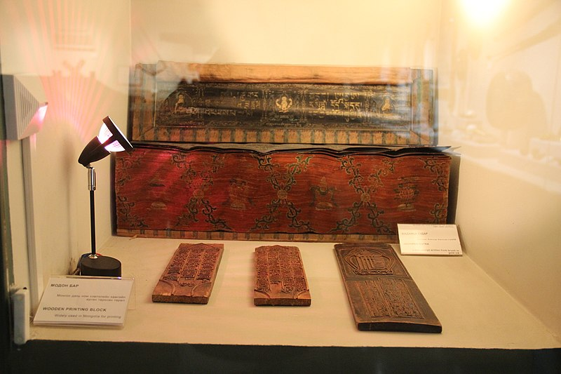
Printing methods
1. Woodblock Printing
History and Development:
Originated in China around 200 AD.
Used extensively in East Asia for printing on textiles and paper.
Technique:
An image or text is carved into a wooden block.
Ink is applied to the surface, and the block is pressed onto the paper or fabric.
Mongolian Traditional Culture Wooden Printing Blocks
Source:https://commons.wikimedia.org/wiki/File:Mongolian_Traditional_Culture_Wooden_Printing_Blocks_(34866893254).jpg

Slide 16
Printing methods
1. Woodblock Printing
Applications:
Early books, religious texts, and decorative textiles.
Advantages:
Simplicity and durability of the woodblocks.
Ability to produce consistent prints over multiple uses.
Disadvantages:
Labor-intensive and time-consuming.
Limited detail and complexity.

Slide 17
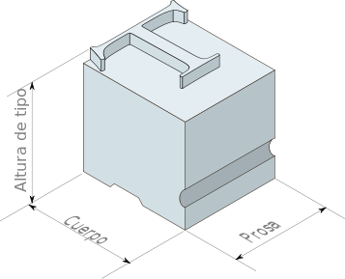
Printing methods
2. Movable Type
History and Development:
Invented by Bi Sheng in China around 1040 AD.
Perfected by Johannes Gutenberg in the 15th century in Europe.
Technique:
Individual characters made from materials like clay, wood, or metal.
Characters are assembled to form pages and can be reused and rearranged.
Metal type kerning dimensions
Source: https://commons.wikimedia.org/wiki/File:Metal_type_kerning_dimensions_es.svg

Slide 18
Printing methods
2. Movable Type
Applications:
Books, newspapers, and other written materials.
Advantages:
Greater efficiency compared to woodblock printing.
Easier to correct errors and make changes.
Disadvantages:
Still relatively slow compared to modern methods.
Requires skilled labor to assemble and disassemble type.

Slide 19
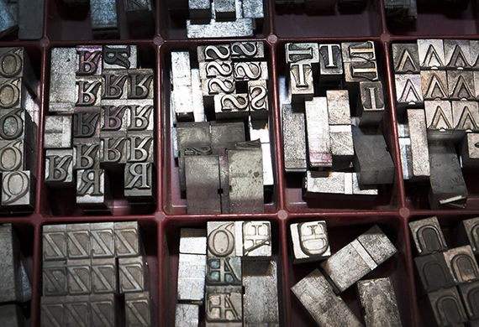
Letterpress Printing methods
History and Development:
Dominant method from the 15th century until the mid-20th century.
Technique:
Raised letters are inked and pressed onto the paper.
Uses movable type and mechanical presses.
Applications:
Books, newspapers, business cards, and invitations.
Advantages:
Produces high-quality, sharp text.
Can create a tactile, embossed effect.
Disadvantages:
Labor-intensive setup.
Less efficient for high-volume printing.
Source:https://www.clashgraphics.com/printing-tips/7-types-of-printing/

Slide 20
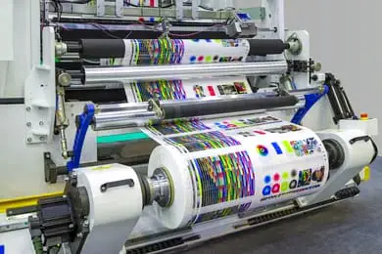
4. Lithography Printing methods
History and Development:
Invented by Alois Senefelder in 1796.
Technique:
Based on the principle that oil and water do not mix.
Uses a flat stone or metal plate; the image area is inked, and
the non-image area is treated to repel ink.
Applications:
Posters, maps, packaging, and fine art prints.
Advantages:
High-quality image reproduction.
Suitable for both text and images.
Disadvantages:
Complex process requiring skilled operators.
Not suitable for very high-volume printing.
Sources:: https://www.testprint.net/printing-methods-techniques/#comment-295

Slide 21
Printing methods
5. Offset Printing
History and Development:
Developed in early 20thC. and became the dominant commercial printing method.
Technique:
The image is transferred from a plate to a rubber blanket, then to the printing surface.
Uses CMYK color model for color printing.
Applications:
Books, newspapers, magazines, brochures, and packaging.
Advantages:
High-quality, consistent prints.
Efficient for large print runs.
Disadvantages:
Setup can be costly and time-consuming.
Not economical for short runs.

Slide 22
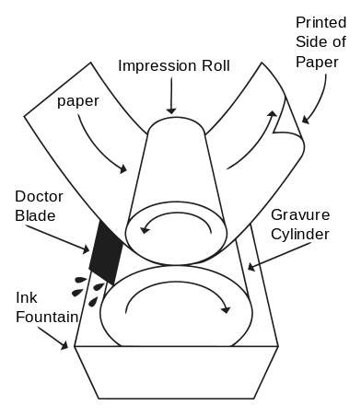
6. Gravure Printing methods
History and Development:
Developed in the 19th century.
Technique:
Uses engraved cylinders to transfer ink onto the paper.
Each cylinder represents one color, requiring multiple cylinders for full-color printing.
Applications:
High-volume printing such as magazines, packaging, and wallpaper.
Advantages:
Excellent print quality with rich colors and fine details.
Very efficient for long runs.
Disadvantages:
High setup costs due to the need for engraved cylinders.
Not economical for small print jobs.
Source : https://commons.wikimedia.org/wiki/File:Rotogravure_PrintUnit.svg

Slide 23
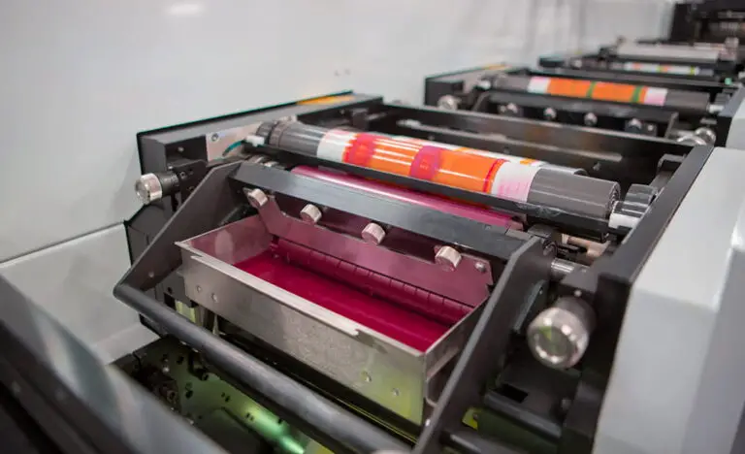
7. Flexography Printing methods
History and Development:
Evolved from letterpress printing in the early 20th century.
Technique:
Uses flexible relief plates to transfer ink to various substrates.
Can print on a wide range of materials, including plastic, foil, and paper.
Applications:
Packaging, labels, newspapers, and wallpapers.
Advantages:
Versatile, can print on non-porous surfaces.
Fast and efficient for long runs.
Disadvantages:
Lower image quality compared to gravure and offset printing.
Initial setup can be costly.
Source: https://www.testprint.net/printing-methods-techniques/#comment-295

Slide 24
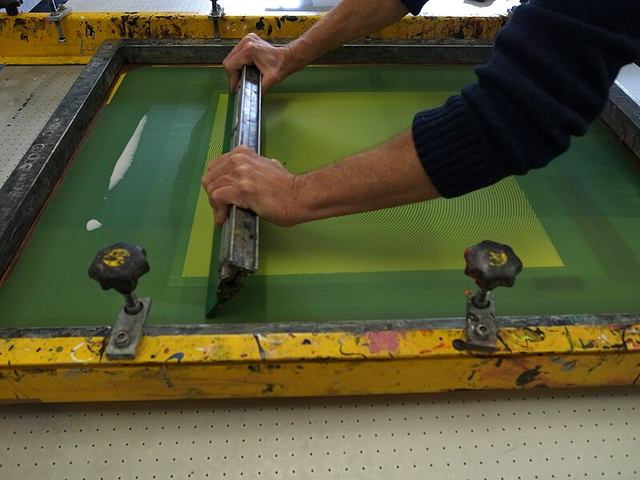
8. Screen Printing methods
History and Development:
Originated in China and Japan over 1,000 years ago,
widely popularized in the 20th century.
Technique:
Uses a stencil (screen) to apply layers of ink on the printing surface.
Each color requires a separate screen.
Applications:
Textiles, posters, signage, and electronic circuit boards.
Advantages:
Versatile and can be used on various materials.
Suitable for both short and long runs.
Disadvantages:
Time-consuming setup for multiple colors.
Less detailed than some other printing methods.
Source:https://commons.wikimedia.org/wiki/File:Serigraphie_esadhar_4.jpg

Slide 25
9. Digital Printing methods
History and Development:
Emerged in the late 20th century with the advent of digital technology.
Technique:
Uses digital files to directly print onto the substrate without the need for plates.
Includes inkjet and laser printing technologies.
Applications:
Small runs, on-demand printing, personalization, and variable data printing.
Advantages:
Quick setup and turnaround.
Cost-effective for short runs and customizable prints.
Disadvantages:
Higher cost per unit for large runs compared to traditional methods.
Lower quality and durability for some applications.

Slide 26
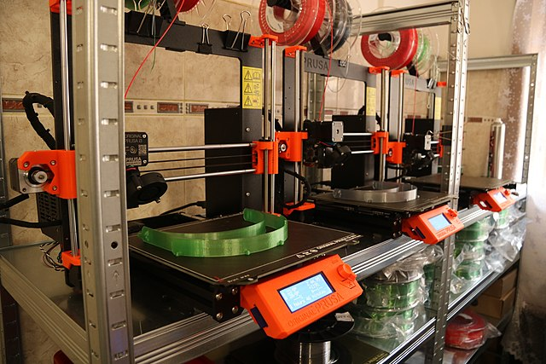
10. 3D Printing methods
History and Development:
Developed in the 1980s and rapidly evolved with advancements in digital technology.
Technique:
Builds three-dimensional objects layer by layer from digital models.
Uses materials such as plastic, resin, metal, and more.
Applications:
Prototyping, manufacturing, medical implants, and art.
Advantages:
Allows for complex, custom designs.
Rapid prototyping and reduced material waste.
Disadvantages:
Limited to certain materials.
Slower and more expensive for mass production compared to traditional methods.
Source: https://commons.wikimedia.org/wiki/File:3D_printing_of_face_shields.jpg

Slide 27
The printing processes of publications
1. Prepress
Prepress is the preparation stage before the actual printing. It ensures that all files and materials are ready for the printing process.
a. Design and Layout
Creation: Using software like Adobe InDesign, Illustrator, or Photoshop to create the layout and design of the publication.
Formatting: Ensuring text, images, and graphics are properly formatted and aligned.
Proofreading: Checking for spelling, grammar, and layout errors.
b. File Preparation
Color Mode: Setting the document to the appropriate color mode (CMYK for print, RGB for digital).
Source: https://edu.gcfglobal.org/en/publisher2010/creating-a-new-publication/1/

Slide 28
The printing processes of publications
Resolution: Ensuring images are high resolution (300 dpi) for print quality.
Bleed and Margins: Adding bleed areas to allow for trimming and setting safe margins to prevent content from being cut off.
c. Proofing
Soft Proofing: Reviewing a digital version of the document for accuracy.
Hard Proofing: Printing a physical proof to check colors, layout, and content.
Corrections: Making necessary adjustments based on proof feedback.
d. Plate Making (for offset printing)
Image Transfer: Transferring the digital image onto printing plates using a process called Computer-to-Plate (CTP).
Plates: Creating separate plates for each color in the design (typically CMYK).

Slide 29
The printing processes of publications
2. Printing
The printing stage is where the prepared files are transferred onto the chosen substrate. Different methods are used based on the type and volume of the publication.
a. Offset Printing
Setup: Installing the printing plates on the press.
Ink Application: Applying ink to the plates, which transfer the ink to a rubber blanket and then onto the paper.
Run: Printing the desired number of copies, adjusting ink levels and registration as needed.
b. Digital Printing
Direct Print: Printing directly from digital files without the need for plates.

Slide 30
The printing processes of publications
Advantages: Quick setup, cost-effective for short runs, allows for customization and variable data printing.
Output: Producing the final prints using inkjet or laser printers.
c. Other Methods
Screen Printing: Using stencils to apply ink layers on various materials.
Gravure and Flexography: High-volume methods often used for packaging and specialty publications.

Slide 31
The printing processes of publications
3. Post-Press/Finishing
Post-press involves all the processes that occur after printing to finalize the publication.
a. Cutting and Trimming
Trimming: Cutting the printed sheets to the final size, removing any bleed areas.
Precision: Ensuring accurate cuts to maintain uniformity across all copies.
b. Binding
Saddle Stitching: Binding the pages with staples along the spine, common for booklets and magazines.
Perfect Binding: Gluing the pages together at the spine, suitable for thicker publications like books.
Spiral Binding: Using plastic or metal coils to bind pages, allowing them to lay flat when open.

Slide 32
The printing processes of publications
c. Folding
Techniques: Folding sheets into the desired format, such as bi-fold, tri-fold, or z-fold.
Accuracy: Ensuring precise folds to avoid misalignment.
d. Other Finishing Touches
Lamination: Adding a protective plastic coating to covers or pages for durability.
Varnishing: Applying a glossy, matte, or satin finish to enhance appearance and protect the printed surface.
Die-Cutting: Cutting out specific shapes or designs, often used for custom covers or unique formats.
Embossing/Debossing: Creating raised or recessed designs for a tactile effect.

Slide 33
The printing processes of publications
4. Quality Control
Throughout the entire process, quality control is crucial to ensure the final product meets the desired standards.
Inspections: Conducting regular checks at each stage of production.
Consistency: Ensuring color consistency, print quality, and accurate binding.
Final Proof: Reviewing the final product before full production or distribution.

Slide 34
Summary
The history and evolution of printing demonstrate a continuous advancement in technology and methods, each stage building on previous innovations to improve speed, quality, and accessibility.
From ancient woodblocks to digital presses, printing has been a pivotal force in shaping human civilization, knowledge dissemination, and cultural development.
Each printing method has its strengths and weaknesses, making them suitable for different applications and needs.
From the ancient woodblock printing to modern digital and 3D printing, the evolution of printing technologies reflects advancements in both artistic expression and industrial efficiency.
Understanding these methods helps in choosing the appropriate technique for a given project, balancing factors such as cost, quality, and production volume.

Slide 35
THANK YOU
LECTURE 12
BY DR. RAPHAEL OGUTU,
Mass Communication Department,
AFRICA NAZARENE UNIVERSITY

