Slide 1
VISUAL COMMUNICATION
WEEK 13 Publication Binding Techniques
By Dr. Raphael Ogutu

Slide 2
VISUAL COMMUNICATION
Publication Binding Techniques
Intended Learning Outcome
At end of this week lesson the students should be able to:
1. Explain the basics of Publication Binding processes or Techniques
2. Discuss Publication Binding processes or Techniques
3. Apply Publication Binding processes or Techniques
4. Visit and learn from the printing and binding industry

Slide 3
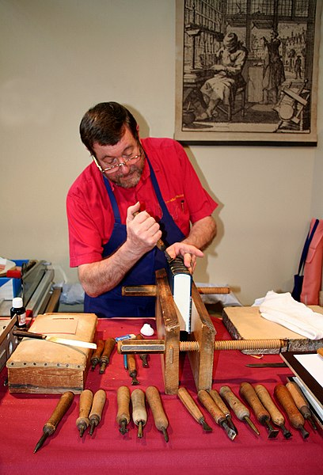
Introduction to Publication Binding Techniques
Publication binding processes or techniques refer to the methods used to secure the pages of a publication together, creating a cohesive and functional document.
Binding not only holds the pages in place but also adds durability and enhances the overall appearance of the publication.
There are various binding techniques available, each with its unique characteristics and suitability for different types of publications.
The type of binding you choose for your publication depends on your budget, your audience, how the document will be used, how you want readers to perceive your brand, and plenty more.
Source: https://commons.wikimedia.org/wiki/File:Relieur_JPG01.jpg

Slide 4
Types of Publication Binding Processes or Techniques
The Saddle Stitching binding process
According to Bookbinding Workshop Singapore (2024), a saddle stitch book is a thin book bound together using either a thread or staples. Commercial saddle stitch binding uses staples to bind books.
1. Prepress Preparation
Before the saddle stitching process begins, the publication's pages must be designed, laid out, and printed. This involves:
Design: Creating the layout of the publication using software like Adobe InDesign, Illustrator, or other desktop publishing tools.
Page Arrangement: Organizing the pages in the correct order for printing, ensuring that they will be in the proper sequence after folding.
Printing: Producing the printed sheets on a printing press or digital printer.

Slide 5
The Saddle Stitching binding process
2. Folding
Once the printed sheets are ready, they are folded in half along the centerfold line. This creates the signature, or group of pages, that will be bound together. The folding process can be done manually or using automated folding machines, depending on the volume of production.
3. Collating
After folding, the signatures are collated in the correct order. This ensures that the pages of the publication are arranged sequentially before binding. Collating can be done manually by hand or using automated collating equipment for larger print runs.
4. Stitching
The collated signatures are then placed on a saddle stitching machine, which holds them in position with a saddle-shaped clamp. Staples are then driven through the fold line of the signatures, securing them together.

Slide 6
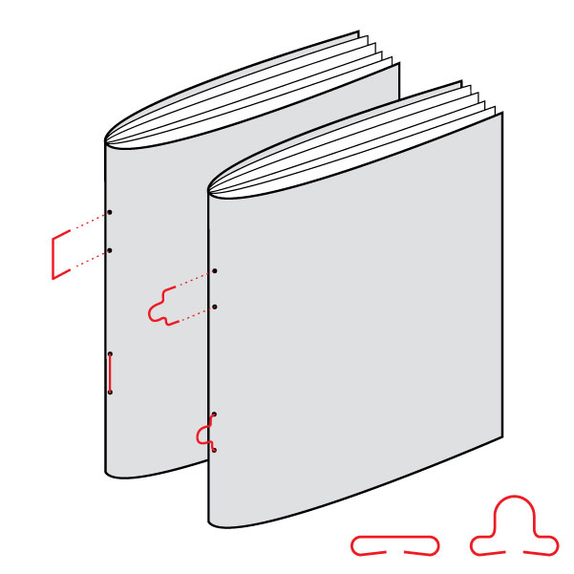
The Saddle Stitching binding process
Source: https://bambra.com.au/news/a-guide-to-book-binding-types/

Slide 7
The Saddle Stitching binding process
4. Stitching
The stitching process typically involves:
Staple Placement: Positioning the staples along the centerfold line to ensure they penetrate through all the layers of paper.
Staple Formation: Forming the staples by bending the legs of the wire or metal staples after they have been driven through the paper.
Trimming: Optionally, the excess staple legs may be trimmed to create a neater finish.
5. Trimming (Optional)
In some cases, after stitching, the edges of the publication may be trimmed to remove any excess paper and achieve a clean, uniform edge. This step is particularly important for ensuring consistency in the finished product, especially if the publication contains full-bleed images or colored backgrounds.
Sources: https://www.lifewire.com/microsoft-publisher-basics-4138207

Slide 8
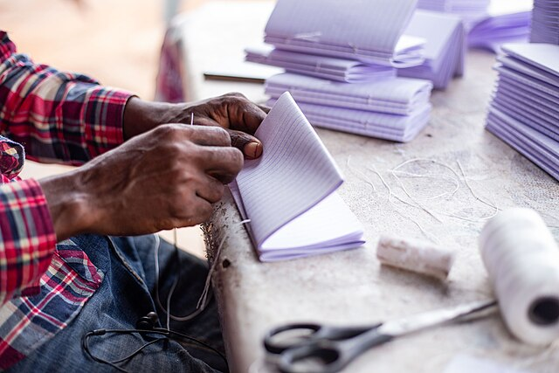
The Saddle Stitching binding process
6. Quality Control
Throughout the saddle stitching process, quality control checks are performed to ensure that the finished publications meet the desired standards.
This includes checking for proper folding, collating, stapling, and trimming, as well as inspecting for any printing defects or errors.
7. Finishing
Once the saddle stitching process is complete and quality control checks have been performed, the finished publications are ready for distribution. They may be stacked, bundled, boxed, or otherwise packaged for shipping to their final destination.
Source: https://commons.wikimedia.org/wiki/File:Book_binding_01.jpg

Slide 9
The Saddle Stitching binding process
7. Finishing
Advantages of Saddle Stitching:
Cost-effective for medium to large print runs.
Quick turnaround time, making it suitable for tight deadlines.
Lays flat when opened, allowing for easy reading and viewing.
Suitable for publications with a low to medium page count.
Provides a clean and professional appearance.
Limitations of Saddle Stitching:
Not suitable for very thick publications or those with a high page count.
Staples may cause damage to pages if not properly positioned.
Not as durable as other binding methods like perfect binding or case binding for long-term use.

Slide 10
The perfect binding process
1. Prepress Preparation
Perfect binding is a common bookbinding technique used for commercially produced books as it is a fast method of binding books that can be easily scaled up to meet the production volume required by commercial book publishers.
Before perfect binding begins, the pages of the publication must be designed, laid out, and printed. This involves:
Design: Creating the layout of the publication using software like Adobe InDesign, Illustrator, or other desktop publishing tools.
Page Arrangement: Organizing the pages in the correct order for printing, ensuring that they will be in the proper sequence after binding.
Printing: Producing the printed pages on a printing press or digital printer.

Slide 11
The perfect binding process
2. Collating
After printing, the individual pages or signatures are collated into the correct order. This ensures that the pages of the publication are arranged sequentially before binding. Collating can be done manually by hand or using automation.
3. Milling
Once collated, the spine edge of the book block is milled or roughened. This process removes a small amount of material from the spine, creating a rough surface for better adhesion of the glue. Milling also increases the flexibility of the spine, allowing the book to open more easily.
4. Gluing
After milling, the book block is placed in a perfect binding machine, where hot glue is applied along the milled spine edge. The glue penetrates into the fibers of the paper, bonding the pages together and forming a strong, durable spine. The glue is applied evenly to ensure uniform adhesion across the entire spine.

Slide 12
The perfect binding process
5. Attaching the Cover
Once the glue is applied, a cover is wrapped around the glued spine of the book block.
The cover can be made of paper, cardstock, or a thicker material like chipboard.
The cover extends slightly beyond the edges of the pages to provide protection and stability.
6. Pressing and Drying
After the cover is attached, the book undergoes a pressing process to ensure proper adhesion of the glue and to flatten the cover.
The book is then allowed to dry completely, typically in a cooling rack or drying cabinet.
Drying time may vary depending on the type of glue used and environmental conditions.

Slide 13
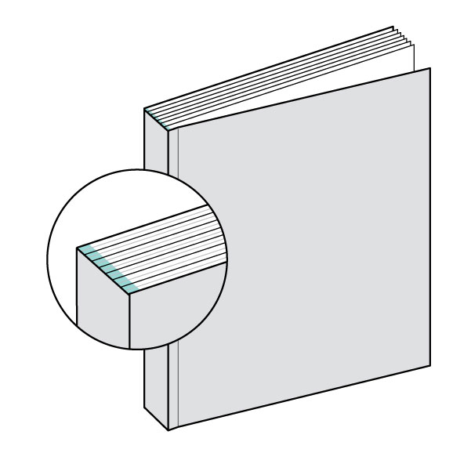
The perfect binding process
7. Trimming
Once the book is dry, any excess material from the edges of the pages and cover is trimmed away to create a clean, uniform edge.
This step ensures that the finished book has neat and even edges, enhancing its overall appearance.
8. Quality Control
Throughout the perfect binding process, quality control checks are performed to ensure that the finished books meet the desired standards.
This includes checking for proper collating, milling, gluing, attaching the cover, trimming, and overall appearance of the finished product.
Source: https://bambra.com.au/news/a-guide-to-book-binding-types/

Slide 14
The perfect binding process
Advantages of Perfect Binding:
Suitable for medium to large print runs.
Professional appearance similar to hardcover books.
Accommodates higher page counts compared to saddle stitching.
Durable and long-lasting binding method.
Allows for printing on the spine for easy identification.
Limitations of Perfect Binding:
Requires longer drying time compared to saddle stitching.
Not suitable for very thin publications or those with low page counts.
Costlier than saddle stitching for short print runs.

Slide 15
Spiral Binding (Coil Binding) process
Spiral binding, also known as coil binding is a method where a continuous spiral of durable plastic or metal coil is threaded through evenly spaced holes along the edge of your document.
It provides a beautiful aesthetic appeal and is adaptable and easy to use across various sectors.
Spiral binding, also known as coil binding, is a popular binding method used to create notebooks, workbooks, manuals, presentations, calendars, and other types of publications.
1. Prepress Preparation
Before spiral binding begins, the pages of the publication must be designed, laid out, and printed. This involves:
Design: Creating the layout of the publication using software like Adobe InDesign, Illustrator, or other desktop publishing tools.

Slide 16
Spiral Binding (Coil Binding) process
1. Prepress Preparation…
Page Arrangement: Organizing the pages in the correct order for printing, ensuring that they will be in the proper sequence after binding.
Printing: Producing the printed pages on a printing press or digital printer.
2. Hole Punching
Once the pages are printed, they are punched with evenly spaced holes along one edge.
The number and spacing of the holes depend on the size of the publication and the diameter of the spiral coil.
Hole punching can be done using a manual or electric punch machine, depending on the volume of production.
.

Slide 17
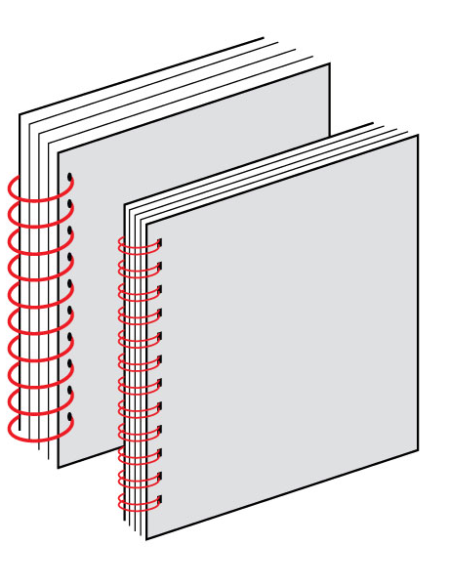
Spiral Binding (Coil Binding) process
3. Coil Insertion
After punching the holes, a plastic or metal coil is inserted through the holes to bind the pages together.
The coil is typically pre-formed into a spiral shape and has small loops at each end to prevent it from unraveling.
Coil insertion can be done manually or using a coil inserting machine for faster and more consistent results.
4. Coil Crimping
Once the coil is inserted through all the holes, the ends of the coil are crimped or bent using coil crimping pliers to secure it in place.
Crimping prevents the coil from accidentally coming loose and ensures that the pages remain securely bound together.
Source: https://bambra.com.au/news/a-guide-to-book-binding-types/

Slide 18
Spiral Binding (Coil Binding) process
5. Trimming (Optional)
In some cases, after spiral binding, the edges of the publication may be trimmed to remove any excess paper and achieve a clean, uniform edge.
This step is particularly important for ensuring consistency in the finished product, especially if the publication contains full-bleed images or colored backgrounds.
6. Quality Control
Throughout the spiral binding process, quality control checks are performed to ensure that the finished publications meet the desired standards. This includes checking for proper hole punching, coil insertion, crimping, trimming (if applicable), and overall appearance of the finished product.
Source: https://edu.gcfglobal.org/en/publisher2010/getting-to-know-publisher-2010/1/

Slide 19
Spiral Binding (Coil Binding) process
7. Finishing
Once the spiral binding process is complete and quality control checks have been performed, the finished publications are ready for distribution. They may be stacked, bundled, boxed, or otherwise packaged for shipping to their final destination.
Advantages of Spiral Binding:
Allows for easy addition or removal of pages.
Pages can lay flat when opened, allowing for easy reading and writing.
Provides 360-degree rotation, allowing the publication to be folded back on itself.
Durable and long-lasting binding method.
Suitable for both small and large print runs.
Limitations of Spiral Binding:
Spiral coils can sometimes get caught or snagged on objects.
Not as professional-looking as perfect binding or case binding for certain types of publications.
Limited options for printing on the spine for easy identification.

Slide 20
Wire-O Binding (Double Loop Wire Binding) process
Also known by other names, such as twin loop, double-loop, Double-O, duo-wire, or simply wire binding.
It is a type of binding that uses a metal wire to join the pages and cover of a document.
The wire is inserted through holes punched in the pages and then twisted into a loop.
Wire-O binding is a popular choice for documents that need to be durable and professional-looking. It is often used for manuals, portfolios, cookbooks, reports, and presentations.
1. Prepress Preparation
Before Wire-O binding begins, the pages of the publication must be designed, laid out, and printed. This involves:
Design: Creating the layout of the publication using software like Adobe InDesign, Illustrator, or other desktop publishing tools.

Slide 21
Wire-O Binding (Double Loop Wire Binding) process
Page Arrangement: Organizing the pages in the correct order for printing, ensuring that they will be in the proper sequence after binding.
Printing: Producing the printed pages on a printing press or digital printer.
2. Hole Punching
Once the pages are printed, they are punched with evenly spaced holes along one edge. The number and spacing of the holes depend on the size of the publication and the diameter of the wire binding element. Hole punching can be done using a manual or electric punch machine, depending on the volume of production.
3. Wire Binding
After punching the holes, a double-loop wire binding element is threaded through the holes to bind the pages together. The wire binding element is typically pre-formed into a double-loop shape and comes in various diameters to accommodate different page counts. Wire binding can be done manually or using a wire binding machine

Slide 22
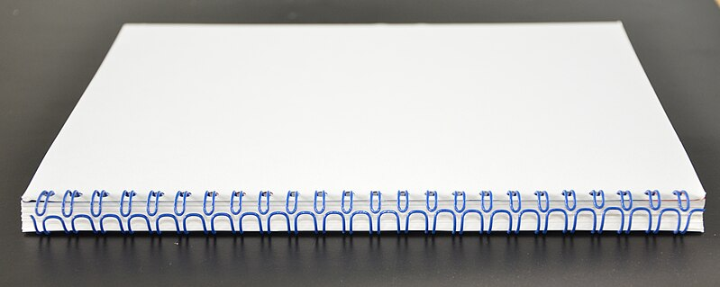
Wire-O Binding (Double Loop Wire Binding) process
Source: https://commons.wikimedia.org/wiki/File:Wire-o.jpg

Slide 23
Wire-O Binding (Double Loop Wire Binding) process
4. Closing the Wire
Once the wire binding element is threaded through all the holes, the ends of the wire are closed using a wire closing device or wire closer. This step ensures that the wire binding element remains securely closed and prevents the pages from accidentally coming loose.
5. Trimming (Optional)
In some cases, after wire binding, the edges of the publication may be trimmed to remove any excess paper and achieve a clean, uniform edge. This step is particularly important for ensuring consistency in the finished product, especially if the publication contains full-bleed images or colored backgrounds.
6. Quality Control
Throughout the Wire-O binding process, quality control checks are performed to ensure that the finished publications meet the desired standards. This includes checking for proper hole punching, wire binding, wire closing, trimming (if applicable), and overall appearance.

Slide 24
Wire-O Binding (Double Loop Wire Binding) process
7. Finishing
Once the Wire-O binding process is complete and quality control checks have been performed, the finished publications are ready for distribution. They may be stacked, bundled, boxed, or otherwise packaged for shipping to their final destination.
Advantages of Wire-O Binding:
Allows for easy addition or removal of pages.
Pages can lay flat when opened, allowing for easy reading and writing.
Provides 360-degree rotation, allowing the publication to be folded back on itself.
Durable and long-lasting binding method.
Professional appearance suitable for business presentations and reports.
Limitations of Wire-O Binding:
Wire binding elements can sometimes get caught or snagged on objects.
Not suitable for very thick publications or those with a high page count.
Limited options for printing on the spine for easy identification.

Slide 25
Case Binding (Hardcover Binding) process
Case binding is a bookbinding method that creates a durable book complete with a hard book cover and a covered spine.
The book covers can be covered with decorative paper, decorative book fabric, leather and more.
The possibilities are endless, it’s up to you to express yourself. Case binding, also known as hardcover binding, is a durable and professional binding method
1. Prepress Preparation
Before case binding begins, the pages of the publication must be designed, laid out, and printed. This involves:
Design: Creating the layout of the publication using software like Adobe InDesign, Illustrator, or other desktop publishing tools.
Page Arrangement: Organizing the pages in the correct order for printing, ensuring that they will be in the proper sequence after binding.
Printing: Producing the printed pages on a printing press or digital printer.

Slide 26
Case Binding (Hardcover Binding) process
2. Collating and Sewing
Once the pages are printed, they are collated into signatures, which are groups of pages that are folded together. The signatures are then sewn together along the spine using a process called Smyth sewing or perfect binding. Sewing the signatures together creates a sturdy book block that will form the core of the hardcover book.
3. Milling
After sewing, the spine edge of the book block is milled or roughened. This process removes a small amount of material from the spine, creating a rough surface for better adhesion of the glue. Milling also increases the flexibility of the spine, allowing the book to open more easily.
4. Applying Endpapers
Endpapers, also known as flyleaves, are attached to the front and back of the book block. These are usually made of thicker paper or cardstock and serve to reinforce the connection between the book block and the cover. Endpapers are glued to the first and last signatures of the book block and wrapped around to the inside covers of the case.

Slide 27
5. Making the Case
The case, or hardcover, is constructed separately from the book block. It consists of two rigid boards made of cardboard or other sturdy material, joined together by a flexible cloth or paper spine. The spine of the case is typically wider than the book block to accommodate the thickness of the book.
6. Attaching the Book Block to the Case
The book block is attached to the case using adhesive. The spine of the book block is glued to the spine of the case, and the endpapers are glued to the inside covers of the case. This process creates a strong and durable bond between the book block and the case.
7. Covering the Case
After attaching the book block to the case, the entire cover is covered with a material such as cloth, leather, or paper. The covering material is glued to the boards of the case and wrapped around the spine. This process not only provides protection for the book but also adds decorative elements to the cover.

Slide 28
Case Binding (Hardcover Binding) process
8. Trimming (Optional)
In some cases, after case binding, the edges of the book may be trimmed to remove any excess covering material and achieve a clean, uniform edge. This step is particularly important for ensuring consistency in the finished product, especially if the covering material has been applied manually.
9. Quality Control
Throughout the case binding process, quality control checks are performed to ensure that the finished books meet the desired standards. This includes checking for proper sewing, milling, endpaper application, case construction, attaching the book block to the case, covering the case, trimming (if applicable), and overall appearance of the finished product.
10. Finishing
Once the case binding process is complete and quality control checks have been performed, the finished hardcover books are ready for distribution. They may be stacked, bundled, boxed, or otherwise packaged for shipping to their final destination.

Slide 29
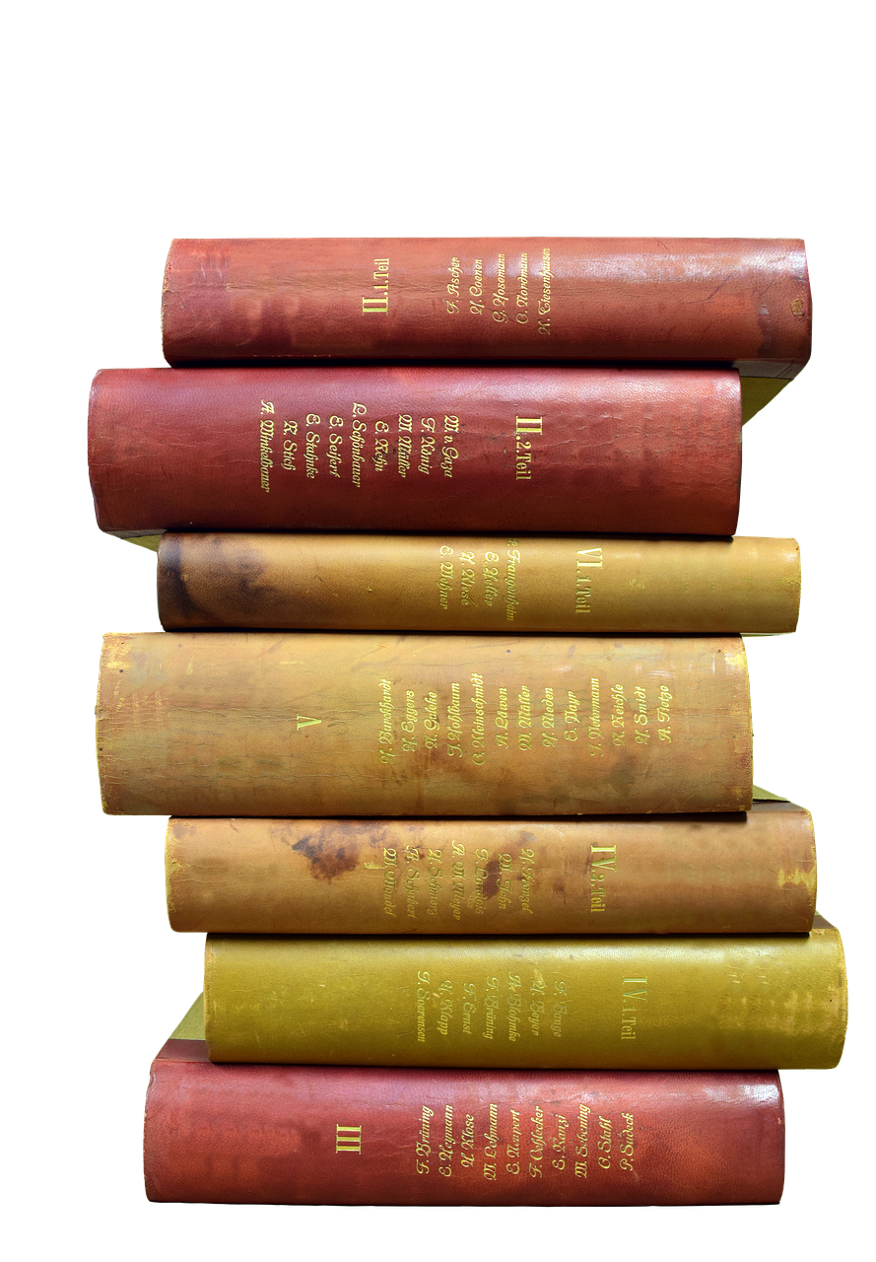
Case Binding (Hardcover Binding) process
Advantages of Case Binding:
Creates a premium and professional-looking product.
Provides durability and protection for the book block.
Suitable for long-term use and display.
Allows for customization of cover materials and designs.
Provides a flat spine suitable for printing titles and other information.
Limitations of Case Binding:
Requires specialized equipment and skilled labor.
More time-consuming and costly compared to other binding methods.
Not suitable for short print runs or publications with low budgets.
Source: https://pixabay.com/photos/book-stack-books-antiquariat-read-2915944//

Slide 30
Comb Binding (Combination Binding) process
Comb binding uses a cylindrical plastic spine with multiple curves tines that serve to hold the pages of a book together. Each tine along the comb is pre-formed into a closed ring shape; similar to a spring, but with thicker tines. Each of these tines also has a small amount of tension. They are flexible enough that they can be pulled open, but strong enough to snap back to the circular shape.
1. Prepress Preparation
Before comb binding begins, the pages of the document must be designed, laid out, and printed. This involves:
Design: Creating the layout of the document using software like Adobe InDesign, Illustrator, or other desktop publishing tools.
Page Arrangement: Organizing the pages in the correct order for printing, ensuring that they will be in the proper sequence after binding.
Printing: Producing the printed pages on a printing press or digital printer.

Slide 31
Comb Binding (Combination Binding) process
2. Hole Punching
Once the pages are printed, they are punched with evenly spaced rectangular holes along one edge. The number and spacing of the holes depend on the size of the document and the diameter of the comb binding element. Hole punching can be done using a manual or electric punch.
3. Comb Binding
After punching the holes, a plastic comb binding element is inserted through the holes to bind the pages together. The comb binding element typically consists of a series of plastic teeth or prongs that interlock with the punched holes to secure the pages in place. Comb binding can be done manually or using a comb binding machine for faster and more consistent results.
4. Closing the Comb
Once the comb binding element is inserted through all the holes, the ends of the comb are closed using a comb binding machine or comb closing device. This step ensures that the comb binding element remains securely closed and prevents the pages from accidentally coming loose.

Slide 32
Comb Binding (Combination Binding) process
5. Trimming (Optional)
In some cases, after comb binding, the edges of the document may be trimmed to remove any excess paper and achieve a clean, uniform edge. This step is particularly important for ensuring consistency in the finished product, especially if the document contains full-bleed images or colored backgrounds.
6. Quality Control
Throughout the comb binding process, quality control checks are performed to ensure that the finished documents meet the desired standards. This includes checking for proper hole punching, comb binding, comb closing, trimming (if applicable), and overall appearance of the finished product.
7. Finishing
Once the comb binding process is complete and quality control checks have been performed, the finished documents are ready for distribution. They may be stacked, bundled, boxed, or otherwise packaged for shipping to their final destination.

Slide 33
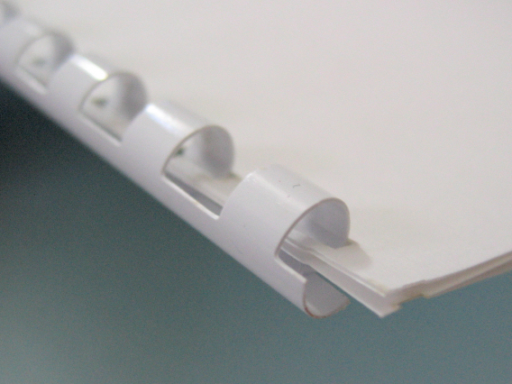
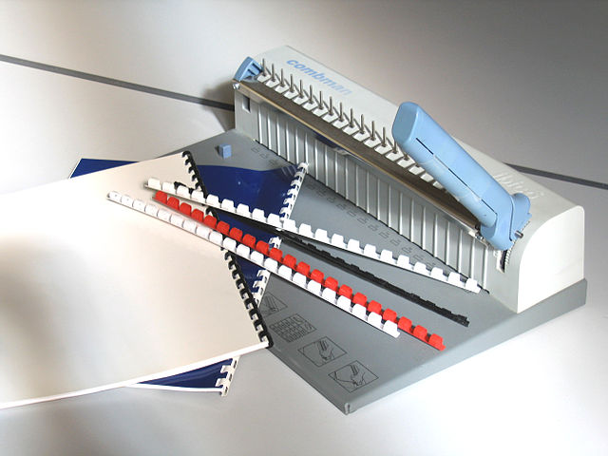
Comb Binding (Combination Binding) process
Advantages of Comb Binding:
Allows for easy addition or removal of pages.
Provides a professional appearance suitable for business documents.
Pages can lay flat when opened, allowing for easy reading and writing.
Durable and long-lasting binding method.
Suitable for both small and large print runs.
Limitations of Comb Binding:
Plastic comb binding elements may not be as durable or aesthetically pleasing as other binding methods.
Limited options for printing on the spine for easy identification.
Not suitable for very thick documents or those with a high page count.
Sources: https://commons.wikimedia.org/wiki/File:Comb_bind_step4.JPG https://commons.wikimedia.org/wiki/File:Reliburot_2047.jpg

Slide 34
Tape Binding process
Tape binding is a document binding process that uses strips coated in thermoplastic glue that, when melted to the spine and covers of a book, creates a strong and lasting bind. Also known as thermal glue strips, Super Strips or glue binding spines, they are available in linen or vinyl finishes and come in a variety of colors
1. Prepress Preparation
Before tape binding begins, the pages of the document must be designed, laid out, and printed. This involves:
Design: Creating the layout of the document using software like Adobe InDesign, Illustrator, or other desktop publishing tools.
Page Arrangement: Organizing the pages in the correct order for printing, ensuring that they will be in the proper sequence after binding.
Printing: Producing the printed pages on a printing press or digital printer.
2. Stacking
Once the pages are printed, they are stacked together in the correct order to form the document. The pages should be aligned evenly along one edge to ensure a neat and uniform binding.

Slide 35
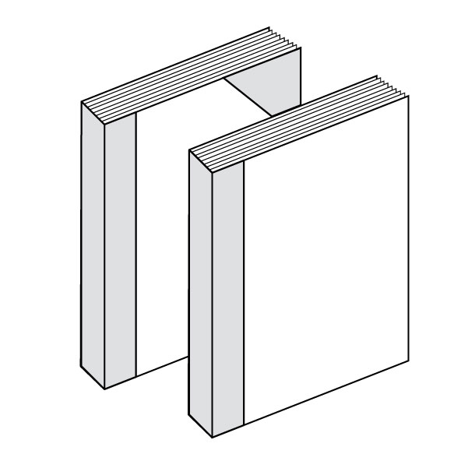
Tape Binding process
3. Attaching the Tape
A cloth or paper tape is cut to the appropriate length and width to cover the entire height of the stacked pages along the binding edge. The tape is then placed along the binding edge of the pages, covering them completely.
4. Applying Hot Glue
Hot glue is applied along the entire length of the tape using a tape binding machine or hot glue dispenser. The hot glue melts the adhesive on the tape, allowing it to adhere firmly to the pages.
5. Pressing
After applying the hot glue, the pages are pressed together firmly to ensure that the tape adheres securely to the pages. This step helps to create a strong and durable bond between the pages and the tape.
Source: https://bambra.com.au/news/a-guide-to-book-binding-types/

Slide 36
Tape Binding process
6. Trimming (Optional)
In some cases, after tape binding, the edges of the document may be trimmed to remove any excess tape and achieve a clean, uniform edge. This step is particularly important for ensuring consistency in the finished product, especially if the document contains full-bleed images or colored backgrounds.
7. Quality Control
Throughout the tape binding process, quality control checks are performed to ensure that the finished documents meet the desired standards. This includes checking for proper stacking, tape attachment, hot glue application, pressing, trimming (if applicable), and overall appearance of the finished product.
8. Finishing
Once the tape binding process is complete and quality control checks have been performed, the finished documents are ready for distribution. They may be stacked, bundled, boxed, or otherwise packaged for shipping to their final destination.

Slide 37
Tape Binding process
Advantages of Tape Binding:
Simple and cost-effective binding method.
Provides a clean and professional appearance.
Allows for easy addition or removal of pages.
Durable and long-lasting binding method.
Suitable for small to medium-sized documents.
Limitations of Tape Binding:
Not suitable for very thick documents or those with a high page count.
Limited options for printing on the spine for easy identification.
May not be as aesthetically pleasing as other binding methods for certain types of documents.

Slide 38
Summary
Publication binding processes or techniques play a crucial role in determining the functionality, durability, and aesthetic appeal of printed materials. Choosing the appropriate binding method depends on factors such as the type of publication, page count, budget, and desired appearance. Understanding the characteristics and suitability of each binding technique helps in selecting the most suitable option for a particular printing project.
Saddle stitching is a versatile and efficient binding process that produces professional-looking publications such as booklets, brochures, and magazines. Perfect binding is a versatile and durable binding process that produces professional-looking paperback books, catalogs, and magazines. Spiral binding is a versatile and durable binding method that produces functional and practical publications such as notebooks, workbooks, and manuals. Wire-O binding is a versatile and durable binding method that produces functional and professional-looking publications such as notebooks, presentations, and reports. Case binding is a high-quality and durable binding method that produces premium hardcover books suitable for a wide range of applications. Comb binding is a versatile and cost-effective binding method that produces functional and professional-looking documents such as reports, presentations, and manuals. Tape binding is a straightforward and practical binding method that produces neat and professional-looking documents.

Slide 39
THANK YOU
LECTURE 10
BY DR. RAPHAEL OGUTU,
Mass Communication Department,
AFRICA NAZARENE UNIVERSITY

