Slide 1



Lecturer:
May S. Flores, LPT, Ed.D.
Professor, School of Education
University of the Assumption
The Philippines
C-PE2: Physical Activities
Toward Health and Fitness 2
Spring 2024
Session 12
C-PE 2 (3 units)
PATHFIT II Exercise-based Program
Spring Semester 2024

Slide 2
Lecturer:
May S. Flores, LPT, Ed.D.
Professor, School of Education
University of the Assumption
The Philippines
C-PE2: Physical Activities
Toward Health and Fitness 2
Spring 2024
Spring Semester 2024
Exercise Assessment Guide
for
PATHFIT Performance Test

Slide 3
Lecturer:
May S. Flores, LPT, Ed.D.
Professor, School of Education
University of the Assumption
The Philippines
C-PE2: Physical Activities
Toward Health and Fitness 2
Spring 2024
Spring Semester 2024
Session Objectives:
Articulate the relationship between test and measurement and the assessment and evaluation.
Gather, organize, analyze and interpret scores and other forms of measurement and evaluation of students’ performance in PATHFIT II class.
Recognize the significance of assessing students’ learning before, during and after instruction.

Slide 4
Lecturer:
May S. Flores, LPT, Ed.D.
Professor, School of Education
University of the Assumption
The Philippines
C-PE2: Physical Activities
Toward Health and Fitness 2
Spring 2024
Spring Semester 2024
Session Objectives:
Manifest the ethical standards in assessing and evaluating student learning.
Demonstrate integrity and honesty in reporting results and findings in assessment.
Exhibit the behavior of an active and participative assessor of student learning.

Slide 5
Lecturer:
May S. Flores, LPT, Ed.D.
Professor, School of Education
University of the Assumption
The Philippines
C-PE2: Physical Activities
Toward Health and Fitness 2
Spring 2024
Spring Semester 2024
1
Test
Measurement
Assessment
Evaluation
Unlocking
Of Terms
2
3
4

Slide 6
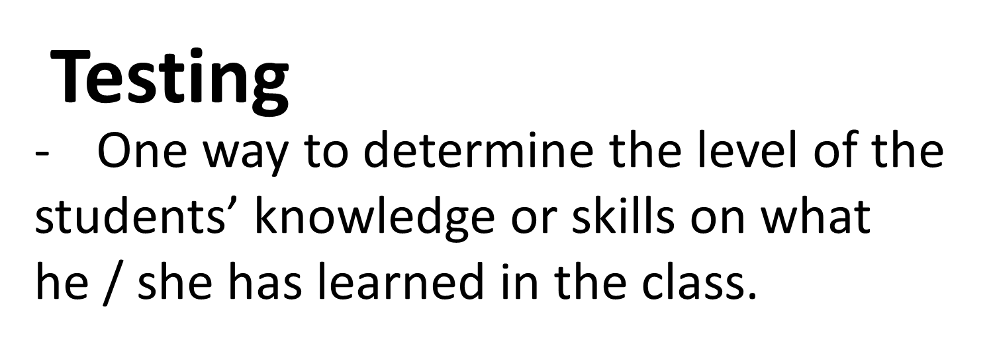
Lecturer:
May S. Flores, LPT, Ed.D.
Professor, School of Education
University of the Assumption
The Philippines
C-PE2: Physical Activities
Toward Health and Fitness 2
Spring 2024
Spring Semester 2024
Purpose and Importance

Slide 7
Lecturer:
May S. Flores, LPT, Ed.D.
Professor, School of Education
University of the Assumption
The Philippines
C-PE2: Physical Activities
Toward Health and Fitness 2
Spring 2024
Spring Semester 2024
Purpose and Importance
Measurement:
The process of quantifying figures,
amount, dimension of students’
performance.

Slide 8
Lecturer:
May S. Flores, LPT, Ed.D.
Professor, School of Education
University of the Assumption
The Philippines
C-PE2: Physical Activities
Toward Health and Fitness 2
Spring 2024
Spring Semester 2024
Purpose and Importance
Evaluation:
It involves collecting and analyzing information
about students' performance.
- Its purpose is to make judgments about students’ performance of a particular activity.

Slide 9
Lecturer:
May S. Flores, LPT, Ed.D.
Professor, School of Education
University of the Assumption
The Philippines
C-PE2: Physical Activities
Toward Health and Fitness 2
Spring 2024
Spring Semester 2024
Purpose and Importance
Assessment:
The process of documenting the
practical data of students performance
to improve learning.

Slide 10
Lecturer:
May S. Flores, LPT, Ed.D.
Professor, School of Education
University of the Assumption
The Philippines
C-PE2: Physical Activities
Toward Health and Fitness 2
Spring 2024
Spring Semester 2024
Traditional
New
Teacher centered
Emphasis is on achieving what is written on the lesson plan.
Passive learners
Exam-driven
Teacher as facilitator
Integration of knowledge and life skills
Active Learners
Several aspects of learners’ abilities will also be assessed

Slide 11
Lecturer:
May S. Flores, LPT, Ed.D.
Professor, School of Education
University of the Assumption
The Philippines
C-PE2: Physical Activities
Toward Health and Fitness 2
Spring 2024
Spring Semester 2024
Authentic Assessment Activities
Conducting field research
Role playing
Doing portfolios
Original creative projects
Writing stories / reports
Performing particular skills

Slide 12
Lecturer:
May S. Flores, LPT, Ed.D.
Professor, School of Education
University of the Assumption
The Philippines
C-PE2: Physical Activities
Toward Health and Fitness 2
Spring 2024
Spring Semester 2024
Authentic Assessment Tools
Observations
Performance samples
Actual performance

Slide 13
Lecturer:
May S. Flores, LPT, Ed.D.
Professor, School of Education
University of the Assumption
The Philippines
C-PE2: Physical Activities
Toward Health and Fitness 2
Spring 2024
Spring Semester 2024
Performance-based Assessment
This measures students' ability to apply the skills and knowledge learned from the class discussion and interaction.

Slide 14
Lecturer:
May S. Flores, LPT, Ed.D.
Professor, School of Education
University of the Assumption
The Philippines
C-PE2: Physical Activities
Toward Health and Fitness 2
Spring 2024
Spring Semester 2024
Performance-based Assessment
application of knowledge and skills, not just recall or recognition
do not produce a single, correct answer
establish authentic contexts for performance
provide evidence of understanding via transfer of learning
integrate two or more subjects
evaluated with established criteria and rubrics

Slide 15
Lecturer:
May S. Flores, LPT, Ed.D.
Professor, School of Education
University of the Assumption
The Philippines
C-PE2: Physical Activities
Toward Health and Fitness 2
Spring 2024
Spring Semester 2024
Components of a Performance-based Assessment
    More complex in nature
    Authentic results
    Process/product-oriented
    Time-bound

Slide 16
Lecturer:
May S. Flores, LPT, Ed.D.
Professor, School of Education
University of the Assumption
The Philippines
C-PE2: Physical Activities
Toward Health and Fitness 2
Spring 2024
Spring Semester 2024
The Outcomes of Education
Immediate Outcomes
Deferred Outcomes

Slide 17
Lecturer:
May S. Flores, LPT, Ed.D.
Professor, School of Education
University of the Assumption
The Philippines
C-PE2: Physical Activities
Toward Health and Fitness 2
Spring 2024
Spring Semester 2024
Immediate Outcomes
These are the kills or competencies acquired
upon completion of a subject taught
Examples:
Sports skills (Basketball, volleyball, swimming, and others.)
Dance skill (social dance, folk dance, and others)

Slide 18
Lecturer:
May S. Flores, LPT, Ed.D.
Professor, School of Education
University of the Assumption
The Philippines
C-PE2: Physical Activities
Toward Health and Fitness 2
Spring 2024
Spring Semester 2024
Deferred Outcomes
The ability to apply the learned skills or competencies in various aspects of lives.
Examples from Immediate Outcomes:
Sports skills (Basketball, volleyball, swimming, and others.)
Dance skill (social dance, folk dance, and others)
Examples for Deferred Outcomes:
Joining competitions, ability to train others, apply in real life situation
Ability to choreograph dance, direct concert and others.

Slide 19
Lecturer:
May S. Flores, LPT, Ed.D.
Professor, School of Education
University of the Assumption
The Philippines
C-PE2: Physical Activities
Toward Health and Fitness 2
Spring 2024
Spring Semester 2024
How can we ensure that assessment of
performance of students are done
efficiently and effectively?
5. Administer; provide feedback
3. Create guidelines & scoring rubric
2. Deliver appropriate instruction
1. Set the objective/s

Slide 20
Lecturer:
May S. Flores, LPT, Ed.D.
Professor, School of Education
University of the Assumption
The Philippines
C-PE2: Physical Activities
Toward Health and Fitness 2
Spring 2024
Spring Semester 2024
Process and Product
What
How
When
Why
Output-based Assessment
Outcomes-based Assessment
Cognitive – Affective - Psychomotor

Slide 21
Lecturer:
May S. Flores, LPT, Ed.D.
Professor, School of Education
University of the Assumption
The Philippines
C-PE2: Physical Activities
Toward Health and Fitness 2
Spring 2024
Spring Semester 2024
Scoring Rubric
Developmental Rubric
Holistic Rubric
Analytic Rubric

Slide 22
Lecturer:
May S. Flores, LPT, Ed.D.
Professor, School of Education
University of the Assumption
The Philippines
C-PE2: Physical Activities
Toward Health and Fitness 2
Spring 2024
Spring Semester 2024
Guide for making Scoring Rubric
Make a list of what you want the students to accomplish through your assignment.
4. Assign each item on your ranked list a percentage value.
2. Organize your list from most important to least important.
5. Assign specific grading criteria for each main category
3. Decide on an overall point value for the tasks.
6. Distribute or display the rubric to the students when you are explaining the tasks.

Slide 23
Lecturer:
May S. Flores, LPT, Ed.D.
Professor, School of Education
University of the Assumption
The Philippines
C-PE2: Physical Activities
Toward Health and Fitness 2
Spring 2024
Spring Semester 2024
Developmental Rubrics
This rubric determine the level of development of the students’ performance.

Slide 24
Lecturer:
May S. Flores, LPT, Ed.D.
Professor, School of Education
University of the Assumption
The Philippines
C-PE2: Physical Activities
Toward Health and Fitness 2
Task: Demonstrate Good Standing Posture
Spring 2024
Spring Semester 2024
Indicators | Yes | No
Stance:
Feet together (about 2-3 inches apart)
Toes are pointing forward
Knees are locked
Trunk / Torso:
The upper and lower back are straightly aligned
Shoulders are properly elevated
Shoulders are balance from side, front and back view
Arms
Both arms are rested on the sides of the body
Head
Back of the head is aligned to the upper back
Over-all
Maintained the alignment of the 3-point contact of the body (back of the head, upper back and glutes)

Slide 25
Lecturer:
May S. Flores, LPT, Ed.D.
Professor, School of Education
University of the Assumption
The Philippines
C-PE2: Physical Activities
Toward Health and Fitness 2
Spring 2024
Spring Semester 2024
Task: Sing of the National Anthem
Objective:
Indicators | Yes (2) | No (1)
Sang the song with mastery of the lyrics without looking on the notes.
Showed appropriate gesture
Maintained eye contact with the audience while singing
Pronounced words clearly with proper diction
Deportment
TOTAL (10 points)
Sing the National Anthem with mastery and with proper gesture.

Slide 26
Lecturer:
May S. Flores, LPT, Ed.D.
Professor, School of Education
University of the Assumption
The Philippines
C-PE2: Physical Activities
Toward Health and Fitness 2
Spring 2024
Spring Semester 2024
Group Activity
Indicators | Yes (2 pts.) | No (1 pt.)
All members of the group are on screen in the entire group presentation
The group submitted their accomplished task on time via google drive
The presented activity is within the context of the group’s assigned topic
The group didn't in any way disturb other groups’ presentation
The group manifested mastery on the presentation of the choses task
Objective:
Students perform dancercise in an online class. The output should be canned and submitted on the given schedule.

Slide 27
Lecturer:
May S. Flores, LPT, Ed.D.
Professor, School of Education
University of the Assumption
The Philippines
C-PE2: Physical Activities
Toward Health and Fitness 2
Spring 2024
Spring Semester 2024
Holistic Rubrics
The emphasis on what the learner is able to demonstrate, rather than what she/he cannot do.
It does not provide specific feedback for improvement.
It is difficult to select the single best performance.

Slide 28
Lecturer:
May S. Flores, LPT, Ed.D.
Professor, School of Education
University of the Assumption
The Philippines
C-PE2: Physical Activities
Toward Health and Fitness 2
Spring 2024
Spring Semester 2024
Criterion | 4 | 3 | 2 | 1 | 0
Criterion 1 | Most desirable attribute | Desirable attribute | Moderately desirable attribute | Slightly desirable attribute | Absence of the attribute
Criterion | Exceeds Standard | Meets Standard | Below Standard | Irrelevant | No Response
Criterion 1 (point) | Observable indicator/s that characterize the descriptive rating with the proportional points for every criterion per accomplishment

Slide 29
Lecturer:
May S. Flores, LPT, Ed.D.
Professor, School of Education
University of the Assumption
The Philippines
C-PE2: Physical Activities
Toward Health and Fitness 2
Spring 2024
Spring Semester 2024
Criterion | Very Good 4 | Good 3 | Fair 2 | Needs Improvement 1 | Not Observed 0
Extremely Desirable Criterion
Extremely Undesirable Criterion
5 4 3 2 1 0

Slide 30
Lecturer:
May S. Flores, LPT, Ed.D.
Professor, School of Education
University of the Assumption
The Philippines
C-PE2: Physical Activities
Toward Health and Fitness 2
Spring 2024
Spring Semester 2024
Analytic Rubrics
Provide useful feedback on areas of strength and weakness.
Criterion can be weighted to reflect the relative importance of each learning dimension.
Takes more time to create and use than a holistic rubric.

Slide 31
Points | Criteria
100 | Executed push and glide with both feet, arms extended upward, reached 10 meter-distance (2nd line)
90 | Executed push and glide with both feet, arms extended upward, but didn’t reach 10 meter-distance (2nd line)
85 | Executed push and glide with one foot, arms extended upward, reached 10 meter-distance (2nd line)
80 | Executed push and glide with one foot, arms extended upward, but didn’t reach 10 meter-distance (2nd line)
75 | Executed push and glide with one foot, arms not extended upward, and didn’t reach 10 meter-distance (2nd line)
70 | Attempted to execute the push and glide but failed in all required positions
60 | Didn’t execute push and glide

Slide 32
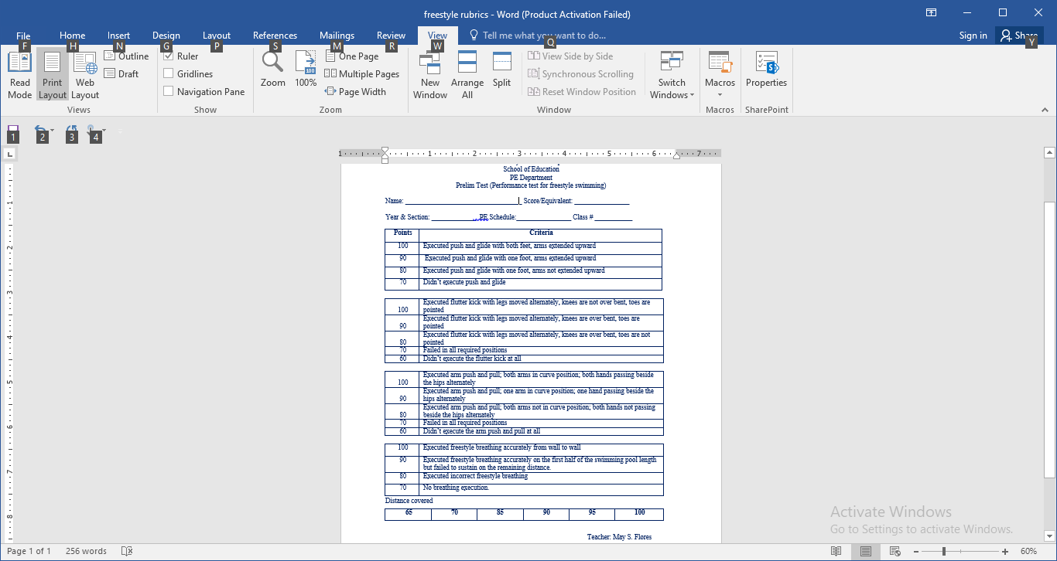
Lecturer:
May S. Flores, LPT, Ed.D.
Professor, School of Education
University of the Assumption
The Philippines
C-PE2: Physical Activities
Toward Health and Fitness 2
Spring 2024
Spring Semester 2024

Slide 33
Lecturer:
May S. Flores, LPT, Ed.D.
Professor, School of Education
University of the Assumption
The Philippines
C-PE2: Physical Activities
Toward Health and Fitness 2
Spring 2024
Spring Semester 2024
Provides feedback on
what the learner missed to do
Developmental
Provides feedback on
what the learner can do
Holistic
Provides feedback on
strength and weakness
Analytic

Slide 34
Lecturer:
May S. Flores, LPT, Ed.D.
Professor, School of Education
University of the Assumption
The Philippines
C-PE2: Physical Activities
Toward Health and Fitness 2
Spring 2024
Spring Semester 2024
References:
Baumgartner, T. (2007). Measurement for Evaluation in Physical Education and Sports Science. McGraw Hill, Boston.
Information Technology University of Florida. (ND). Modifying Assessment Strategy for Online Teaching. [Online Article] [Accessed June 5, 2024] Modifying Assessment Strategy for Online Teaching - Center for Instructional Technology and Training - University of Florida (ufl.edu)
Navarro, R. (2013). Authentic Assessment of Student Learning Outcomes: Assessment of Learning 2. Lorimar Publishing, Quezon City, Philippines.
Perry, A.; Pottep, P. & Ostendorf,W. (2014). Skills Performance Checklist for Clinical Nursing Skills and Techniques. Elsevier Mosby, Maryland.
Santos, R. (2007). Assessment of Learning. Lorimar Publishing, Quezon City, Philippines.

