Slide 1
Writing for Business
Lecture 1
Introduction to the Course; The Communication Process
Lecturer: Dr. Anne Eboi

Slide 2


Slide 3

Introduction: Writing for Business
Introduction to the Course and The Communication Process
The nature of organizations/theories; Types of business communication; formal & informal communication
Barriers to effective communication; Listening skills; Etiquette; and Ethics
The three-step writing process
The sentence structure; Grammar
Writing negative, positive, persuasive, direct, and indirect messages
Outlining; paraphrasing; paragraphing, and summarizing; quotations
Writing the business letter, email, and memo; career (CV writing and interviews)
New media tools; business research methods; computer tools for gathering information
Writing reports; formal and Informal
Writing proposals and business plans
Business meetings (agenda and minute writing; virtual meetings)

Slide 4
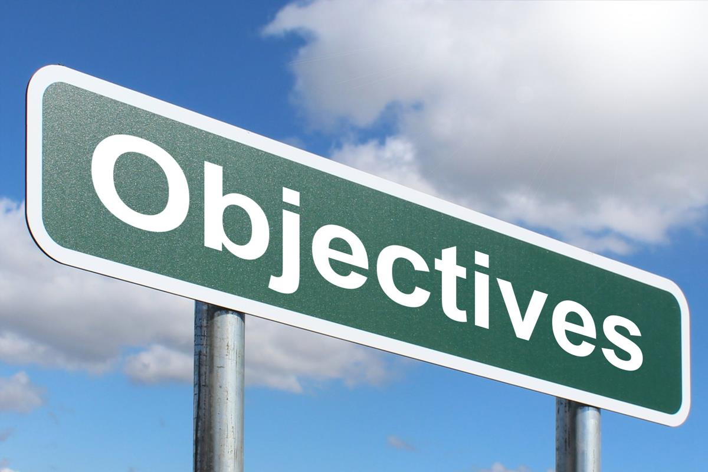
Course Objectives
By the end of this course, you should be able to:
Write a variety of lucid, precise and concise business documents
Structure written communication to achieve the desired results
Communicate effectively the intended purpose of business communication
Create professional business documents that adhere to ethical standards
Image: www.picserver.org on creative commons

Slide 5
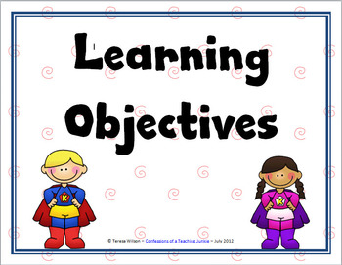
Introduction: Learning Objectives
By the end of this lesson, you should be able to:
Explain terms like Communication, Business Communication, Writing for Business, etc.
Explain the communication process
Apply the communication process in business settings

Slide 6
What is Communication?
The exchange of meanings between individuals through a common system of symbols (Gordon George, 2024- on Britannica)
Commonly described as an exchange of information, news, ideas, etc. via oral or written channels
The process by which information is exchanged between individuals or groups of people through commonly agreed symbols
The transmission of a message from a source to a receiver.

Slide 7
Dictionary Definitions of Communication
Miriam Webster: A process by which information is exchanged between individuals through a common system of symbols, signs, or behavior
Collins: The act or an instance of communicating; the imparting or exchange of information, ideas, or feelings
Oxford Learners Dictionary: The activity or process of expressing ideas and feelings or of giving people information

Slide 8

What is Communication?
Thus, communication is a two-way process where information is exchanged.
“… the ingredient that makes organization possible. It is the vehicle through which the basic management functions are carried out…Virtually all actions taken in an organization are preceded by communication.” (Adegbola, et al., n.d)

Slide 9
Purpose/Role of Communication
There are at least three general types of communication goals:
1) Self-presentation goals (who we are and how we want to be perceived)
2) Relational goals (how we develop, maintain, and terminate relationships)

Slide 10

Purpose/Role of Communication
3) Instrumental goals (how we manipulate others, gain compliance, manage interpersonal conflict, use and recognize interpersonal influence strategies (anchoring and contrast effects, reciprocity, commitment, liking, social proof, authority, and scarcity etc.) (Uttarakhand Open University)
Image: Tima Miroshnichenko on Pexels.com

Slide 11
Business Communication
A specialized genre of general communication- a process of transmitting or exchanging information within and outside an organization to achieve a certain purpose (which is often for the good of the organization)
Business communication branches into two types: internal and external communication.

Slide 12
Business Communication
Internal communication can either be oral or written and involves members within the organization.
Examples of internal business communication includes:
Communicating a change in policy
Conducting a business meeting
Communication on promotions
Directing employees
Motivating employees

Slide 13
Characteristics of Internal Communication
Internal- Downward, Upwards, and Horizontal communication
Verbal and Non-verbal communication
Formal or informal communication

Slide 14
Business Communication
External business communication is either oral and/or written and involves members of the organization and those outside the organization (external stakeholders)
Examples of internal business communication includes:

Slide 15

Business Communication
Accountability report to a sponsor
Business prospects
Annual returns/reports about company performance
Sales and marketing
Public relations activities

Slide 16
Characteristics of External Business Communication
External communication (inwards to outwards)
Formal
Oral or written

Slide 17
Activity
Refer back to the picture we saw at the beginning of this lecture. In pairs and using 2 minutes, discuss at least three things that come to your mind about the picture that relate to communication/business communication.
Possible responses:
Communication is a two-way process
It involves the exchange of ideas
A communication goal to fulfil relational needs
It may be a sign of public relations

Slide 18

Adegbola et al (n.d) identify the following functions of organizational communication:
1. Information
2. Control
3. Motivation
4. Relationship building
5. Employee engagement
6. Employee Coaching
7. Evaluation 8. Direction

Slide 19



What does ‘Writing for Business’ mean?
“Business writing refers to professional communication which includes genres such as policy recommendations, advertisements, press releases, application letters, emails, and memos.” (The Writing Center- University of North Carolina at Chapel Hill, n.d)
“Business writing is a communication channel companies use to communicate with their internal and external audience.” (Technical Writer HQ, n.d)
In other words, any writing we engage with/in at the organization or business environment is termed ‘writing for business.’

Slide 20
Why Write for Business?
1. To pass information professionally or officially
  The goal of business writing is to communicate effectively, professionally, and concisely.
2. To persuade so that the reader can act

Slide 21
What are the forms of business writing?
Emails
Memos
Letters
Press releases
Advertisements
Reports
Manuals
Literature for marketing
Policy documents
Any document that communicates business matters

Slide 22
What is good business writing?
Follows the rules
Is easy to read
Attracts the reader
Meets the reader’s expectations
Is clear and concise
Is efficient and effective (McLean, 2015)

Slide 23
The Communication Process
Communication is a process; it is not an event and neither is it haphazard
Scholars, through years of research, have developed models of communication where they have tried to capture the communication process
One of the earliest models was by Harold Laswell (1948) who developed a model that is widely known as the 5Ws. It stated, “Who says What in Which channel to Whom with What effect.”

Slide 24
The Communication Process
The Claude Shannon and Warren Weaver (1949) model is referred to as the transmission model of communication and introduces the noise element.
Thomas Osgood (1954) introduces a model with a dynamic communication process where the sender and receiver have an interactive process.
Wilbur Schramm’s (1954) model furthers the communication process’ conversation by introducing a shared field of experience or commonality.

Slide 25
The Communication Process
George Gerbner’s (1956) model introduces perceptual and receptive dimensions to the communication process, relating the message to reality.
Theodore M. Newcomb’s Model (1953) emphasizes on the role of communication in societal relationships/environment.
Bruce H. Wesley’s and M.S. MacLean’s Model (1957) is a mass media model which introduces the concept of the gatekeeper.
Thus, based on the findings of these scholars and others, we have derived a general idea of what the communication process entails. It consists of the following elements/components:

Slide 26
The Communication Process
1
2
Participant (Sender (encoder), Receiver (decoder)): These are communicators who assume the role of sender and receiver during communication. The sender forms a message(s) and attempts to transmit it/them to other people/entities via a channel while the receiver processes the message(s) and behavior(s)
that he/she receives and reacts to.
Message: These are the meanings, symbols, etc. exchanged or transmitted through sending and receiving messages.

Slide 27
The Communication Process
Channel: The route/way/path/means of transportation traveled by the message
Feedback: The response to a message and indicates to the sender whether the message was seen, heard, received, and understood

Slide 28
The Communication Process
Noise: Anything that draw people’s attention and interferes with the communication process. These can be internal or external.
Context: Context is the physical, social, historical, psychological and cultural settings in which communication occurs.

Slide 29
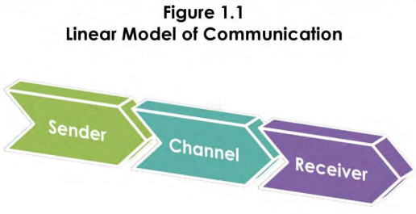
The Communication Process
Source: courses.lumenlearning.com

Slide 30
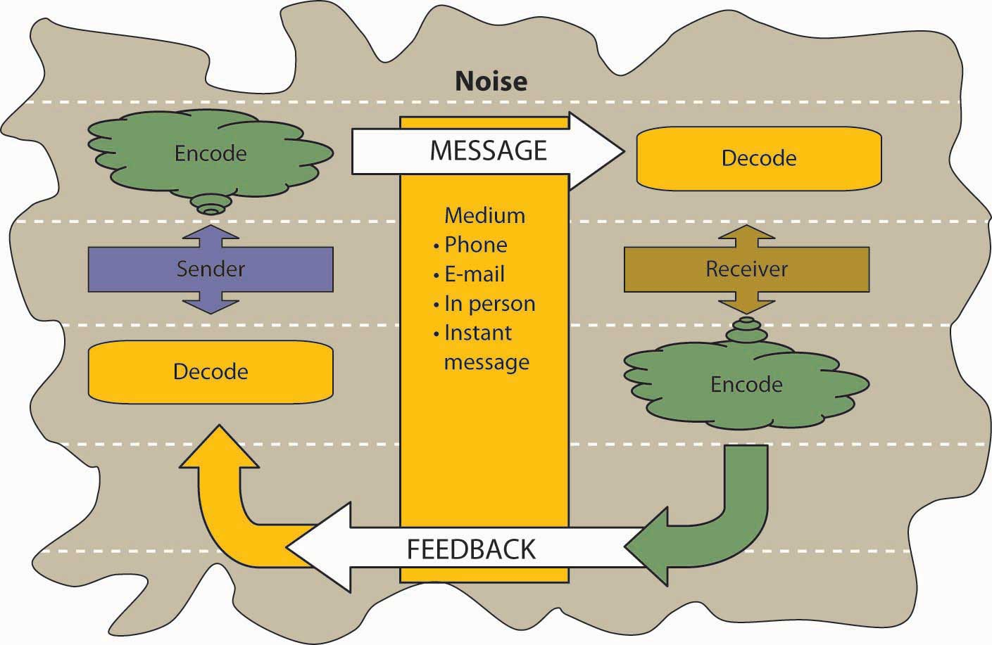
The Communication Process
Source: open.lib.umn.edu

Slide 31
Summary
Communication is a two-way process where messages/meanings are exchanged through mutually agreed symbols
Three main purposes of communication are to fulfil self-presentation, relational, and instrumental goals
Business communication is a specialized form of general communication, comprising internal and external communication
Functions of organizational communication include: information, control, motivation, relationship building, employee engagement, employee coaching, evaluation and direction
Writing for business is a branch of business communication

Slide 32

Summary
Business writing is professional communication in written form used by organizations to communicate to internal and external audiences
Two main functions of business writing are to inform and persuade
Forms of business writing include emails, memos, letters, press releases, web writing, etc.
Good business writing follows the rules, is easy to follow and attracts the reader
The communication process consists of the following: elements/components: Source (sender), message, channel, receiver, feedback, noise, and context

Slide 33
Activity
Scenario
John is the Human Resource Manager at XYZ Company and is conducting a workshop for employees concerning two amended policies that every employee needs to be aware of. He has divided the employees into groups for discussions, but this causes distractions to the CEO who is meeting an important client in the next room. During the Q & A session, John notices that Mary has been on her phone throughout and has hardly participated, unlike Mercy who showed enthusiasm throughout the sessions.

Slide 34

Activity
From the scenario, identify the elements/components of the communication process.
Possible responses
Sender: John
Message: Policy amendments
Channel: Face-to-face
Receiver: Employees
Feedback: Mercy (enthusiastic contributor); Mary (on her phone)
Noise: Group discussions; phone
Context: Office

Slide 35
References
Adegbola, et. al. (n.d.). Business Communication. Nigeria Open University
Connor, P. (2011). Business Writing: An Introduction. Writing@CSU. Colorado State University.
Gordon, G. (2024). Communication. Britannica
Mclean, S. (2012). Communication for Business Success
Radhika, K. (n.d.).The models of communication.
Technical Writer HQ. (n.d.). What is Business Writing?
The Writing Center- University of North Carolina at Chapel Hill. (n.d.). Business Writing.
Uttarakhand Open University. (n.d.). The Concept of Communication.
Image on Slide 2 from PowerPoint

Slide 36
Homework
Watch the video titled, “What is Business Writing” and make short notes. Your answer is due in the next class.
https://technicalwriterhq.com/writing/business-writing/

Slide 37


