Slide 1

WRITING FOR BUSINESS
Lecture 2
Nature of Organization; Informal vs Formal Communication
Lecturer: Dr. Anne Eboi
Notes:
NOTE:
To change the image on this slide, select the picture and delete it. Then click the Pictures icon in the placeholder to insert your own image.

Slide 2

Lesson Objectives
By the end of this lesson, you should be able to:
1. Describe the theories or approaches on the nature of organization
2. Distinguish between formal and informal communication and explain the flow of organizational communication
Image: PowerPoint

Slide 3
Introduction
Recap of the previous class: Communication, business communication, writing for business, the communication process
Nature of organization: The classical approach; Scientific management theory; Bureaucracy; Human relations approach. Also, natural vs rational; open vs closed systems
Formal vs informal communication (the flow of communication)

Slide 4
Last Week’s Homework
Business writing is a tool that businesses use to communicate concepts and ideas through the written work.
Business writing serves multiple purposes including informing, persuading, and promoting goodwill.
Examples of business writing include mails, memos, letters, reports, and marketing material.

Slide 5

Last Week’s Homework Cont…
Effective business writing is clear, compelling and error-free
Business writing is categorized into instructional eg user guides/manuals; informational eg report writing; transactional eg letters, memos, emails, contracts; and persuasive writing eg grant proposal, product brochure

Slide 6
Last Week’s Homework Cont…
Benefits of effective business writing include revenue growth, increased sales, faster time to market, customer retention, cost reduction, improved productivity, reduced customer support costs, reduced employee turnover, reduced mitigation, reduced accidents, reduced risk of lawsuits, etc.
Principles of effective business writing include clarity of purpose, clarity of thought, identifying target audience, using an appropriate tone, using active voice, sharing accurate and relevant information, avoiding jargon, practicing with passion, avoiding grammatical mistakes and incorrect structures, and paying attention to proofreading

Slide 7
Activity
Think of a company. You probably work in this company as an intern or even a full-time employee. If you are not working, you can think of a company where your parent or guardian is engaged. At the end of this session, please tell us which theoretical approach you think your company follows.

Slide 8
The Organization: The Classical Approach
The organization functions at the level of purpose and formal structure.
Four things create successful organizations: Planning the work; the organization’s technical requirements; management principles; and the assumption of logical and rational behavior.
Authors associated with this school of thought include Francis Taylor, Henri Fayol, Lyndall Urwick, James Mooney, Allan Reiley, and Edward Brech.

Slide 9
The Classical Approach…
Some of the classical approach principles proposed by Mooney and Reiley include:
The principle of co-ordination – the need for people to act together with unity of action, the exercise of authority and the need for discipline
The scalar principle – the hierarchy of organization, the grading of duties and the process of delegation; and
The functional principle – specialization and the distinction between different kinds of duties
Key words are efficiency and performance
highly structured, highly formalized, and function through a system that prioritizes coordination, a hierarchy, and specialization
Example of a university

Slide 10




The Organization: Scientific Management Theory
1.
2.
3.
Technically structuring the work organization and offering monetary incentives had the ability to highly motivate workers to produce greater outputs.
Father of the theory is Francis W. Taylor (1856-1917)- there is one best way to perform each task by analyzing all work processes and breaking them down into discrete component parts.
Management as a function for increasing productivity

Slide 11

The Organization: Bureaucracy
Max Weber, a German sociologist, defined Bureaucracy as, “an organizational structure characterized by many laws, standardized procedures, procedures and requirements, number of desks, the meticulous division of labor and responsibility, clear hierarchies and professional interactions between employees that are almost impersonal."
Bureaucracy is a subdivision of the classical approach and is found in many large-scale organizations. Bureaucracy proponents are more theoretical in their stance than classical writers. Weber argues that bureaucracy boasts more technical superiority than other organizational forms and that tasks and responsibilities are defined within management’s structure, leading to standardization of work procedures. Under this theory, it does not matter who holds an office since all positions are standardized.

Slide 12
Bureaucracy…
Stewart (2016) summarizes bureaucracy features as:
Specialization, which applies more to the job than to the person undertaking the job, making for continuity because the job usually continues if the present job-holder leaves.
Hierarchy of authority makes for a sharp distinction between administrators and the administered. Within the management ranks, there are clearly defined levels of authority.
System of rules aims to provide for an efficient and impersonal operation. The system of rules is generally stable, although some rules may be changed or modified with time.
Impersonality means that allocation of privileges and the exercise of authority should not be arbitrary, but in accordance with the laid-down system of rules.
Example of the military

Slide 13


Human Relations Theory: The Hawthorne Experiments
Elton Mayo (1880-1949), regarded as the father of human resources, became known when he shared his research findings in 1922 (during the Great Depression period) on the relationship between the managers and the workers.
Image: PowerPoint

Slide 14

Human Relations Theory…
He went on to observe workers at textile mills in Pennsylvania in 1923 where he noticed that workers increased production when they were granted breaks throughout the day. Mayo introduced organizations to the relationship between work and the social aspect, that is human relations. While classical theorists emphasized the structure and formal organization, human relations (sometimes known as ‘behavioral’ or ‘informal’) focused on social factors among workers as well as their behavior while at work.
Image: PowerPoint

Slide 15
Human Relations Theory…
Elton Mayo
The Hawthorne Experiments
While he was a research professor at the Harvard Business School, Mayo started on his most famous research initiative (1924-32), the Hawthorne Studies. Together with colleagues at Harvard, Fritz Roethlisberger and William Dickson, Mayo examined the various changes at the Western Electric Company in Illinois and wanted to know how these changes impacted productivity.
These researchers then published their findings indicating that people are motivated more than just the satisfaction of economic needs. They concluded that human beings are essentially social in nature and were far from merely being labelled economic beings. Additionally, people belong to groups, so management should consider group psychology and attitudes for increased productivity.

Slide 16
Human Relations Theory…
The Hawthorne experiments were done in four phases:
Phase 1: The illumination experiments with the finding that illumination had no effect on productivity but that there were other factors involved that increased productivity.
Phase 2: The relay assembly test room. The authors noted that productivity increased because of attitude change and not due to positive changes in physical factors
Phase 3: The interviewing program where the researchers discovered that the workers’ behavior was influenced by group behavior
Phase 4: The bank wiring observation room

Slide 17



Human Relations Theory…
Group behavior.
Management must understand that a typical group behavior can dominate or even supersede individual propensities.
Social unit.
A factory is not only a techno-economic unit, but also a social unit and it should be noted that men are social beings. This social characteristic at work plays an important role in motivating people. The output increased in the Relay Room due to a social group that functioned effectively and workers shared a warm relationship with their supervisors.
Group influence.
The workers in a group developed a common psychological bond uniting them as a group in the form of informal organization. The researchers noted that workers’ behavior is influenced by these groups. Thus, management demands may not influence productivity; but pressure from the group can.

Slide 18
Human Relations Theory…
Motivation
Human and social motivation can play a greater role than monetary incentives when it comes to managing groups.
Supervision.
Productivity is affected by the supervisor’s style. Friendly supervisors who take a keen interest in their worker’s social problems are likely to obtain better results since the worker’s attitude undergoes a positive influence.
Working conditions.
When conditions at work improve, productivity increases.

Slide 19
Human Relations Theory…
Employee morale.
Mayo pointed out that employee morale (both individual and in groups) can have profound effects on productivity.
Communication.
When managers explain the logic behind certain decisions to workers and allow them to participate in decision making, the output increases.
Balanced approach.
The authors found out that productivity increased when all factors were considered to improve the whole, rather than a part of an aspect.
l
l

Slide 20
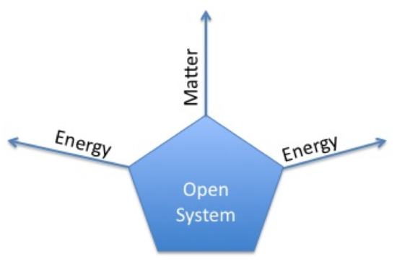
Rational vs Natural; Open vs Closed Systems
The link between human resource department today and the human relations approach
Rational system uses rigid procedures, standardization by way of regulation, emphasis on expected behavior, policy- driven
Rational systems focus on performance and efficiency. They are hierarchical with management exercising control to achieve organizational goals
Rational systems correspond to closed systems and the classical theories
Natural system corresponds to the human relations or open systems
Image: PowerPoint

Slide 21
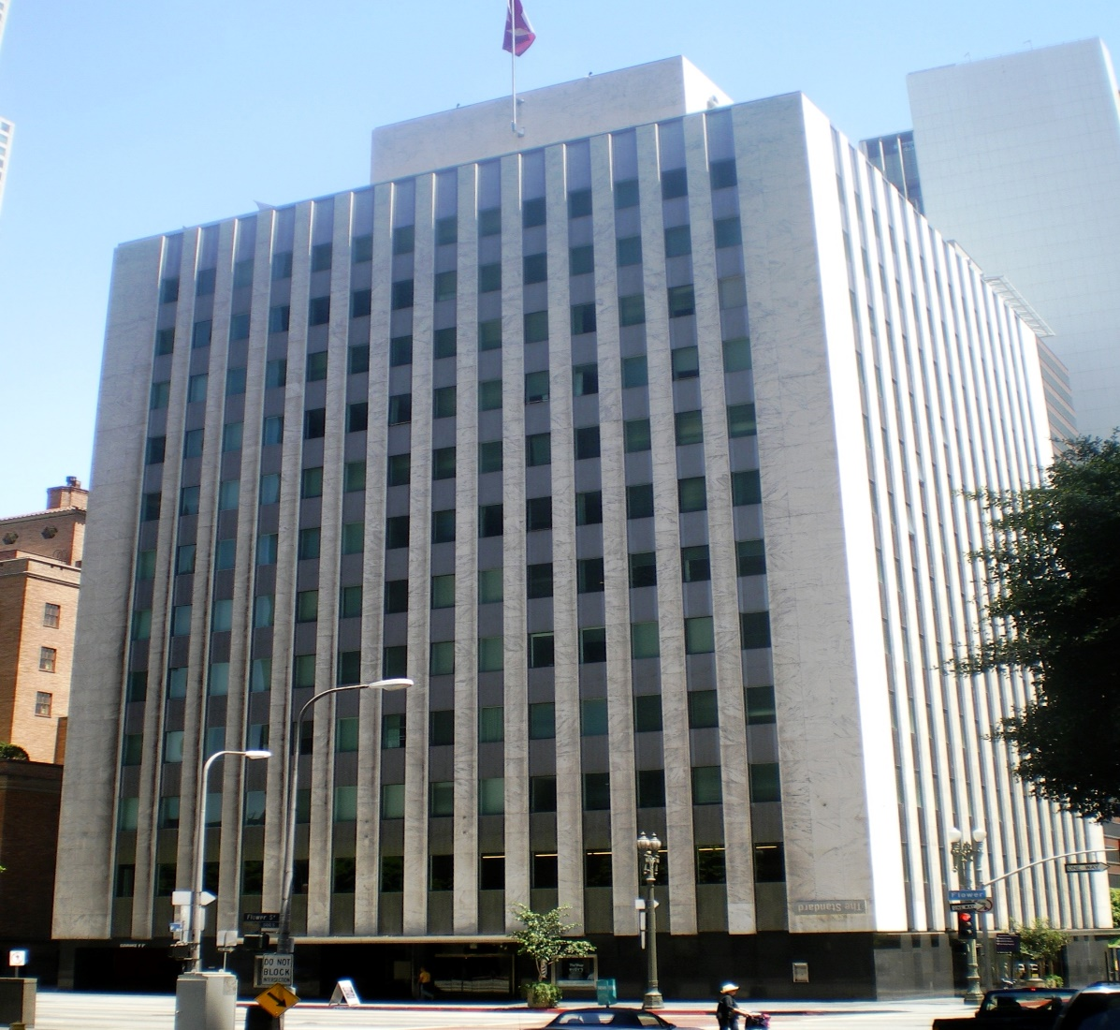
Activity
At the beginning, I asked you to think of a company; it can be your current workplace or any other. Now that we have discussed the nature of organization in detail, which of the four approaches fits your organization? Discuss with your classmate. Ensure to give reasons.
Image: PowerPoint

Slide 22
Formal Vs Informal Communication; Flow of Communication
Organizations experience both formal and informal communication. This is what is also known as the flow of communication in an organization. Formal communication includes downwards, upwards, and horizontal communication, while informal communication occurs through diagonal/grapevine communication.

Slide 23
Flow of Communication
1. The downward flow of communication
In downward communication, information is formally transferred from people in authority or higher levels to those at the lower level. Employees receive information through a chain of command, for example, the head of department in a university formally communicating to a lecturer through email. Information communicated downwards includes policies, strategies, new information, and procedures and these messages can be relayed through memos, reports, word-of-mouth, meetings, etc. However, while downward communication helps in the running of the organization through passing information and motivating the employees, it also has its limitations. These include message distortion, information overflow, delays in passing information, and incomplete communication.

Slide 24
Flow of Communication
2. The upward flow of communication
Upward communication refers to information traveling from the subordinates to management within the organization. Employees might want to ask their supervisors questions, make requests, submit proposals, issue complaints, etc. Upward communication is equally important because management gets to receive information, obtain views, develop a sense of participation, etc. However, limitations may include delays in passing messages, distortions, fear by employees to approach management, etc.

Slide 25
Flow of Communication
3. Horizontal/Lateral communication
Horizontal or lateral communication refers to the exchange of information between people who occupy the same level in the organization. For example, one bank teller requesting information from another teller via email. This type of communication helps to socialize people, strengthen departments, coordinate inter-departmental activities, etc. However, employees can form groupings with a negative agenda, misunderstandings can occur, it can promote negativity, etc.

Slide 26
Flow of Communication
4. Diagonal/Grapevine communication
It is the type of communication where employees from different levels and departments share information. For example, members in multidisciplinary jobs. The advantages of diagonal communication include that it is faster, has less workload, and is useful in digital communication. However, wrong messages and rumors can be circulated and in the process harming the organization. Since there is no one person responsible, no one takes responsibility should anything go wrong.

Slide 27

Flow of Communication
5. External Communication
An organization also needs to communicate externally. For instance, an organization may need to communicate to financial institutions, media, suppliers, vendors, community etc. A company planning to do an event will need a substantial amount of external communication.
Image: Powerpoint

Slide 28
Lesson Summary
Here is what we learned:
Objective 1:
The nature of organization; the classical approach, scientific management theory, bureaucracy, and human relations theory
We also learned about the rational vs natural approaches and open vs closed systems
Objective 2:
We learned that communication at the work place takes place both formally and informally.
Formal communication includes downward, upward, horizontal/lateral, and sometimes external while informal communication includes grapevine communication.
Next week, we delve into barriers to effective communication, listening, and the ethics of communication.
conclusion
Seco Skill

Slide 29
Homework
Please read the attached PDF on nature of the organization. It contains more information that you will find useful.
Also, read the PDF indicated in the Reference section.

Slide 30
References
Approaches to Organization and Management. (n.d.). Pearson. https://www.pearsonhighered.com/assets/samplechapter/0/2/7/3/0273757342.pdf
Chhatrapati Shahu Ji Maharaj University. (n.d.). Lecture 5. https://gyansanchay.csjmu.ac.in/wp-content/uploads/2021/11/Lecture-5-1.pdf
Kelly, A. H. (2024). The organization: Rational, Natural, and Open Systems. https://www.linkedin.com/pulse/organization-rational-natural-open-systems-kelly-a-hinks-wmrge/
Podar College. (n.d). Business Communication Semester 1 Notes.https://www.rapodar.ac.in/pdf/elearn/Business%20Communication%20Semester%20I%20notes.pdf
Schiavo, A. (2024). HR 101: Who was Elton Mayo, the father of HR?https://www.hr-brew.com/stories/2024/05/06/hr-101-who-was-elton-mayo-the-father-of-hr
Vedantu. (2024). Bureaucratic theory by Max Weber.https://www.vedantu.com/commerce/bureaucratic-theory-by-max-weber

Slide 31


