Slide 1
Writing for Business
Lecture 4
The Three-Step Writing Process; Writing Business Messages
Lecturer: Dr. Anne Eboi

Slide 2

Introduction
Learning Objectives
Learning Objectives
By the end of this lesson, you should be able to:
Describe the three-step writing process
Plan and write business messages using the three-step writing process

Slide 3
Introduction
Recap of Lecture 3
Recap of Lecture 3
Sender-related barriers, receiver-related barriers and channel-related barriers
Communication barrier classification: physical or environmental; physiological; semantic or language; personal; emotional; socio- psychological; cultural; and organizational barriers
Intercultural differences and listening
We need to overcome these barriers to communicate effectively: Listen to understand eg deliberately take notes and listen to evaluate.
Ethics of business writing- observe ethical principles in our writing. For example, avoid plagiarism.

Slide 4
Introduction
Last Week’s Homework
Last Week’s Homework
Five zones of professional etiquette
Business etiquette in the workplace
Business etiquette in social settings
Telephone etiquette
Business etiquette in the digital age
Business etiquette with mobile devices
Conference call etiquette
Everyone must turn on their video
Everyone must use a headset
Pause every few sentences when you are speaking
Set clear rules for your video conference

Slide 5
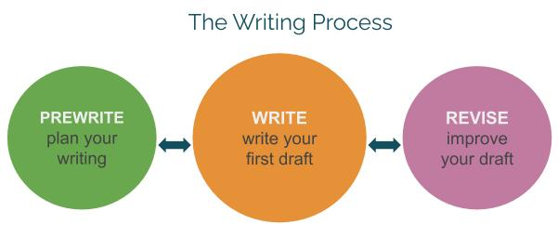

Slide 6
The Three-Step Writing Process
Williams (2020)
Williams (2020)
Williams (2020) opines that writing is more than just the act of physically writing out words. Thus, it is important to understand the writing process very well to gain more control over it.
Williams’ (2020) writing process involves the ‘prewriting’ step where you plan your writing; the ‘write’ step where you write your first draft; and the ‘revise’ step where you improve your draft.

Slide 7
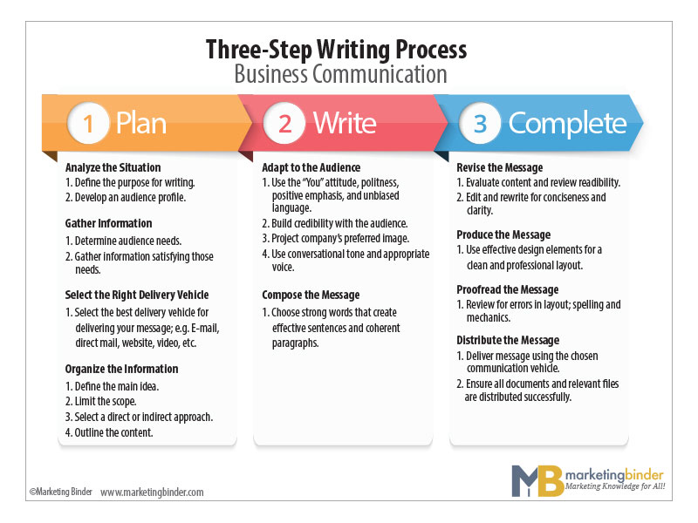

Slide 8
The Three-Step Writing Process
1. 1 Plan (Pre-writing)
Think about planning a wedding in your culture. How much goes into it?
1.1.1 Analyze the situation
Define the purpose for writing and develop an audience profile
1.1.2 Gather information
Determine the needs of the audience and how to satisfy audience needs
Bovee & Thill (2012) also suggest three main parts: Plan (Pre-writing), Write (Composing), and Complete (Post-writing)

Slide 9
The Three-Step Writing Process
1.1.3 Select the right delivery vehicle
Consider the best channel. For example, a formal report, a written document that presents information, analysis and recommendations on a specific subject.
1.1.4 Organize the information
Organization involves defining the main idea, limiting the scope, selecting the approach (direct or indirect) and outlining the content.
Bovee & Thill (2012) also suggest three main parts: Plan (Pre-writing), Write (Composing), and Complete (Post-writing)

Slide 10
The Three-Step Writing Process
1.2 Write
Adapt to the audience
The second step of the writing process is to write which involves adapting to your audience as well as composing the message.
Adapting to the audience means being sensitive to the audience’s needs since most people only attend to communication they think will benefit them.
If they think you do not care about their needs, they will not pay attention.

Slide 11
The Three-Step Writing Process
One way to show audiences that you care is by using the ‘You’ attitude which in essence involves the reader and makes them feel a part of the process.
The ‘You’ attitude is audience-centered communication which takes care of the audience’s wishes, hopes, preferences and interests.
Bovee and Thill (2012) suggest that the simplest way to use the ‘You’ attitude is to replace terms like ‘I’ ‘me’ ‘us’ and ‘ours’ with ‘you’ and ‘yours’ as demonstrated below:

Slide 12
The Three-Step Writing Process
Tuesday is the only day that we can promise a quick response to purchase order requests; we are swamped the rest of the week. | If you need a quick response, please submit your purchase order requests by Tuesday.
We can offer MP3 players with 50-70 or 100 gigabytes of storage capacity. | You can choose an MP3 player with 50-70 or 100 gigabytes of storage capacity.

Slide 13
The Three-Step Writing Process
Using the ‘You’ attitude shows the audience that the communication is about them, not you, the sender. However, Bovee and Thill (2012) advise that using ‘You’ may not always work. There are times the ‘You’ attitude can sound condescending, authoritative and rude. For example:
Wrong: You did not bring in your goods on time for packaging hence the delay.
Right: The goods were not delivered on time for packaging.
So, using ‘You’ should not only be about the pronoun, but about you displaying a genuine interest in the audience.

Slide 14
The Three-Step Writing Process
Being polite (choosing words carefully to reflect politeness) is another way to demonstrate that you care for your audience. You must maintain standards of etiquette no matter how provocative the client might be. You have heard of the saying, “The customer is king.” Venting out your frustrations to your customer, colleagues and other stakeholders should not arise because you will jeopardize the goodwill your company enjoys.
Bovee and Thill (2012) advise that we demonstrate diplomatic skills through emotional intelligence and offer the following example:
Wrong: Once again, you have managed to bring down the entire website through your incompetent programming.
Right: Let’s review the last website update to explore ways to improve the process.

Slide 15
The Three-Step Writing Process
Ensuring positive emphasis. In life, there seems to be more bad than good news. I often tend to think most people get drawn into bad news faster than in the good, and some people actually thrive in chaotic situations. Not so in the business world. While we can never hide negative news, we must always find something positive to accompany the bad news. Making the effort to emphasize the positive in the midst of negativity will help foster a good relationship with your audience. So, avoid a negative tone even when you must deliver negative news. Here is an example:
Wrong: It is impossible to fix your curtains today.
Right: Your curtains will be ready on Wednesday. Meanwhile, can we send someone over to fix temporary ones today?

Slide 16
The Three-Step Writing Process
Try not to focus on the mistakes or shortcomings of your audience or using words that can offend. Instead, you can emphasize solutions to problems or use euphemisms. For example, instead of ‘disabled people’ you can use ‘people abled differently.’ However, Bovee and Thill (2012) caution against overuse of euphemisms because they can be misused. They can be annoying when people are forced to ‘read between the line’ and unethical if they hide the truth. For example, avoiding to use the words ‘lay off’ when the company wants to fire some employees. Consider the following quotation:
“If you are considering using a euphemism, ask yourself this question: Are trying to protect the reader’s feelings or your own feelings? Even if it is unpleasant, people generally respond better to an honest message delivered with integrity than they do to a sugar-coated message that obscures the truth.” (Bovee & Thill, 2012).

Slide 17
The Three-Step Writing Process
Using unbiased language can also assist with adapting to audience needs. It means you have not discriminated against any group of people. It means avoiding unfair and unethical language that groups people based on their personal features like race, disability, gender, age, ethnicity, and so on.
Biased language can be realized through gender-discriminatory language such as ‘chairman.’ You can avoid pronouns like ‘he’ or ‘she’ and use ‘they’ or refer to them as ‘chairperson.’ In some cases, all genders are referred to as ‘he,’ while in others, women prefer to be addressed as ‘Ms.’ instead of ‘Miss’ or ‘Mrs.’

Slide 18
The Three-Step Writing Process
Biased language can also be realized through race, and this can show discrimination against a particular race or ethnicity. For example, ‘Nigger,’ or ‘Please, give that Somali the report to go through before handing it in.’
Disability should never arise in business communication, unless it’s relevant in that communication. Avoid using terminologies like ‘retard’ or ‘cripple.’ Also, recognize the person in a person living with disability and not his/her disability. For example, instead of ‘blind employee’ use ‘employee with visual impairment.’

Slide 19

The Three-Step Writing Process
Biased language
Biased language
Age bias can come in when we mention age, yet it has no relevance to the communication. When referring to people who are advanced in age, we can use age-responsive terms like ‘senior citizen’ instead of ‘old people’ because the former carries some respect around it. The opposite can also be the case when we dismiss a younger person with claims of inexperience.

Slide 20

The Three-Step Writing Process
Build credibility
Build credibility
You need to build credibility with your audience by being ethical. Being ethical means you communicate only the truth. For example, if you did not attain a certain percentage that you promised (like to raise literacy levels to 75%), do not falsify data to impress the donor. Being ethical also means not succumbing to plagiarism. Plagiarism can be deliberate or not, and in the case of the latter, the onus is on you to cite your sources properly and carefully, write a reference list, paraphrase, and so on to avoid it.

Slide 21
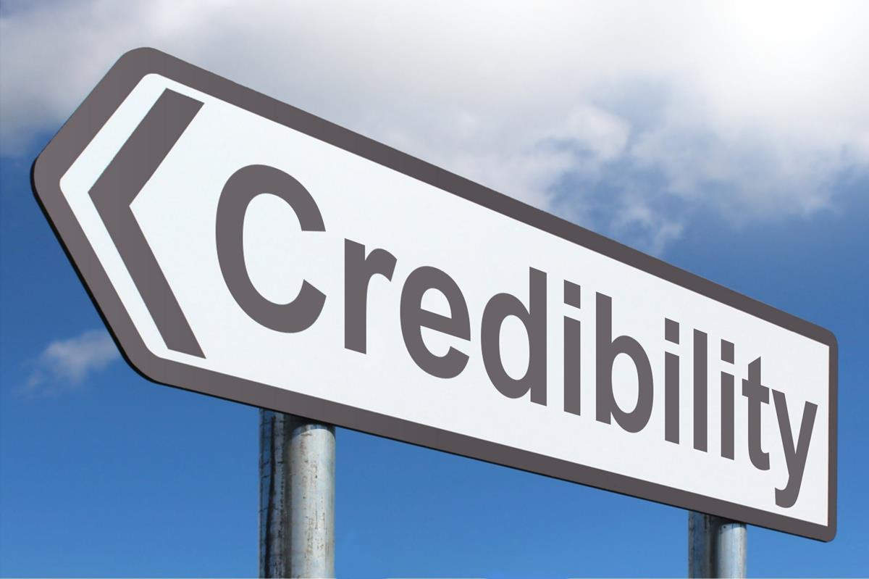
The Three-Step Writing Process
Credibility
Credibility
Bovee and Thill (2012) propose the inclusion of the following characteristics that can help you build credibility: Honesty; Objectivity; Awareness of audience needs; Credentials, knowledge and expertise; Endorsement; Performance; and Sincerity

Slide 22

The Three-Step Writing Process
Credibility
Credibility
Words like ‘hope’ and ‘trust’ as the authors demonstrate below, can erode your credibility:
Wrong: We trust that this recommendation will be helpful.
Right: We are pleased to make this recommendation.
Credibility can collapse like a stack of cards.

Slide 23

The Three-Step Writing Process
Projecting company image
Projecting company image
Building positive relationships with your audience involves projecting your company’s preferred image in your writing. Every company desires to create and maintain a certain image that endears it to its publics. Mistakes like grammatical errors, plagiarism, carelessly done work, and so on impact negatively on a company’s image. Hence, most companies have developed communication style guides for harmony.

Slide 24
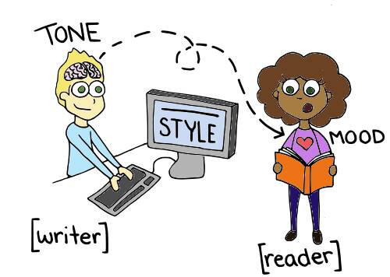
The Three-Step Writing Process
Style
Style
Style is about the words you choose to use. It creates an overall impression in your writing and a positive or colorful message. Use a conversational tone and appropriate voice. Tone can either be formal or informal, and you need to determine the appropriate time for its use. For example, using a formal tone with colleagues daily may make you sound stiff. On the other hand, unnecessary jokes, pompous language, intimate language, bragging, etc. can cause problems with your clients who are better served by a formal tone.

Slide 25

The Three-Step Writing Process
Plain language
Plain language
Bovee and Thill (2012) advocate for the use of plain language, which represents simplicity and an unadorned style that allows easier understanding, thus showing respect to the audience. Employees spend less time trying to figure out confusing messages eg: We can continually exist to synergistically supply value-added deliverables such that we may continue to proactively maintain enterprise-wide data to stay competitive in tomorrow’s world.

Slide 26
The Three-Step Writing Process
The type of verb you select affects the tone of your writing. Look at the following sentences:
Active: Myra sent the boss an email.
Passive: An email was sent to the boss by Myra.
In the first sentence, the emphasis is on the subject, ‘Myra’ who performs the action, while the object ‘the boss’ receives the action. In the second sentence, the subject ‘an email’ receives the action. The active voice is preferred because it represents strong, livelier, interesting, direct and easy to read writing. The passive voice on the other hand is cumbersome, longer and vague. However, there are cases when the passive voice may be the better option, for example, in diplomacy where you want to avoid pinpointing anybody.

Slide 27
The Three-Step Writing Process
1.3 Compose the Message
I have always advised people to just write without worrying about mistakes. This is out of personal experience. When we set out to write, we think it’s a difficult task and don’t quite know how to begin. Usually, the beginning is tough, but once you put pen to paper, the ideas start flowing, and you don’t want to stop to correct this and that. Just continue writing. The revision and corrections will come later.
You must have heard of writer’s block (where the mind stops producing words to write). This should not deter you. There is plenty of advice out there on how to overcome mental block, such as stopping and listening to music, jogging, watching TV, jogging your brain, playing games, etc. You can even stop writing and spend the time working on the non-text sections of your writing like videos, podcast, tables, charts, etc.

Slide 28
The Three-Step Writing Process
Choosing powerful words entails understanding denotation (literal, dictionary meaning) and connotation (implicit, associative meaning). We are advised to be careful how we use connotations because they may carry positive, neutral or negative meanings. For example, ‘aged’ may mean ‘vintage’ (positive), ‘old’ (neutral) or ‘decrepit’ (negative). We also need to balance between abstract and concrete words. Abstract words tend to be intellectual, bookish and philosophical while concrete terms refer to tangible things you can see, touch and see. Bovee and Thill (2012) advise that we minimize on abstractions, and instead create a blend. For instance, state the concept in abstract terms, then follow it up with concrete terms, like ‘sizable loss’ to an actual figure that represents the loss.
In composing the message, avoid wrong word usage or making grammatical mistakes because they touch on your credibility. It shows you lack knowledge of grammatical rules or that you lack respect for your audience. The audience may also decide not to trust information from a company that appears uninformed.

Slide 29
The Three-Step Writing Process
Choosing powerful words also involves finding words that communicate well such as choosing familiar words, avoiding clichés and buzzwords and using jargon carefully. Find examples of these on page 159 from Bovee and Thill (2012). Further, consult thesaurus and dictionaries as much as possible. You can also visit www.visuwords.com).
Composing the message also involves writing effective sentences. You can do this by choosing from the four types of sentences: Simple, complex, compound and compound-complex. You can also have a healthy mix of these sentences because too many simple sentences make it difficult to comprehend relationships in those sentences, while only having a series of compound, complex and compound-complex sentences makes your writing a mouthful and difficult to understand.

Slide 30
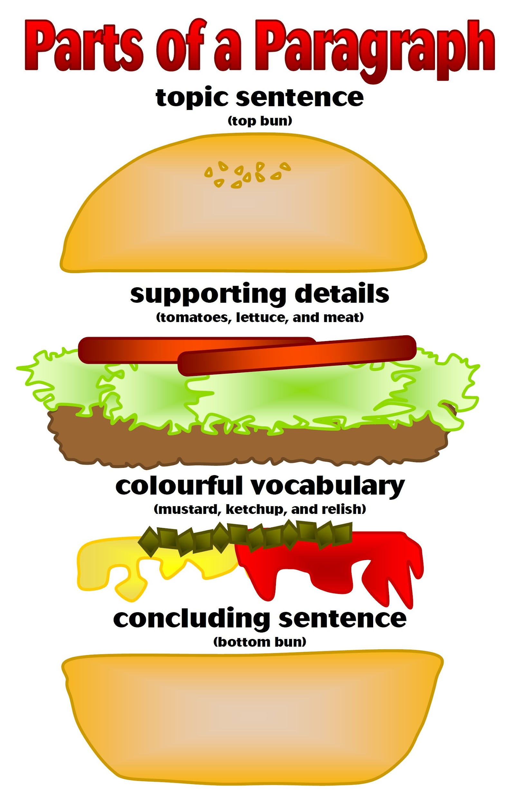
The Three-Step Writing Process
Composing the message
Composing the message
Composing the message involves creating unified, coherent paragraphs by using topic sentences, supporting sentences and transitions/connectors.
You can use technology to compose and shape your message. Read more about these from page 174-175 from Bovee and Thill (2012).

Slide 31
The Three-Step Writing Process
1.4 Complete
1.4.1 Revise the message
The ‘Complete’ phase involves revising, producing, proofreading and distributing the message. When you revise the message, evaluate the content and review its readability. Does the content contain exactly what you want to say? Readability means that the report is clear, concise and error-free; that the reader will not have trouble reading the document. It is imperative that you edit and rewrite the words, sentences or paragraphs for conciseness and clarity.

Slide 32
The Three-Step Writing Process
1.4.3 Proofread the message
1.4.2 Produce the message
Producing the document means checking that the design elements have been used effectively for a clean and professional layout. For instance, the figures and tables are well-arranged, are of the right size, are labeled and correspond to the content they refer to.
Completing the message also means proofreading. In journalism, we call it the last line of defense, hence ought to be undertaken carefully. In proofreading, one corrects the errors in layout, spelling and mechanics. For instance, check to ensure that all the punctuation marks have been used correctly; there is not a single misspelt world; and that there are no errors in the layout and visuals.

Slide 33
The Three-Step Writing Process
1.4.4 Distribute the message
Distributing the message is the last step and it simply means to deliver your information to Donor A using the vehicle you chose at the beginning. In our case, we chose a report, so we must deliver a report that is informative, credible, and professional to our funding partner. Some vehicles like reports contain other files and documents often attached, such as questionnaires used in a research, maps, video, audio files, etc. All these should be submitted together successfully.

Slide 34

The Three-Step Writing Process
Homework
Homework
Read Bovee and Thill (2012) from page 124- 210 and attempt as many exercises as you can. Then discuss the possible answers with your seatmate.

Slide 35
References
Bovee C. L. & Thill, J. V. (2012). Business communication today. (11th ed.). Pearson.
MB Marketing Binder. The three-step writing process for business communication. Image. https://marketingbinder.com/category/business-communication/
Williams, V. (2020). Chapter 2: The writing process. BC Campus. https://pressbooks.bccampus.ca/businesswritingessentials/chapter/planning-to-write/
All images except for MB Marketing Binder’s are drawn from creative commons through PowerPoint’s Bing

Slide 36

The End

