Slide 1
WRITING FOR BUSINESS
Lecture 5
Grammar; Sentence Structure; Spelling; Diction; Punctuation
Lecturer: Dr. Anne Eboi

Slide 2

INTRODUCTION
Learning Objectives
Learning Objectives
By the end of this lecture;
You should be able to revise and familiarize yourself with some aspects of English grammar
Compose effective sentences in business writing
Write words correctly without spelling errors and mind the use of diction
Use punctuation correctly in business writing

Slide 3
INTRODUCTION
Recap of Lecture 4
Recap of Lecture 4
The three-step writing process
Plan
Analyze the situation
Gather information
Select the right delivery vehicle
Organize the information
Write
Adapt to the audience
Compose the message
Complete
Revise the message
Produce the message
Proofread the message
Distribute the message

Slide 4
INTRODUCTION
Welcome to Lecture 5, where we delve into grammar, sentence structure, spelling, diction and punctuation. Last week, we were introduced to the three-step writing process comprising of planning, writing and completing.
Grammar is an essential component in business writing and any business writer should be grammatically correct in their communication. Grammar is important because it makes your writing clearer so that your intended audience can understand your writing. Consider the following famous example of bad grammar as narrated by McRae (2015):
The panda eats, roots, shoots, and leaves.

Slide 5
INTRODUCTION
McRae (2015) reminds us of the rule that we never place a comma between a verb and its objects. Because we have placed the comma between eats and roots, it absurdly seems like the animal eats, roots around in the ground, fires a gun, then departs, when all we were talking about was the panda’s diet.
Taylor (2005) argues that in business communication, positive results can only be realized through effective language use and that our English should be simple, courteous, relaxed and straightforward. She suggests that accurate business communication is important because it helps to establish a relationship, communicate ideas precisely and convey a good image of the organization.
To begin with, let us briefly look at parts of speech that make up the English language.

Slide 6
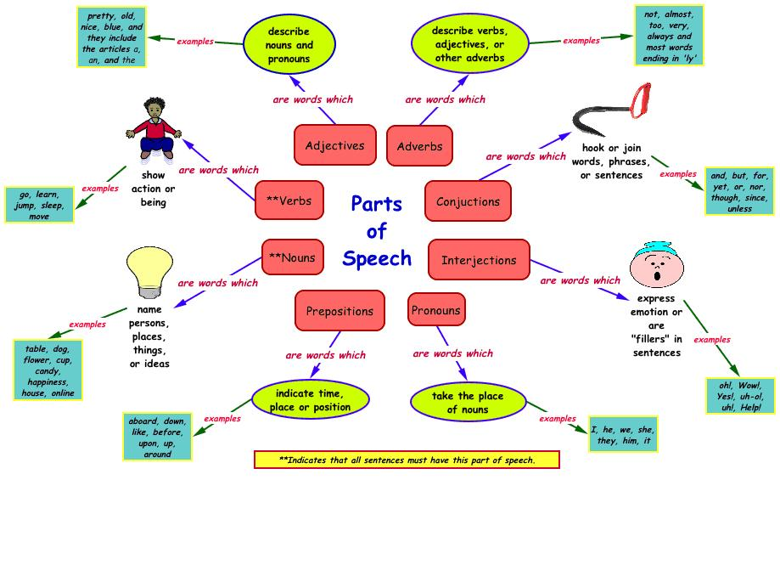
GRAMMAR- PARTS OF SPEECH
Parts of Speech
Parts of Speech
The following section has been compiled using information from Bovee and Thill (2012), McRae (2015) and Taylor (2015).
There are 8 parts of speech in English: Noun; verb; adjective; adverb; conjunction; preposition; pronoun and interjection. All the sentences you form come from these parts of speech. We will briefly look at each.

Slide 7
PARTS OF SPEECH- NOUNS
The dictionary defines a noun as a word used to identify any of a class of people, places and things. Simply put, nouns are naming words. Examples of nouns include proper nouns (written with an initial capital letter; do not take an article; generally lack plural forms and name specific things or items). Examples of proper nouns include London, Abuja, Mount Kenya, Jack, Friday and so on. Majority of the nouns are common, take small letters and are divided into countable and uncountable nouns. Examples of common nouns include memorandum, report, liquid, cash, information, etc. Nouns can also be concrete where they name tangible things like traffic, boxes, windows, and abstract nouns that name intangible things like air, water, money, time. Nouns can be singular (sample) or plural (samples); compound (whiteboard); collective (audience, team); and possessive (Joel’s).

Slide 8
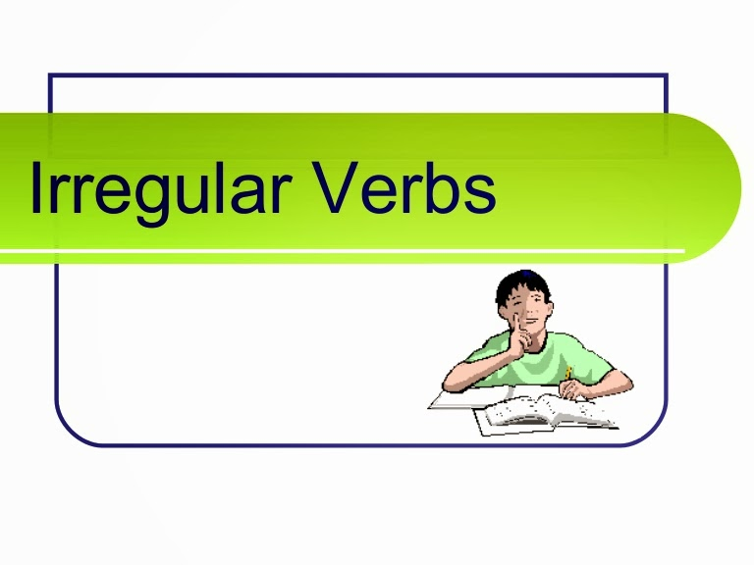
PARTS OF SPEECH-VERBS
Verbs
Verbs
Verbs signal an occurrence, action or state of being. Action verb examples include write, type, hold, weigh, etc. while verbs of state examples include is, am, has, etc. Verbs come in various types such as: Transitive (take a direct object) vs intransitive (does not take a direct object); active (shows action) vs passive (subject of the sentence undergoes the action indicated by the verb); auxiliary/linking verbs such as is, has, do; and helping verbs (modals like can, could, may, ought to, etc.).

Slide 9
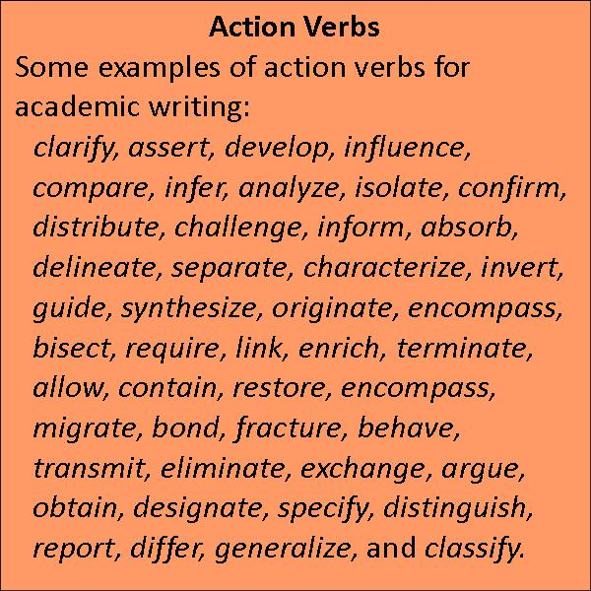
PARTS OF SPEECH-VERBS
Verbs
Verbs
Examples of transitive vs intransitive:
Transitive: The CEO chaired an executive meeting.
Intransitive: The CEO laughed loudly.
Examples of active vs passive:
Active: The supervisor gave Michael a warning letter citing gross misconduct.
Passive: A warning letter was issued to Michael who was accused of gross misconduct.

Slide 10
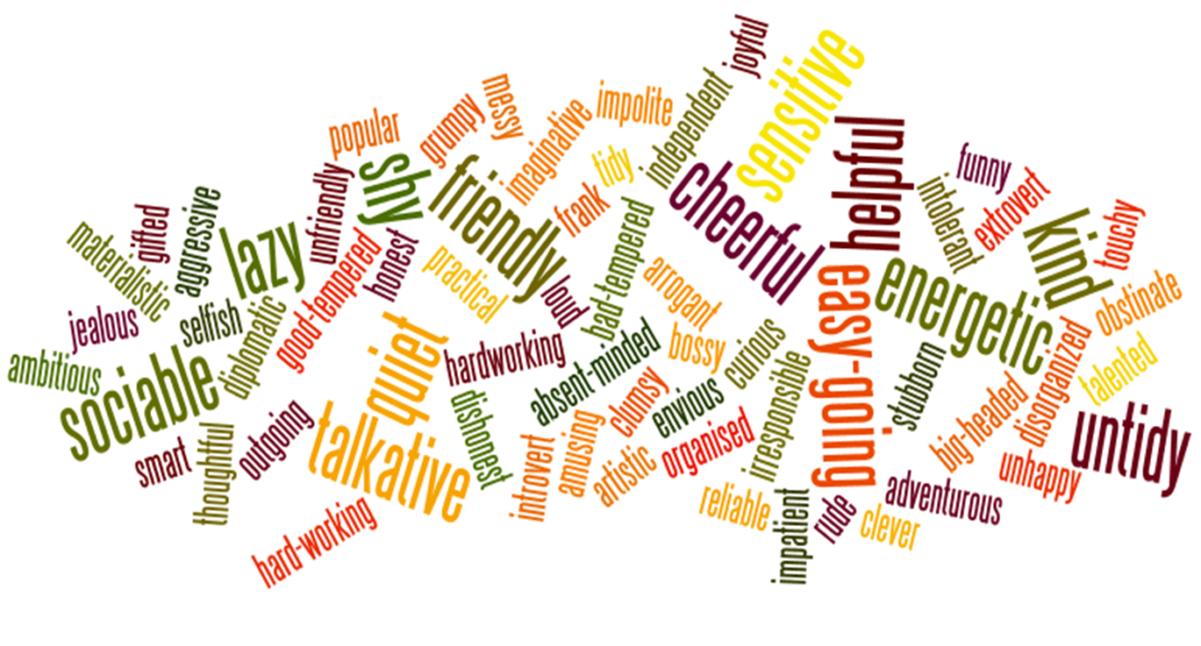
PARTS OF SPEECH- ADJECTIVES
Adjectives
Adjectives
Adjectives modify, qualify, quantify or describe other words so that the meaning is more specific. They are divided into attributive (placed before the word they modify eg valuable property) or predicative (placed after the word they modify eg the property was valuable). Types of adjectives include numbers (six, tenth, 23), articles (a, an, the), possessives (mine, ours), demonstratives (this, that, these, those), interrogatives (who, whose, what), and indefinites (anyone, some).

Slide 11
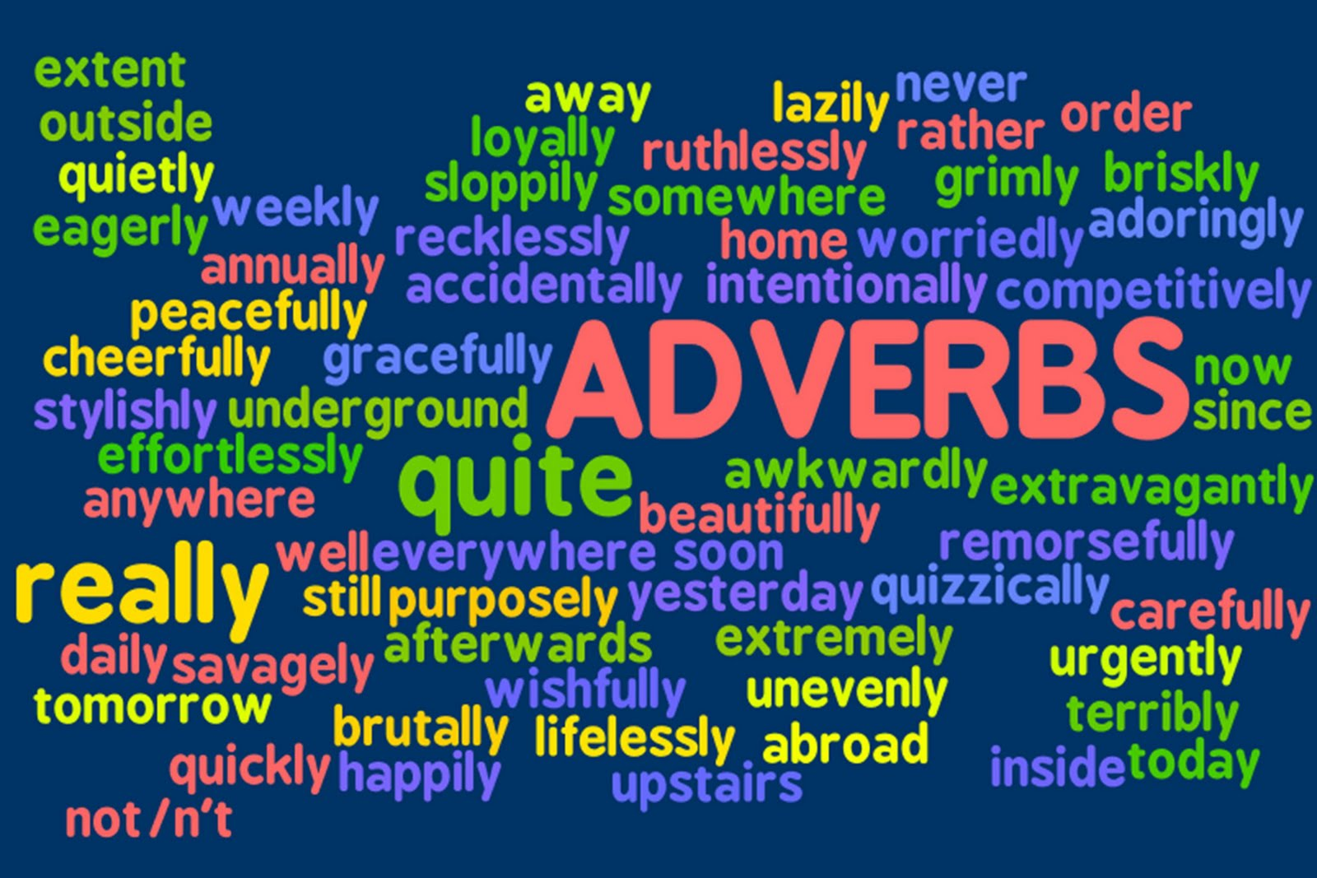
PARTS OF SPEECH- ADVERBS
Adverbs
Adverbs
Adverbs intensify or qualify the meaning of a verb, adjective or another adverb. They tell where, how, when, the manner, the extent, etc. Most adverbs are formed by adding -ly to adverbs. Examples of adverbs include quickly, fast, unequivocally, adversely, extremely, and so on.

Slide 12
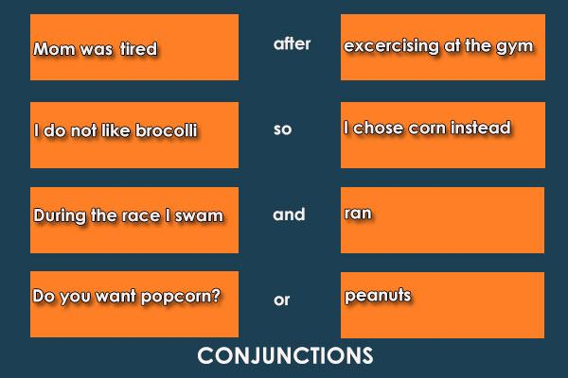
PARTS OF SPEECH-CONJUNCTIONS
Conjunctions
Conjunctions
Conjunctions link other words, phrases or clauses together to form compound and complex sentences, thus help us to avoid short, jerky sentences. We have three types of conjunctions: Coordinating conjunctions which join words, phrases and clauses of equal grammatical rank in a sentence. In English, they are for, and, nor, but, or, yet and so; Correlative conjunctions which work in pairs and include not only/but also; either/or; hardly/when; neither/nor and so on; and Subordinating conjunctions which help to join dependent and independent clauses and examples include as, because, although, since, and so on.

Slide 13
PARTS OF SPEECH-PRONOUNS
Pronouns are the little words we use to replace nouns with. They require an antecedent (the pronoun needs to have been mentioned/named before). Pronouns are useful because they help us avoid repetition. Types include personal pronouns (I, me, our); Relative pronouns, which connect independent clauses to relative or dependent clauses (whose, who, which, that); Demonstrative pronouns (this, that, these, those); Reflexive/Intensive pronouns which end in self or selves (ourselves, himself); Indefinite pronouns which refer to a person or thing you don’t specifically identify (someone, anything, something); Possessive pronouns that show ownership (eg limiting pronouns such as my, your, its, her, his, their, our and whose as well as absolute pronouns such as mine, yours, his, hers, ours, and theirs); and Interrogative pronouns which are used to ask questions (who, what, which, whose and whom).

Slide 14
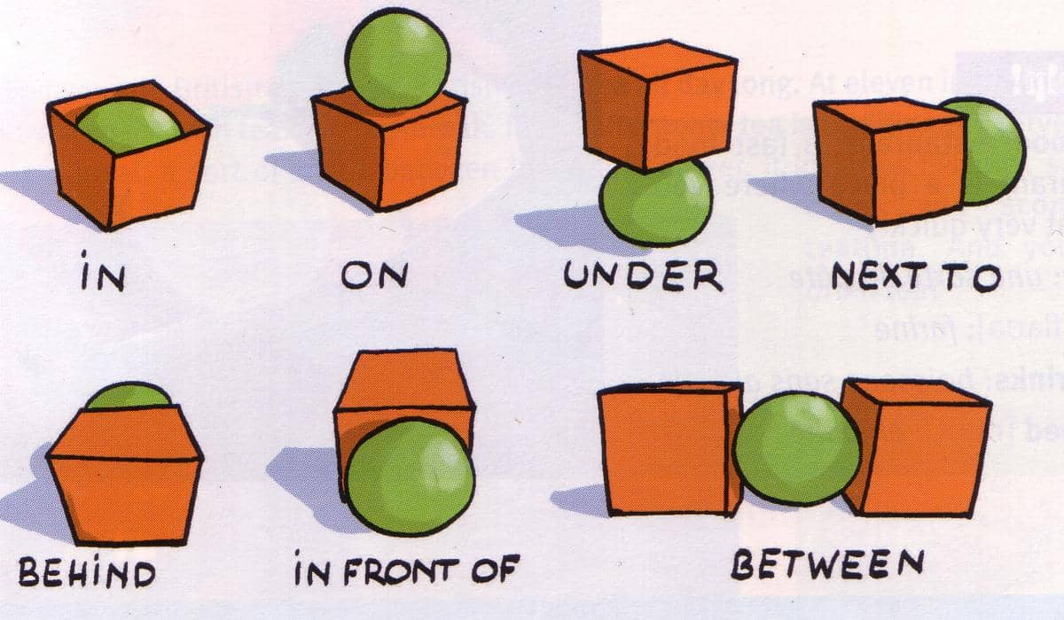
PARTS OF SPEECH-PREPOSITIONS
Prepositions
Prepositions
Prepositions are short and unassuming words that link nouns, pronouns or phrases to other words in a sentence. They express time (before, after, in, on, at), position (on, in, under, inside, above, at), movement (through, over, across, down, up) among others.

Slide 15
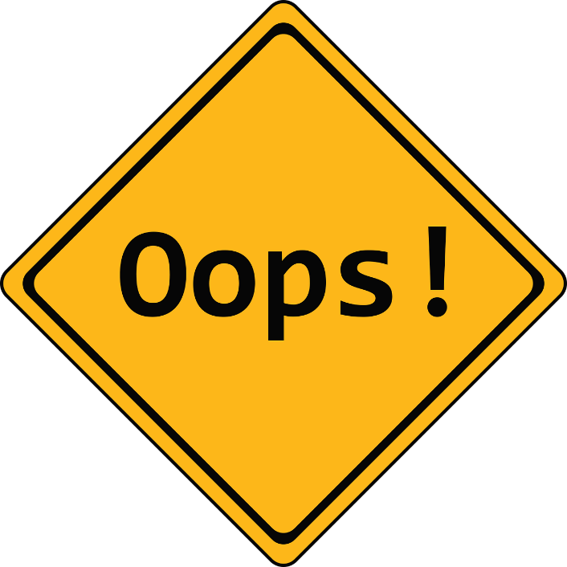
PARTS OF SPEECH-INTERJECTIONS
Interjections
Interjections
Interjections are words used to express emotions like surprise, wonder, delight, joy, disdain, and so on and examples include oops, phew, yuck etc. They are often followed by exclamation marks.

Slide 16
SENTENCE STRUCTURE
We have various sentence types. For instance, we can classify sentences as declarative/statement, interrogative, imperative and exclamatory. Examples:
Declarative: Our company is celebrating 25 years of existence.
Interrogative: Who will take the minutes in this meeting?
Imperative: Email me your proposal.
Exclamatory: Who would have thought!
However, we are more concerned another type of sentence, often called the structural type of sentence. These are:

Slide 17

SENTENCE STRUCTURE
Simple Sentence
Simple Sentence
A simple sentence contains one complete subject and one complete predicate, and expresses one main idea.
Examples include:
January is the hottest month in Kenya.
The meeting starts at 3pm.

Slide 18
SENTENCE STRUCTURE- COMPOUND SENTENCE
A compound sentence is made up of two or more independent clauses (simple sentences or main clauses). Main clauses can be linked by a conjunction, semi-colon or conjunctive adverb. Examples include:
Mary typed the letter quickly and immediately showed it to the boss. (Joined by a conjunction ‘and’)
Most people travel to their work stations; others work remotely. (Joined by a semi-colon)
Most jobs are found in the city; therefore, we often experience rural-urban migration. (Joined by a conjunctive adverb)

Slide 19
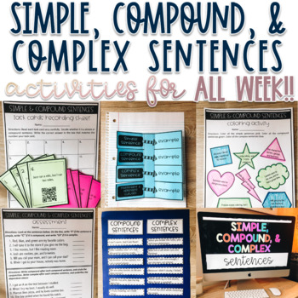
SENTENCE STRUCTURE
Complex Sentence
Complex Sentence
A complex sentence contains one main clause and one or more subordinate clauses (a group of words with a subject and predicate but does not express a complete thought and cannot stand alone as a sentence). Examples include:
Because James was late for work, he decided to extend his working hours till 6pm.
If the invited guests fail to show up, we will have to donate this food to a children’s home.

Slide 20
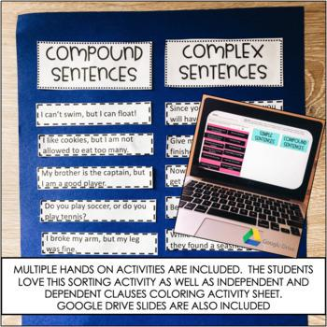
SENTENCE STRUCTURE
Compound-complex Sentence
Compound-complex Sentence
A compound-complex sentence has two main clauses and one or more subordinate clauses. Examples include:
The boss was very angry, so he started uttering unprintable words because Joan had made a terrible mistake.
Since you are heading to town, please get us two reams of printing paper and remember to post the letter to Kitui.

Slide 21
SPELLING
In writing for business, spelling errors are unacceptable since they tell your audience that you do not care. You may not believe it, but frequent spelling errors can cost your company business. Business communication today leverages on technologies like computers and MS Word, meaning that instances of spelling errors should be minimal. MS Word comes with an inbuilt software that can detect spelling mistakes by underlining it in red color. However, be very careful because you may spell a word correctly yet the word is not the one you wanted to use. In this case, software like Grammarly can help detect such anomalies.

Slide 22
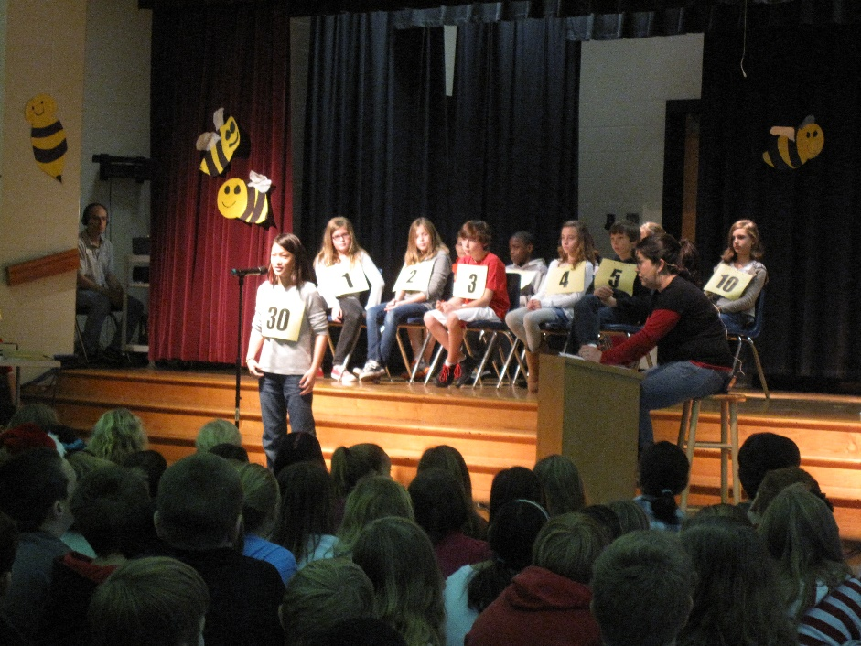
SPELLING
Spelling
Spelling
McRae (2015) argues that spellcheck is just a back-up to your own careful reading of the text because there are many errors the spellcheck will miss. The author advises that after you have spellchecked and checked grammar, read the text again. He opines that every piece of text must receive three eyes: Yours, spell check and finally yours again. There are simply no shortcuts. You must aim for 100 % accuracy.

Slide 23
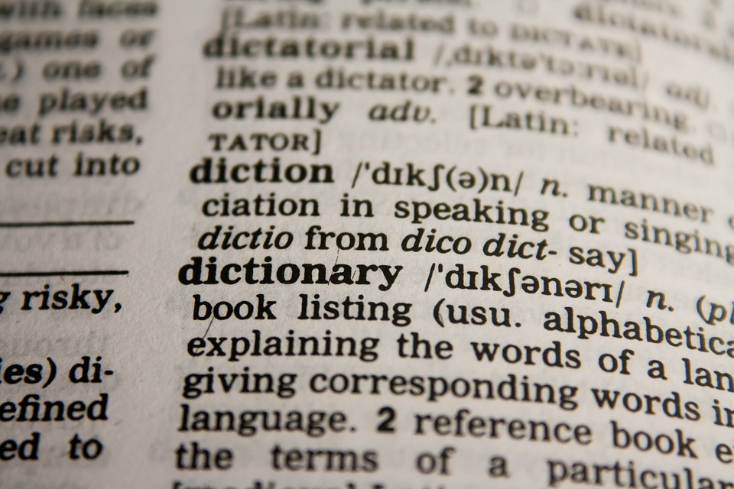
DICTION
Diction
Diction
Diction refers to word choice. In brief, the words you choose matter and can make or break your writing. Here is a quote from Mark Twain to emphasize how important choice of words is:
“The difference between the right word and almost the right word is like the difference between lightning and the lightning bug.”

Slide 24
DICTION
Words function as basic tools to help create color and texture in writing. They reflect and determine how formal a writing is, as well as shape the reader’s perceptions. Dean (2000) argues that diction depends on the topic, purpose and intended audience of the communication. For example, you will select words that resonate with your topic, say, a report on the learning management systems available for your educational institution to purchase. Concerning purpose, if you wish to inform your audience about something, you will choose appropriate, straightforward diction as opposed to playful, ironic words meant to entertain. On audience, the level of formality will influence appropriate word choices. Additionally, an effective voice can be created by our choice of words. Clear, concrete and exact terminologies will shape the voice you use in your writing. For example, rather than saying ‘John’s conduct was bad,’ say, ‘John’s conduct was inappropriate.’

Slide 25
DICTION
Diction can broadly be characterized as formal or informal. For example, germ vs bug; relatives vs folks; child vs kid; position vs job, and so on. Diction can also be categorized as general vs specific as shown in the following example: ‘Look’ is used in a general sense, but when you want to be specific, you can use ‘stare’ ‘ogle’ ‘gaze’ ‘peer’ and so on. Another example is ‘walk’ for general. The specific words would include ‘saunter’ ‘amble’ ‘stroll’ ‘shuffle’ ‘stride’ among others. We also talk of diction in terms of denotative and connotative meanings. Denotations are the words and their meanings exactly as found in the dictionary, while connotations are implied meanings. For example, slender and thin may have similar meanings but may not necessarily mean the exact same thing. There is also colloquial diction and slang, which is the language of everyday use. It is usually conversational and includes common and simple words, idioms, slang, jargon and contractions.

Slide 26
PUNCTUATION
Punctuation is a tool comprising of certain marks used to make our writing clearer. Common punctuation marks include the comma, full stop (period), colon, semi-colon, question mark, apostrophe, exclamation, dash, hyphen, parenthesis, brackets, braces and ellipses. They help us to organize our writing and make it easier for the reader. Note that language is dynamic and even though we have punctuation rules to guide us, we may encounter new forms of writing. For example, previously, Vice-President was not complete without a hyphen, but today the hyphen is an option. Let us look briefly at some of them.

Slide 27
PUNCTUATION
Full stop (period)
Comma
We use the full stop to mark the end of a sentence, for example: “The CEO will address us at 11am today.” However, be careful not to use periods after headings and captions.
The comma is used to separate a series of words or phrases of the same kind. An example would be, ‘His is an angry, bitter, painful cry.’ It also marks off words or phrases of the same kind; marks off words that address someone; mark off specific words or phrases such as additionally; and mark off words, phrases or clauses in parenthesis. Commas are also useful when they introduce subordinate clauses in a complex sentence, for example, ‘If it rains, I shall plant corn.’

Slide 28
PUNCTUATION
Semi-colon
Colon
Semi-colons signify a longer pause than a comma but shorter than a period. For example, “There was a rumor that the President had been impeached; few people believed it though.” Semi-colons also help separate longer items in a list, for example: “The East African nations and their capital cities include: Kenya, Nairobi; Uganda, Kampala; Tanzania, Dar-es Salaam; Rwanda, Kigali; and Burundi, Bujumbura.”
Colons can help introduce a full sentence quote if you do not want to go the usual way. For example: Upon winning the marathon, Chepchumba said: “It was very competitive.” Colons also help to introduce lists, for example: I bought school items for the following children: Mercy, Jane, Nancy and Julius. There are more uses for a colon and I suggest that you read about them.

Slide 29
PUNCTUATION
Paragraph Breaks
Quotation Marks
Did you know that a paragraph break is a mark of punctuation? So, ensure to keep breaking into new paragraphs because it helps you organize your work and makes it easier for the audience.
Whenever we want to quote someone verbatim, we use quotation marks. Other uses include headlines, book titles and extracts from written reports. Sometimes we use quotation marks when we want to draw attention to particular words or phrases in a sentence. The caution here is to be consistent in their use: whether to select single or double quotation marks.

Slide 30
PUNCTUATION
Question Marks
Exclamation Marks
Question marks are important as they signify that a question has been asked. For example:
Who wrote the email?
These marks show emotions and feelings. For example, ‘How beautiful!’ However, be careful with them since they come off as informal. In writing for business, often times we will be formal in our writing.

Slide 31
PUNCTUATION
Ellipsis
Apostrophe
Sometimes, you want to omit certain words because they make your writing longer, yet their absence will not be felt. In that case, use ellipsis (…)
We use the apostrophe when we want to indicate that a letter has been omitted. For example, can’t is the short form of cannot hence, can’t indicates that ‘n’ and ‘o’ have been left out. We also use an apostrophe to show that the possessive aspect is present e.g. Children’s rights.

Slide 32
PUNCTUATION
Hyphen
Dashes
We use hyphens in numbers that are written out, for example, sixty-five; compound words such as empty-handed; and in titles, for example, Vice-President.
We use dashes when we want to mark a stronger parenthesis as well as use an explanation, for example: Kenya has many types of indigenous fruits- guavas, black plum, jack fruit and baobab fruits. (Note that you can also use a colon in place of the dash). To mark a surprise or add emphasis, you can use a dash. For example: You have made a mess of yourself- you must suffer the consequences.

Slide 33
SUMMARY
We have explored the use of parts of speech, sentence structure, spelling, diction and punctuation. What we have said consistently is that grammar and mechanics form a significant part of your writing and that you should aim for 100% accuracy. Accuracy is demanded of us, business writers, because the world must receive accurate writing from us, otherwise our company’s image would suffer damage. The readers notice errors and this jeopardizes not only the company’s future, but our own future as employees. My advice is that since learning is a continuous process, continue polishing your language using online platforms. There are many websites including YouTube that have lessons on grammar and mechanics. I have indicated some below, but you can also find some by yourself.

Slide 34

HOMEWORK
Homework
Homework
Explore the following website that will give you links to 16 of the best websites for learning English: http://www.edutechpost.com/best-free-english-learning-websites-apps/

Slide 35
REFERENCES
Bovee C. L. & Thill, J. V. (2012). Business communication today. (11th ed.). Pearson.
Dean, N. (2000). Voice lessons: classroom activities to teach diction, detail, imagery, syntax, and tone. Maupin House.
McRae, P. (2015). Business and professional writing: A basic guide. Canada: Broadview Press.
Taylor, S. (2005). Communication for Business: A practical approach. (4th Ed). Pearson Longman.
Images: All the images are drawn from Creative Commons through Bing and PowerPoint

Slide 36

THE END

