Slide 1
WRITING FOR BUSINESS
Lecture 6
Direct and Indirect Approach; Positive, Negative, and Persuasive Messages
Lecturer: Dr. Anne Eboi

Slide 2
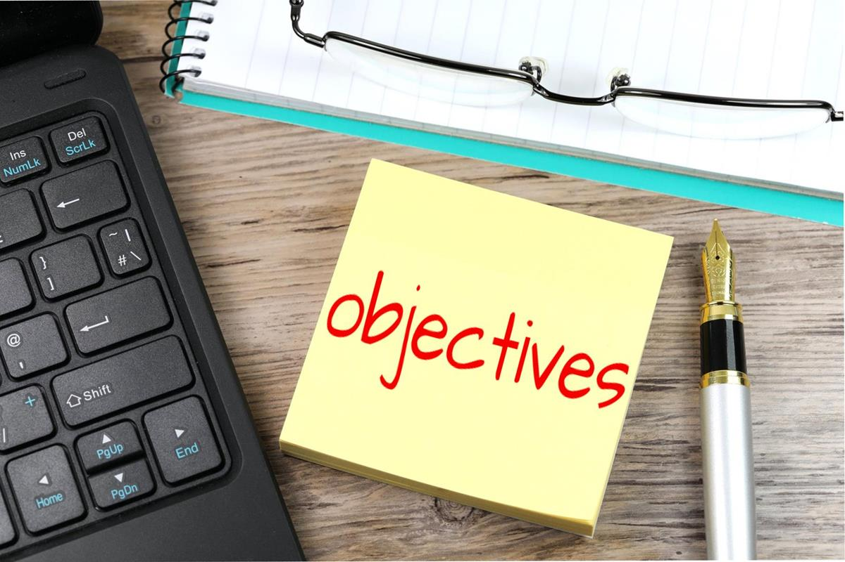
INTRODUCTION
Learning Objectives
Learning Objectives
By the end of this lesson, you should be able to:
Differentiate a negative from a positive message
Distinguish between direct and indirect approaches
Write a positive, negative and persuasive message either directly or indirectly

Slide 3
INTRODUCTION
Recap of Lecture 5
Recap of Lecture 5
Grammar
Parts of speech; Nouns, Verbs, Adjectives, Adverbs, Conjunctions, Pronouns, Prepositions, Interjections
Sentence Structure
Simple sentences
Compound sentences
Complex sentences
Compound-complex sentences
Spelling
Use three eyes
Diction
Word choice matters
Punctuation
Full stop; Comma; Semi-colon; Colon; Question mark; Quotation marks, etc.

Slide 4
INTRODUCTION
Welcome to Lecture Six! By now we have an idea about what writing for business is about. We started off by laying a foundation where we saw theoretical perspectives underpinning business communication. We were introduced to the three-step writing process which assists us in writing business documents such as reports, memos, proposals, manuals, newsletters, and so on. Today, we will learn that we just don’t write messages; instead, we must be conscious about what messages we need to write. Writing for business can come in the form of positive, negative or persuasive messages which can take a direct or indirect approach.

Slide 5
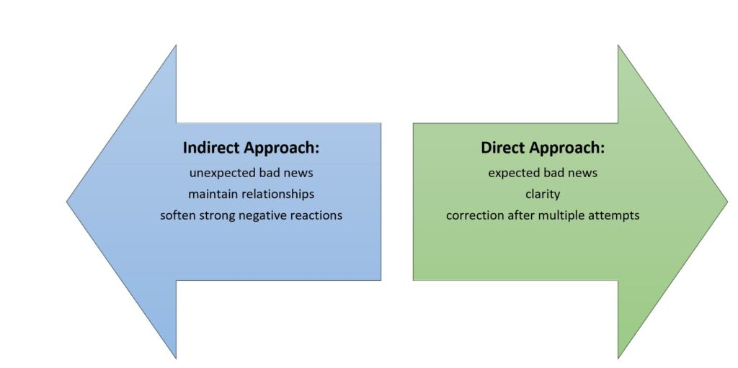

Slide 6
Direct and Indirect Approaches
Messages can either take a direct or indirect approach.
Direct messages are straightforward and to the point. Whenever we are responding to messages seeking information, simple requests, non-controversial messages or those requiring our immediate attention, we can be direct. The key characteristics of direct messages include using clear and concise language; providing specific and explicit information; and using an action-oriented tone.
The following are two examples of direct messages:

Slide 7
Direct Messages
Example 1: Passing information
Example 2: Request Message
Dear Team SOC,
This is a polite reminder that our quarterly meeting will be held next week on Tuesday in the conference room at 11:00 a.m. Please come prepared with your progress reports in addition to any relevant materials you may wish to present.
Thank you.
Hi Mandela,
Could you kindly send me the updated conference report by close of business? We need it for the upcoming conference planning meeting. Let me know if you have any questions.
Thanks!

Slide 8
Indirect Messages
Indirect messages are used when the information or request is sensitive, complex or potentially controversial. These messages require a more tactful and diplomatic approach to soften the impact and preserve relationships. The key features of indirect messages include polite and diplomatic language; subtle or gradual introduction of the main point; and explanations before delivering the main message. Here are two examples of indirect messages:

Slide 9
Indirect Messages
Example 1: Sensitive message
Dear Mr. Ismail,
I hope this email finds you well. I wanted to discuss an issue that has come to our attention regarding the recent project proposal. While the proposal shows promise, we have identified a few areas that may benefit from further refinement and clarification. Can we schedule a meeting to discuss these points in more detail? I believe a collaborative discussion will help us ensure that the final proposal meets our mutual objectives. Thank you for your attention to this matter.
Regards,
Mark.

Slide 10
Indirect Messages
Example 2: Declining message
Hi Pauline,
I appreciate the opportunity to work with you on the new project. After careful consideration and evaluation, we have determined that our current workload and resources do not allow us to take on the additional project at this time. We value our relationship with you and would be happy to explore alternative solutions or discuss future collaborations. Please let me know if you have any questions or if there is anything else I can assist you with. Thank you for your understanding.
Regards,
Mueni.

Slide 11
Positive Messages
In business writing, we communicate to both internal and external audiences. To do so, we use channels such as letters and memos as shown above. One way to build relationships and establish rapport and goodwill is to write positive messages. Thus, we can use positive messages to build and maintain relationships, show gratitude, announce good news, and so on (Last, 2019; University of Minnesota, 2015).

Slide 12
Positive Message
Examples of positive messages include acceptances, announcements, invitations, gratitude, confirmations, among others (Last, 2019). Writing Routine (n.d) as cited in the University of Minnesota (2015) posits that goodwill in writing can be established through communicating good news, providing requested feedback, sharing relative and helpful information among others which leaves your audience with a good impression of you. Further, positive messages not only build a company’s business relationships, but also its ethos. Bovée and Thill (2012) add that positive messages are useful when expressing appreciations, congratulations or condolences and fostering goodwill.

Slide 13

Positive messages
Positive messages
Positive messages
Positive messages are meant to build a sense of goodwill and aim to foster, maintain and solidify relationships (Writing Routine… n.d). Goodwill is the positive emotion or feeling created to encourage people to maintain a good, working business relationship. Note that positive messages can include routine communication (letters, memos, emails, etc.) and non-routine writing (reports, proposals, manuals, etc.).

Slide 14
Positive messages
According to Bovee and Thill (2012), a reader needs to be persuaded that the message they are reading is worth believing in, so the writer should endeavor to create passion and a deep connection between the writer and the reader. Some situations will present themselves negatively, but the writer should be sensitive to the reader and think and write positively. Use simple terms because complex terms may frustrate the reader, turning an otherwise positive message into a negative message. Also avoid negative words like ‘impossible’ ‘loss’ ‘reject’ and so on and instead use positive words like ‘valuable’ ‘progress’ and ‘benefit.’ Bovee and Thill (2012) suggest that positive writing conveys optimism in the midst of a difficult situation. For example,
Negative: We are not sure about salary increment until later in the year.
Positive: We will find out about salary increment by July of this year.

Slide 15
Qualities of a positive message
What you have written qualifies as a positive message if it contains the following:
Purpose: Clearly spells out the reason for writing
Credit individuals: Does the message give credit to people by mentioning their names?
Straight to the point: Ensure you do not meander
Positive: It should use positive words and language especially where negative messages are concerned

Slide 16
Organizing the message
Last (2019) suggests that we organize positive messages using the direct method, as follows:
An opening that includes the key idea or an announcement
Background information that explains the context or situation
An explanation of the subject matter so the reader understands what is required
A courteous close and/or an action statement

Slide 17
Organizing the message
Bovee and Thill (2012) advise that where we expect no resistance to our messages, we can apply the direct method when disclosing simple positive messages. Oftentimes you will find this approach in memos, emails and letters where we state the message in a precise and concise manner. However, where bad news is concerned, be strategic in the sense that you prepare the reader for the bad news before you finally say it. The authors further advise that we consider our audience before penning a message so that our writing sounds more about them than about us.

Slide 18
Content of a positive message
Konnikova (2014) suggests that positive writing follows three principles: ethos, pathos and logos. In other words, have we been ethical in our communication? Have we considered the emotional aspect of our reader and have we written things that make sense to our reader? Ethically speaking, our reader should read facts and assertive statements that show we are experts in our fields. The author calls for the use of memory-inducing triggers such as precise statements, lists, simple words and positive active words. Besides, positive writing concentrates on quality and not quantity and should be necessary, not writing for the sake of writing.

Slide 19

Tone in positive writing
Tone
Tone
Driscoll (2010) opines that tone in business writing directly affects the reader because it reflects on the writer’s attitude towards the subject of the message and reader. To get the tone correct, the author suggests that we first determine purpose of the message and target audience- then we will know what tone best communicates the intended message. If the tone is correct, a correct response will automatically follow. To achieve the correct tone, Driscoll (2010) suggests the following:

Slide 20
Tone in positive message
Tone
Tone
The audience as the subject of the text so they feel included or write from the reader’s perspective eg Instead of writing “I will work on your project soon,” write “your project will commence soon.”
Using the first person pronoun is not advisable because the text reads negatively personal.
Use a confident, courteous and sincere tone e.g. “I believe there are more qualified people, but I hope you will consider me” is wrong because it implies you are not qualified for the position. A confident tone means you are knowledgeable, hence, can easily persuade the reader. However, let’s be careful not to be overconfident because that may be interpreted as arrogance.

Slide 21
Tone in positive messages
Tone
Tone
Avoid discriminatory language such as gender, age-related terms, etc.
Avoid complex language- aim for simplicity
Emphasize (short, simple sentences) and use subordination (in compound sentences) appropriately.
Use the ‘You’ attitude.
Use a polite, sincere and gracious tone even when relaying negative messages, for example: Instead of “you do not meet the qualifications, hence we cannot hire you,” write “we appreciate your interest in our company, but we regret to inform you that there are more qualified applicants.”
Write at an appropriate level of difficulty for the target audience. For example, writing at a lower level of difficulty when writing to highly learned individuals would be ridiculous.

Slide 22
Negative message
Just like it is in life, we will encounter both the good and the bad times. You may win a lottery today and profoundly alter your financial situation. However, ten years down the line, you may be diagnosed with a life-threatening condition. So it is at the workplace where you will deliver both positive and negative news. Negative messaging means we deliver disappointing, unpleasant or critical information or feedback. Our task as professionals is to ensure we deliver the negative message in a respectful and responsible way. Smith (2019) argues that delivering bad-news messages requires care and skills because people tend to resist negative messages. Examples of negative messages include being fired, having your application rejected, lost shipment, increased business rates, a postponed appointment, lost benefits, etc.

Slide 23
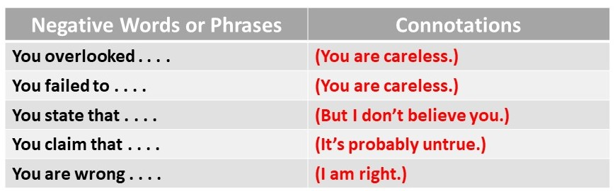
Negative messages
Negative messages
Negative messages
Smith (2019) asserts that we can convey negative messages directly or indirectly. The writer ought to carefully consider the situation before deciding whether to be direct or indirect. For example, if you know the reader will resist the message, then use the indirect approach, with the main idea located closer to the end of the message than at the beginning. The idea here is to create a buffer to ready the reader for the negative news.

Slide 24
Seven goals of negative message delivery
Negative message delivery
Negative message delivery
Business Communication for Success as cited in University of Minnesota (2015) proposes seven goals of delivering bad news:
Be clear and concise in order not to require additional clarification.
Help the receiver understand and accept the news.
Maintain trust and respect for the business or organization and for the receiver.
Avoid legal liability or erroneous admission of guilt or culpability.
Maintain the relationship, even if a formal association is being terminated.
Reduce the anxiety associated with the negative news to increase comprehension.
Achieve the designated business outcome.

Slide 25
Seven goals of negative message delivery
Let me briefly explain the first two goals. Goal one is clear, where clarity and conciseness are demanded to avoid confusion. Imagine you have written an employee a letter of dismissal, but it is not clear. The employee will come back to ask you what you mean and you will now be forced to clarify, probably embarrassed by your poor communication.
How do you help the receiver to understand and accept the bad news? You can organize your message using the indirect approach because bad news can emotionally and mentally destabilize us. Imagine sitting in front of a doctor who drew your blood to test your HIV status. He casually tells you, ‘You have HIV/AIDS.’ It is worse when it is written. I speculate that it’s the reason doctors shroud their language and handwriting in mystery. An ethical doctor will first sit you down and first discuss the test results in detail before embarking on treatment options. He/she can even say things like, ‘About 44 million people live with HIV globally and today, more than ever, the survival rate is at an all-time high with faithful medication.’ ‘It could be worse, you know,’ and so on.

Slide 26
Organization of negative message delivery
Negative message delivery
Negative message delivery
Business Communication for Success as cited in University of Minnesota (2015) and Smith (2019) suggest the following four-part organization when delivering a negative message:
Buffer/cushion
Justification/Explanation
Bad news + redirection
Positive action closing
The buffer phase involves writing neutral or positive statements to soften the blow of bad news. Smith (2019) suggests the following buffer strategies:
Good news: If presented with both the good and bad news, start with the good news.
Compliment: Always begin by complimenting someone you are about to reject.

Slide 27
Organization of negative message delivery
Negative message delivery
Negative message delivery
Gratitude: Always show appreciation even when you are about to decline a claim the other company has submitted and which does not qualify.
Agreement: You know that your audience will disagree with whatever you have to say. Start with where you both agree e.g., “We can all agree that . . ..”
Facts: You may need to begin with cold, hard facts if positives are difficult to begin with.
Understanding: Express sympathy and understanding first if there are less positives for you to begin with (as cited in Guffey et al. 2016)
Apology: Yes, you can offer an apology if you are the reason for the negative message. However, be careful that your apology does not disadvantage you in legal proceedings.

Slide 28
Organization of negative message delivery
The justification or explanation part explains why there is an issue in the first place. It provides the background or context for the bad news before delivery of the negative message. Limaye (1997) as cited in Smith (2019) argues that an explanation is an ethical and moral requirement. For example, imagine a rejected job applicant accusing the company of bias- they heard from the grapevine that they were not selected due to pregnancy, which points to discrimination. The applicant is threatening to expose you on social media. Your explanation will describe the strict hiring criteria and the high quality applications and interviews your company received. You will explain your hiring policy which strictly forbids discrimination of any kind. Your goal is for the reader to accept the bad news as inevitable, hence do not sound mysterious or arbitrary. Smith (2019) advises that you should never admit liability without your company’s legal counsel’s input.

Slide 29
Organization of negative message delivery
The third phase involves delivering the bad news, but do so accurately and clearly. The indirect approach is preferred, not because you intend to hide the negative message, but to minimize negative reactions which can cause anger and depression. Being indirect also ensures that you are sensitive, unlike Donald Trump’s ‘You are fired!’ reality show’s signature statement. Remember we said above that one way to write positive messages is through subordination. Smith (2019) suggests putting the bad news in a subordinate clause in the passive voice as demonstrated below:
Though another candidate was hired for the position, . . .

Slide 30
Organization of negative message delivery
Subordination using the passive voice helps you to draw attention away from you being the applicant’s source of rejection. This way, you redirect the reader’s attention elsewhere. Redirection aims to offer a solution strategy, an alternative, or subsequent actions that augur well for the situation at hand. In some cases, you can offer a consolation prize or say something nice which will be appreciated as better than nothing. You can continue with a positive closing such as:
. . . we wish you success in your continued search for employment (Smith, 2019).
The last phase involves closing with a positive action. In fact, the example above on wishing the candidate success in a job search constitutes a positive action. You should ensure the reader has understood the bad news while you remain positive, courteous and forward looking. Smith (2019) recommends that you end the conversation without inviting further correspondence. You certainly do not want to continue with this conversation.

Slide 31
Organization of negative message delivery
University of Minnesota (2015) suggests that we can avoid lawsuits if we do not engage in the following:
Negative or abusive language- stay away from profanity, sarcasm, insults, and harsh accusations. Some of your responses may be construed as libelous or slanderous.
Oversharing but speaking the truth- in an effort to justify your actions, you may inadvertently share more than you really wanted to. For example, sharing the scoring sheet of all the job applicants. Tell the truth in the process of justification to avoid scrutiny and accusations of lying.
Failing to respect the reader’s right to privacy- do not call out someone, even an employee in a group memo or email, even if the accusation is correct. This action is deemed as unprofessional and may create an unnecessary hostile work environment.

Slide 32
Sample Negative Message
Dear Njuguna,
I hope this email finds you well. I wish to thank you for your hard work and dedication to the project thus far. Your commitment to meeting deadlines and attention to detail have been commendable.
However, I need to discuss some concerns that have arisen regarding the quality of your recent deliverables. Upon reviewing the deliverables, we noticed several errors and inconsistencies that require immediate attention. These errors could impact the overall success of the project and the client's satisfaction.
To address these concerns, we recommend conducting a thorough review of the deliverables to identify and correct any errors. Additionally, collaborate with the quality assurance team to help ensure the accuracy and consistency of the final output.
We understand that setbacks can occur and we are confident in your ability to rectify the situation. We value your contributions to the project and believe that by working together, we can overcome these challenges.
Thank you again for your dedication to the project. We are confident that with your expertise and attention to detail, we can overcome these challenges and deliver a successful outcome. If you have any questions or need any assistance, please don't hesitate to reach out.
Yours sincerely,
Mwende,
Supervisor.

Slide 33
Persuasive Messages
Persuasion is an art that requires the communicator to present convincing arguments for the audience to adopt the communicator’s view. Ashman (2018) asserts that a persuasive message is the central message that informs, convinces, intrigues, or calls to action. In business communication, these messages are used to convey ideas, proposals, recommendations or requests.
Aristotle is one of the earlier philosophers associated with the rhetorical triangle which combines logos(logic), pathos (emotional appeal), and ethos (ethics) used by communicators as a persuasive strategy for tailoring messages to audiences. The communicator needs to appeal to the audience’s sense of reason, sense of emotion, and ethics. For example, you may need to write to the local community asking them to desist from polluting the local river. You will appeal to their sense of logic if you gave them potential negative impacts of river pollution, both long-term and short-term. You can use emotional appeals by adding graphics that display an extremely filthy river and its effects on the human body. You can let them know of your credentials and track record in environmental conservation for credibility and to appeal to their sense of ethos.

Slide 34
Persuasive Messages
Principles of persuasion
Principles of persuasion
Smith (2019) lists the following principles of persuasion:
Principle of Reciprocity- I scratch your back, you scratch mine.
Principle of Scarcity- We want what we can’t have, so scarcity can be a selling point.
Principle of Authority-An endorsement by an authority or expert gives credibility. What do the experts say about this and that product?
Principle of Commitment and Consistency- Committing to something makes you feel obligated to follow through on it.
Principle of Consensus-We tend to trust first-person testimonials and exhibit a herd mentality.
Principle of Liking- We are more likely to buy something from someone we like, who likes us, who is attractive, and who we can identify with because we see enough points of similarity between ourselves.

Slide 35
Persuasive Messages
AIDA stands for A – Attention-getting Opening; I – Interest-building Body; D – Desire-building Details and Overcoming Resistance; A – Action-motivating Closing. It is a model used in advertising and which is akin to the indirect approach where items or services are brought to your attention in many other ways but not directly. For example, you won’t see a commercial saying, “The shoes in our collection cost $100 upwards. Come and buy.” Instead, you will see commercials of beautiful or handsome, wealthy ladies or gentlemen driving the latest Mercedes and saying how smooth the ride into the future was. Commercials will present you with problem-solution scenarios, use special effects, use celebrities, etc. (Smith, 2019).

Slide 36
Persuasive Messages
Persuasive message
Persuasive message
According to Smith (2019), consider the following when crafting a persuasive message:
Understand your audience's needs, preferences and concerns so that your message resonates with their interests and motivations.
Start with a strong opening.
State your proposition clearly.
Provide supporting evidence or data.
Address potential objections.
Highlight benefits and outcomes.
Use persuasive language and tone.
Use a call to action.
Follow up and offer assistance.

Slide 37
Sample Persuasive Message
You are writing a persuasive message to propose a new software implementation to the IT department. Here is a sample persuasive message:
Dear Company XYZ,
We are delighted to introduce to you our new automated invoice management system that can save your team hours of tedious work, allowing them to focus on more strategic tasks. A recent study by XYZ Research indicates that companies that have implemented flexible work arrangements experienced a 25% increase in employee retention rates and a 20% boost in overall productivity.
We understand that some managers may have concerns about maintaining team collaboration in a remote work environment. However, our proposed solution includes regular virtual meetings, collaboration tools and performance tracking mechanisms to ensure effective teamwork. Our project management software can assist your team to streamline task allocation, improve project tracking and reduce project delivery time by 30%, resulting in increased client satisfaction and higher profitability. Your organization is on the verge of revolutionizing its manufacturing processes and achieve unprecedented levels of efficiency and cost savings with the use of our cutting-edge technology.

Slide 38
Sample Persuasive Letter Cont…
To get started with our software solution, schedule a demo with our sales team by clicking the link below or replying to this email. Don't miss the opportunity to transform your operations and stay ahead of the competition.
I would be happy to schedule a call to discuss any questions or concerns you may have. Feel free to reach out to me directly, and I will be glad to assist you.
Regards,
Jared Mayfair,
Company ABC.

Slide 39
Summary
This lecture was about how to create messages that resonate with our audiences. We learned that both positive and negative messages exist at the workplace, but we must be strategic enough to know how to respond to each message. As a business, we must aim to create and maintain goodwill with our clients and other stakeholders. Hence, a negative message can use the indirect approach to soften the blow and to show that we care. On the other hand, a positive message can take the direct approach since it is delivering good news. However, we also noted that negative messages can take the direct approach if and when the situation demands. Finally, we learned that persuasive messages are important in a business setting because we are always trying to persuade people to either buy our product or services.

Slide 40

Activity
Write a negative message
Write a negative message
Write any negative message of your choice (email, memo, or letter), then exchange with your partner for peer-review. Award marks out of 10 and justify your mark.

Slide 41
References
References
References
Ashman, M. (2018). Persuasive messages. Introduction to Professional Communications.https://pressbooks.bccampus.ca/professionalcomms/chapter/5-7-persuasive-messages/
Bovee C. L. & Thill, J. V. (2012). Business communication today. (11th ed.). Pearson.
Last, S. (2019). Negative messages. Communication Essentials for Business. https://pressbooks.senecapolytechnic.ca/communicationessentialsforbusiness/chapter/7-4- negative-messages/
University of Minnesota (2015). Positive routine messages. Business Communication for Success. https://pressbooks.pub/unsw/chapter/20-8-positive-routine-messages/
Smith, J. (2019). Persuasive messages. Communication at Work. https://ecampusontario.pressbooks.pub/communicationatwork/chapter/8-4-persuasive-messages/
Smith, &. (2019b). Persuasive messages. Communication at Work. https://kpu.pressbooks.pub/communicationsatwork/chapter/8-4-persuasive-messages/
University of Minnesota. (2015). Delivering a negative news messages. Business Communication for Success. https://open.lib.umn.edu/businesscommunication/chapter/17-1-delivering-a-negative-news-message/
Images: All the images are drawn from Creative Commons through Bing on PowerPoint

Slide 42


