Slide 1
WRITING FOR BUSINESS
LECTURE 7: OUTLINING; PARAPHRASING; SUMMARIZING; QUOTATIONS; PARAGRAPHING;
LECTURER: DR. ANNE EBOI

Slide 2
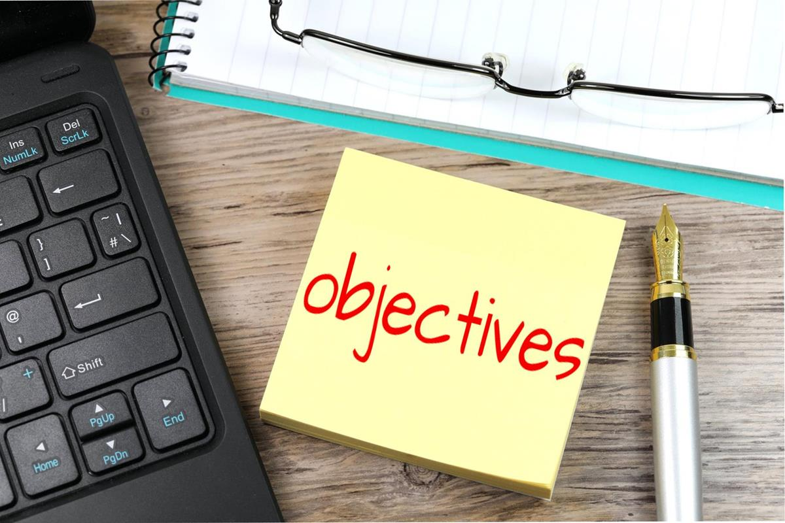
INTRODUCTION
LEARNING OBJECTIVES
LEARNING OBJECTIVES
By the end of this lesson, you should be able to:
Create an outline for your written business correspondence
Paraphrase materials from sources
Write effective paragraphs
Summarize a given text
Employ quotations effectively

Slide 3
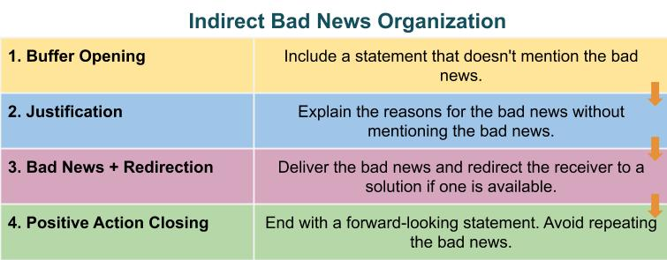
INTRODUCTION
RECAP OF PREVIOUS LECTURE
RECAP OF PREVIOUS LECTURE
Both positive and negative messages exist at the workplace.
Negative messages can use the indirect approach to soften the blow .
Positive messages can take the direct approach since it is delivering good news.
Persuasive messages are important in a business setting because we are always trying to persuade people to either buy our product or services.

Slide 4
OUTLINING
It is the first step in writing-involves organization- organizing and connecting your ideas so that the reader can make sense of them.
Outlines are very important when you are engaged in longer writing such as a report, proposal, manual, essay, etc.
A piece of writing where you list the key ideas and in the order in which you want to present them.
Ensures that you stay focused on your subject matter and that you do not leave any important point out.
Conor (2011) opines that the outline’s complexity depends on the extent, or scope of your writing task.

Slide 5
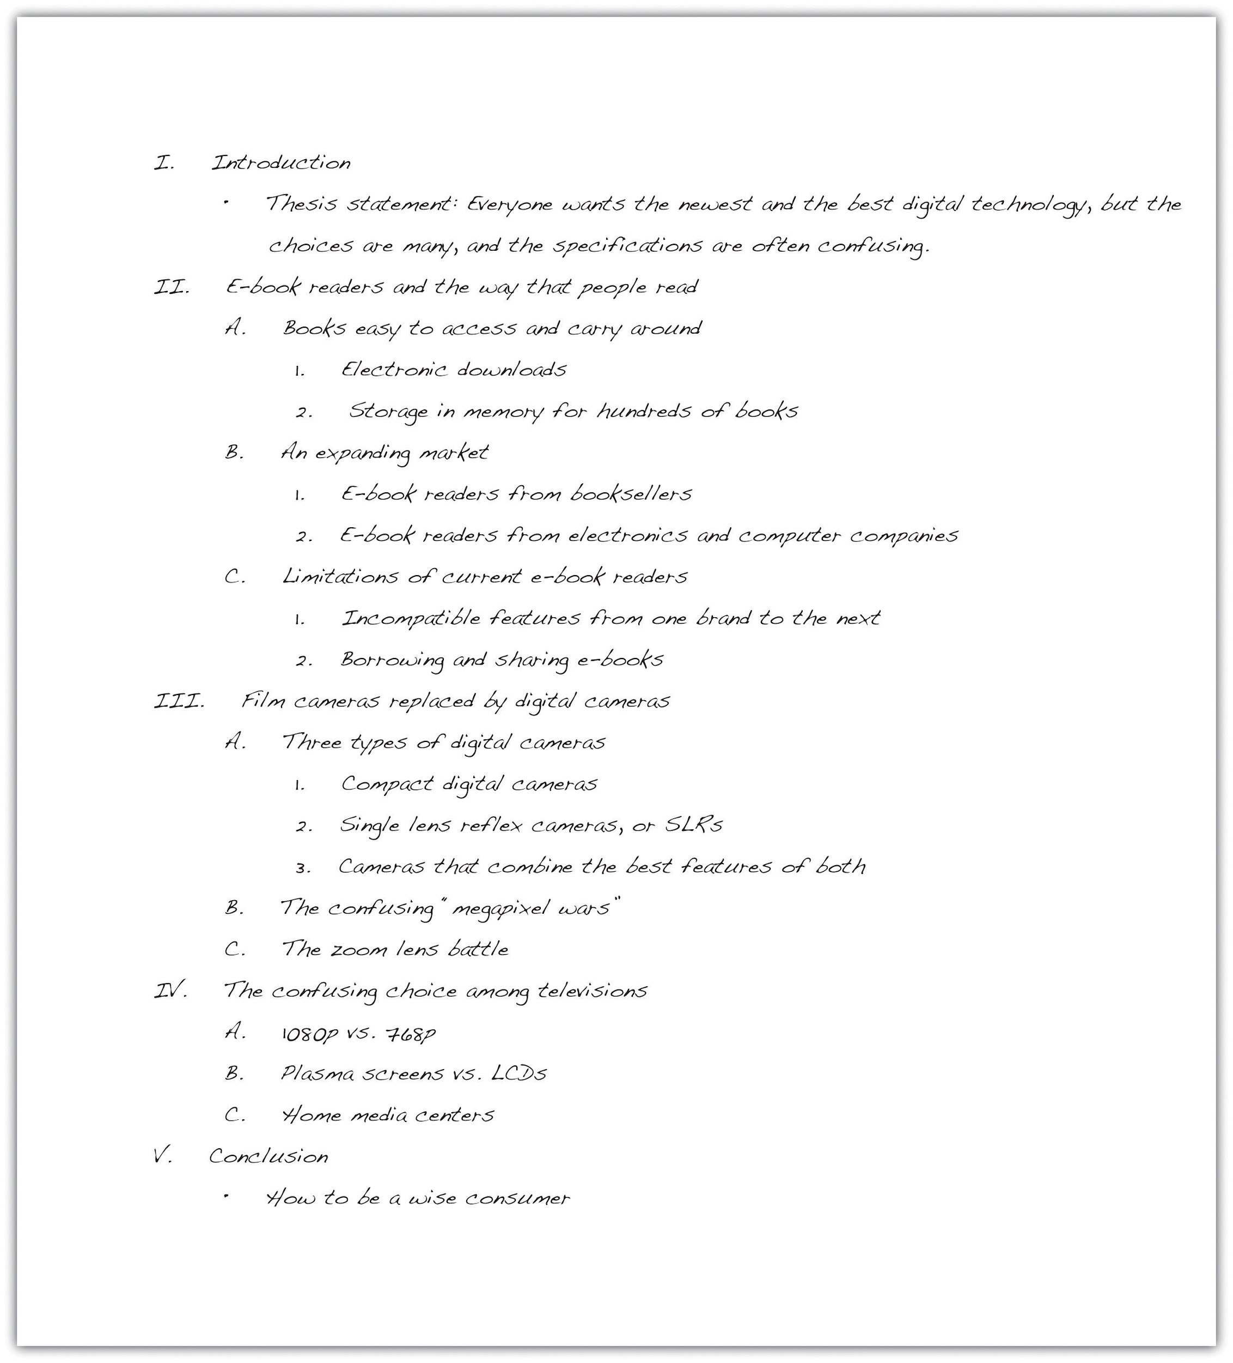
OUTLINING
TYPES OF OUTLINES
COMPLEX OUTLINES
Conor (2011) classifies outlines as simple, intermediate and complex.
A simple outline is an informal ordering of the main points a writer intends to include in a written document.
An intermediate outline is a short summary of what you want to say but with entire paragraphs.
A complex outline includes headings and subheadings for each topic. Main topics become main headings while key points become subheadings as well as lesser subordinate points.

Slide 6
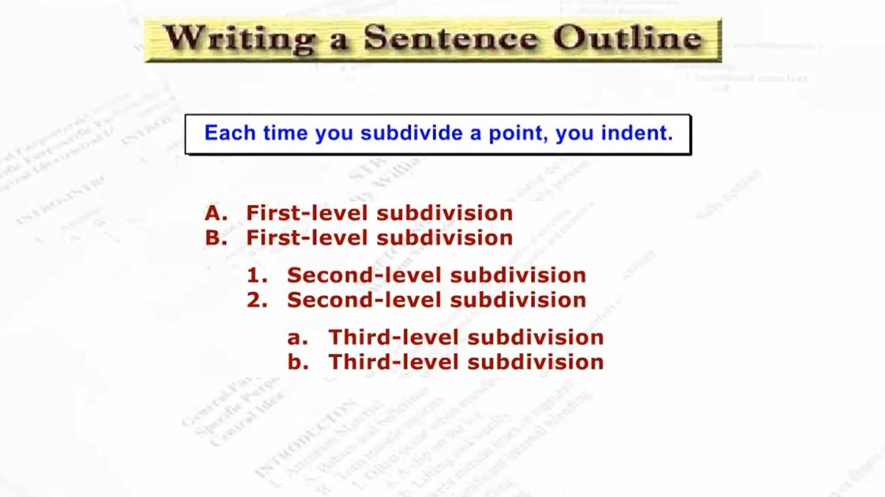
OUTLINING
TYPES OF OUTLINES
TYPES OF OUTLINES
The University of Minnesota (2015) recognizes the existence of formal and informal outlines. Informal outlines concern tasks the individual wants to accomplish. For example, an outline for a speech to be delivered in class. Business writing makes use of formal outlines which fall into two categories: topic and sentence outline.

Slide 7
OUTLINING
The University of Minnesota (2015) suggests that you can format both outlines as follows:
Place your introduction and thesis statement at the beginning, under Roman numeral I.
Use Roman numerals (II, III, IV, V, etc.) to identify main points that develop the thesis statement.
Use capital letters (A, B, C, D, etc.) to divide your main points into parts.
Use Arabic numerals (1, 2, 3, 4, 5, etc.) if you need to subdivide any As, Bs, or Cs into smaller parts.
End with the final Roman numeral expressing your idea for your conclusion.

Slide 8
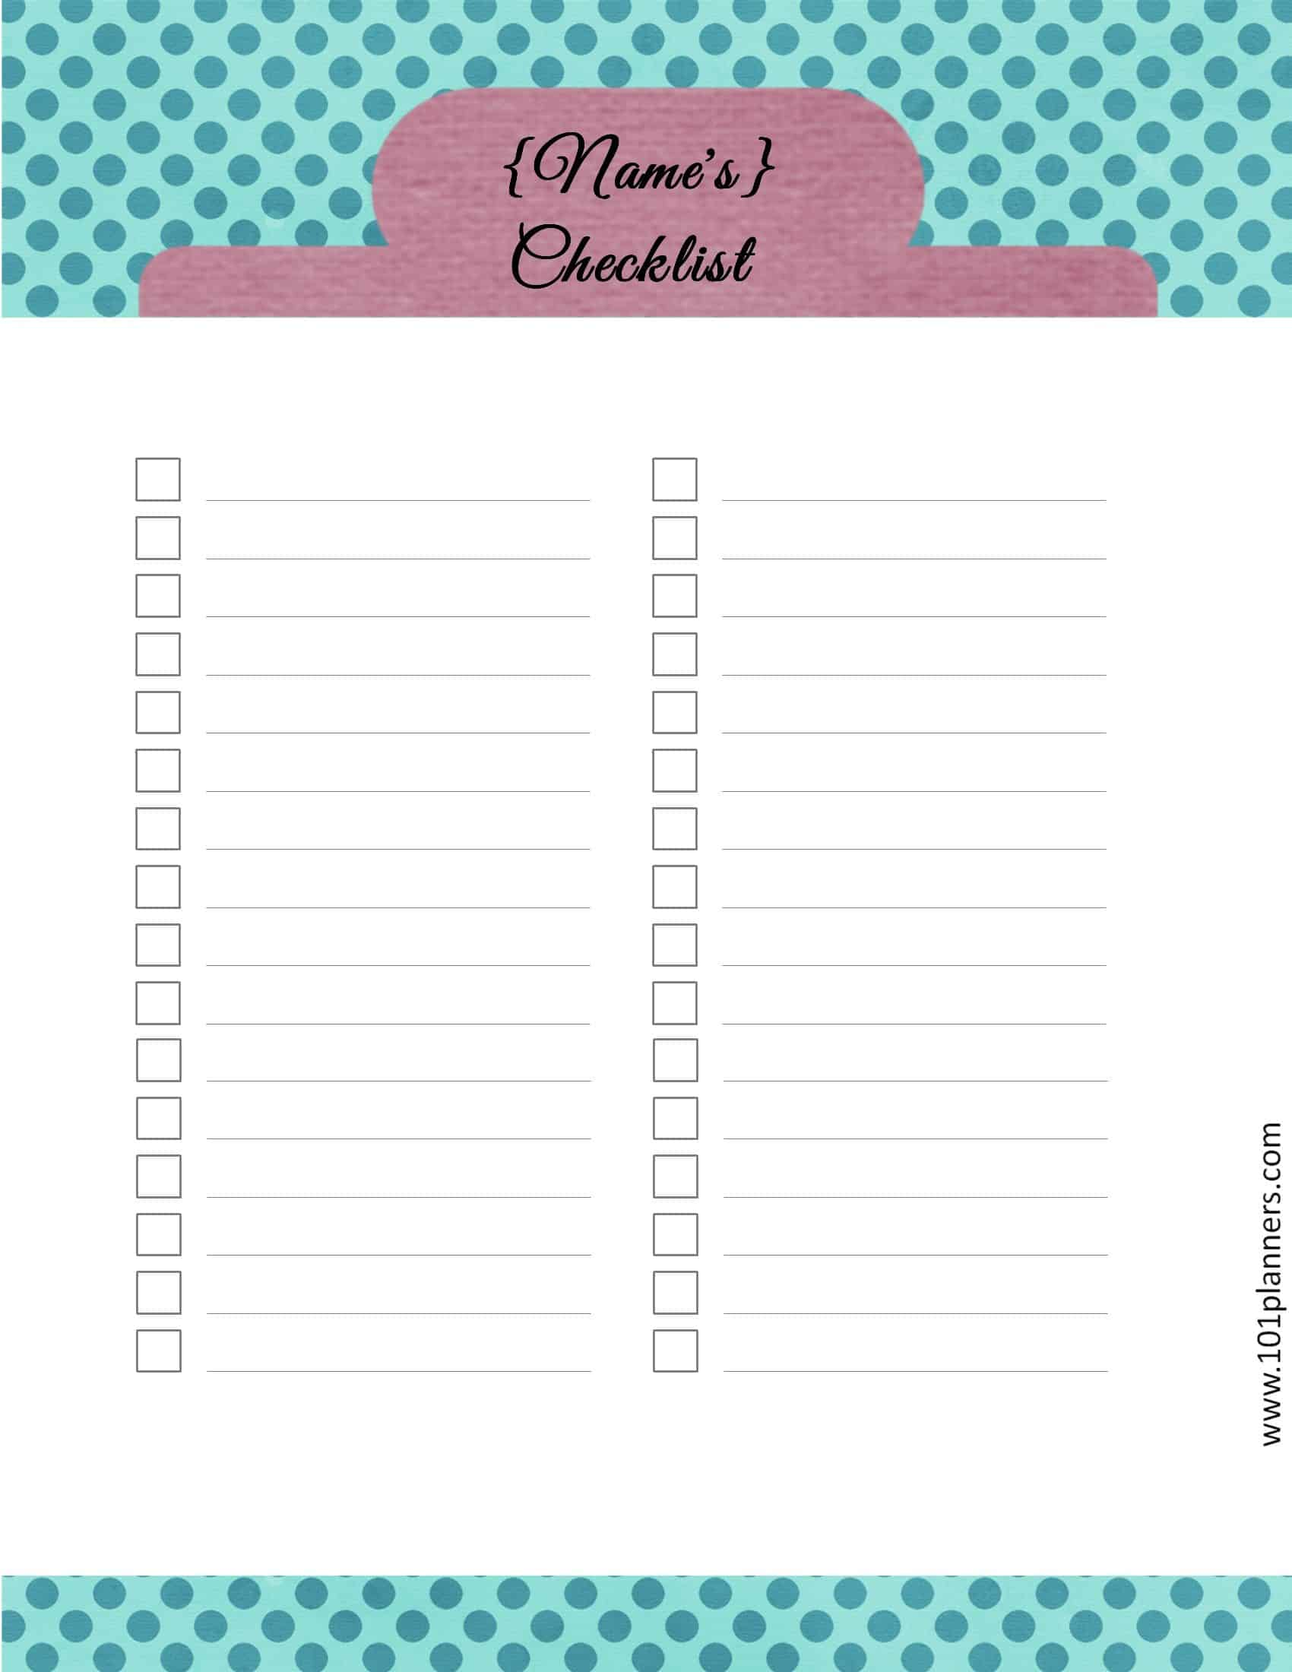
TYPES OF OUTLINES
Task: Jesse is writing a business letter in response to a client who is unhappy about his company's services. Write a simple list or topic outline for Jesse.
Begin with a thesis statement before you break into your outline.

Slide 9
OUTLINING
Areas | Main points
Thesis statement | Admit the wrong; apologize; suggest way out; reassure client of company commitment to exemplary service
Introduction | Recognize client's complaint Express understanding of client dissatisfaction
Apology | Sincerely express regret for inconvenience caused Admit company responsibility
Elucidation | Briefly explain the cause Guarantee client of issue resolution
Proposed resolution | Present clear solutions If applicable, offer recompense
Assurance | Reaffirm commitment to excellent services Inform client they can seek further assistance
Conclusion | Appreciate client for raising concern Express hope for positive future Provide client with contact information

Slide 10
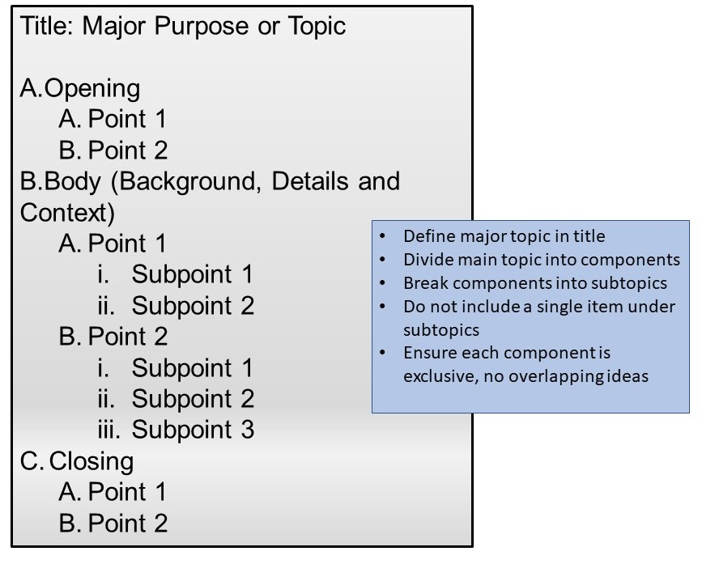
OUTLINING
TYPES OF OUTLINES
TYPES OF OUTLINES
Williams and Sonja (2022) suggest two types of outlines: Traditional outlines and rough outlines. The traditional outline features numbering and indentation to capture your main topics, sub-topics, sub-sub topics, etc. A rough outline on the other hand is less formal in which you list your ideas in the order that makes sense to you.

Slide 11
PARAPHRASING
Paraphrasing involves putting a passage from source material into your own words. What this simply means is that you read material from a source, say a book, a journal article, website, and so on, then use your own words to say the exact same thing. You must be careful to attribute what you are writing to the original source. Oftentimes what you have as paraphrased material is a shorter or condensed version of the original material. In cases where you do not have to cite according to some style guide, give credit where it is due by mentioning the source informally. For example, when writing an article from a public relations perspective which you want published by a leading local daily, you can say something like, “An article from The People Daily raises a concern about drink-driving that is reportedly on the rise.”

Slide 12
PARAPHRASING
The University of Minnesota (2015) offers the following steps you should take when paraphrasing a passage, which I am quoting verbatim:
Read the passage out loud, paying attention to the complete thought rather than the individual words.
Explain the concept in your own words to a friend or colleague, out loud, face-to-face.
Write the concept in your own words, and add one or more illustrative examples of the concept that are meaningful to you.
Reread the original passage and see how your version compares with it in terms of grammar, word choice, example, and conveyance of meaning.
If your writing parrots the original passage or merely substitutes synonyms for words in the original, return to step one and start over, remembering that your goal is to express the central concepts, not to “translate” one word into another.
When you are satisfied that your expression of the concept can stand on its own merit, include it in your document and cite the original author as the source of the idea.

Slide 13
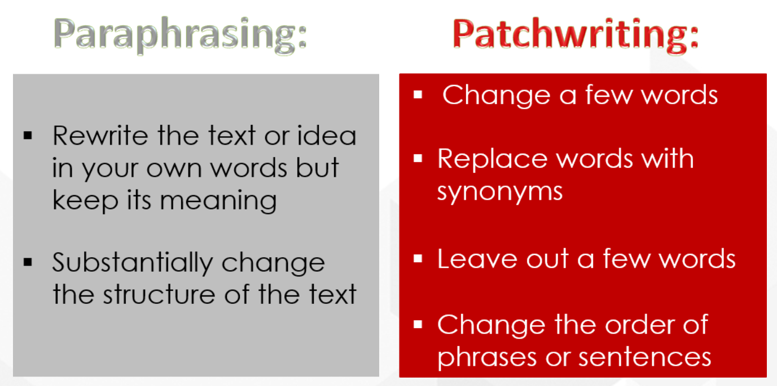
PARAPHRASING
COMMON ERRORS IN PARAPHRASING
COMMON ERRORS IN PARAPHRASING
Common errors in paraphrasing include:
Words and sentence structures being too close to the original
The meaning in the paraphrased text differing with the original
Excluding citations
The paraphrased text not making sense.

Slide 14
PARAPHRASING
Sample Paraphrasing
The following sample is adapted from Locker (2003) as cited in Mohamed Kheider University of Biskra (n.d.). It is a very good example of how paraphrasing should be executed.
Original passage
Statements that seem complimentary in one context may be inappropriate in another. For example, women in business are usually uncomfortable if male colleagues or superiors compliment them on their appearance: the comments suggest that the women are being treated as visual decoration rather than as contributing workers (Locker, 2003).

Slide 15
PARAPHRASING
Paraphrased passage
Women may feel uneasy upon receiving ordinarily positive comments on their appearance from male coworkers or supervisors. To these women, the remarks carry an implied meaning: instead of being thought of as productive employees, they are actually being viewed as just a pretty part of the atmosphere. Depending on the situation, words or expressions which appear favorable may actually be unsuitable in a conversation (Locker, 2003).
Comment: The paraphrased version is acceptable because of the following:
It changes both the wording and sentence structure
It includes all the points
It retains the meaning of the original passage
It changes the order of ideas.

Slide 16
SUMMARIZING
To summarize is to express the most important ideas or facts in your own words. The University of Minnesota (2015) defines it this way: “To summarize is to reduce a concept, idea, or data set to its most basic point or element.”
We should not confuse it with paraphrasing, which involves restating the original text in your own words.
In summary, you pick out the main ideas and they are significantly shorter than the original.
Additionally, care should be taken not to reduce the original passage to the extent that we lose its context or original richness.
Summarizing a passage effectively demonstrates your understanding of the text.
Remember to attribute your sources as well.

Slide 17
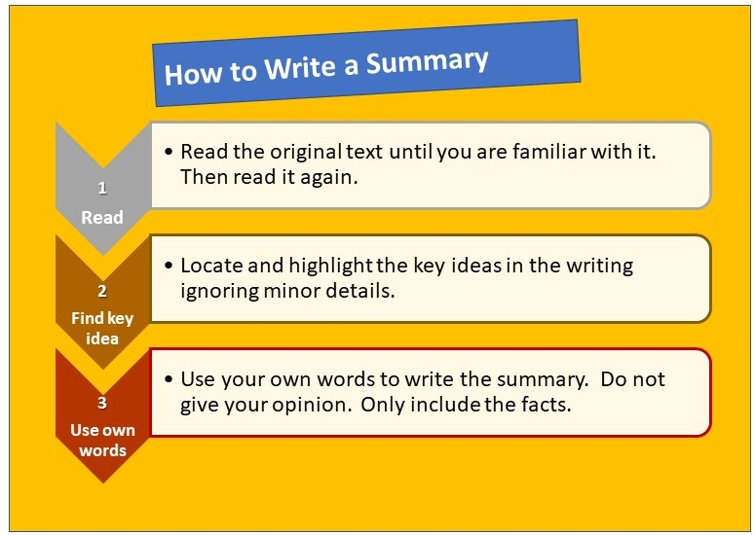
SUMMARIZING
SUMMARY
SUMMARY
Summary is useful when writing a formal report (these usually run into pages) where you must write an executive summary of that report. This summary must contain all the main ideas/concepts of the report usually on one page. An executive summary will state the problem, purpose and objectives, methodology used to generate data, findings or results, recommendations, and so on. Another example concerns a business writer who is writing a proposal or report and wishes to summarize a section of a novel or play because it is significant.

Slide 18
SUMMARIZING
Hucker (2009: 352) as cited in Mohamed Kheider University of Biskra (n.d.) lists the following guidelines for writing an effective summary:
In the first sentence, mention the title of the text, the name of the author, and the author's thesis or central point.
Maintain a neutral tone; be objective.
Use the third-person point of view and the present tense.
Keep your focus on the text. Don't state the author's ideas as if they were your own.
Put all or most of your summary in your own words; if you borrow a phrase or a sentence from the text, put it in quotation marks and give the page number in parentheses.
Limit yourself to presenting the text's key points.
Be concise; make every word count.

Slide 19
SUMMARIZING
The following sample has been drawn from Pel (n.d), as cited in Mohamed Kheider University of Biskra (n.d.) .
Original text
Since the time of Descartes, it is estimated that no fewer than five hundred attempts have been made to create artificial languages for international use. The most successful by far has been Esperanto, a language constructed around the end of the nineteenth century by Dr. Zamenhof of Poland. Esperanto is a language that is extremely easy to learn and speak, with its words drawn mainly from English, German, the Romance languages, Latin and Greek. (Pel, p. 75).

Slide 20
SUMMARIZING
The Outline
Many artificial languages have been made.
Esperanto is the most successful one.
Constructed by Zamenhof around the 19th century.
Easy to learn and speak
Based on E, G, the Romance, L and Gr. in terms of vocabulary
Summarized version
Of the many artificial languages that have been developed, Esperanto, invented by Zamenhof about 1900, has been the most successful. Easy to learn and speak, its vocabulary comes mainly from Western European languages, Latin, and Greek. (Pel, p. 75).

Slide 21
QUOTATIONS
Quotations help to indicate that the said material is an outside source. It means that you want to include someone else’s words to help advance your argument.
According to Plotnick (2002), as cited in Lane (2023), quotations can be used in the following situations as quoted verbatim:
The language is mainly elegant, powerful or memorable.
You wish to confirm the credibility of your argument by enlisting the support of an authority on your topic.
The passage is worthy of further analysis.
You wish to argue with someone else’s position in considerable detail.
Research that involves participants to help foreground the unique voices and perspectives of the participants.

Slide 22
QUOTATIONS
In writing for business, quotations can help clarify a message, support an argument or add credibility. Thus, select quotes from reputable, authoritative sources or experts. Quotes should be attributed and align with the purpose, as well as support main arguments. In using quotes, it is advisable to introduce it with a brief explanation to provide context by using signal words or introductory phrases such as, “As stated by…” Also, use quotation marks (“…”) and remember to place commas and full stops inside (not outside) the closing quotation.
Example:
Wrong: “Listening to employees is something I effortlessly do because I understand the value of maintaining good employee relations”.
Correct: “Listening to employees is something I effortlessly do because I understand the value of maintaining good employee relations.”

Slide 23
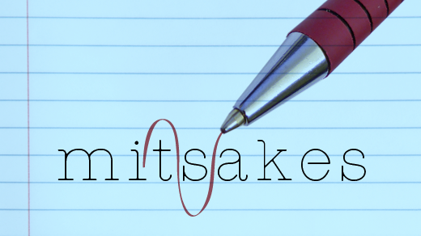
QUOTATIONS
ERRORS IN QUOTATIONS
ERRORS IN QUOTATIONS
One of the mistakes novice writers make is to use so many quotes that they choke their writing. Quotes should be used strategically, sparingly and only for emphasis. Another thing to consider regarding quotations is whether to include them within your paragraph or indent so that they stand alone. You should indent (block quotes) if the quote is longer than four lines. When you block or indent a quotation, do not use quotation marks. Here is an example of how an author can use a block quote:

Slide 24
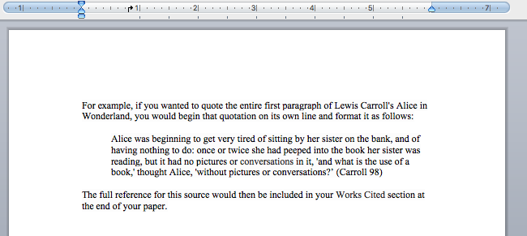
QUOTATIONS
BLOCK QUOTES
BLOCK QUOTES
Majimbo (2024) suggests that the integration of digital tools is essential for modern business operations as seen below:
    As businesses evolve in the digital age, leveraging technology not only enhances productivity but also provides a competitive edge. Companies that implement advanced information systems can streamline their operations, foster stronger customer relationships, and improve decision-making through data-driven insights. In this context, digital transformation is no longer optional but a strategic necessity for long-term success.

Slide 25
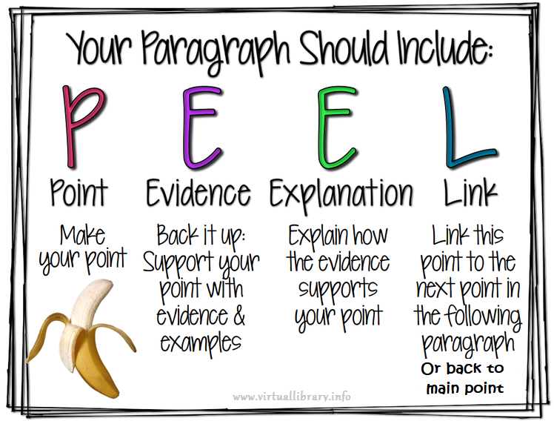
PARAGRAPHING
PARAGRAPHS
PARAGRAPHS
Paragraphs are distinct sections of writing which consist of one or more sentences and deal with one theme. Paragraphs start on a new line and this is regarded as a paragraph break. Smith (2019) refers to them as “the building blocks of all business documents.” The author states that paragraphs may differ in form and length, but all effective paragraphs must contain unity, coherence and organization.

Slide 26
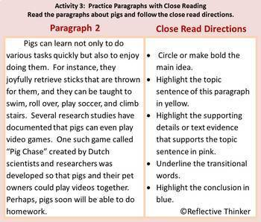
PARAGRAPHING
UNITY
UNITY
A paragraph is unified by a topic sentence, support sentences and concluding sentence. The topic sentence is often the first and carries the meaning of the paragraph. Support sentences then come in to develop the topic sentence by use of examples, statistics, facts, illustrations and so on. It is advisable to deal with one point, idea, or theme per paragraph.

Slide 27
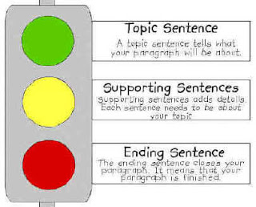
PARAGRAPHING
UNITY
UNITY
Cruthers (2021) suggests the following three uses of a topic sentence:
Informs the reader of the paragraph’s direction.
Guides the reader through the major points that support the writer’s purpose.
Places boundaries on the paragraph’s content.

Slide 28
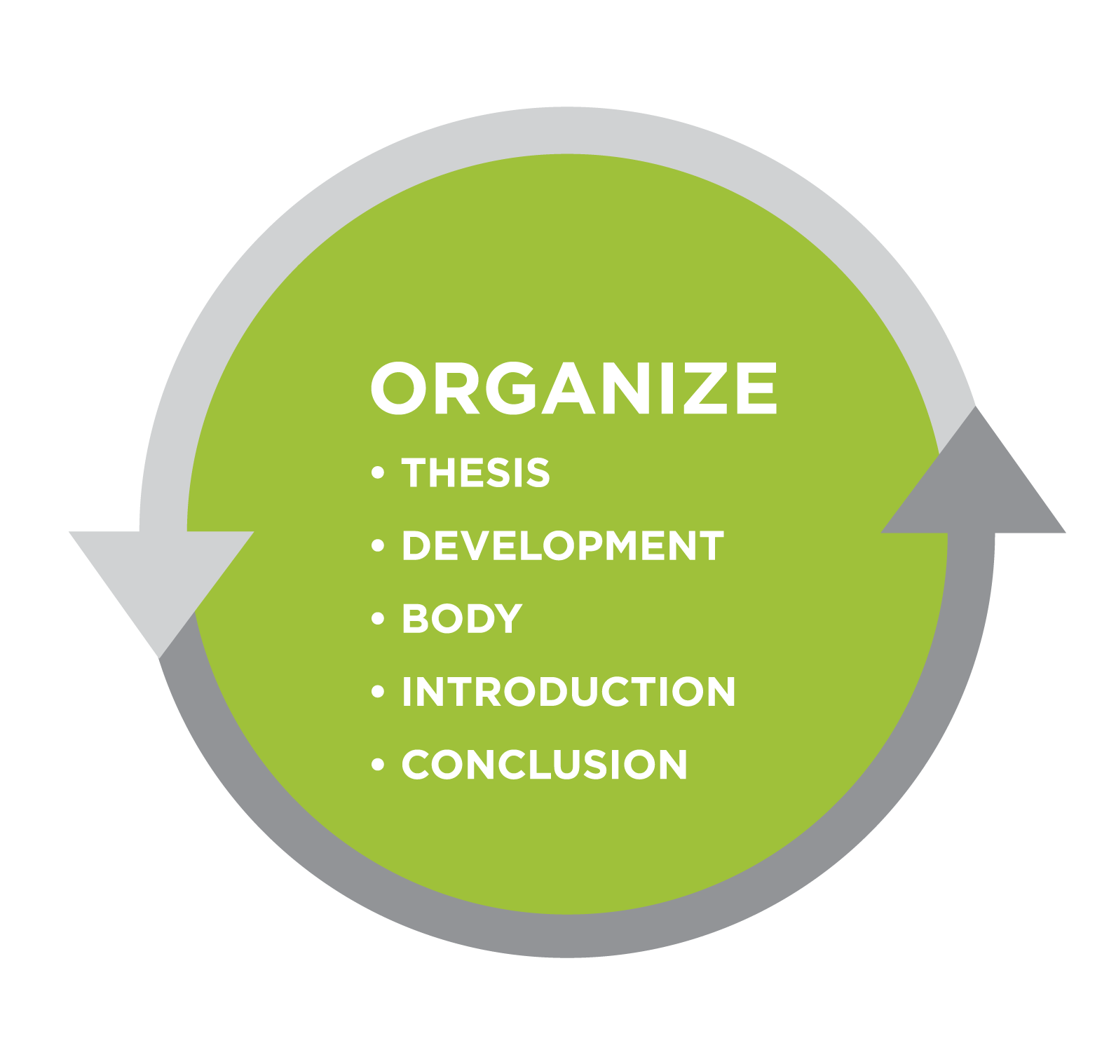
PARAGRAPHING
ORGANIZATION
ORGANIZATION
Business information is organized using direct or indirect paragraphs. In direct paragraphs, the topic sentence comes first, followed by the supporting sentences, while the opposite happens in indirect paragraphs where the supporting sentences come first. Most business writing (such as routine communication or positive messages) uses direct paragraphs. Negative news is best delivered by indirect paragraphs.

Slide 29
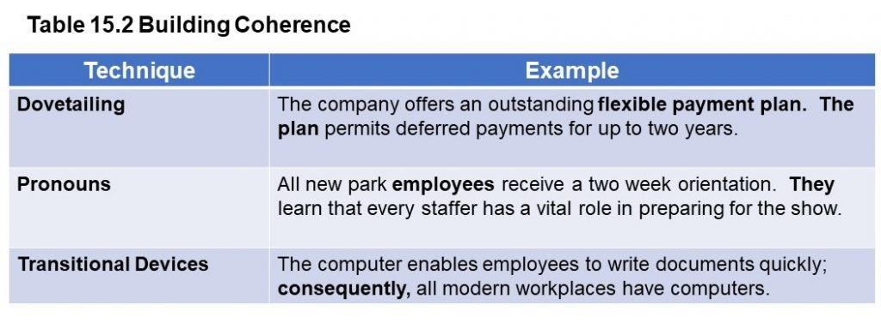
PARAGRAPHING
COHERENCE
COHERENCE
Coherence is the way you connect and link ideas in a paragraph so that the reader has an easier time. Incoherent paragraphs contain sentences that do not flow, confusing the reader. Smith (2019) offers these tips for writing coherent paragraphs:
Dovetailing: The topic that ends one sentence begins the next.
Pronouns: Combine pronouns with a noun to which each it refers.
Transitional devices: Use transitional words like additionally, in view of, however, next, further, consequently, etc.

Slide 30
PARAGRAPHING
Cruthers (2021) offers the following example of a paragraph that contains unity, coherence and organization:
This quarter, Instagram marketing was the top performer of our social media marketing plan. For every dollar we spent on Instagram marketing, we made $7.45. Overall, Instagram accounts for 57% of social-media-driven traffic to our website and 78% of all social-media-driven purchases. Much of this success is due to our Instagram influencer program. For every $1 in free product we give out, we make $23 in product sales. In May, we also hosted a unicorn-themed party for Instagram influencers in the Vancouver area to promote our Pastel Cloud Eye Paints, which led to our hashtag trending locally and a 167% increase in local product sales. We therefore recommend investing more heavily in Instagram next quarter in order to expand our influencer program.

Slide 31
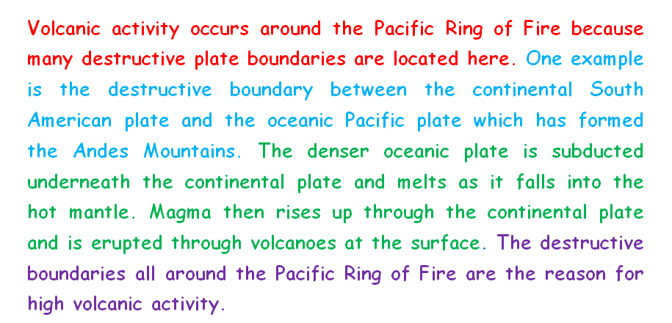
PARAGRAPHING
SAMPLE PARAGRAPH CONTINUED
SAMPLE PARAGRAPH CONTINUED
In the previous slide, the sentence highlighted in blue is the topic sentence, which is supported by the rest of the sentences without color. The author has organized his/her points from general to specific. The transitions are highlighted in bold, while the concluding sentence is highlighted in green.

Slide 32

SUMMARY
SUMMARY
SUMMARY
Today we have learned about outlining (writing the main points that you will later develop into a bigger piece); paraphrasing (using your own words to restate what the original source said); summarizing (reducing a piece of writing into main points using your own words); quotations (using someone’s words verbatim but using quotation marks); and paragraphing (putting your sentences into one unified, coherent, organized section of a writing). Every business writer ought to hone these five skills for effective business communication.

Slide 33

ACTIVITY & HOMEWORK
ACTIVITY & HOMEWORK
ACTIVITY & HOMEWORK
Read the contents of this page and attempt all the knowledge checks with your seatmate. For homework, watch the attached video and make notes. https://pressbooks.senecapolytechnic.ca/buscomm/chapter/sentences-and-paragraphs/

Slide 34
REFERENCES
Connor, P. (2011). Business Writing: An Introduction. Writing@CSU. Colorado
State University. https://writing.colostate.edu/guides/guide.cfm?guideid=70
Cruthers, A. (2021). Writing effective paragraphs. Business Writing for Everyone.
https://kpu.pressbooks.pub/businesswriting/chapter/writing-effective-paragraphs/
Lane, J. (2023). Quoting: When and how to use quotations.
https://www.lib.sfu.ca/about/branches-depts/slc/writing/sources/quoting
Mohammed Kheider University of Biskra (n.d.). Paraphrasing and summarizing.
https://univ-biskra.dz/sites/fll/images/benmedour/Lecture%205.%20Paraphrasing%20and%20summarising.pdf

Slide 35
REFERENCES
Smith, J. (2019). Sentences and Paragraphs. Communication@Work. https://pressbooks.senecapolytechnic.ca/buscomm/chapter/sentences-and-paragraphs/
University of Minnesota. (2015). Outlining. Business Writing for Success. https://pressbooks-dev.oer.hawaii.edu/cmchang/chapter/7-2-outlining/
University of Minnesota. (2015). Paraphrasing. Business Communication for
Success: Public Speaking Edition. https://opentext.ku.edu/businessspeaking/chapter/6-4-paraphrase-and-summary-versus-plagiarism/
Williams, V. & Sonja, N. (2022). Outlining. Fundamentals of Business Communication Revised. https://pressbooks.bccampus.ca/businesswritingessentials2/chapter/4-2-outlining/
Images: All the images are drawn from Creative Commons through Bing on PowerPoint

Slide 36


