Slide 1
WRITING FOR BUSINESS Lecture 8: Letters, Memos and Emails; CVs; Interviews
Lecturer: Dr. Anne Eboi

Slide 2

Introduction
Learning Objectives
Learning Objectives
By the end of this lesson, you should be able to:
a) Write a business letter, email and memo
b) Write a curriculum vitae
c) Describe job interviewing techniques

Slide 3
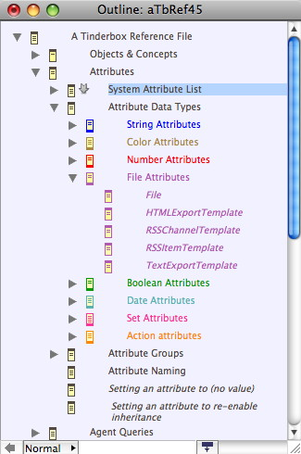
Introduction
Recap of Previous Lecture
Recap of Previous Lecture
An outline is very important to help organize your thoughts
Paraphrase to avoid plagiarism; change the structure and wordings and retain the actual meaning of the original source.
Summarizing means picking only the main points and rewriting the passage using your own words.

Slide 4

Introduction
Recap of Previous Lecture
Recap of Previous Lecture
Quotations are powerful sources of information, but must be attributed properly and quotation marks used.
Writing effective paragraphs involves writing the topic and supporting sentences which unify the paragraph and provides cohesion and organization.

Slide 5
Week 7 Homework
Writing Effective Paragraphs
Avoid vague topic sentences; Write clear ones
Make outlines for each paragraph to guide your writing
Effective writing requires that we make constant choices about what is important
Ensure all the supporting sentences are related to the topic sentence. These are signposts that will keep you focused
Revise to make it easier for the reader, save the reader’s time, yet preserve key points

Slide 6
Writing the Business Letter
One of the most commonly used company correspondences
Routine communication
Formal document in professional communication to convey information, express interest, make requests or provide a response
Business letter writing is an art to master for effective professional communication
Ensure clarity, conciseness and use a respectful, professional tone while maintaining an appropriate structure.

Slide 7
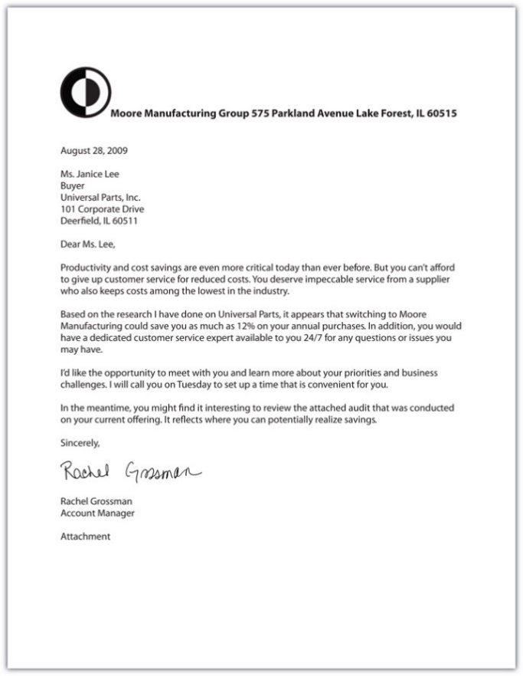
Writing the Business Letter
Why business letters are important
Business letters ensure we maintain professionalism
Business letters communicate the message clearly
Business letters serve as a record of communication; useful as a reference for future discussions.

Slide 8
Types of Business Letters
Letter of inquiry
It is a courteous request for information or can be used to ask questions. When writing this letter, state your purpose for writing, then provide a statement of what you want to know (a list of questions). You can also politely request that the information be availed by a given date.
Complaint letter
This letter expresses dissatisfaction with a given service or product. When writing the letter: refer to the order, its date and number; clearly describe the deficiency or error; clearly explain the inconvenience or loss incurred and the action that should be taken to remedy the situation; and request for an investigation or adjustment.

Slide 9

Types of Business Letters
Recommendation letter
Recommendation letter
This letter is written to vouch for an applicant’s educational or professional performance for a job, admission to college or a scholarship. It offers insight into a person’s qualities and experiences. When writing a recommendation letter, state the position being recommended; give the applicant’s positive attributes; assure the recipient that the applicant will not disappoint them if given the opportunity; and offer a concluding remark.

Slide 10
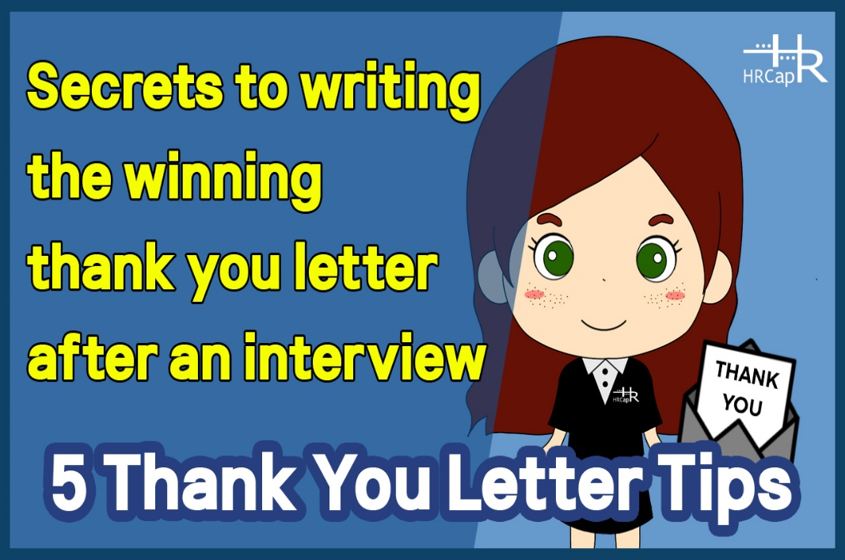
Types of Business Letters
Letter of appreciation
Letter of Appreciation
This is a thank you letter written by one party to another to show appreciation or gratitude. When writing the appreciation letter, indicate the benefits derived from the good deeds; urge the receiver to continue in that spirit; and conclude your letter.

Slide 11
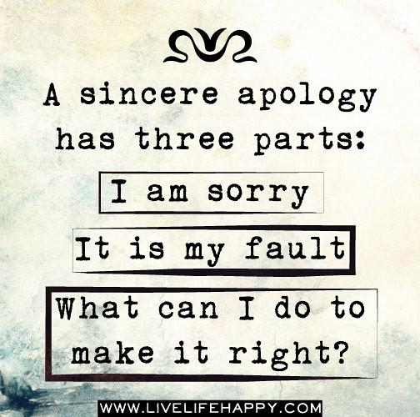
Types of Business Letters
Letter of apology
Letter of apology
“An apology letter is a written acknowledgment of how the writer's behavior or words adversely affected another person or group. It can be used to make amends in both personal and workplace situations for a mistake” (Calonia, 2022). When writing this letter, immediately accept the wrong done; commit not to allow a repeat; and state how you will remedy the situation to avoid a repeat.

Slide 12
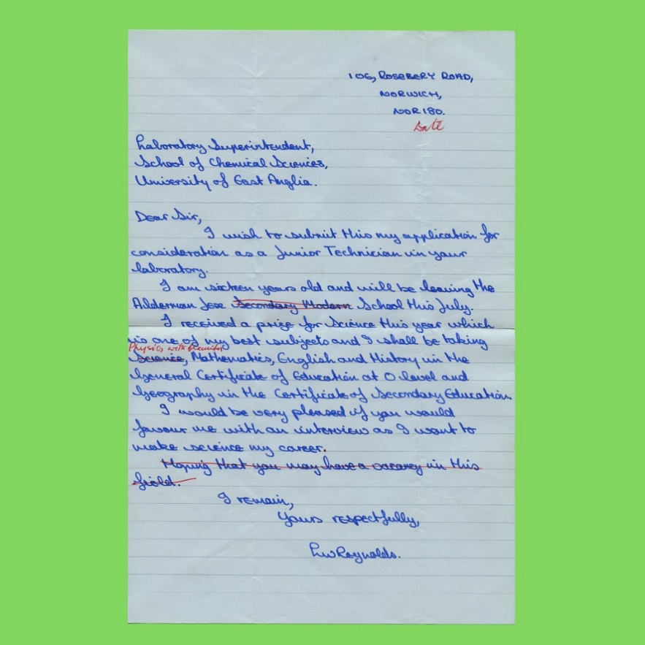
Types of Business Letters
Application letter
Application letter
It accompanies a curriculum vitae or resume for a job application. When writing this letter, state how you found out about the position; why particularly you are interested in the position; and how your specific qualifications meet the organization’s needs. The qualifications include your education, training, skills and work-related experiences.
Other types of letters include a resignation letter which formally announces and expresses the desire to terminate employment, a sales letter whose aim is to promote products or services to customers, and many others.

Slide 13
Structure of a Business Letter
A standard business letter typically follows the following format:
Sender’s information such as name, address, phone number and email address
Date- when the letter was sent
Recipient’s information
Salutation- the professional beginning with a greeting using the recipient’s last name. For example, “Dear Mr. Kamau.” You can use “Dear Sir/Madam’ if you do not know the recipient’s name or are not sure of the gender or marital status.

Slide 14
Structure of a Business Letter
Body of the letter-divided into introduction (self-introduction or purpose statement), main content (details) and closing (summary of expected action or expression of gratitude)
Closing-signing off using polite language such as ‘Best regards.”
Signature-this can be a physical signature if it is a physical letter or digital signature (or typing your name) if it is a digital letter.
Remember to use a professional font (recommended Serif fonts like Times New Romans, Cambria, Arial, Garamond, etc), font size (11 or 12), spacing (single spacing for paragraphing and a space between paragraphs), left align (block style) and a respectful, formal tone throughout the letter.

Slide 15
Sample Letter of Inquiry
Sample letter of inquiry
Sample inquiry letter
Anne Eboi
39th Street Athi River
Nairobi
Phone: +254-20-456-7891
Email: anneboi@email.com
October 30, 2024
Mr. Hezekiah Owilo
Sales Manager
Mapinduzi Corporation
42nd Street Muthangari Drive
Nairobi
Dear Mr. Owilo,
I am writing to inquire about the new video conferencing facility introduced by Simulizi Corporation. We wish to update our video conferencing capabilities and would like more information on the pricing, possible discounts for a non-profit institution like ours and whether you offer free training on using the new software.
I would appreciate receiving a response at your earliest convenience. Thank you for your time and assistance.
Sincerely,
Anne Eboi

Slide 16
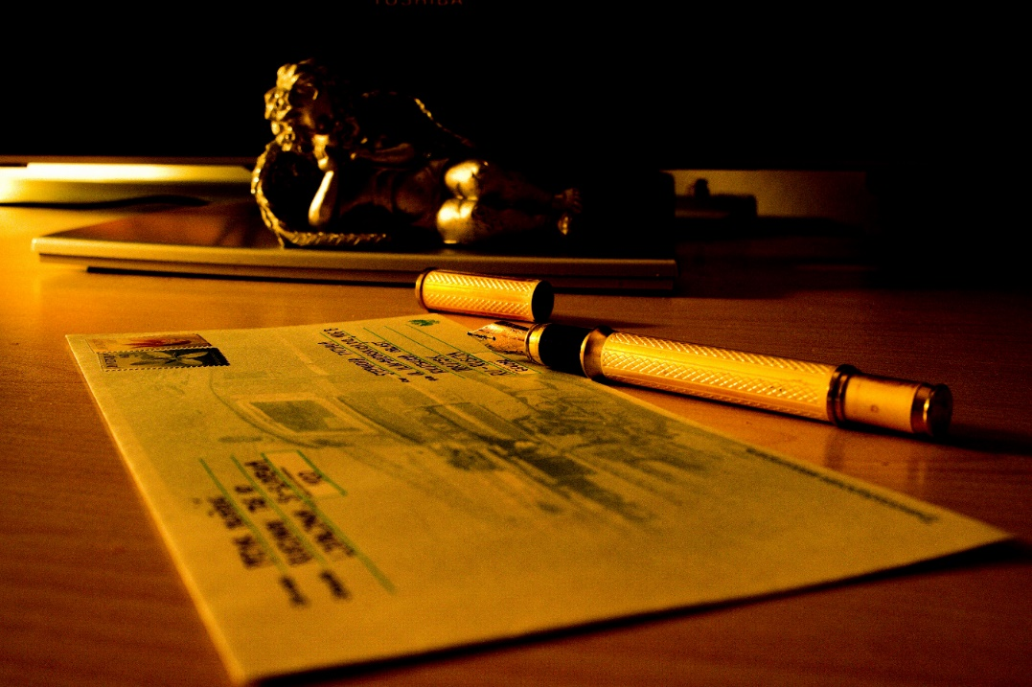
Business Letters
Concluding remarks
Concluding remarks
Finally, avoid using an incorrect, unprofessional tone such as being too aggressive or too casual in your business letter because this can harm your professional image. Secondly, avoid lengthy, unclear content by getting straight to the point. Always thoroughly edit and proofread your letter before dispatching it. Lastly, ensure that all relevant details are included in your letter.

Slide 17
Memos
Used within an organization for routine communication of procedures, policies and other related official communication.
Provide updates or information on an action or event
Written from a one-to-all perspective like in mass communication (Williams, 2020).
Involve multiple audiences hence careful writing required. For example, policies may contain legalese language yet memos are expected to be read and understood by employees across all educational divides.
Take the direct and indirect approaches as previously discussed.

Slide 18

When to Write a Memo
Memos
Memos
Announcement of new policies or amendments
Offer instructions
Announcements
Procedures
Trip and some informal reports

Slide 19
Style and Tone of a Memo
Consistent with business writing, memos require a formal, professional tone. However, most memos are written in a conversational style (a little informal but professional). Note that policy and report memos can acquire a more formal tone. Williams (2020) opines that since the audience is internal, the writing style assumes a relationship (professional though) with the audience. He advises that we maintain an appropriate tone since the audience is heterogeneous even though it is localized.

Slide 20
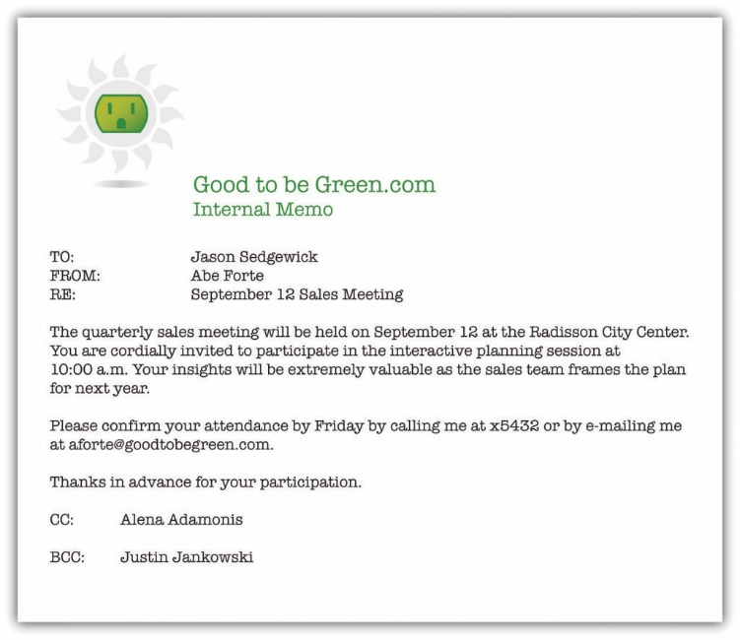
Writing Effective Memos
Memos
Memos
Consider audience needs- the goal is to ensure everyone in the target audience understands your communication
Always use a professional tone
The subject should be declared and emphasized

Slide 21
Structure of a Memo
Date- when the memo is distributed
To- name of the memo’s recipients
From-name and job title of the author
Subject line- main idea summarized
Introductory paragraph- reason for writing, background information, etc.
Body-supporting details for reason stated above
Closing- a closing thought, any required action or summary

Slide 22
Sample Memo- Baker (2020)
Sample memo
Sample memo
To: All Employees
From: Larry Ogawa, President, University of State
Date: February 14, 2009
Subject: Future Expenditure Guidelines
After careful deliberation, I have determined it is necessary to begin the initial steps of a financial stewardship program that carries UState through what appears to be a two-year cycle of a severe state shortfall in revenue and subsequent necessary legislative budget reductions.
Beginning February 9, 2009, the following actions are being implemented for the General Fund, Auxiliary Fund, and Capital Fund in order to address the projected reductions in our state aid for the remainder of this year 2008–09 and for next year 2009–10.
1. Only purchases needed to operate the university should be made so that we can begin saving to reduce the impact of 2009–10 budget reductions.
2. Requests for out-of-state travel will require approval from the Executive Committee to ensure that only necessary institutional travel occurs.
3. Purchases, including in-state travel and budget transfers, will require the appropriate vice president’s approval.
Please understand that we are taking these prudent steps to create savings that will allow UState to reduce the impact of projected cuts in expected 2009–10 legislative reductions.
Thank you for your cooperation, and please direct any questions to my office.

Slide 23
Emails
Also known as electronic mail, email is a form of written communication distributed virtually to internal or external stakeholders. It has replaced hard copy letters and printed memos and is used for fairly brief messages. Email is considered formal communication even when it appears informal in personal contexts. Baker (2020) advises that emails should reflect professionalism even when they are used for internal communication; we should never write what we wouldn’t want read in public or in front of the company president. However, like every business writing, it must be professionally written to reflect the company’s values. Your company can automate emails to acknowledge public communication or as reminders, for example, of upcoming deadlines on payment, etc. Some organizations use a standard template with standard paragraphs which employees populate from a bank of sentences.

Slide 24
Tips for Effective Business Emails
Salutations should demonstrate respect and professionalism. For example, using ‘Dear’ for external communication and ‘Hi’ for internal communication.
Clear, brief and specific subject lines
Brevity is king
Create a signature block that automatically has your name and business contact information
No abbreviations like YOLO (you only live once)
Prompt responses. Nevertheless, never answer provocative emails emotionally- give it some time.
Format and structure your email appropriately, e.g. paragraph breaks, writing brief paragraphs, etc.
Avoid unnecessarily replying to all- do not reply to all the original recipients unless your reply concerns all

Slide 25
Tips for Effective Business Emails
Test a link before including it in the email
Use capital letters appropriately and sparingly. Using all caps is perceived as shouting and rudeness on the internet
If you are attaching large files, alert the recipient first to avoid triggering the spam folder or exceeding the recipient’s limit
Revise, review, edit, proofread. There is no room for poorly written business communications
Follow up/provide feedback. Endeavor to respond to every email even as you send a follow-up after 24 hours in case your message went to the recipient’s spam folder.

Slide 26
Sample Emails
Email
Email
Kindly note that the last date to submit your individual and group entry designs to the Head of Design for the competition is October 30, 2024. The Design Committee headed by the Head of Design will sit on November 1, 2024 to evaluate and select the three best designs to represent Kwetu Designs. The Committee is expected to announce the three winners to represent the company on November 2, 2024.
Feel free to contact me or the Head of Design in case of any question. We encourage you to expedite on this matter.
Regards,
Emma Awinja
CEO, Kwetu Designs
Phone: +254-20-252-2340
To: All employees
From: emma.awinja@kwetudesigns.org
Subject: Reminder about Upcoming Design Competition
Dear Team,
I hope this email finds you well. I am writing to remind you about the upcoming design competition in which we are participating. The competition is scheduled for December 30, 2024.

Slide 27
Curriculum Vitae
A curriculum vitae (CV) is a comprehensive, concise document that summarizes your educational background, experience, proficiency, professional skills and other relevant information. This document helps you to sell your skills, talents and proficiencies and is useful when applying for jobs. A CV can run into several pages. Its presentation should reflect your focus. Note also that the CVs style varies from discipline to discipline.
Apart from job applications, CVs can be used in consulting, grant application, fellowships, leadership, publishing, etc.

Slide 28
Tips for Writing Effective CVs
Akwaboah (n.d) suggests the following tips for writing effective CVs:
Avoid grammatical mistakes
Place your most compelling information at the top
Ensure a neat presentation
Be honest
Format your CV properly
Include career objectives to let the employer know what you are about
Tailor your CV to the current job you are applying for

Slide 29
Tips for Writing Effective CVs
Garcia (2014) also offers the following tips:
The CV must be well-formatted which includes:
A well-organized, easy to read CV
A list of all relevant items in reverse chronological order per section
Use of bold, italic, underline and capitalization to draw attention
The most important information strategically placed near the top or left area of a page
A footer with page numbers and your last name in case pages are separated

Slide 30
Sections in a CV (Courtesy of the University of Illinois)
The suggested sections are mainly applicable to academia. You are free to tailor your CV according to your profession or discipline.
Heading: Name, email address, mailing address (only one) and phone number
Education: List of academic degrees, with in progress or most recently earned placed first. Also include the name of the institution, city, degree type, major and minor, month and year degree will be or was awarded
Relevant experience: List positions that show off your skills and expertise. You can group experiences into relevant categories to enhance your CV (e.g. Research, Teaching and Administration). For each position, include: title, organization name, city and state, dates position was held; and bullet points that summarize your activities/duties, accomplishments and successes. Use action verbs.

Slide 31
Sections in a CV (Courtesy of the University of Illinois)
Publications: Give bibliographic citations for articles, pamphlets, chapters in books, research reports, or any other publication that you have authored or co-authored. Use the format appropriate to your particular academic discipline for a clean look.
Presentations (Oral and poster): Give titles of professional presentations, name of conference or event, dates and location, and a brief description.
Honors and awards: Receipt of competitive scholarships, fellowships and assistantships; names of scholastic honors; or any other awards.
References: Three to five are appropriate. If you are responding to an advertisement that asks for references, include those requested on a separate addendum sheet.

Slide 32
Interviewing for Employment and the Interview Process
An interview is a formal meeting between a prospective employee and a business representative or representatives. In many cases, you either meet with one person who will interview you (ask questions/have a conversation) or it can be a panel. The panel will often consist of a human resource person, a supervisor in your department, owner of the company or any other relevant individual.
The purpose of an interview is to assess whether you are the right fit for the job. The interviewer wants to know whether you can make meaningful contributions to the company.

Slide 33
Sections in a CV (Courtesy of the University of Illinois)
The University of Minnesota (2016), identifies the following types of interviews:
Traditional interview
Telephone interview
Panel interview
Information interviews
Meal interviews
Group interviews
Video interviews
Nondirective interviews

Slide 34

Sections in a CV (Courtesy of the University of Illinois)
Principles of interviewing
Principles of interviewing
Princeton University suggests the following three principles of interviewing that you must always bear in mind:
Preparation is key
No matter the specific questions they ask, interviewers are looking for the same general things
The most successful interview candidates are skilled communicators

Slide 35
Interview Process
Princeton University also suggests the following interview process for interviewees:
Before: Preparation time where you generate a likely list of interview questions with answers and study them; self-identify in case you have challenges like hearing impairment; plan to pay for travel expenses; prepare a list of questions to ask the interviewer
During: Ask if you can take notes; ask thoughtful questions to show you are listening; and listen carefully to the questions and respond appropriately. Get to know: how to get back to the interviewer, the next step in the recruiting process and the anticipated time frame before the next step
After: Send tailored thank you notes to your interviewers but take care not to sound like a pest

Slide 36
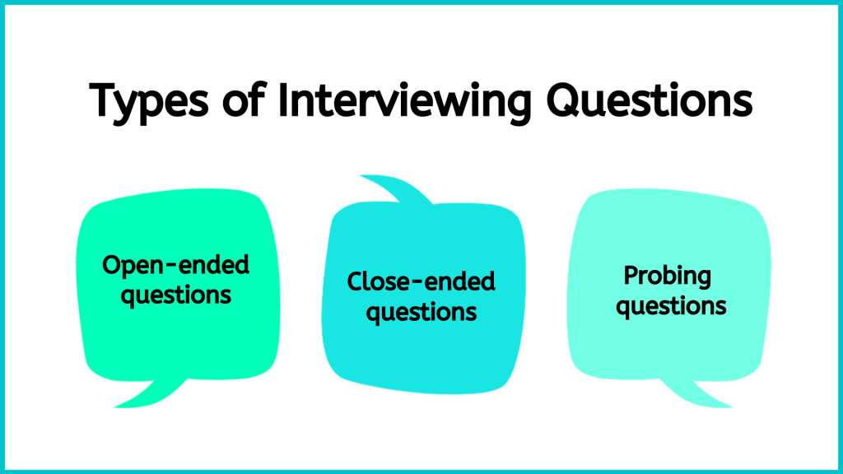
Types of Interview Questions
Interviews
Interviews
Types of interview questions include:
CV-based questions
Situational or behavioral
Case study
Brain teaser

Slide 37
Summary
Letters, memos and emails are used for routine communication at the office and every business writer should master the art of writing them. Things to consider for effective writing of these forms of correspondence include the correct tone, appropriate content, effective paragraphing, an acceptable format and so on. We also learned that a CV is an important document that summarizes your education, experiences and professional qualifications, and if well-written, is your selling point when job-hunting. Once your CV has passed the test and got you into an interview, you must now conduct yourself appropriately in the interview room to get that job.

Slide 38
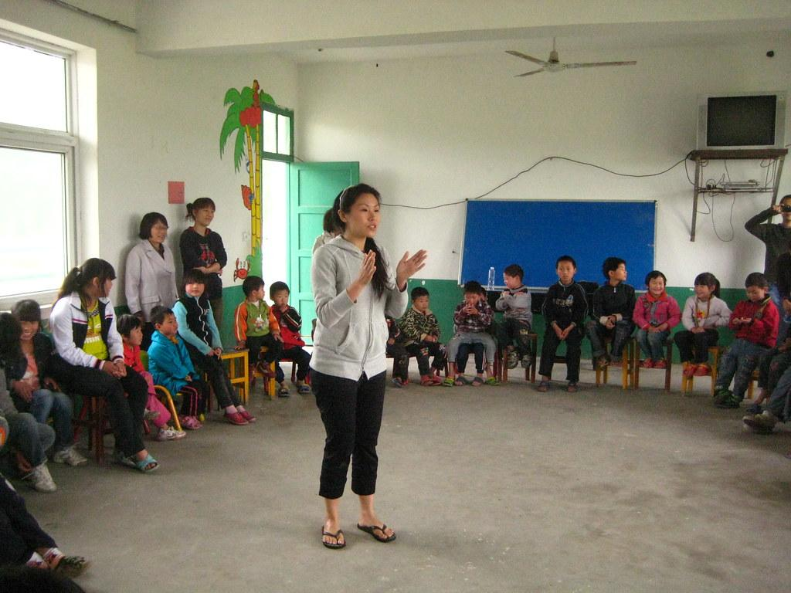
Activity and Homework
Activity & Homework
Activity & Homework
Activity
You are going to write your CV however basic it may seem.
Homework
Read all the resources mentioned in the reference list for more details, examples and activities concerning what we have learned.

Slide 39
References
Akwaboah, Y. (n.d.). A lecture on how to write a CV and a cover letter. https://www.academia.edu/15368235/A_lecture_on_how_to_write_a_CV_and_a_Cover_Letter
Baker, S. (2020). Emails, memos and letters. Professional and Technical Writing.https://pressbooks.nscc.ca/profcommunication/chapter/chapter-4/
Calonia, J. (2022). How to write an apology letter. Grammarly.https://www.grammarly.com/blog/writing-tips/apology-letter/#:~:text=The%20purpose%20of%20an%20apology,the%20recipient's%20experience%20and%20feelings.
Garcia, J. (2014). Curriculum vitae: Tips and samples. University of Illinois.https://grad.illinois.edu/sites/default/files/pdfs/cvsamples.pdf
Princeton University. (n.d.). Interview Guide. Center for Career Development.https://careerdevelopment.princeton.edu/sites/g/files/toruqf1041/files/media/interview_guide_5.pdf
University of Minnesota. (2016). Interviewing. Human Resource Management.https://open.lib.umn.edu/humanresourcemanagement/chapter/5-3-interviewing/
Williams, V. (2020). Emails, memos and letters. Fundamentals of Business Communication.https://pressbooks.bccampus.ca/businesswritingessentials/chapter/chapter-7-2/
Images: All images are drawn from Creative Commons through Bing on PowerPoint

