Slide 1
WRITING FOR BUSINESS
Lecture 9
New Media Tools; Business Research Methods; Computer Tools for Gathering Information
Lecturer: Dr. Anne Eboi

Slide 2

INTRODUCTION
Learning Objectives
Learning Objectives
By the end of this lesson, you should be able to:
Use new media tools in writing for business effectively
Conduct research in business
Use computer tools for gathering information

Slide 3
INTRODUCTION
Recap of previous lecture
Recap of previous lecture
Letters, memos and emails are used for routine communication at the workplace.
A business letter is a formal document used in professional communication to convey information, express interest, make requests or provide a response.
A memo (memorandum) is a document used within an organization for routine communication of procedures, policies and other related official communication.
Meanwhile, an email is a form of written communication for conveying brief company messages and is distributed virtually both internally and externally.
A curriculum vitae (CV) is a comprehensive, concise document that summarizes your educational background, experience, proficiency, professional skills and other relevant information.
Learn about interview techniques to ace the job interview

Slide 4
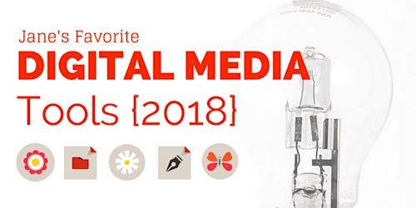
  NEW MEDIA TOOLS FOR BUSINESS NEW MEDIA TOOLS FOR BUSINESS WRITING
New media tools
New media tools
New media tools offer you an opportunity to craft compelling content that is more efficient and impactful.
Tools that you can use in writing for business include content creation, error-checking and editing; collaboration; project management and workflow; social media management; email marketing and communication; and analytics and SEO tools.

Slide 5
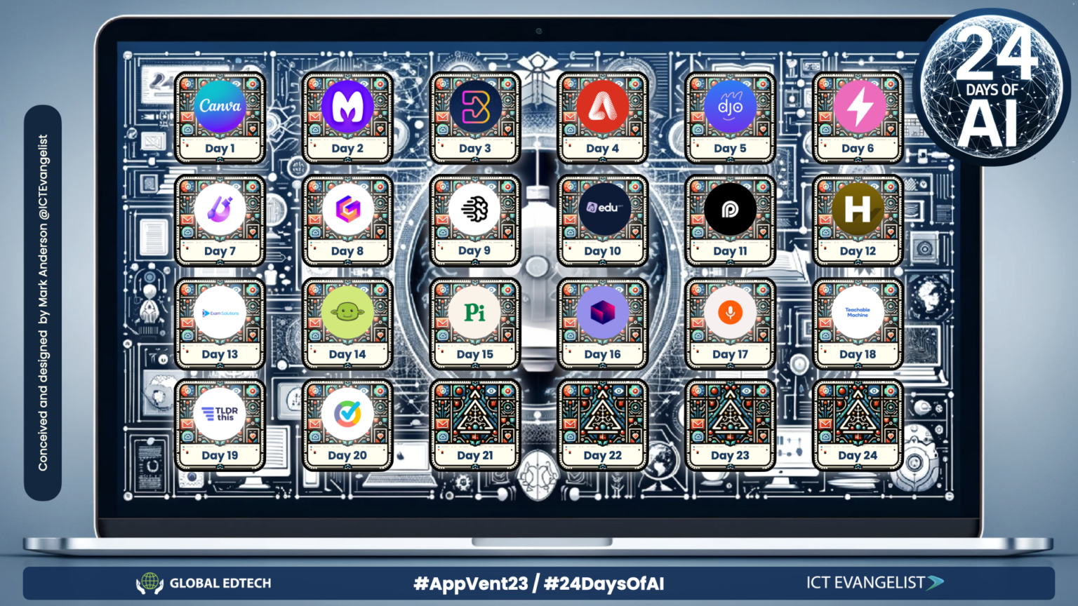
NEW MEDIA TOOLS FOR BUSINESS NEW MEDIA TOOLS FOR BUSINESS WRITING
Content creation, error- checking and editing tools
Content creation, error- checking and editing tools
Content creation tools are useful for writing content quickly and efficiently. These AI tools are a game-changer in that they have made content creation easier and less costly in terms of time. Some popular tools include:

Slide 6
NEW MEDIA TOOLS FOR BUSINESS NEW MEDIA TOOLS FOR BUSINESS WRITING
ChatGPT
University of Central Arkansas (2024) describes Chat GPT as “an artificial intelligence program that generates dialogue.” This tool uses “machine learning algorithms to process and analyze large amounts of data to generate responses to user inquiries.” It is a language processing program that can understand human language and respond as requested. Users feed it with prompts and it will respond exactly as the user has requested. For example:
“Write brief notes on how businesses can engage with their audiences online.” Once it has generated this content but it is not to your satisfaction, you can give it further prompts, such as, “Can you now focus only on X (formerly Twitter) and explain how a non-profit can use it to engage with audiences?”

Slide 7
NEW MEDIA TOOLS FOR BUSINESS WRITING
The University of Central Arkansas (2024) elaborates that chat GPT can be conversational, generate stories, essays, poems, answer questions, solve math equations, translate between languages, debug and fix code, and classify things. However, I say that ChatGPT is not the ultimate and neither is it superior to the human brain. It has ever generated incorrect information for me and had I not been hawk-eyed, I would have submitted a wrong response. The University notes that the chatbot may fail to understand a topic since its answers are based on data limited to before 2020.
While ChatGPT is a huge advancement in technology, it poses serious concerns and challenges for learning. The University of Central Arkansas (2024) reports that ChatGPT use appears to be the newest wave of academic dishonesty, and is quickly turning into a tsunami. There are technologies such as GPTZero that can detect plagiarism, but the greater concern is that students are not engaging in the writing process, thus missing out on opportunities for research, critical thinking and ownership. My advice is that ChatGPT is great for idea generation, but is not your ultimate thinker and writer. You are the writer and should only view AI as a tool to assist you.

Slide 8
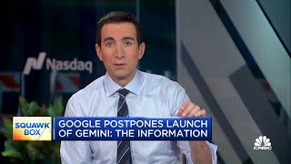
NEW MEDIA TOOLS FOR BUSINESS WRITING
Gemini
Gemini
Formerly known as Bard, Gemini is a generative AI chatbot developed by Google. Just like ChatGPT, it is a language model that operates in much the same way.

Slide 9
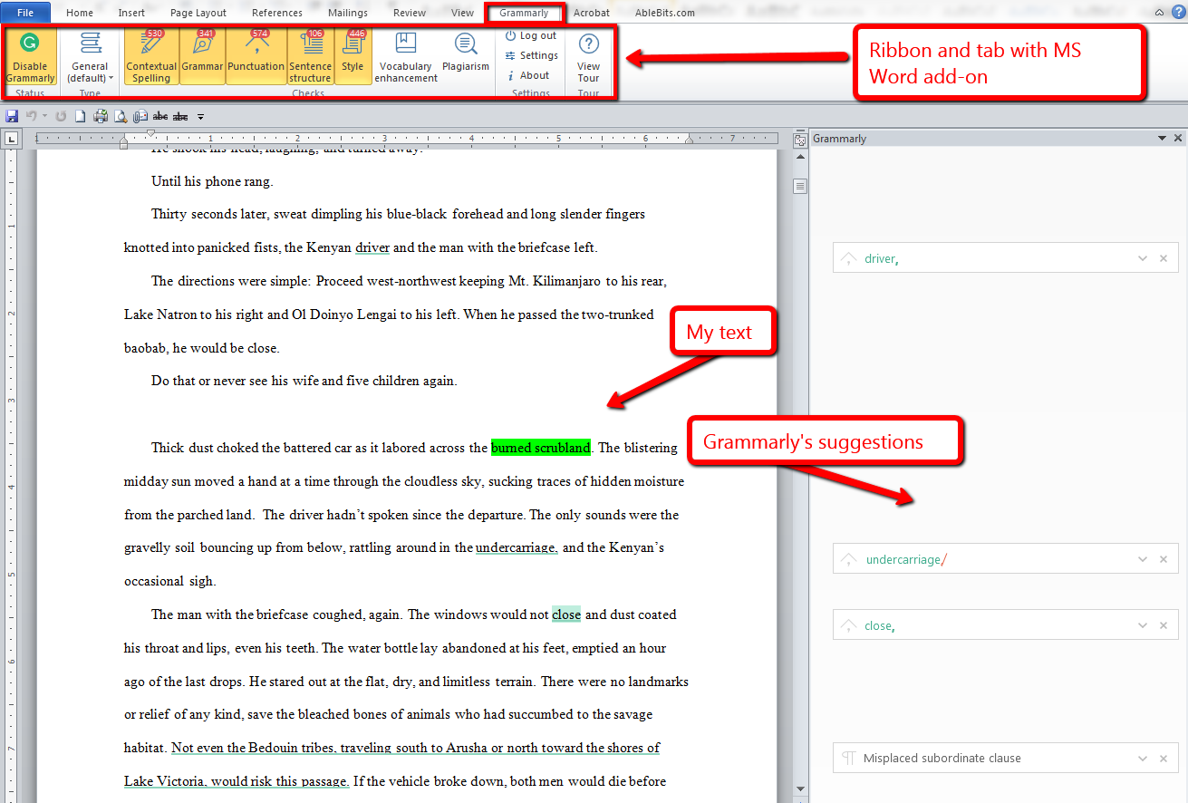
NEW MEDIA TOOLS FOR BUSINESS NEW MEDIA TOOLS FOR BUSINESS WRITING
Grammarly
Grammarly
A cloud-based typing assistant operating in real-time to check grammar, spelling, punctuation, and other things like sentence construction, tone, clarity, style, engagement, among others. The platform also suggests replacements once it has identified the errors.

Slide 10
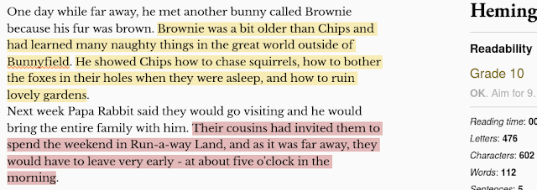
NENW MEDIA TOOLS FOR BUSINESS NEW MEDIA TOOLS FOR BUSINESS WRITING
Hemmingway Editor
Hemmingway Editor
An app that mainly focuses on correcting complex sentences and common errors by highlighting them using different color schemes. It aims to simplify dense, complicated and convoluted sentences to help the reader not get lost.

Slide 11
NEW MEDIA TOOLS FOR BUSINESS WRITING
QuillBot
Other new media tools
QuillBot is an eight-in-one tool that helps with paraphrasing and summarizing as well as checking for grammar, plagiarism and AI use. It can also generate citations, translate and help with the flow of a document.
Other useful tools for content generation and which I want you to explore include video creating sites like Capcut, Wistia and Vimeo. You can create great graphics using Canva, DesignWizard, Lunacy, Blender, Google Slides, and yes, even our good old PowerPoint can help you create professional slides for your business engagement.

Slide 12
NEW MEDIA TOOLS FOR BUSINESS WRITING
Business writers can leverage on collaboration tools for teams to create, edit and manage documents together in real time. They include:
Google Docs where multiple users can simultaneously co-create a document as well as edit and leave comments. You can use Google Docs to write reports, proposals, manuals, programs, and many more.
Slack. This tool offers instant messaging, file transfers, message search capability, and a modern interface for managing channels and direct messages.
Microsoft Teams. It provides a comprehensive collaboration experience where users can engage in chats, file sharing and video meetings.
There are many other video conferencing tools you can use for collaboration. These include Zoom, Google Meet, the Big Blue Button, Class for Teams, Webex, and many more.

Slide 13
NEW MEDIA TOOLS FOR BUSINESS WRITING
Business writers can remain organized and keep track of their projects, deadlines and tasks through project management and workflow tools. Examples include Asana, Trello, Monday.com.
Social media management tools
These tools assist businesses to engage with their audiences on social media platforms. They help to manage, schedule and analyze written content. Examples include Buffer, Hootsuite and Canva (despite being essentially a design tool).
In summary, there are many more tools that I suggest you explore online. These include email marketing and communication tools such as Mailchimp, Constant Contact, HubSpot, and so on. You can also look at Analytics and SEO tools that help to measure how effective your written content is as well as deliver your messages to a wider target audience. Examples include Google Analytics, Semrush, and Yoast SEO. You can also explore more social media tools that can assist with engagement such as WordPress for blogging and Wikis.

Slide 14
BUSINESS RESEARCH
University of Calcutta (2020) defines business research as “research activities carried out relating to the different functionaries in the business and corporate world. Business research is a process of acquiring detailed information of all the areas of business and using such information in maximizing the sales and profit of the business.” Companies can then decide on the most profitable products or services to retain or improve.
Bhat (n.d.) refers to business research as business intelligence where companies determine whether they can excel in new regions or even when to choose a marketing approach for a product/service. The author also opines that business research can help businesses understand their competitors.

Slide 15
BUSINESS RESEARCH
Why is business research important?
The University of Calcutta (2020) proposes the following reasons for conducting research in general:
To gain familiarity with a phenomenon or to achieve new insights into it. (exploratory or formulative research studies)
To describe accurately the characteristics of a particular individual, situation or a group. (descriptive research)
To determine the frequency with which something occurs or with which it is associated with something else. (diagnostic research)
To test a hypothesis of a causal relationship between variables. (hypothesis testing research)
Business research helps companies to maximize on profit, cut costs, establish consumer behavior, establish best marketing strategies, ensure sound financial and personnel management, etc.

Slide 16
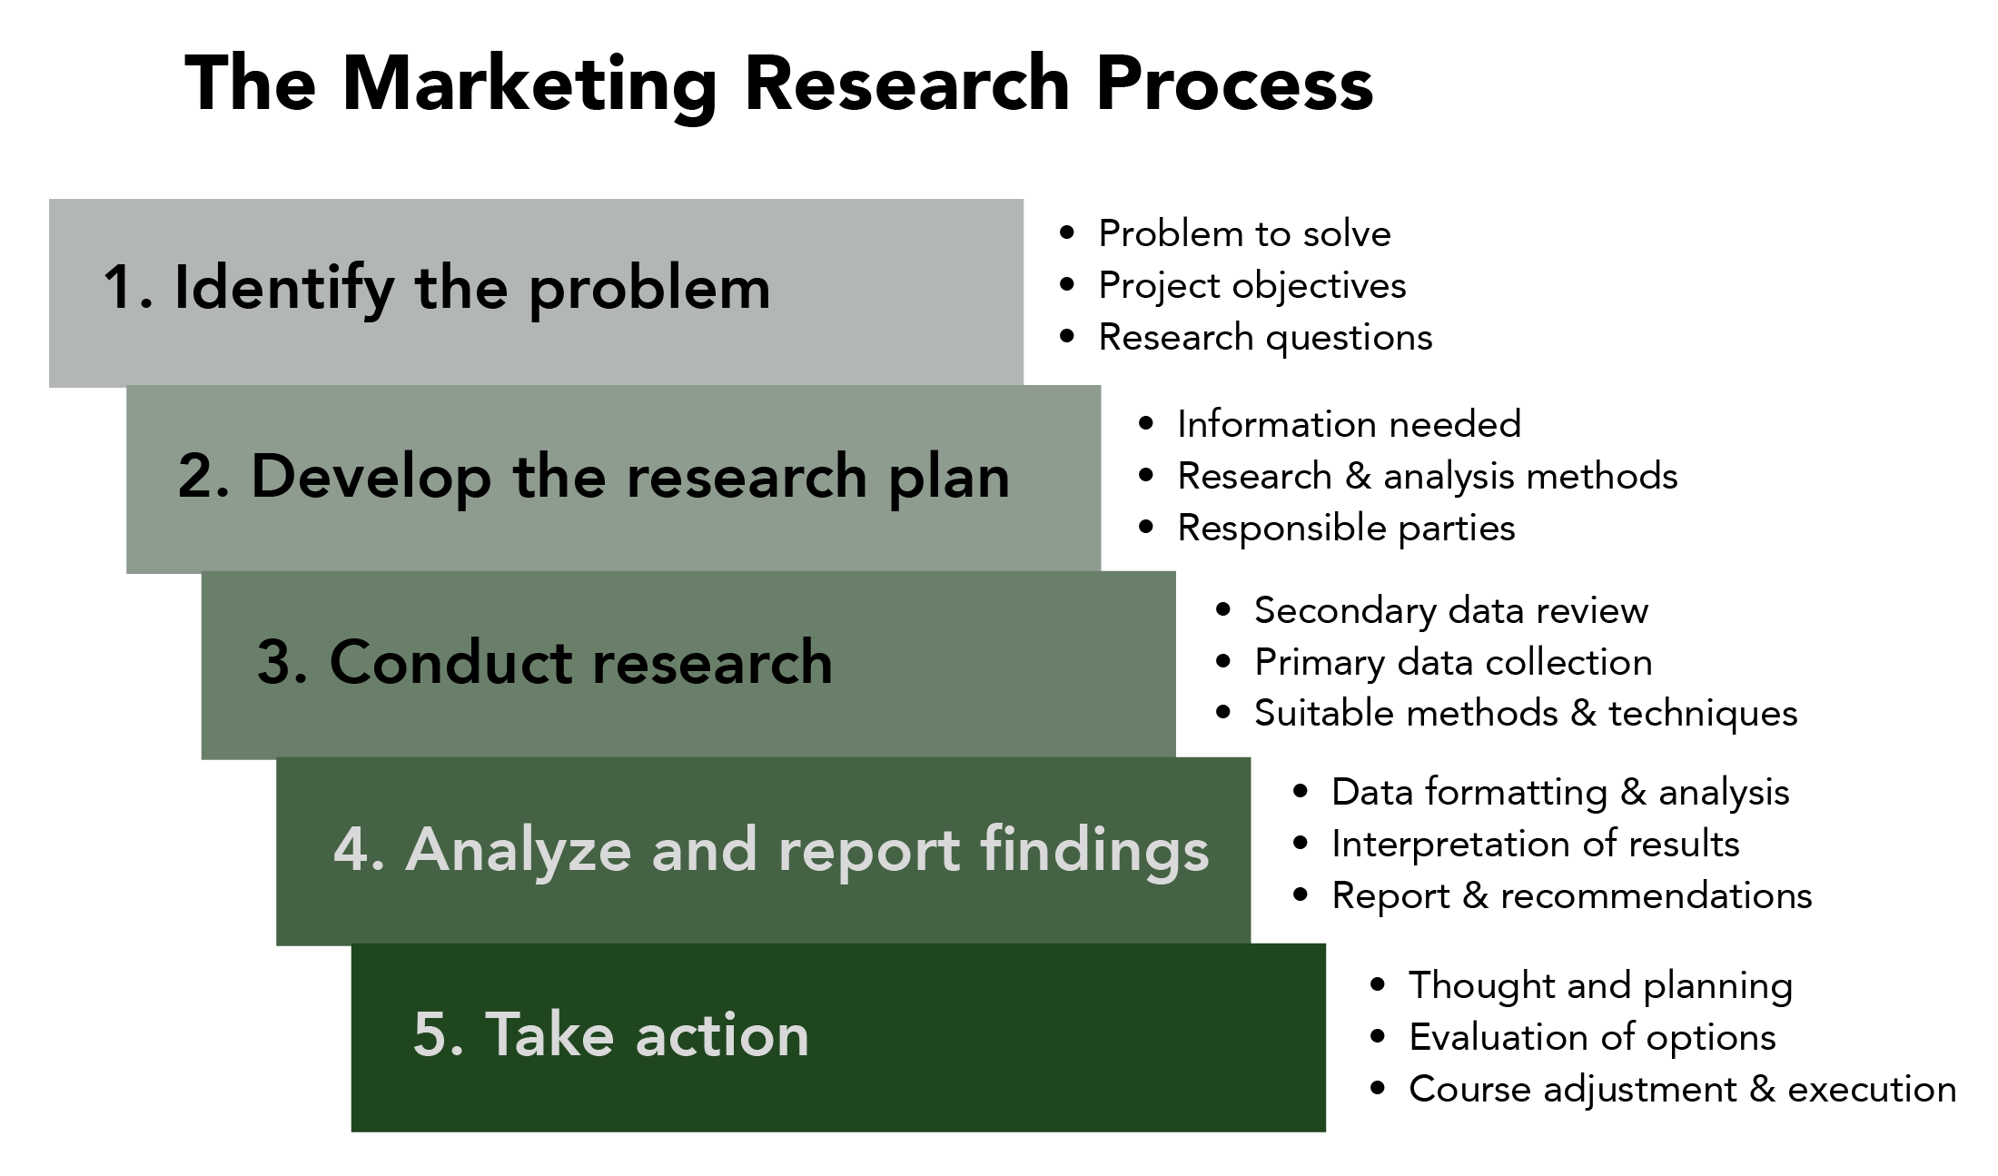
BUSINESS RESEARCH
Business research process
Business research process
Determine purpose
Write the objectives (SMART)
Do a literature review/survey
Include the method
Collect, analyze and interpret the data
Write the report and implement

Slide 17
BUSINESS RESEARCH
Qualities of good business research
Qualities of good business research
The University of Calcutta (2020) suggests the following qualities of good research:
Purpose clearly defined
Research process detailed
Research design thoroughly planned
High ethical standards applied
Limitations frankly revealed
Adequate analysis for decision-makers’ needs
Findings presented unambiguously
Conclusions justified
Researcher’s experience reflected

Slide 18
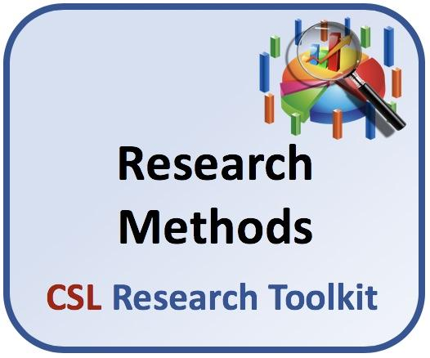
BUSINESS RESEARCH
Research methodologies
Research methodologies
Generally, we talk of three methodologies: Quantitative, qualitative and mixed methods. The following notes have been inspired by Khan (n.d.).

Slide 19
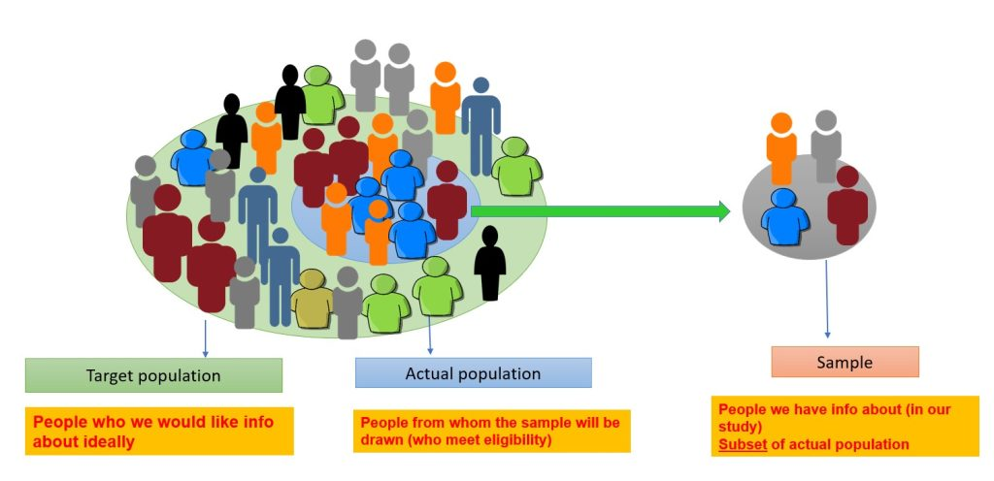
BUSINESS RESEARCH
Quantitative research methodologies
Quantitative research methodologies
It is a systematic, empirical process by which numerical data is collected and analyzed to describe, explain, predict or control given variables and with the intention to generalize across groups of people. The approach uses statistical, mathematical or computational techniques such as the Statistical Package for the Social Sciences (SPSS) to analyze data. The research designs used in business research include:

Slide 20

BUSINESS RESEARCH
Survey research
Survey research
Survey research involves the use of a questionnaire, online poll, online survey and others to obtain opinions, attitudes and views of audiences. Types of surveys include cross-sectional surveys (data is collected at a given point in time) and longitudinal surveys (data is collected over a long period of time to understand changes in respondent behavior). An example of survey research includes an organization that creates a poll on its website or social media site to gauge its customers’ opinions of a recent product released into the market.

Slide 21
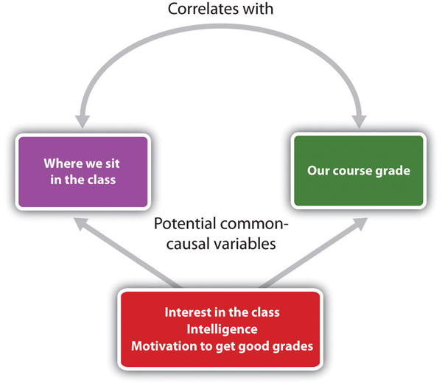
BUSINESS RESEARCH
Correlational research
Correlational research
You conduct correlational research when you want to establish the relationship between two variables and how they impact each other. The results will help you understand trends, patterns and relationships. For instance, you may want to understand the relationship between products and gender. From a casual observation, you notice that one product is particularly liked by a specific gender. Based on the results, the company can use the information to improve the product to attract the other gender as well.

Slide 22
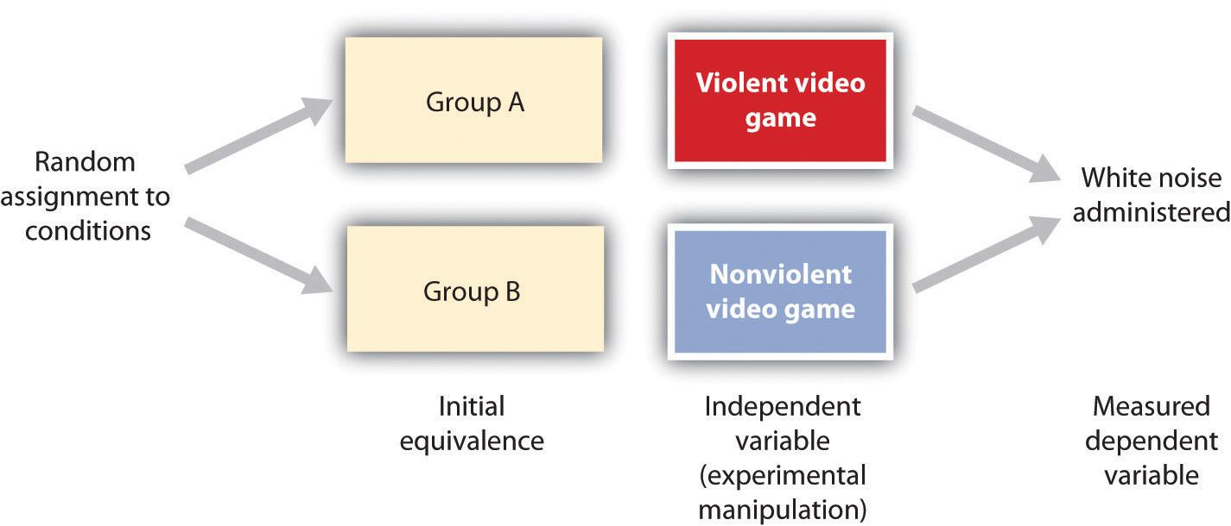
BUSINESS RESEARCH
Causal-comparative research
Causal-comparative research
This type of research helps to deduce the cause and effect relationship between entities. The researcher identifies and analyzes the independent variable’s effect on the dependent variable. You do not manipulate either of the variables but observe any changes on the variables. For example, you can study the effect of content creation tools in business writing on organizational performance. You will observe the changes in business traction since you started using the tools.

Slide 23
BUSINESS RESEARCH
Experimental research
This method involves carrying out an experiment to prove a theory. It is useful because it unearths certain consumer behavioral traits leading to more revenue. An experiment is conducted on some consumers where their behavior is analyzed concerning how certain parameters impacted them. Examples are provided below by Khan (n.d.)
Experimental research was conducted recently to understand if particular colors have an effect on its consumers’ hunger. A set of the audience was then exposed to those particular colors while they were eating and the subjects were observed. It was seen that certain colors like red or yellow increase hunger. Hence, such research was a boon to the hospitality industry. You can see many food chains like Mcdonalds, KFC, etc. using such colors in their interiors, brands, as well as packaging.
Another example of inferences drawn from experimental research, which is used widely by most bars/pubs across the world is that loud music makes a person drink more in less time. This was proven through experimental research and was a key finding for many business owners across the globe.

Slide 24
BUSINESS RESEARCH
Literature review and online research
Sometimes known as desk research, literature review means that you gather information from existing documents, often available at libraries, government reports, civil society organization reports, books, journal articles, etc. Technology has even made it easier for the researcher because of massive storage of material in databases. For instance, if you want to do a content analysis involving a given publication like the Daily Nation in Kenya, simply check on its database- you will find papers as old as when they started archiving their newspapers online. To understand competition, the researcher can review the literature concerning the competitor. However, we should be careful to conduct the review based on credible sources.

Slide 25
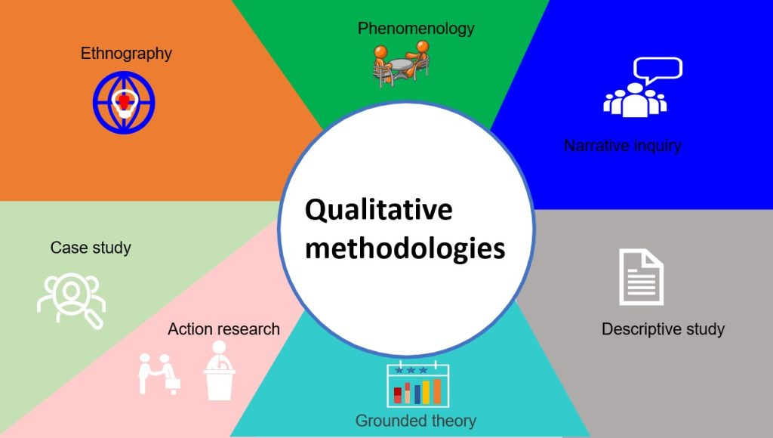
BUSINESS RESEARCH
Qualitative research methods
Qualitative research methods
Qualitative research gathers and analyzes non-numerical data in a natural setting to understand participants’ perspectives, experiences and behavior. The researcher gathers data through in-depth open-ended conversations (interviews), focus groups, observation, content analysis, document analysis, and so on. The aim is to understand what the audience thinks and why they think so. For example, what motivates a consumer to buy Product A and not B, even though both may provide the same experience?

Slide 26
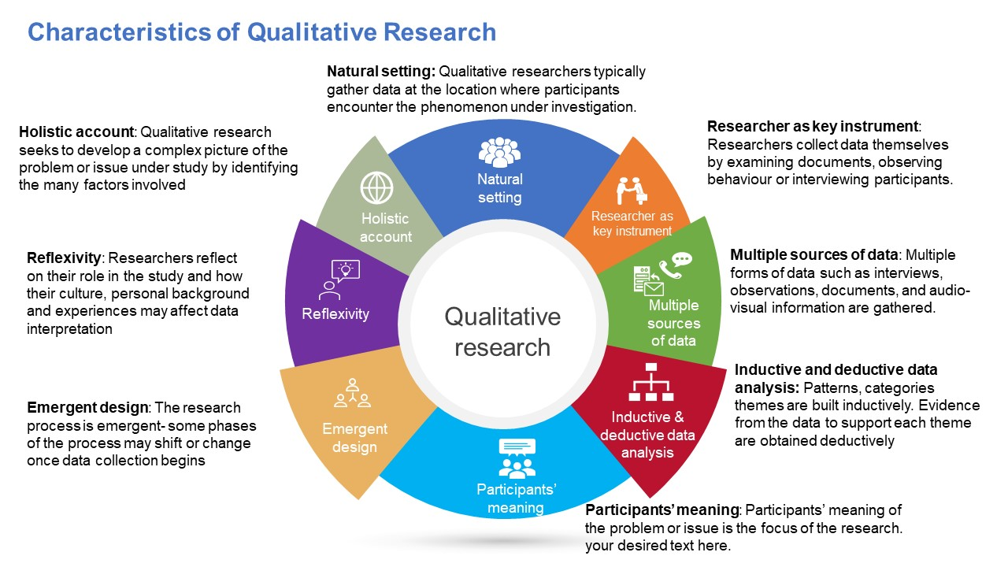
BUSINESS RESEARCH
Interviews
Interviews
Interviews seek detailed information from the informant, unlike questionnaires. Open-ended questions allow the informant to respond to questions at length. The researcher has room to rephrase questions, ask new questions, etc. For instance, you may want to understand why your company has a stronger presence with more engagement on Facebook than on X.

Slide 27

BUSINESS RESEARCH
Focus groups
Focus groups
In focus groups the researcher gathers at least 6-12 individuals in a group to understand their perspectives and behaviors. The participants selected must have similar characteristics that qualify them to be in the group. The researcher takes advantage of conversational communication. Khan (n.d.) provides the example of a screen making company that wants to know the screen size preferred by the target audience. The researcher can use a focus group to gain in-depth understanding to inform decisions on the company’s product line.
NOTE: Interviews and focus groups are NOT designs but methods of gathering qualitative data.

Slide 28
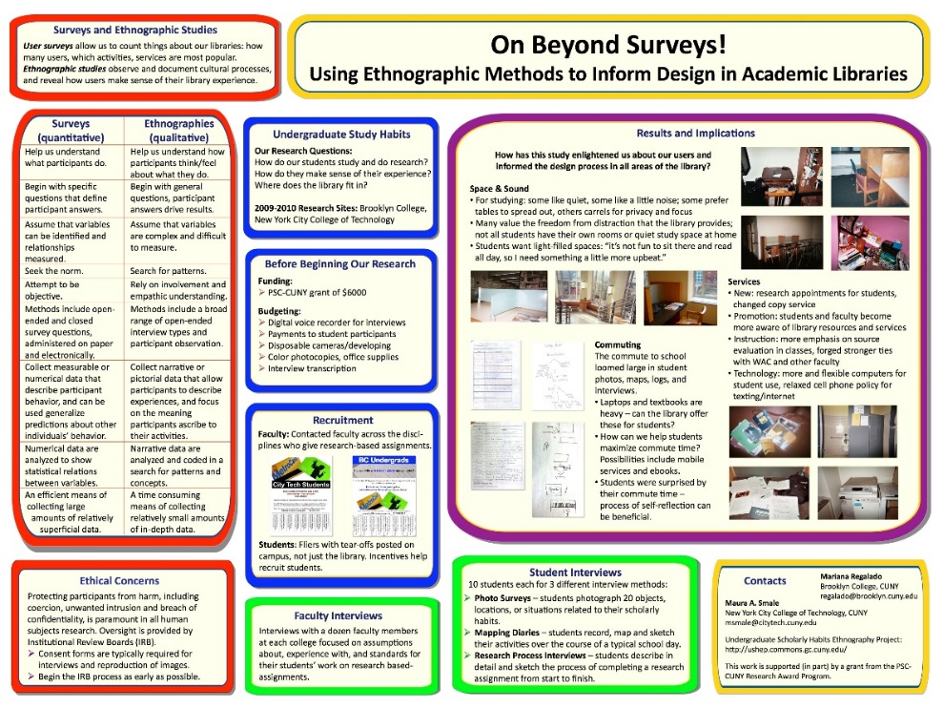
BUSINESS RESEARCH
Ethnographic research
Ethnographic research
A type of research that requires the researcher to immerse themselves in the natural environment to observe the target audience and collect data. This method is best when you want to understand culture, challenges and so on. Although it is time-consuming and expensive, it can yield excellent, precise results. For example, I once saw a video clip of an owner of an airline that decided to travel on his plane as a very fussy passenger. He wanted to see what his staff would do under extreme provocation and he was glad with the results. Another example is that of The Government Inspector by Nikolai Gogol. In the play, the government inspector is expected to arrive and stay in the town incognito to assess service delivery.

Slide 29
BUSINESS RESEARCH
Case study research
Case study simply involves studying a case (firm) to assess customer satisfaction, challenges encountered and suggest solutions. Khan (n.d) provides the following example:
A service company has provided a testing solution to one of its clients. Research is conducted to find out the challenges faced during the project, scope of work, objectives that were to be achieved and solutions to these challenges. The study can end with the benefits that the company provided through their solutions, like reduced time to test batches, easy implementation or integration of the system, or even cost reduction. Such a study showcases the capability of the company and hence can be stated as empirical evidence to the new prospect.

Slide 30
BUSINESS RESEARCH
Website profiling visitor profiling
Khan (n.d.) opines that website intercept research is an innovative approach to gather direct feedback from website visitors using surveys. You can use a website intercept survey to understand your visitor’s intention, behavior path, satisfaction and others, enabling you to evaluate their online experiences. For example, you can use a pop-up message requesting your visitor to rate your website. The aim of this research is to improve the customer’s experience, satisfaction, and consequently higher revenue and market share.
Note that mixed methods combine qualitative and quantitative methods.

Slide 31

COMPUTER TOOL FOR GATHERING INFORMATION
Computer tools for gathering information
Computer tools for gathering information
Information gathering is vital for effective business writing because it enhances credibility and supports arguments with data. Technology has transformed and streamlined the way we conduct research as well granted us access to a wide range of resources and tools. We can use the following types of computer tools to aid information gathering in business writing:

Slide 32
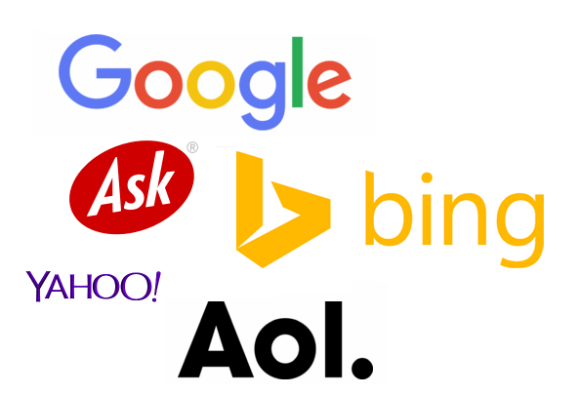
COMPUTER TOOL FOR GATHERING COMPUTER TOOL FOR GATHERING INFORMATION \
Search engines
Search engines
Search engines such as Google which also provides options such as advanced search by date, file type and so on. You can also use Google Scholar if you are seeking academic articles. Effective searching involves use of keywords and Boolean operators. Bing and Yahoo are also examples of effective search engines. These two carry different features and algorithms and are useful when you are seeking diversity.

Slide 33
COMPUTER TOOL FOR GATHERING COMPUTER TOOL FOR GATHERING\
Online databases
Online databases such as academic databases can also prove useful. Examples of databases with scholarly articles include Scopus, Web of Science, Education Resources Information Centre (ERIC), PubMed, JSTOR, and so on. ProQuest and EBSCOhost are examples of business research databases.
Industry-specific databases also exist and are very important when seeking specific information involving an industry. Examples include IBISWorld for industry analysis and Statista for statistics and reports.
Government and NGO resources are also available for your research. I believe all governments in the world store valuable information online. For example, you can find relevant data in government websites such as the Kenya National Bureau of Statistics, Communications Authority of Kenya, National Council for Population and Development, and so on. International and local non-profit organizations like the UN, WHO, UNICEF, and others have significant information for a business researcher.

Slide 34
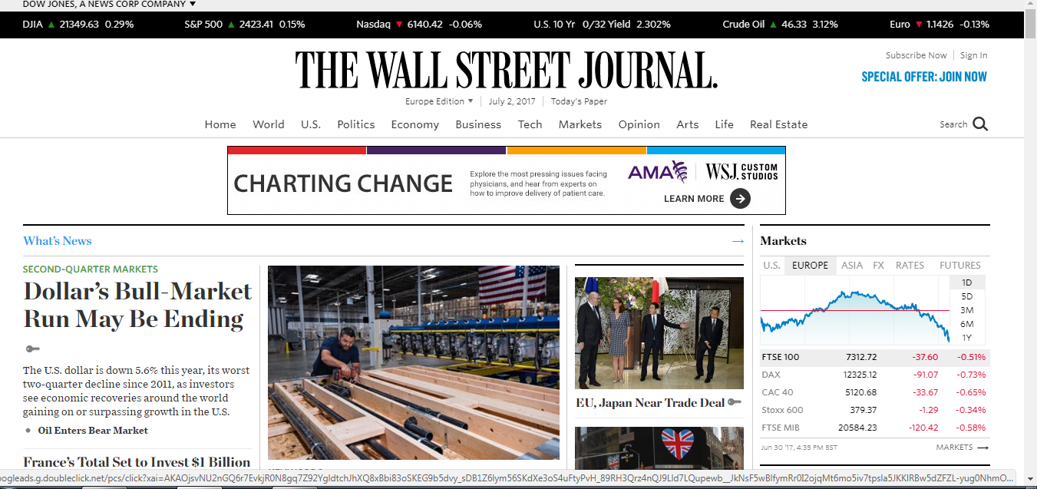
COMPUTER TOOL FOR GATHERING COMPUTER TOOL FOR GATHERING INFORMATION\
Business and news websites
Business and news websites
You can make use of the vast resource from business and news outlets, such as the BBC, The Wall Street Journal, the Daily Nation, etc. Others include trade publications for niche industries such as Msafiri by Kenya Airways. You can also visit other companies’ websites which will offer you their annual reports, press releases, financial statements, investor relations and many more.

Slide 35
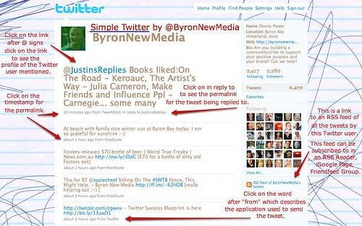
COMPUTER TOOL FOR GATHERING COMPUTER TOOL FOR GATHERING
Social media and networking
Social media and networking
Platforms like LinkedIn offer industry and professional networking insights you can leverage. LinkedIn is great with group discussions and posts on current trends. You can also leverage X for breaking news and real-time updates and also follow industry leaders for insights.

Slide 36
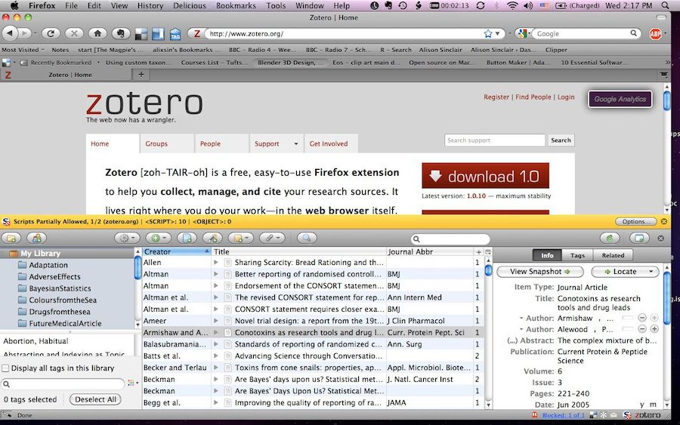
COMPUCOMPUTER TOOL FOR GATHERING INFORMATION TER TOOL FOR GATHERING INFORMATION
Research tools and software
Research tools and software
Research tools and software. These include reference management tools like Mendeley, Zotero and EndNote which help you organize and cite your sources. You can also use survey tools such as SurveyMonkey and Google Forms which assist you in gathering primary data. Besides, these tools help with feedback and market research. Lastly, you can use data analysis software like Microsoft Excel to organize and analyze your data and SPSS if your data is more complex.
The information above was drawn from Del Principe (2024), Thoughtful Learning (2024), and Zote (2023).

Slide 37
SUMMARY
Today we went on an exploratory journey. We started off by exploring new media tools that offer you an opportunity to craft compelling content that is more efficient and impactful. These included content creation, error-checking and editing; collaboration; project management and workflow; social media management; email marketing and communication; and analytics and SEO tools. We then learned about business research, where we gather detailed information of all the areas of business and use the results to maximize on the sales and profit of the business. Research approaches for business include qualitative, quantitative, or mixed methods. Quantitative research methods include survey, correlational, causal-comparative, experimental and literature review. Qualitative research methods include ethnography, case study, and website visitor profiling with interviews and focus groups used to gather data. Finally, we learned about a wide range of resources and tools the computer provides which can help us when conducting business research. Examples include search engines, online databases, business and news websites, social media and marketing and research tools and software.

Slide 38

HOMEWORK
Homework
Homework
Explore the wide range of new media tools and computer resources that I have mentioned which we use to write more effective business correspondence as well as enhance our research capabilities.

Slide 39
REFERENCES
Bhat, A. (n.d.). Business research: Methods, types and examples. https://www.questionpro.com/blog/business-research/#:~:text=Business%20research%20is%20a%20process,most%20profitable%20or%20in%20demand.
Del Principe, A. (2024). The 13 best free graphic design software for marketers and beginners. https://blog.hubspot.com/marketing/best-free-graphic-design-software
Thoughtful Learning. (2024). Using social media for business. Write for Business. https://writeforbusiness.com/book/write-business/chapter-14-social-media
University of Calcutta. (2020). Business research methods. https://www.caluniv.ac.in/academic/Commerce/Study/S-IV-BRM.pdf
University of Central Arkansas (2024). Chat GPT: What is it? https://uca.edu/cetal/chat-gpt/
Zote, J. (2023). 19 social media tools for your brand in 2024. Sprout Social. https://sproutsocial.com/insights/social-media-tools/
All images courtesy of Creative Commons through Bing on PowerPoint

