Slide 1
WRITING FOR BUSINESS
Lecture 10
Writing Reports: Formal and Informal
Lecturer: Dr. Anne Eboi

Slide 2

INTRODUCTION
Learning Objectives
Learning Objectives
By the end of this lesson, you should be able to:
a)Distinguish between formal and informal reports
b)Write effective formal reports
c)Write effective informal reports

Slide 3
INTRODUCTION
Recap of Lecture 9
Recap of Lecture 9
Technology has revolutionized the way we write and present information.
New media tools offer an opportunity to craft compelling content that is more efficient and impactful.
They include content creation, error-checking and editing; collaboration; project management and workflow; social media management; email marketing and communication; and analytics and SEO tools.
In business research, we gather detailed information and use the results to maximize on the sales and profit of the business.
The computer provides tools which can help us when conducting business research.

Slide 4

REPORTS
Reports
Reports
The business environment requires reports which are considered very important for disseminating information. Oliu et al. (2016, p. 335) define a report as “an organized presentation of factual information prepared for a specific audience” while Bovee and Thill (2012, p. 409) see them as written accounts (whether printed or online) “that objectively communicate information about some aspect of business.”

Slide 5

REPORTS
Reports
Reports
Reports can be voluntary or solicited; the audience can be internal or external; and can vary in length and complexity (Bovee and Thill, 2012).
Reports are extremely important for any business as captured in Bovee and Thill (2012, p. 407):
Printed and online reports (including entire websites) are the major leagues of business communication. These are the tools you use to analyze complex problems, educate audiences, address opportunities in the marketplace, win contracts and even launch new companies through compelling business plans.

Slide 6
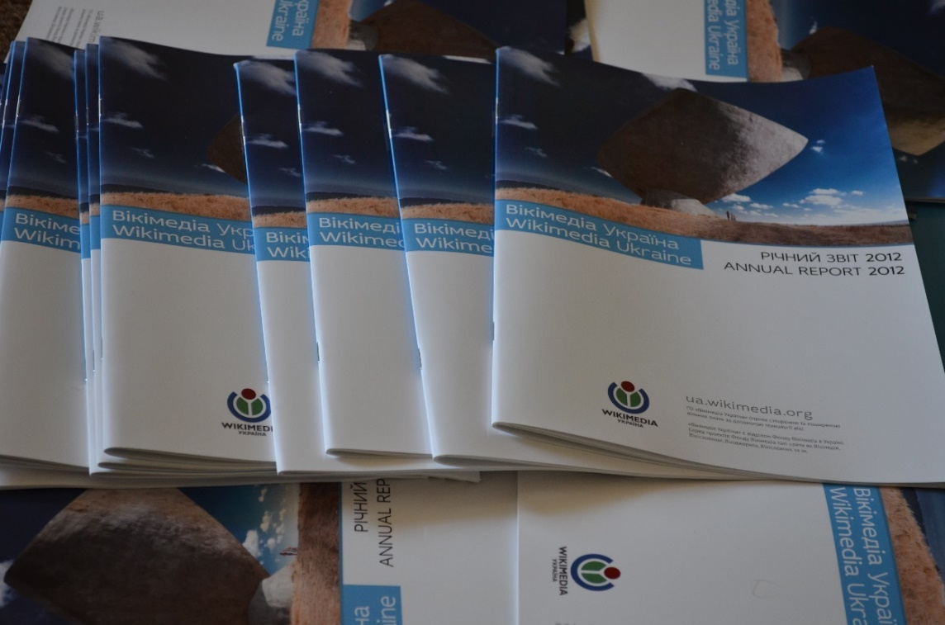
REPORTS
Reports
Reports
Blicq and Moretto (2001, p. 4) pose the following question regarding report writing.
Question: What is the most difficult thing about report writing?
According to the authors, you are bound to provide any of the following responses:
Getting started
Organizing the information: arranging it in the proper order.
The writing: getting the right words down on paper the first time.

Slide 7
WRITING THE REPORTS
As noted by Blicq and Moretto (2001), getting started is one of the biggest challenges in report writing. Most people report that they cannot find the right words to get started. Various authors recognize this difficulty and have offered several ways that writers can use. For example, Blicq and Moretto (2001) recommend identifying the reader, identifying the message (using the Pyramid Method), focusing the message, developing the details and expanding the details. You can read more about this from page 4-15.
On their part, Bovee and Thill (2012, p. 410) suggest that we can use the three-step writing process when writing reports as shown below:

Slide 8
WRITING THE REPORTS
Plan | Write | Complete
Analyse the situation: Clarify the problem or opportunity at hand, define your purpose, develop an audience profile, and develop a work plan. | Be sensitive to audience needs with a ‘you’ attitude, politeness, positive emphasis, and bias-free language. Build a strong relationship with your audience by establishing your credibility and projecting your company’s image. Control your style with a tone and voice appropriate to the situation. | Revise the message: Evaluate content and review readability, then edit and rewrite for conciseness and clarity.
Gather information: Determine audience needs and obtain the information necessary to satisfy those needs; conduct a research project, if necessary. | Compose the message: Choose strong words that will help you create effective sentences and coherent paragraphs throughout the introduction, body, and close of your report or proposal. | Produce the message: Use effective design elements and suitable layout for a clean, professional appearance; seamlessly combine text and graphical elements.
Select the information: Choose the best medium for delivering your message; consider delivery through multiple media. |  | Proofread the message: Review for errors in layout, spelling, and mechanics.
Organize the information: Define your main idea, limit your scope, select the direct or indirect approach, and outline your content using an appropriate structure for an informational report, an analytical report, or a proposal. |  | Deliver your report using the chosen medium; make sure all documents and all relevant files are distributed successfully.

Slide 9

TYPES OF REPORTS
Types of reports
Routine reports
Two types of reports: formal and informal. Tylor (2005) classifies them as routine and special reports as follows:
Routine reports
Representatives’ reports on sales visits
Managers’ reports on the work of their departments
Equipment and maintenance reports
Progress report
Safety report
Accident report

Slide 10

TYPES OF REPORTS
Special reports
Special report
Reports written in response to requests for specific information
Reports made on a special topic after research and investigation
Report regarding a change of policy
Market research report
(Taylor, 2005)

Slide 11
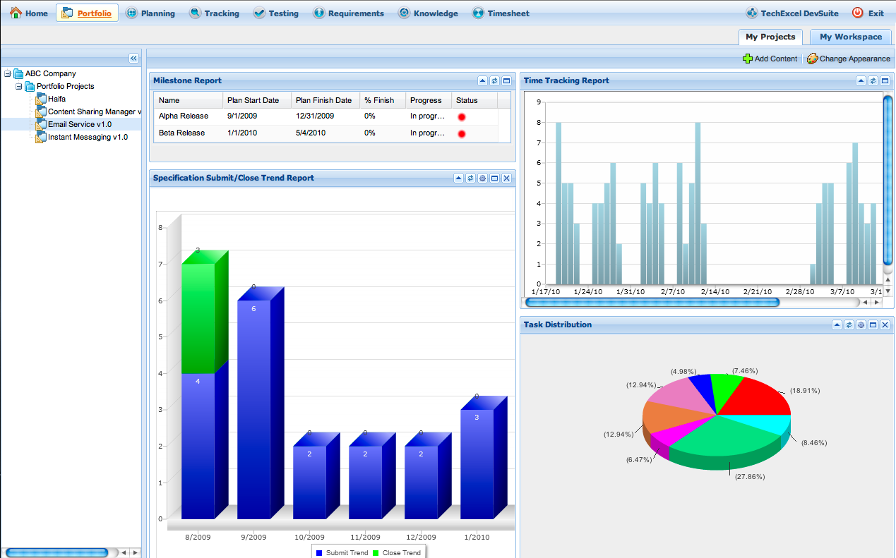
TYPES OF REPORTS
Writing skills
Writing skills
According to Taylor (2005), a report may just be a simple statement concerning an event, a visit or circumstance, while others are more detailed. The author reports that no matter the length and purpose of a report, each requires the following special writing skills:
The ability to record facts clearly and objectively
The ability to interpret information and make conclusions
The ability to present suggestions on ways in which a situation may be improved. (Taylor, p.198)

Slide 12
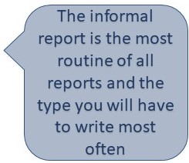
INFORMAL REPORTS
Informal reports
Informal reports
The following information on both formal and informal reports is drawn or inspired from Blicq and Moretto (2001), Bovee and Thill (2012), Oliu et al. (2016) and Taylor (2005).

Slide 13
INCIDENT REPORTS
Oliu et al. (2016, p. 345) define incident reports as ‘the record of a mechanical breakdown, a medical emergency, or a personal confrontation in an institution.’ These types of reports describe events- what, how, and why they occurred. Examples of incident reports include personal injuries, work stoppage due to factors like worker illness, accidents, and so on. These incidents must be reported to enable the managers take steps to address the situation or mitigate its possible re-occurrence in the future. Oliu, et al. (2016) state the importance of incident records because they can be used by the police and the courts should there be need to establish guilt or liability.
These reports also show the effect of the events and what can be done or should have been done as a preventive measure. According to Blicq and Moretto (2001), an incident report includes a summary (quick synopsis of the event and its outcome), background (circumstances leading up to the event), facts and events (what happened) and outcome (the result; the effect; action taken; and action to be taken).
The incident report is written by the person in charge at the time the incident happened. The writer must also observe ethics when doing an incident report by being thorough, accurate and objective.

Slide 14
TRIP REPORTS
This kind of report compiles information on business trips such as conference or seminar attendance, site visits, visits to clients, installations, repairs to a client’s equipment, evaluation of a client’s facilities, assistance on a field project and many more. It is often written in the form of a memorandum.
The report should contain the date, purpose, the place or person visited and what was accomplished. You can also mention who authorized the trip, what was not accomplished and why, as well as any other relevant details such as something extra unforeseen that you/they had to do.
Blicq and Moretto (2001) suggest the following additional things you can include in your conference report:
What you expected to gain, learn or find out
What the program promised to cover
The sessions you chose to attend and why
What you gained/learned
What other activities you attended
Oliu et al. (2016) advice that you include trip expenses if required, write the report in chronological order, and end the report with conclusions and recommendations.

Slide 15
INSPECTION REPORTS
This report is similar to the trip report because it involves a trip. Inspection reports are written after examination of a building to determine its safety or suitability, inspection of construction work, checking the quality of manufactured goods, products ordered, etc. Blicq and Moretto (2001) provide the following guidelines for writing an inspection report:
Brief summary
Cover ‘who’ went ‘where’ ‘why’ and ‘when’
Quality of what was inspected or quality and quantity of work done
Work that must be done or conditions that must be corrected
The result: what action should be taken and by whom.

Slide 16
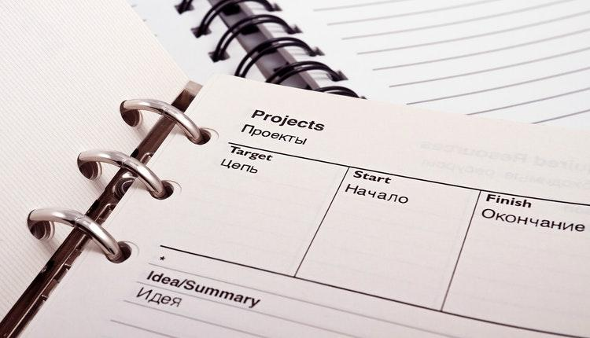
PROGRESS REPORTS
Progress & periodic reports
Progress & periodic reports
These help to inform decision makers about the status of a continuing project. Both reports are the same, the difference being that progress reports (occasional) capture milestones in the life of a project while periodic reports document the status of an ongoing project at regular intervals, eg weekly, bi-weekly, etc. Progress reports are required for long-term and complex projects. They are important because managers can keep track of the project and make any changes if need be.

Slide 17
INVESTIGATIVE REPORTS
Blicq and Moretto (2001) opine that investigative reports are longer since they document a problem, identify its cause, suggest corrections, evaluate available corrective measures and decide on the most suitable corrective measure. Oliu et. al. (2016) describe these reports as “systematic studies or research assessments of something or someone.” The authors state that investigative reports are mainly used in medical, industrial and law enforcement settings to investigate how and why disease outbreaks, accidents and crimes occur. We also use them in business settings to investigate market trends, competitor activities, incentives to spur productivity among employees, investment opportunities and so on.
Oliu et al. (2016) advise that investigative reports be written in an e-memo format if it targets an internal audience and as a letter if the audience is external. However, if the investigation is long and complex, then it should be written as a formal report. When writing the report, start with a summary of the investigation, state why the investigation was carried out, and say who commissioned it. In the body, provide details of the method of investigation, findings and recommendations.

Slide 18
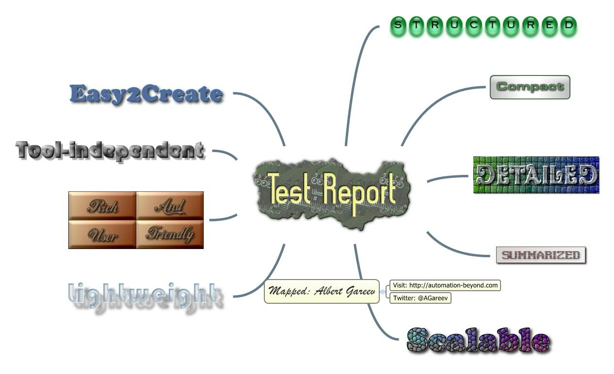
TEST/LABORATORY REPORTS
Test reports
Test reports
These reports record the findings following a test. The common fields that use these types of reports include chemistry, fire science, metallurgy, bio-medical, etc. The sites where tests can be conducted include laboratories, vehicle test tracks, test kitchens, field engineering, etc. The results often inform the continuation or discontinuation of a product or to enable streamlining of manufacturing procedures. Oliu et al. (2016) advise that we must be precise in language use since tests are very sensitive. They also advise the use of the passive voice and visual aids such as tables, graphs or illustrations to help with results’ interpretation.

Slide 19
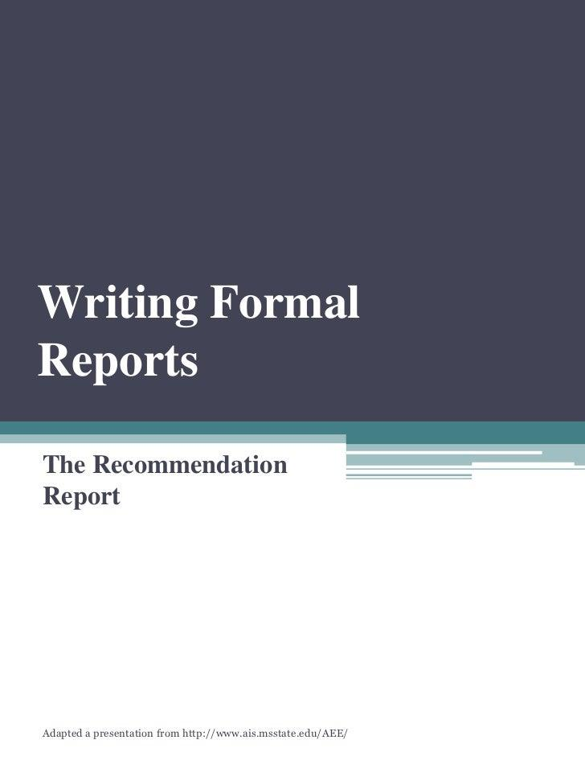
FORMAL REPORTS
Formal reports
Formal reports
According to Taylor (2005), committees and groups are involved in formal report writing following detailed investigation or research. Blicq and Moretto (2001) state that a formal report refers to:
‘…the type of document rather than its title. A formal report is more likely to be referred to as a feasibility study, an investigation or evaluation report, a product analysis, or a project report.

Slide 20
ORGANIZATION OF A FORMAL REPORT
Formal report organization
Formal report organization
Taylor (2005) suggests the following format for a formal report:
Headings: A formal report must have two headings: company name and report heading
Terms of reference: This section contains the reason for the report, what was requested and when the request was made.
Procedure: Describe the methods for data collection
Findings: Write in detail what you found out and remember that this is the longest section. You can use numbers and sub-headings
Conclusions
State the logical implications or what can be inferred from the findings. Do not introduce new facts.
Recommendations (if requested)
Make recommendations on the basis of your findings and conclusions. Again, do not introduce anything new here.
Closing section
Ensure your report is signed with a name and title, both located at the foot. Also include the date when the report was written.

Slide 21
ORGANIZATION OF A FORMAL REPORT
Formal report organization
Formal report organization
Reports should be written objectively and should be impersonal and factual. You should use complete sentences and reported speech (third person).
On their part, Blicq and Moretto (2001) identify two ways formal reports can be organized: Traditional and alternative approach. The traditional approach is similar to Taylor’s (2005) except Taylor left out several critical components like a summary, appendices, etc. Thus, the traditional approach looks like this:
Cover letter
Cover page
Title page
Summary
Table of contents
Introduction
Discussion
Conclusions
Recommendations
Reference or bibliography
Appendix
Back cover

Slide 22
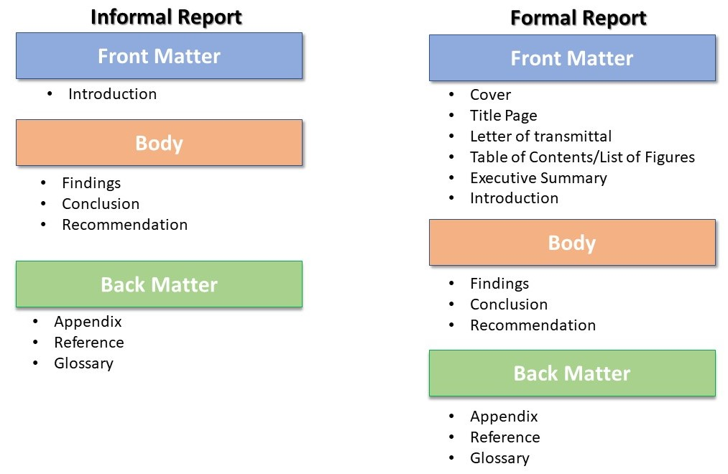
ORGANIZATION OF A FORMAL REPORT
Formal report organization
Formal report organization
The alternative approach is preferred when you need to meet the needs of the audience. For example, some may require that the conclusions and recommendations be brought forward. Let us briefly look at the components that make up a formal report as discussed by Blicq and Moretto (2001) and Oliu et al. (2016) (who introduce more components).

Slide 23
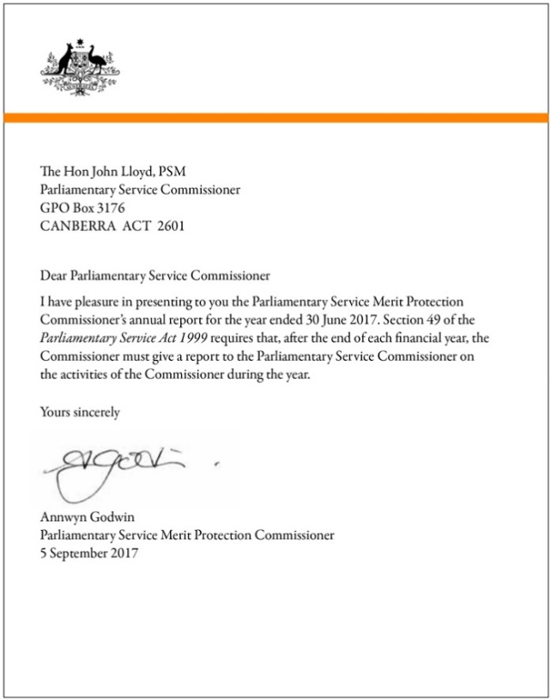
ORGANIZATION OF A FORMAL REPORT
Cover letter
Cover letter
I did mention in a previous lecture that we tend to confuse cover letter with an application letter. Or use them interchangeably. A cover letter is the transmittal document that conveys a report from one person to another or from one firm to another. It is attached to the report but is not part of the report. Look at the brief example below (a small section of the letter):
I enclose our report titled “Fundraising Techniques for Successful Outcomes at Mjengo Corporation” which has been prepared in response to our discussions on November 23, 2023. The report provides a detailed overview of fundraising techniques the company can adopt to raise money for the remaining projects.

Slide 24
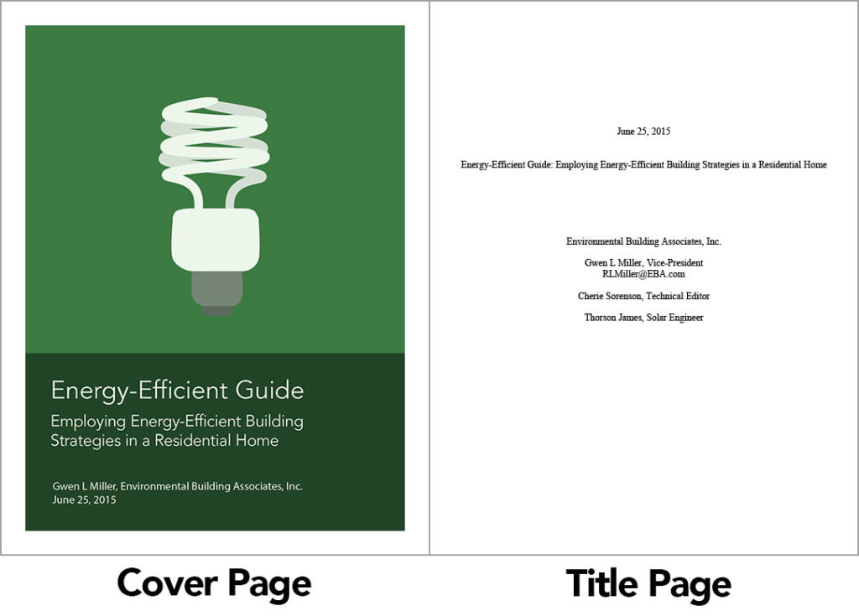
ORGANIZATION OF A FORMAL REPORT
Title page
Title page
Blicq and Moretto (2001) suggest the following main elements of a title page:
Full title which is informative but not too long
The name of the organization and sometimes the recipient’s name
The name of the organization sending the report and sometimes the name of the author
The date of the report and report number if available

Slide 25
ORGANIZATION OF A FORMAL REPORT
Sometimes known as an abstract or executive summary, the summary provides a brief of what to expect in the report. It is located between the title page and table of contents. This section occupies a page by itself. Blicq and Moretto (2001) call it the most important part of the report because it serves as an introduction into the entire document.
Oliu et al. (2016, p. 364) call an abstract “a condensed version of a report or journal article that summarizes and highlights its major points.” According to the authors, abstracts are either descriptive (include information about the purpose, scope and methods) or informative (an expanded version of the descriptive abstract). It also summarizes the results, conclusions and recommendations, if any. The authors suggest that descriptive abstracts are best used in progress reports, information surveys and reports which compile a variety of information.

Slide 26
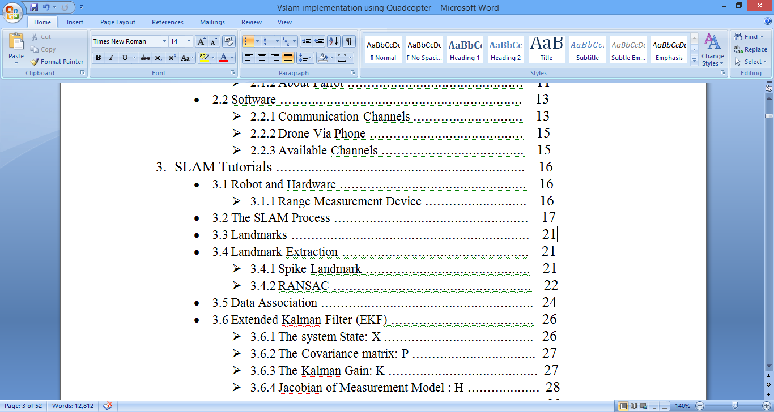
ORGANIZATION OF A FORMAL REPORT
Table of contents
Table of contents
It helps readers find specific pages or information and also helps your work look organized. I suggest that you automatically generate a table of contents rather than doing it manually because it tends to appear disjointed and unprofessional. Additionally, if you are using a particular style guide, then I suggest you follow it to the letter. For example, when to use title case, sentence case, all CAPS etc.

Slide 27
ORGANIZATION OF A FORMAL REPORT
List of Figures
List the figures you used in your report and indicate the page they are located. Use a new page.
List of Tables
Same above
Foreword (optional)
It is written by someone who is not the author of the report and the purpose is to highlight the significance of the report. The author is often an expert in the field or a company executive. The forward provides the date it was written and the name of the author.
Preface (optional)
It is written by the author to give the background, purpose and scope of the report. The audience may be mentioned if necessary. Other things that may appear in a preface include acknowledgements and permissions obtained.

Slide 28
ORGANIZATION OF A FORMAL REPORT
List of abbreviations and symbols
We include a list of abbreviations and symbols to help readers interpret them; and when they are too many.
Introduction
This section introduces the reader to the circumstances and reasons that caused the writing of the report. The reader gets to understand what the report is about and how the issues were resolved. Blicq and Moretto (2001) suggest three main components of an introduction:
The background that gives the circumstances leading up to the current status, relevant history and the necessity of undertaking the study
The purpose that outlines expected outcomes, terms of reference and details about the authorizer of the report
The scope which describes limitations such as time, resources, depth of study and inclusion/exclusion criteria

Slide 29
ORGANIZATION OF A FORMAL REPORT
Discussion: The discussion section provides the details of the report. It provides answers to the purpose and background highlighted in the introduction. It is important to write clearly so that the overall logic of the report is clear to the reader. Use simple terms and avoid jargon so that your writing is easily understood. Of course you would have analyzed your audience to know what to write so that your report is acceptable. Your writing must never overestimate or underestimate your reader’s knowledge. For example, establish whether your report will be read by the management, experts in a field or the ordinary person. Organize your work so that it flows logically.

Slide 30
ORGANIZATION OF A FORMAL REPORT
Conclusion
A conclusion restates what has been discussed before and offers some form of closure. It is derived from the report findings which enable the author to draw conclusions. The conclusion should be brief and satisfy the requirements set in the introduction. Remember, you should never present new information in the conclusion and neither should you advocate for action.
Recommendations
Just like in conclusions, recommendations are drawn from the discussion. This section provides you with the opportunity to advocate for action. Also, as noted in the conclusion, this section also must satisfy the requirements set in the introduction. Further, it should follow naturally from the conclusion. It should use the active voice, and if you are making several recommendations, write in point form.

Slide 31
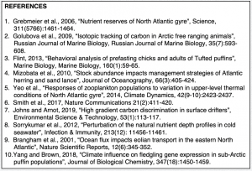
ORGANIZATION OF A FORMAL REPORT
Formal report organization
Formal report organization
References/ Bibliography
List all the sources you used to create the report. You will organize them according to the style guide you are using/recommended at the work place.
Appendix
You may have used certain materials or documents which cannot fit within the document. Or if they were to fit, they would make the document look and sound awkward. We collect them in this section. Examples include maps, questionnaires, pictures, time schedules, budgets, detailed test results, etc.

Slide 32
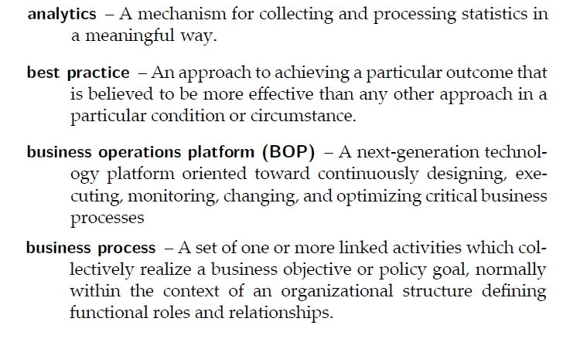
ORGANIZATION OF A FORMAL REPORT
Formal report organization
Formal report organization
Glossary
If your report will be read by people not familiar with the terms you have used, then you should include a glossary. List the definitions of these specialized terms alphabetically, but ensure to keep them concise and written in plain language. Remember too that each entry should be written on a new line. Here is an example by Oliu et al (2016):
Capital gain: The difference between an asset’s purchase price and selling price, when the difference is positive.

Slide 33
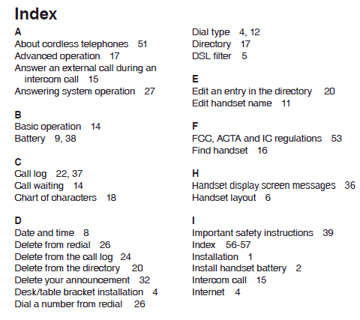
ORGANIZATION OF A FORMAL REPORT
Formal report organization
Formal report organization
Index
“An index is an alphabetical list of all the major topics and sub-topics found in the report. It cites the pages where each topic can be found and allows readers to locate information on particular topics quickly and easily…” (Oliu et al., pg. 390).

Slide 34
ORGANIZATION OF A FORMAL REPORT
Note: Remember to follow the conventions of writing, which include the language, tone, etc. You must also take care to observe ethics in report writing. Note also that we talk of front and back matter in a report. Front matter refers to the preliminaries or first portion that comes before the report proper. It includes the title page, abstract, table of contents, list of figures, list of tables, forward, preface, and list of abbreviations and symbols. The back matter contains all supplemental documents such as references/bibliography, appendices, glossary, index, etc.

Slide 35
SUMMARY
We have learned that reports are essential documents used at the workplace. There are formal and informal reports. Informal reports are often used in routine communication and include incident, trip, investigation, progress, inspection and test reports. Each one serves a certain purpose and is uniquely written. On the other hand are formal reports which are written following extensive research or to cover a more detailed issue. Reports follow a structure which includes but is not limited to the cover page, title page, abstract or summary, the table of contents page, an introduction, discussion, conclusions, recommendations, reference or bibliography, appendix and more.

Slide 36

ACTIVITY
Activity
Activity
Read more about reports from the four text books mentioned in this lecture and which are found in the reference section below.

Slide 37
REFERENCES
Blicq, R. S., & Moretto, L. A. (2001). Writing reports to get results: Quick, effective results using the pyramid method. (3rd edition). IEEE Press.
Bovee C. L. & Thill, J. V. (2012). Business communication today. (11th ed.). Pearson.
Taylor, S. (2005). Communication for Business: A practical approach. (4th Ed). Pearson Longman.
Oliu, W. E., Brusaw, C. T., & Alred, G. J. (2016). Writing that works: Communicating effectively on the job. New York: MacMillan Publishing.
All images courtesy of Creative Commons through Bing on PowerPoint

