Slide 1

Lesson 11: Writing Proposals and Business Plans

Slide 2
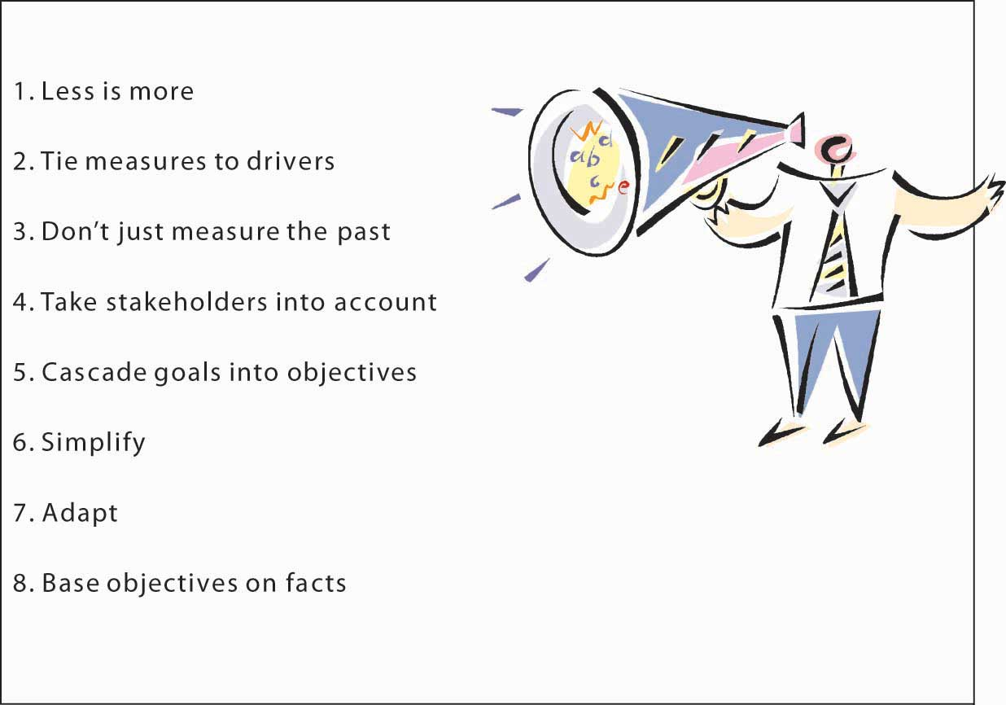
LESSON OBJECTIVES
By the end of this lecture, you should be able to:
Describe proposals and business plans
Write a proposal
Create a business plan

Slide 3

INTRODUCTION
Welcome to Lecture 11! We learned that:
Reports are essential documents used at the workplace.
There are formal and informal reports.
Informal reports are often used in routine communication and include incident, trip, investigation, progress, inspection and test reports.
Formal reports are written following extensive research or when there is need to cover a more detailed issue.
Reports follow a structure, that is, cover page, title page, abstract or summary, the table of contents page, an introduction, discussion, conclusions, recommendations, reference or bibliography, appendix and more.
www.futuremanagers.com

Slide 4
WHAT IS A PROPOSAL?
Oliu et al (2016, p.423): “…a document written to persuade members of a company or other organization that what is proposed will benefit them by solving a problem or fulfilling a need.”
Williams (2020): “Business proposals are documents designed to make a persuasive appeal to the audience to achieve a defined outcome, often proposing a solution to a problem.”

Slide 5
TYPES OF PROPOSALS
INTERNAL PROPOSALS
The aim of an internal proposal is to recommend a change or improvement within an organization.
There are two types of internal proposals: routine or formal.
Examples of routine internal proposals include the purchase of media equipment for journalism students, hiring new employees, requests to attend conferences, requests for curriculum review retreats, promotion of employees, and so on.
www.futuremanagers.com

Slide 6
TYPES OF PROPOSALS
INTERNAL PROPOSALS
Formal internal requests may involve intensive capital e.g. opening another branch in a new location, restructuring a business, implementing a nationwide program, initiating a project, etc.
Oliu et al (2016): A formal internal proposal should be organized into sections such as problem statement, proposed solution, recommendation and an offer to implement the recommendation.
www.futuremanagers.com

Slide 7
TYPES OF PROPOSALS
INTERNAL PROPOSALS
Generally, the proposal should contain sections that describe the background, the issue and why it’s a problem, options to resolve the problem, methodology, budget, practical solution or recommendation, a reference list, appendices, etc.

Slide 8
TYPES OF PROPOSALS
INFORMAL PROPOSALS
Guffey et al. (2019) suggest that we break informal proposals into six sections: introduction, background, plan, staffing, budget and authorization. For formal proposals, the authors suggest the same format except we need to add a letter of transmittal, title page, table of contents, list of figures, executive summary and appendices. Note that what Oliu et al (2016) call routine vs formal internal proposals is what Guffey et al (2019) call formal vs informal. Williams (2020) proposes that the memo format be used for internal proposals while the business-letter format be used among organizations.
www.futuremanagers.com

Slide 9
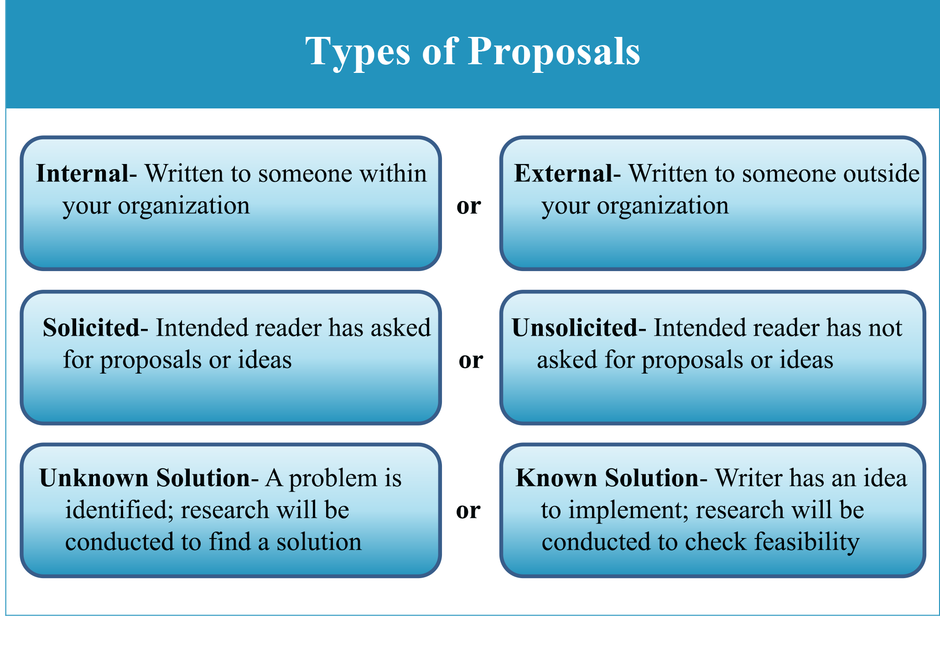
TYPES OF PROPOSALS
Solicited vs Unsolicited
Solicited vs Unsolicited
There are generally two types of external proposals: Solicited vs unsolicited.

Slide 10
TYPES OF PROPOSAL
SOLICITED PROPOSALS
You must have seen company adverts in the newspaper titled, “Request for proposals (RFPs)” or “Invitation for bids (IFBs).” These companies may send out the RFPs though mail or the media. Today, these requests are shared on social media spaces. The RFPs or IFBs contain what the proposal should have and how it should be organized.

Slide 11
TYPES OF PROPOSALS
UNSOLOCITED PROPOSALS
There was no prior request. Your task is to convince the recipient that a need or problem exists before you embark on the proposal part. For example, you can propose that a company needs to digitize its services instead of relying on paperwork by using an efficient IT system you have built. Before sending out a proposal, begin with a letter of inquiry and once the response is positive, analyze your audience’ needs to determine your priority areas.

Slide 12

TYPES OF PROPOSALS
Grant, research and sales proposals
Grant, research and sales proposals
Other proposal types include grant and research proposals as well as sales proposals.

Slide 13
TYPES OF PROPOSALS
GRANT AND RESEARCH PROPOSALS
These types of proposals request funding to solve a problem or fulfill a need. For instance, a non-profit dealing with children with disability can submit a proposal requesting funds to improve the physical facilities of the home. Or a professor can submit a research proposal to seek funds for a research involving indigenous seeds and how the seeds can be preserved. Granting organizations usually post an RFP on their websites. As a writer, carefully consider the RFP or guidelines by the granting organization, otherwise your application will be rejected on technicalities.

Slide 14
TYPES OF PROPOSALS
GRANT PROPOSAL
Oliu et al (2016) propose the following guidelines for a grant proposal:
Cover letter | Project outcomes
Title page | Budget narrative
Application form | Schedule
Introduction/Summary/Abstract | Organization description
Literature review | Conclusion
Project narrative | Attachments
Project description

Slide 15
TYPES OF PROPOSALS
SALES PROPOSAL
The sales proposal is a major marketing tool for business and industry (Oliu et al, 2016). It is written by a company that aims to provide goods or services to a potential client for a specified price and period of time. The goal of a sales proposal is to convince the buyer that the seller’s products or services meet the buyer’s requirements so that a problem is solved or operations improved. Sales proposals can either be short (a page) or long (hundreds of pages).

Slide 16
TYPES OF PROPOSALS
SALES PROPOSAL
An example of a short sales proposal is one seeking to repaint someone’s warehouse while a long sales proposal might bid to construct a complex shopping center. In writing a sales proposal, analyze your audience’s needs, then see if your company can match those needs. Next, analyze your company’s strengths against your competitors’- the advantages and disadvantages. Short sales proposals are written on standardized forms available online or within Word-processing programs.

Slide 17
TYPES OF PROPOSALS
SALES PROPOSAL
The long sales report may include some or all of the following, according to Oliu et al. (2016):
Cover or transmittal letter | Site-preparation description
Title page | Training requirements
Executive or project summary | Statement of responsibilities
General description of products | Description of vendor
Detailed solutions or rationale | Organizational sales pitch
Cost analysis | Conclusion (optional)
Delivery schedule or work plan | Appendixes

Slide 18

PERSUASION
Persuasion
Persuasion
Persuasion involves convincing someone that your idea is worth a positive response.

Slide 19
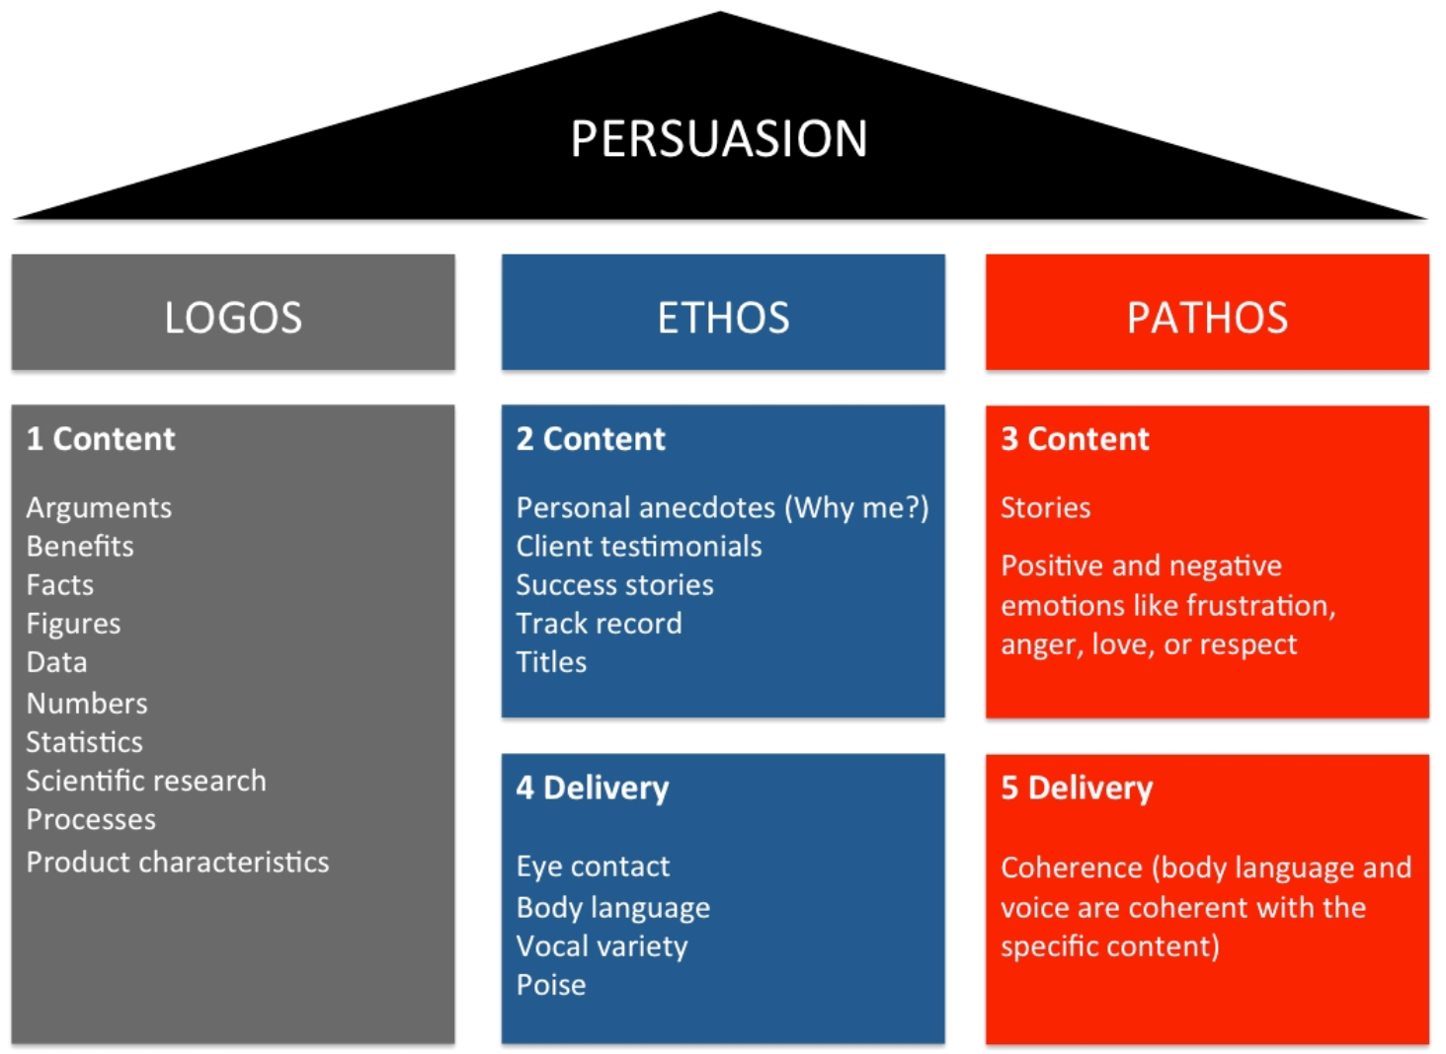
ETHOS
Ethos
Ethos
Ethos refers to ethics or credibility. For example, in a sales report, the prospective client will want to know who the seller is and his credibility standing. When they search the selling company online, the client expects to see good reviews. Williams (2020) opines that the selling entity has a responsibility to showcase their credibility by referencing previous clients, demonstrating order fulfillment, etc.

Slide 20
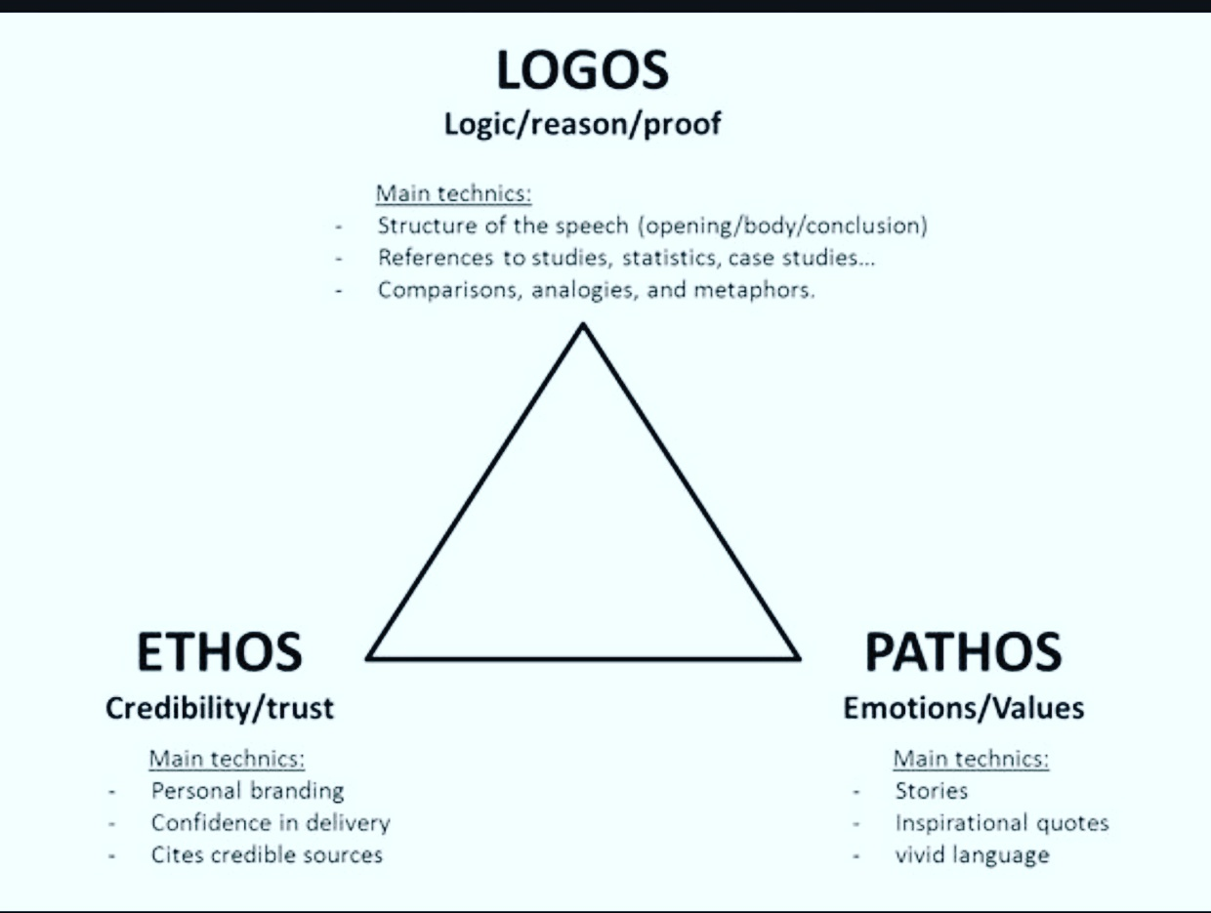
PATHOS
Pathos
Pathos
Pathos refers to your passion and enthusiasm about what you are offering. For instance, the professor seeking funding to advance the science of seeds should exude that passion and excitement in his proposal. He may talk about how his research will aid in food security. He must ensure his solution is unique and stands out in the marketplace.

Slide 21
LOGOS
Logos
Logos
Logos refers to logic or reason where you seek to persuade the granting organization or superior using reason. You can do this by clearly and comprehensively substantiating each point. Include specific details such as statistics, expert opinions, anecdotes, etc.

Slide 22
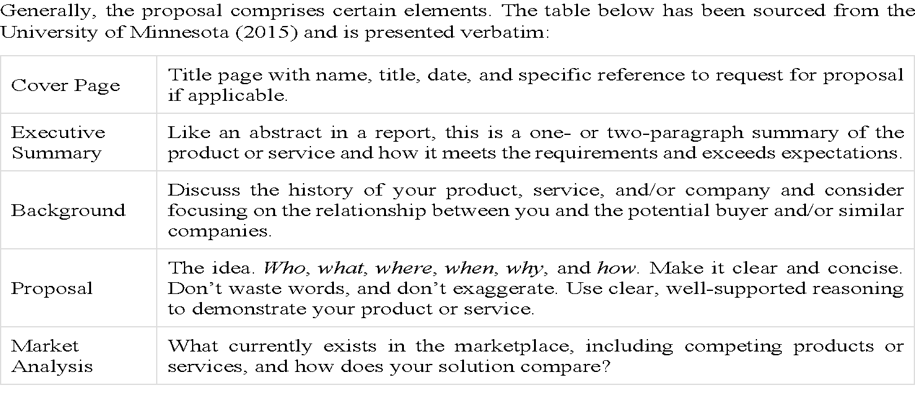
ELEMENTS FOR A PROPOSAL

Slide 23
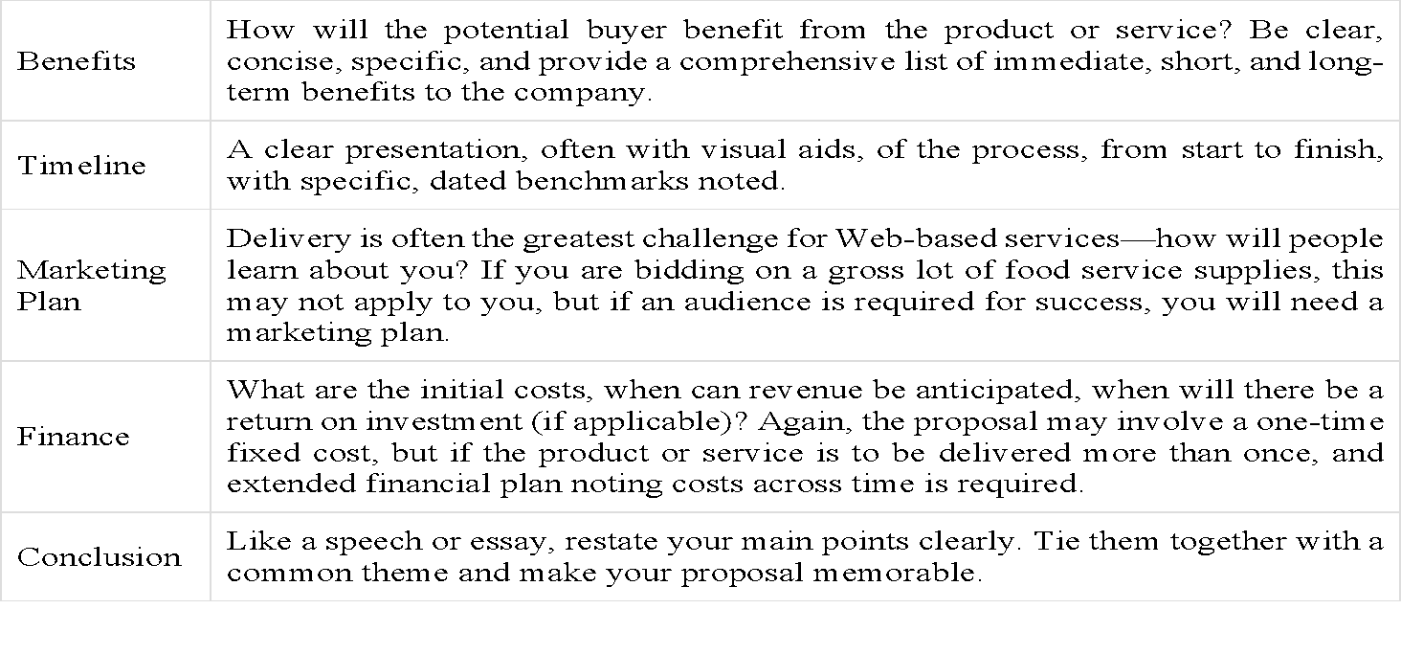
ELEMENTS FOR A PROPOSAL

Slide 24
CHARACTERISTICS OF A WINNING PROPOSAL
Hamper and Baugh (2011) offer the following, as quoted verbatim:
Evidence that you clearly understand the client’s problem and situation.
A strategy and program plan or design that the client feels will solve the problem and produce the desired results. (Tell the client enough without telling them everything)
Clear documentation of your firm’s qualifications and capabilities for carrying out the program plan. (List of previous client work and staff resumes)

Slide 25
CHARACTERISTICS OF A WINNING PROPOSAL
Evidence that your firm is reliable and dependable. You can include references or client contacts who will vouch for your firm.
A convincing reason why the client should choose your firm over all the other firms competing for the job (highlight a competitive edge)
Finally, your proposal should look like a winner (convey the spirit and professionalism of your company)

Slide 26
9-STEP PROPOSAL PREPARATION AND WRITING PROCESS
Hamper and Baugh (2011) also suggest the following as quoted verbatim:
Conduct a bid/no bid analysis and make a decision (RFP and economic analysis)
Assign an individual (or a leader and team) responsibility for proposal development.
Analyze the RFP and develop a checklist. Also develop a preliminary unique selling point (USP) to address the issues in the RFP.
Develop a schedule for proposal preparation.

Slide 27
9-STEP PROPOSAL PREPARATION AND WRITING PROCESS
Assign and complete research, analysis, program development and time/cost tasks.
Write a first draft and develop graphics.
Review and revise successive drafts.
Obtain final management approval of the proposal, prepare a cover letter or letter of transmittal, executive summary, appendixes or attachments and other details.
Present the proposal to the client. If the proposal is not accepted, assign your firm’s client contact to find out why the client chose a competitor’s bid.

Slide 28
PROPOSAL REVISION CHECKLIST
Williams (2020) proposes the following revision checklist:
Right format
Good introduction
Identify exactly what you are proposing to do
Ensure that a report is somehow involved in the proposed project
Ensure sections are in a logical, natural order
Break out the costs section into specifics- hourly rates etc.
For internal projects, include the section on costs and qualifications e.g. printing and binding
Watch out for technobabble or jargon

Slide 29
BUSINESS PLAN
Hayes (2024) defines a business plan as, “… a document that outlines a company's goals and the strategies to achieve them.”
Eastern Mediterranean University (EMU) (2022) define it as “…a written document prepared by the entrepreneur that describes all the relevant internal and external elements and strategies for starting a new venture.”
Business plans are ideal for both established businesses and startups. With business plans, the established companies keep on track while aligned with their objectives for growth while startups get the opportunity to attract potential investors and lenders. A business plan integrates the marketing, sales, finance, human resource and manufacturing arms of the business.

Slide 30
IMPORTANCE OF A BUSINESS PLAN
EMU (2022) suggests that a business plan is important because it helps to:
aid in critical decisions
avoid the big mistakes
prove the viability of the business
set better objectives and benchmarks
communicate objectives and benchmarks
provide a guide for service providers
secure financing
better understand the broader landscape
reduce risk

Slide 31
ELEMENTS OF A BUSINESS PLAN
Hayes (2024) details the following elements of a business plan:
Executive summary: Introduce your company and include your mission statement, firm’s leadership and details about the employees, locations and operations.
Products and services: What products do you offer or plan to introduce? Describe them and include details such as price, lifespan and unique benefits to the consumer. You can also include patents, information on research and development, propriety technology and production and manufacturing processes.

Slide 32
ELEMENTS OF A BUSINESS PLAN
Market analysis: Detail your company’s current state as well as your competitors’. What kind of clients are you targeting and how do you plan on taking away market share from your competitors?
Marketing strategy: How do you plan on attracting and retaining customers? You can include the advertising and marketing campaigns you plan to host as well as the channels of distribution for your products and services.
Financial plans and projections: Include financial statements and other relevant financial information if you are an established business but can give financial targets and estimates if your company is new.

Slide 33
ELEMENTS OF A BUSINESS PLAN
Egyankosh.ac (n.d) proposes the following elements of a business plan:
Executive summary- written once the document is complete
Company summary- snapshot of the company i.e. the scope, type of business, owners, business expectations and recent sales/growth trends (if any)
Products and services section- services offered while highlighting areas of specialization
Industry and market analysis- share the details of the targeted market e.g. customer segmentation, customer needs and competitive trends

Slide 34
ELEMENTS OF A BUSINESS PLAN
Strategy and implementation- both short-term and long-term; specific strategy in line with market dynamics
Marketing plan- pricing details, promotions, communication and distribution of services
Operational plan includes the Standard Operating Procedures (SOPs)
Management team- information about the company’s administration, senior functional members and partners, including their background and experience
Financial summary- details of the sales forecasts, cost overheads, balance sheets and profit-loss accounts spread over short-term, medium and long-term, i.e. 4-5 years

Slide 35
STEPS IN PREPARING A BUSINESS PLAN
Assess the internal environment- self-examination. What is the position of the service offered by the company? Are the resources available? What are the company strengths and weaknesses? Assess the external environment- You can assess your competitor, the political and economic environment to ascertain the opportunities and threats.
Write your goals and objectives after the environmental assessment. Goals are broader and speak of the long-term while objectives are short-term, defining measurable actions to attain the goals. An example of a goal could be to increase traffic to your blog in the next three months while an objective could be to implement an email marketing campaign promising 10% discount in the next three months.
Craft business strategies. Formulate the strategies to achieve your goals and objectives.
Write a business plan. Besides all the aspects we have discussed above, you can also add your company’s vision, mission, sub-business plans as well as monitoring and evaluation.
Financial assessment and writing. Write a financial assessment of the business because it will act as a benchmark for monitoring and evaluation. You can use standard business templates.

Slide 36
WHY SOME BUSINESS PLANS FAIL
A bad business idea
Lack of expertise
Unrealistic plan
Assumptions about success
Neglecting the finances
Poor spelling and grammar
Lack of belief in the plan

Slide 37
SUMMARY
A proposal is a document designed to make a persuasive appeal to the audience for a defined outcome, often proposing a solution to a problem.
Internal proposals can be formal or informal (routine)
External proposals can be solicited or unsolicited
We also have grant, research and sales proposals
Persuasion is key to effective proposals
Proposals include a title page, executive summary, background, proposal, market analysis, benefits, timelines, marketing plan, finance and conclusion
Business plans, elements of a business plan, and why some business plans fail.

Slide 38
ACTIVITY
The University of Minnesota (2015) has provided the following exercise which I suggest you do.
Prepare a business proposal in no more than two pages. Do not include actual contact information. Just as the example has employees named after colors, your (imaginary) company should have contact information that does not directly link to real businesses or you as an individual.
Search for an RFP (request for proposal) or similar call to bid, and post it to your class. Compare the results with your classmates, focusing on what is required to apply or bid.

Slide 39
REFERENCES
Eastern Mediterranean University. (2022). The business plan: Creating & starting the venture entrepreneurship. https://staff.emu.edu.tr/faramarzkhosravi/Documents/courses/ieng452-mane452/Lecture%20Notes/spring2021-2022/Chapter5-The-Business-Plan.pdf
Egyankosh. (n.d.). Business plan preparation. https://egyankosh.ac.in/bitstream/123456789/69667/1/Unit-10.pdf
Hamper, R. J. & Baugh, L. S. (2011). Handbook for writing proposals. McGraw Hill.
Hayes, A. (2024). Business plan: What it is, what's included, and how to write one. Investopedia. https://www.investopedia.com/terms/b/business-plan.asp
Oliu, W. E., Brusaw, C. T., & Alred, G. J. (2016). Writing that works: Communicating effectively on the job. MacMillan Publishing.
University of Minnesota. (2015). Business Proposal. Business Communication for Success. https://open.lib.umn.edu/businesscommunication/chapter/9-3-business-proposal/
Williams, V. (2020). Business proposals. Fundamentals of Business Communication. https://pressbooks.bccampus.ca/businesswritingessentials/chapter/chapter-13-business-proposals
All the images courtesy of Creative Commons through Bing on PowerPoint

