Slide 1
WRITING FOR BUSINESS
Lecture 12
Business Meetings; Virtual Meetings; Agenda and Minute Writing
Lecturer: Dr. Anne Eboi

Slide 2
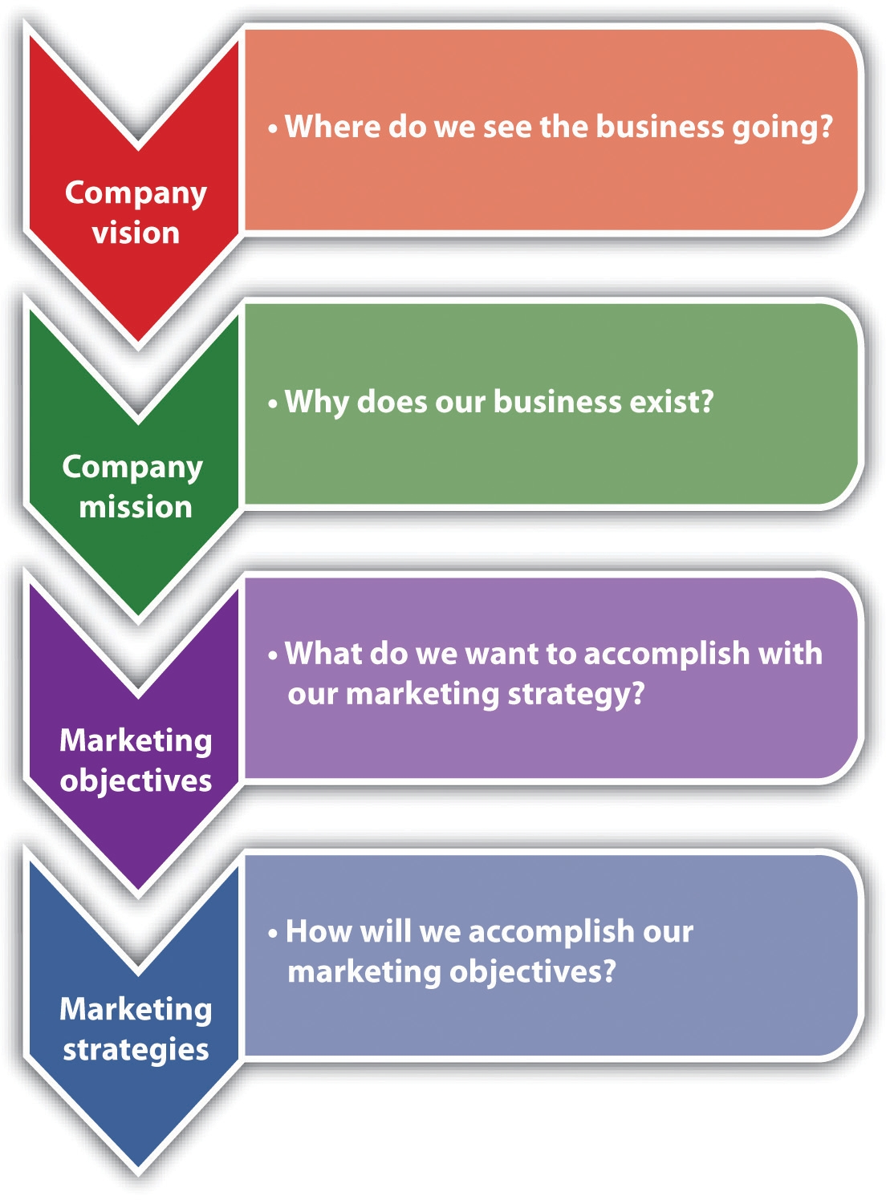
LEARNING OBJECTIVES
Learning Objectives
Learning Objectives
By the end of this lecture, you should be able to:
Describe how to conduct business meetings, both physical and online
Create a meeting agenda
Take minutes during a meeting

Slide 3
RECAP OF PREVIOUS LECTURE
A proposal is a document designed to persuasively appeal to the audience for a defined outcome, often proposing a solution to a problem.
Types of proposals- internal and external
Internal proposals can be formal or informal (routine).
External proposals can be solicited or unsolicited.
Other types of proposals include grant, research and sales proposals.
Persuasion, which includes ethos, pathos and logos, is key to effective proposal writing.
Proposal elements include a title page, executive summary, background, proposal, market analysis, benefits, timelines, marketing plan, finance and conclusion.
Business plans, elements of a business plan and why some business plans fail.

Slide 4
BUSINESS MEETINGS
Businesses cannot operate without meetings.
Meetings provide opportunities for sharing information, immediate feedback and making suggestions.
Adler & Elmhorst (2011, p. 272) call meetings ‘a fact of life.’ The authors report that 11-20 million meetings occur in America daily and that meetings are costly both in resources and time.
However, not all meetings are productive and according to one survey, employees think a third of the meetings are not necessary and are poorly conducted.

Slide 5
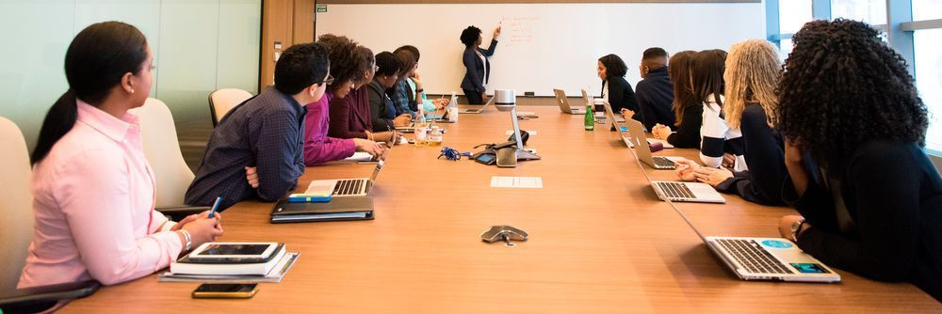
BUSINESS MEETINGS
Purposes for Meetings
Purposes for Meetings
However, meetings are useful and Taylor (2005) lists the following purposes they serve:
To give information to a group of people
To obtain assistance
To create involvement and interest
To put forward ideas or grievances for discussion
To report on some activity or experience
To coordinate or arrange activities

Slide 6

TYPES OF MEETINGS
Types of Meetings
Types of Meetings
Adler & Elmhorst (2011) suggest three categories of meetings: Information-sharing meetings; Problem-solving meetings and ritual activities.
Information-sharing meetings: E.g. an editorial meeting for a newspaper and a company with many branches nationally with weekly virtual meetings to keep all the workers up to date.

Slide 7
TYPES OF MEETINGS
Problem-solving or decision-making meetings: E.g. a high school teachers’ meeting. Adler & Elmhorst (2011) identify problem-solving meetings as the most common in businesses.
Ritual activities: Adler & Elmhorst (2011) opine that these meetings (often called progress review meetings) are social in nature and can even take place in a local bar. Even though the meeting environment may not appear businesslike, the authors state that such meetings are important for several reasons: to reaffirm members’ commitment to the company and to one another; it’s a forum to share ideas and information that might appear inappropriate at work; and it is sort of a perk that confers status on members.

Slide 8
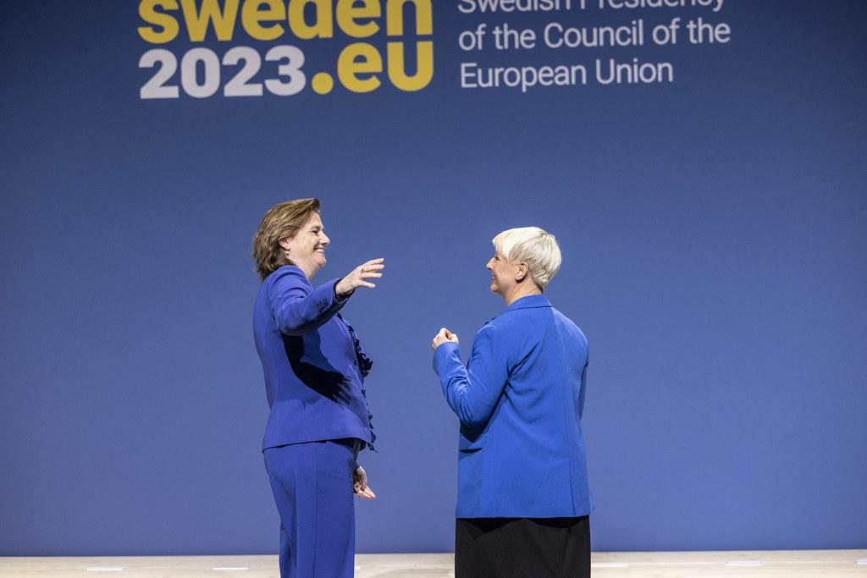
TYPES OF MEETINGS
Formal and Informal Meetings
Formal and Informal Meetings
Taylor (2005) classifies them as formal and informal meetings.

Slide 9

TYPES OF MEETINGS
Formal Meetings
Formal Meetings
According to Taylor (2005), these meetings occur according to the laid-down company policies (Article of Association, Constitution, Standing Orders, etc). These meetings need a quorum and the secretary is the officer designated by law to take minutes. Types of formal meetings include:
Annual general meetings: These are held annually to assess company operations in the last year. Shareholders must receive a 21-day notice ahead of the meeting.

Slide 10
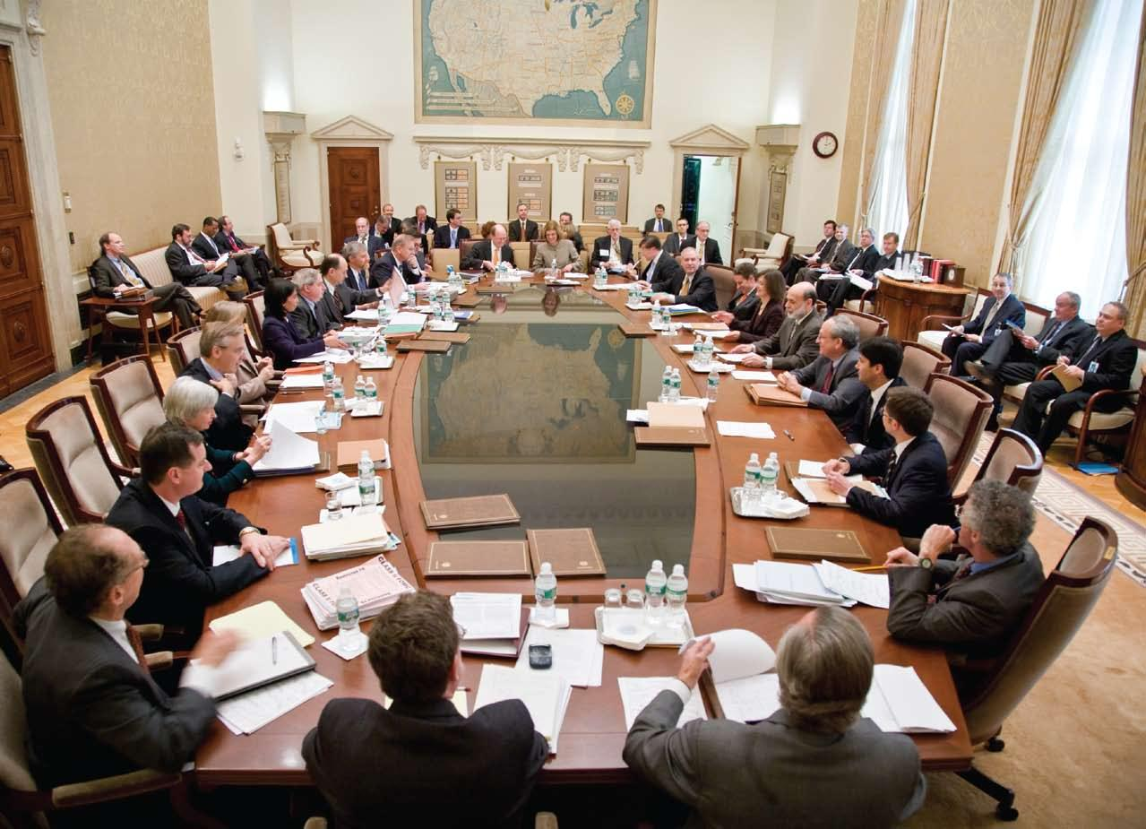
TYPES OF MEETINGS
Formal Meetings
Formal Meetings
Statutory meetings: These meetings (required by law) enable directors and shareholders to communicate and consider special reports.
Board meetings: These meetings (chaired by the Board Chairman and attended by all directors) are held as often as required.

Slide 11

TYPES OF MEETINGS
Informal Meetings
Informal Meetings
Informal meetings do not follow strict laid-down regulations as formal meetings and include the following:
Management meetings: As the name suggests, this is a meeting by managers who gather to discuss specific issues, solve problems, receive and comment on progress reports, etc.

Slide 12
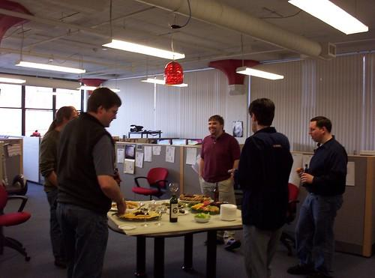
TYPES OF MEETINGS
Informal Meetings
Informal Meetings
Departmental meetings: These meetings, chaired by the head of department, occur at the departmental level.
Working parties: Involve teams that work on a specific project or problem.

Slide 13

TYPES OF MEETINGS
Regular and Specialized Meetings
Regular and Specialized Meetings
Andrews and Andrews (1988) classify meetings as regular and specialized. Regular meetings help to monitor the work environment, keep people informed and detect problems early enough. For example, departments that are required to meet weekly.

Slide 14
VIRTUAL MEETINGS
Advancements in technology have enabled virtual meetings which have become normal across organizations.
These meetings can occur via teleconference or videoconference.
Adler and Elmhorst (2011) state that the convener dials the first participant in a teleconference, taps the hang-up button, then calls the rest of the members. Once everyone is on board, the convener sends another signal which allows for conversations to begin.
With videoconferencing, participants can see one another as they engage.
Today, there exist a variety of videoconferencing facilities one can subscribe to such as Zoom, Google Meet, Class for Teams, the Big Blue Button, Webex, etc.

Slide 15
VIRTUAL MEETINGS
Virtual Meetings
Virtual Meetings
Adler and Elmhorst (2011) offer the following guidelines when attending teleconferences or videoconferences:
Send all documentation that will be discussed to all participants before the meeting
Participants to introduce themselves and their locations at the start of the meeting
Participants to identify themselves in telephone conversations to avoid confusion
No interruptions or leaving out certain participants
Ensure minimum distractions e.g. silence your phone
Use the best equipment

Slide 16
VIRTUAL MEETINGS
Virtual Meetings
Virtual Meetings
Learnlight (2018) offers the following tips for a virtual meeting:
Good organization: Have a group calendar; have a notification system; find a tool that works for you; structure your meetings
Focus on what’s important: Set clear objectives
Adopt a mandatory video-on policy: Mind non-verbal cues
Acknowledge all in the call
Share the mic
Don’t allow disrespect
Keep meetings short
Agree on the next steps

Slide 17

MEETING ATTENDEE
As an Attendee
As an attendee
Be involved
Discuss and don’t interrupt the speaker
Have good listening skills
Avoid distractions
Keep time

Slide 18

AGENDA WRITING
Agendas
Agendas
An agenda refers to a list of matters to be discussed in a meeting. Adler and Elmshorst (2011) state that a meeting without an agenda is like a ship at sea without a destination or compass. The purpose of an agenda is to outline the main ideas of the meeting as well as assign responsibilities and deadlines to be discussed.

Slide 19

AGENDA WRITING
Agendas
Agendas
An agenda is often driven by the needs of the company or meeting and will contain the following items:
Date, time and location
List of attendees
Goal of the meeting
Background information
The person/group that has called the meeting
Items to be discussed (include, but not limited to roll call, approval of previous minutes, matters arising, the business of the day- which can be a list of items to be discussed and adjournment)

Slide 20
SAMPLE AGENDA
Sample Agenda
Sample Agenda
Date: 28th November 2024
Time: 9am
Location: LR 4B
Meeting convener: Mr. Mark Kibwana- CEO
Attendees: All Employees
Call to order
Welcome and introductions
Review of agenda and meeting objectives
Recording of attendance
Confirmation of previous minutes
Reading of previous minutes
Confirmation of minutes
Matters arising
Discussion of unfinished business
Amendments if any

Slide 21
SAMPLE AGENDA
Sample Agenda
Sample Agenda
Employee issues
Presentation of current status regarding employees
Discussion of employee issues
Project updates
Reviewing current projects
Discussing milestones or challenges
New branch
Presentation of the new branch
Q & A session
Open forum
Any other pertinent business
Closing & adjournment
Summary of key takeaways
Next meeting date
Adjournment

Slide 22
CONDUCTING A MEETING
Begin and end on time
Have an effective opening to set the tone and mood of the meeting
Explain why the group is meeting (goals) and how the meeting will run
Give background information
Ensure members participate and give each member an equal chance. You can use questions to draw listeners to participate
Keep discussions on track
Maintain a positive tone
Conclude the meeting and close it when the scheduled time has arrived and when the agenda has been covered. Provide a summary of what was discussed and acknowledge the group’s contributions.

Slide 23
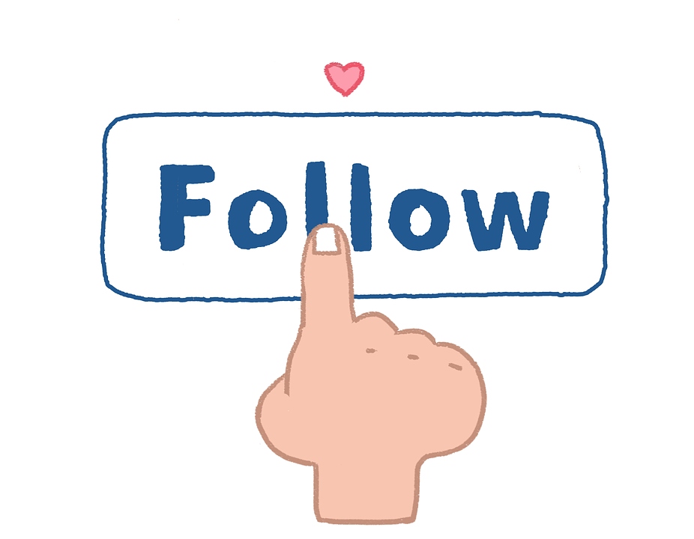
CONDUCTING A MEETING
Follow Up
Follow Up
Always make a point to follow up so that people do not forget what was said. Some members may have taken away different interpretations, so a follow-up will help bring everybody on board. You can follow up by sending a memo or email summarizing the meeting’s accomplishments and highlighting delegated tasks and responsibilities.

Slide 24
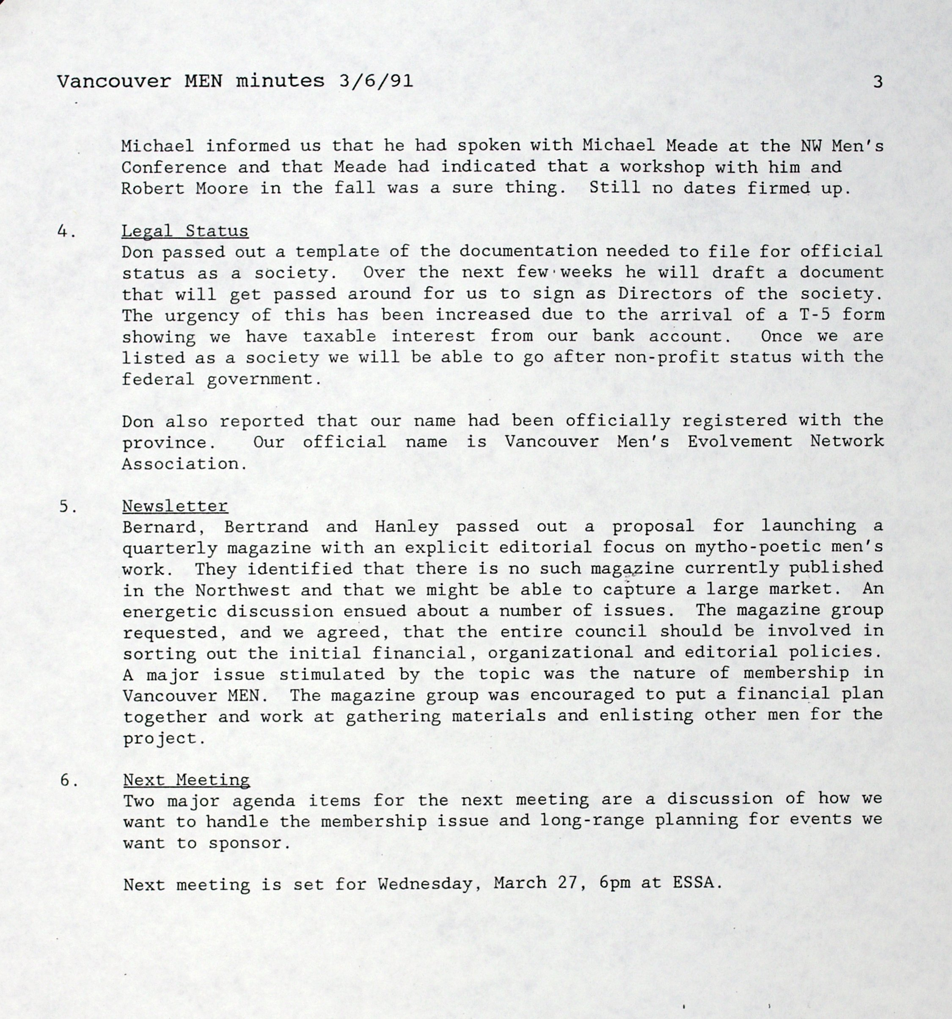
MINUTES
Minutes
Minutes
Minutes are an official record of a meeting.
Only the designated secretary or assistant secretary takes minutes. In other meetings, anyone can be appointed to take the minutes.
The records indicate what was said during the meeting and what actions should be pursued.
Minutes help to keep the members who could not attend informed.

Slide 25
ELEMENTS OF MINUTES
Title that contains the group that is meeting and the date, place and time
List of the members present, absent, and those who sent apologies
The agenda of the current meeting for which minutes are being written
Confirmation of previous minutes
Matters arising from previous minutes (unfinished business)
New business represented in various points/list of items to be discussed. The discussions include actions or tasks to be undertaken, the responsible people, decisions made by participants, main points, etc.

Slide 26

MINUTE WRITING
Minute Writing
Minute Writing
Record accurate details, so come prepared
If using a laptop, ensure you have a functioning laptop with enough charge.
Take only the main points to avoid being overwhelmed and missing out on the meeting as a whole.
After the meeting, clean up the minutes and send them out as soon as possible.

Slide 27

WRITING OF MINUTES
Minute Writing
Minute Writing
The minutes can be displayed in a variety of formats. Some companies have templates.
Use the past tense since minutes are a record of what has taken place.
Use the third person/reported speech.

Slide 28
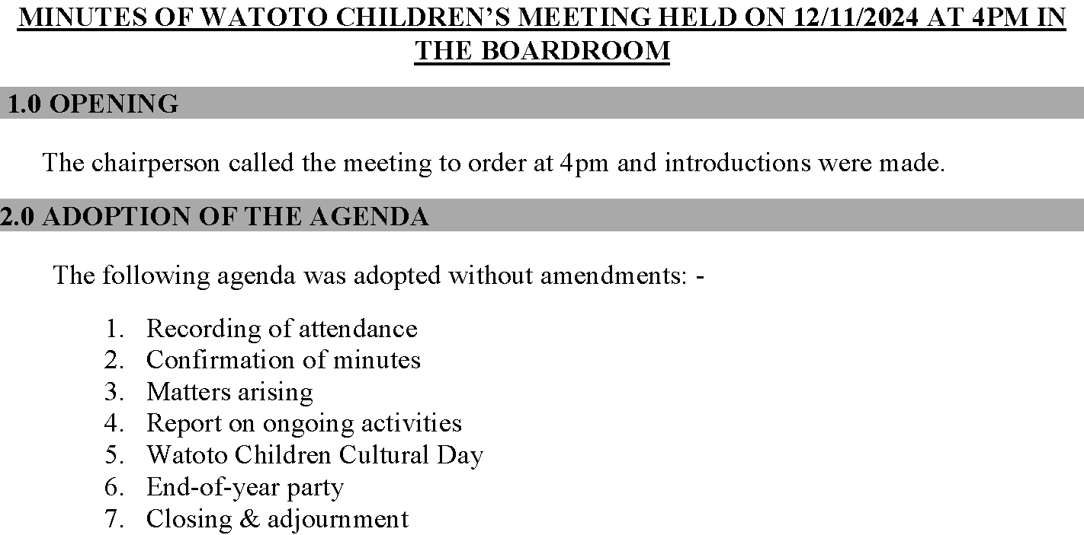
SAMPLE MINUTES

Slide 29
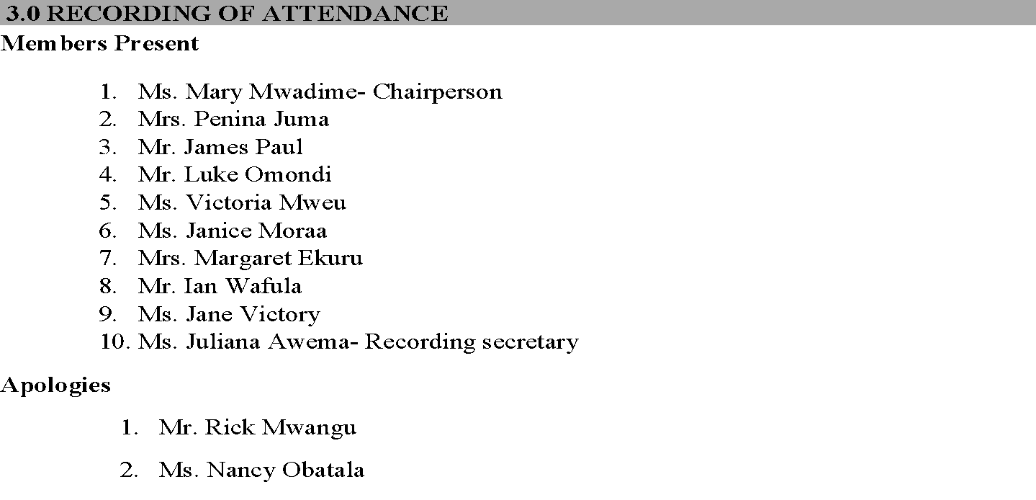
SAMPLE MINUTES

Slide 30
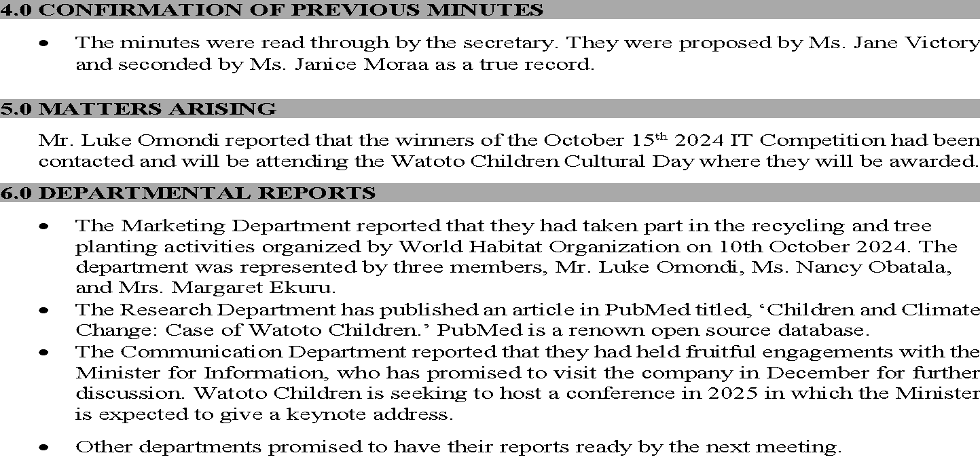
SAMPLE MINUTES

Slide 31
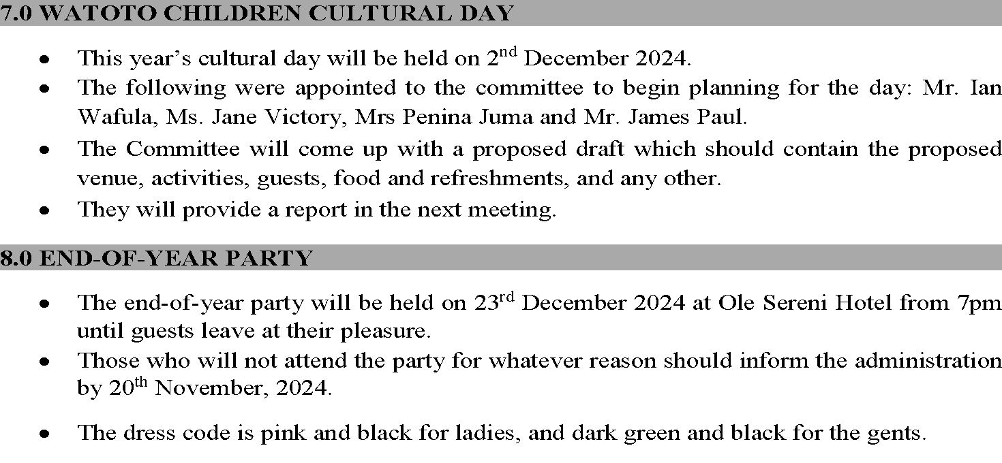
SAMPLE MINUTES

Slide 32
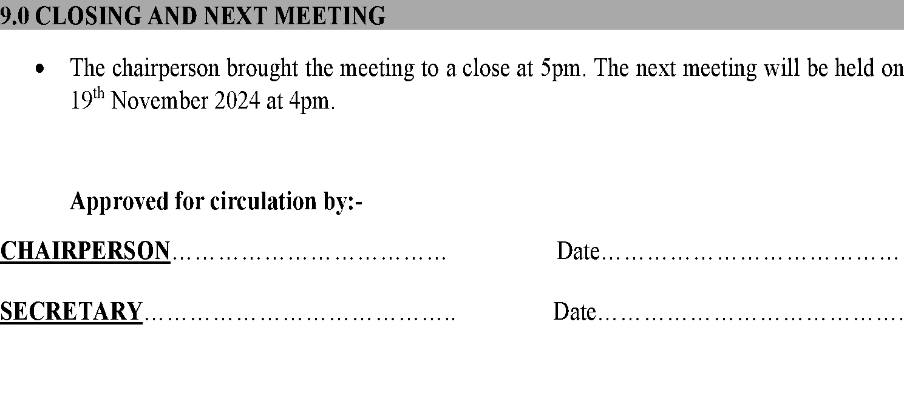
SAMPLE MINUTES

Slide 33
SUMMARY
Business meetings are necessary for brainstorming, sharing ideas, decision-making, to report on an activity, coordinate some activities, etc.
Types of meetings include formal and informal meetings, regular and specialized meetings, etc.
Virtual meetings have gained prominence but there is a way to conduct them, eg turning on cameras, muting mics unless speaking, etc.
Before a meeting can take place, an agenda should have been shared among the participants
During the meeting, minutes are taken to keep a record of the discussions and resolutions passed.

Slide 34

ACTIVITY
Activity
Activity
Read the article about business meetings by the Harvard Business Review and make notes.
In groups of 6, conduct a mock meeting where one of you will be the chair and another the secretary. The secretary will take minutes and type them out. The rest of the members will critique the minutes.

Slide 35
REFERENCES
Adler, R. B. & Elmhorst, J. M. (2010). Communicating at work. McGraw Hill.
Andrews, D. C. & Andrews, W. D. (1988). Business communication. Macmillan Publishing Company.
Jay, A. (n.d.). How to run a meeting. https://hbr.org/1976/03/how-to-run-a-meeting
Learnlight. (2018, November 27). 8 Tips for more effective virtual meetings. https://www.learnlight.com/en/articles/8-tips-more-effective-virtual-meetings/
Smith, J. & Williams, V. (2020). Meetings and web conferencing. Fundamentals of Business Communication. https://pressbooks.bccampus.ca/businesswritingessentials/chapter/11-3-group-meetings-and-web-conferencing/
Taylor, S. (2005). Communication for Business: A practical approach. (4th Ed). Pearson Longman.
All the images courtesy of Creative Commons though Bing on PowerPoint

