Slide 1

Strategic Management
Lecturer Two: Internal Environmental Scanning
Lecturer: Stephen Githii
Image Source: Microsoft 365 built-in stock image

Slide 2
Introduction
Last lecture we introduced strategic management by offering different perspectives
This current lecture we are going to dive deeper into the process
We will cover different schools of thought or views

Slide 3
Learning Outcomes
Comprehensive overview of strategic management process
Highlight key schools of thought in the discipline
Examine practical application in global context

Slide 4

Opening Story- Ship Captain
Image Source: Microsoft 365 built-in stock image​

Slide 5

Pause and Reflection
What is the ultimate destination or goal for your ship (organization)?
How important is it to have a clear vision before starting the sail?
If you were the captain of the ship, what important information would you need about the waters (market) before your journey?
What resources (crew, supplies) are essential for your journey?

Slide 6
Pause and Reflection
How would you decide between different routes (strategic options)?
How would you monitor your progress during the journey?
What indicators would you use to determine if you are on the right path, or you need to adjust your course?

Slide 7
Opening Case: Apple
From a struggling company in 1990s
To the most valuable company in the world today.
What happened?

Slide 8
Opening Case: Apple
He (Steve Jobs) implemented a series of strategic changes
Streamlining product lines from over 300 to just 10,
Focusing on innovation, prioritizing design, user experience, cutting-edge technology, to launching the “think different” campaign.

Slide 9

Takeaways
Lead with a clear vision
Innovation should solve customer problems
Build a brand not just a product
Beauty of recurring revenue streams
Think ecosystem not just standalone

Slide 10
Schools of Thought in Strategic Management
The schools provide perspectives and frameworks
Each of these schools offers unique insights into complexities of decision making
They guide how organizations formulate, implement, and evaluate their strategies.

Slide 11

Planning School
This school of thought proposes that strategy as a formal and structured process
It requires detailed plans, timelines, objectives and procedures
The whole process is documented
Image Source: Microsoft 365 built-in stock image

Slide 12
Design School
Strategy is seen as the fit between internal capabilities and external environment
This works well in a stable environment
Therefore, strategy design is an intentional and thoughtful process

Slide 13
Design School
Success of the school is dependent on the knowledge of the organization
The school emphasize the analysis of strength, weakness, opportunity and threats

Slide 14

Positioning School
This sees strategy as the selection of strategic position in the market or the industry
Firm can use tool such as BCG matrix, five forces, and value chain to position their products
Exemplified by Porter’s generic strategies that relates to cost leadership, differentiation, and focus
Image Source: Microsoft 365 built-in stock image

Slide 15
The entrepreneurial school
This school focus on the founder or the entrepreneur as we mentioned in week one, people like Steve Jobs, Howard and Dell
The firm follows the direction of the CEO or the founder
The CEO must be visionary and have strong leadership skill

Slide 16
Cognitive School
This focuses on the mental models, perceptions and beliefs of key decision-makers within the organization
It heavily relies on how individuals process information
It requires you to understand customer’s perception and craft a strategy based on that

Slide 17
The learning School
This looks at what has happened in the past and build the future based on this
The firm may also look at what has worked or not worked in other organizations

Slide 18
The learning School
What has worked is not a guarantee that it will work today or in future
It may not be the best approach during crisis

Slide 19
The Power School
The school emphasize the role of power and politics in organizations
The school say that the people with power make decisions
It points out that strategy formulation is a process of negotiation, persuasion and influence among the different players both internally and externally.

Slide 20
The cultural School
The school focuses on organizational culture and its impact on strategy execution
The embedded culture in the firm- in terms of norms, shared values, and beliefs has influence on the strategic decisions

Slide 21
The cultural School
Understanding the organizational culture can help a leader to align strategies to ensure greater buy-in which increases chances of implementation success.
The school embroil the need to consider cultural dynamics during strategic planning phase

Slide 22
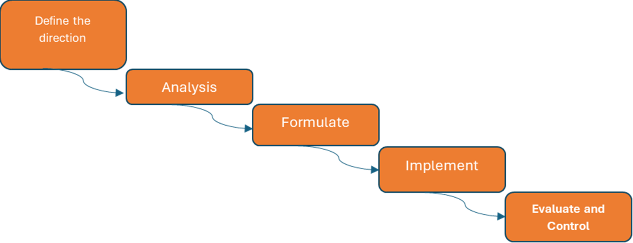
The Strategic Management Process

Slide 23

Where you want to go, and your purpose
The vision statement: Determining where you want to be in the future in your given industry

Slide 24
Where you want to go, and your purpose
The Mission statement: Being clear on what is your purpose as a firm, and those that you will impact as your key stakeholders

Slide 25

2. Environmental Scanning:
Image Source: Microsoft 365 built-in stock image
Internal Analysis:
Assessing organizational strengths and weaknesses (resources, capabilities, culture). You can use tools such as SWOT and VRIO frameworks

Slide 26
2. Environmental Scanning:
Image Source: Microsoft 365 built-in stock image
External Analysis:
Identifying opportunities and threats in the macro and microenvironments
Tools such as PESTEL and FIVE forces framework are helpful in this phase.

Slide 27
3. Strategy Formulation:
Setting Objectives:
Defining clear, measurable, achievable, relevant, and time-bound (SMART) goals.

Slide 28
3. Strategy Formulation:
Developing Strategies: Choosing appropriate strategies based on analysis (corporate, business, and functional levels which we talked about in week 1).

Slide 29
4. Strategy Implementation:
Organizing Resources: Allocating financial, human, and technological resources effectively. Getting the ones that you don’t have and are necessary.
01
Developing Structures: Designing organizational structures, systems, and processes that support the chosen strategy.
02
Managing Change: Overcoming resistance to change and ensuring smooth implementation.
03

Slide 30

5. Strategy Evaluation and Control:
Measuring Performance:
Comparing Results to Objectives:
Taking Corrective Action: .
Image Source: Microsoft 365 built-in stock image

Slide 31

Topic Review
Strategic management is crucial for navigating the complexities of the market, like a ship's captain needing a plan for uncharted waters.
Various schools of thought, offer different perspectives on strategy formulation and implementation, each with strengths and weaknesses.

Slide 32
Topic Review
The Apple turnaround case highlights the importance of visionary leadership
Understanding different schools of thought helps managers tailor strategies to specific organizational needs
In the next topic we shall dig deeper into internal environmental scanning.

Slide 33

References
All images are from Microsoft 365 built-in stock image

