Slide 1

Strategic Management
Source: Microsoft 365 built-in stock image
Lecture 7: Strategy Analysis and Choice
Lecturer: Stephen Githii

Slide 2

Session Overview
• Transition from strategy formulation to strategy choice
• Explore tools for evaluating strategic options
• Discuss decision-making frameworks
• Apply to case studies and scenarios

Slide 3
Learning Outcomes
1. Explain strategy analysis and choice
2. Compare different strategy analysis tools
3. Apply decision-making criteria to real cases

Slide 4

Case: Coffee Co-op Dilemma
Source: Microsoft 365 built-in stock image
A local cooperative is considering its strategic future
Options: Go it alone, Merge, or Partner with a buyer
Question: Which path ensures long-term impact and survival?

Slide 5

Discussion Questions
1. What internal and external factors should they consider?
2. What makes a strategic option ‘good’?
3. Which tools would help analyze these choices?

Slide 6

Case Example: Southwest Airlines
• Focused on short-haul, low-cost, high-frequency service
• Avoided large airports; used single aircraft type
• Strategic coherence led to profitability and growth
Source: Microsoft 365 built-in stock image

Slide 7
Lessons from Southwest
Clear differentiation and cost control
Alignment between strategy and operations
Importance of choosing a coherent path

Slide 8

What is Strategy Analysis and Choice?
According to Morris & Hodges (2019), strategy analysis involves evaluating alternative strategies using decision criteria to select the most appropriate course of action.
It is the bridge between formulation and implementation.
This decision will require you to use a given criterion
Source: Microsoft 365 built-in stock image

Slide 9
Key Evaluation Criteria
Suitability: Does the strategy fit with the external environment?
Feasibility: Can we afford and operationalize it?
Acceptability: Will stakeholders support it?

Slide 10
Tools for Strategy Analysis
SWOT Matrix: Matches internal strengths and weaknesses with external opportunities and threats.
TOWS Matrix: Develops strategic alternatives from SWOT elements.
BCG Matrix: Analyzes business units/products based on market growth and share.

Slide 11
Tools for Strategy Analysis
GE/McKinsey Matrix: Assesses business units using industry attractiveness and business strength.
QSPM (Quantitative Strategic Planning Matrix): Provides an objective basis for strategy comparison.

Slide 12

BCG Matrix: Overview
Developed by Boston Consulting Group
Helps allocate resources among SBUs
Based on market growth rate and relative market share
Source: Microsoft 365 built-in stock image

Slide 13

BCG Matrix: Axes Explained
Y-axis: Market growth rate (industry attractiveness)
X-axis: Relative market share (competitive strength)

Slide 14
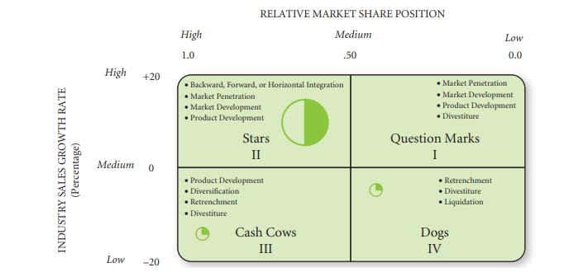
BCG Matrix

Slide 15
BCG Matrix: The Quadrants
1. Stars – High growth, high share
2. Cash Cows – Low growth, high share
3. Question Marks – High growth, low share
4. Dogs – Low growth, low share

Slide 16
Strategic Implications per Quadrant
• Stars – Invest for growth
• Cash Cows – Maintain and harvest profits
• Question Marks – Decide: invest or divest
• Dogs – Divest or reposition

Slide 17
BCG Matrix: Example
Example: Apple Inc.
• iPhone – Cash Cow
• Apple Watch – Question Mark
• iPad – Star (in some markets)
• iPod – Dog

Slide 18
BCG Matrix: Advantages
• Simple and visual tool
• Helps prioritize investments
• Encourages resource focus

Slide 19
BCG Matrix: Limitations
• Assumes only two factors matter
• Market growth not always linked to attractiveness
• Ignores synergies among SBUs

Slide 20
GE Matrix: Overview
• Also known as McKinsey Matrix
• Evaluates SBUs based on industry attractiveness and business strength
• More detailed than BCG Matrix

Slide 21

GE Matrix: Axes Explained
Y-axis: Industry Attractiveness
X-axis: Business Unit Strength
Each axis has multiple weighted factors
Source: Microsoft 365 built-in stock image

Slide 22
GE Matrix: Sample Diagram
Nine-cell matrix
Zones: Grow, Hold, Harvest
Helps prioritize investments

Slide 23
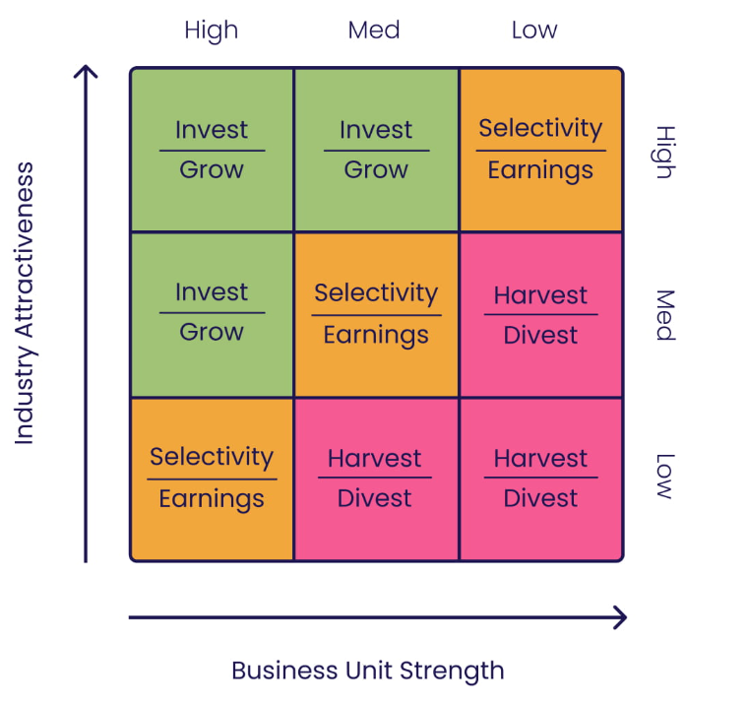
GE Matrix (Source: https://www.cascade.app/blog)

Slide 24
Industry Attractiveness Factors
• Market size and growth rate
• Profit margins
• Competitive intensity
• Technological requirements

Slide 25
Business Unit Strength Factors
• Market share
• Product quality
• Brand strength
• Distribution network

Slide 26
GE Matrix: Strategic Zones
• Grow: High strength and attractiveness
• Hold: Medium areas – selective investment
• Harvest: Low priority areas – limit resources

Slide 27
GE Matrix: Advantages
• Multi-factor approach
• Encourages strategic thinking
• Better resource allocation decisions

Slide 28
GE Matrix: Weaknesses
• Data-heavy and subjective
• Complex scoring can vary across evaluators
• Time-consuming for smaller firms

Slide 29
QSPM Matrix: Overview
• Quantitative Strategic Planning Matrix
• Evaluates strategic options objectively
• Helps determine the best strategy among alternatives

Slide 30
QSPM: Core Components
1. Key external and internal factors (from EFE/IFE)
2. Weight assigned to each factor
3. Attractiveness Scores (AS) for each strategy
4. Total Attractiveness Scores (TAS) to rank strategies

Slide 31

QSPM: Step-by-Step Process
1. List key factors from IFE and EFE
2. Assign weights to each factor (sum = 1.00)
3. Develop alternative strategies
4. Assign attractiveness scores (AS: 1–4) per strategy
5. Compute TAS = Weight × AS
6. Sum TAS for each strategy
Source: Microsoft 365 built-in stock image

Slide 32
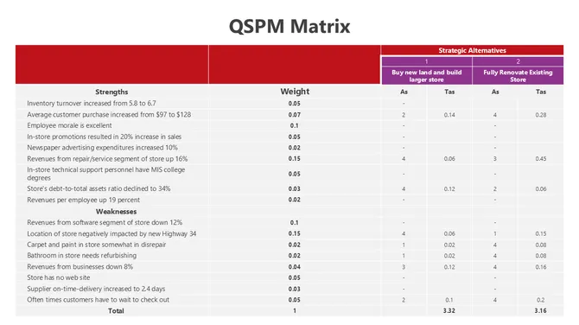
Source: https://www.slideegg.com/

Slide 33
QSPM Example
Strategy A: Expand into new market
Strategy B: Launch new product line
TAS A = 3.15; TAS B = 2.65 → Choose Strategy A

Slide 34
QSPM: Advantages
• Systematic and objective
• Utilizes previously gathered data (IFE/EFE)
• Facilitates strategic decision making

Slide 35
QSPM: Limitations
• Attractiveness scores can be subjective
• Time-consuming to develop
• Requires accurate and reliable data inputs

Slide 36

Strategic Choice Approaches
Source: Microsoft 365 built-in stock image
Corporate-Level Strategies: Growth, stability, retrenchment.
Business-Level Strategies: Cost leadership, differentiation, focus.

Slide 37
Summary and Wrap-Up
BCG and GE help assess portfolio strategies
QSPM guides objective strategic choice
Real-world application requires context and judgment

Slide 38
Summary and Wrap-up
Strategic analysis and choice is not about selecting the most exciting idea—it’s about disciplined decision-making rooted in evidence, capability, and long-term vision. As Morris and Hodges (2019) emphasize, the best strategy is the one an organization can and will implement effectively.
In our next lecture we will talk about strategic leadership and change management, key ingredients when it comes to successful strategy implementations.

Slide 39
References
David. F, David. F (2015) Strategic Management- Concepts and Cases, 5th Ed, Pearson,
Kirby, London.
Morris, J., & Hodges, T. (2019). Strategic Management. Open Educational Resources,
Oregon State University, Chapter 6 – “Strategy Analysis and Choice”.
https://www.cascade.app/blog (Accessed on 5/3/2025)
https://www.slideegg.com/ (Accessed on 5/3/2025)

