Slide 1

Strategic Management
Lecture 11: Risk Management and Crisis Strategy
Lecturer: Stephen Githii

Slide 2
Why This Topic Matters
Strategy faces disruption
Risk planning builds resilience

Slide 3

Learning Outcomes
Define risk vs. crisis
Explore risk and crisis tools
Apply principles to personal life

Slide 4

BP Disaster Overview
2010: Oil rig explosion
Massive environmental and financial fallout (Ingersoll, Lockie, Reavis, 2012).

Slide 5

What Went Wrong?
Ignored safety warnings
No crisis protocols in place
Billion environmental lawsuit

Slide 6

Strategic Lessons from BP
Match ambition with risk planning
Crisis plans are vital

Slide 7

What is Strategic Risk?
Disrupts strategic goals
Comes from internal or external sources

Slide 8

What is Risk Management?
Is the systematic process of identifying, assessing, and responding to risks that could impact business operations
Supports confident decisions

Slide 9

What is a Crisis?
Sudden, high-impact event
Needs urgent leadership response
May force strategy change

Slide 10

Risk vs. Crisis
Risk = Possibility
Crisis = Reality

Slide 11

Step 1 – Risk Identification
Spot internal and external risks
Examples: economic shifts, leadership change

Slide 12

Step 2 – Risk Assessment
Rate likelihood and impact
Use qualitative/quantitative tools

Slide 13
Step 3 – Mitigation
Reduce risk or impact
Plan actions in advance

Slide 14

Step 4 – Monitoring
Track emerging risks
Update risk profiles often

Slide 15

Step 5 – Response Planning
Create clear contingency plans
Be ready to activate them

Slide 16

Tools for Risk/Crisis Management
We have several tools
Some we have looked in the past
Thus, we will focus on the new ones

Slide 17

SWOT Analysis
Focus on threats
Protect competitive position

Slide 18

2. PESTLE Analysis
Track macro risks
Plan for political to ecological changes/adjustments

Slide 19

3. Risk Heat Map – Overview
Plot risks: Likelihood x Impact
Color-coded priority zones

Slide 20
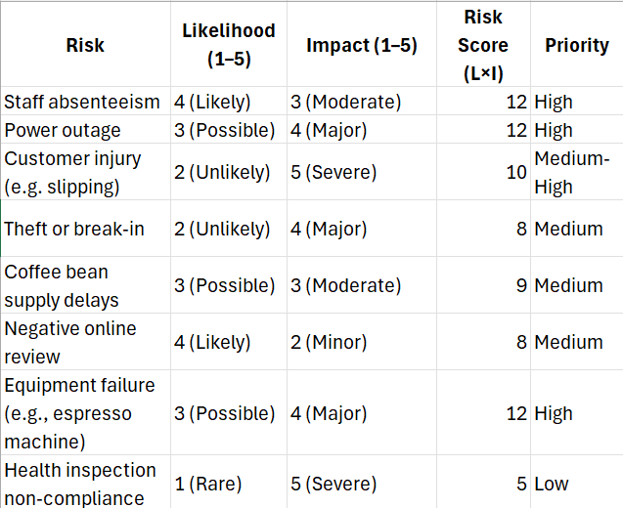
Using the Heat Map
Score risks (1–5)
Multiply likelihood × impact

Slide 21
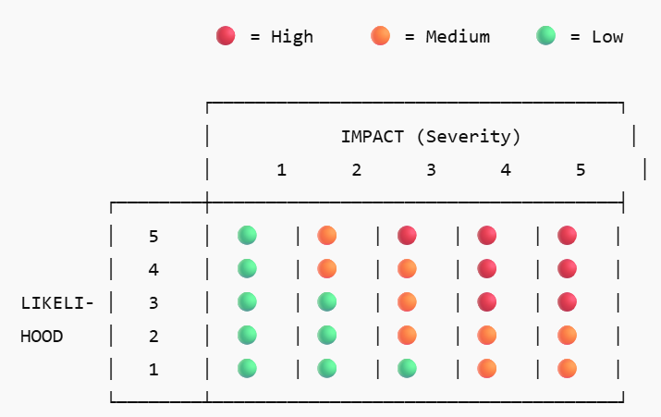
Interpreting the Heat Map
Red = High Risk = Urgent
Green= not concern now = monitor

Slide 22

Coffee Shop Risk Example
Risks: theft, outages, equipment failure
High scores need action

Slide 23

What is Business Continuity Planning (BCP)?
It ensures that essential functions continue during and after a crisis.
Keep operations running
Combines planning + communication

Slide 24
Steps in BCP (Part 1)
Risk assessment
Impact analysis
Strategy development

Slide 25
Steps in BCP (Part 2)
Plan creation
Training and drills
Plan maintenance

Slide 26

BCP Essentials
Emergency contacts
Backups and recovery
Clear communication plans

Slide 27

Coffee Shop BCP
Risk: Power outage
Response: Generator, manual brewing, social media alert

Slide 28

Why Apply Personally?
Build resilience
Prepare for disruptions

Slide 29

Personal Risks to Manage
Job loss, illness, cyber threats
Poor financial or time choices

Slide 30

Managing Personal Risk
Emergency fund, insurance
Healthy habits and backups

Slide 31

Personal Crisis Response
Act fast and stay calm
Recover, reflect, adapt

Slide 32

Recap – What We Covered
Risk vs. crisis
Risk tools and planning
Personal application
Next topic will be about Innovation and Disruptive Strategies

Slide 33

Key Takeaways
Risk is inevitable
Crisis needs clarity
Resilience is strategic

Slide 34
References
Ingersoll, C., Locke, R. M., & Reavis, C. (2012). BP and the Deepwater Horizon disaster of 2010. MIT Sloan School of Management. https://mitsloan.mit.edu/teaching -resources-library/bp-and-deepwater-horizon-disaster-2010
Morris, J., & Hodges, T. (2019). Strategic management. Oregon State University. https://open.oregonstate.education/strategicmanagement/

