Slide 1

Sustainable Finance -
Lecture 1 (PART 1)
Lesson Title: Introduction to the concept of Sustainable Finance
Instructor: Dr. Mary Githinji

Slide 2
Course Overview & Objectives
1
Course Overview
2
Understand ESG factors
3
Explore key financial instruments
Introduction to sustainable finance, its significance, and key players.
Explore the role of Environmental, Social, and Governance factors in finance.
Learn about financial instruments for sustainability.
4
Analyze global trends
5
Examine technology and regulation
Examine global trends and challenges in sustainable finance.
Understand the role of technology and regulation in sustainable finance.

Slide 3





Learning Outcomes
Understand fundamentals
Understand the fundamentals of sustainable finance and its role in promoting economic, environmental, and social sustainability.
Analyze ESG factors
Analyze ESG factors and their impact on financial decision-making, investment strategies, and corporate governance.
Evaluate financial instruments
Evaluate key financial instruments such as green bonds, sustainability-linked loans, and impact investing.
Assess global trends
Assess global trends, challenges, and regulatory frameworks shaping sustainable finance.
Apply principles
Apply sustainable finance principles to real-world scenarios, including risk assessment, investment analysis, and policy recommendations.

Slide 4

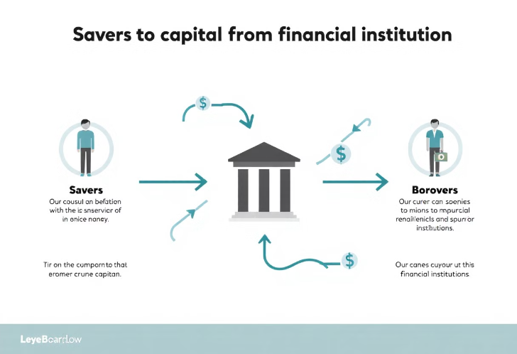
What is Finance? How does the Financial System work?
Finance
Financial System
Finance: source of Funds
Financial System: Platform where money moves from the Savers to the borrowers.

Slide 5
What is Sustainable Finance?
Definition
Scope
Integrating Environmental, Social, and Governance (ESG) factors into financial decisions.
Includes ESG investing, impact investing, green finance, and climate finance.

Slide 6


Let us talk
What Do You Know About Sustainable Finance?
Have you heard of ESG investing?
Can finance drive sustainability?
What are examples of sustainable finance in your country?

Slide 7
What is Sustainable Finance?
Definition
Scope
Financial System
Integrating Environmental, Social, and Governance factors into financial decisions.
Includes ESG investing, impact investing, green finance, and climate finance.
Platform where money moves from savers to borrowers with sustainability in mind.

Slide 8




Why is Sustainable Finance Important?
Addresses climate change
Promotes social equity
Ensures long-term financial stability
Funding renewable energy projects and initiatives.
Supporting microfinance and fair labor practices.
Managing climate risks and promoting sustainable growth.

Slide 9
Role of Finance in Sustainability
Mobilize Capital
mitigate risks
Example
Financial institutions mobilize capital for sustainable projects, For example: A bank issuing green bonds to fund solar energy projects.
Particularly climate-related risks that impact investment decisions.
A bank issuing green bonds to fund solar energy projects.

Slide 10
Evolution of Sustainable Finance
1997: Kyoto Protocol
1
First global agreement on climate change.
2
2006: UN Principles for Responsible Investment (PRI)
2015: Paris Agreement
3
Established framework for responsible investment practices.
Global commitment to net-zero emissions.
4
2020s
Growth of ESG investing and sustainable debt markets.
Key Concepts in Sustainable Finance
ESG Investing – Assessing financial decisions based on ESG factors.
Impact Investing – Investments aiming for both profit and positive impact.
Green Finance – Financial products focused on environmental sustainability.
Climate Finance – Funding for climate adaptation & mitigation.

Slide 11
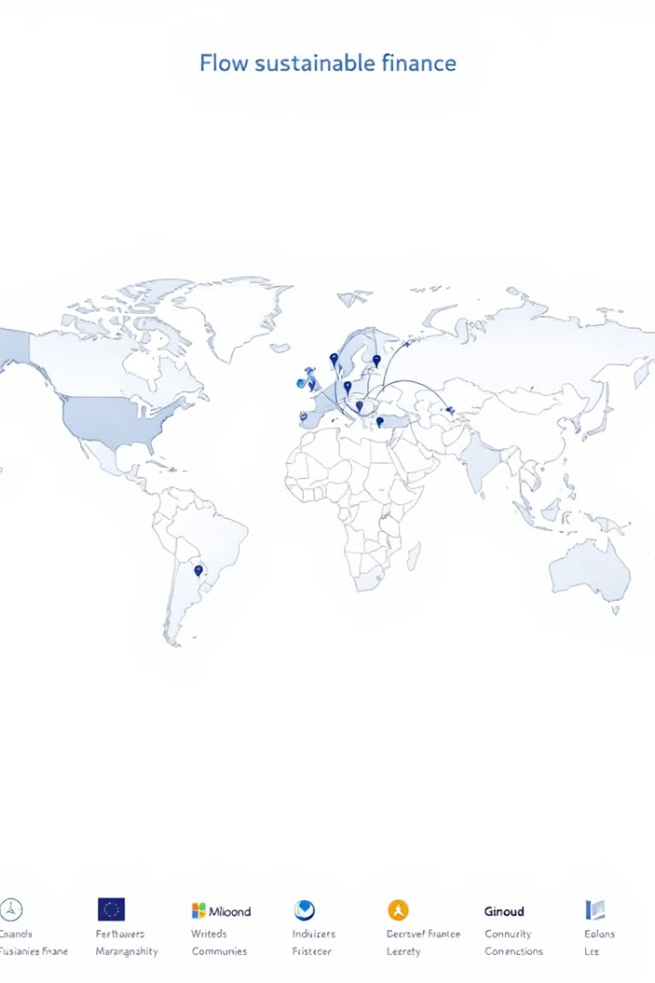




Key Players & Global Trends
Banks
Investors
Governments & IFIs
Provide green loans and sustainable investments.
$35T+ in global sustainable assets.
IMF, World Bank, development banks creating frameworks.
Corporations
Committing to net-zero targets and ethical business practices.

Slide 12




Global Trends and Key Players
Corporations
1
Commit to net-zero targets and ethical business
Governments & IFIs
2
IMF, World Bank, African Development Bank
Investors
3
Fund ESG projects (e.g., BlackRock, pension funds)
Banks
4
Provide green loans and sustainable investments
Global Trends in Sustainable Finance
Growing ESG Investments – $35T+ in global sustainable assets.
Rise of Green Bonds & Sustainable Debt – Over $1.5T issued in 2023.
Increased Regulation – EU Taxonomy, TCFD, SEC ESG disclosures.
(Sources: World Bank, IMF, UNPRI)

Slide 13
Let us talk
Who Should Drive Sustainable Finance?
Should it be governments, corporations, or individuals?
What policies or incentives could help?

Slide 14

Challenges in Sustainable Finance
Greenwashing
Lack of Standardization
Companies misleading investors about environmental credentials, like the Volkswagen emissions scandal.
Different ESG rating methodologies creating confusion in markets.
Data Issues
Inconsistent and non-transparent ESG reporting hampering decision-making.

Slide 15





The Future of Sustainable Finance
Stronger Regulations
More ESG disclosure requirements across global markets.
New Financial Products
Expansion of sustainability-linked loans and innovative instruments.
Technology Integration
AI, blockchain, and big data improving ESG tracking and reporting.
Emerging Markets Growth
Africa and Asia rapidly adopting green finance models.

Slide 16
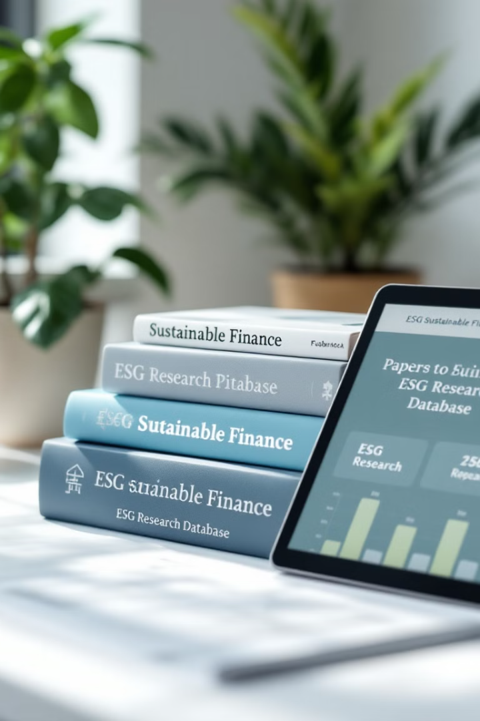
References
Jeucken, M. (2001)
Sustainable finance and banking: The financial sector and the future of the planet. Routledge.
Vargas, C. (2021)
Sustainable finance fundamentals. Springer.
Meo, M. S., & Staniewski, M. W. (2022)
Green bonds and sustainable finance: The evolution of portfolio management in conventional markets. Palgrave Macmillan.
Grigg, N. S. (2021)
Infrastructure finance: The business of infrastructure for a sustainable future. Wiley.

