Slide 1

Sustainable Finance -
Lecture 1 (PART 2)
Lesson Title: Introduction to the concept of Sustainable Finance
Instructor: Dr. Mary Githinji

Slide 2

Sustainable Finance Strategies
Exploring the intersection of finance and sustainability through investment strategies, instruments, risks, and technological innovations.

Slide 3

Sustainable Investment Strategies
1
Negative Screening
2
Best-in-Class
Avoiding harmful industries (e.g., fossil fuels).
Investing in leaders in ESG practices.
3
Impact Investing
Focusing on measurable positive impact.

Slide 4
Green Bonds & Sustainable Debt Instruments
Green Bonds
Sustainability-Linked Bonds
Funds go to climate projects.
Tied to company ESG targets.

Slide 5




Risks & Challenges in Sustainable Finance
Greenwashing
Lack of Standardization
ESG Data Issues
Companies misleading investors (e.g., Volkswagen emissions scandal).
Inconsistent and non-transparent reporting.
Different ESG rating methodologies.

Slide 6
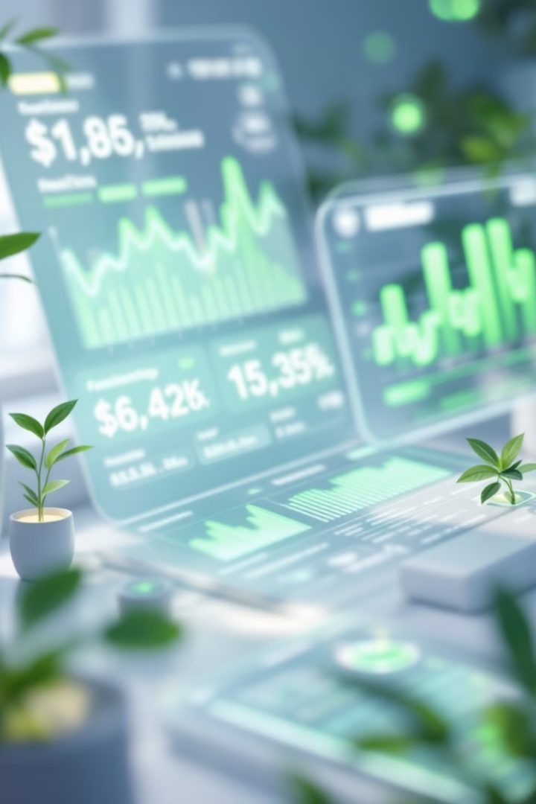
Does Technology Help in Sustainable Finance?
Technology plays a crucial role in advancing sustainable finance practices through various innovative applications.

Slide 7
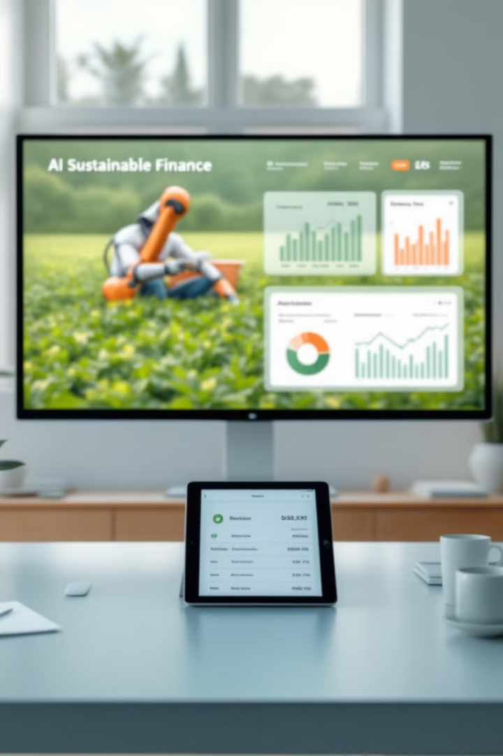
Role of Technology in Sustainable Finance
AI & Big Data
Blockchain
ESG data collection & fraud detection.
Transparent ESG reporting & tracking.
Agribusiness Innovations
Non-fossil fuel tech, precision farming.

Slide 8

Sustainability Reflection Questions
What are the Risks if Sustainability is not checked?
1
2
Have you ever been affected by climate change?
What industries are affected the most?
3

Slide 9



Sustainability Risks in Finance
Transition Risks
2
Policy shifts toward sustainability
Physical Risks
1
Climate disasters
Carbon Tax Impact
3
Effects on fossil fuel companies

Slide 10

Sustainable Finance: Trends, Challenges, and Opportunities
Governments and corporations are promoting sustainable finance
Future trends in this field,
Challenges and opportunities,
Real-world examples
Key takeaways for understanding the evolving landscape of sustainable finance.

Slide 11
How Governments Promote Sustainable Finance
Policy Incentives
Corporate Integration
Tax incentives for renewable energy.
companies integrating ESG into their business models.
Example: The U.S. Inflation Reduction Act funding green projects.
Example: Tesla's investment in battery technology.

Slide 12
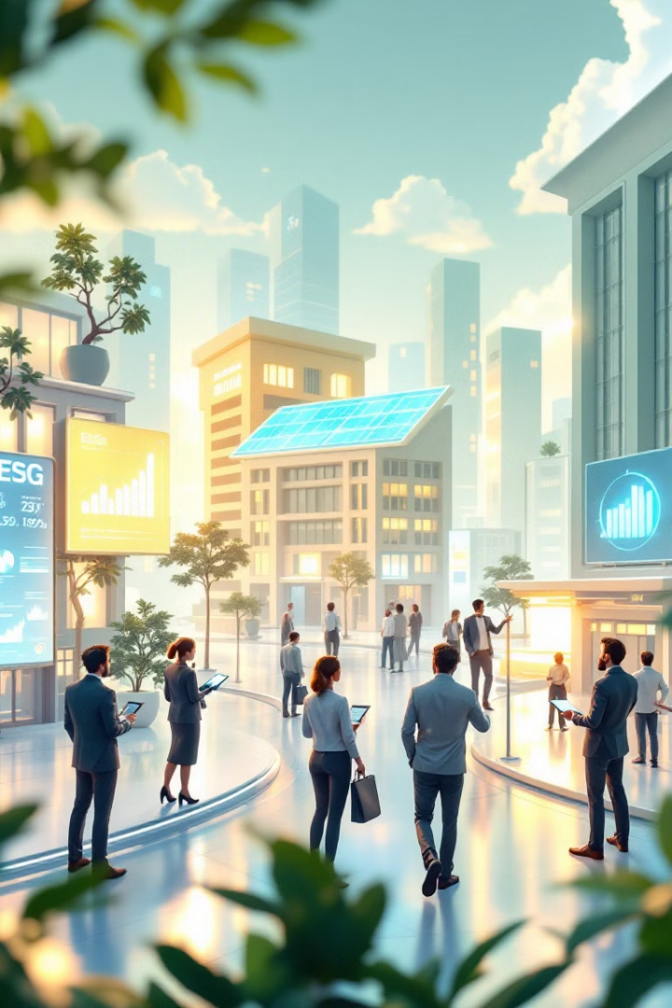
Future of Sustainable Finance
1
Stronger Regulations
2
New Financial Products
More ESG disclosure requirements.
Expansion of sustainability-linked loans.
3
Emerging Markets Growth
Africa, Asia adopting green finance models.

Slide 13

Challenges in Sustainable Finance
Greenwashing
Growth Opportunities
greenwashing, lack of ESG data standardization, and regulatory inconsistencies.
Areas of growth, such as financial innovation and non-fossil fuel technology.
Example: Volkswagen emissions scandal
Example: AI and blockchain improving ESG data tracking.

Slide 14




Real-World Examples of Sustainable Finance Initiatives
EU Green Deal
African Development Bank
Measurable Impact
The EU Green Deal
Impact of these initiatives.
Green bonds initiative with measurable impact.

Slide 15

Interactive Wrap-Up Discussion
1
Key Question 1
"What do you see as the biggest challenge for sustainable finance?"
2
Key Question 2
"How do you think finance will evolve to become more sustainable?"
3
Future Trends
Stricter regulations, financial innovations, and emerging markets.
4
Example
Expansion of sustainability-linked loans

Slide 16

Summary & Key Takeaways
Innovation Frontiers
Current Challenges
Future innovations in AI, blockchain, and financial instruments.
Global Growth
Challenges include greenwashing & regulatory gaps.
ESG Integration
Growing global trends in ESG investments & green finance.
Sustainable finance integrates ESG into financial decisions.

Slide 17
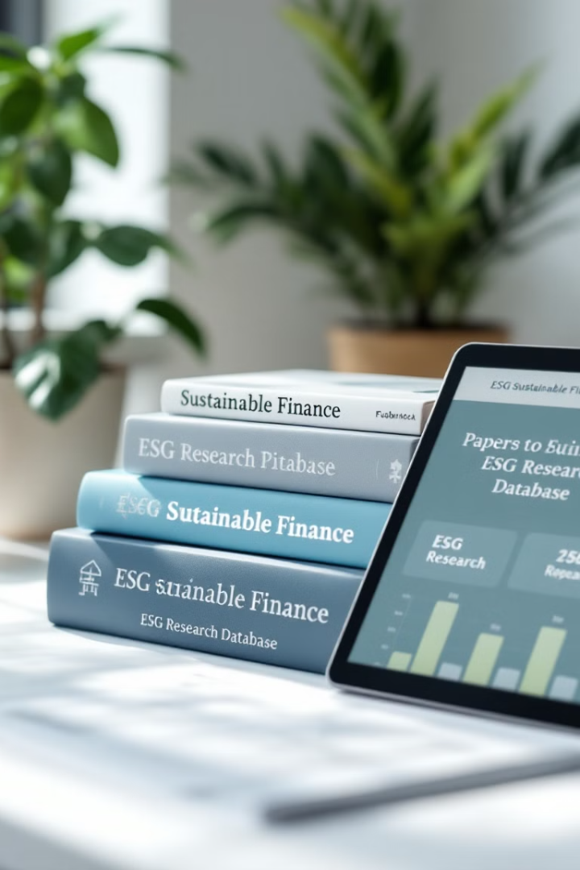
References
Jeucken, M. (2001)
Sustainable finance and banking: The financial sector and the future of the planet. Routledge.
Vargas, C. (2021)
Sustainable finance fundamentals. Springer.
Meo, M. S., & Staniewski, M. W. (2022)
Green bonds and sustainable finance: The evolution of portfolio management in conventional markets. Palgrave Macmillan.
Grigg, N. S. (2021)
Infrastructure finance: The business of infrastructure for a sustainable future. Wiley.

Slide 18
Thank you

