Slide 1

Sustainable Finance – Lecture 4
Lesson Title: Green Bonds and Climate Finance
Instructor: Dr. Mary Githinji

Slide 2

INTRODUCTION
Climate change represents one of the most significant challenges to global development. In response, the financial sector has increasingly embraced tools that support environmental objectives, notably green bonds. These debt instruments are designed specifically to fund projects with positive environmental impacts, forming a critical subset of climate finance. This lesson provides a comprehensive overview of green bonds and their growing role in sustainable finance.

Slide 3
Learning Outcomes
By the end of this session, students will be able to:
Define climate finance and green bonds.
Identify the key characteristics and types of green bonds.
Analyze the role of green bonds in sustainable development.
Evaluate real-world case studies, including those from emerging economies.
Critically assess challenges and propose policy recommendations.

Slide 4
Understanding Climate Finance
Climate finance refers to local, national, or transnational Key characteristics include:
Focus on reducing greenhouse gas emissions.
Enhancing climate resilience.
Supporting sustainable development goals (SDGs). Major multilateral frameworks guiding climate finance include:
United Nations Framework Convention on Climate Change (UNFCCC)
Paris Agreement
Green Climate Fund (GCF)

Slide 5
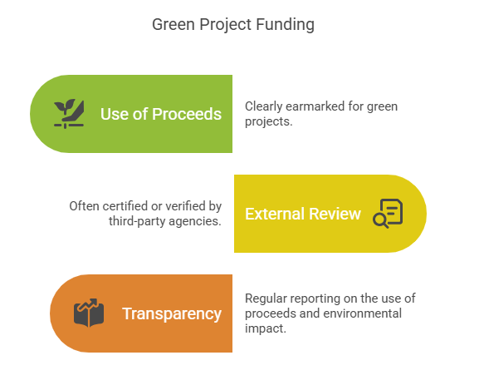
Green Bonds:

Slide 6
Green Bonds:
Green bonds are fixed-income financial instruments issued to raise capital specifically for environmental projects. Key characteristics include:
Use of proceeds: Clearly earmarked for green projects (e.g., renewable energy, clean transport, sustainable agriculture).
External review: Often certified or verified by third-party agencies (e.g., Climate Bonds Initiative).
Transparency: Regular reporting on the use of proceeds and environmental impact.

Slide 7
Why Green Bonds Matter
Green bonds help bridge the finance gap in climate action by channeling funds into projects that support the achievement of the Sustainable Development Goals (SDGs) and the Paris Agreement targets. They:
•Provide an opportunity for investors to align their portfolios with ESG (Environmental, Social, and Governance) principles.
•Encourage issuers to adopt more sustainable business practices.
•Create incentives for innovation in green technologies and infrastructure.
As climate-related financial disclosures become more widespread and regulatory frameworks tighten, green bonds are poised to become a mainstream tool for sustainable finance.

Slide 8
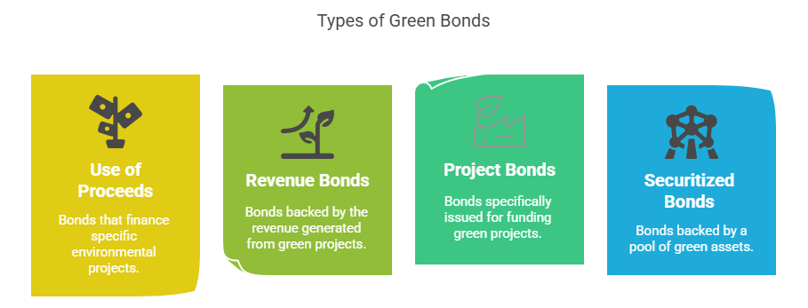
Types of Green Bonds

Slide 9
Types of Green Bonds
Standard green use of proceeds bonds
Green revenue bonds
Green project bonds
Green securitized bonds

Slide 10
Standard Green Use of Proceeds Bonds
The most common type.
The issuer raises capital and commits to using the proceeds exclusively for eligible green projects.
Backed by the issuer’s entire balance sheet.
Example: World Bank Green Bonds fund a pool of climate-focused projects.

Slide 11
Green Revenue Bonds
Secured by revenue generated from green projects (e.g., tolls, user fees).
Higher risk than standard green bonds.
Example: A municipality issuing a bond for a waste-to-energy plant repaid from energy sales.

Slide 12
Green Project Bonds
Linked directly to a specific project.
Issued by a special purpose vehicle (SPV).
Investors bear risks and returns related to the project's performance.
Example: Renewable energy company issues bonds to build a solar farm

Slide 13
Green Securitized Bonds
Backed by a portfolio of green assets (e.g., green loans, EV leases).
Common in residential solar, green mortgages.
Enables bundling of small green projects into investable products.

Slide 14
Comparison of Green Bond Types
Type | Backed By | Risk Level | Common Issuers | Example Projects
Standard Use of Proceeds | Issuer’s full balance sheet | Low to Moderate | Governments, Corporates | Solar power, green transport
Green Revenue Bonds | Project-specific revenue | Moderate to High | Municipalities, Utilities | Water systems, toll roads
Green Project Bonds | Specific project | Higher | SPVs, Private firms | Wind farms, waste-to-energy
Green Securitized Bonds | Green asset portfolio | Varies | Banks, Finance firms | Solar leases, green mortgages

Slide 15
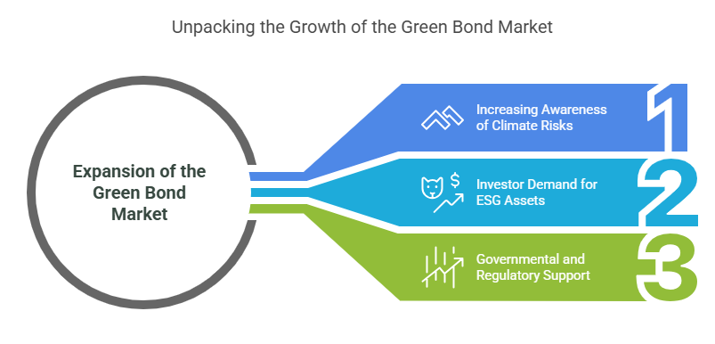
Growth of the Green Bond Market

Slide 16
Growth of the Green Bond Market
First issued by European Investment Bank (2007).
Growth driven by climate risk awareness, ESG demand, and supportive policies.
Global issuance exceeded USD 500 billion in 2023.

Slide 17
Current Market Size and Trends
By 2023, global green bond issuance had surpassed USD 500 billion in a single year—a historic milestone. Cumulative issuance since inception is now well over USD 2 trillion, reflecting both investor appetite and issuer diversity.
Sovereign issuers: Countries such as Germany, France, Chile, and Nigeria have issued green bonds to fund national environmental programs.
Municipal issuers: Cities like New York, Paris, and Johannesburg are leveraging green bonds for urban sustainability projects.
Corporate issuers: Companies such as Apple, Toyota, and Tata Power have used green bonds to finance clean energy, green buildings, and sustainable manufacturing.

Slide 18
Emerging Markets on the Rise
Growing involvement in green bonds due to infrastructure and climate finance needs.
Notable countries: China, India, Kenya.
Instruments to attract private capital to climate projects.

Slide 19
Case Study 1: Nigeria’s Sovereign Green Bond
First African sovereign green bond.
Funded reforestation, solar power, energy efficiency.
Signaled market credibility and boosted awareness.

Slide 20
Case Study 2: Kenya's Green Bond Programme
Led by the Nairobi Securities Exchange.
Enabled firms to raise funds for green buildings and clean energy.
Collaboration with development partners.

Slide 21
Case Study 3: Corporate Example
Tata Power issued green bonds for clean energy capacity.
Demonstrates corporate interest in sustainable operations.
Enhances brand value and investor trust.

Slide 22
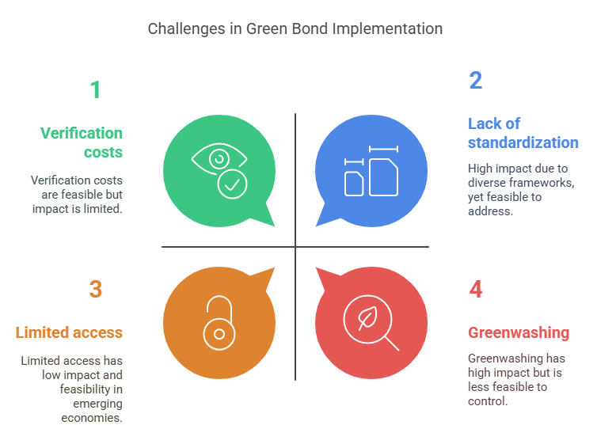
Challenges in the Green Bond Market

Slide 23
Challenges in the Green Bond Market
Greenwashing: Misuse of labels without real benefits.
Lack of standard definitions.
High certification costs.
Institutional and technical barriers in developing countries

Slide 24
Policy Recommendations
Harmonize green bond standards globally (e.g., EU Green Bond Standard).
Provide capacity building and technical assistance.
Offer concessional financing and guarantees.
Promote sovereign green bonds as market benchmarks.
Encourage private sector participation.
Improve transparency and environmental impact tracking.

Slide 25
The Role of International Cooperation
Collaboration among governments, IFIs, and private investors.
Sharing best practices and funding models.
Supporting capacity development in emerging economies

Slide 26
The Future of Green Bonds
Integration with digital finance and block chain.
Linking green finance to social and sustainability bonds.
Expansion into adaptation finance

Slide 27
Interactive Poll or Discussion
What sector in your country would benefit most from green bonds?
Energy
Transport
Housing
Agriculture

Slide 28
Summary
Green bonds are vital for channeling funds to climate-smart projects.
The market is expanding, including in emerging economies.
With proper policy and institutional support, they can drive a global green transition.

Slide 29
Key Takeaways
Climate finance and green bonds are essential tools.
Various bond structures exist for diverse needs.
Market growth is promising but requires more harmonization and access.

Slide 30
Conclusion
Green bonds represent a transformative innovation in sustainable finance. With strategic policy interventions, international cooperation, and continued innovation, green bonds can unlock financing for climate-resilient and low-carbon development, especially in emerging economies.

Slide 31
References
Climate Bonds Initiative (2023). "Green Bond Market Summary."
UNFCCC (2022). "Climate Finance: Overview."
OECD (2021). "Scaling Up Green Finance."
World Bank (2022). "Green Bonds: Country Experiences and Outlook."
International Finance Corporation (2021). "Green Bond Impact Report."

Slide 32
Thank You

