Slide 1

Sustainable Finance – Lecture 5
Lesson Title: Climate Risk Assessment
Instructor: Dr. Mary Githinji

Slide 2

Introduction
Definition of climate risk assessment
Relevance in today's climate context.
Importance of systematic analysis for resilience and planning)

Slide 3
INTRODUCTION
Climate change presents unprecedented challenges to ecosystems, economies, and societies. Climate risk assessment identifies, quantifies, and seeks to mitigate the effects of climate-induced hazards. As global temperatures rise, the need to analyze vulnerabilities and exposures systematically becomes increasingly critical for informed decision-making and enhancing resilience across sectors.

Slide 4
Learning Outcomes
By the end of this session, learners will be able to:
Define climate risk and identify its components.
Differentiate between types of climate risks.
Describe qualitative and quantitative risk assessment approaches.
Apply a methodological framework for climate risk assessment.
Identify challenges and critical factors influencing assessments.
Recognize the role of community participation and indicators in risk analysis.

Slide 5
Climate Risk Concepts
Climate risk encompasses the potential for adverse consequences from climate-related hazards. These risks are generally classified into:
Physical risks: Result from extreme weather events and long-term climate shifts.
Transition risks: Stem from policy and market changes during the shift to a low-carbon economy.
Liability risks: Involve legal consequences for entities failing to act on climate risks.
Understanding these classifications is key to holistic risk assessment.

Slide 6
The Reality of Climate-Induced Risks
Empirical evidence shows the tangible impacts of climate change such as:
Rising sea levels
More frequent extreme weather events
Droughts and biodiversity loss
Vulnerable populations, particularly in low-income countries, face greater risks due to limited adaptive capacity. Key sectors affected include finance, agriculture, infrastructure, and health systems.

Slide 7
Why Climate Risk Assessment Matters
Policy development
Financial decision-making
Safeguarding sustainable development
Portfolio and infrastructure resilience

Slide 8
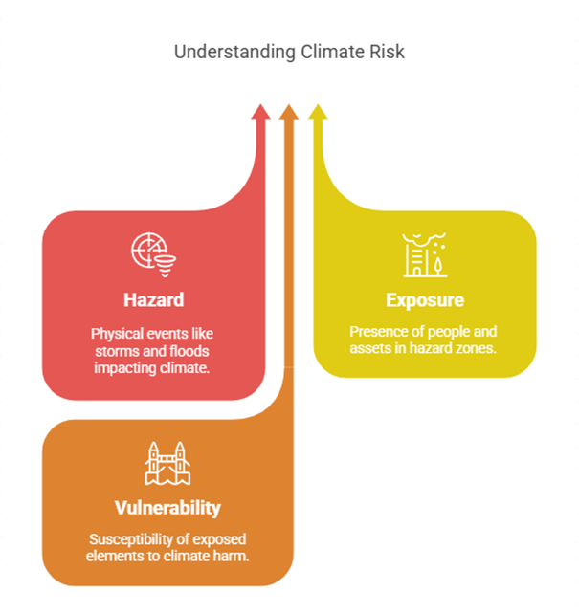
Components of Climate Risk

Slide 9
Components of Climate Risk
Climate risk is a function of three components:
Hazard: Climate-related physical events (e.g., storms, droughts).
Exposure: Presence of people, assets, or ecosystems in hazard-prone areas.
Vulnerability: Susceptibility of exposed elements to harm.
These interact dynamically. For instance, a flood affecting a low-income area with poor infrastructure creates a high-risk scenario.

Slide 10
Deep Dive – Hazard
Definition and examples
Acute vs chronic hazards
Intensity, frequency, geographic scale

Slide 11
Deep Dive – Hazard
A hazard is the potential occurrence of a climate-related physical event or trend that may cause loss of life, injury, property damage, or environmental degradation. These hazards are manifestations of climate change and include tropical cyclones, prolonged droughts, floods, heat waves, and sea-level rise. Hazards can be acute (short-term and intense) or chronic (slow-onset and long-term), and their intensity, frequency, and geographic reach may vary.

Slide 12
Deep Dive – Exposure
Presence of assets or people in at-risk areas
Urban vs rural exposure
Mapping exposure hotspots

Slide 13
Deep Dive – Exposure
Exposure refers to the presence of people, infrastructure, economic assets, ecosystems, or cultural heritage in areas that could be adversely affected by climate hazards. It determines who or what is at risk and to what extent. For instance, a coastal city with a dense population and critical infrastructure (ports, hospitals, power plants) is highly exposed to rising sea levels and storm surges.

Slide 14
Deep Dive – Vulnerability
Susceptibility to harm
Adaptive capacity
Role of poverty, education, infrastructure

Slide 15
Deep Dive – Vulnerability
Vulnerability is the degree to which exposed systems are susceptible to harm due to climate hazards and their capacity to cope, adapt, or recover. It is influenced by social, economic, institutional, and environmental factors, such as poverty, education, governance, and access to resources. Even if two regions have the same level of exposure to a hazard, their vulnerability levels may differ greatly depending on these factors.

Slide 16
Approaches to Climate Risk Assessment
Approaches include:
Qualitative methods: Stakeholder interviews, expert judgment, narrative scenarios.
Quantitative methods: Climate modeling, statistical analysis, vulnerability indices.
A mixed-methods approach enhances accuracy and contextual relevance.

Slide 17
Climate Risk Assessment Framework
Scoping & Objectives
Data Collection
Hazard Mapping
Exposure & Vulnerability Analysis
Risk Quantification
Communication & Integration

Slide 18
People’s Perception & Participation
Local knowledge improves accuracy
Perception influences risk behavior
Participatory planning improves ownership

Slide 19
Importance of Indicators
Indicators help measure and monitor risk:
Climatic: Temperature anomalies
Socioeconomic: Poverty rates
Environmental: Land degradation

Slide 20
Importance of Indicators
Indicators are essential for measuring and monitoring risk. They may include climatic (e.g., temperature anomalies), socioeconomic (e.g., poverty rates), and environmental (e.g., land degradation) metrics. Indicators facilitate comparison, trend analysis, and the evaluation of adaptation interventions. Selecting appropriate indicators is crucial for meaningful assessments.

Slide 21
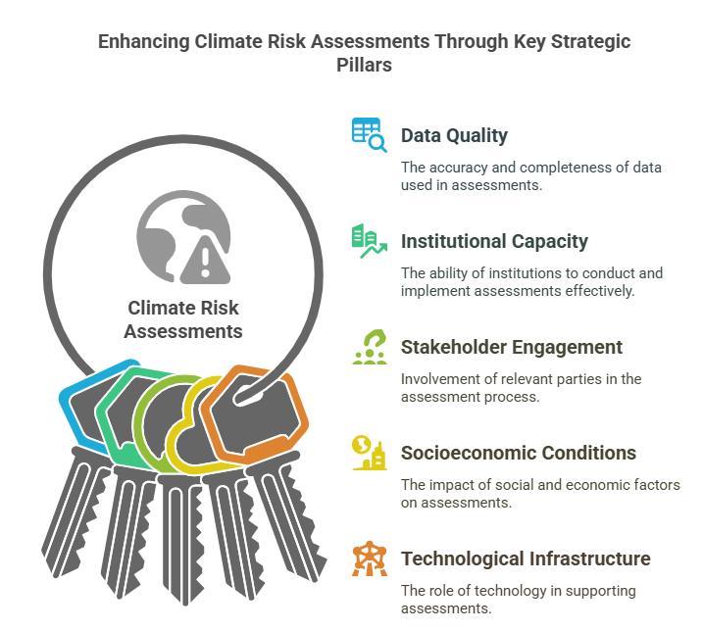
Key Influencing Factors

Slide 22
Key Influencing Factors
Data quality & availability
Institutional capacity
Political will
Socioeconomic conditions
Technology infrastructure

Slide 23
Contextualizing These Factors
Each of these factors needs to be considered in the local or regional context for the climate risk assessment to be relevant and reliable. For instance, a robust assessment in a high-income country with advanced technological infrastructure may not be directly applicable to a low-income country with limited access to data, resources, or technologies. Contextualizing the factors ensures that the assessment is tailored to the specific needs and capacities of the region, making it more useful for decision-makers and stakeholders.
In summary, the reliability and relevance of climate risk assessments depend on the quality of data, the capacity of institutions, the level of stakeholder engagement, socioeconomic conditions, and the technological infrastructure available. A comprehensive understanding of these factors, along with their interactions, enhances the robustness and usability of climate risk assessments, ensuring that they lead to effective and equitable adaptation strategies.

Slide 24
Influencing Factors
Key influencing factors include:
Data availability and quality: Reliable, current data is essential.
Institutional capacity and political will: Strong institutions and committed leadership drive successful assessments.
Stakeholder engagement: Inclusive processes capture diverse perspectives.
Socioeconomic conditions: Income levels and infrastructure affect vulnerability.
Technological infrastructure: Tools for data collection, analysis, and adaptation strategies are vital.

Slide 25
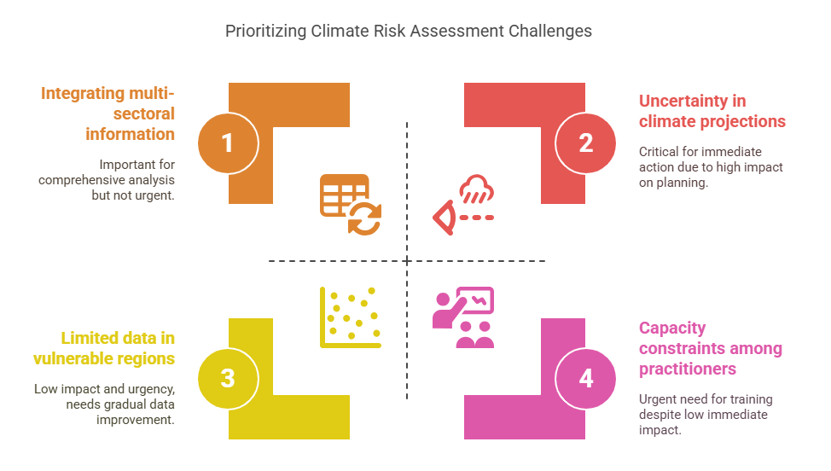
Challenges in Risk Assessment

Slide 26
Challenges in Risk Assessment
Challenges include:
Uncertainty in climate projections
Limited data in vulnerable regions
Integrating multi-sectoral information
Aligning local and global risk frameworks
Capacity constraints among practitioners Addressing these challenges requires investment in research, capacity-building, and inclusive governance mechanisms.

Slide 27
Addressing the Challenges
Use of robust decision-making tools
Cross-sector coordination
Capacity building initiatives
Open data and technology sharing
Community-based assessments

Slide 28
Conclusion & Key Takeaways
Climate risks are real, complex, and growing.
Systematic assessments are essential for resilience.
Inclusive, data-driven, and context-sensitive approaches are vital.
Your role as professionals, planners, or policymakers is critical in applying this knowledge.

Slide 29
References
Masum, S. J. H. (2019). Climate Risk Assessment Review. ResearchGate.
European Commission (2020). EU Taxonomy for Sustainable Activities.
Network for Greening the Financial System (NGFS). (2021). Scenarios in Action.
Task Force on Climate-related Financial Disclosures (TCFD). (2017). Final Recommendations Report.

Slide 30
Thank You

