Slide 1

Sustainable Finance – Lecture 6
Lesson Title: Regulatory Frameworks in
Sustainable Finance
Instructor: Dr. Mary Githinji

Slide 2

INTRODUCTION
Sustainable finance is increasingly recognized as a crucial lever for achieving global climate, social, and governance goals. Regulatory frameworks are pivotal in shaping market behavior, guiding financial institutions, and ensuring alignment with environmental, social, and governance (ESG) objectives. This lesson explores the evolution, significance, and effectiveness of regulatory frameworks in sustainable finance. It discusses international and national-level approaches, highlights best practices, and outlines the challenges and opportunities in harmonizing regulatory efforts.

Slide 3
Introduction
The global financial system plays a central role in supporting sustainable development. As investors, firms, and governments seek to integrate ESG considerations into financial decisions, regulatory frameworks have emerged as essential instruments for ensuring consistency, transparency, and accountability. These frameworks provide the structural and legal backing required to align capital flows with long-term sustainability goals, such as those outlined in the Paris Agreement and the United Nations Sustainable Development Goals (SDGs).

Slide 4
Learning Outcomes
By the end of this session, students will be able to:
Define sustainable finance and explain the importance of regulatory frameworks.
Identify key international and national regulatory instruments in sustainable finance.
Explain the role and structure of ESG disclosure standards such as TCFD and ISSB.
Evaluate the challenges facing regulatory frameworks in sustainable finance.
Propose opportunities for enhancing regulatory coherence and effectiveness globally.

Slide 5
Defining Sustainable Finance and the Role of Regulation

Slide 6
What is Sustainable Finance?
Sustainable finance refers to the process of taking due account of ESG considerations in investment decision-making and financial service delivery. It encompasses a broad range of financial instruments and mechanisms, such as green bonds, ESG-focused funds, and climate risk disclosures.

Slide 7
Importance of Regulatory Frameworks
Regulatory frameworks provide the foundation for credible, transparent, and enforceable sustainable finance practices. They:
Standardize ESG disclosures
Guide institutional investors
Prevent greenwashing
Facilitate risk pricing
Foster innovation and long-term investment

Slide 8
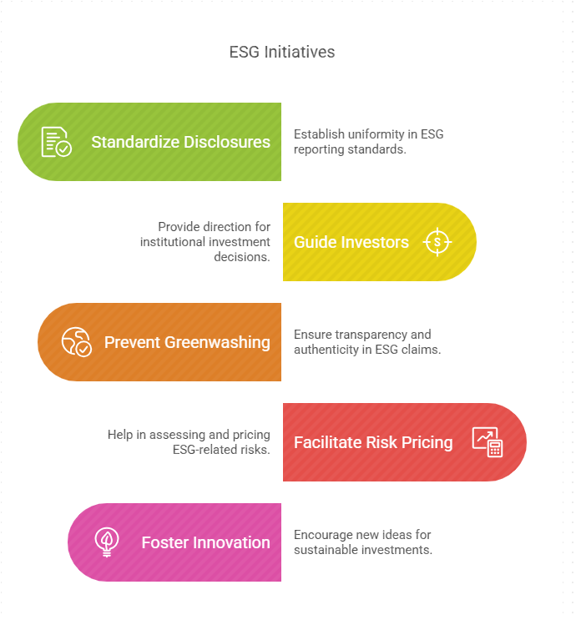
Components of Climate Risk

Slide 9
Global Regulatory Landscape
The European Union (EU)
United States
Asia-Pacific and Emerging Markets

Slide 10
The European Union (EU)
The EU leads with its comprehensive Sustainable Finance Action Plan, which includes:
EU Taxonomy Regulation: A classification system to determine environmentally sustainable economic activities.
Sustainable Finance Disclosure Regulation (SFDR): Requires asset managers to disclose how they integrate ESG risks.
Corporate Sustainability Reporting Directive (CSRD): Enhances non-financial reporting standards for corporations.

Slide 11
United States
The U.S. approach is more market-driven, but recent actions by the Securities and Exchange Commission (SEC) have introduced proposed rules on climate-related disclosures and ESG investment fund labeling

Slide 12
Asia-Pacific and Emerging Markets
Countries like Japan, China, and Singapore are developing green taxonomies and encouraging voluntary disclosures. China’s Green Bond Endorsed Project Catalogue and alignment with the International Platform on Sustainable Finance (IPSF) show increasing regulatory coordination.

Slide 13
Key Regulatory Instruments
Taxonomies
ESG Disclosure Requirements
Climate Stress Testing and Prudential Regulation

Slide 14
Taxonomies
Taxonomies classify which economic activities are sustainable. The EU taxonomy serves as a model for other jurisdictions, enabling consistent capital allocation and reducing market fragmentation.

Slide 15
The Four Pillars of Climate-Related Financial Disclosures
An essential component of sustainable finance regulation is the standardized disclosure of climate-related information. The Task Force on Climate-related Financial Disclosures (TCFD) recommends a framework based on four foundational pillars that organizations should use to enhance transparency and comparability in climate-related reporting. These pillars are increasingly embedded in national and international regulatory frameworks and have guided the development of the International Sustainability Standards Board (ISSB) disclosure standards.

Slide 16
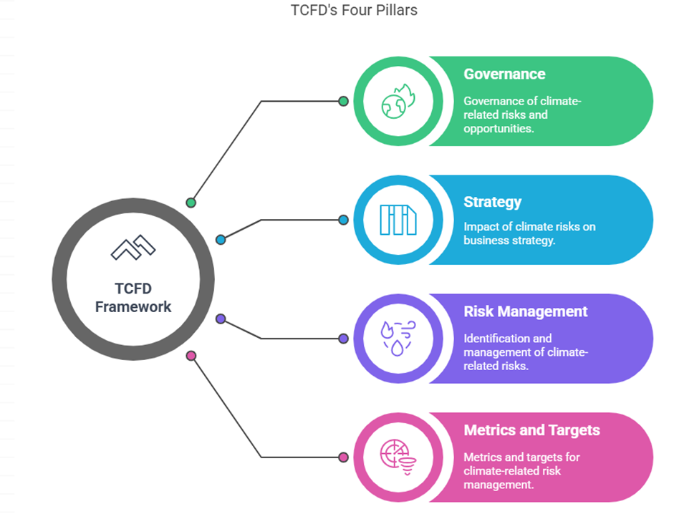
The Four Pillars of Climate-Related Financial Disclosures

Slide 17
Pillar 1: Governance
Disclose the organization’s governance around climate-related risks and opportunities.
•Describe the board’s oversight of climate-related risks and opportunities.
• Describe management’s role in assessing and managing climate-related risks and opportunities

Slide 18
Pillar 2: Strategy
Disclose the actual and potential impacts of climate-related risks and opportunities on the organization’s businesses, strategy, and financial planning where such information is material.
•Describe the climate-related risks and opportunities the organization has identified over the short, medium, and long term.
•Describe the impact of climate-related risks and opportunities on the organization’s businesses, strategy, and financial planning.
• Describe the resilience of the organization’s strategy, taking into consideration different climate-related scenarios, including a 2°C or lower scenario.

Slide 19
Pillar 3: Risk Management
Disclose how the organization identifies, assesses, and manages climate-related risks.
•Describe the organization’s processes for identifying and assessing climate-related risks.
• Describe the organization’s processes for managing climate-related risks.
• Describe how these processes are integrated into the organization’s overall risk management.

Slide 20
Pillar 4: Metrics and Targets
Disclose the metrics and targets used to assess and manage relevant climate-related risks and opportunities where such information is material.
•Disclose the metrics and targets used by the organization to assess climate-related risks.
• Disclose Scope 1, Scope 2, and, if appropriate, Scope 3 greenhouse gas (GHG) emissions, and the related risks.
•Describe the targets used by the organization to manage climate-related

Slide 21
ESG Disclosure Requirements
Mandatory disclosures enable investors to assess the sustainability-related risks and impacts of their portfolios. Frameworks such as the Task Force on Climate-related Financial Disclosures (TCFD) and International Sustainability Standards Board (ISSB) promote global comparability.

Slide 22
ESG Disclosure Requirements
Task Force on Climate-related Financial Disclosures (TCFD)
International Sustainability Standards Board (ISSB)
Regional and National Disclosure Requirements

Slide 23
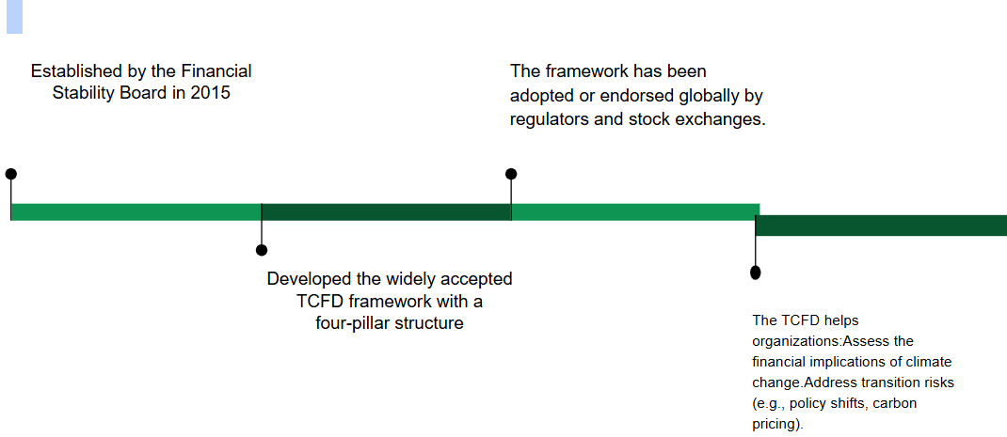
Task Force on Climate-related Financial Disclosures (TCFD)

Slide 24
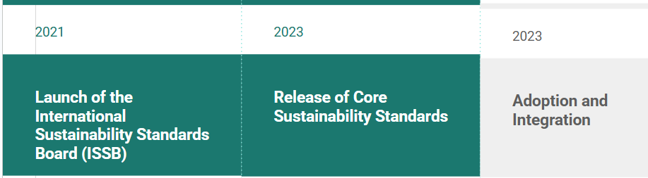
International Sustainability Standards Board (ISSB)

Slide 25
Regional and National Disclosure Requirements
In addition to global frameworks, numerous countries and regions have enacted mandatory ESG disclosure rules tailored to their contexts:
•European Union (EU): The Sustainable Finance Disclosure Regulation (SFDR) and the Corporate Sustainability Reporting Directive (CSRD)
•United States: The Securities and Exchange Commission (SEC) has proposed rules requiring public companies to disclose material climate-related risks,
•China: The China Securities Regulatory Commission (CSRC) is developing mandatory ESG disclosure rules for listed companies
•Kenya and South Africa: Emerging market regulators are encouraging ESG integration through guidance notes

Slide 26
Climate Stress Testing and Prudential Regulation
Central banks and financial supervisors, through networks like the Network for Greening the Financial System (NGFS), integrate climate risks into macro-prudential oversight and conduct climate stress testing for financial institutions.

Slide 27
Challenges in Sustainable Finance Regulation
Fragmentation and Inconsistencies
Greenwashing and Enforcement Gaps
Data Availability and Quality

Slide 28
Opportunities and the Way Forward
Harmonization of Standards
Capacity Building in Developing Countries
Role of Technology

Slide 29
Conclusion & Key Takeaways
Strong regulatory frameworks are key to credible sustainable finance.
Policies must align with global standards and fit local contexts.
Collaboration among regulators, institutions, and global bodies is vital to scale sustainable finance and ensure a resilient, inclusive future.

Slide 30
References
Masum, S. J. H. (2019). Climate Risk Assessment Review. ResearchGate.
European Commission (2020). EU Taxonomy for Sustainable Activities.
Network for Greening the Financial System (NGFS). (2021). Scenarios in Action.
Task Force on Climate-related Financial Disclosures (TCFD). (2017). Final Recommendations Report.

Slide 31
Thank You

