Slide 1

Sustainable Finance- Lecture 7
Lesson Title: Agri-Green Financing and Technology
Instructor: Dr. Mary Githinji

Slide 2
Presentation Outline
Introduction: The Agri-Sustainability Nexus
Understanding Agri-Green Financing
Drivers of Agri-Green Financing
Green Technologies Revolutionizing Agriculture
Challenges in Scaling Finance and Technology
Success Stories: Case Studies
Charting the Pathways Forward
Conclusion & Call to Action

Slide 3
Learning Outcomes
By the end of this session, Learners will be able to:
Define Agri-Green Financing
Analyze Drivers of Green Finance in Agriculture
Understand Key Green Agricultural Technologies
Assess Challenges in Scaling Agri-Green Finance and Technology
Examine Real-World Applications through Case Studies
Propose Pathways Forward
Apply Concepts to Policy or Business Contexts

Slide 4
Introduction - The Imperative for Green Agriculture
Agriculture: At the Nexus of Environment & Economy
Critical source of livelihood for billions.
Significant environmental footprint: ~23% of global greenhouse gas emissions (IPCC, 2019).
Facing challenges: Climate change, food insecurity, land degradation.
Necessity: Transition to green agriculture is imperative.

Slide 5
Introduction - The Role of Agri-Green Finance & Technology
The Solution: Finance and Technology for Sustainability
Agri-Green Financing: Mobilizing capital for environmentally sound practices.
Technological Innovation: Integrating smart technologies to:
  Enhance productivity
  Boost resilience
  Improve sustainability
  A pathway to sustainable agricultural systems.

Slide 6
The Concept of Agri-Green Financing - Definition
What is Agri-Green Financing?
Definition: Allocation of financial resources (public or private) for agricultural practices contributing to environmental sustainability.
Core Principles (aligned with UNEP, 2016):
Climate risk mitigation
Biodiversity conservation
Promotion of the circular economy

Slide 7
Key Instruments (1/2)
Key Financial Instruments for Agri-Green Initiatives
Green Bonds:
Issued to fund sustainable agricultural infrastructure.
Examples: Efficient irrigation, eco-friendly storage solutions.
Sustainability-Linked Loans:
Loan terms linked to achieving specific environmental performance metrics (ICMA, 2023).

Slide 8
Key Instruments (2/2)
Key Financial Instruments for Agri-Green Initiatives
Carbon Credits and Payment for Ecosystem Services (PES):Financial incentives for practices like carbon sequestration and land restoration.
Microfinance and Agri-Insurance: Tailored products for smallholders to adopt climate-resilient practices and manage risks.

Slide 9
Drivers of Agri-Green Financing - Policy & Regulation
Driving Force: Policy and Regulatory Frameworks
Governments are key enablers through:
  Subsidies for sustainable practices
  Tax incentives
  Regulatory mandates (FAO, 2021)
Nationally Determined Contributions (NDCs): Crucial under the Paris Agreement for aligning financial flows with green objectives.

Slide 10
Drivers of Agri-Green Financing - Market & ESG
Driving Force: Market Demand & ESG Pressures
Consumer Shift: Growing preference for organic, ethically, and sustainably sourced food.
Agribusiness Response: Adopting Environmental, Social, and Governance (ESG) practices.
Investor Influence: Financiers and institutional investors increasingly prioritizing ESG in investment decisions.

Slide 11
Drivers of Agri-Green Financing - IFIs
Driving Force: Role of International Financial Institutions (IFIs)
Key IFIs (World Bank, IFAD, AfDB) prioritizing climate-smart agriculture.
Contributions:
  Offering concessional funding.
  Providing crucial technical support and capacity building.
  Setting standards and sharing best practices.

Slide 12

Question: Are there any Green Technologies in Agriculture adopted in your country?

Slide 13
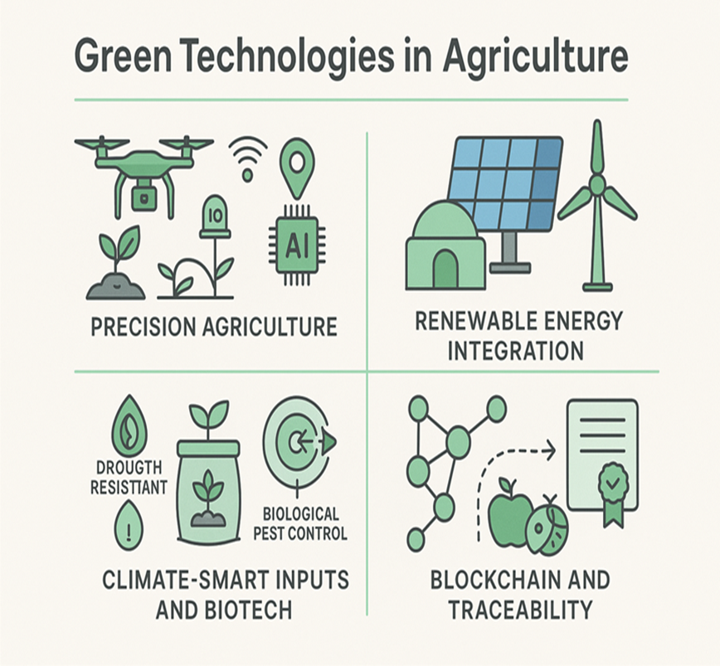
Green Technologies in Agriculture - Overview

Slide 14
Green Technologies in Agriculture - Overview
Revolutionizing Farms: Green Technologies
Harnessing innovation to enhance efficiency and sustainability:
  Precision Agriculture
  Renewable Energy Integration
  Climate-Smart Inputs & Biotech
  Blockchain & Traceability

Slide 15
Green Technologies - Precision Agriculture
Smart Farming: Precision Agriculture
Utilizing IoT, drones, GPS, and AI for site-specific crop management.
Benefits (Zhang et al., 2020):
Reduces resource waste (water, fertilizer, pesticides).
Boosts crop yields.
Lowers greenhouse gas emissions.

Slide 16
Green Technologies - Renewable Energy
Powering Sustainability: Renewable Energy Integration
Reducing reliance on fossil fuels in agricultural operations.
Examples (IRENA, 2022):
Solar-powered irrigation systems.
Bio digesters for waste-to-energy.
Wind turbines for on-farm electricity generation.
Provides decentralized energy solutions.

Slide 17
Green Technologies - Climate-Smart Inputs & Biotech
Resilient Growth: Climate-Smart Inputs & Biotech
Essential for sustainable productivity in a changing climate.
Key Innovations (FAO, 2018):
  Drought-resistant and flood-tolerant seeds.
  Organic fertilizers and soil health enhancers.
  Biological pest control systems.

Slide 18
Green Technologies - Blockchain & Traceability
Transparency & Trust: Blockchain in Agri-Supply Chains
Improves supply chain transparency and accountability.
Advantages (Gurtu & Johny, 2019):
Enables verifiable sustainable certification.
Facilitates access to premium markets for sustainably produced goods.
Reduces fraud and improves food safety.

Slide 19
Question: What are the Challenges of Agri-Green Finance and Technology

Slide 20
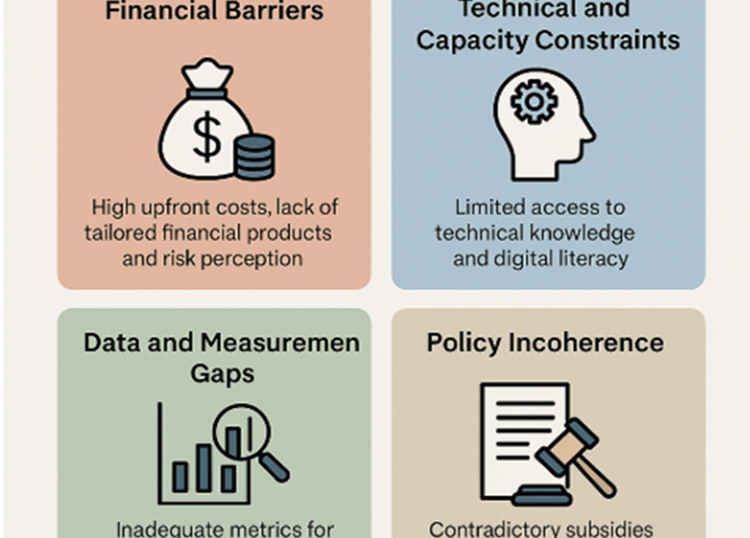
Challenges in Scaling Agri-Green Finance and Technology

Slide 21
Challenges in Scaling - Financial Barriers
Hurdles to Adoption: Financial Barriers
Significant obstacles hinder widespread investment:
High upfront costs for green technologies and practices.
Lack of financial products tailored to agricultural needs.
Perceived high risks by investors, especially for:
  Smallholder farmers
  Agri-Small and Medium Enterprises (SMEs)

Slide 22
Challenges in Scaling - Technical & Capacity Constraints
Hurdles to Adoption: Technical & Capacity Constraints
Limited access to crucial resources in rural areas:
  Technical knowledge and expertise on green technologies.
  Digital literacy required for adopting modern Agri-tech.
These gaps reduce the adoption rate of beneficial green technologies

Slide 23
Challenges in Scaling - Data & Policy Gaps
Hurdles to Adoption: Data, Measurement & Policy
Data and Measurement Gaps:
  Inadequate metrics for tracking environmental performance.
  Affects investors' due diligence and regulatory monitoring.
Policy Incoherence:
  Contradictory subsidies (e.g., for chemical fertilizers vs. organic inputs).
  Unclear land tenure rights can disincentivize long-term green investments.

Slide 24
Case Studies - Kenya
Success Story: Kenya’s Climate-Smart Agriculture Project (KCSAP)
Support: World Bank.
Focus: Integrates sustainable land management, renewable energy, and financial inclusion for rural farmers.
Impact: Enhancing resilience and productivity for smallholders.

Slide 25
Case Studies - India
Success Story: India’s NABARD Green Fund
Initiative: National Bank for Agriculture and Rural Development (NABARD).
Mechanism: Provides refinancing for:
  Renewable energy projects in agriculture.
  Agroforestry initiatives.
Goal: Scaling up green investments in the agricultural sector.

Slide 26
Case Studies - China
Success Story: China's Agri-Tech Transformation
Strategy: Massive investments in modernizing agriculture.
Key Areas (China Agricultural Outlook, 2023):
  Artificial Intelligence (AI) in farming.
  Drone agriculture for precision application.
  Sustainable livestock systems.
Outcome: Enhanced productivity while cutting emissions.

Slide 27

Pathways Forward (1/2)
Charting the Course: Pathways Forward
Blended Finance Models:
Combining public and private capital.
De-risking green agricultural investments to attract private sector participation.
Digital Financial Services (DFS):
Leveraging mobile banking and fintech solutions.
Ensuring inclusive access to green finance, especially for remote communities.

Slide 28
Pathways Forward (2/2)
Integrated Policy Ecosystems:
Harmonizing agricultural, financial, and environmental policies.
Creating a supportive environment for systemic change.
Monitoring and Reporting Standards:
Developing Agri-specific green taxonomies (e.g., EU Green Taxonomy, 2022).
Establishing robust impact reporting frameworks to ensure accountability and transparency.

Slide 29
Conclusion
The Future is Green and Growing
Agri-green financing and technology are pivotal for sustainable agriculture.
Potential: The sector can become a cornerstone of climate action and rural resilience.
Necessity for Transformation:
Coordinated efforts from governments, financial institutions, agribusinesses, and tech providers.
Overcoming systemic barriers.
Ensuring inclusive, scalable, and measurable progress.

Slide 30
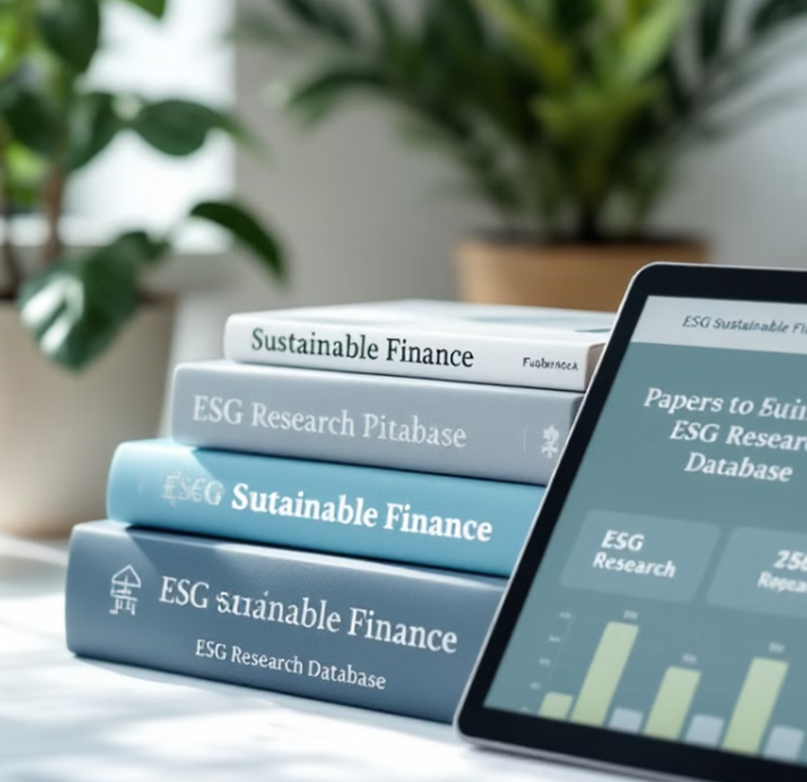
References
FAO. (2018). Climate-Smart Agriculture Sourcebook.
FAO. (2021). The State of Food and Agriculture 2021.
Gurtu, A., & Johny, J. (2019). Potential of blockchain technology in supply chain management.
ICMA. (2023). Sustainability-Linked Loan Principles.
IPCC. (2019). Climate Change and Land.
IRENA. (2022). Renewable Energy for Agriculture.
UNEP. (2016). Green Finance for Developing Countries.
Zhang, C., et al. (2020). Applications of remote sensing in precision agriculture.
China Agricultural Outlook, 2023
EU Green Taxonomy, 2022

Slide 31

Thank you

