Slide 1

Sustainable Finance- Lecture 8
Lesson Title: Sustainable Banking and Lending
Instructor: Dr. Mary Githinji

Slide 2

Presentation Outline
Introduction
Understanding Sustainable Banking
Sustainable Lending
Benefits of Sustainable Banking and Lending
Challenges in Implementing Sustainable Banking and Lending
Case Studies
Conclusion and Q&A

Slide 3
Learning Outcomes
By the end of this lecture, students will be able to:
Define and explain sustainable banking and lending,
Identify and elaborate on the seven principles of sustainable banking, Differentiate between various types of sustainable lending
Analyze the benefits and challenges of implementing sustainable banking and lending practices
Evaluate real-world case studies of banks practicing sustainable banking

Slide 4

What is a Bank?
A bank is a financial institution licensed to receive deposits and make loans. Banks are central to the financial system and play a critical role in the economy by facilitating financial transactions, mobilizing savings, and allocating capital efficiently.

Slide 5
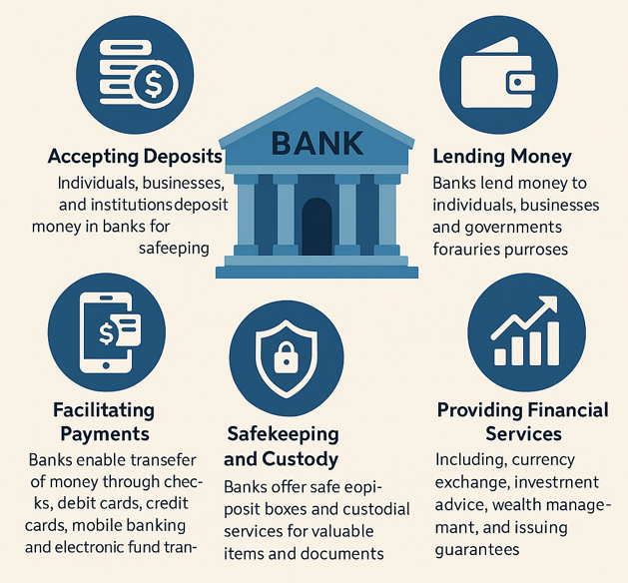
Core Functions of a Bank:

Slide 6
Core Functions of a Bank:
Accepting Deposits: Individuals, businesses, and institutions deposit money in banks for safekeeping. Deposits may be demand (withdrawable anytime) or time deposits (fixed period).
Lending Money: Banks lend money to individuals, businesses, and governments for various purposes, charging interest in return.
Facilitating Payments: Banks enable the transfer of money through checks, debit cards, credit cards, mobile banking, and electronic fund transfers.
Safekeeping and Custody: Banks offer safe deposit boxes and custodial services for valuable items and documents.
Providing Financial Services: Including currency exchange, investment advice, wealth management, and issuing guarantees.

Slide 7
Why Sustainable Finance Now?
A New Financial Paradigm
Growing global awareness of ESG issues (Climate, Social Equity)
Alignment with global goals (Paris Agreement, SDGs)
Investor demand & regulatory pressure increasing
Beyond profit: Long-term value creation and societal well-being

Slide 8
What is Sustainable Banking?
Defining Sustainable Banking
Integrating Environmental, Social, and Governance (ESG) criteria into all banking operations and strategy.
A shift from profit-only to a purpose-driven approach.
Proactive management of ESG risks and opportunities.
Commitment to positive impact alongside financial returns. (Reference: UNEP FI, 2020)

Slide 9
Principles of Sustainable Banking
Environmental Responsibility
Social Responsibility
Governance Transparency (and Ethical Conduct)

Slide 10
Core Principle 1: Environmental Responsibility
Protecting Our Planet
Minimizing bank's operational footprint (e.g., carbon emissions).
Financing green projects:
  Renewable Energy (Solar, Wind)
  Energy Efficiency
  Sustainable Transport & Agriculture
Avoiding/reducing finance for harmful industries (e.g., new coal power).

Slide 11
Core Principle 2: Social Responsibility
Empowering People & Communities
Prioritizing well-being of customers, employees, communities.
Promoting:
  Financial Inclusion (underserved populations)
  Affordable Housing, Healthcare, Education
  Fair Labor Practices & Diversity, Equity, Inclusion (DEI)
  Human Rights in financed projects.

Slide 12
Core Principle 3: Governance & Ethical Conduct
Building Trust Through Transparency
Ensuring ethical conduct, accountability, and transparent decision-making.
Key aspects:
  Board oversight of sustainability.
  Robust ESG risk management frameworks.
  Transparent reporting (e.g., TCFD, IFRS S1/S2).
Anti-corruption measures & stakeholder engagement.

Slide 13
Guiding Frameworks for Sustainable Banking
Setting the Standards
UN Principles for Responsible Banking (PRB):
  Framework for aligning banking strategy with society’s goals.
  Focus on Impact, Clients & Customers, Stakeholders, Governance & Culture, Transparency & Accountability.
Equator Principles:
  Risk management framework for project finance.
Addresses environmental and social risks in large infrastructure projects.

Slide 14
Focus on Sustainable Lending
Financing the Transition
Providing credit/financial support to projects & businesses committed to sustainability.
Goes beyond traditional credit risk: incorporates ESG due diligence.
Aims to:
  Mitigate environmental and social risks.
  Enhance positive impacts.
  Support sustainable development. (Reference: World Bank, 2021)

Slide 15
Types of Sustainable Lending
Green Loans
Social Loans
Sustainability-Linked Loans (SLLs)
Transition Finance
Blue Loans and Bonds

Slide 16
Types: Green Loans
Funding Green Initiatives
Definition: Loans exclusively for projects with clear environmental benefits.
Examples: Renewable energy, energy efficiency, green buildings, clean transport, reforestation.
Framework: Often guided by Green Loan Principles (GLP).

Slide 17
Social Loans
Investing in Social Progress
Definition: Loans for projects with positive social outcomes.
Examples: Affordable housing/infrastructure, healthcare, education, SME financing for underserved groups, job creation.
Framework: Often guided by Social Loan Principles (SLP).

Slide 18
Types: Sustainability-Linked Loans (SLLs)
Incentivizing Sustainable Performance
Definition: General purpose loans with interest rates tied to borrower achieving pre-defined Sustainability Performance Targets (SPTs).
Mechanism: KPIs set (e.g., CO2 reduction, water efficiency), performance verified.
Framework: Guided by Sustainability-Linked Loan Principles (SLLP) – targets must be ambitious & credible

Slide 19
Emerging Types of Sustainable Lending
Expanding the Toolkit
Transition Finance:
  Supporting high-emitting companies in their shift to greener models.
Blue Loans/Bonds:
  Financing ocean conservation and sustainable marine economies.
Innovation continues to drive new instruments.

Slide 20

Question: Are there any benefits for Sustainable Banking and Lending?

Slide 21
Benefits of Sustainable Banking and Lending
Risk Mitigation
Enhanced Reputation and Brand Value
Increased Customer Loyalty and Trust
Access to New Market Opportunities
Improved Stakeholder Relations
Long-Term Value Creation and Economic Resilience

Slide 22
Benefit 1: Robust Risk Mitigation
Building Resilience
Reduces exposure to:
  Physical Risks: Climate impacts on assets.
  Transition Risks: Policy/tech changes stranding assets.
  Credit Risks: ESG-affected borrowers defaulting.
  Reputational & Litigation Risks. (Reference: OECD, 2022)

Slide 23
Benefit 2: Enhanced Reputation & Loyalty
Strengthening Stakeholder Trust
Positive brand image attracts & retains:
  Customers (especially ethically-minded ones)
  Employees (talent seeking purpose)
  Investors (ESG-focused funds)
Increased customer trust and loyalty.

Slide 24
Benefit 3: New Market Opportunities
Driving Growth & Innovation
Access to rapidly growing green and social finance markets.
Development of innovative sustainable products and services.
Opportunity to lead in a transitioning economy.

Slide 25
Benefit 4: Long-Term Value & Stability
Investing in a Sustainable Future
Contributes to a more stable and resilient economy.
Supports long-term value creation for the bank and society.
Potential for improved financial performance over time.

Slide 26
Challenges in Implementing Sustainable Banking and Lending
Lack of Standardization and Data Gaps
Regulatory Complexity and Inconsistency
Limited Awareness and Capacity Building
Integrating ESG into Risk Management Frameworks
Short-term vs. Long-term Incentives
Cost of Transition
Defining Materiality

Slide 27
Challenge 1: Standardization & Data
Navigating Complexity
Lack of Standardization: Varied definitions, metrics, and reporting frameworks.
  Risk of "greenwashing."
Data Gaps & Quality: Difficulty obtaining reliable, comparable ESG data from borrowers.

Slide 28
Challenge 2: Implementation Hurdles
Overcoming Obstacles
Regulatory Complexity: Diverse and evolving rules across jurisdictions.
Limited Awareness & Capacity: Need for training staff, clients.
Integration Costs: Investment in new systems, expertise.

Slide 29
Challenge 3: Mindset & Materiality
Shifting Perspectives
Short-term vs. Long-term Focus: Aligning incentives with long-term sustainability goals.
Integrating ESG into Risk Models: Quantifying ESG risks.
Defining Materiality: Identifying key ESG factors for specific sectors/borrowers

Slide 30
Case Study 1: Deutsche Bank
Global Bank, Sustainable Strategy
Focus: Sustainable finance volume targets, ESG integration in lending.
Pillars: Sustainable Finance Framework, ESG risk assessment (sector-specific targets), product innovation, operational efficiency.
Aim: Supporting client transition to greener models.

Slide 31
Case Study 2: KCB Group (East Africa)
Regional Leader in Green Finance
Focus: Green financing for renewable energy, energy efficiency, sustainable agriculture, green buildings.
Initiatives: Partnerships (e.g., Kenya Green Building Society), SME support, ESG risk integration in credit, sustainability reporting.
Impact: Driving sustainable development in East Africa

Slide 32
The Evolving Regulatory Landscape
Policy Driving Change
Central Banks & Supervisors: Focus on climate-related financial risks.
Green Taxonomies (e.g., EU Taxonomy): Defining sustainable activities.
Mandatory ESG/Climate Disclosures: Increasing transparency (e.g., TCFD, IFRS S1/S2 - ISSB standards).
Climate Scenario Analysis & Stress Testing.

Slide 33
Technology: The Enabler of Sustainable Finance
Innovation Powering Sustainability
AI & Big Data: For ESG data analysis, risk modeling, impact measurement.
Blockchain: For transparency (e.g., green bond tracking, supply chains).
Fintech Platforms: Offering sustainable investment options, green loans.
Streamlining access and improving efficiency

Slide 34

The Future: Mainstreaming Sustainable Finance
Towards a Sustainable Financial System
Sustainable finance moving from niche to norm.
Increased integration into core business strategies.
Greater collaboration between financial institutions, regulators, and stakeholders.
Continuous innovation in products and methodologies.

Slide 35
Conclusion & Q&A
A Transformative & Necessary Shift
Sustainable banking and lending are crucial for balancing profitability with planetary and societal well-being.
An ongoing journey requiring commitment, innovation, and collaboration.

Slide 36
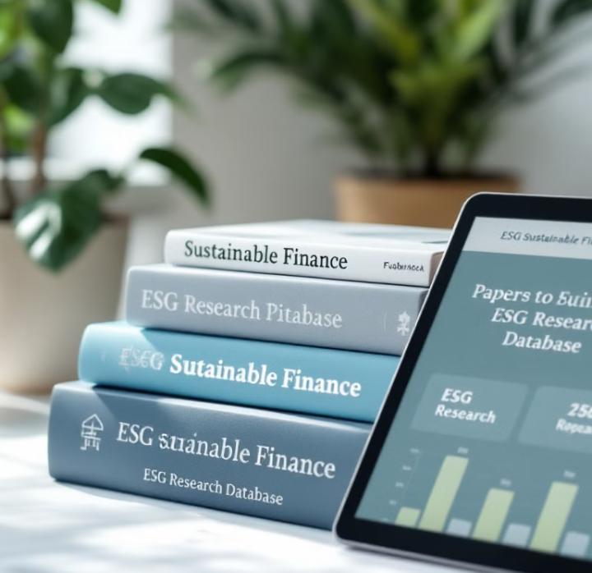
References
IFC. (2019). Sustainability in Banking.
UNEP FI. (2020). Principles for Responsible Banking.
World Bank. (2021). Sustainable Lending Practices.
OECD. (2022). ESG Integration in Financial Services.

Slide 37
Thank you

