Slide 1

Sustainable Finance- Lecture 9
Lesson Title: The Role of Development Financial Institutions
Instructor: Dr. Mary Githinji

Slide 2
Presentation Outline
Introduction & DFI Fundamentals
Sustainable Finance & DFI Nexus
DFIs as Catalysts: Instruments & Mobilization
Spotlight on Action: Climate, Agriculture, Just Transition
Operational Realities: Partnerships & Impact Measurement
Challenges & Future Trends

Slide 3
Learning Outcomes
By the end of this session, Learners will be able to:
Define DFIs and analyze their unique developmental mandate.
Critically assess the synergy between sustainable finance and DFI operations.
Evaluate key financial instruments DFIs use to catalyze sustainable investment.
Discuss DFI contributions to climate action, Agri-transitions, and just transition.
Analyze challenges and emerging trends shaping the future of DFIs in sustainable finance.

Slide 4
Imperative for Sustainable Development
UN Sustainable Development Goals (SDGs): 17 interconnected goals requiring ~USD 5-7 trillion annually (pre-COVID estimates; gap widened).
Paris Agreement: Limiting global warming necessitates massive redirection of capital towards low-carbon, climate-resilient pathways.
Significant Financing Gap: Private commercial finance alone is insufficient/unwilling to bridge this gap, especially in developing economies and for projects with long-term horizons or perceived high risks.
This creates a critical space for specialized financial actors.

Slide 5
What are Development Financial Institutions?
Specialized financial entities established (nationally or multilaterally) to support economic and social development by providing finance and advisory services.
Core Purpose: To bridge financing gaps and address market failures where commercial FIs fall short due to risk perception, scale, or tenor.
Public Policy Mandate: Primarily driven by development impact objectives rather than sole profit maximization.
Historically focused on infrastructure, industrialization, SMEs; now increasingly prioritizing sustainability.

Slide 6
Distinguishing Features of DFIs
Public or Hybrid Ownership: State-backed or owned by multiple governments; influences objectives & funding costs.
Long-Term Investment Focus ("Patient Capital"): Essential for projects with extended gestation and payback periods (e.g., large infrastructure, forestry).
Higher Risk Appetite: Willingness to invest in riskier sectors, geographies (e.g., fragile states), or innovative technologies for developmental impact.
Counter-Cyclical Role: Can maintain or increase lending during economic downturns when private capital retracts, promoting stability.
Development Impact Mandate: Success measured by environmental and social outcomes alongside financial sustainability. social outcomes alongside financial sustainability.

Slide 7
Classifying Development Financial Institutions
National DFIs: Focus on domestic development priorities.
Examples: Development Bank of Kenya (DBK), KfW (Germany), BNDES (Brazil), Development Bank of Southern Africa (DBSA).
Regional DFIs: Target development within specific geographic regions.
Examples: African Development Bank (AfDB), Asian Development Bank (ADB), European Bank for Reconstruction and Development (EBRD), Trade and Development Bank (TDB - Eastern & Southern Africa).
Multilateral DFIs (MDBs - a subset): Broader international membership and global/multi-regional scope.
Examples: World Bank Group (IBRD, IFC, MIGA, IDA), European Investment Bank (EIB), Islamic Development Bank (IsDB).

Slide 8
Understanding Sustainable Finance
Financial services integrating Environmental, Social, and Governance (ESG) considerations into investment and lending decisions and ongoing stewardship.
Aims to:
•Channel capital towards activities delivering positive environmental and social outcomes.
•Manage ESG-related risks and opportunities.
•Support long-term, resilient economic growth.
Key elements: Climate finance, green finance, social finance, impact investing.

Slide 9
The DFI-Sustainable Finance Nexus
•Natural Alignment with Mandates: Many DFIs have longstanding (implicit or explicit) mandates focused on poverty reduction, infrastructure, social well-being – inherently linked to sustainability.
•Direct Contribution to SDGs & Paris Agreement: DFIs are key implementers, channeling public finance and mobilizing private capital towards these global goals. Sustainability is now explicitly embedded in most DFI strategies.
•Long-Term Risk Management: ESG integration helps DFIs identify and manage climate physical/transition risks, stranded asset risks, and social risks in their portfolios.
•Demonstration & Market-Building: By investing in sustainable projects, DFIs demonstrate viability and help create/deepen markets for sustainable finance.

Slide 10
DFIs & High-Impact Sectors for Sustainability
DFIs concentrate efforts in sectors critical for sustainable transitions:
Energy: Renewable energy generation, energy efficiency, grid modernization, clean cooking solutions.
infrastructure: Sustainable transport (rail, BRTs), climate-resilient infrastructure, water and sanitation systems.
Agriculture & Land Use: Climate-smart agriculture, sustainable forestry, food security initiatives, reducing post-harvest loss.
Industry: Decarbonization of heavy industry, circular economy models.
Social Sectors: Affordable housing, healthcare access, education infrastructure.

Slide 11


Question: In what ways can DFIs strengthen their role in mobilizing private sector investment for green and inclusive growth in your country?

Slide 12
The Catalytic Role of DFIs: Mobilizing Private Capital
The scale of sustainable finance needed far exceeds public resources.
DFIs play a crucial "catalytic" role by:
  De-risking Investments: Making projects attractive to private investors.
  Demonstrating Viability: Pioneering investments in new sustainable technologies or markets.
  Setting Standards: Establishing ESG criteria and best practices.
  Aggregating Capital: Pooling resources for larger-scale impact.
Aim: Shift private capital from "billions to trillions" for sustainable development.

Slide 13
Catalysts for Sustainable Investment: Instruments and Approaches
Concessional Financing and Blended Finance
Guarantees and Risk Insurance
Green Bonds and ESG-Linked Loans
Technical Assistance (TA)
Platform Creation & Co-investment

Slide 14
Instrument 1: Concessional & Blended Finance
Concessional Finance: Loans or grants with terms more generous than market rates (lower interest, longer grace/repayment periods). Often used for high-impact projects with limited commercial viability or in low-income countries.
Blended Finance: Strategic use of DFI concessional funds alongside commercial capital (from DFIs themselves or private sector).
  Rationale: Improves risk/return profile, absorbs first losses, makes projects bankable.
  Example: A renewable energy project where DFI provides a subordinated loan or first-loss guarantee, attracting senior debt from commercial banks

Slide 15
Instrument 2: Guarantees & Risk Insurance
  DFIs offer various guarantees to mitigate specific risks perceived by private investors:
  Political Risk Guarantees: Protect against risks like expropriation, currency inconvertibility, political violence (e.g., MIGA's offerings).
  Credit Guarantees: Partial or full guarantees on loans, reducing default risk for lenders.
  Specific Project/Sector Guarantees: Tailored to risks in renewable energy auctions, energy efficiency projects, etc.
  Impact: Lowers the cost of capital and encourages private sector participation in perceived high-risk but high-impact sustainable ventures.

Slide 16
Instrument 3: GSS Bonds & ESG-Linked Loans
  Green, Social, Sustainability (GSS) Bonds:
DFIs are major issuers, raising funds earmarked for eligible environmental/social projects.
Role in market development, standard-setting (e.g., alignment with ICMA Green Bond Principles).
  Sustainability-Linked Loans/Bonds (SLLs/SLBs):
Loan/bond terms (e.g., interest rate) tied to borrower achieving pre-defined, ambitious ESG targets (KPIs).
Incentivizes broader corporate sustainability improvements beyond specific project finance.
DFIs often pioneer these in emerging markets.

Slide 17
Instrument 4: Technical Assistance & Capacity Building
Mechanism: Technical Assistance (TA) & Capacity Building
Beyond Finance: DFIs provide crucial non-financial support:
Project Preparation: Assisting in developing bankable sustainable projects (feasibility studies, ESIA).
Capacity Building: Strengthening local institutions, SMEs, and financial intermediaries in ESG integration, sustainable practices.
Policy Advice: Supporting governments in developing enabling policy and regulatory frameworks for sustainable investment (e.g., renewable energy feed-in tariffs, green building codes).
TA is critical for creating a pipeline of investable sustainable projects.

Slide 18
Co-Investment Platforms & Fund Structures
Mechanism: Platforms for Collective Investment
DFIs establish platforms or funds to facilitate co-investment from private sector actors (institutional investors, commercial banks).
Examples:
  IFC’s Managed Co-Lending Portfolio Program (MCPP).
  AfDB's co-financing arrangements with other DFIs and private funds.
  Specialized climate funds or sustainable infrastructure funds managed or anchored by DFIs.
Benefits: Leverages DFI due diligence, market knowledge, and ESG expertise; allows private investors to access diversified sustainable asset portfolios.

Slide 19
DFI Action: Driving Climate Mitigation
DFIs are major financiers of climate mitigation projects:
Renewable Energy (solar, wind, geothermal, hydro).
Energy Efficiency (industrial, buildings, appliances).
Sustainable Transport (public transit, EVs, rail).
Afforestation/Reforestation & Sustainable Land Management.
Commitments:
Many MDBs commit to aligning all operations with Paris Agreement.
Significant climate finance targets (e.g., EIB's €1 trillion by 2030 for climate action & environmental sustainability; AfDB targets for climate finance, aiming for 50% adaptation).
IDFC members consistently exceed green finance targets (collectively over USD 1.2 trillion 2015-2022).

Slide 20
DFI Action: Building Climate Adaptation & Resilience
Increasing DFI focus on adaptation, especially for vulnerable countries (LDCs, SIDS).
Financing for:
Climate-resilient infrastructure (roads, ports, water systems).
  Drought-resistant agriculture & water management.
  Early warning systems & disaster risk reduction.
  Coastal protection and ecosystem-based adaptation.
Challenges: Adaptation projects often have less clear revenue streams, making them harder to finance commercially; DFI concessional finance is crucial here. Parity between mitigation and adaptation finance is a key goal for many DFIs (e.g., AfDB).

Slide 21
DFI Action: Sustainable Agriculture & Food Systems
Agriculture: Critical for food security, livelihoods, yet a major GHG emitter and highly climate-vulnerable.
DFI Contributions:
  Promoting Climate-Smart Agriculture (CSA): enhancing productivity, resilience, and reducing emissions.
  Financing sustainable value chains (reducing post-harvest loss, improving processing with renewables).
  Supporting sustainable land/water management (irrigation, agroforestry).
  Developing risk mitigation (e.g., weather-index insurance).
Example: AfDB’s "Feed Africa" strategy emphasizes sustainable intensification and climate resilience.

Slide 22
DFI Action: Ensuring a Just & Inclusive Transition
The shift to low-carbon economies has social implications (job losses in fossil fuel sectors, impacts on communities).
DFIs are increasingly focusing on "Just Transition":
  Ensuring social and economic benefits of climate action are shared equitably.
  Mitigating negative impacts on workers and communities.
Activities:
  Financing re-skilling and alternative livelihood programs.
  Investing in regional economic diversification in affected areas.
  Promoting stakeholder dialogue and inclusive planning.
  Examples: EIB's Just Transition Mechanism, EBRD's initiatives.

Slide 23
The Imperative of Partnerships for DFIs
The scale of sustainable development challenges requires collective action.
Partnerships are essential for DFIs to:
  Scale Up Impact: Reach more beneficiaries and projects.
  Leverage Resources: Combine financial and human capital.
  Share Risks: Distribute risks among multiple actors.
  Access Expertise: Benefit from specialized knowledge (technical, local).
  Enhance Policy Coherence: Align efforts with national/international goals.
  Improve Efficiency: Avoid duplication of efforts.

Slide 24
Key DFI Partnerships: A Collaborative Ecosystem
Governments & Policymakers: Policy dialogue, creating enabling environments, co-financing national strategies (NDCs).
Other DFIs (MDBs, Regional/National): Co-financing, knowledge sharing, harmonizing standards (e.g., MDB working groups on Paris Alignment).
Private Sector (Banks, Institutional Investors, Corporations): Mobilizing capital, risk-sharing, developing commercial solutions.
Civil Society Organizations (NGOs, CBOs): Project implementation, community engagement, monitoring, advocacy.
Academia & Research Institutions: Innovation, impact assessment methodologies, data analysis.

Slide 25
Measuring & Reporting Sustainable Impact
Accountability: Measuring and Reporting DFI Impact
Crucial for demonstrating effectiveness, transparency, and learning.
Challenges:
  Attribution and additionally (proving DFI impact).
  Quantifying diverse social/environmental outcomes.
  Standardization of metrics across institutions.
  Cost and complexity of data collection/verification.
Key Frameworks & Efforts:
  Harmonized Indicators for Private Sector Operations (HIPSO).
  IRIS+ (GIIN) for impact investors.
  DFIs' own results measurement frameworks, often aligned with SDGs.
  Increasing adoption of TCFD, and future alignment with ISSB standards

Slide 26
Key Challenges for DFIs (Part 2)
Further Hurdles in DFI Operations
Developing Bankable Project Pipelines: Shortage of well-structured, investment-ready sustainable projects, especially in LDCs or newer green sectors. Requires significant upstream work (TA, capacity building).
Managing Complex E&S Risks: Increasingly complex environmental and social due diligence and monitoring requirements for high-impact projects (e.g., large hydro, biodiversity considerations under TNFD).
Keeping Pace with Innovation: Rapidly evolving sustainable technologies and financial instruments require continuous learning and adaptation.

Slide 27
Emerging Trends in DFI Sustainable Finance
The Evolving Landscape for DFIs
Digitalization & Fintech: Leveraging technology for MSME green finance, agricultural value chains, impact monitoring (e.g., satellite data for deforestation).
AI & Big Data: Enhancing ESG risk assessment, portfolio analysis, identifying sustainable investment opportunities.
Nature-Positive Finance & Biodiversity: Growing focus beyond climate, towards protecting and restoring nature (TNFD alignment, financing for biodiversity conservation).
Systemic Resilience: Increased attention to financing projects that build broader economic, social, and ecological resilience (e.g., sustainable food systems, robust health infrastructure).
Enhanced Focus on Mobilization Effectiveness: More scrutiny on how effectively DFIs mobilize additional private capital.

Slide 28

The Future Outlook for DFIs in Sustainable Finance
Deeper ESG Integration: Moving from "do no harm" and risk management to proactively seeking and maximizing positive impact across all operations ("Impact DFIs").
Scaling Private Capital Mobilization: Innovating further with blended finance, securitization, and other instruments to meet the vast SDG/climate financing needs.
Leadership in Standard Setting: Continuing to drive market standards for sustainable finance, ESG disclosure (ISSB adoption), and impact management.
Increased Focus on Policy Dialogue: Working with governments to create systemic change and unlock country-level sustainable investment.
Greater accountability through robust impact measurement and transparent reporting.

Slide 29

Conclusion:
DFIs are uniquely positioned at the intersection of public policy and private finance.
Their role in catalyzing investment, pioneering new markets, managing risk, and channeling finance to critical sustainable development areas is indispensable.
Navigating challenges requires continuous innovation, robust partnerships, and unwavering commitment to their development mandates.
The evolution of DFIs will be central to achieving the SDGs and the Paris Agreement.

Slide 30
Question: How can Development Financial Institutions balance the need for financial sustainability with their mandate to support high-risk, low-return sustainable development projects?

Slide 31

Development Financial Institutions (DFIs)
Environment

Slide 32
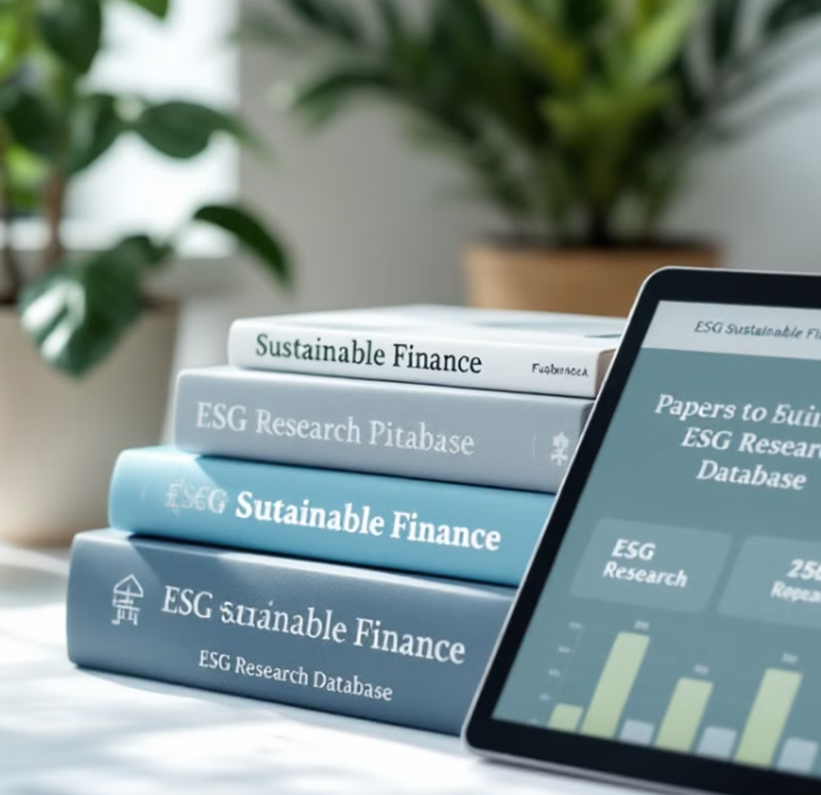
References
Global Impact Investing Network (GIIN). (2023). Annual Impact Investor Survey.
OECD. (2020). The role of development finance institutions in financing sustainable development.
AfDB. (2016). Feed Africa: Strategy for agricultural transformation in Africa 2016–2025.
IDFC. (2023). Green Finance Mapping Report. (And general knowledge of EIB/AfDB strategies)
Attridge, S., & Engen, L. (2019). Blended finance in the poorest countries: The need for a better approach. ODI
UNEP Finance Initiative. (2021). Rethinking Impact to Finance the SDGs
Smallridge, D., & de Olloqui, F. (2011). A health diagnostic tool for public development banks. Inter-American Development Bank

Slide 33
Thank you

