Slide 1

Sustainable Finance- Lecture 10
Lesson Title: Case studies in Sustainable Finance
Instructor: Dr. Mary Githinji

Slide 2
Presentation Outline
CASE STUDEY 1: Acorn Green Bond, Kenya
CASE STUDY 2:Benban Solar Park, Egypt

Slide 3
Learning Outcomes
By the end of this session, Learners will be able to:
Examine Real-World Applications through Case Studies
Understand the Role of Guarantees, Partnerships, and Green Certification
Explore how sustainable finance enabled its development.
Analyze the financing instruments used for Green Projects

Slide 4
Acorn Green Bond

Slide 5
Learning Objectives
Understanding Green Bonds
Green Finance for Sustainable Urban Development
Risk Mitigation in Green Financial Instruments
Role of Certification and Third-Party Assurance
Policy and Regulatory Frameworks for Green Finance
Enabling Factors for Green Bond Success
Lessons for Emerging Markets in Sustainable Finance

Slide 6
Introduction - Acorn Green Bond
Issuer: Acorn Holdings Ltd (Kenya)
Size: KSh 5 Billion Note Program
Purpose: Finance green-certified student accommodation
Significance: First green bond listed on Nairobi Securities Exchange and London Stock Exchange

Slide 7
What Makes This Sustainable Finance?
Core Features:
Environmental: Certified green buildings (IFC EDGE)
Social: Focused on student housing — affordable and safe
Financial: Structurally viable with risk mitigation through guarantees
Governance: High transparency and multiple certifications

Slide 8
Risk Mitigation Through Guarantees
GuarantCo Guarantee: Covered 50% of principal and interest
Effect: Improved credit rating, attracted private investors
Sustainable Finance Insight: Guarantees reduce risk perception in climate-aligned investment

Slide 9
Commercial Viability & Policy Alignment
Demand Drivers: Youth bulge and Urbanization
Policy Context: Affordable Housing under Kenya’s Big 4 Agenda
Result: Financially viable and aligned with national development goals
Lesson: Sustainability must meet real market demand and national priorities

Slide 10
Sustainability Certifications & Ratings
External Verifications:
IFC EDGE: Green building certification
Climate Bonds Initiative: Green Bond certification
Moody’s: Independent credit rating
EY: Audited financial model
Lesson: Independent certification ensures credibility, transparency, and investor trust

Slide 11
Multistakeholder Collaboration
Partners Involved:
GuarantCo: Partial guarantee provider
IFC EDGE: Green certification
Moody’s: Credit rating
Climate Bonds Initiative: Bond certification
EY: Model auditor
MaceYMR: Technical advisor for bondholders
Lesson: Sustainable finance is ecosystem-based, requiring strong, credible partnerships

Slide 12
Key Impacts
Environmental: Reduced carbon footprint via green buildings
Social: Created safe, affordable student housing
Financial: Pioneered a new instrument in Kenyan capital markets
Replicability: Demonstrated bankability of sustainability-aligned real estate projects

Slide 13
Critical Analysis & Class Discussion
Questions
What are the risks and limitations of using guarantees in green finance?
How critical is commercial viability for sustainability success?
Can this model be replicated in other sectors or countries?

Slide 14
Conclusion & Takeaways
Acorn Green Bond combines financial innovation, social purpose, and environmental impact.
Risk sharing (via guarantees) was key to market uptake
Independent certification builds investor confidence
Sustainable finance is both technical and collaborative

Slide 15
Benban Solar Park: A Flagship Sustainable Finance Case in Africa

Slide 16
Learning Objectives
Understand Benban Solar Park’s role in Egypt’s renewable energy strategy.
Explore how sustainable finance enabled its development.
Analyze the financing instruments used.
Evaluate ESG (Environmental, Social, Governance) outcomes.
Reflect on its replicability across Africa.

Slide 17
Project Overview
Location: Aswan, Egypt (Sahara Desert)
Size: 37 km² | Output: 3.8 TWh/year
Households Powered: 1 million+
CO₂ Emissions Reduced: 2 million tonnes/year

Slide 18
Sustainable Development Goals (SDGs) Alignment
SDG 7: Affordable and Clean Energy
SDG 13: Climate Action
SDG 8: Decent Work and Economic Growth
SDG 17: Partnerships for the Goals

Slide 19
Financial Instruments Used
Feed-in-Tariff (FiT) mechanism for investor incentives
Blended finance: Public + Private + Multilateral
Shariah-compliant financing: ICD + Alfa Solar ($28.5M)
Syndicated loans: EBRD, FMO, GCF ($87M)

Slide 20
Role of Development Finance Institutions (DFIs)
African Development Bank: $55M loan
European Bank for Reconstruction and Development (EBRD)
Green Climate Fund (GCF)
Dutch Development Bank (FMO)
Key Point: DFIs de-risking private capital through concessional loans and guarantees.

Slide 21
Environmental Impact Assessment
Clean energy generation replacing fossil fuels.
Contribution to Egypt’s Paris Agreement NDC targets.
Reduction of 100,000–2,000,000 tonnes CO₂ annually.

Slide 22
Social Impact and Inclusion
20,000 construction jobs, 6,000 permanent
Gender inclusion: Female engineers
Educational pipeline: Solar technical high school initiative

Slide 23
Governance and Regulation
25-year operating rights granted to 39 private companies
Oversight by Egyptian New and Renewable Energy Authority (NREA)
Policy framework: Egypt’s 2035 Energy Strategy

Slide 24
Challenges and Risk Mitigation
Environmental challenges: extreme heat (up to 50°C)
Policy risk: long-term regulatory certainty needed
Technical: grid integration for renewable supply
Risk mitigation: FiT guarantees, DFI backing

Slide 25
Replicability Across Africa
High solar potential across Sub-Saharan Africa
Scalable financing models (FiT + blended finance)
Need for local capacity building and grid investment

Slide 26
Summary: Sustainable Finance Lessons
Strategic alignment of policy, finance, and sustainability
Importance of mixed financing and stakeholder collaboration
A benchmark for large-scale, clean energy projects in Africa

Slide 27
Class Discussion & Reflection
What are the key takeaways from Benban for future financial leaders?
Could this model apply to your country or sector?

Slide 28
Discussion Questions
How does blended finance address the challenges faced by companies?
What challenges might companies face when implementing such programs?
How can these initiatives be scaled across industries and regions?

Slide 29
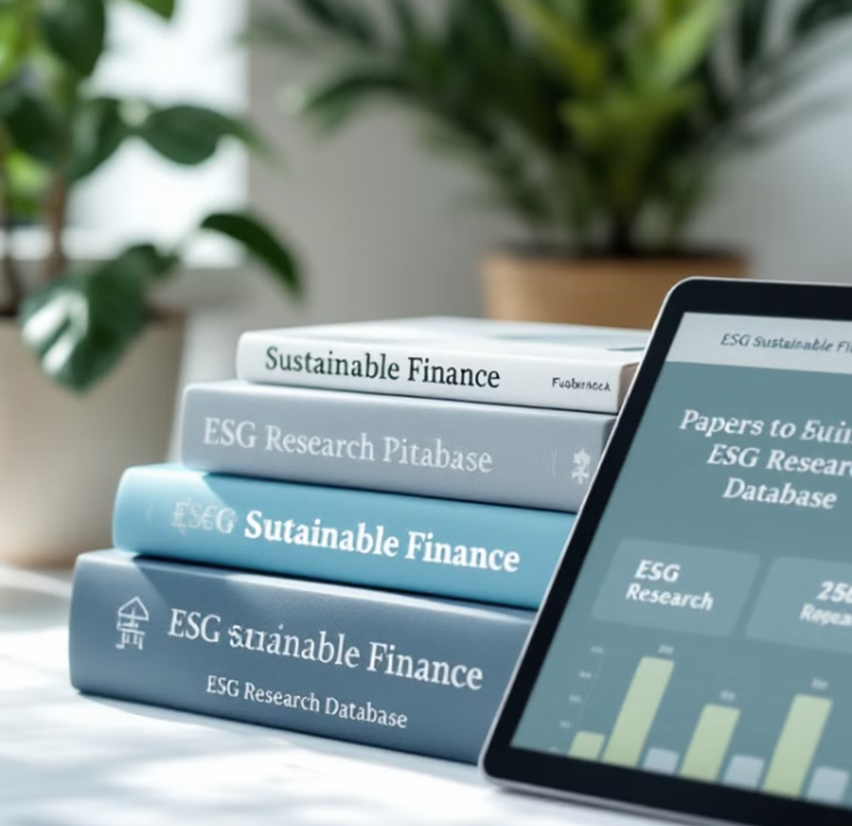
Suggested Readings & Resources
EBRD Project Documents on Benban
European Bank for Reconstruction and Development (EBRD). (n.d.). ACWA Benban Solar PV II.
Egypt’s 2035 Integrated Sustainable Energy Strategy
Ministry of Electricity and Renewable Energy (MOERE), Arab Republic of Egypt. (2016). Integrated Sustainable Energy Strategy to 2035
UN SDG Investment Guide for Africa
United Nations Development Programme (UNDP). (2020). SDG Investor Maps: Africa Investment Opportunity Insights.
Blended Finance Toolkit (OECD)
Organisation for Economic Co-operation and Development (OECD). (2020). The OECD DAC Blended Finance Guidance
Kenya Bankers Association (KBA). (2024). Landscape of Sustainable Finance in Kenya’s Banking Industry.

Slide 30

Thank you

