Slide 1

Sustainable Finance- Lecture 11
Lesson Title: Ethical & Social Dimension of Finance
Instructor: Dr. Mary Githinji

Slide 2
Learning Outcomes
By the end of this session, Learners will be able to:
Define the core concepts of ethical and social finance, and distinguish between them in theory and practice.
Explain the principles guiding ethical financial behavior, including fairness, accountability, and sustainability.
Describe the role of social finance in promoting inclusive development, especially in underserved communities.

Slide 3

Learning Outcomes
Critically evaluate the importance and impact of ESG (Environmental, Social, and Governance) factors and CSR (Corporate Social Responsibility) in financial institutions.
Analyze the governance and regulatory frameworks that influence ethical behavior in the financial sector, both globally and locally.
Identify and assess the main challenges and critiques associated with ethical and social finance, including issues like greenwashing and impact measurement.
Apply ethical reasoning to real-world financial scenarios and decision-making processes.

Slide 4
Introduction
Finance influences economic development, societal well-being, and sustainability.
Traditional finance prioritizes profit; recent global issues demand ethical approaches.
This presentation explores ethical finance foundations, social finance tools, ESG/CSR frameworks, governance, and critiques.

Slide 5
What is Ethical Finance?
Definition: Finance integrating ESG criteria and societal values.
Shift from shareholder to stakeholder focus.
Embedded in moral and societal systems.

Slide 6
Principles of Ethical Finance
Transparency: Open, accessible information.
Accountability: Responsibility beyond shareholders.
Fairness & Justice: Equitable access & treatment.
Long-term Value: Sustainable, intergenerational focus.
Non-maleficence: Do no harm.

Slide 7
Ethical Finance Quote & Frameworks
Quote (Haigh & Hazelton, 2004): "Ethical finance integrates values of equity and justice..."
Frameworks: UNPRI, ESG Investing, Global Reporting Initiative (GRI).

Slide 8
Ethics in Financial Decision-Making
Common dilemmas:
  Insider trading
  Executive compensation
  Predatory lending
  Controversial investments
Moral compass beyond fiduciary duty.

Slide 9
Social Finance and Inclusive Development
What is Social Finance?
Microfinance and Financial Inclusion
Social Enterprises and Impact Investing

Slide 10
Social Finance and Inclusive Development
Definition: Purpose-driven investment for social/environmental returns.
Instruments:
  Social Impact Bonds
  Microfinance
  Community Finance
  Green & Social Bonds

Slide 11
Critical Analysis & Class Discussion
Questions
What is Microfinance?
How Can Microfinance Institutions help with attaining the objectives of Ethical finance?

Slide 12
Microfinance and Financial Inclusion
Provides financial services to underserved.
Benefits:
  Empowers women & low-income groups (Yunus, 1999).
Challenges:
  High interest rates
  Over-indebtedness
Commercialization

Slide 13
Social Enterprises & Impact Investing
Social enterprises: Business for social/environmental good.
Impact investing: Seeks financial return + measurable social impact.
Market > USD 1 trillion (GIIN, 2022).

Slide 14
Financial Return
Social Impact

Slide 15
Social Enterprises & Impact Investing
Social enterprises: Business for social/environmental good.
Impact investing: Seeks financial return + measurable social impact.
Market > USD 1 trillion (GIIN, 2022).

Slide 16
ESG and Corporate Social Responsibility (CSR)
ESG Integration in Finance
Corporate Social Responsibility
ESG and Corporate Social Responsibility (CSR)

Slide 17
ESG Integration in Finance
ESG = Environmental, Social, Governance.
Long-term risk/opportunity assessment.
ESG Factors:
  E: Climate, pollution, biodiversity
  S: Human rights, labor, equity
  G: Ethics, transparency, board oversight

Slide 18
ESG: Financial and Ethical Benefits
Not philanthropy; sustainable firms yield long-term returns (Friede et al., 2015).
Growing adoption: BlackRock, EU SFDR, Taxonomy.
Challenges: Metric inconsistencies, ESG-washing.

Slide 19
Corporate Social Responsibility (CSR)
CSR: Ethical business practices for societal benefit.
Activities:
  Charity, employee programs, sustainability, ethical sourcing
Guided by: ISO 26000, UNGC, GRI

Slide 20
CSR: Authenticity vs Greenwashing
Greenwashing risk: Misleading ethical claims.
Real CSR requires:
  Strategic alignment
  KPIs & impact measurement
  Transparent reporting

Slide 21
Question: Is there a difference between ESG vs CSR?

Slide 22
ESG vs CSR
CSR: Internally driven, ethical posture.
ESG: Externally evaluated, risk/performance metric.
Both essential for ethical, sustainable finance.

Slide 23
Governance & Regulatory Frameworks
Role of Regulation
Codes of Conduct and Voluntary Standards

Slide 24
Governance & Regulatory Frameworks
Regulatory role:
  SFDR: Sustainability disclosure
  EU Taxonomy: Define green activities
  NGFS: Climate risks in central banking
Quote: "Strong governance..." (Boatright, 2014)

Slide 25
Voluntary Standards & Self-Regulation
UNPRI: ESG integration for investors
Equator Principles: Risk management in project finance
IFC Standards: Sustainability benchmarks in emerging markets
Benefits: Transparency, ESG integration

Slide 26
Challenges and Critiques
Greenwashing & social-washing: Erode credibility
Inconsistent standards and data gaps
Trade-offs: Profit vs purpose
Need for authentic, measurable action

Slide 27
Ethical Trade-offs
Ethical finance must often navigate value conflicts, such as:
  •Choosing between short-term profits and long-term social benefits
  •Balancing economic growth with environmental preservation
  •Addressing systemic inequality within financial systems

Slide 28
Case Studies and Applications
The Rise of Islamic Finance
It offers an alternative model for socially responsible finance with global appeal (El-Gamal, 2006).
Kenya’s Green Bond Programme
It illustrates the integration of ethical finance into national development planning.

Slide 29
Conclusion
Ethical finance redefines value and purpose.
Requires integration of ESG, CSR, inclusive finance, and strong governance.
Future finance must serve people and the planet.

Slide 30
Discussion Questions
What challenges do ethical investors face?
How can we distinguish real CSR from greenwashing?
Should ethical standards be voluntary or mandatory?

Slide 31
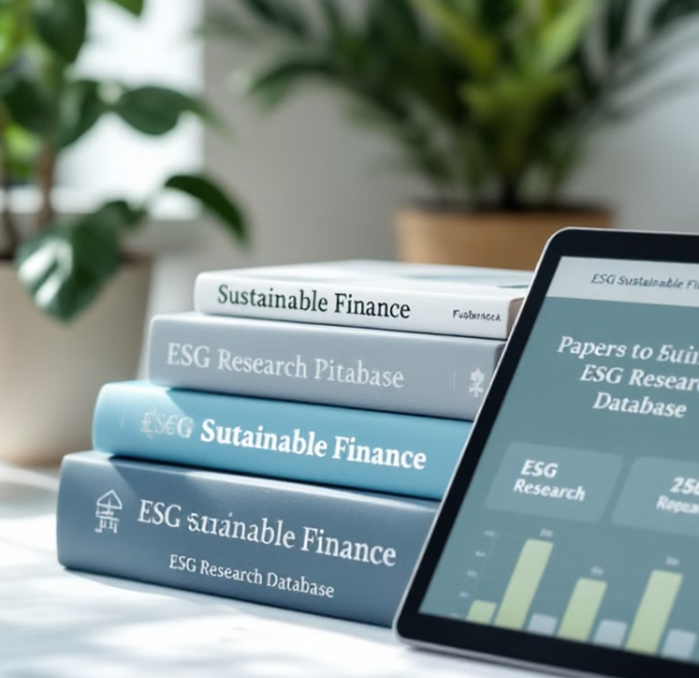
Suggested Readings & Resources
Boatright, J. R. (2014). Ethics in Finance. Wiley-Blackwell.
El-Gamal, M. A. (2006). Islamic Finance: Law, Economics, and Practice. Cambridge University Press.
European Commission. (2020). Sustainable Finance Disclosure Regulation (SFDR). Brussels.
Friede, G., Busch, T., & Bassen, A. (2015). “ESG and financial performance: Aggregated evidence from more than 2000 empirical studies.” Journal of Sustainable Finance & Investment, 5(4), 210-233.
Global Impact Investing Network (GIIN). (2022). Annual Impact Investor Survey.
Global Reporting Initiative (GRI). (2023). Sustainability Reporting Standards.
Haigh, M., & Hazelton, J. (2004). “Financial markets: A tool for social responsibility?” Journal of Business Ethics, 52(1), 59-71.
ISO. (2010). ISO 26000: Guidance on Social Responsibility.
Porter, M.E., & Kramer, M.R. (2011). Creating shared value. Harvard Business Review, 89(1/2), 62–77.
Yunus, M. (1999). Banker to the Poor: Micro-Lending and the Battle Against World Poverty. PublicAffairs.

Slide 32
Thank you

